Slide 1

CDM status
FP1-MOTIONAL WP30 – Task 30.2

Slide 2
A - sRSM Topology
Version 1.0 rc1, documentation compiled 12/12/2024
UIC – A. Magnien

Slide 3
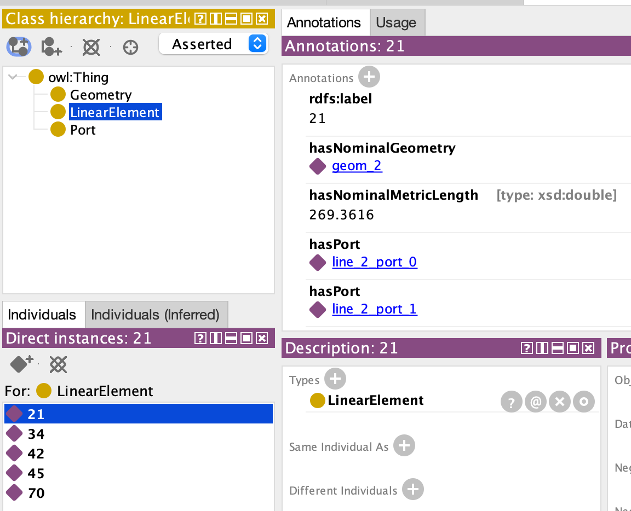
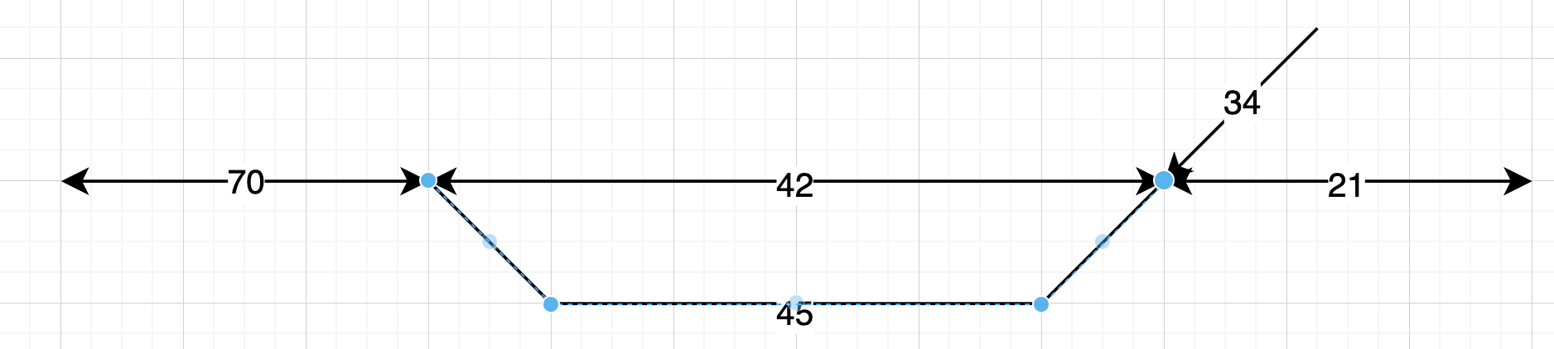
Simple example
View in Protégé desktop
Using GeoSPARQL
Track sections (linear elt. At MICRO level) identified by their labels

Slide 4
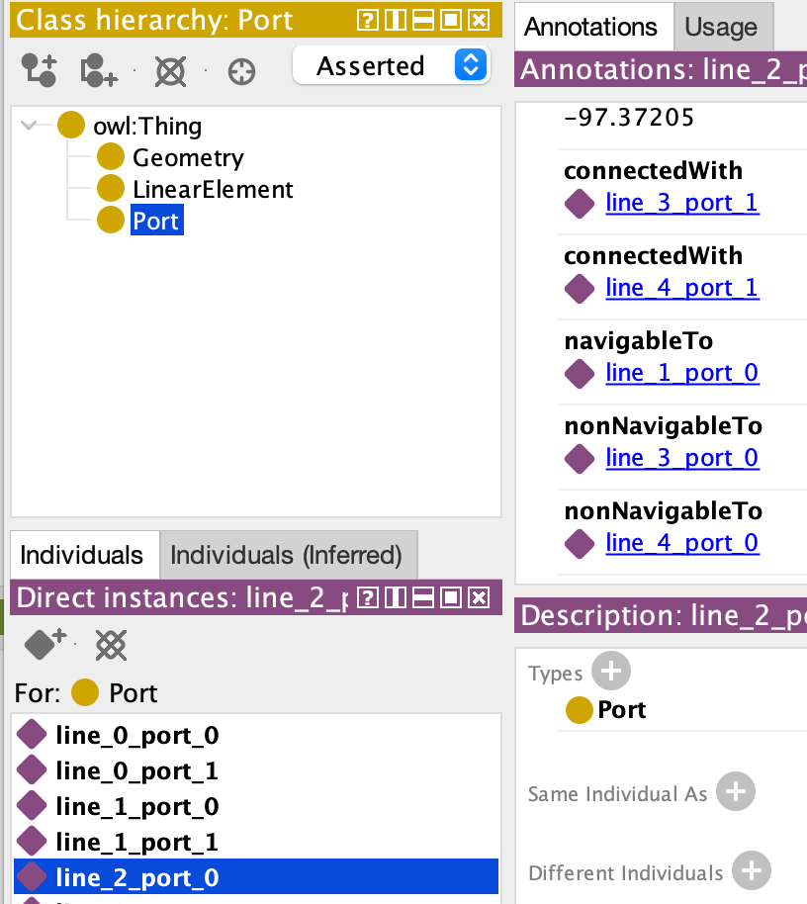
Connections & Navigabilities expressed between “ports”
View in Protégé desktop
A linear element can also be represented by a single “line” with waypoints (a linestring, in fact) : see line_3 below
port 1 – line_4 -- port 0
port 0 --------- line_1 ---------port 1
port 0 -- line_2 --port 1
port 0 --------- line_3 ---------port 1
Notes:
connectedWith is symmetric ➔ stated once for the two ports concerned (here, one such statement does not appear)
navigableTo is expressed “from exit to exit”
You cannot navigate from element line_2 (label “21” to element line_4 (label “34”) because of sharp angle
You cannot navigate from line_2 to line_3 because crossing is assumed to be diamond crossing by default
Slip crossing can be input using a special symbol

Slide 5
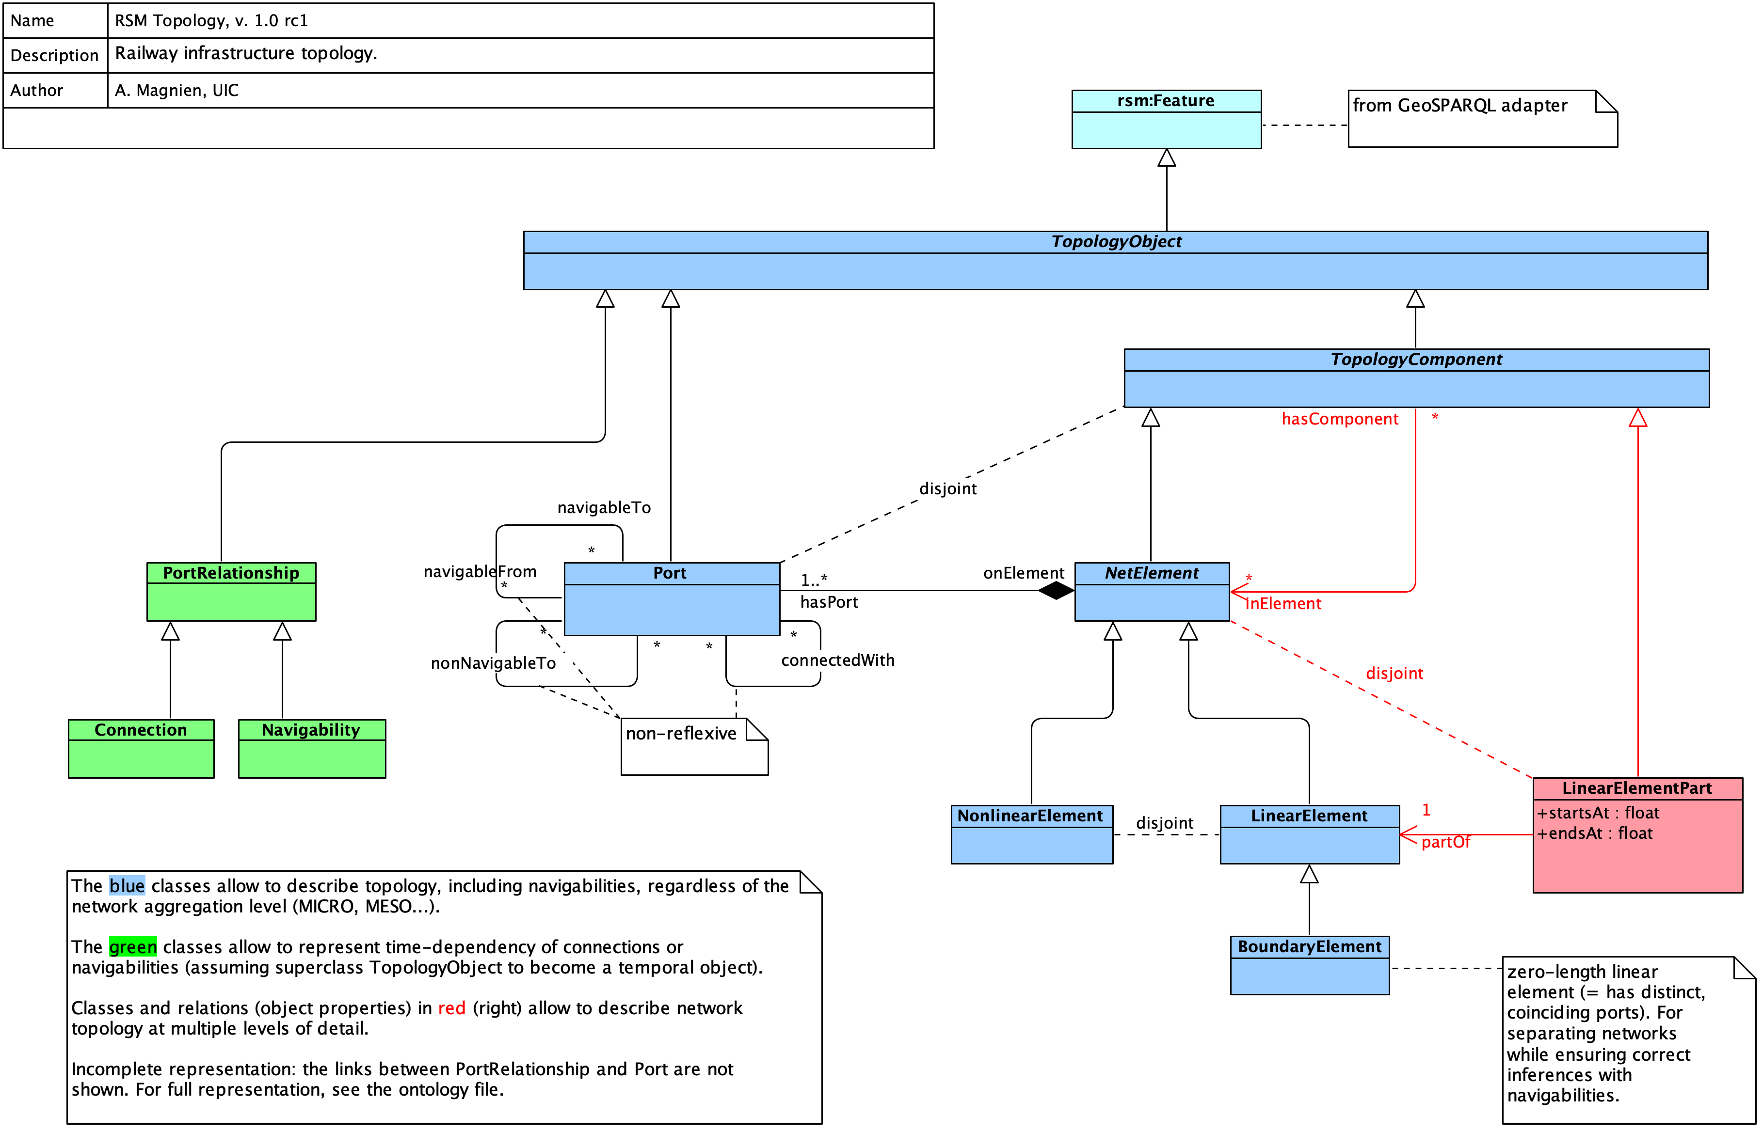
Topology diagram (UML approximation)

Slide 6
One vocabulary, four parts
simple, allow automated checks and path finding
aligned with ERA ontology 3.1.0
Composite objects (for MESO, MACRO)
Obsolete see localisation
Reified properties (for track layout transformations)
Properties (for everyday use)
Your network layout
Properties can be inferred (UML: derived) from reified properties

Slide 7
From reified properties to simple properties
Connection X-Y
valid from today
valid until tomorrow
connection
with port
Connection property
as object
with annotations, …
X1
Y0
X
Y
has port
on element
connectedWith (symmetric)
Connection property
as relation
possibly with annotations, … (RDF-star extended syntax, limited support)
X1
Y0
X
Y
connectedWith = hasPort o connection o withPort o onElement (property chain, in OWL terms)

Slide 8

B - Localisation “package”

Slide 9
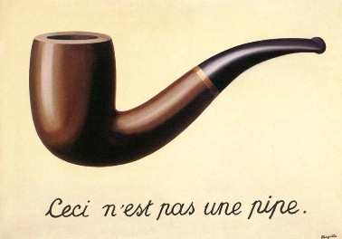
Ceci n’est pas point.
WKT string denotes a point
"POINT(45.6789 -123.4567)"
2D coordinates are not a point
(45.6789 -123.4567)
… and reference system and units are missing, so this is merely a pair of numbers, not a coordinate.
René Magritte, 1929
WKT = Well-Known Text, ISO/IEC 13249-3:2016

Slide 10
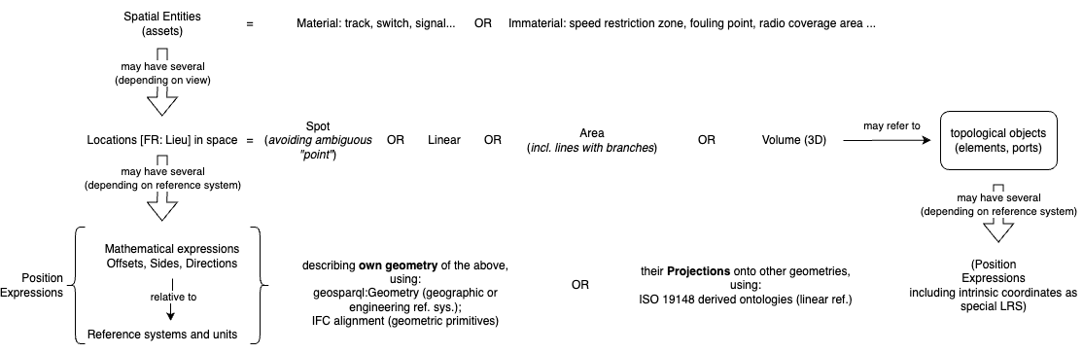
Entities, Locations, Positions
The revealing question: is X a Y, or can X have several Y?
File available in SemanticRSM GitHub under Documentation/Illustrations/Entities…drawio

Slide 11
Position expression
Geographic
Geodetic (GPS...)
Projections (ETRS89...)
Geometric
Engineering or local coordinates
Cartesian coordinates
Linear
“Distance along”
GML or WKT serialisation
WKT or IFC (STEP) serialisation
Legacy Kilometric Points
“True” distance along remains fundamental to signalling, incl. ETCS

Slide 12

The quest for standards
Stop, who would cross the Bridge to Interoperability Must answer me these questions three, 'ere the other side he see
Ask me the questions bridge keeper, I'm not afraid
What is your name?
My name is Sir Airy of Youeyesee
What is your quest?
To seek the Conceptual Data Model
What is your favourite linear referencing standard?
ISO 19148:2021
Right, off you go
Joke aside, committing to a standard or an ontology is never inconsequential
© Monty Python, 1975

Slide 13
Linear referencing
ISO 19148
derived from
Linear referencing: ISO 19148:2021
Earlier version already used by RTM/RSM, then LinX4Rail CDM
Complex UML (interfaces, non-substitutable subclasses…)
Ontology avatars of ISO 19148
DATEX II version 3 ontology (flattened, simplified, extended) – for road transport; owner: ; license CC BY 3.0
SRTI DATEX II (better structure and annotations); owner: IRTIC (univ. of Valencia); license CC BY 4.0
Problem:
simplification inter alia confuses point and position expression (of point), so back to the original…
No blunt criticism here – Datex simplifies 19148 when possible but has to cope with other complexities.
derived from
Profile (= superset of subset)
of
Datex II v.3
SRTI Datex II
Profile [?] of
ISO 19148 adapter
references
sRSM localisation
Not quite satisfactory (inflation…), but: Whether small ISO adapter can and should be replaced by some Datex version is a task we can postpone (benefit to be assessed)

Slide 14
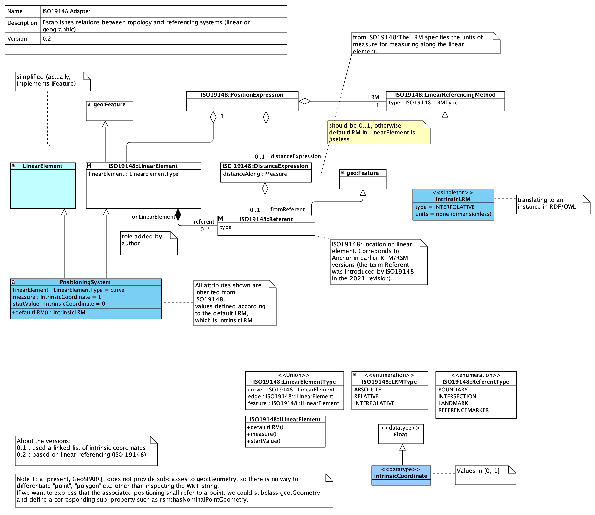
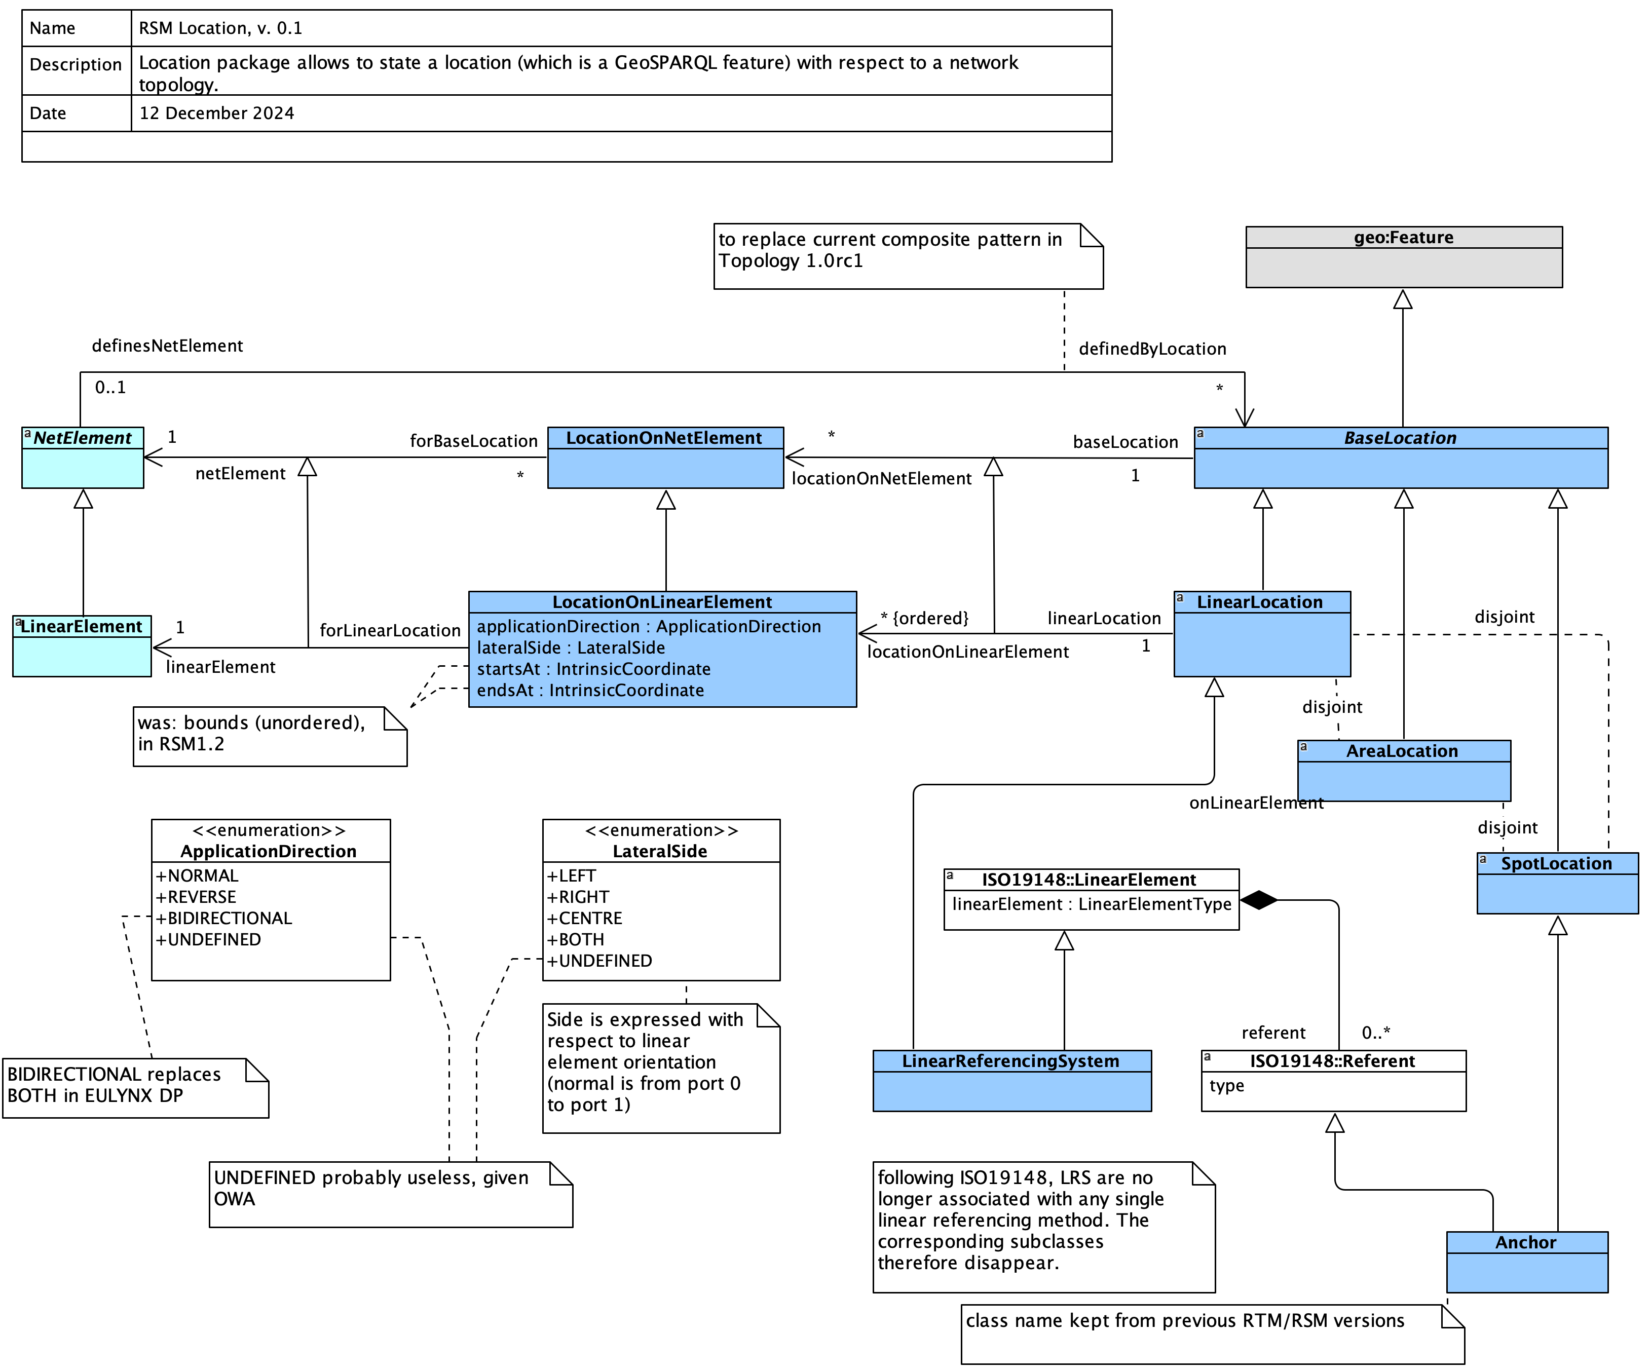
Result… as of today
ISO 19148 adapter
Loca(lisa)tion package

Slide 15


Discussion, conclusion, next steps
[AM] Publish vocabularies (adapter, localisation “package”)
[AM] Publish sample TTL file (based on NRD sample data, license permitting)
[AM] Update sRSM Wiki
Added during meeting:
Time-dependent properties are of general interest (maintenance use cases, etc.) (way forward: annotation properties? ➔ future workshop)

Slide 16

C - References, links

Slide 17
About RDF, OWL, …
RDF-star : https://www.ontotext.com/knowledgehub/fundamentals/what-is-rdf-star/ a quasi-standard, well supported by triple stores such as GraphDB, not (yet) by Protégé desktop ontology editor

Slide 18
About CDM, RSM, …
CDM repository
sRSM (semantic RSM) repository
sRSM Wiki
Datex ontologies : see under sRSM / External models

