Slide 1

CDM status
FP1-MOTIONAL WP30 – Task 30.2

Slide 2
sRSM Topology
Version 1.0 rc1, documentation compiled 12/12/2024
UIC – A. Magnien

Slide 3
Model
Vocabularies

Slide 4
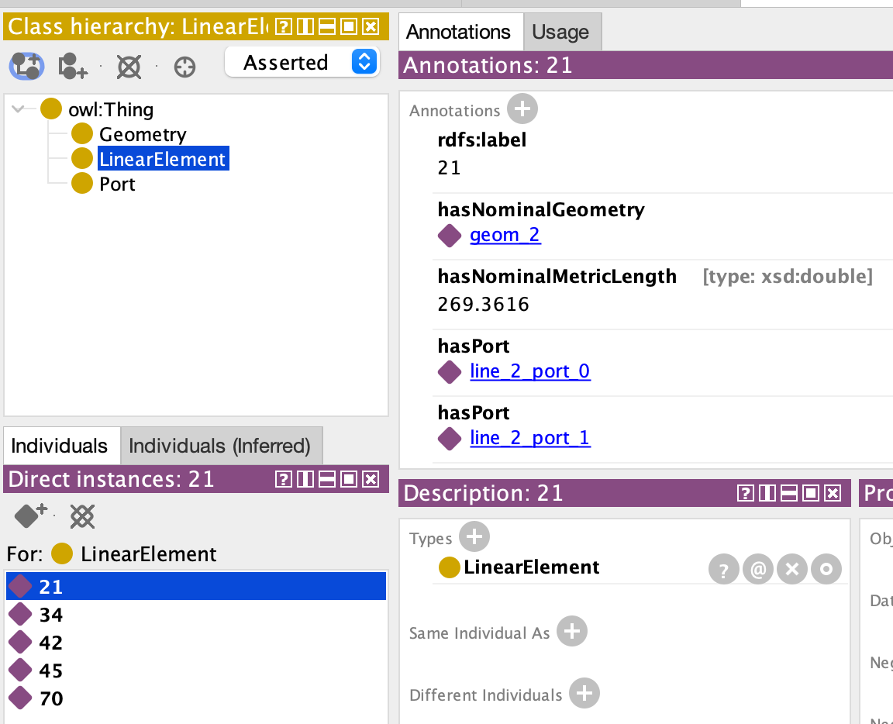
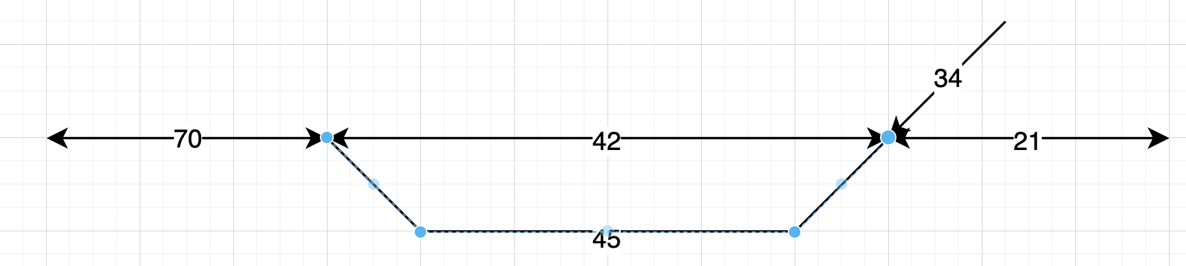
Simple example
View in Protégé desktop
Using GeoSPARQL
Track sections (linear elt. At MICRO level) identified by their labels

Slide 5
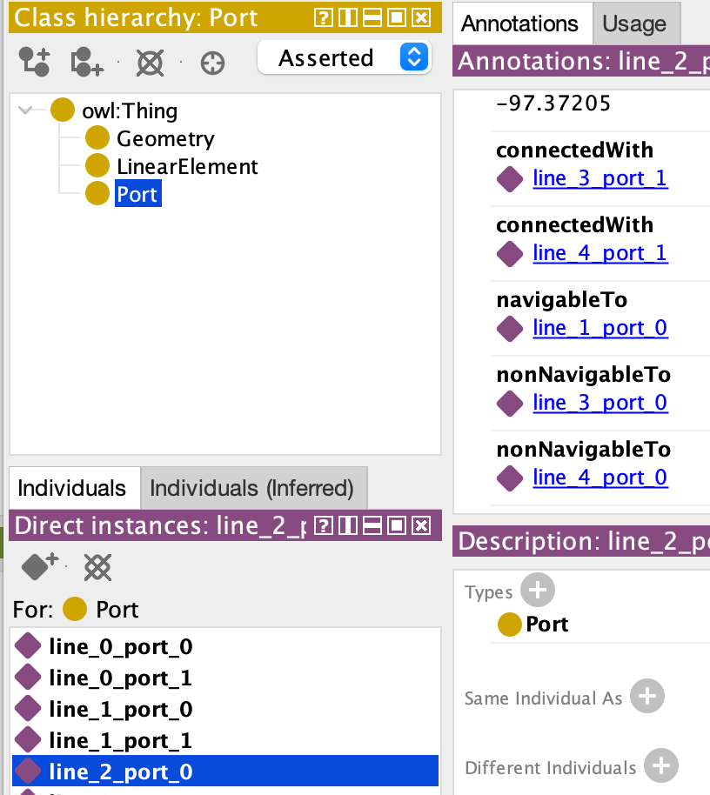
Connections & Navigabilities expressed between “ports”
View in Protégé desktop
A linear element can also be represented by a single “line” with waypoints (a lisetring, in fact) : see line_3 below
port 1 – line_4 -- port 0
port 0 --------- line_1 ---------port 1
port 0 -- line_2 --port 1
port 0 --------- line_3 ---------port 1
Notes:
connectedWith is symmetric ➔ stated once for the two ports concerned (here, one such statement does not appear)
navigableTo is expressed “from exit to exit”
You cannot navigate from element line_2 (label “21” to element line_4 (label “34”) because of sharp angle
You cannot navigate from line_2 to line_3 because crossing is assumed to be diamond crossing by default
Slip crossing can be input using a special symbol

Slide 6
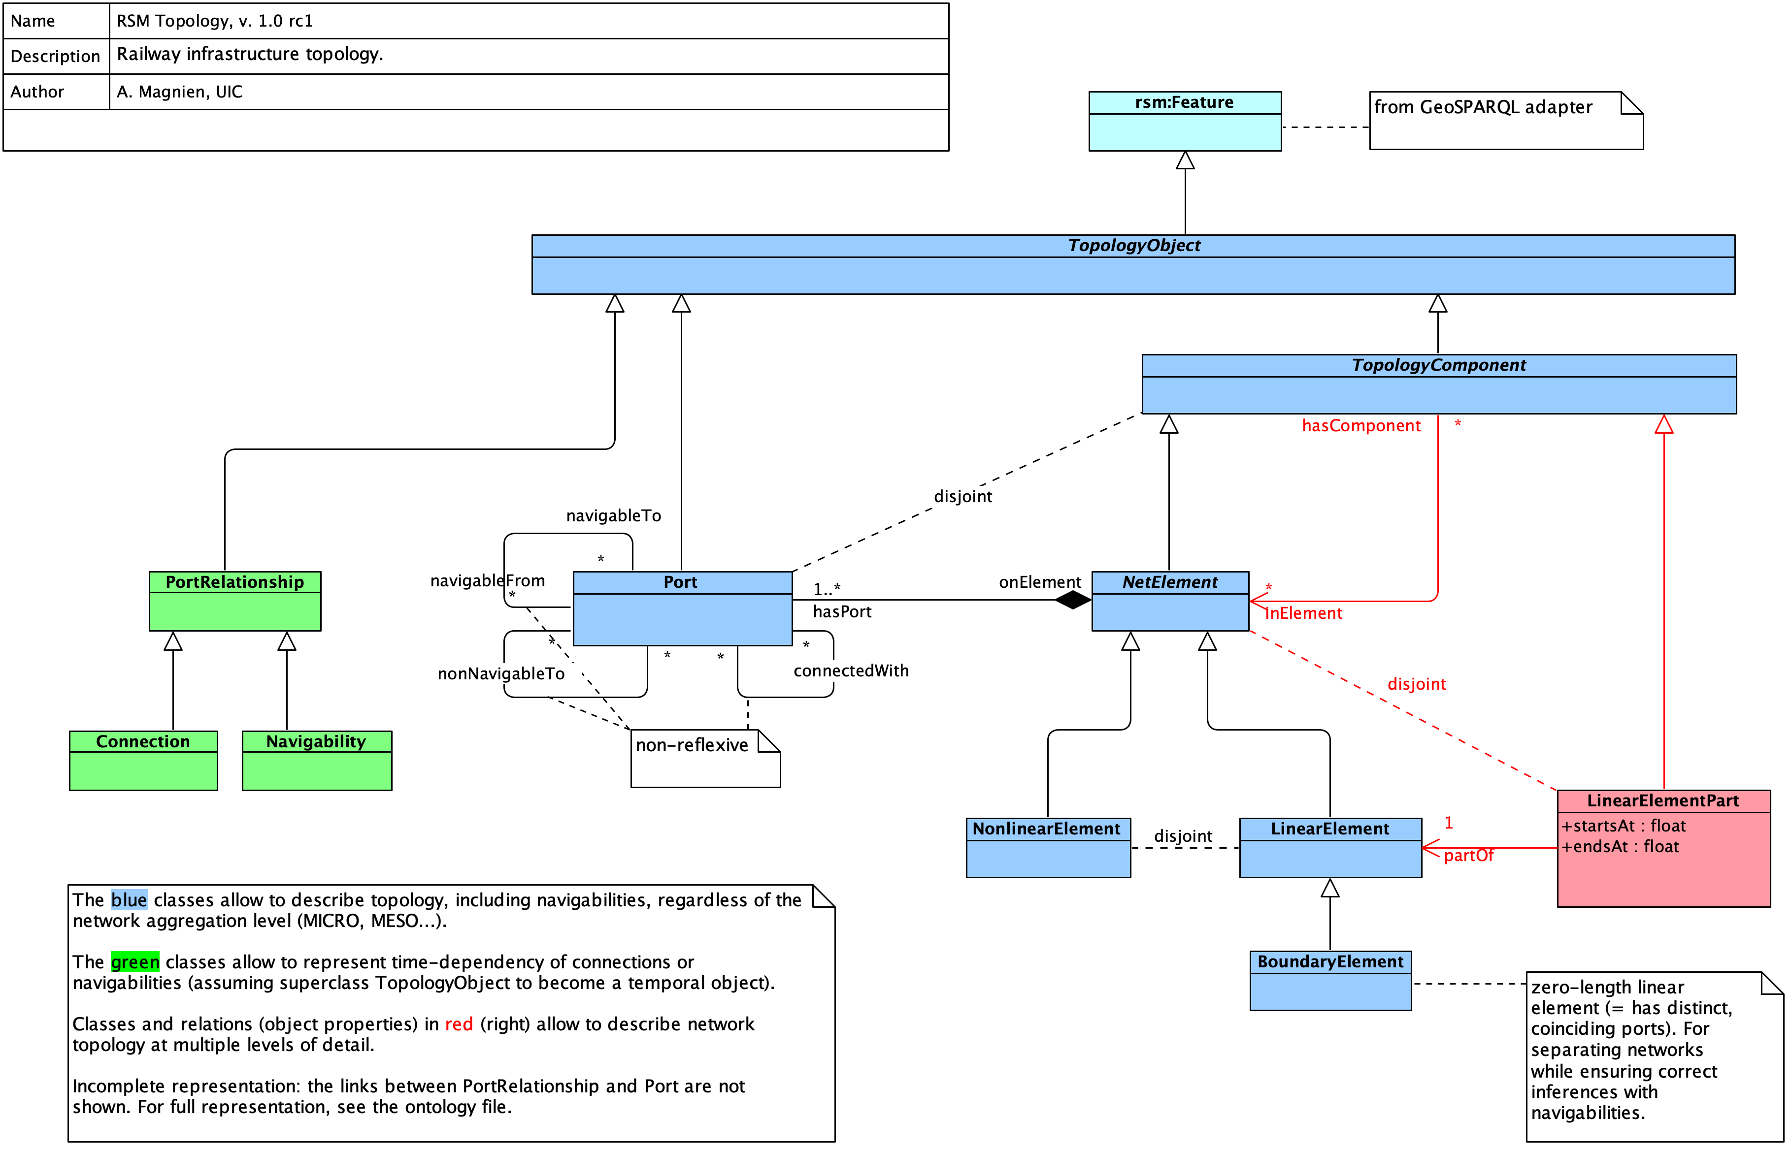
Diagram, raw

Slide 7
One vocabulary, four “zones”
Composite objects (for MESO, MACRO)
Reified properties (for track layout transformations)
Properties (for everyday use)
Objects

Slide 8

Localisation “package”

Slide 9
Discussion, conclusion, next steps

Slide 10
References, links

