Slide 1
Proposal
Artwork Trading Platform
Zheng Liu and Jing Jiang

Slide 2
Digital Artwork
Digital artwork includes a wide range of things:
Font, music, painting, photo……
Questions: Are they protected?
They should!
Why is it hard to deal with them?
Digital!
Notes:
Take picture as example. Many of the websites still allow people to download. Facebook.
Some don’t. Instagram. Tumblr.

Slide 3
How can we help?
An easy way to buy and sell.
Clear and secure record.
Smart contract can help create deals with specific requirements.
Blockchain is a good place to keep the data.
Buy and Sell? You need currency.

Slide 4
A short example
Art: Mona Lisa
Owner: Peter
Alice wants to post it on her website for three months.
Tom wants to buy it.
Catherine wants to use it in her commercial on Instagram.
Different requirements but limited number of types.

Slide 5
Types we support
Buy: a complete transfer of ownership.
Rent: Use the artwork for a certain amount of time and designated purposes.
Subscribe: Get access to all artworks of an artist for a certain amount of time.
Realizable with tokens.

Slide 6
Targets
From:
Inefficient communication and paperwork. Vulnerable to fraud.
To:
An online platform that is easy-to-use, reliable, powerful and with more freedom.
And Increase people’s awareness of copyright of digital artwork.

Slide 7
Roles:
Jing: management and planning. Structure design and coding for the seller(artist) side:
artwork, set initial price, copyright open for rent, copyright open for sale, open for subscription, etc.
Zheng: background research. Website maintenance. Structure design and coding for the buyer side and other systematic processes:
bid, resell, start auction, close auction, cancel auction, etc

Slide 8
Evaluation & Demonstration
When we finish the project, we will test it evaluate it and demonstrate it.
Function: We will first make our project work as intended. All types of transactions and smart contracts have to work. A life cycle of a sample artwork will be shown.
Design Targets: Besides basic functionality, we need to test whether our project is easy to use, efficient and robust enough compared to our expectation. It will be compared to a traditional way of trading.

Slide 9
Maintenance
In terms of maintenance of our project. We decide to make a website for our final project. We will submit an summary of our project and update it every time we make some progress. Also, we will manage our code on github. The url of the github repository is https://github.com/jassiay/BlockchainClassFinalProject.
This github is Jing Jiang’s personal account.

Slide 10
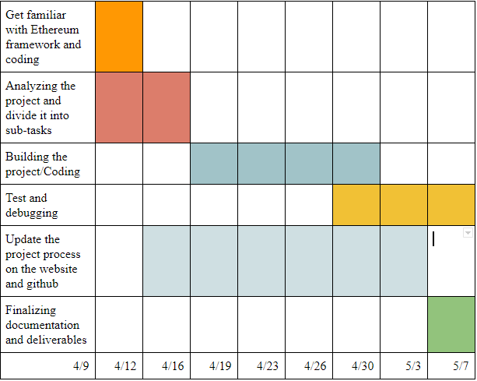
Schedule

Slide 11
Reference
https://eco.copyright.gov Office of Copyright
https://www.cryptokitties.co/ Official website of CyptoKitties
https://ethfiddle.com/09YbyJRfiI Source code of CryptoKitties
https://help.instagram.com/478745558852511 Instagram: Term of use
https://github.com/jpmorganchase/quorum Quorum source code

Slide 12
Questions?
Thank You!

