Slide 1

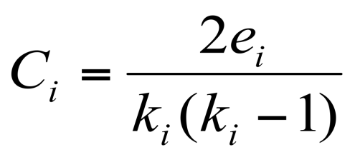
Clustering coefficient:
What portion of i’s neighbors are connected?
Node i with degree k_{i}
§ C_{i} ∈ [0,1]
§
where e_{i} is the number of edges between the neighbors of node i
i
i
i
C_{i}=0 C_{i}=1/3 C_{i}=1
¡ Average clustering coefficient: C =
1
N
∑ i
C
N
i

Slide 2

¡ Clustering coefficient:
What portion of i’s neighbors are connected?
Node i with degree k_{i}
§
where e_{i} is the number of edges between the neighbors of node i
B
k_{B}=2, e_{B}=1, C_{B}=2/2 = 1 k_{D}=4, e_{D}=2, C_{D}=4/12 = 1/3
A
F
D
E
C
G
H

