Slide 1
CWE-121
Stack-based Buffer Overflow
Tran bo dem tren stack — tu ghi vuot den dieu khien luong thuc thi
Mini seminar S01 · NT521 — Lap trinh khai thac lo hong
Nhom 3: [CHUA CHOT: A, B, C] · Ngay: [CHUA CHOT]
Notes:
Gioi thieu nhom. Muc tieu: phan tich lo hong tran stack theo mach source->sink->guard, demo CTF ret2win va mot CVE that (glibc CVE-2015-7547).

Slide 2
Lo hong tran bo dem tren stack la gi?
Muc 1 — Gioi thieu
Buffer = vung nho co dinh; tren stack la bien cuc bo (vd char buf[64])
Overflow = ghi NHIEU HON suc chua -> de du lieu nam ke ben
Du lieu vao tu: nguoi dung, tep, mang
Hay gap: C/C++, dich vu mang, thu vien he thong, firmware
Tac dong: tu crash -> chiem quyen dieu khien luong thuc thi
Vi du
char buf[64];
read(0, buf, 200);
Doc 200 byte vao cho chi chua 64 byte
=> ghi vuot 136 byte, de len du lieu stack ke ben.
Notes:
Nhap chuoi qua dai. Nhan manh: loi o ngon ngu khong kiem tra bien tu dong.

Slide 3
Nguyen ly, dieu kien va dang pho bien
Muc 2 — Nguyen ly
dia chi CAO
Ghi tu buf di len dia chi cao -> cham saved rbp -> dia chi tra ve
Dieu kien: (a) input toi duoc sink; (b) ghi khong gioi han theo kich thuoc dich; (c) buffer tren stack
Dang pho bien: strcpy/gets/scanf("%s"); read(fd,buf,n) voi n lon; off-by-one; tinh sai do dai
Phan biet: CRASH ≠ dieu khien duoc luong thuc thi
... frame caller
dia chi tra ve
saved rbp
buf[63] ... buf[0]
dia chi THAP · ghi bat dau tu buf di len
So do minh hoa — offset that phai do tren binary
Notes:
So do chi minh hoa. Khoang cach buf -> return address do bang gdb o phan demo.

Slide 4
CWE-121 va quan he ho hang
Muc 3 — CWE
CWE-119 — Thao tac vuot bien buffer (rong)
CWE ≠ CVE
CWE = LOAI yeu diem (vd CWE-121)
CVE = MOT lo hong cu the trong san pham cu the (vd CVE-2015-7547)
Luu y that: NVD gan CVE-2015-7547 la CWE-119 (muc cha), ban chat ky thuat la 121
CWE-787 — Out-of-bounds Write
CWE-121 — Stack-based Buffer Overflow
← chu de S01
Notes:
Trich dinh nghia MITRE nguyen van khi noi. NVD gan 119, ban chat la 121 (con cua 119) — khong tu sua nhan.

Slide 5
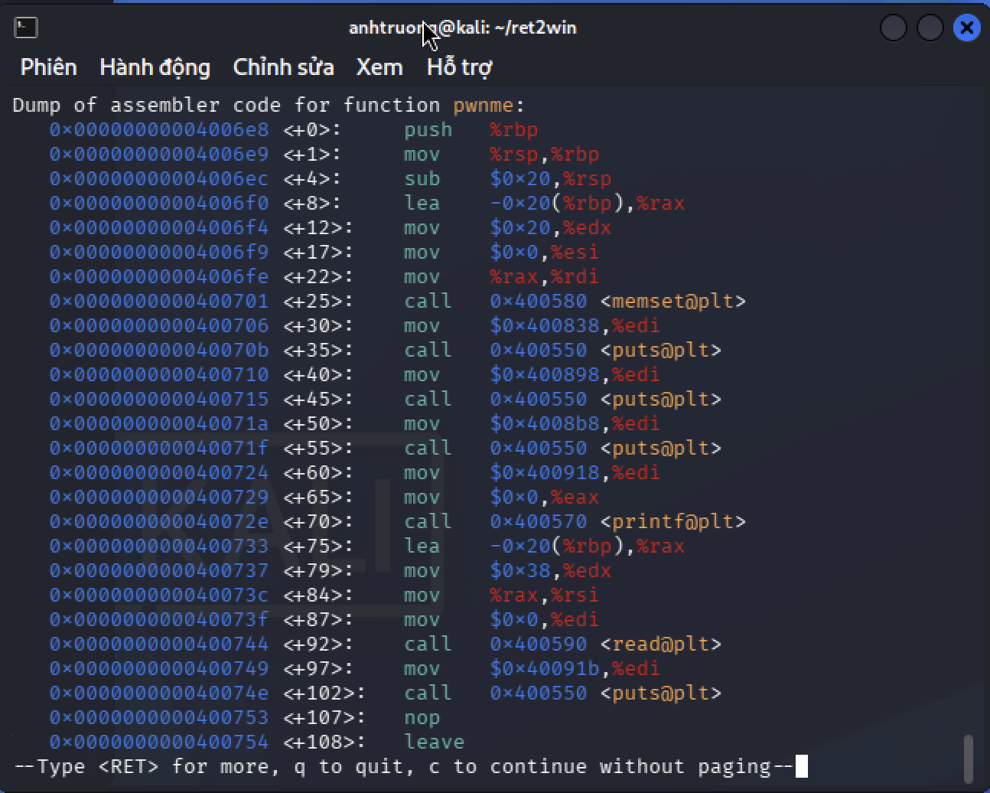
Vi tri & nguyen nhan trong binary ret2win
Muc 4 — Vi tri & nguyen nhan
Binary: ret2win (ROP Emporium, x86-64, not stripped)
checksec: No canary · NX enabled · No PIE
Ham pwnme (0x4006e8): read(0, buf, 0x38=56) vao buffer 32 byte
=> doc 56 byte vao cho chua 32 byte -> ghi vuot 24 byte
Ham dich ret2win = 0x400756 (goi system("/bin/cat flag.txt"))
Notes:
Chinh dong chu binary in: "fit 56 bytes into 32 bytes of stack buffer". Chi ro read va buffer trong disassembly.

Slide 6
Chuoi khai thac (5 buoc)
Muc 5 — Chuoi khai thac
1
Gui input dai hon buffer (56 byte)
Payload
2
Ghi tran qua 32B buffer + 8B saved rbp -> toi dia chi tra ve
b'A'*40
+ p64(0x400770) # ret gadget
+ p64(0x400756) # ret2win
3
offset = 40 byte; ghi de bang dia chi ret2win = 0x400756
No PIE -> dia chi co dinh.
NX khong can vi nhay toi ham co san.
4
Ham ket thuc -> lenh ret nhay toi ret2win()
5
ret2win() goi system("/bin/cat flag.txt") -> in flag
Notes:
Day la "ret-to-function", khong shellcode. Ret gadget giai thich o slide sau.

Slide 7
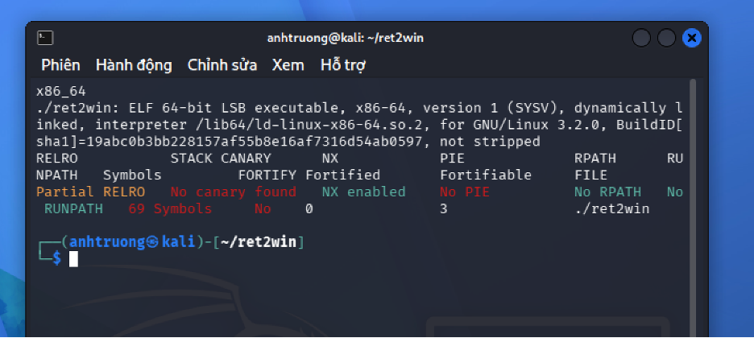
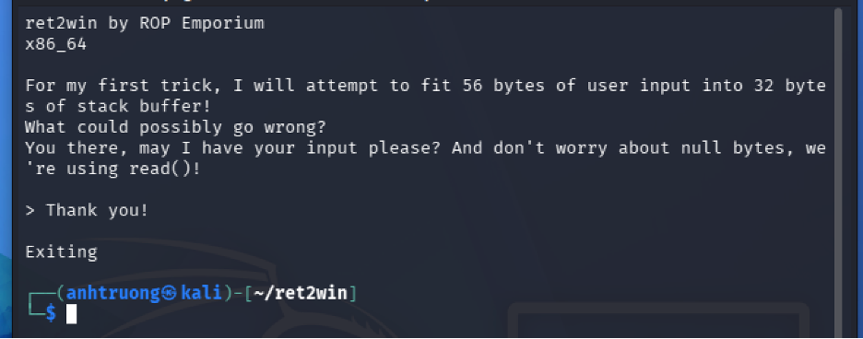
Demo — kiem tra binary & chay binh thuong
Muc 7 — Demo
uname -m · file · checksec
Chay input ngan -> thoat binh thuong
Moi truong: Kali amd64 tren UTM (Emulate) — duoc phep, co lap, an toan.
Notes:
Noi ro chay trong VM emulate; day la mot gioi han (slide dieu kien & gioi han).

Slide 8
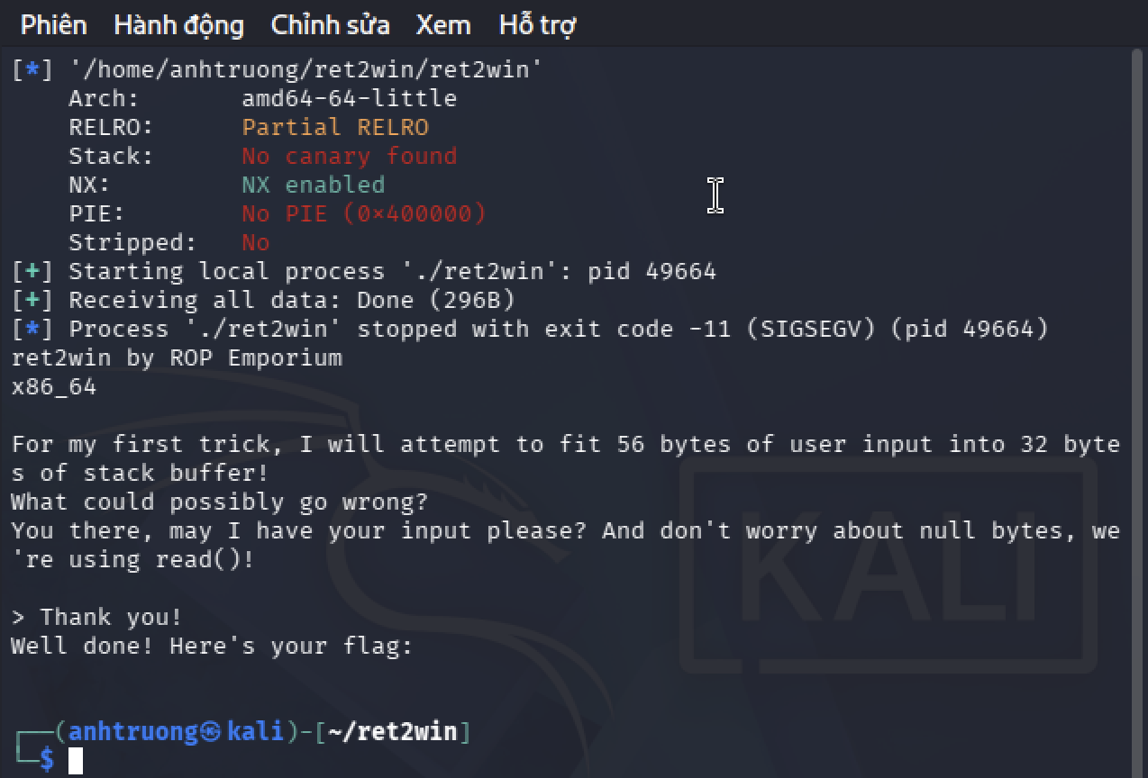
Da dieu khien dia chi tra ve
Muc 7 — Demo
Lan chay dau: payload A*40 + ret2win (chua can le)
In "Well done! Here's your flag:" -> da nhay vao ret2win()
Roi SIGSEGV trong system() (stack lech 16 byte)
Bang chung: chay code cua ret2win = DA DIEU KHIEN return address, manh hon chi "crash"
Notes:
Phan biet muc bang chung: day la "da doi luong thuc thi", CHUA phai "dat muc tieu" (flag chua in vi system crash).

Slide 9
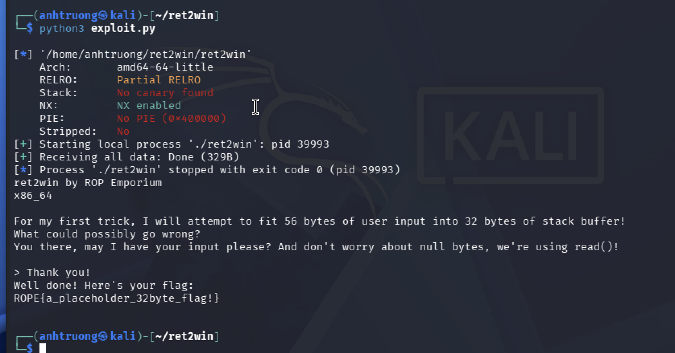
Dat muc tieu challenge — in flag
Muc 7 — Demo
Lan 2: them ret gadget 0x400770 can le stack 16 byte
exit code 0 -> in ROPE{a_placeholder_32byte_flag!}
Vi sao can ret gadget: system() dung movaps doi stack boi so 16; mot ret day stack lech 8 byte cho khop
Demo chay lai >= 2 lan on dinh (exit 0)
Notes:
Cau chuyen 2 buoc (control -> align -> flag) la diem nhan. Co phuong an anh/video du phong neu demo truc tiep loi.

Slide 10
CVE that: CVE-2015-7547 (glibc getaddrinfo)
Muc 6 — CVE
San pham | glibc (getaddrinfo) — anh huong RHEL 6/7, Debian/Ubuntu/SUSE...
Phien ban | 2.9 – 2.22, va tu 2.23
CWE (NVD) | CWE-119 (ban chat la 121, con cua 119)
CVSS | v2 6.8 / v3.0 8.1 (High) · Red Hat: Critical
Du lieu doi phuong | Phan hoi DNS tao rieng (DNS doc hai / MITM)
Khac phuc | Va glibc >= 2.23; workaround han che; tat IPv6 vo dung
Chi nghien cuu & trinh bay — khong tai hien khai thac.
Notes:
Nhan: NVD gan 119, ban chat ky thuat la 121 — khong tu sua nhan NVD.

Slide 11
CVE-2015-7547 — co che & khac phuc
Muc 6 — CVE
getaddrinfo() truy van song song A (IPv4) + AAAA (IPv6)
Buffer 2048 byte cap bang alloca() tren stack
Loi: sai dong bo con tro/kich thuoc o phan hoi thu hai -> ghi toi ~63 KB du lieu doi phuong
Du lieu doi phuong: phan hoi DNS tao rieng (DNS doc hai / ke chen giua)
Khac phuc: va glibc >= 2.23; workaround (gioi han TCP <=1023B) han che; TAT IPv6 vo dung
So voi ret2win
Giong: deu ghi VUOT buffer tren stack.
Khac:
· Nguon du lieu = mang (DNS), khong phai argv
· Loi o quan ly con tro/kich thuoc, khong phai strcpy don gian
Notes:
Lien he ro voi phan demo de nguoi nghe thay cung mot ban chat CWE-121.

Slide 12
Khac phuc & phong ngua
Muc 8 — Khac phuc
Goc re: gioi han ghi theo kich thuoc dich
snprintf / fgets / kiem tra do dai (xem bai tap 3 doan ma)
Kiem thu: AddressSanitizer, fuzzing, SAST
Cac lop bao ve giam kha nang khai thac, KHONG xoa loi
Co che | Tac dung | ret2win
Stack canary | Phat hien ghi tran toi return | Tat
NX | Stack khong thuc thi | Bat
ASLR / PIE | Ngau nhien hoa dia chi | PIE tat
Sua tan goc = gioi han ghi theo kich thuoc dich.
Notes:
Doi chieu ma loi vs ma sua trong notes/bai_tap_3_doan_ma.

Slide 13
Dieu kien & gioi han (noi dung da/chua xac nhan)
Muc 9 — Dieu kien & gioi han
Hang muc | Trang thai
Input toi sink | Da xac nhan (demo)
Offset do tren binary | Da xac nhan = 40 (buffer 32 + rbp 8)
Dieu khien dia chi tra ve | Da xac nhan (anh 04: "Well done" roi SIGSEGV)
Dat muc tieu (in flag) | Da xac nhan (anh 05: exit 0, ra flag)
ASLR luc chay | Quan sat duoi EMULATION — khong dai dien may that
CVE: tu tai hien khai thac | KHONG lam (chi nghien cuu)
Notes:
Thanh that ve dieu chua kiem chung (ASLR duoi emulation).

Slide 14
Muc 10 — Ket luan
Ket luan
Tran stack: ghi vuot buffer -> de dia chi tra ve -> doi luong thuc thi
Da chung minh tren ret2win (dat muc tieu); CVE-2015-7547 cho thay tac dong that quy mo lon
Phong ngua: gioi han ghi + cac lop bao ve (canary/NX/ASLR/PIE)
Tai lieu: MITRE CWE-121/787/119 · ROP Emporium ret2win · NVD / Red Hat / Google (CVE-2015-7547) · GCC stack protector · Clang ASan
Moi nguon/URL tren slide can duoc tra lai truoc khi trinh bay.
Notes:
3 y ket luan ngan, khong phong dai. Ghi nguon da tra lai.

