Slide 1
Medi-Info
A Patient Centered Information exchange system

Slide 2
About Medi-Info
Medi Info is a web portal to be developed as a Patient Centered Information Exchange System for Hospitals which will allow them to easily upload various information related to patients which only the patient can access and view at any time.
It will reduce the need of the patient to visit the Hospital every time to get an update. It will act as an effective way of communication between the Healthcare providers and the Patients. It will maintain the privacy of the individuals as the information shared can only be viewed by the parties directly involved.

Slide 3


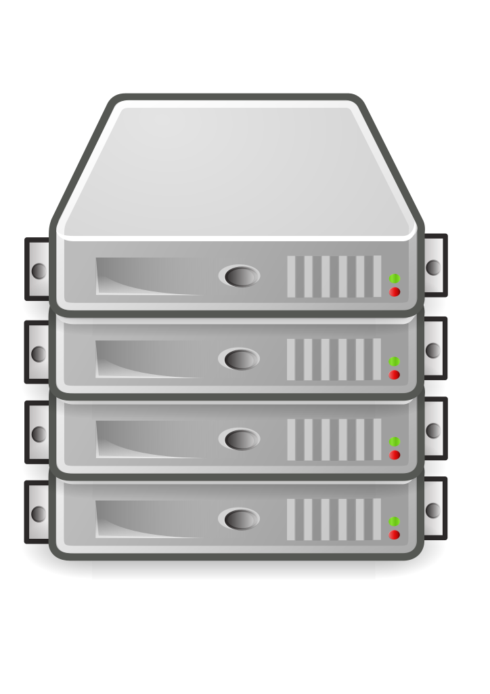
Overview of the design
Frontend
Database
Returned data(JSON)
User Request(Axious)
C/R/U/D Request to Database (depending on User)
Result data
Backend

Slide 4

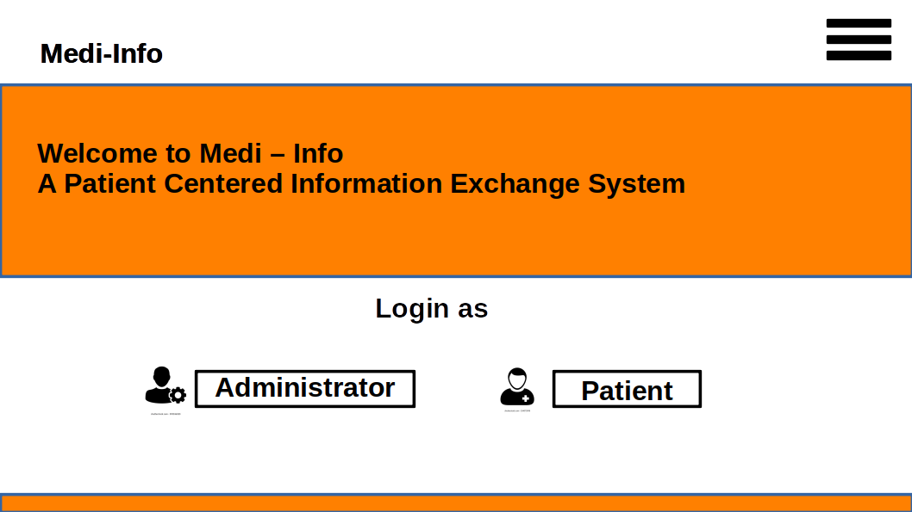
Frontend Design and Features
Illustration of the Homepage of the web portal with some information related to the host of the portal, Login Option as Admin/Patient as well as a Sidebar with additional navigation options.

Slide 5
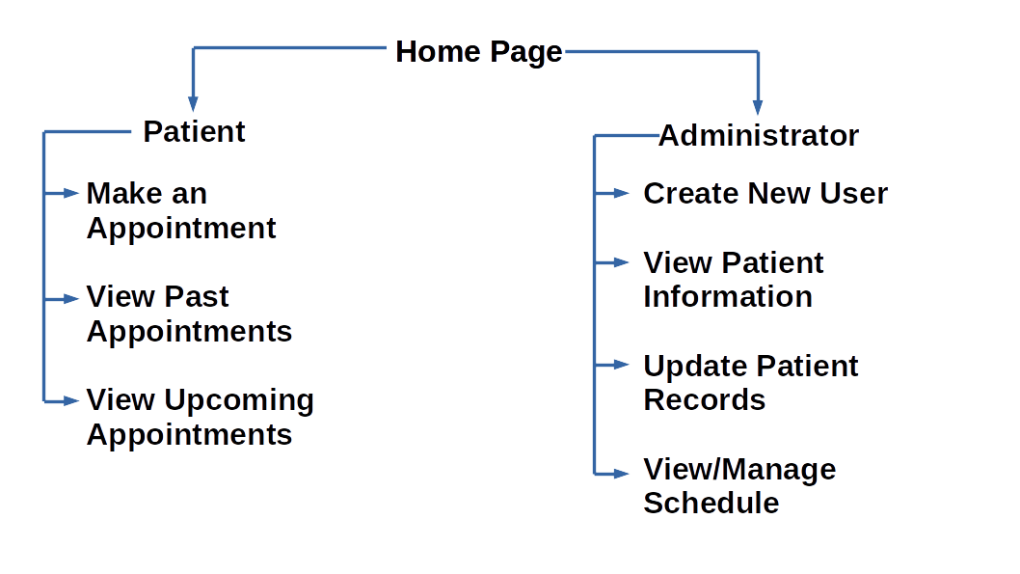
Navigation Options(as per User)

Slide 6
How information will be Rendered to the Patient
01
Patient Registration
Patient is registered on visiting the hospital first time
A unique Patient ID is alloted
Patient can access the portal using this unique ID
02
Appointment
Patient makes an appointment using the portal
New Appointment with UID is created
Patient is given preferred date & time slot for visiting
03
Results
Patients Medical Results if any are uploaded under the appropriate appointment section
Patient can view the same by accessing the portal

Slide 7
BackEnd
Routes | Get | Post/Delete/Put
Create New | Render a creation form | Save user to database
Read data | Render required data from database | N/A
Update data | Render a update form | Update data by requested data
Delete data | N/A | Delete data from database
Login | Render a login form | Authenticate user
Register | Render a register form | Create new user in database
Logout | N/A | Logout requested user

