Slide 1

TypeRacer Network
Đồ án Lập trình mạng (NT106)
Vũ Hoàng Long
Nguyễn Tuấn Hùng
Lê Tuấn Hùng
Notes:
https://docs.google.com/document/d/17R8kLIth44-JgdWp_MSD8tDJ-47vueqxkflndKPp3nk/edit?usp=sharing

Slide 2






Tổng quan Dự án
Register
Login
Create room
Game đua gõ phím đa người chơi hoạt động theo thời gian thực dựa trên kiến trúc Client-Server.
Sử dụng TCP Socket thuần, đảm bảo tốc độ truyền tải cao và độ trễ thấp.
Join room
Quick play
Chat
Đầy đủ tính năng thực tế: Đăng ký/Đăng nhập, Tạo/Tìm phòng, Chat, Leaderboard và Lịch sử đấu.
Kiến trúc phần mềm tối ưu, đáp ứng đầy đủ tiêu chí logic và ứng dụng mượt mà.
History
Ranking
AI

Slide 3
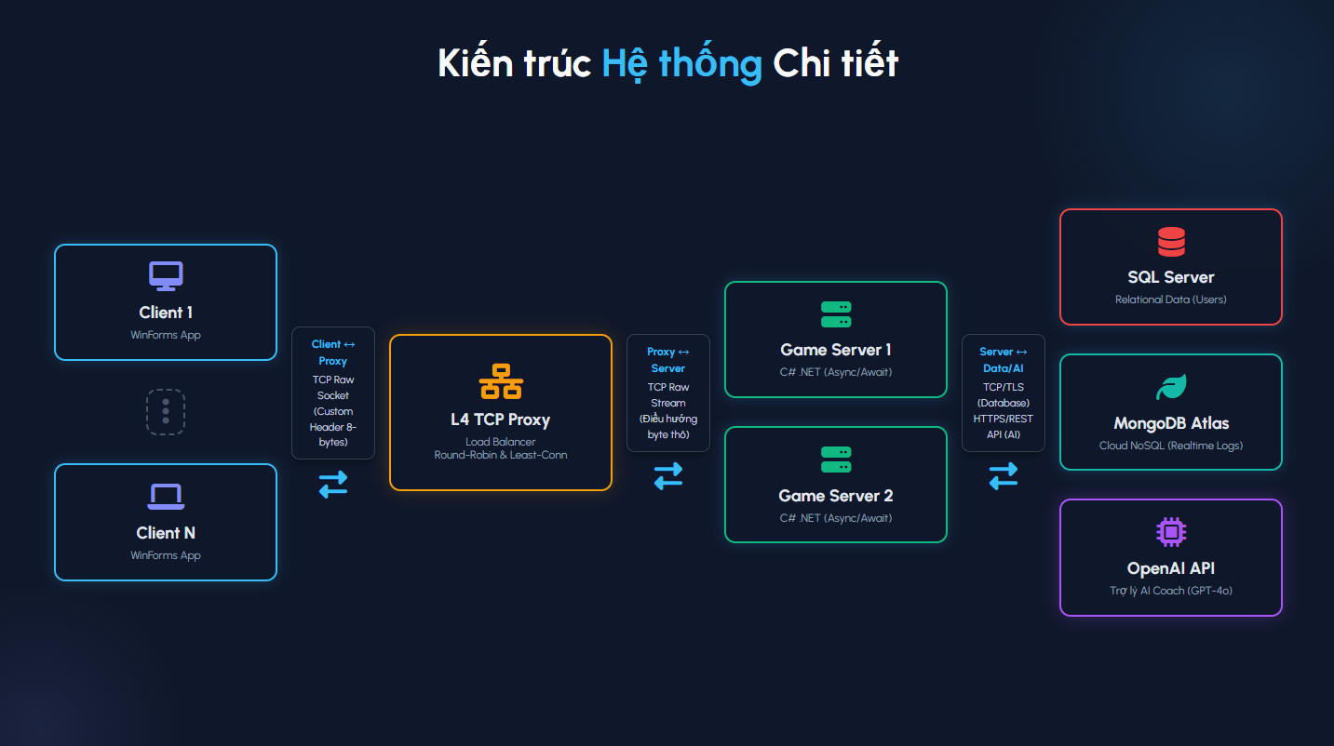
Notes:
<!DOCTYPE html>
<html lang="vi">
<head>
<meta charset="UTF-8">
<meta name="viewport" content="width=device-width, initial-scale=1.0">
<title>TypeRacer - Network Programming</title>
<link rel="preconnect" href="https://fonts.googleapis.com">
<link rel="preconnect" href="https://fonts.gstatic.com" crossorigin>
<link href="https://fonts.googleapis.com/css2?family=Urbanist:wght@400;500;700&display=swap" rel="stylesheet">
<link rel="stylesheet" href="https://cdnjs.cloudflare.com/ajax/libs/font-awesome/6.5.1/css/all.min.css">
<style>
/* 1. THE SETUP */
* {
box-sizing: border-box;
margin: 0;
padding: 0;
}
body {
background-color: #020617; /* Very dark slate */
display: grid;
gap: 20px;
grid-template-columns: 1fr;
margin: 0;
min-height: 100vh;
padding: 20px 0;
place-items: center;
}
.slide-container {
align-items: flex-start;
background-color: #0f172a; /* Slate 900 */
border-radius: 8px;
box-shadow: 0 10px 30px rgba(0, 0, 0, 0.5);
display: flex;
flex-direction: column;
font-family: 'Urbanist', sans-serif;
height: 1020px;
justify-content: center;
overflow: hidden;
padding: 60px;
position: relative;
width: 2280px;
}
/* 1.1 BACKGROUND DECORATION */
.slide-container::before {
content: '';
position: absolute;
top: -20%;
right: -10%;
width: 700px;
height: 700px;
border-radius: 50%;
z-index: 0;
}
.slide-container::after {
content: '';
position: absolute;
bottom: -20%;
left: -10%;
width: 500px;
height: 500px;
border-radius: 50%;
z-index: 0;
}
.slide-container > * {
position: relative;
z-index: 1;
}
/* 2. CONSISTENT TYPOGRAPHY */
.slide-container h1,
.slide-container h2,
.slide-container h3 {
color: #f8fafc;
font-weight: 700;
font-family: 'Urbanist', sans-serif;
}
.slide-container h1 span,
.slide-container h2 span,
.slide-container h3 span {
color: #38bdf8; /* Sky 400 */
}
.slide-container p,
.slide-container li,
.slide-container td,
.slide-container .subtitle {
color: #bae6fd; /* Sky 200 */
font-family: 'Urbanist', sans-serif;
}
/* Font Sizes */
.slide-container h1 {
font-size: 72px;
line-height: 1.1;
margin-bottom: 20px;
}
.slide-container .slide-title {
font-size: 48px;
line-height: 1.2;
margin-bottom: 40px;
width: 100%;
}
.slide-container h3 {
font-size: 28px;
margin-bottom: 15px;
}
.slide-container p,
.slide-container li {
font-size: 20px;
line-height: 1.6;
margin-bottom: 15px;
}
.slide-container .subtitle {
font-size: 24px;
color: #94a3b8; /* Slate 400 */
margin-bottom: 0;
}
/* 3. LAYOUT DEFINITIONS */
.content-area {
display: flex;
flex-direction: column;
flex-grow: 1;
width: 100%;
justify-content: center;
}
.title-layout {
text-align: center;
width: 100%;
align-self: center;
}
.two-column {
display: flex;
gap: 60px;
width: 100%;
align-items: center;
}
.two-column > div {
flex: 1;
}
.bullet-list ul {
list-style: none;
}
.bullet-list li {
position: relative;
padding-left: 35px;
margin-bottom: 20px;
}
.bullet-list li::before {
content: '\f0da'; /* FontAwesome play icon */
font-family: 'Font Awesome 6 Free';
font-weight: 900;
color: #38bdf8;
position: absolute;
left: 0;
top: 2px;
font-size: 20px;
}
.image-wrapper {
border-radius: 12px;
border: 1px solid rgba(56, 189, 248, 0.3);
box-shadow: 0 0 20px rgba(56, 189, 248, 0.1);
overflow: hidden;
height: 400px;
width: 100%;
}
.image-wrapper img {
width: 100%;
height: 100%;
object-fit: cover;
display: block;
}
/* Bleed Image Layout */
.slide-container.bleed-image-layout {
display: grid;
grid-template-columns: repeat(2, minmax(0, 1fr));
gap: 60px;
padding: 0;
align-items: start;
}
.slide-container.bleed-image-layout > .content-container {
padding: 60px 0 60px 60px;
display: flex;
flex-direction: column;
height: 100%;
justify-content: center;
}
.slide-container.bleed-image-layout > .image-container {
height: 720px;
width: 100%;
overflow: hidden;
}
.slide-container.bleed-image-layout img.bleed-image-side {
width: 100%;
height: 720px;
object-fit: cover;
border-radius: 0 8px 8px 0;
}
/* Tiled Content */
.tiled-content {
display: grid;
grid-template-columns: repeat(3, 1fr);
gap: 30px;
width: 100%;
}
.tile {
background: rgba(30, 41, 59, 0.6);
border: 1px solid rgba(56, 189, 248, 0.2);
border-radius: 16px;
padding: 35px 25px;
text-align: center;
display: flex;
flex-direction: column;
align-items: center;
}
.tile .icon {
font-size: 40px;
color: #38bdf8;
margin-bottom: 20px;
background: rgba(56, 189, 248, 0.1);
width: 80px;
height: 80px;
border-radius: 50%;
display: flex;
align-items: center;
justify-content: center;
}
.tile p {
font-size: 18px;
color: #cbd5e1; /* Lighter text for tiles */
}
/* Table Layout */
.table-layout {
width: 100%;
background: rgba(30, 41, 59, 0.6);
border-radius: 12px;
border: 1px solid rgba(56, 189, 248, 0.2);
overflow: hidden;
}
.table-layout table {
width: 100%;
border-collapse: collapse;
}
.table-layout th {
background-color: rgba(15, 23, 42, 0.8);
color: #38bdf8;
font-size: 22px;
padding: 20px 30px;
text-align: left;
border-bottom: 2px solid rgba(56, 189, 248, 0.3);
}
.table-layout td {
padding: 18px 30px;
color: #e2e8f0;
border-bottom: 1px solid rgba(148, 163, 184, 0.1);
font-size: 19px;
}
.table-layout tr:last-child td {
border-bottom: none;
}
.table-layout td strong {
color: #818cf8;
font-weight: 700;
}
/* Rounded Image Layout */
.rounded-image-layout {
align-items: center;
}
.rounded-image-layout .image-wrapper {
border-radius: 50%;
height: 400px;
width: 400px;
flex-shrink: 0;
margin: 0 auto;
border: 4px solid rgba(56, 189, 248, 0.3);
box-shadow: 0 0 30px rgba(56, 189, 248, 0.15);
}
/* Q&A Layout */
.qa-layout {
text-align: center;
width: 100%;
align-self: center;
}
.qa-layout h2 {
font-size: 90px;
margin-bottom: 30px;
color: #38bdf8;
}
.qa-layout p {
font-size: 28px;
color: #cbd5e1;
}
/* Architecture Diagram Layout */
.arch-diagram {
display: flex;
flex-direction: column;
align-items: center;
gap: 15px;
width: 100%;
margin-top: 10px;
}
.arch-row {
display: flex;
gap: 40px;
justify-content: center;
align-items: center;
width: 100%;
}
.arch-box {
background: rgba(15, 23, 42, 0.9);
border: 2px solid #38bdf8;
border-radius: 12px;
padding: 15px 25px;
text-align: center;
color: #f8fafc;
box-shadow: 0 0 15px rgba(56, 189, 248, 0.2);
min-width: 220px;
position: relative;
}
.arch-box i {
font-size: 32px;
margin-bottom: 12px;
color: #818cf8;
}
.arch-box h4 {
font-size: 20px;
margin-bottom: 5px;
color: #e2e8f0;
font-weight: 700;
}
.arch-box p {
font-size: 15px !important;
margin-bottom: 0 !important;
color: #94a3b8 !important;
}
.arch-arrow {
color: #38bdf8;
font-size: 20px;
display: flex;
flex-direction: column;
align-items: center;
gap: 5px;
}
.arch-arrow span {
font-size: 13px;
color: #cbd5e1;
background: #0f172a;
padding: 4px 12px;
border-radius: 12px;
border: 1px solid #334155;
z-index: 2;
}
</style>
</head>
<body>
<!-- Slide 3.5: Detailed Architecture Diagram -->
<div class="slide-container" id="slide-arch">
<h2 class="slide-title" style="text-align: center;">Kiến trúc <span>Hệ thống</span> Chi tiết</h2>
<div class="content-area">
<div class="arch-diagram">
<!-- Clients Layer -->
<div class="arch-row">
<div class="arch-box">
<i class="fa-solid fa-desktop"></i>
<h4>Client 1</h4>
<p>WinForms App</p>
</div>
<div class="arch-box" style="border: 2px dashed #475569; background: transparent; box-shadow: none; min-width: 100px;">
<i class="fa-solid fa-ellipsis" style="color: #475569; margin-bottom: 0;"></i>
</div>
<div class="arch-box">
<i class="fa-solid fa-laptop"></i>
<h4>Client N</h4>
<p>WinForms App</p>
</div>
</div>
<div class="arch-arrow">
<i class="fa-solid fa-arrow-down"></i>
<span>TCP Raw Socket (Custom Header Protocol)</span>
</div>
<!-- Proxy Layer -->
<div class="arch-row">
<div class="arch-box" style="border-color: #f59e0b; width: 450px;">
<i class="fa-solid fa-network-wired" style="color: #f59e0b;"></i>
<h4>L4 TCP Load Balancer</h4>
<p>Thuật toán: Round-Robin & Least-Connections</p>
</div>
</div>
<div class="arch-arrow">
<i class="fa-solid fa-arrows-split-up-and-left"></i>
<span>Điều hướng Traffic (Phân tải)</span>
</div>
<!-- Server Layer -->
<div class="arch-row">
<div class="arch-box" style="border-color: #10b981;">
<i class="fa-solid fa-server" style="color: #10b981;"></i>
<h4>Game Server 1</h4>
<p>C# .NET (Async/Await)</p>
</div>
<div class="arch-box" style="border-color: #10b981;">
<i class="fa-solid fa-server" style="color: #10b981;"></i>
<h4>Game Server 2</h4>
<p>C# .NET (Async/Await)</p>
</div>
</div>
<div class="arch-arrow">
<i class="fa-solid fa-arrow-down"></i>
<span>Data Access Layer (Repository Pattern)</span>
</div>
<!-- Database Layer -->
<div class="arch-row">
<div class="arch-box" style="border-color: #ef4444;">
<i class="fa-solid fa-database" style="color: #ef4444;"></i>
<h4>SQL Server</h4>
<p>Dữ liệu Relational</p>
</div>
<div class="arch-box" style="border-color: #14b8a6;">
<i class="fa-solid fa-leaf" style="color: #14b8a6;"></i>
<h4>MongoDB Atlas</h4>
<p>Cloud NoSQL (Realtime Logging)</p>
</div>
</div>
</div>
</div>
</div>
</body>
</html>

Slide 4

Đáp ứng Tiêu chí Chấm điểm
Tiêu chí Đánh giá | Kỹ thuật Triển khai trong Đồ án
I/O (File, Network) & Thread | Giao thức tự định nghĩa (Custom Header). Xử lý Async đa luồng độc lập.
Database & Sign in/up | MongoDB Atlas / SQL. Băm mật khẩu. Quản lý Session Token.
Multi Client / Multi Server | Xử lý hàng trăm luồng kết nối. Kiến trúc hỗ trợ nhiều Game Server.
Load Balancing | Code riêng L4 Proxy, điều phối Round-Robin & Least-Connections.
Demo via LAN/Internet | Sẵn sàng triển khai trên VPS (SQL/Mongo) qua Internet.

Slide 5




Lõi Kỹ thuật Tối ưu
Giao thức Custom
Đa luồng
Đồng bộ State
Thiết kế gói tin chuẩn xác với Header 8-byte (Length, Type, Flags). Khắc phục triệt để lỗi dính gói tin (TCP stream framing) thường gặp.
Mỗi Client được cấp phát một Task xử lý độc lập. UI Client không bị block nhờ cơ chế Async/Await toàn diện. (NetworkStream.ReadAsync)
Sử dụng cơ chế khóa (Lock) luồng an toàn khi nhiều Client thao tác đồng thời vào chung một phòng (Room) hoặc dữ liệu trận đấu.

Slide 6
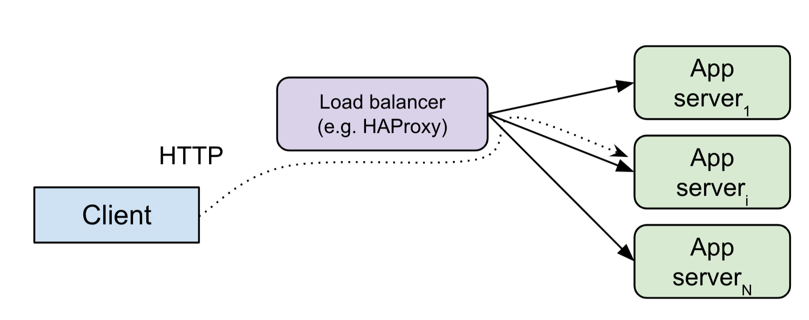
TCP Load Balancer
Tự phát triển một L4 TCP Proxy đứng trước các Game Servers.
Điều hướng traffic theo hai thuật toán: Round-Robin và Least-Connections.
Proxy luồng byte thô hai chiều (raw stream) siêu nhẹ, không cần parse protocol game.
Tích hợp cơ chế Health Check liên tục ở mức TCP, tự động loại bỏ server chết để đảm bảo High Availability.

Slide 7
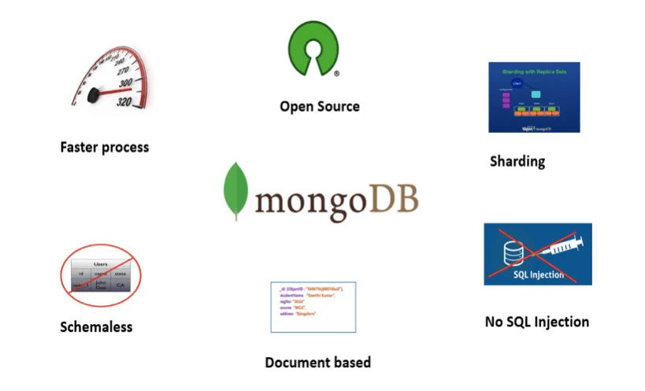
Lưu trữ & Bảo mật
Database linh hoạt: SQL Server + MongoDB Atlas qua repository/provider, có schema, index, seed và migration.
Cryptography: PBKDF2-HMAC-SHA256 + salt; payload TCP của client mã hóa AES-256-CBC với IV ngẫu nhiên từng message.
Quản lý phiên: session token random, duplicate login invalidate session cũ; report/export có SHA-256 verification hash.

Slide 8
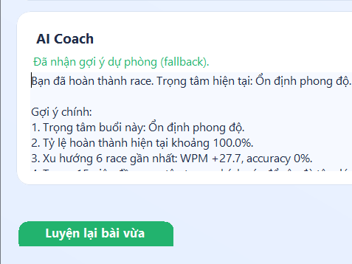
Trợ lý AI Coach
Tiêu chí Sáng tạo: Tính năng độc đáo giúp dự án ghi điểm phần Tư duy Sáng tạo.
Tích hợp OpenClaude gpt-5.5, validate JSON và retry tối đa 5 lần.
Phân tích WPM, accuracy và lỗi realtime ở mức ký tự/từ/n-gram ngay sau race.
Sinh training pack 10-12 bài, mission chơi ngay; fallback bank 100 bài khi provider lỗi.

Slide 9
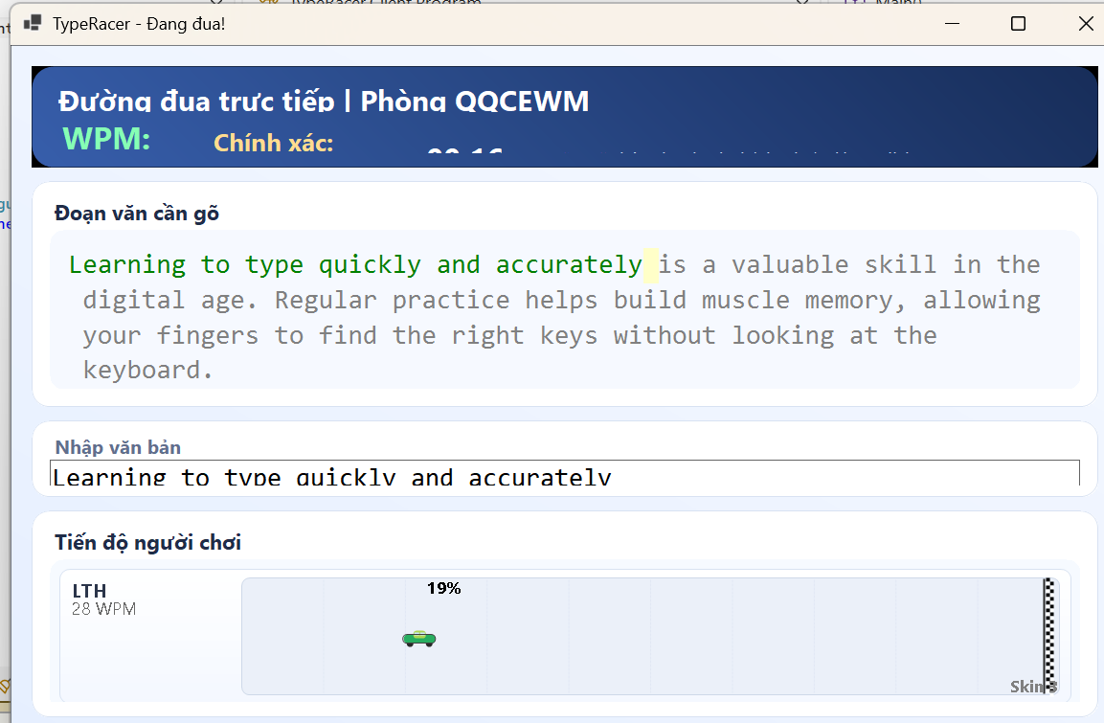
Giao diện & Triển khai
Custom UI: Giao diện WinForms được code thủ công, tạo Custom Controls cho Track xe đua chạy mượt mà từ 0% - 100%.
Trải nghiệm tốt: Cập nhật giao diện real-time không gây hiện tượng giật lag màn hình (flickering).
Đóng gói sẵn sàng: Client được build thành file `.exe` chạy độc lập không cần cài đặt Visual Studio.
Triển khai máy chủ dễ dàng bằng Script tự động trên VPS (Linux/Windows).

Slide 10
Demo
Thanks!

Slide 11
Notes:
<!DOCTYPE html>
<html lang="vi">
<head>
<meta charset="UTF-8">
<meta name="viewport" content="width=device-width, initial-scale=1.0">
<title>TypeRacer - Network Programming</title>
<link rel="preconnect" href="https://fonts.googleapis.com">
<link rel="preconnect" href="https://fonts.gstatic.com" crossorigin>
<link href="https://fonts.googleapis.com/css2?family=Urbanist:wght@400;500;700&display=swap" rel="stylesheet">
<link rel="stylesheet" href="https://cdnjs.cloudflare.com/ajax/libs/font-awesome/6.5.1/css/all.min.css">
<style>
/* 1. THE SETUP */
* {
box-sizing: border-box;
margin: 0;
padding: 0;
}
body {
background-color: #020617; /* Very dark slate */
display: grid;
gap: 20px;
grid-template-columns: 1fr;
margin: 0;
min-height: 100vh;
padding: 20px 0;
place-items: center;
}
.slide-container {
align-items: flex-start;
background-color: #0f172a; /* Slate 900 */
border-radius: 8px;
box-shadow: 0 10px 30px rgba(0, 0, 0, 0.5);
display: flex;
flex-direction: column;
font-family: 'Urbanist', sans-serif;
height: 1020px;
justify-content: center;
overflow: hidden;
padding: 60px;
position: relative;
width: 2280px;
}
/* 1.1 BACKGROUND DECORATION */
.slide-container::before {
content: '';
position: absolute;
top: -20%;
right: -10%;
width: 700px;
height: 700px;
border-radius: 50%;
z-index: 0;
}
.slide-container::after {
content: '';
position: absolute;
bottom: -20%;
left: -10%;
width: 500px;
height: 500px;
border-radius: 50%;
z-index: 0;
}
.slide-container > * {
position: relative;
z-index: 1;
}
/* 2. CONSISTENT TYPOGRAPHY */
.slide-container h1,
.slide-container h2,
.slide-container h3 {
color: #f8fafc;
font-weight: 700;
font-family: 'Urbanist', sans-serif;
}
.slide-container h1 span,
.slide-container h2 span,
.slide-container h3 span {
color: #38bdf8; /* Sky 400 */
}
.slide-container p,
.slide-container li,
.slide-container td,
.slide-container .subtitle {
color: #bae6fd; /* Sky 200 */
font-family: 'Urbanist', sans-serif;
}
/* Font Sizes */
.slide-container h1 {
font-size: 72px;
line-height: 1.1;
margin-bottom: 20px;
}
.slide-container .slide-title {
font-size: 48px;
line-height: 1.2;
margin-bottom: 40px;
width: 100%;
}
.slide-container h3 {
font-size: 28px;
margin-bottom: 15px;
}
.slide-container p,
.slide-container li {
font-size: 20px;
line-height: 1.6;
margin-bottom: 15px;
}
.slide-container .subtitle {
font-size: 24px;
color: #94a3b8; /* Slate 400 */
margin-bottom: 0;
}
/* 3. LAYOUT DEFINITIONS */
.content-area {
display: flex;
flex-direction: column;
flex-grow: 1;
width: 100%;
justify-content: center;
}
.title-layout {
text-align: center;
width: 100%;
align-self: center;
}
.two-column {
display: flex;
gap: 60px;
width: 100%;
align-items: center;
}
.two-column > div {
flex: 1;
}
.bullet-list ul {
list-style: none;
}
.bullet-list li {
position: relative;
padding-left: 35px;
margin-bottom: 20px;
}
.bullet-list li::before {
content: '\f0da'; /* FontAwesome play icon */
font-family: 'Font Awesome 6 Free';
font-weight: 900;
color: #38bdf8;
position: absolute;
left: 0;
top: 2px;
font-size: 20px;
}
.image-wrapper {
border-radius: 12px;
border: 1px solid rgba(56, 189, 248, 0.3);
box-shadow: 0 0 20px rgba(56, 189, 248, 0.1);
overflow: hidden;
height: 400px;
width: 100%;
}
.image-wrapper img {
width: 100%;
height: 100%;
object-fit: cover;
display: block;
}
/* Bleed Image Layout */
.slide-container.bleed-image-layout {
display: grid;
grid-template-columns: repeat(2, minmax(0, 1fr));
gap: 60px;
padding: 0;
align-items: start;
}
.slide-container.bleed-image-layout > .content-container {
padding: 60px 0 60px 60px;
display: flex;
flex-direction: column;
height: 100%;
justify-content: center;
}
.slide-container.bleed-image-layout > .image-container {
height: 720px;
width: 100%;
overflow: hidden;
}
.slide-container.bleed-image-layout img.bleed-image-side {
width: 100%;
height: 720px;
object-fit: cover;
border-radius: 0 8px 8px 0;
}
/* Tiled Content */
.tiled-content {
display: grid;
grid-template-columns: repeat(3, 1fr);
gap: 30px;
width: 100%;
}
.tile {
background: rgba(30, 41, 59, 0.6);
border: 1px solid rgba(56, 189, 248, 0.2);
border-radius: 16px;
padding: 35px 25px;
text-align: center;
display: flex;
flex-direction: column;
align-items: center;
}
.tile .icon {
font-size: 40px;
color: #38bdf8;
margin-bottom: 20px;
background: rgba(56, 189, 248, 0.1);
width: 80px;
height: 80px;
border-radius: 50%;
display: flex;
align-items: center;
justify-content: center;
}
.tile p {
font-size: 18px;
color: #cbd5e1; /* Lighter text for tiles */
}
/* Table Layout */
.table-layout {
width: 100%;
background: rgba(30, 41, 59, 0.6);
border-radius: 12px;
border: 1px solid rgba(56, 189, 248, 0.2);
overflow: hidden;
}
.table-layout table {
width: 100%;
border-collapse: collapse;
}
.table-layout th {
background-color: rgba(15, 23, 42, 0.8);
color: #38bdf8;
font-size: 22px;
padding: 20px 30px;
text-align: left;
border-bottom: 2px solid rgba(56, 189, 248, 0.3);
}
.table-layout td {
padding: 18px 30px;
color: #e2e8f0;
border-bottom: 1px solid rgba(148, 163, 184, 0.1);
font-size: 19px;
}
.table-layout tr:last-child td {
border-bottom: none;
}
.table-layout td strong {
color: #818cf8;
font-weight: 700;
}
/* Rounded Image Layout */
.rounded-image-layout {
align-items: center;
}
.rounded-image-layout .image-wrapper {
border-radius: 50%;
height: 400px;
width: 400px;
flex-shrink: 0;
margin: 0 auto;
border: 4px solid rgba(56, 189, 248, 0.3);
box-shadow: 0 0 30px rgba(56, 189, 248, 0.15);
}
/* Q&A Layout */
.qa-layout {
text-align: center;
width: 100%;
align-self: center;
}
.qa-layout h2 {
font-size: 90px;
margin-bottom: 30px;
color: #38bdf8;
}
.qa-layout p {
font-size: 28px;
color: #cbd5e1;
}
/* Architecture Diagram Layout */
.arch-diagram {
display: flex;
flex-direction: column;
align-items: center;
gap: 15px;
width: 100%;
margin-top: 10px;
}
.arch-row {
display: flex;
gap: 40px;
justify-content: center;
align-items: center;
width: 100%;
}
.arch-box {
background: rgba(15, 23, 42, 0.9);
border: 2px solid #38bdf8;
border-radius: 12px;
padding: 15px 25px;
text-align: center;
color: #f8fafc;
box-shadow: 0 0 15px rgba(56, 189, 248, 0.2);
min-width: 220px;
position: relative;
}
.arch-box i {
font-size: 32px;
margin-bottom: 12px;
color: #818cf8;
}
.arch-box h4 {
font-size: 20px;
margin-bottom: 5px;
color: #e2e8f0;
font-weight: 700;
}
.arch-box p {
font-size: 15px !important;
margin-bottom: 0 !important;
color: #94a3b8 !important;
}
.arch-arrow {
color: #38bdf8;
font-size: 20px;
display: flex;
flex-direction: column;
align-items: center;
gap: 5px;
}
.arch-arrow span {
font-size: 13px;
color: #cbd5e1;
background: #0f172a;
padding: 4px 12px;
border-radius: 12px;
border: 1px solid #334155;
z-index: 2;
}
</style>
</head>
<body>
<!-- Slide 3.5: Detailed Architecture Diagram -->
<div class="slide-container" id="slide-arch">
<h2 class="slide-title" style="text-align: center;">Kiến trúc <span>Hệ thống</span> Chi tiết</h2>
<div class="content-area">
<div class="arch-diagram">
<!-- Clients Layer -->
<div class="arch-row">
<div class="arch-box">
<i class="fa-solid fa-desktop"></i>
<h4>Client 1</h4>
<p>WinForms App</p>
</div>
<div class="arch-box" style="border: 2px dashed #475569; background: transparent; box-shadow: none; min-width: 100px;">
<i class="fa-solid fa-ellipsis" style="color: #475569; margin-bottom: 0;"></i>
</div>
<div class="arch-box">
<i class="fa-solid fa-laptop"></i>
<h4>Client N</h4>
<p>WinForms App</p>
</div>
</div>
<div class="arch-arrow">
<i class="fa-solid fa-arrow-down"></i>
<span>TCP Raw Socket (Custom Header Protocol)</span>
</div>
<!-- Proxy Layer -->
<div class="arch-row">
<div class="arch-box" style="border-color: #f59e0b; width: 450px;">
<i class="fa-solid fa-network-wired" style="color: #f59e0b;"></i>
<h4>L4 TCP Load Balancer</h4>
<p>Thuật toán: Round-Robin & Least-Connections</p>
</div>
</div>
<div class="arch-arrow">
<i class="fa-solid fa-arrows-split-up-and-left"></i>
<span>Điều hướng Traffic (Phân tải)</span>
</div>
<!-- Server Layer -->
<div class="arch-row">
<div class="arch-box" style="border-color: #10b981;">
<i class="fa-solid fa-server" style="color: #10b981;"></i>
<h4>Game Server 1</h4>
<p>C# .NET (Async/Await)</p>
</div>
<div class="arch-box" style="border-color: #10b981;">
<i class="fa-solid fa-server" style="color: #10b981;"></i>
<h4>Game Server 2</h4>
<p>C# .NET (Async/Await)</p>
</div>
</div>
<div class="arch-arrow">
<i class="fa-solid fa-arrow-down"></i>
<span>Data Access Layer (Repository Pattern)</span>
</div>
<!-- Database Layer -->
<div class="arch-row">
<div class="arch-box" style="border-color: #ef4444;">
<i class="fa-solid fa-database" style="color: #ef4444;"></i>
<h4>SQL Server</h4>
<p>Dữ liệu Relational</p>
</div>
<div class="arch-box" style="border-color: #14b8a6;">
<i class="fa-solid fa-leaf" style="color: #14b8a6;"></i>
<h4>MongoDB Atlas</h4>
<p>Cloud NoSQL (Realtime Logging)</p>
</div>
</div>
</div>
</div>
</div>
</body>
</html>

Slide 12
Final
Tất cả tiêu chí
Giữa kỳ
Cuối kỳ
Mục tiêu
Tổng quan kiến trúc. Demo tính năng nền: login, room, race, chat, leaderboard, socket, load balancer.
Bổ sung hardening, AI cá nhân hóa, game mode, export, kiểm thử tự động và kịch bản demo theo rubric.
Mỗi cải tiến trả lời được: thuộc tiêu chí nào, bằng chứng nằm ở file/script nào, demo.
TypeRacer Network | Báo cáo cuối kì
11/30

Slide 13
Cải tiến theo tiêu chí đánh giá
Rubric 100 điểm
Nội dung logic 50
Giao diện 20
Nhóm 20
Sáng tạo 10
• protocol + dispatcher • thread/state safety • DB + auth + crypto • multi-client/server
• race track + live stats • result/certificate/export • AI panel + practice UX • UI audit guard
• chia vai demo • log kiểm thử • file bằng chứng
• AI Coach thật • game mode mới • mission cá nhân hóa
65 OK
27/27
10/10
8/8
rubric_evidence_audit.py
unit test core logic
edge matrix VPS
race concurrency VPS
TypeRacer Network | Báo cáo cuối kì
12/30

Slide 14
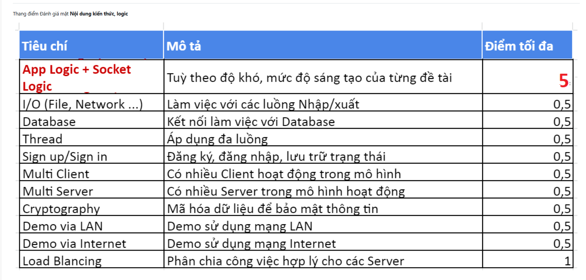
TypeRacer Network | Báo cáo cuối kì
14/30

Slide 15
Protocol/socket:
App Logic + Socket
Framing rõ ràng
Dispatcher theo nhóm
Guard bảo vệ
Header 8 bytes: Length, Type, Flags; tránh dính gói/tách gói của TCP stream.
Auth 100, Room 200, Game 300, Chat 400, Stats 500, System 900.
Protected actions bị chặn khi chưa login hoặc session không hợp lệ.
Encrypted flag
Edge handling
Kiểm chứng
Client chính thức gửi payload AES; server phản hồi encrypted khi session đã dùng encrypted flag.
Malformed flow ngoài room trả ERROR rõ, không silent timeout.
Script python
TypeRacer Network | Báo cáo cuối kì
14/30

Slide 16
Room/Race lifecycle
App Logic + Multi Client
Create
Join
Ready
Typing
Finish
host tạo room + mode
capacity + session guard
all-ready/countdown
progress broadcast
lock + persist result
Luồng cải tiến
Chống dữ liệu xấu
Kết quả chạy
• host rời phòng có transfer • timeout khi không finish • duplicate finish bị chặn
• typing burst bị clamp • finish lock tránh ghi trùng • stats request có bounds
Script python
TypeRacer Network | Báo cáo cuối kì
15/30

Slide 17
Thread & state safety
Thread + Multi Client
State dùng ConcurrentDictionary
Send lock bằng SemaphoreSlim
Finish/timeout lock
Quản lý clients, rooms, mistake memory theo key; giảm rủi ro race condition khi nhiều client thao tác.
Mỗi session serialize thao tác ghi NetworkStream, tránh nhiều task cùng ghi lên một socket.
Tránh double-finish và vẫn trả kết quả khi có người không hoàn thành.
HeartbeatService
AI grace
Background monitor phát hiện client rớt.
Không đá client khi request AI kéo dài.
TypeRacer Network | Báo cáo cuối kì
16/30

Slide 18
Load balancing
Multi Server + Load Balancing
Thuật toán
Health check
Proxy L4
RoundRobin và LeastConnections; backend có active connection counter thread-safe.
TCP check định kỳ; backend offline bị loại khỏi danh sách chọn.
Forward byte stream hai chiều, không cần parse protocol game.
Kết quả chạy local
ROUND_ROBIN ok: backend-a/b xen kẽ HEALTH_FAILOVER ok: traffic chỉ vào backend còn sống LOAD BALANCER PROBE TEST PASSED
TypeRacer Network | Báo cáo cuối kì
17/30

Slide 19
Persistence
Database + I/O
SQL Server
MongoDB provider
Repository contracts
Schema, index, seed passages, migration language; dùng cho VPS runtime và leaderboard/history.
MongoUser/Race/Chat/Passage repositories, auto seed nếu collection rỗng, config qua env.
Server bootstrap chọn provider qua Data: Provider, giúp demo mở rộng kiến trúc dữ liệu.
I/O file
FileLogger ghi log server theo timestamp; ResultForm xuất .txt, JSON, CSV cho race/AI analytics.
TypeRacer Network | Báo cáo cuối kì
18/30

Slide 20
Auth & cryptography:
Sign in/up + Cryptography
Password
Session
Payload TCP
PBKDF2-HMAC-SHA256 + salt riêng từng user
Token random; duplicate login invalidate session cũ; logout clear state liên quan.
AES-256-CBC, IV ngẫu nhiên từng message, flag Encrypted trong protocol.
PASS
AES
SHA-256
encrypted_protocol_test.py qua VPS
random IV / roundtrip / tamper tests
verification hash cho report/export
TypeRacer Network | Báo cáo cuối kì
19/30

Slide 21
Gameplay modes: tăng chiều sâu sản phẩm
App Logic + Sáng tạo
Classic
Accuracy
No Backspace
Sudden Death
Race chuẩn để so sánh WPM/accuracy.
Ưu tiên độ chính xác, phù hợp luyện kỷ luật gõ.
Dùng phím xóa là bị loại, tăng áp lực thao tác.
Sai ký tự là bị loại sau kiểm tra từ/Telex.
AI Practice 4 cấp
Kết quả chạy
easy, medium, hard, nightmare; bot/RPM mục tiêu tăng theo cấp, dùng lại trong AI mission.
game_mode_protocol_test.py PASS đủ 8 case: classic, accuracy, no_backspace, sudden_death, AI practice 4 cấp.
TypeRacer Network | Báo cáo cuối kì
20/30

Slide 22
Custom text & warm-up:
UI/UX + Sáng tạo
Custom passage room
Solo practice từ lobby/result
Warm-up phòng chờ
Host tự nhập đoạn gõ; server normalize và tạo passage cho race, room list hiển thị nguồn text.
Có thể luyện ngay đoạn custom hoặc bài AI mà không cần đủ người chơi.
Raw WPM, accuracy streak, lỗi ghi ngay lúc gõ sai dù đã sửa.
Quick Play
Chờ phòng
Warm-up
Race
Ghi lỗi
không rảnh tay
luyện câu ngắn
vào trận chính
phục vụ AI
TypeRacer Network | Báo cáo cuối kì
21/30

Slide 23
Race screen:
UI/UX + App Logic
Live metrics
Race track
Rule enforcement
WPM, raw WPM, accuracy, đúng/sai, combo, timer theo phòng.
Xe chạy 0-100%, update realtime hạn chế flicker.
No Backspace/Sudden Death được xử lý ngay trong input flow.
Sample timeline
Lưu WPM/raw/accuracy theo thời gian để vẽ chart sau race.
TypeRacer Network | Báo cáo cuối kì
22/30

Slide 24
Result screen
UI/UX + I/O
Certificate
Progress local
Export/share
Bronze/Silver/Gold/Platinum/Diamond theo WPM + accuracy, có verification hash ngắn.
Daily challenge, personal best theo mode, keyboard mastery từ lỗi realtime.
Copy score, xuất report .txt, analytics JSON/CSV, Verification SHA-256.
Ý nghĩa
Không chỉ “hiển thị kết quả”; có file I/O, có tính xác minh, có dữ liệu để phân tích sau race.
TypeRacer Network | Báo cáo cuối kì
23/30

Slide 25
AI Coach pipeline
Tư duy sáng tạo
Observe
Memory
Prompt
Validate
Practice
TYPING_UPDATE sai
char/word/n-gram
OpenClaude gpt-5.5
JSON contract + retry
mission + passages
Điểm khác biệt
Dữ liệu volatile
Lỗi được ghi ngay lúc người chơi bấm sai, kể cả sau đó đã xóa sửa.
Clear theo user/room để không lưu lỗi riêng tư lâu hơn cần thiết.
TypeRacer Network | Báo cáo cuối kì
24/30

Slide 26
AI output
Sáng tạo + UI/UX
Problem-key story
Heatmap & fingerprint
Training pack
AI chọn weak keys/ngram thật rồi sinh story passage có thể chơi ngay.
QWERTY weak-key heatmap, typing fingerprint, personalization score.
10-12 passage mới, novelty/coverage/confidence audit.
Mission chơi ngay
Drill cá nhân hóa
Kể chuyện khi demo
AI practice missions có objective, timer, target, badge và passage riêng.
Weak-key deck, adaptive n-gram drills, spaced repetition, mastery checkpoints.
“AI không thay người chơi; AI biến lỗi của họ thành giáo án kế tiếp.”
TypeRacer Network | Báo cáo cuối kì
25/30

Slide 27
AI reliability
Sáng tạo + Thread
Validate/retry
Fallback bank
Heartbeat grace
Response phải đúng shape; retry tối đa 5 lần trước khi fallback.
100 đoạn luyện nội bộ để user vẫn có bài mới nếu AI/network lỗi.
Request AI dài không làm heartbeat đá client khỏi phòng.
Bằng chứng đang chạy
edge_matrix_test.py trên VPS: ai_coach_auth_and_shape PASS; tổng edge matrix 10/10 PASS.
TypeRacer Network | Báo cáo cuối kì
26/30

Slide 28
Hiệu quả hợp tác nhóm
Teamwork 20 điểm
Client/UI
Server/protocol
DB/deploy/test
Login preset, lobby, custom text, room warm-up, race track, Result + AI panel.
TCP protocol, dispatcher, lifecycle room/race, heartbeat, mistake memory.
SQL/Mongo repositories, VPS, crypto test, load balancer, stress/concurrency.
TypeRacer Network | Báo cáo cuối kì
29/30

Slide 29
Thanks!
→ Demo
Đồ án Lập trình mạng (NT106)
Vũ Hoàng Long
Nguyễn Tuấn Hùng
Lê Tuấn Hùng
TypeRacer Network | Báo cáo cuối kì
30/30

