Slide 1


Computer Science and Engineering
High-Fidelity Switch Models
for SDN Emulation
Danny Y. Huang
Kenneth Yocum
Alex C. Snoeren
University of California, San Diego

Slide 2

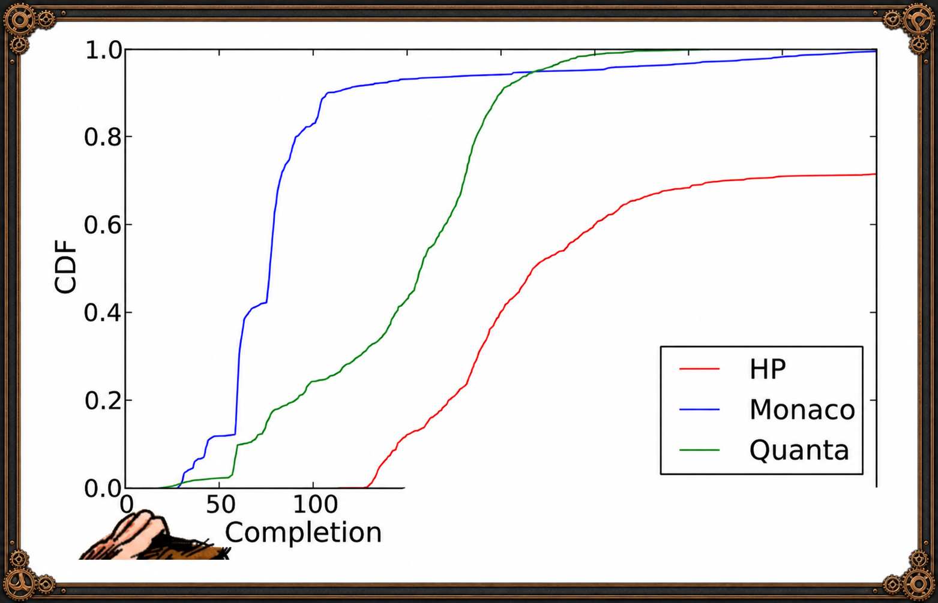
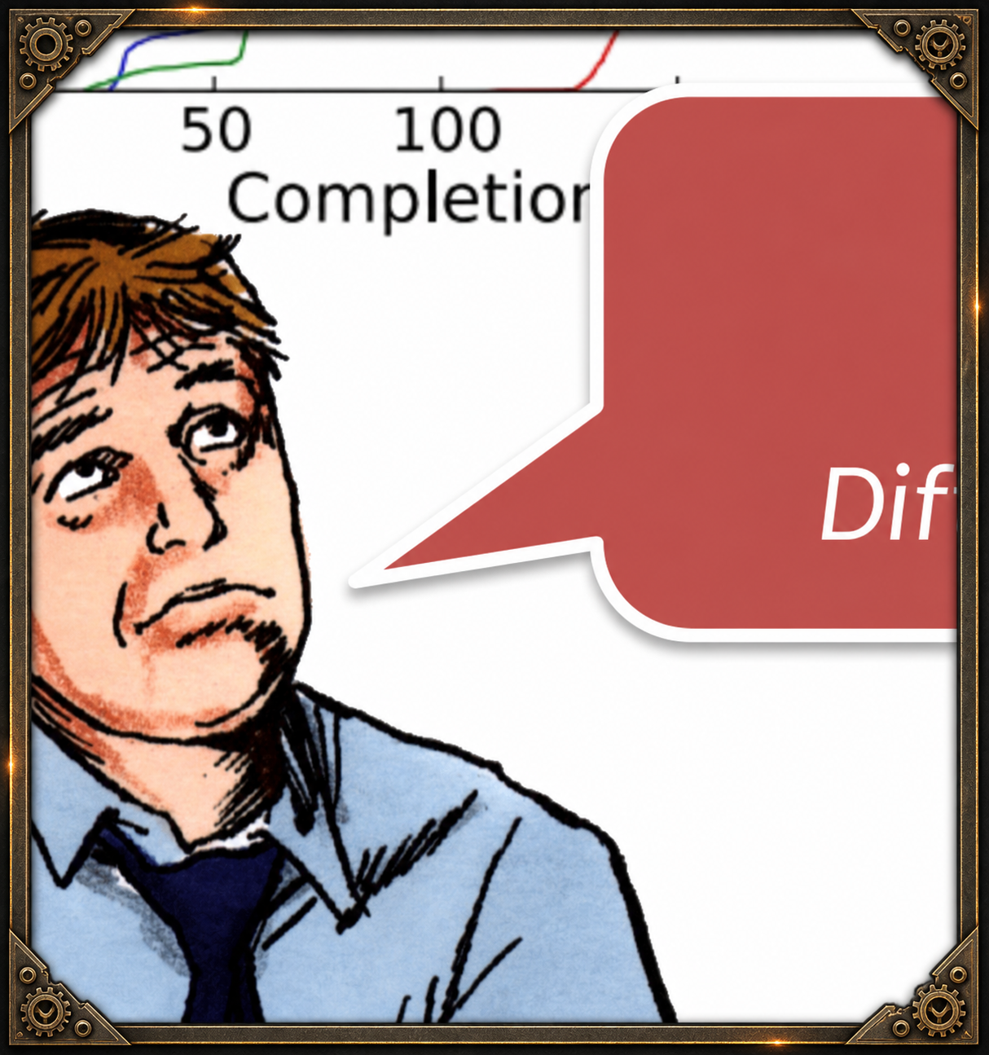
Buying OpenFlow Switches
Clients
Same topology.
Same workload.
Different performance!
red
5

Slide 3
Control-Path Delays
Controller (POX)
Disproportionately
affects short flows.
Packet-in
Events
Flow-mod
Events
Ingress
Delay
CPU
Egress
Delay
OpenFlow
Switch
TCAM
Ingress
Egress
Data plane traffic
Application Workload
10

Slide 4
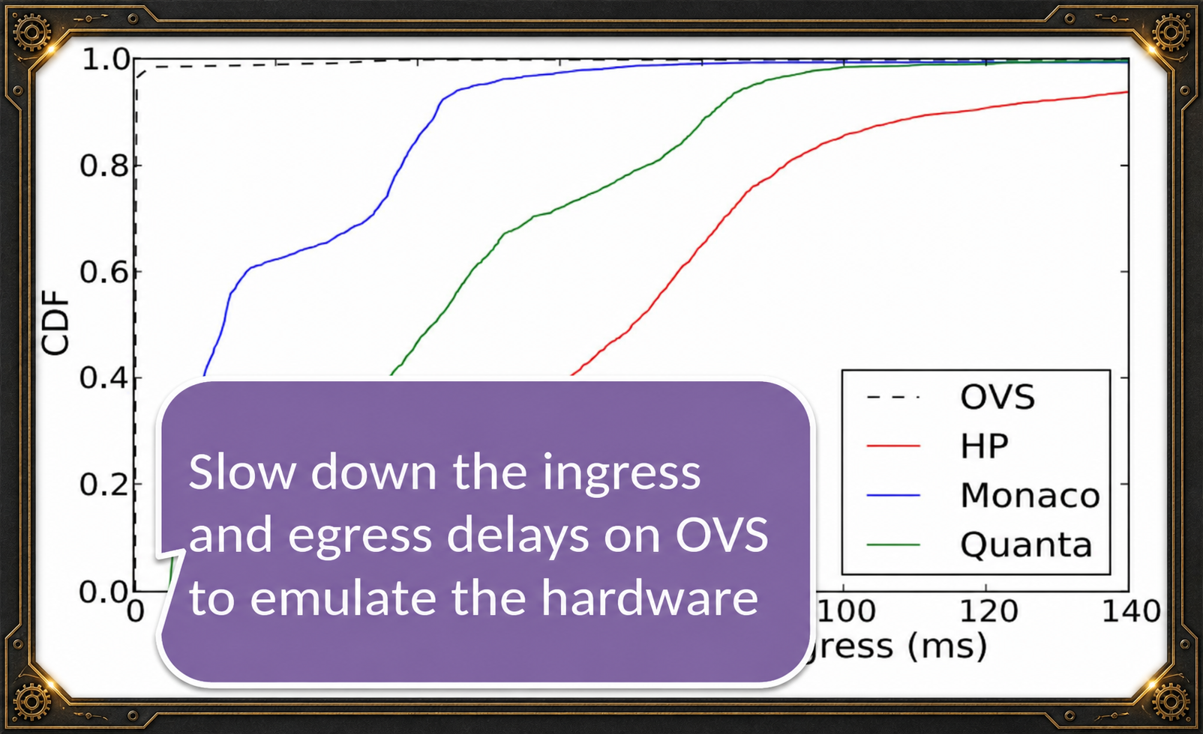
Measure Egress Delay
OVS: almost
no delays!
14

Slide 5
Summary
Future Work
• Hard to predict performance due to vendor variations.
• We designed an emulator for control-path delays.
• Simple, but achieves reasonable approximation.
• Increase realism. Capture more artifacts.
• Expand workload coverage. Automate switch measurements.
• Capture interactions among multiple switches.
Acknowledgements Marco Canini and Dan Levin (TU Berlin)
George Porter (UC San Diego)
19

Slide 6

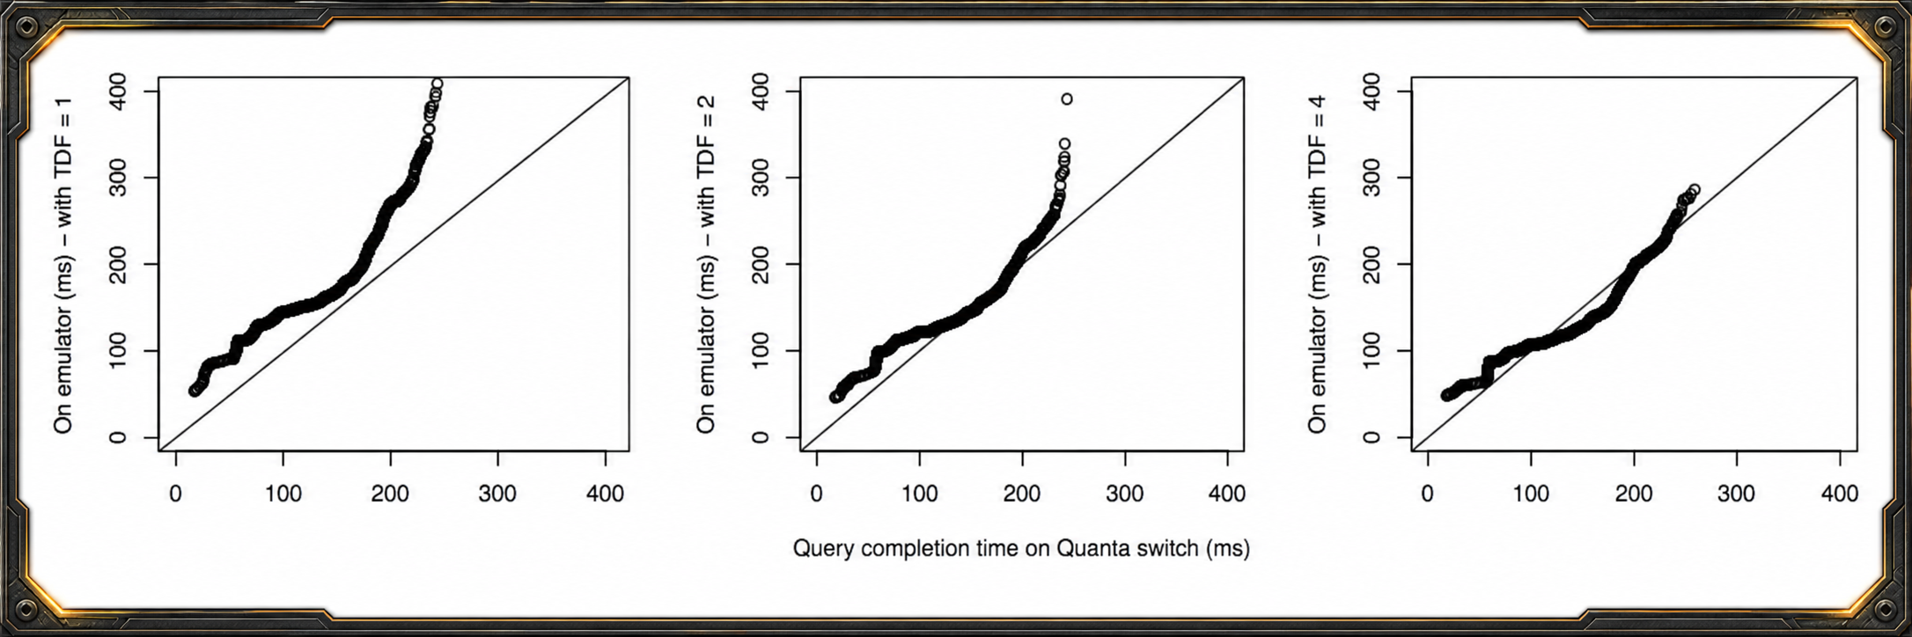
Time Dilation
23

