Slide 1


Pano: Optimizing 360 Video Streaming
with a Better Understanding of
Quality Perception
Yu Guan, Chengyuan Zheng, Xinggong Zhang, Zongming
Guo, Junchen Jiang
1

Slide 2

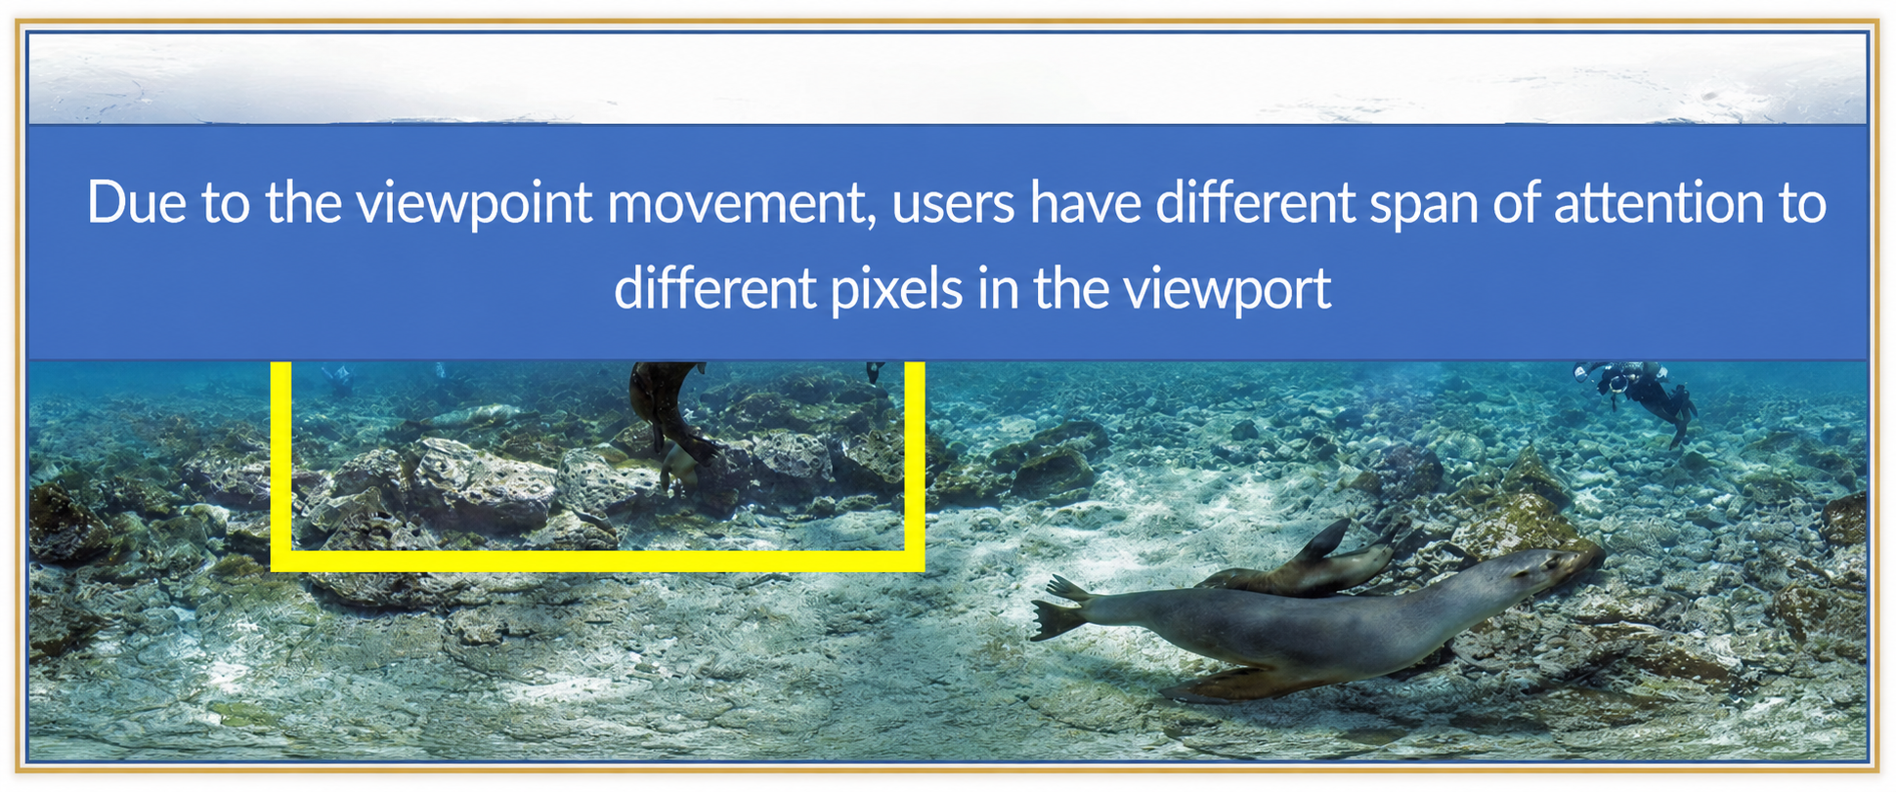
Key observation
Due to the viewpoint movement, users have different span of attention to
different pixels in the viewport
Watching a traditional video
Watching a 360 video
6

Slide 3
Our approach
Identify where the user's attention is
Drop the quality of areas the user doesn't pay attention to
11

Slide 4
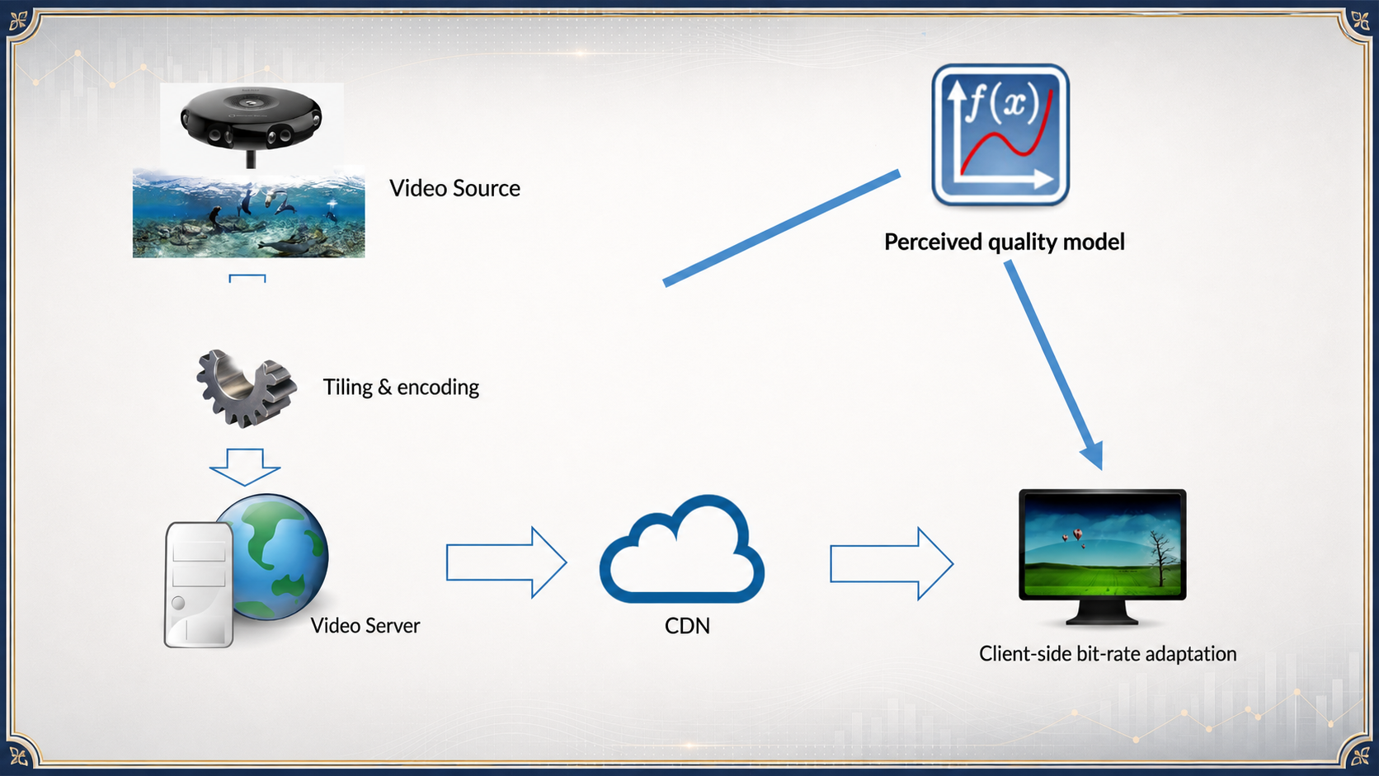
How to achieve this in a real system?
Challenge 2: How to encode 360
videos based on user perceive quality?
16

Slide 5
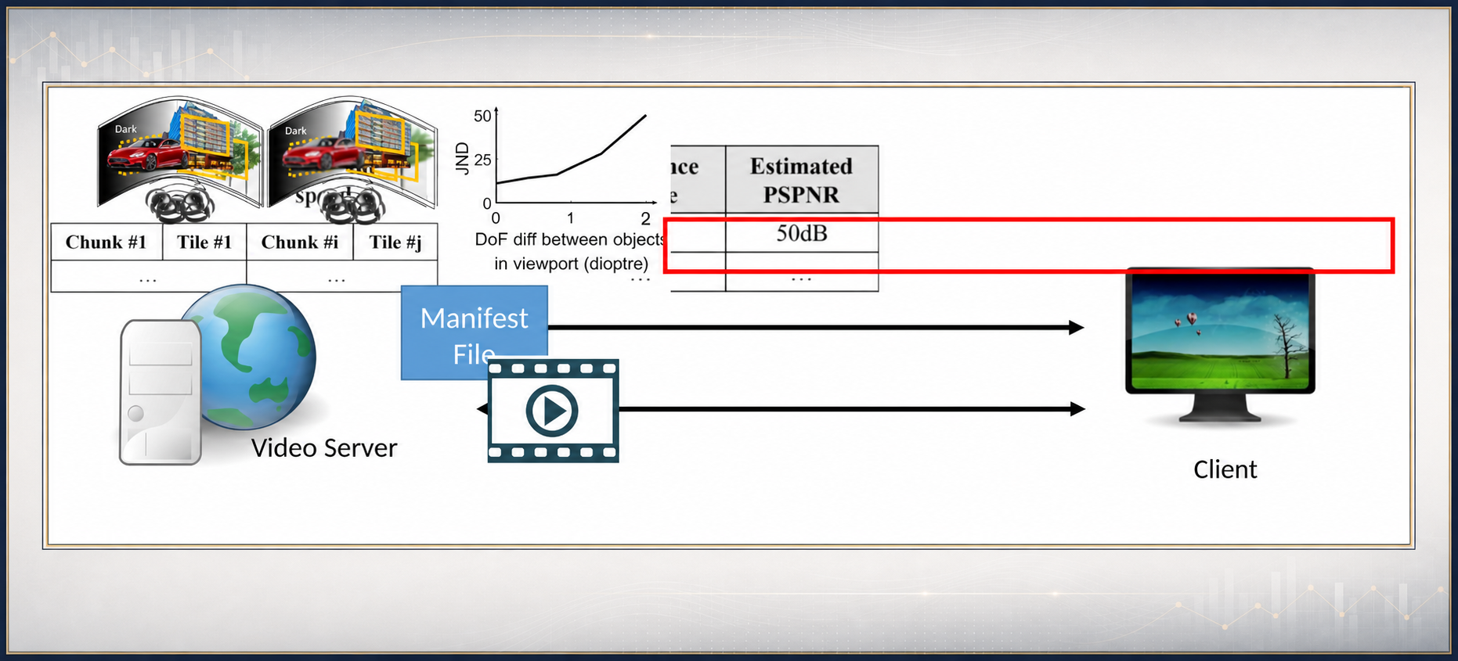
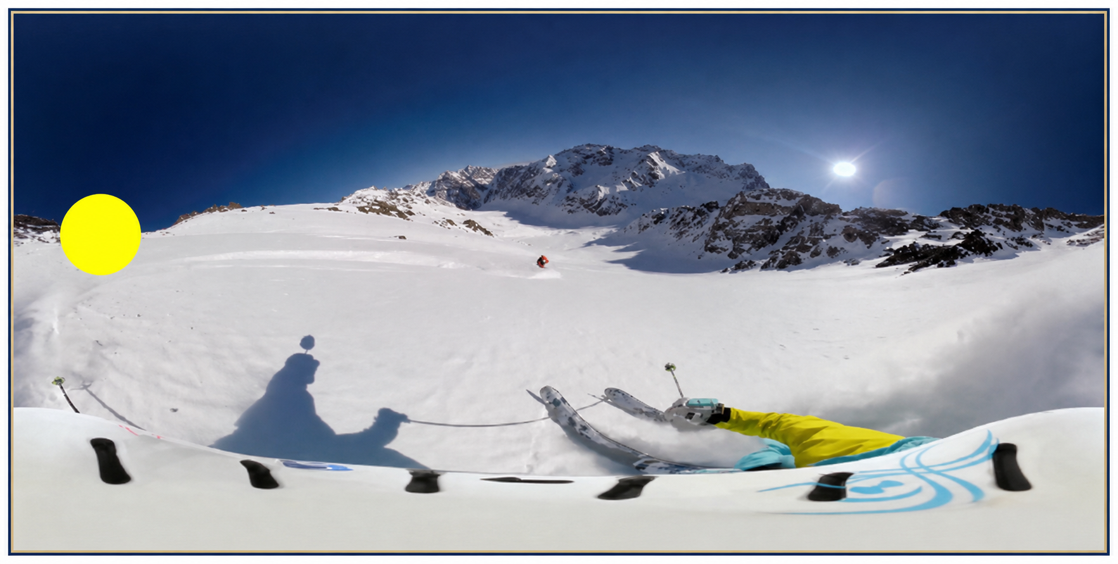
Solution #3: Client-side perceived quality
look up
Video Playback
21

Slide 6

Conclusion
• Existing works assume users pay equally high attention to all pixels in the viewport ⇒ Huge bandwidth consumption
• Key observation: Users have limited span of attention
• Our approach: Optimizing users perceived quality considering users' attention
• Results: Substantially higher users perceived quality under the same bandwidth consumption
26

