Slide 1
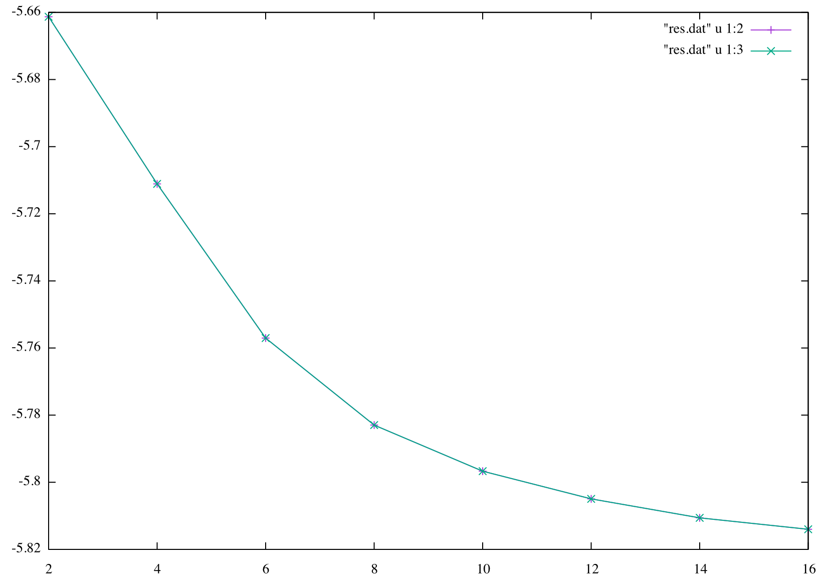
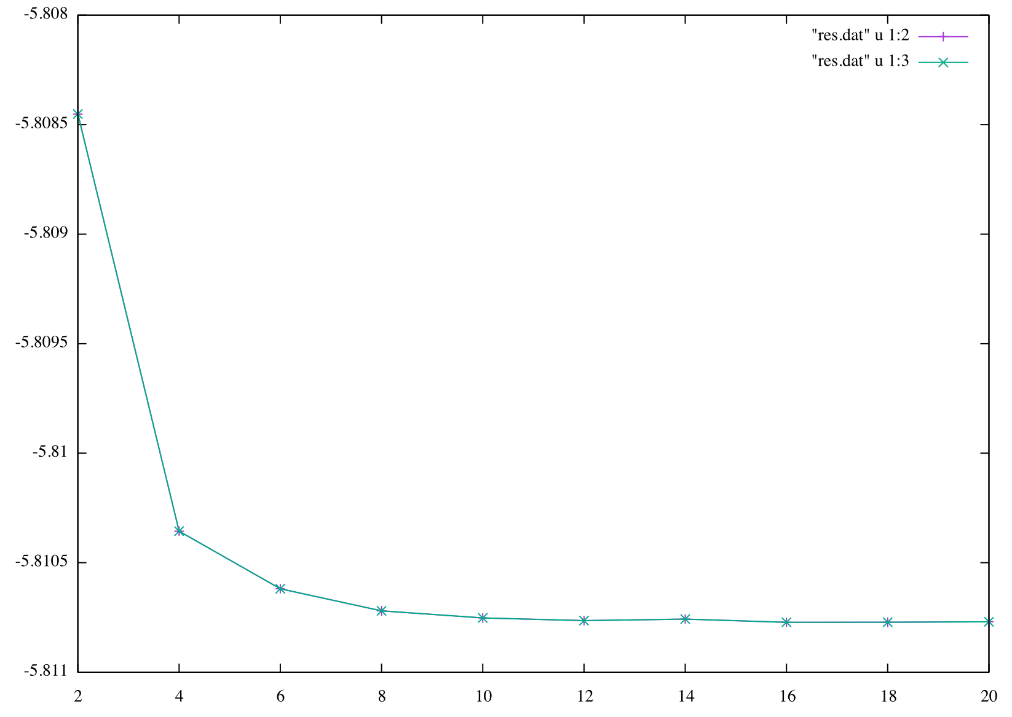
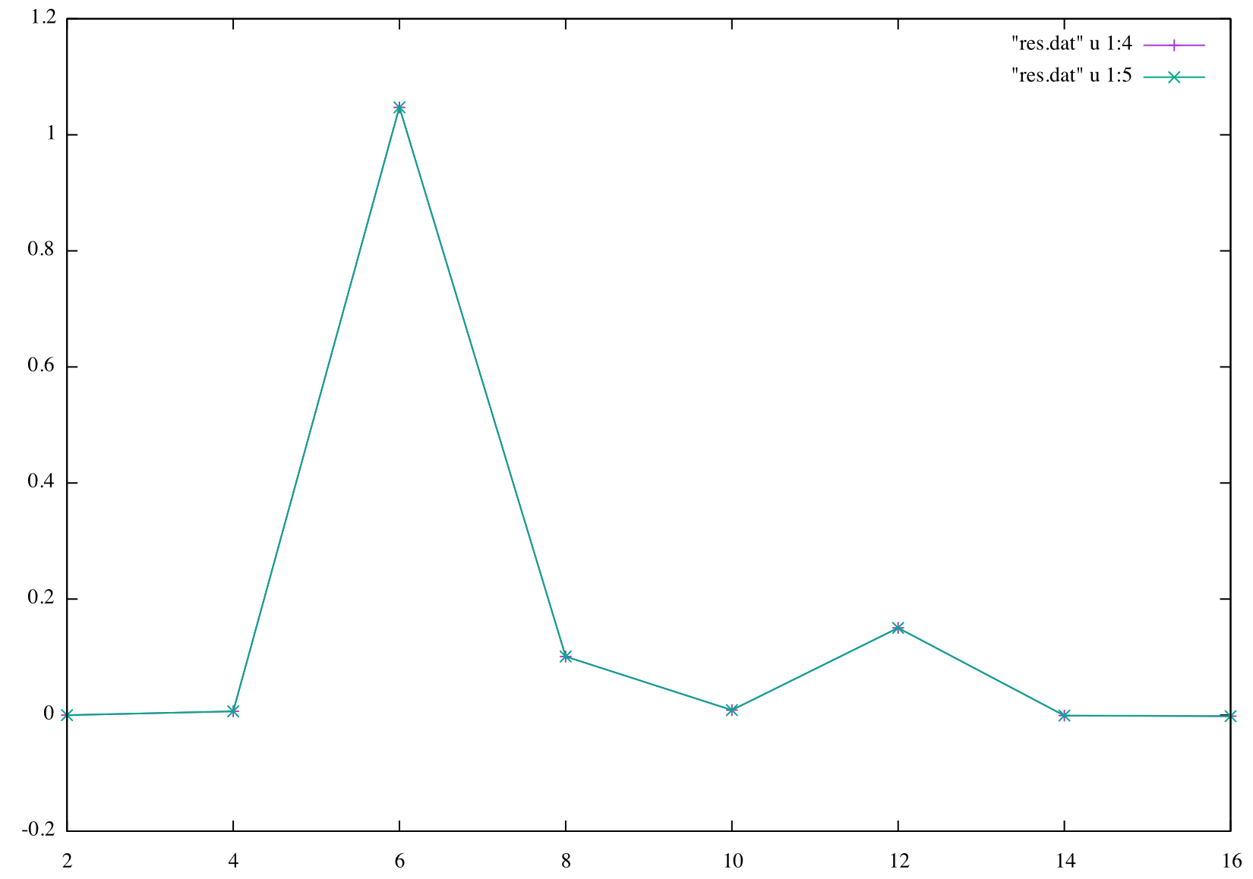
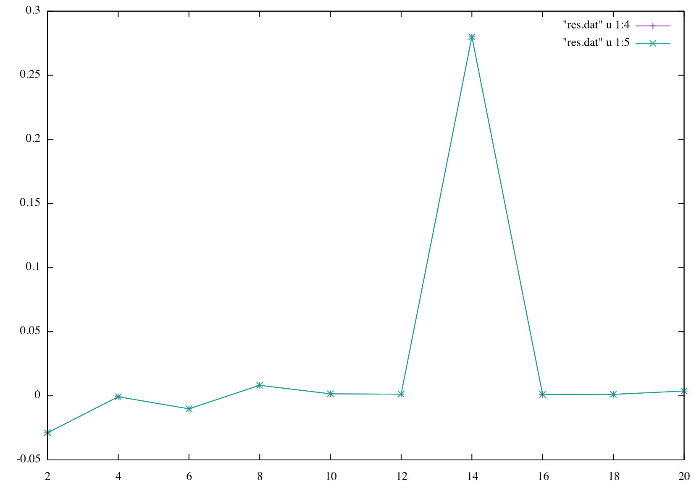
theta_order = 6
phi_order= 10
r_order = 14
E(3d,0d)
E(3d,0d)
r_order
theta_order, phi_order = 2*
theta_order = 6
phi_order= 10
r_order = 14
f(3d,0d)
f(3d,0d)

