Slide 1
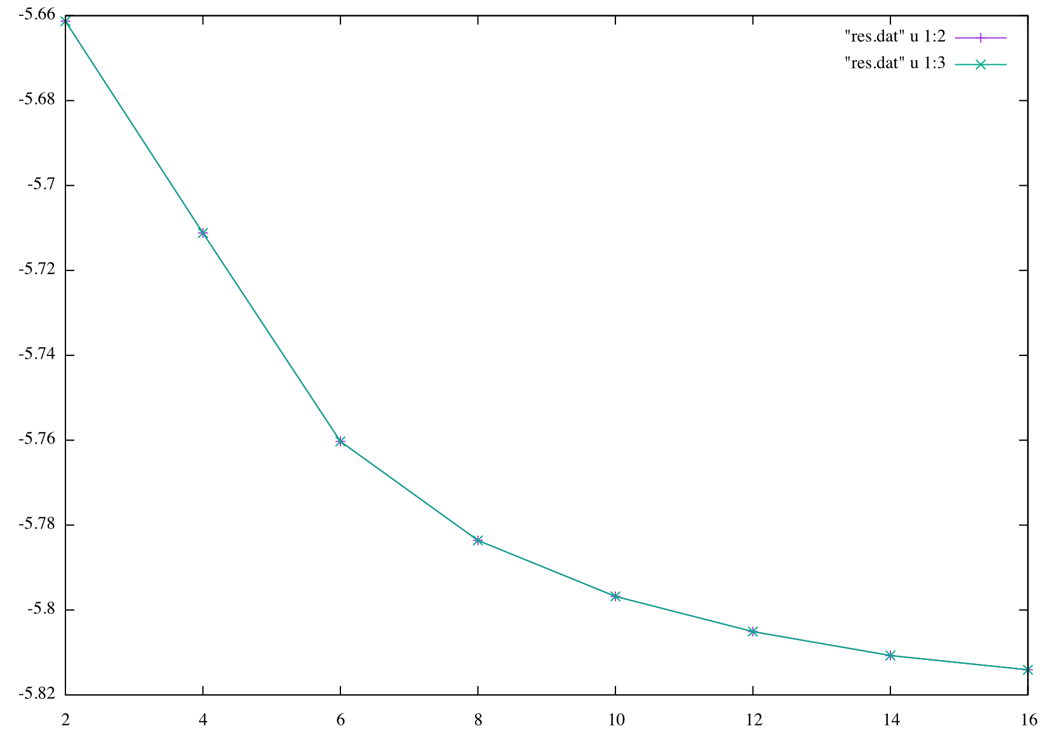
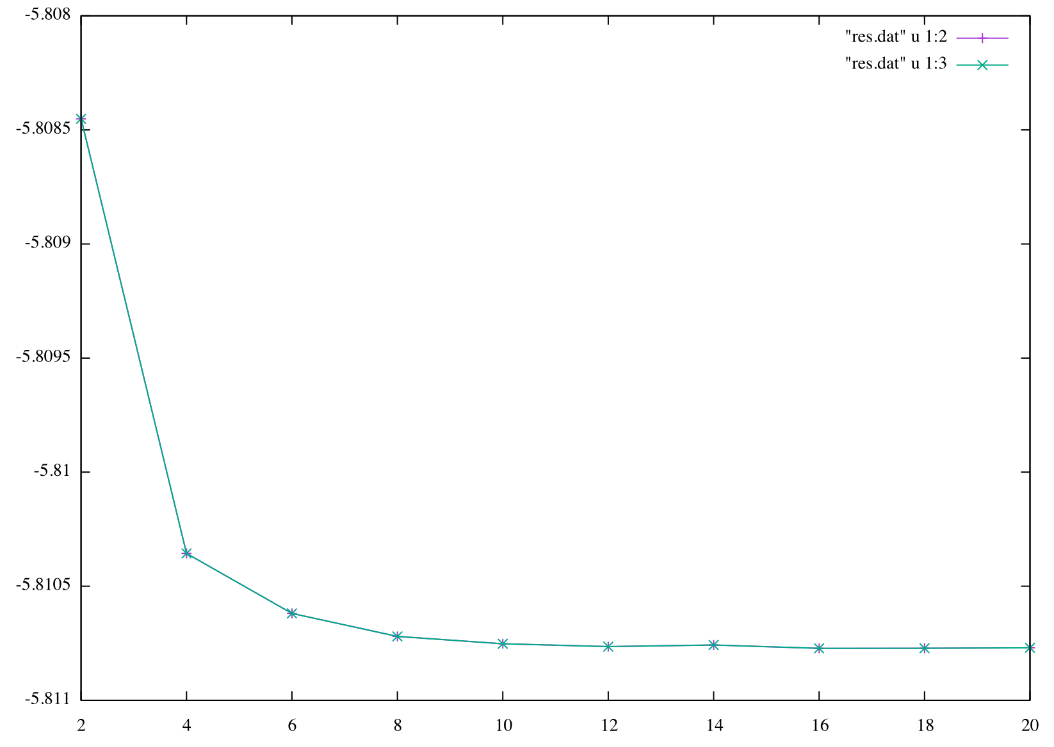
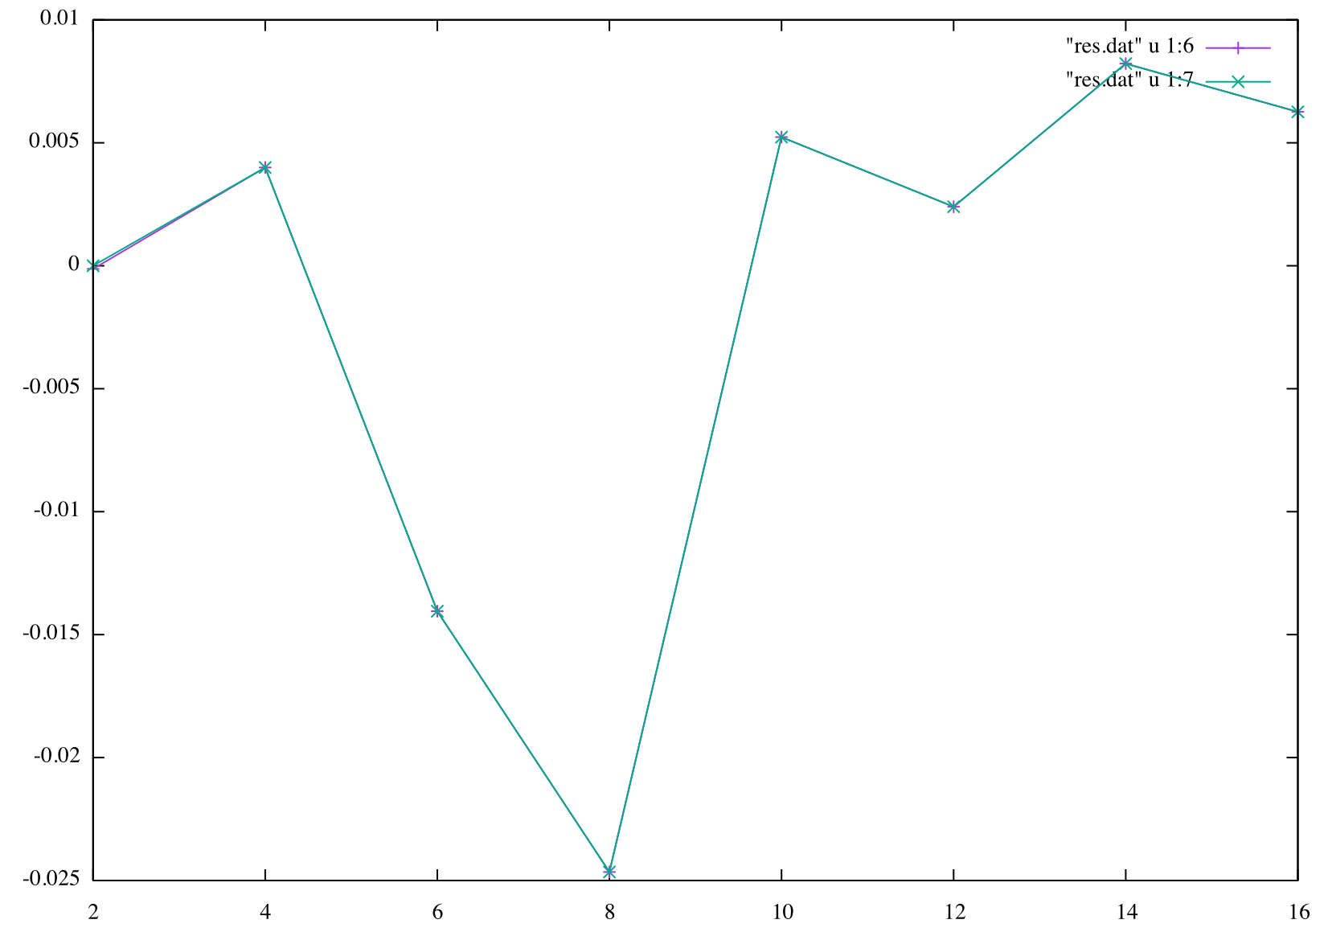
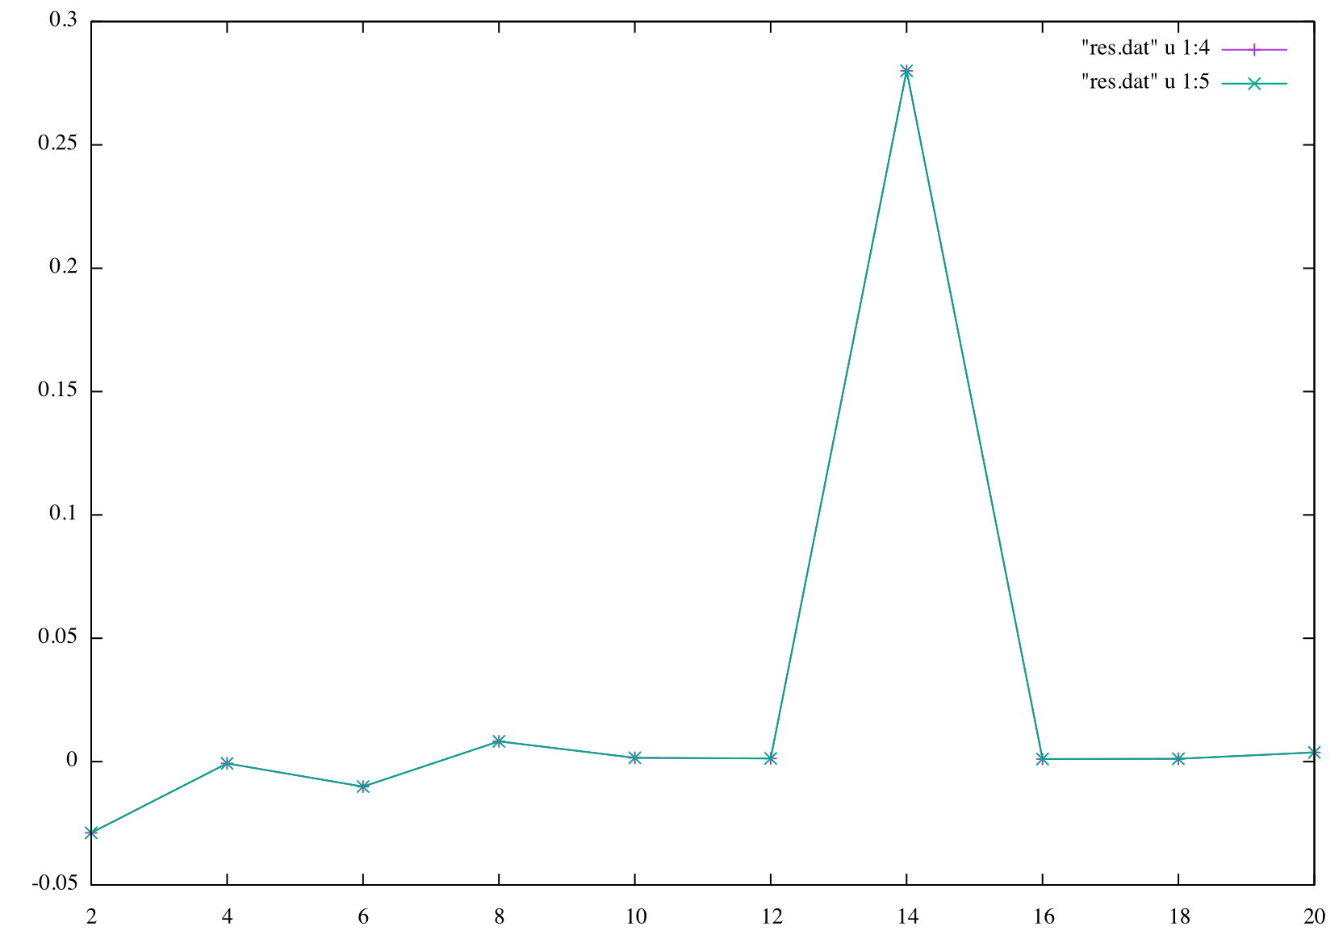


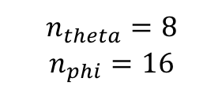
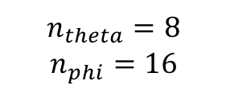


$$n_{theta}=8$$
$$n_{phi}=16$$
$$n_{phi}={2n}_{theta}$$
$$n_{r}=14$$
E_grid (3d, 0d)
f_grid (3d, 0d)
$$n_{r}$$
$$n_{theta}$$
$$n_{phi}={2n}_{theta}$$
$$n_{r}=14$$
$$n_{theta}=8$$
$$n_{phi}=16$$
E_grid (3d, 0d)
f_grid (3d, 0d)

Slide 2
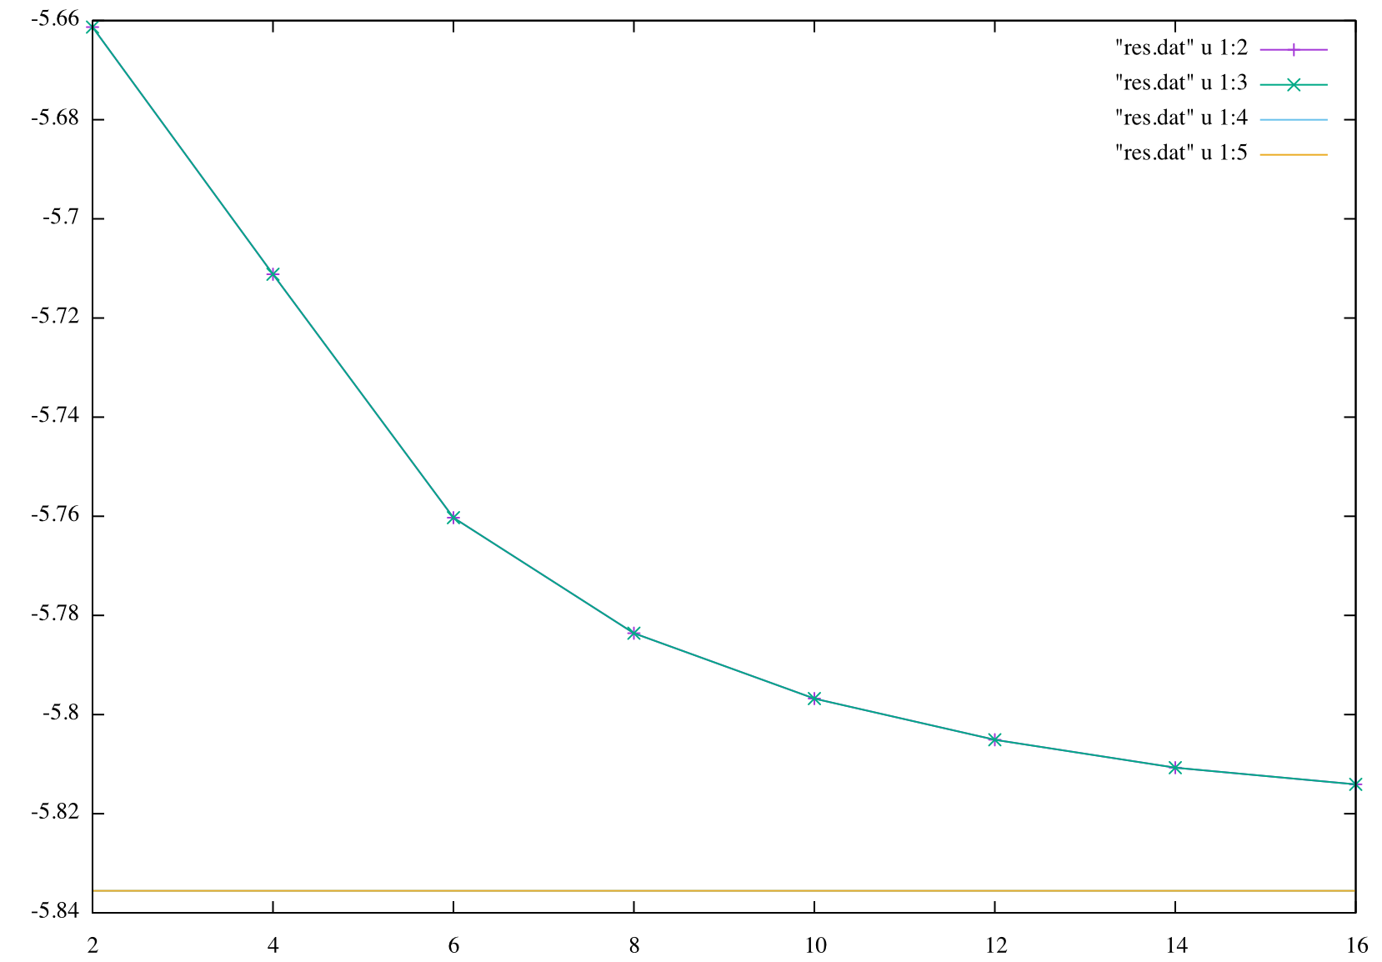
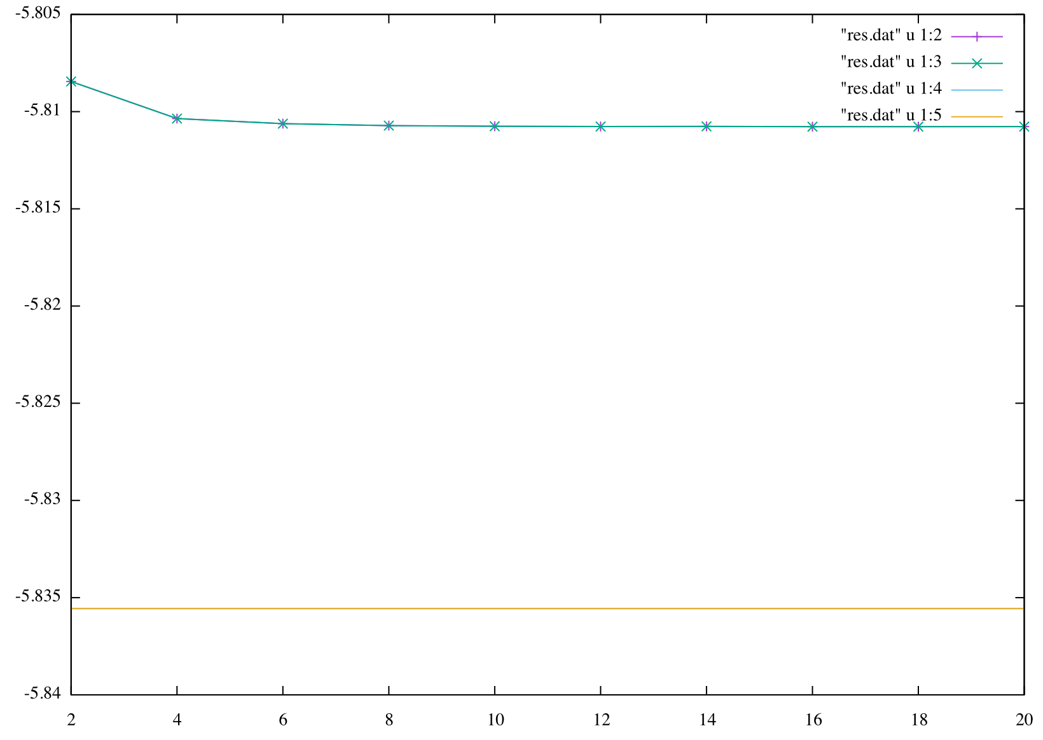
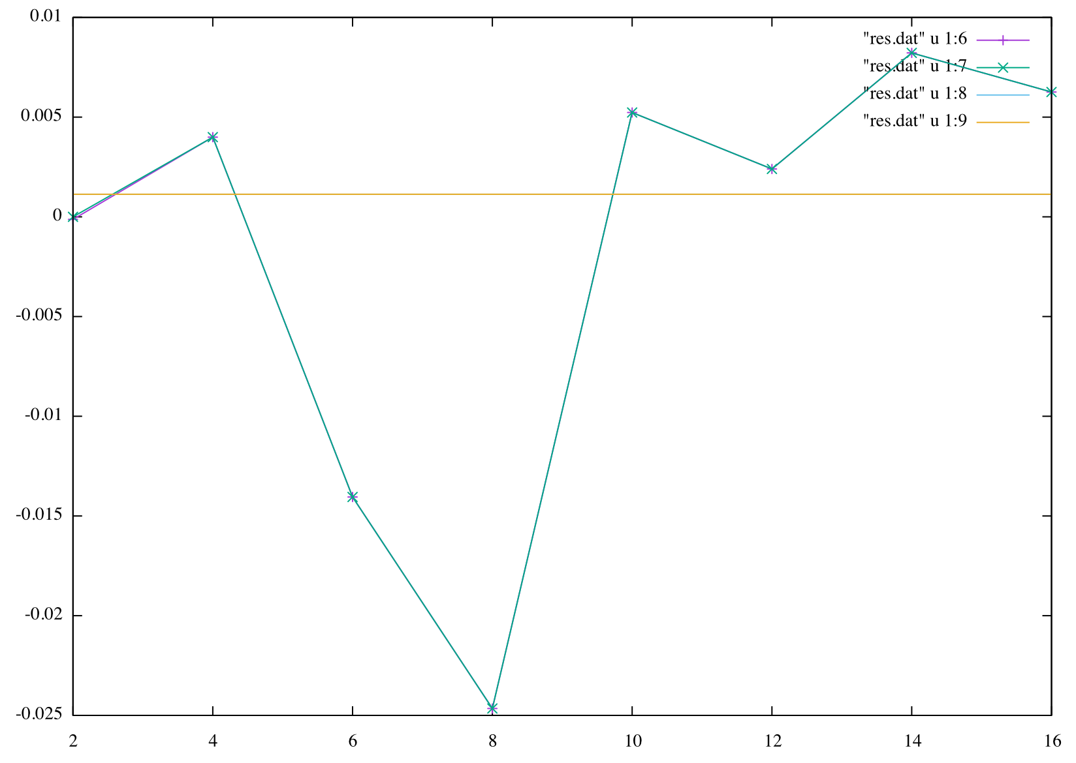
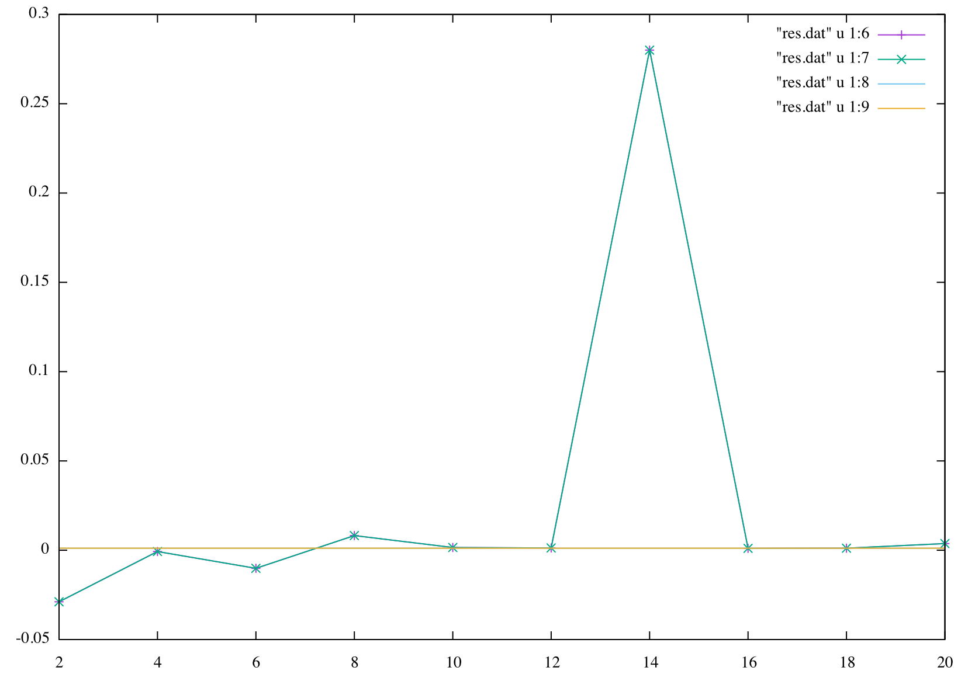

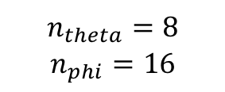
$$n_{theta}=8$$
$$n_{phi}=16$$
f_grid (3d, 0d)
$$n_{phi}={2n}_{theta}$$
$$n_{r}=14$$
E_grid (3d, 0d)
f_analytic (3d, 0d)
E_analytic (3d, 0d)
$$n_{r}$$
$$n_{theta}$$
f_analytic (3d, 0d)
$$n_{phi}={2n}_{theta}$$
$$n_{r}=14$$
f_grid (3d, 0d)
f_grid (3d, 0d)
$$n_{theta}=8$$
$$n_{phi}=16$$
f_analytic (3d, 0d)

