Slide 1
Case Studies with Projections
Ronak Buch & Laxmikant (Sanjay) Kale
http://charm.cs.illinois.edu
Parallel Programming Laboratory
Department of Computer Science
University of Illinois at Urbana-Champaign
11th Workshop of the INRIA-Illinois-ANL JLPC, Sophia Antipolis, France
June 12, 2014

Slide 2
Basic Problem
We have some Charm++ program
Performance is worse than expected
How can we:
Identify the problem?
Measure the impact of the problem?
Fix the problem?
Demonstrate that the fix was effective?

Slide 3
Key Ideas
Start with high level overview and repeatedly specialize until problem is isolated
Select metric to measure problem
Iteratively attempt solutions, guided by the performance data

Slide 4
Key Ideas
Start with high level overview and repeatedly specialize until problem is isolated
Select metric to measure problem
Iteratively attempt solutions, guided by the performance data

Slide 5
Stencil3d Performance

Slide 6
Stencil3d
Basic 7 point stencil in 3d
3d domain decomposed into blocks
Exchange faces to neighbors
Synthetic load balancing experiment
Calculation repeated based on position in domain

Slide 7
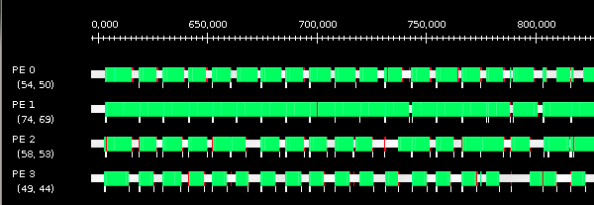
No Load Balancing

Slide 8
No Load Balancing
Clear load imbalance, but hard to quantify in this view

Slide 9
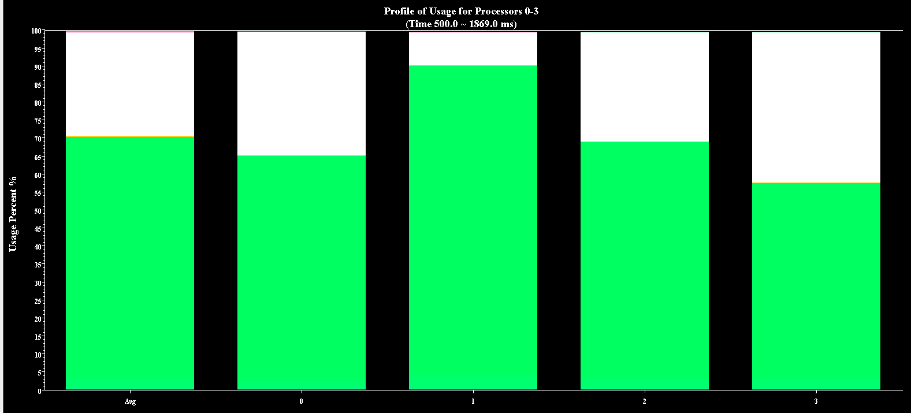
No Load Balancing
Clear that load varies from 90% to 60%

Slide 10
Next Steps
Poor load balance identified as performance culprit
Use Charm++’s load balancing support to evaluate the performace of different balancers
Trivial to add load balancing
Relink using -module CommonLBs
Run using +balancer <loadBalancer>

Slide 11
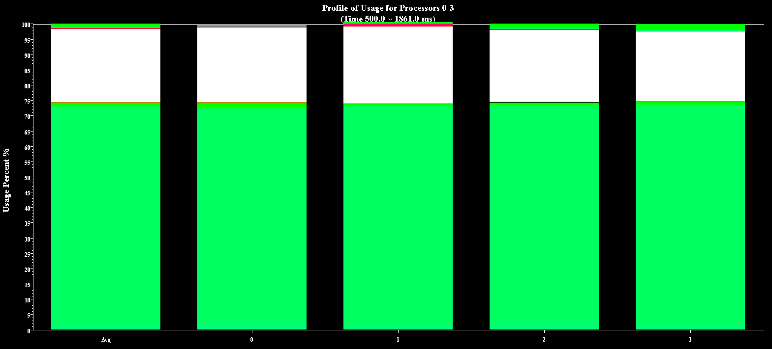
GreedyLB
Much improved balance, 75% average load

Slide 12
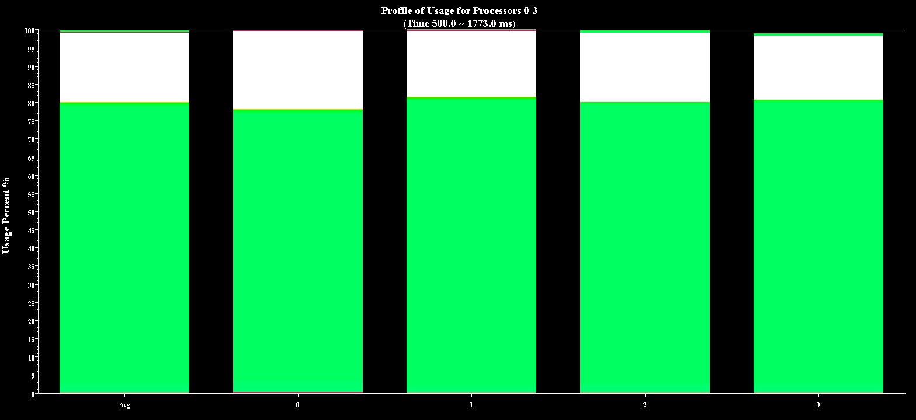
RefineLB
Much improved balance, 80% average load

Slide 13
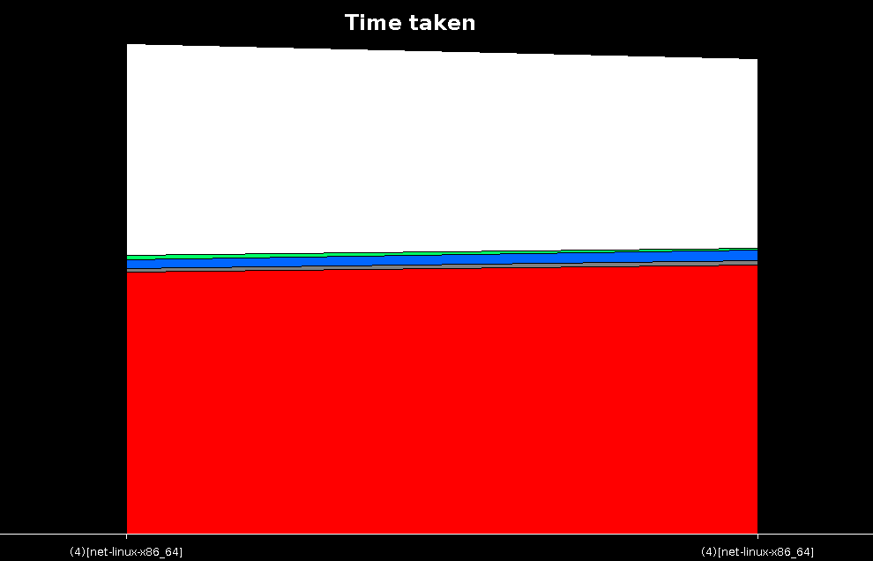
Multirun Comparison
Greedy on left, Refine on right.
Notes:
Can see that refine is a bit faster.

Slide 14
ChaNGa Performance

Slide 15
ChaNGa
Charm N-body GrAvity solver
Used for cosmological simulations
Barnes-Hut force calculation
Following data uses dwarf dataset on 8K cores of Blue Waters
dwarf dataset has high concentration of particles at center

Slide 16
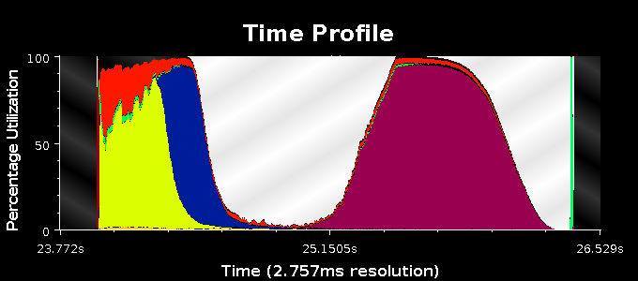
Original Time Profile

Slide 17
Original Time Profile
Why is utilization so low here?

Slide 18
Original Time Profile
Some PEs are doing work.

Slide 19
Next Steps
Are all PEs doing a small amount of work, or are most idle while some do a lot?
Outlier analysis can tell us
If no outliers, then all are doing little work
If outliers, then some are overburdened while most are waiting

Slide 20
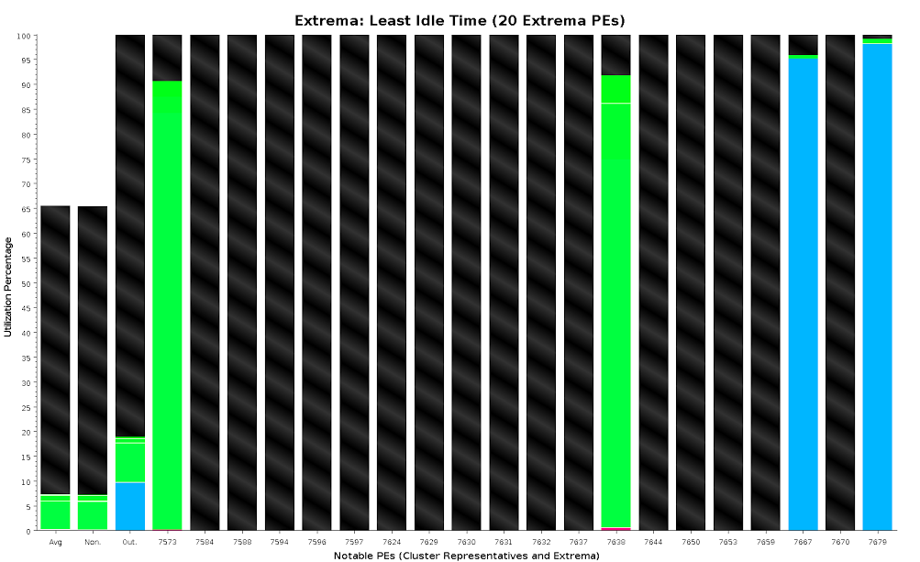
Outlier Analysis

Slide 21
Outlier Analysis
Large gulf between average and extrema
=>
Load imbalance

Slide 22
Next Steps
Why does this load imbalance exist? What are the busy PEs doing and why are other waiting?
Outlier analysis tells us which PEs are overburdened
Timeline will show what methods those PEs are actually executing

Slide 23
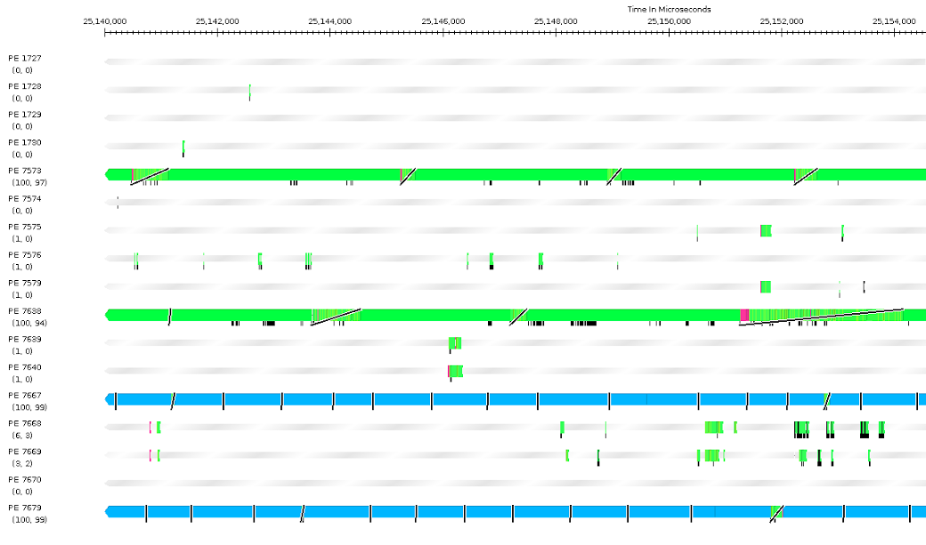
Timeline

Slide 24
Timeline

Slide 25
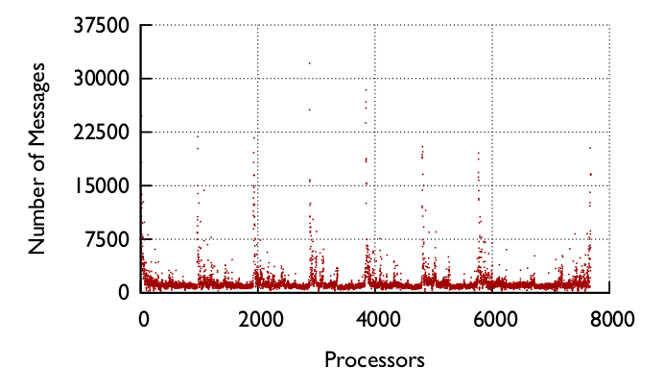
Original Message Count
Wrote new tool to parse Projections logs.
Large disparity of messages across processors.
Notes:
Motivated creation of analysis tool for projections. Development is driven by actual use cases.

Slide 26
Next Steps
Can we distribute the work?
After identifying the problem, the code revealed that this was caused by tree node contention.
To solve this, we tried randomly distributing copies of tree nodes to other PEs to distribute load.

Slide 27
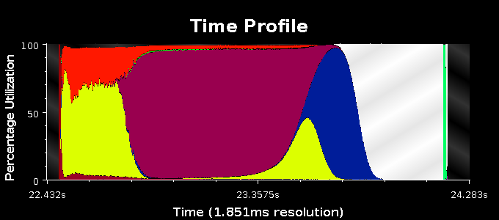
Final Time Profile

Slide 28
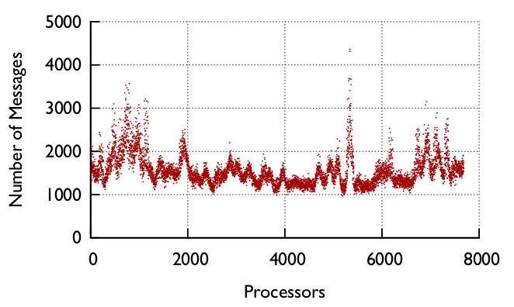
Final Message Count
Used to have 30000+ messages on some PEs, now all process <5000. Much better balance.
Notes:
Motivated creation of analysis tool for projections. Development is driven by actual use cases.

