Slide 1
Projections Overview
Ronak Buch & Laxmikant (Sanjay) Kale
http://charm.cs.illinois.edu
Parallel Programming Laboratory
Department of Computer Science
University of Illinois at Urbana-Champaign

Slide 2
Manual
http://charm.cs.illinois.edu/manuals/html/projections/manual-1p.html
Full reference for Projections, contains more details than these slides.

Slide 3
Projections
Performance analysis/visualization tool for use with Charm++
Works to limited degree with MPI
Charm++ uses runtime system to log execution of programs
Trace-based, post-mortem analysis
Configurable levels of detail
Java-based visualization tool for performance analysis

Slide 4
Instrumentation
Enabling Instrumentation
Basics
Customizing Tracing
Tracing Options

Slide 5
How to Instrument Code
Build Charm++ with the --enable-tracing flag
Select a -tracemode when linking
That’s all!
Runtime system takes care of tracking events

Slide 6
Basics
Traces include variety of events:
Entry methods
Methods that can be remotely invoked
Messages sent and received
System Events
Idleness
Message queue times
Message pack times
etc.

Slide 7
Basics - Continued
Traces logged in memory and incrementally written to disk
Runtime system instruments computation and communication
Generates useful data without excessive overhead (usually)

Slide 8
Custom Tracing - User Events
Users can add custom events to traces by inserting calls into their application.
Register Event:
int traceRegisterUserEvent(char* EventDesc, int EventNum=-1)
Track a Point-Event:
void traceUserEvent(int EventNum)
Track a Bracketed-Event:
void traceUserBracketEvent(int EventNum, double StartTime, double EndTime)

Slide 9
Custom Tracing - Annotations
Annotation supports allows users to easily customize the set of methods that are traced.
Annotating entry method with notrace avoids tracing and saves overhead
Adding local to non-entry methods (not traced by default) adds tracing automatically

Slide 10
Custom Tracing - API
API allows users to turn tracing on or off:
Trace only at certain times
Trace only subset of processors
Simple API:
void traceBegin()
void traceEnd()
Works at granularity of PE.

Slide 11
Custom Tracing - API
Often used at synchronization points to only instrument a few iterations
Reduces size of logs while still capturing important data
Allows analysis to be focused on only certain parts of the application

Slide 12
Tracing Options
Two link-time options:
-tracemode projections
Full tracing (time, sending/receiving processor, method, object, …)
-tracemode summary
Performance of each PE aggregated into time bins of equal size
Tradeoff between detail and overhead

Slide 13
Tracing Options - Runtime
+traceoff disables tracing until a traceBegin() API call.
+traceroot <dir> specifies output folder for tracing data
+traceprocessors RANGE only traces PEs in RANGE

Slide 14
Tracing Options - Summary
+sumdetail aggregate data by entry method as well as time-intervals. (normal summary data is aggregated only by time-interval)
+numbins <k> reserves enough memory to hold information for <k> time intervals. (default is 10,000 bins)
+binsize <duration> aggregates data such that each time-interval represents <duration> seconds of execution time. (default is 1ms)

Slide 15
Tracing Options - Projections
+logsize <k> reserves enough buffer memory to hold <k> events. (default is 1,000,000 events)
+gz-trace, +gz-no-trace enable/disable compressed (gzip) log files

Slide 16
Memory Usage
What happens when we run out of
reserved memory?
-tracemode summary: doubles time-interval represented by each bin, aggregates data into the first half and continues.
-tracemode projections: asynchronously flushes event log to disk and continues. This can perturb performance significantly in some cases.

Slide 17
Projections Client
Scalable tool to analyze up to 300,000 log files
A rich set of tool features : time profile, time lines, usage profile, histogram, extrema tool
Detect performance problems: load imbalance, grain size, communication bottleneck, etc
Multi-threaded, optimized for memory efficiency

Slide 18
Visualizations and Tools
Tools of aggregated performance viewing
Time profile
Histogram
Communication
Tools of processor level granularity
Overview
Timeline
Tools of derived/processed data
Outlier analysis: identifies outliers

Slide 19
Analysis at Scale
Fine grain details can sometimes look like one big solid block on timeline.
It is hard to mouse-over items that represent fine-grained events.
Other times, tiny slivers of activity become too small to be drawn.

Slide 20
Analysis Techniques
Zoom in/out to find potential problem spots.
Mouseover graohs for extra details.
Load sufficient but not too much data.
Set colors to highlight trends.
Use the history feature in dialog boxes to track time-ranges explored.

Slide 21
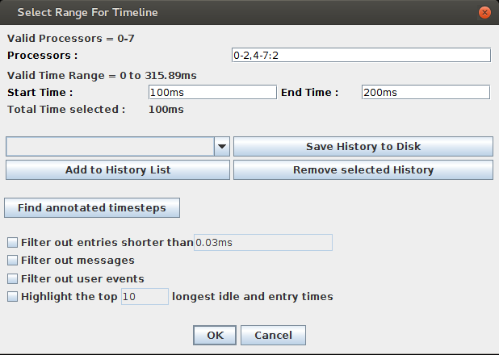
Dialog Box

Slide 22
Select processors: 0-2,4-7:2 gives 0,1,2,4,6
Dialog Box

Slide 23
Select time range
Dialog Box

Slide 24
Add presets to history
Dialog Box

Slide 25
Aggregate Views

Slide 26
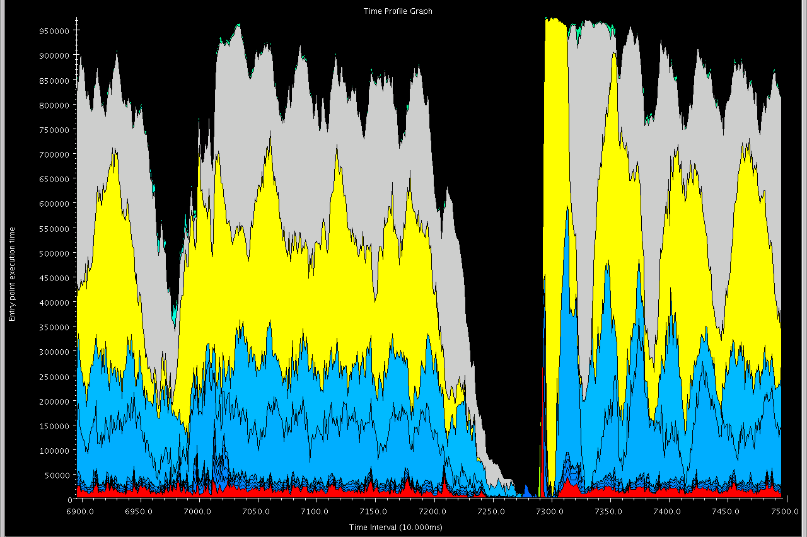
Time Profile

Slide 27
Time spent by each EP summed across all PEs in time interval

Slide 28
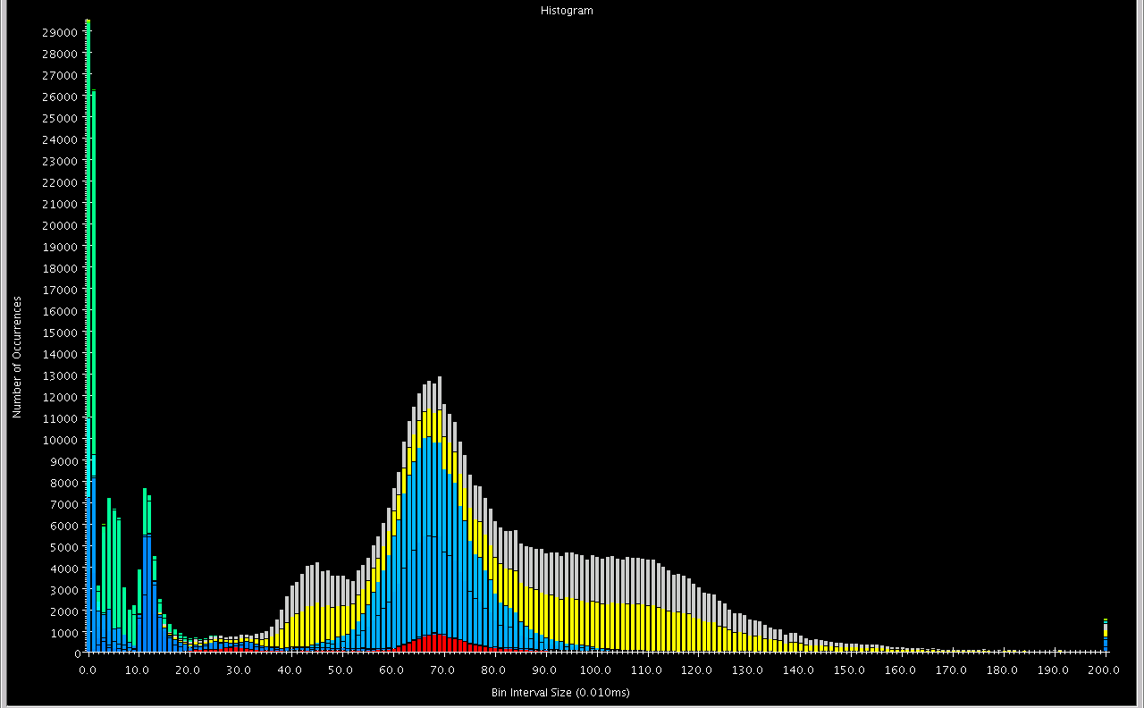
Histogram

Slide 29
Shows statistics in “frequency” domain.
Notes:
How many methods took a certain amount of time? What percentage of total execution time was composed of methods taking a certain execution duration?

Slide 30
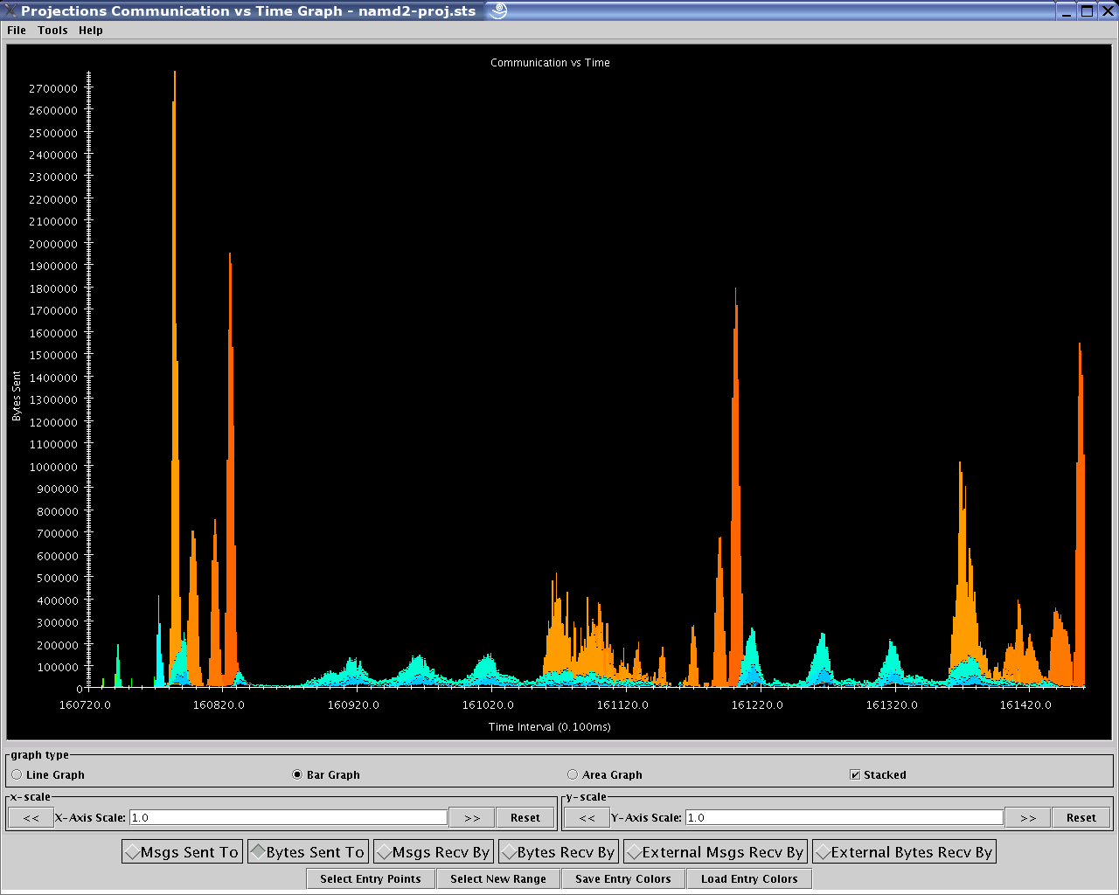
Communication vs. Time

Slide 31
Shows communication over all PEs in the time domain.
Notes:
Y-axis in units of bytes sent, shows number of bytes sent from each method in each time interval

Slide 32
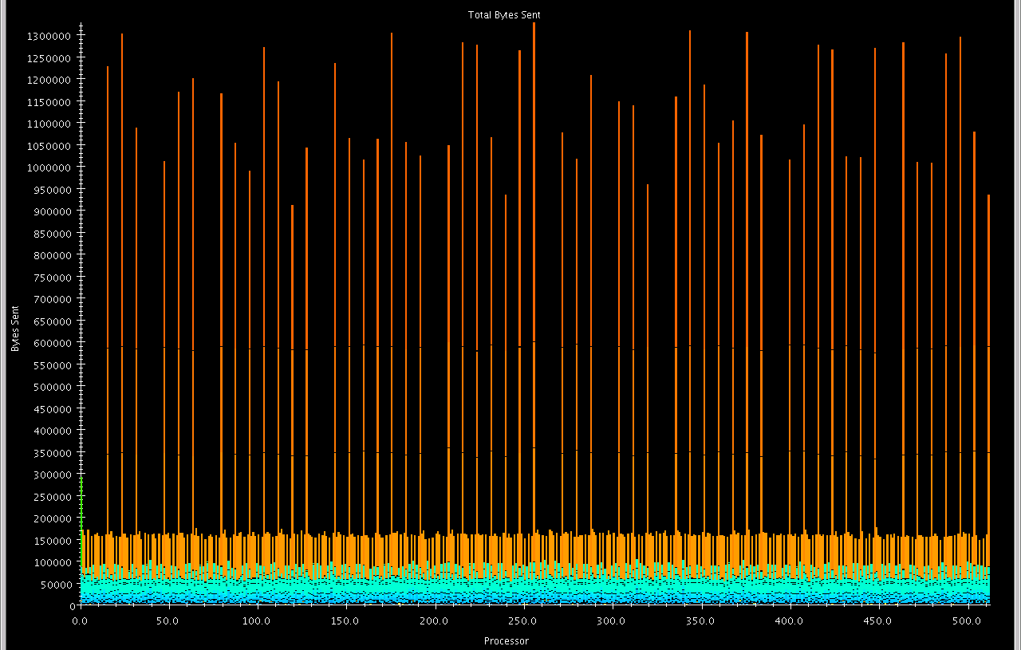
Communication per Processor

Slide 33
Shows how much each PE communicated over the whole job.

Slide 34
Processor Level Views

Slide 35
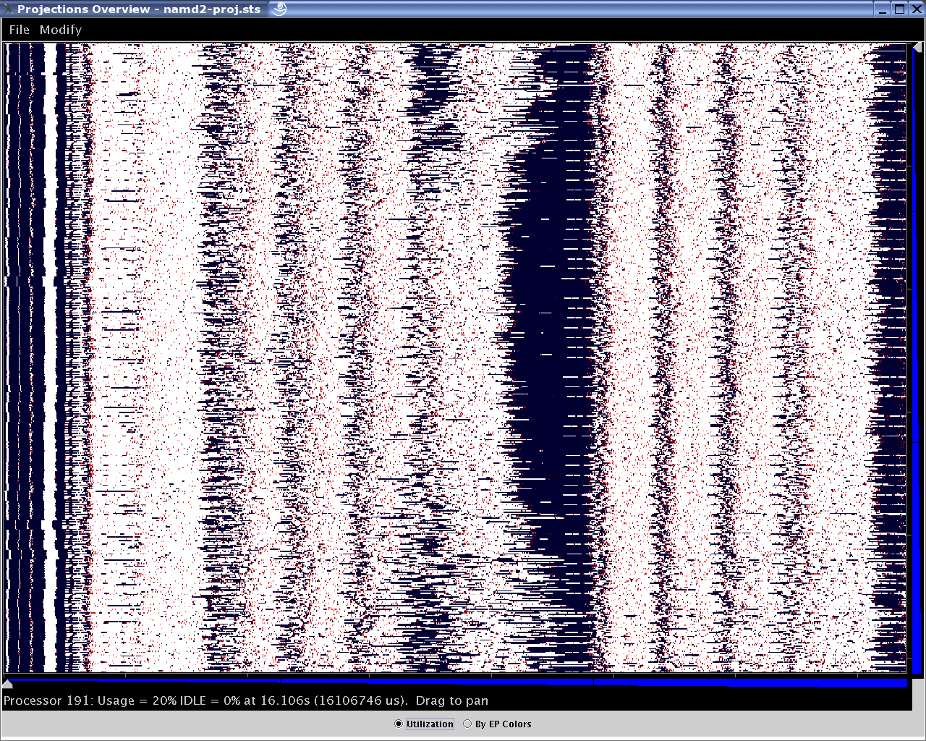
Overview

Slide 36
Time on X, different PEs on Y

Slide 37
Intensity of plot represents PE’s utilization at that time

Slide 38
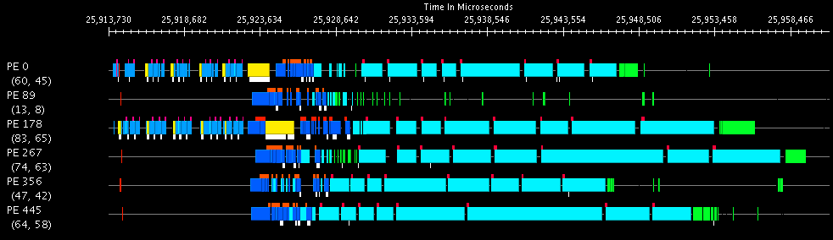
Timeline

Slide 39
Most common view. Much more detailed than overview.

Slide 40
Clicking on EPs traces messages, mouseover shows EP details.

Slide 41
Colors are different EPs. White ticks on bottom represent message sends, red ticks on top represent user events.

Slide 42
Processed Data Views
Notes:
Will only mention one, other processed data views exist (noise miner) but are of utility in only narrow domain

Slide 43
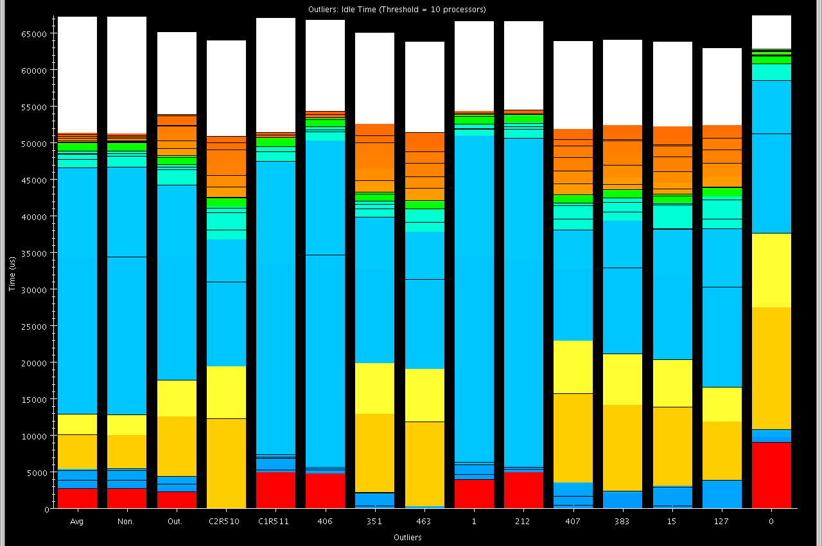
Outlier Analysis

Slide 44
k-Means to find “extreme” processors

Slide 45
Global Average

Slide 46
Non-Outlier Average

Slide 47
Outlier Average

Slide 48
Cluster Representatives and Outliers

Slide 49
Advanced Features
Live Streaming
Run server from job to send performance traces in real time
Online Extrema Analysis
Perform clustering during job; only save representatives and outliers
Multirun Analysis
Side by side comparison of data from multiple runs

Slide 50
Future Directions
PICS - expose application settings to RTS for on the fly tuning
End of run analysis - use remaining time after job completion to process performance logs
Simulation - Increased reliance on simulation for generating performance logs
Notes:
Most analysis is currently done on users’ workstations, for large jobs, this becomes untenable; end of run analysis would improve this

Slide 51
Conclusions
Projections has been used to effectively solve performance woes
Constantly improving the tools
Scalable analysis is become increasingly important
Notes:
Most analysis is currently done on users’ workstations, for large jobs, this becomes untenable; end of run analysis would improve this

