Slide 1
Outline
Introduction
Object Design
Execution Model
Hello World
Benefits of Charm++
Charm++ Basics
Object Collections
Overdecomposition
Migratability
Checkpointing and Resilience
Structured Dagger
Application Design
Performance Tuning
Using Dynamic Load Balancing
Interoperability
Debugging
Further Optimization

Slide 2
Debugging Parallel Applications
It can be very difficult
The typical “printf” strategy may be insufficient
Using gdb
Very easy with Charm++!
Just run the application with the ++debug command line parameter and a gdb window for each PE will open through X (and can be forwarded)
Not very scalable
We have developed a scalable tool for debugging Charm++ applications
It’s interactive
Allows you to change message order to find bugs!
“What-if” scenarios can be explored using provisional message delivery
Memory can be tracked to find memory leaks

Slide 3
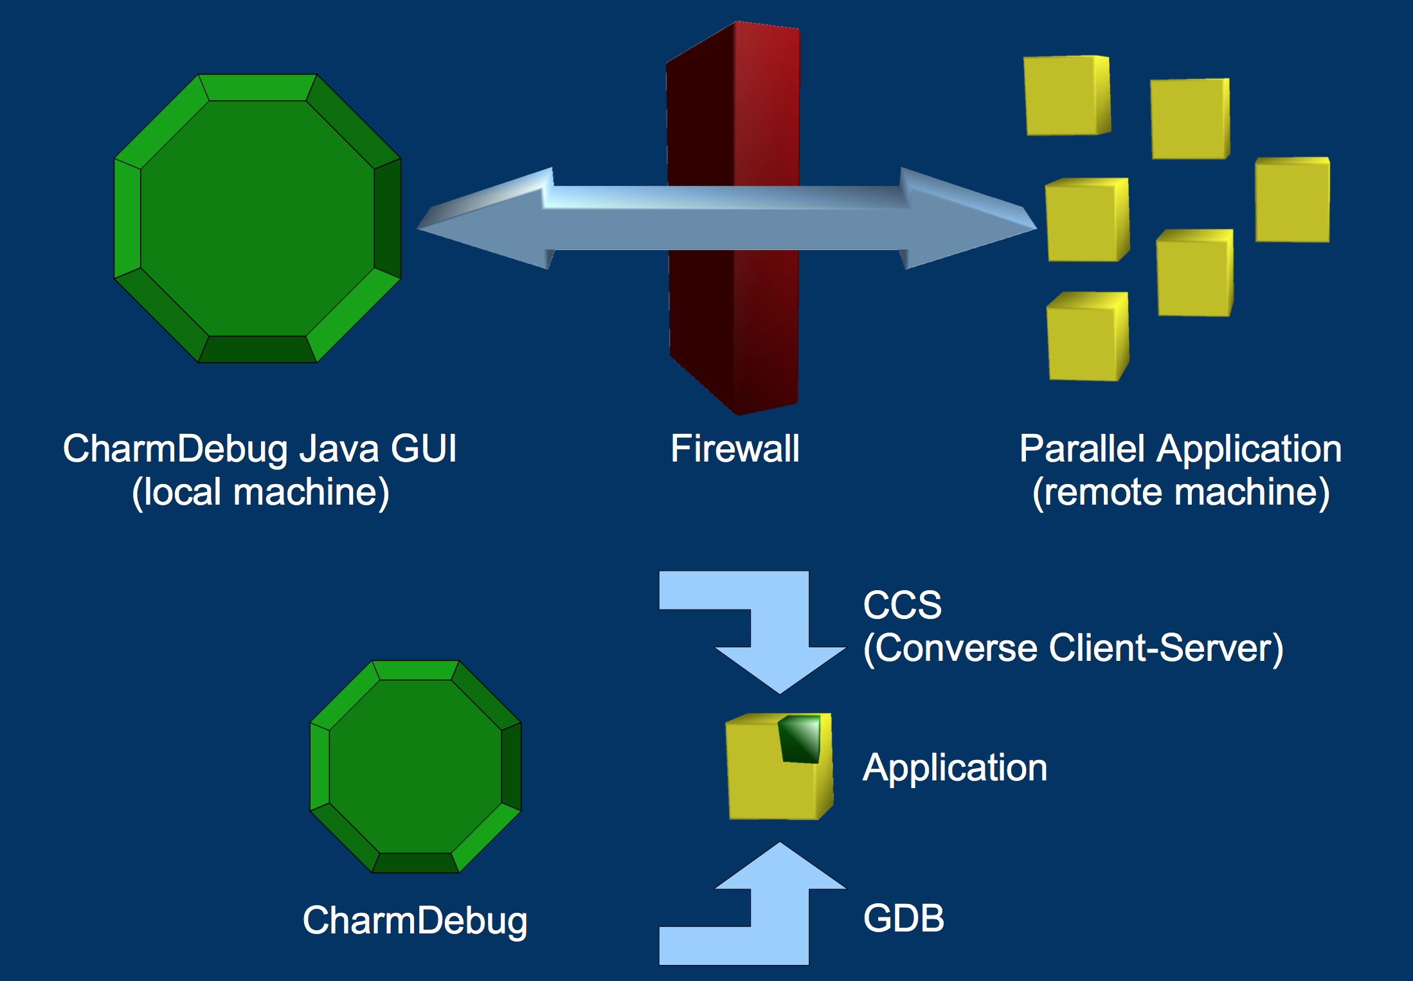
Overview of CharmDebug

Slide 4
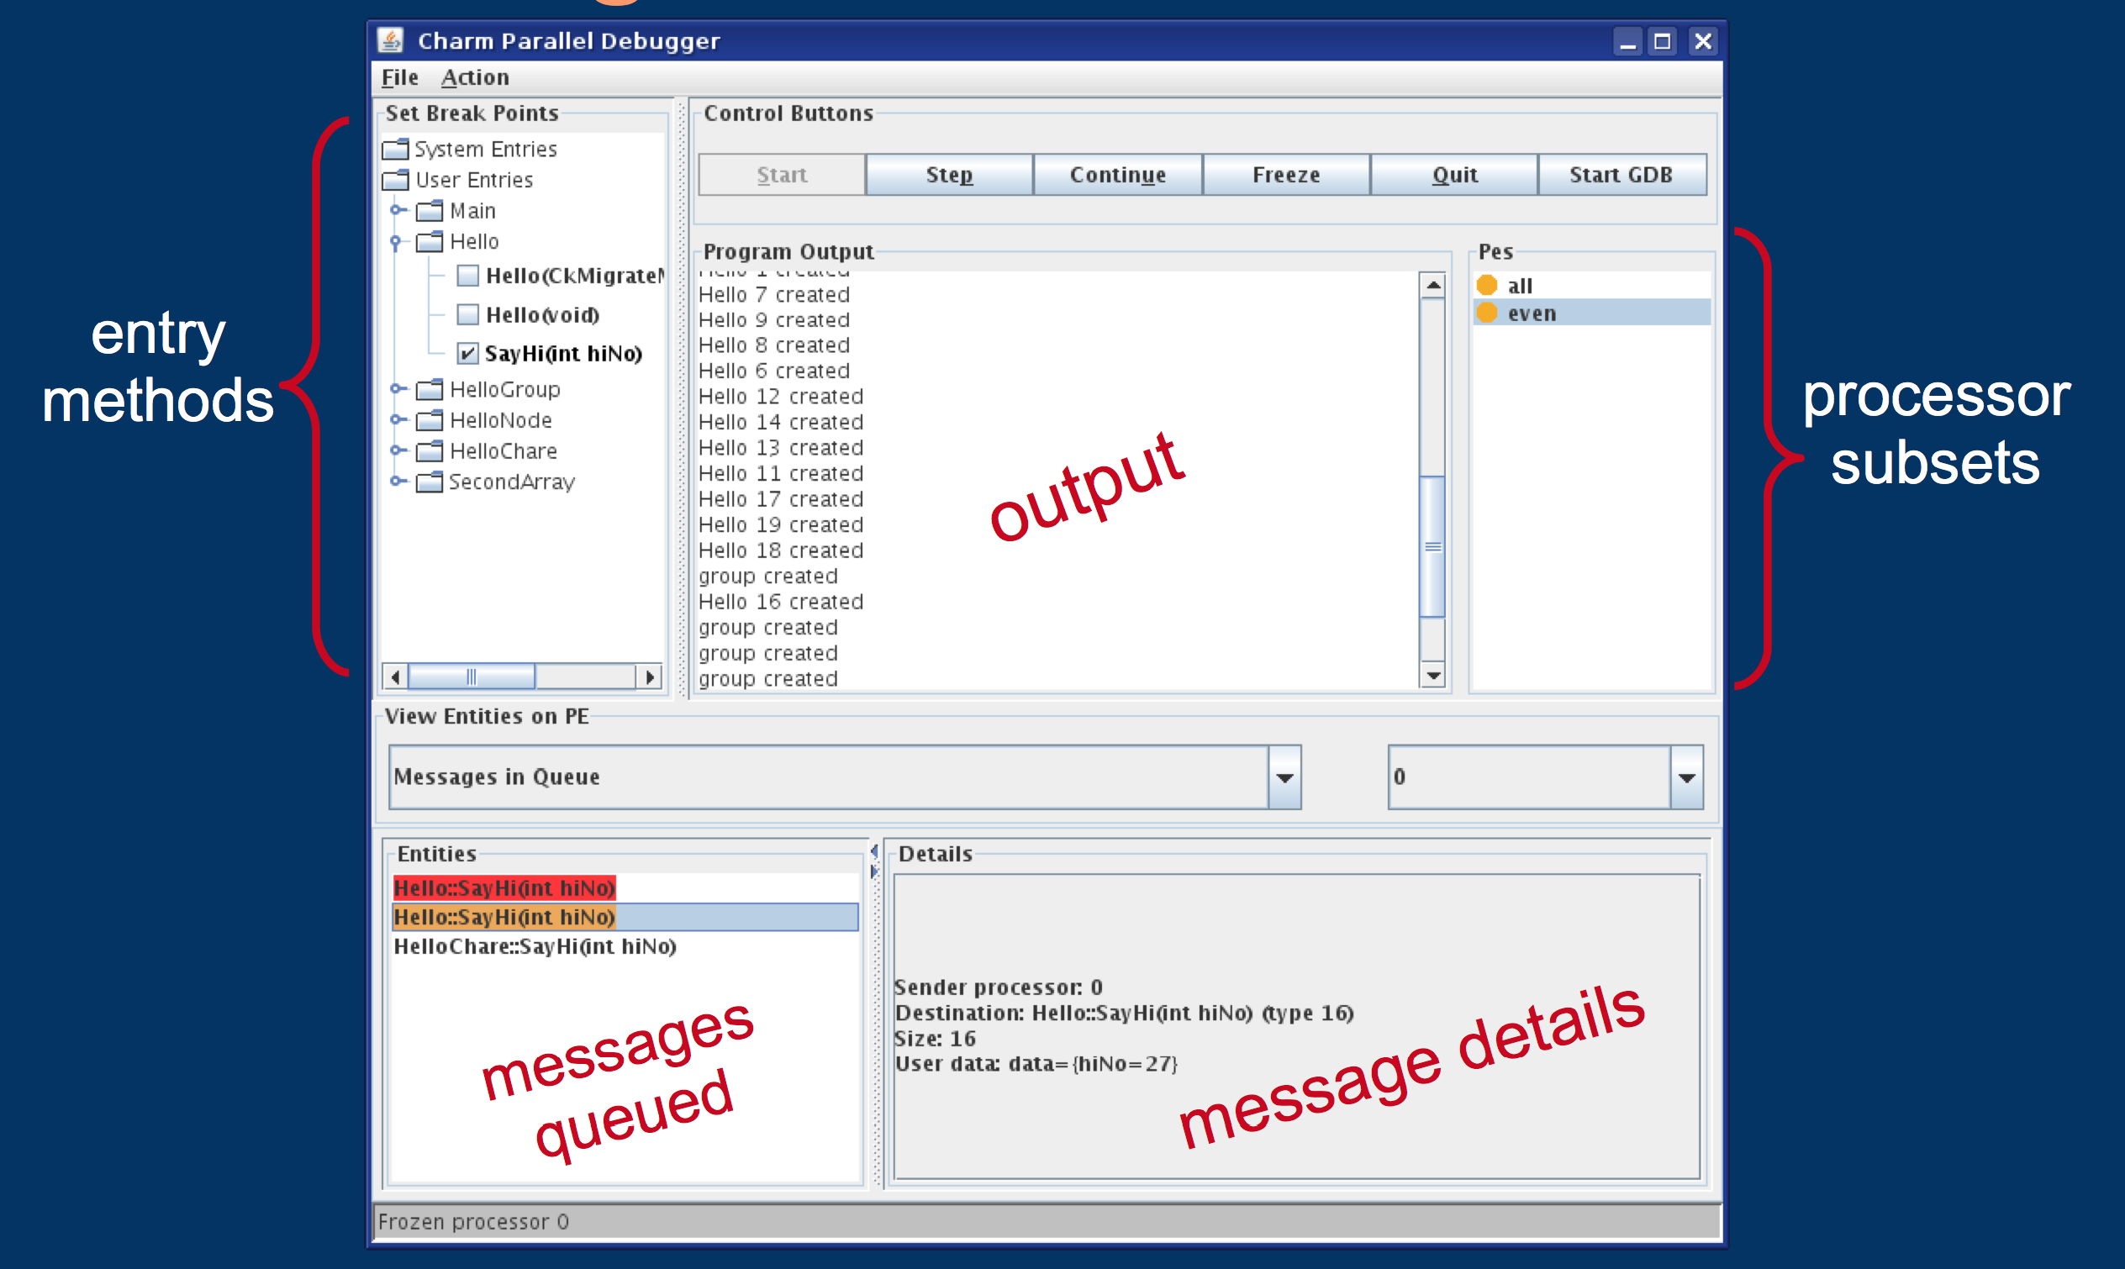
CharmDebug

Slide 5
Getting CharmDebug
It is part of Charm++
For the basic feature set, nothing special needs to be done
Precompiled for java 6
Use ant to recompile
Help
charm@cs.illinois.edu (preferred)
ppl@cs.illinois.edu

Slide 6
Compiling Your Applications for use with CharmDebug
Charm++
Use –g
No –O3 or --with-production
Application
Just compile with –g
OR
Compile with –debug
Adds -g -O0, --memory charmdebug, Python modules

Slide 7
Launching in Debug Mode
Attach to running application in net- build
Uses CCS to receive application output
Attach to running application in other builds
Read the output file of the application
Start a new application in net- build
Can use tunnels
Options available also in command line
Use charmdebug help to see them

Slide 8
Outline
Introduction
Object Design
Execution Model
Hello World
Benefits of Charm++
Charm++ Basics
Object Collections
Overdecomposition
Migratability
Checkpointing and Resilience
Structured Dagger
Application Design
Performance Tuning
Using Dynamic Load Balancing
Interoperability
Debugging
Further Optimization

Slide 9
Overview of Performance Enhancement Feature

Slide 10
Quiesence Detection
What if determining global termination of an application is difficult?
Mechanism to detect completion - Quiesence!
From any chare, invoke
CkStartQD(CkCallback(CkIndex_Main::finished(), mainProxy));
Runs in background, waits for all outstanding messages to be consumed.
Invokes the callback when quiesence is detected.

Slide 11
Shared Memory Optimizations
Objects’ memory buffers disjoint
Communication will leverage refcounted message pointers to avoid copying
Avoids packing/unpacking within node
Single copy of node level read only structures
Dedicated thread for intra-node communication

Slide 12
Controlling Placement
In some applications, load patterns don’t change much as computation progresses
You, the programmer, may want to control which chare lives on which processors
This is also true when load may evolve over time, but you want to control initial placement of chares
The feature in Charm++ for this purpose is called Map Objects
Sec. 13.2.2 of the Charm++ manual

Slide 13
Messages
Avoids extra copy
Can be custom packed
Reusable
Useful for transfer of complex data structures
It provides explicit control for the application over allocation, reuse, and scope
Encapsulates variable size quantities
Execution order of messages in the queue can be prioritized

Slide 14
Groups
Like a chare-array with one chare per PE
Encapsulate processor local data
May access the local member as a regular C++ object
In .ci file,
group ExampleGroup {
// Interface specifications as for normal chares
// For instance, the constructor ...
entry ExampleGroup(parameters1);
// ... and an entry method
entry void someEntryMethod(parameters2);
};
No difference in .h and .C file definitions

Slide 15
Node Groups
A chare-array with one chare per node
In non-smp mode groups and node groups are same
No difference in .h and .C
Creation and usage same as others
An entry method on a node-group member may be executed on any PE of the node
Concurrent execution of two entry methods of a node-group member may happen
Use [exclusive] for entry methods which are unsuitable for reentrance safety

Slide 16
Customizing Entry Method Attributes
threaded executed using separate thread
each thread has a stack, and may be suspended, for sync methods or futures
to set stacks size use +stacksize < size in bytes >
sync - returns a value
inline entry method invoked immediately if destination chare on same PE
blocking call
reductiontarget target of an array reduction
Takes parameter marshaled arguments
notrace not traced for projections

Slide 17
Customizing Entry Methods
expedited entry method skips the priority-based message queue in Charm++ runtime (for groups)
immediate - skips the message scheduling queue (for any chare array)
nokeep message belongs to Charm
exclusive mutual exclusion on execution of entry methods on node-groups
python can be called from python scripts

Slide 18
Sections
It is often convenient to define subcollections of elements within a chare array
Example: rows or columns of a 2D chare array
One may wish to perform collective operations on the subcollection (e.g. broadcast, reduction)
Sections are the standard subcollection construct in Charm++
CProxySection_Hello proxy =
CProxySection_Hello::ckNew(helloArrayID, 0, 9, 1, 0, 19, 2, 0, 29, 2);

Slide 19
sync methods
Synchronous as opposed to asynchronous
They return a value - always a message type
Other than that, just like any other entry method:
In the interface file:
entry [sync] MsgData ∗ f(double A[2∗m], int m );
In the C++ file:
MsgData ∗f(double X[], int size) {
...
m = new MsgData(..);
...
return m;
}

Slide 20
Threaded methods
Any method that calls a sync method must be able to suspend:
Needs to be declared as a threaded method
A threaded method of a chare C
Can suspend, without blocking the processor
Other chares can then be executed
Even other methods of chare C can be executed
Low level thread operations for advanced users:
CthThread CthSelf()
CthAwaken(CthThread t)
CthYield()
CthSuspend()

Slide 21
Customized Load Balancers
Statistics collected by Charm
struct LDStats { // load balancing database
ProcStats ∗procs; //statistics of PEs
int count;
int n_objs;
int n_migrateobjs;
LDObjData∗ objData; //info regarding chares
int n_comm;
LDCommData∗ commData; //communication information
int ∗from_proc, ∗to_proc; //residence of chares
}
Use LDStats, ProcArray and ObjGraph for processor load and communication statistics
work is the function invoked by Charm RTS to perform load balancing

Slide 22
Conclusion
Charm++ is a production-ready parallel programming system
Program mostly in C++
Very powerful runtime system
Dynamic load balancing
Automatic overlap of computation and communication
Fault tolerance built in
Topics we did not cover:
Many different types of load balancers
Threaded methods in detail
Futures
Accelerator support
Topology aware communication strategies
More information on http://charm.cs.illinois.edu/

