Slide 1
AMPI and Charm++
L. V. Kale
Sameer Kumar
Orion Sky Lawlor
charm.cs.uiuc.edu
2003/10/27

Slide 2
Overview
Introduction to Virtualization
  What it is, how it helps
Charm++ Basics
AMPI Basics and Features
AMPI and Charm++ Features
Charm++ Features

Slide 3
Our Mission and Approach
To enhance Performance and Productivity in programming complex parallel applications
  Performance: scalable to thousands of processors
  Productivity: of human programmers
  Complex: irregular structure, dynamic variations
Approach: Application Oriented yet CS centered research
  Develop enabling technology, for a wide collection of apps.
  Develop, use and test it in the context of real applications
How?
  Develop novel Parallel programming techniques
  Embody them into easy to use abstractions
  So, application scientist can use advanced techniques with ease
  Enabling technology: reused across many apps

Slide 4
What is Virtualization?

Slide 5
Virtualization
Virtualization is abstracting away things you don’t care about
  E.g., OS allows you to (largely) ignore the physical memory layout by providing virtual memory
  Both easier to use (than overlays) and can provide better performance (copy-on-write)
Virtualization allows runtime system to optimize beneath the computation

Slide 6
Virtualized Parallel Computing
Virtualization means: using many “virtual processors” on each real processor
  A virtual processor may be a parallel object, an MPI process, etc.
  Also known as “overdecomposition”
Charm++ and AMPI: Virtualized programming systems
  Charm++ uses migratable objects
  AMPI uses migratable MPI processes

Slide 7
Virtualized Programming Model
User writes code in terms of communicating objects
System maps objects to processors
System implementation
User View

Slide 8
Decomposition for Virtualization
Divide the computation into a large number of pieces
  Larger than number of processors, maybe even independent of number of processors
Let the system map objects to processors
  Automatically schedule objects
  Automatically balance load

Slide 9
Benefits of Virtualization

Slide 10
Benefits of Virtualization
Better Software Engineering
  Logical Units decoupled from “Number of processors”
Message Driven Execution
  Adaptive overlap between computation and communication
  Predictability of execution
Flexible and dynamic mapping to processors
  Flexible mapping on clusters
  Change the set of processors for a given job
  Automatic Checkpointing
Principle of Persistence

Slide 11
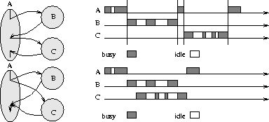
Why Message-Driven Modules ?
SPMD and Message-Driven Modules
(From A. Gursoy, Simplified expression of message-driven programs and quantification of their impact on performance, Ph.D Thesis, Apr 1994.)
Notes:
This is very nicely illustrated in a figure I borrowed from Attila Gursoy’s thesis. Module A needs to avail services from Module B and C. In a message-passing paradigm, these modules cannot execute concurrently, thus idle times in one modules cannot be substituted by computations from another module. This is possible in message-driven paradigm. We therefore base our component architecture on a message-driven runtime system, called Converse. We describe Converse next.

Slide 12
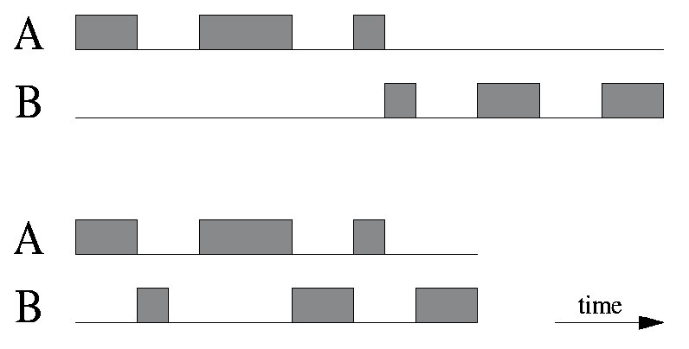
Example: Multiprogramming
Two independent modules A and B should trade off the processor while waiting for messages

Slide 13
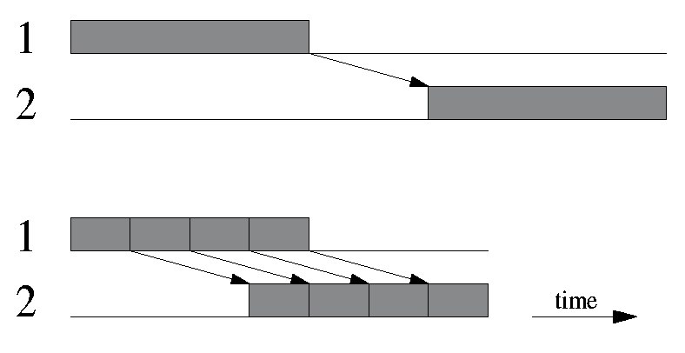
Example: Pipelining
Two different processors 1 and 2 should send large messages in pieces, to allow pipelining

Slide 14
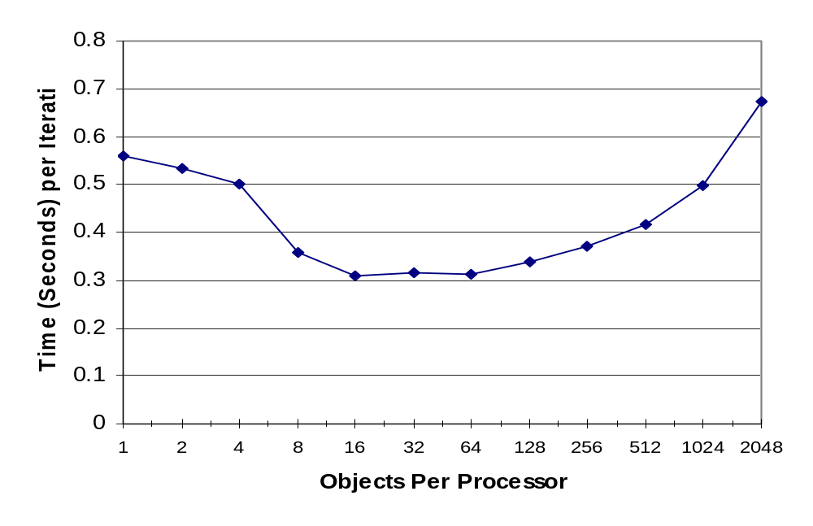
Cache Benefit from Virtualization
FEM Framework application on eight physical processors

Slide 15
Principle of Persistence
Once the application is expressed in terms of interacting objects:
  Object communication patterns and computational loads tend to persist over time
  In spite of dynamic behavior
    Abrupt and large, but infrequent changes (e.g.: mesh refinements)
    Slow and small changes (e.g.: particle migration)
Parallel analog of principle of locality
  Just a heuristic, but holds for most CSE applications
  Learning / adaptive algorithms
  Adaptive Communication libraries
  Measurement based load balancing

Slide 16
Measurement Based Load Balancing
Based on Principle of persistence
Runtime instrumentation
  Measures communication volume and computation time
Measurement based load balancers
  Use the instrumented data-base periodically to make new decisions
  Many alternative strategies can use the database
    Centralized vs distributed
    Greedy improvements vs complete reassignments
    Taking communication into account
    Taking dependences into account (More complex)

Slide 17
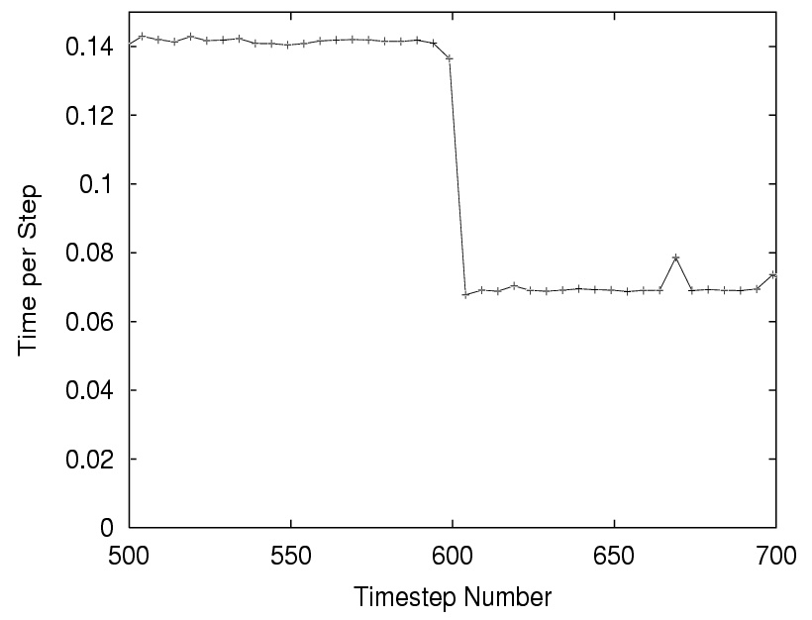
Example: Expanding Charm++ Job
This 8-processor AMPI job expands to 16 processors at step 600 by migrating objects. The number of virtual processors stays the same.

Slide 18
Virtualization in Charm++ & AMPI
Charm++:
  Parallel C++ with Data Driven Objects called Chares
  Asynchronous method invocation
AMPI: Adaptive MPI
  Familiar MPI 1.1 interface
  Many MPI threads per processor
  Blocking calls only block thread; not processor

Slide 19
Support for Virtualization
Virtual
Charm++
AMPI
Degree of Virtualization
CORBA
MPI
RPC
None
TCP/IP
Message Passing
Asynch. Methods
Communication and Synchronization Scheme

Slide 20
Charm++ Basics
(Orion Lawlor)

Slide 21
Charm++
Parallel library for Object-Oriented C++ applications
Messaging via remote method calls (like CORBA)
  Communication “proxy” objects
Methods called by scheduler
  System determines who runs next
Multiple objects per processor
Object migration fully supported
  Even with broadcasts, reductions

Slide 22
Charm++ Remote Method Calls
Interface (.ci) file
array[1D] foo {
entry void foo(int problemNo);
entry void bar(int x);
};
To call a method on a remote C++ object foo, use the local “proxy” C++ object CProxy_foo generated from the interface file:
Generated class
In a .C file
CProxy_foo someFoo=...;
someFoo[i].bar(17);
i’th object
method and parameters
This results in a network message, and eventually to a call to the real object’s method:
In another .C file
void foo::bar(int x) {
...
}

Slide 23
Charm++ Startup Process: Main
Interface (.ci) file
module myModule {
array[1D] foo {
entry foo(int problemNo);
entry void bar(int x);
}
mainchare myMain {
entry myMain(int argc,char **argv);
}
};
Special startup object
In a .C file
Generated class
#include “myModule.decl.h”
class myMain : public CBase_myMain {
myMain(int argc,char **argv) {
int nElements=7, i=nElements/2;
CProxy_foo f=CProxy_foo::ckNew(2,nElements);
f[i].bar(3);
}
};
#include “myModule.def.h”
Called at startup

Slide 24
Charm++ Array Definition
Interface (.ci) file
array[1D] foo {
entry foo(int problemNo);
entry void bar(int x);
}
In a .C file
class foo : public CBase_foo {
public:
// Remote calls
foo(int problemNo) { ... }
void bar(int x) { ... }
// Migration support:
foo(CkMigrateMessage *m) {}
void pup(PUP::er &p) {...}
};

Slide 25
Charm++ Features: Object Arrays
Applications are written as a set of communicating objects
User’s view
A[0]
A[1]
A[2]
A[3]
A[n]

Slide 26
Charm++ Features: Object Arrays
Charm++ maps those objects onto processors, routing messages as needed
User’s view
A[0]
A[1]
A[2]
A[3]
A[n]
System view
A[0]
A[3]

Slide 27
Charm++ Features: Object Arrays
Charm++ can re-map (migrate) objects for communication, load balance, fault tolerance, etc.
User’s view
A[0]
A[1]
A[2]
A[3]
A[n]
System view
A[0]
A[3]

Slide 28

Charm++ Handles:
Decomposition: left to user
  What to do in parallel
Mapping
  Which processor does each task
Scheduling (sequencing)
  On each processor, at each instant
Machine dependent expression
  Express the above decisions efficiently for the particular parallel machine

Slide 29
Charm++ and AMPI: Portability
Runs on:
  Any machine with MPI
    Origin2000
    IBM SP
  PSC’s Lemieux (Quadrics Elan)
  Clusters with Ethernet (UDP)
  Clusters with Myrinet (GM)
  Even Windows!
SMP-Aware (pthreads)
Uniprocessor debugging mode

Slide 30
Build Charm++ and AMPI
Download from website
  http://charm.cs.uiuc.edu/download.html
Build Charm++ and AMPI
  ./build <target> <version> <options> [compile flags]
  To build Charm++ and AMPI:
    ./build AMPI net-linux -g
Compile code using charmc
  Portable compiler wrapper
  Link with “-language charm++”
Run code using charmrun
Notes:
Version includes your communication network and OS
Charmc-options like -g

Slide 31
Other Features
Broadcasts and Reductions
Runtime creation and deletion
nD and sparse array indexing
Library support (“modules”)
Groups: per-processor objects
Node Groups: per-node objects
Priorities: control ordering

Slide 32
AMPI Basics

Slide 33
Comparison: Charm++ vs. MPI
Advantages: Charm++
  Modules/Abstractions are centered on application data structures
    Not processors
  Abstraction allows advanced features like load balancing
Advantages: MPI
  Highly popular, widely available, industry standard
  “Anthropomorphic” view of processor
    Many developers find this intuitive
But mostly:
  MPI is a firmly entrenched standard
  Everybody in the world uses it

Slide 34
AMPI: “Adaptive” MPI
MPI interface, for C and Fortran, implemented on Charm++
Multiple “virtual processors” per physical processor
  Implemented as user-level threads
    Very fast context switching-- 1us
  E.g., MPI_Recv only blocks virtual processor, not physical
Supports migration (and hence load balancing) via extensions to MPI

Slide 35
AMPI: User’s View
7 MPI threads

Slide 36
AMPI: System Implementation
7 MPI threads
2 Real Processors

Slide 37
Example: Hello World!
#include <stdio.h>
#include <mpi.h>
int main( int argc, char *argv[] )
{
int size,myrank;
MPI_Init(&argc, &argv);
MPI_Comm_size(MPI_COMM_WORLD, &size);
MPI_Comm_rank(MPI_COMM_WORLD, &myrank);
printf( "[%d] Hello, parallel world!\n", myrank );
MPI_Finalize();
return 0;
}

Slide 38
Example: Send/Recv
...
double a[2] = {0.3, 0.5};
double b[2] = {0.7, 0.9};
MPI_Status sts;
if(myrank == 0){
MPI_Send(a,2,MPI_DOUBLE,1,17,MPI_COMM_WORLD);
}else if(myrank == 1){
MPI_Recv(b,2,MPI_DOUBLE,0,17,MPI_COMM_WORLD,
&sts);
}
...

Slide 39
How to Write an AMPI Program
Write your normal MPI program, and then…
Link and run with Charm++
  Compile and link with charmc
    charmc -o hello hello.c -language ampi
    charmc -o hello2 hello.f90 -language ampif
  Run with charmrun
    charmrun hello
Notes:
Example of two threads sharing one counter.
A sets it to 2, B increments it, A reads the incorrect count.
Isomalloc: special memory allocation mode, give allocated memory the same virtual address on all processors.
problem: address space limitation on 32-bit machines. 4GB – OS, conventional heap allocation, = virtual address ~1GB
divided over 20PE -> 50MB per PE

Slide 40
How to Run an AMPI program
Charmrun
  A portable parallel job execution script
  Specify number of physical processors: +pN
  Specify number of virtual MPI processes: +vpN
  Special “nodelist” file for net-* versions

Slide 41
AMPI MPI Extensions
Process Migration
Asynchronous Collectives
Checkpoint/Restart

Slide 42
AMPI and Charm++ Features

Slide 43
Object Migration

Slide 44
Object Migration
How do we move work between processors?
Application-specific methods
  E.g., move rows of sparse matrix, elements of FEM computation
  Often very difficult for application
Application-independent methods
  E.g., move entire virtual processor
  Application’s problem decomposition doesn’t change

Slide 45
How to Migrate a Virtual Processor?
Move all application state to new processor
Stack Data
  Subroutine variables and calls
  Managed by compiler
Heap Data
  Allocated with malloc/free
  Managed by user
Global Variables
Open files, environment variables, etc. (not handled yet!)

Slide 46
Stack Data
The stack is used by the compiler to track function calls and provide temporary storage
  Local Variables
  Subroutine Parameters
  C “alloca” storage
Most of the variables in a typical application are stack data

Slide 47
Migrate Stack Data
Without compiler support, cannot change stack’s address
  Because we can’t change stack’s interior pointers (return frame pointer, function arguments, etc.)
Solution: “isomalloc” addresses
  Reserve address space on every processor for every thread stack
  Use mmap to scatter stacks in virtual memory efficiently
  Idea comes from PM²

Slide 48
Migrate Stack Data
Processor A’s Memory
Processor B’s Memory
0xFFFFFFFF
0xFFFFFFFF
Thread 1 stack
Thread 2 stack
Migrate Thread 3
Thread 3 stack
Thread 4 stack
Heap
Heap
Globals
Globals
Code
Code
0x00000000
0x00000000

Slide 49
Migrate Stack Data
Processor A’s Memory
Processor B’s Memory
0xFFFFFFFF
0xFFFFFFFF
Thread 1 stack
Thread 2 stack
Migrate Thread 3
Thread 3 stack
Thread 4 stack
Heap
Heap
Globals
Globals
Code
Code
0x00000000
0x00000000

Slide 50
Migrate Stack Data
Isomalloc is a completely automatic solution
  No changes needed in application or compilers
  Just like a software shared-memory system, but with proactive paging
But has a few limitations
  Depends on having large quantities of virtual address space (best on 64-bit)
    32-bit machines can only have a few gigs of isomalloc stacks across the whole machine
  Depends on unportable mmap
    Which addresses are safe? (We must guess!)
    What about Windows? Blue Gene?

Slide 51
Heap Data
Heap data is any dynamically allocated data
  C “malloc” and “free”
  C++ “new” and “delete”
  F90 “ALLOCATE” and “DEALLOCATE”
Arrays and linked data structures are almost always heap data

Slide 52
Migrate Heap Data
Automatic solution: isomalloc all heap data just like stacks!
  “-memory isomalloc” link option
  Overrides malloc/free
  No new application code needed
  Same limitations as isomalloc
Manual solution: application moves its heap data
  Need to be able to size message buffer, pack data into message, and unpack on other side
  “pup” abstraction does all three

Slide 53
Migrate Heap Data: PUP
Same idea as MPI derived types, but datatype description is code, not data
Basic contract: here is my data
  Sizing: counts up data size
  Packing: copies data into message
  Unpacking: copies data back out
  Same call works for network, memory, disk I/O ...
Register “pup routine” with runtime
F90/C Interface: subroutine calls
  E.g., pup_int(p,&x);
C++ Interface: operator| overloading
  E.g., p|x;

Slide 54
Migrate Heap Data: PUP Builtins
Supported PUP Datatypes
  Basic types (int, float, etc.)
  Arrays of basic types
  Unformatted bytes
Extra Support in C++
  Can overload user-defined types
    Define your own operator|
  Support for pointer-to-parent class
    PUP::able interface
  Supports STL vector, list, map, and string
    “pup_stl.h”
  Subclass your own PUP::er object

Slide 55
Migrate Heap Data: PUP C++ Example
#include “pup.h”
#include “pup_stl.h”
class myMesh {
std::vector<float> nodes;
std::vector<int> elts;
public:
...
void pup(PUP::er &p) {
p|nodes; p|elts;
}
};

Slide 56
Migrate Heap Data: PUP C Example
struct myMesh {
int nn,ne;
float *nodes;
int *elts;
};
void pupMesh(pup_er p,myMesh *mesh) {
pup_int(p,&mesh->nn);
pup_int(p,&mesh->ne);
if(pup_isUnpacking(p))
{ /* allocate data on arrival */
mesh->nodes=new float[mesh->nn];
mesh->elts=new int[mesh->ne];
}
pup_floats(p,mesh->nodes,mesh->nn);
pup_ints(p,mesh->elts,mesh->ne);
if (pup_isDeleting(p))
{ /* free data on departure */
deleteMesh(mesh);
}
}

Slide 57
Migrate Heap Data: PUP F90 Example
TYPE(myMesh)
INTEGER :: nn,ne
REAL*4, ALLOCATABLE(:) :: nodes
INTEGER, ALLOCATABLE(:) :: elts
END TYPE
SUBROUTINE pupMesh(p,mesh)
USE MODULE ...
INTEGER :: p
TYPE(myMesh) :: mesh
fpup_int(p,mesh%nn)
fpup_int(p,mesh%ne)
IF (fpup_isUnpacking(p)) THEN
ALLOCATE(mesh%nodes(mesh%nn))
ALLOCATE(mesh%elts(mesh%ne))
END IF
fpup_floats(p,mesh%nodes,mesh%nn);
fpup_ints(p,mesh%elts,mesh%ne);
IF (fpup_isDeleting(p)) deleteMesh(mesh);
END SUBROUTINE

Slide 58
Global Data
Global data is anything stored at a fixed place
  C/C++ “extern” or “static” data
  F77 “COMMON” blocks
  F90 “MODULE” data
Problem if multiple objects/threads try to store different values in the same place (thread safety)
  Compilers should make all of these per-thread; but they don’t!
Not a problem if everybody stores the same value (e.g., constants)

Slide 59
Migrate Global Data
Automatic solution: keep separate set of globals for each thread and swap
  “-swapglobals” compile-time option
  Works on ELF platforms: Linux and Sun
    Just a pointer swap, no data copying needed
    Idea comes from Weaves framework
  One copy at a time: breaks on SMPs
Manual solution: remove globals
  Makes code threadsafe
  May make code easier to understand and modify
  Turns global variables into heap data (for isomalloc or pup)

Slide 60
How to Remove Global Data: Privatize
Move global variables into a per-thread class or struct (C/C++)
  Requires changing every reference to every global variable
  Changes every function call
extern int foo, bar;
void inc(int x) {
foo+=x;
}
typedef struct myGlobals {
int foo, bar;
};
void inc(myGlobals *g,int x) {
g->foo+=x;
}

Slide 61
How to Remove Global Data: Privatize
Move global variables into a per-thread TYPE (F90)
MODULE myMod
INTEGER :: foo
INTEGER :: bar
END MODULE
SUBROUTINE inc(x)
USE MODULE myMod
INTEGER :: x
foo = foo + x
END SUBROUTINE
MODULE myMod
TYPE(myModData)
INTEGER :: foo
INTEGER :: bar
END TYPE
END MODULE
SUBROUTINE inc(g,x)
USE MODULE myMod
TYPE(myModData) :: g
INTEGER :: x
g%foo = g%foo + x
END SUBROUTINE

Slide 62
How to Remove Global Data: Use Class
Turn routines into C++ methods; add globals as class variables
  No need to change variable references or function calls
  Only applies to C or C-style C++
extern int foo, bar;
void inc(int x) {
foo+=x;
}
class myGlobals {
int foo, bar;
public:
void inc(int x);
};
void myGlobals::inc(int x) {
foo+=x;
}

Slide 63
How to Migrate a Virtual Processor?
Move all application state to new processor
Stack Data
  Automatic: isomalloc stacks
Heap Data
  Use “-memory isomalloc” -or-
  Write pup routines
Global Variables
  Use “-swapglobals” -or-
  Remove globals entirely

Slide 64
Checkpoint/Restart

Slide 65
Checkpoint/Restart
Any long running application must be able to save its state
When you checkpoint an application, it uses the pup routine to store the state of all objects
State information is saved in a directory of your choosing
Restore also uses pup, so no additional application code is needed (pup is all you need)

Slide 66
Checkpointing Job
In AMPI, use MPI_Checkpoint(<dir>);
  Collective call; returns when checkpoint is complete
In Charm++, use CkCheckpoint(<dir>,<resume>);
  Called on one processor; calls resume when checkpoint is complete

Slide 67
Restart Job from Checkpoint
The charmrun option ++restart <dir> is used to restart
  Number of processors need not be the same
You can also restart groups by marking them migratable and writing a PUP routine – they still will not load balance, though

Slide 68
Automatic Load Balancing
(Sameer Kumar)

Slide 69
Motivation
Irregular or dynamic applications
  Initial static load balancing
  Application behaviors change dynamically
  Difficult to implement with good parallel efficiency
Versatile, automatic load balancers
  Application independent
  No/little user effort is needed in load balance
  Based on Charm++ and Adaptive MPI

Slide 70
Load Balancing in Charm++
Viewing an application as a collection of communicating objects
Object migration as mechanism for adjusting load
Measurement based strategy
  Principle of persistent computation and communication structure.
  Instrument cpu usage and communication
Overload vs. underload processor

Slide 71
Feature: Load Balancing
Automatic load balancing
  Balance load by migrating objects
  Very little programmer effort
  Plug-able “strategy” modules
Instrumentation for load balancer built into our runtime
  Measures CPU load per object
  Measures network usage

Slide 72
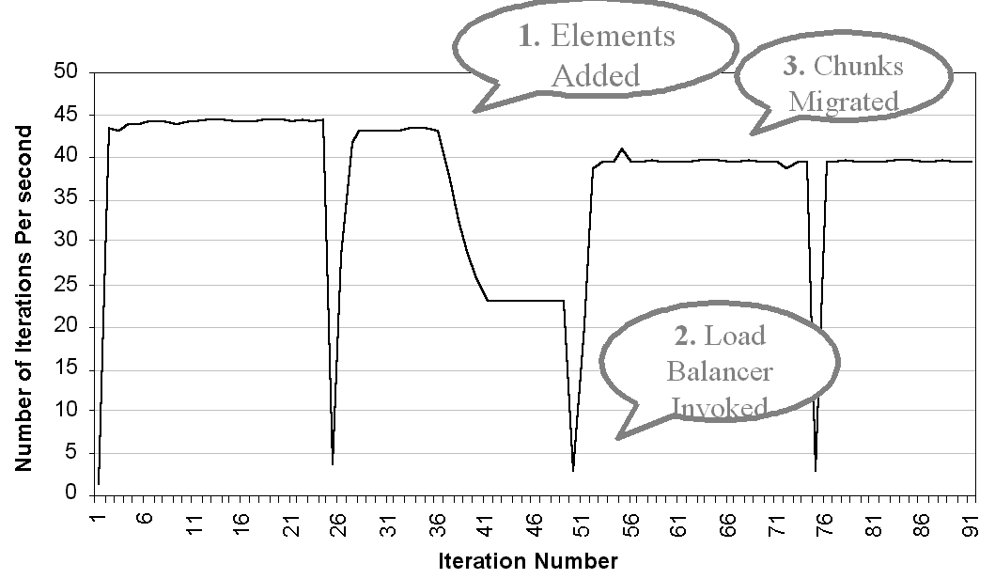
Charm++ Load Balancer in Action
Automatic Load Balancing in Crack Propagation

Slide 73
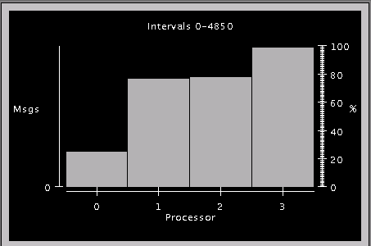
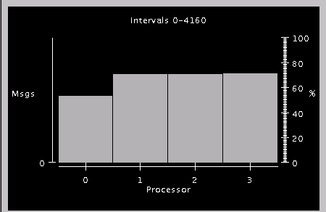
Processor Utilization: Before and After
Notes:
Interval 48.5s / 41.6s
Jacobi 2048 (dimension) .1 (threshold) 32 chares 4 processors

Slide 74
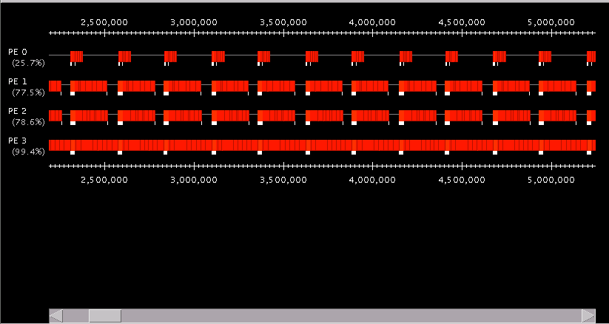
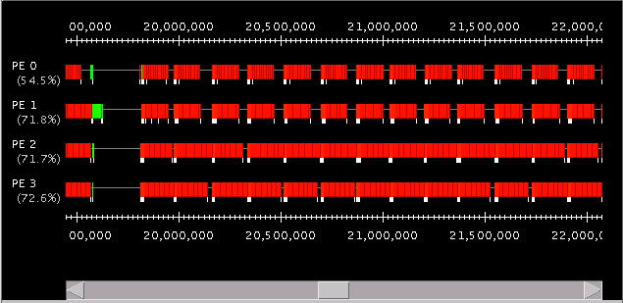
Timelines: Before and After Load Balancing
Notes:
Each chare waits for the others to complete for starting the next step
2 steps take Approx 500 us
2 steps take approx. 300 us

Slide 75
Load Balancing as Graph Partitioning
Cut object graph into equal-sized pieces (METIS)
mapping of objects
LB View
Charm++ PE

Slide 76
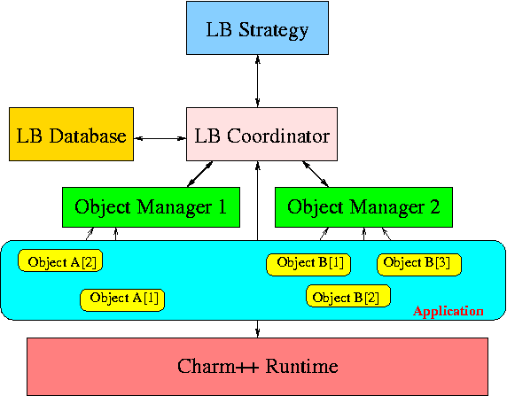
Load Balancing Framework
LB Framework

Slide 77
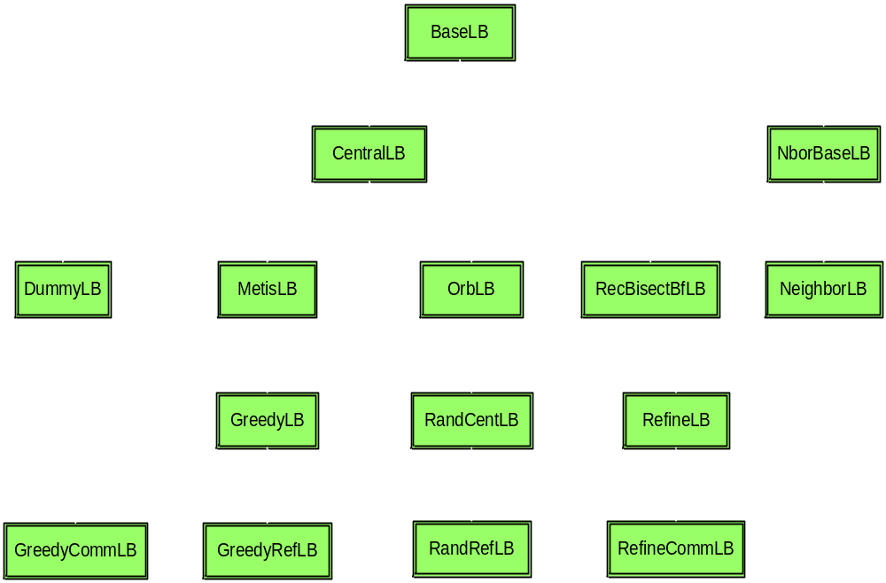
Load Balancing Strategies

Slide 78
Load Balancer Categories
Centralized
  Object load data are sent to processor 0
  Integrate to a complete object graph
  Migration decision is broadcasted from processor 0
  Global barrier
Distributed
  Load balancing among neighboring processors
  Build partial object graph
  Migration decision is sent to its neighbors
  No global barrier

Slide 79
Centralized Load Balancing
Uses information about activity on all processors to make load balancing decisions
Advantage: since it has the entire object communication graph, it can make the best global decision
Disadvantage: Higher communication costs/latency, since this requires information from all running chares

Slide 80
Neighborhood Load Balancing
Load balances among a small set of processors (the neighborhood) to decrease communication costs
Advantage: Lower communication costs, since communication is between a smaller subset of processors
Disadvantage: Could leave a system which is globally poorly balanced

Slide 81
Main Centralized Load Balancing Strategies
GreedyCommLB – a “greedy” load balancing strategy which uses the process load and communications graph to map the processes with the highest load onto the processors with the lowest load, while trying to keep communicating processes on the same processor
RefineLB – move objects off overloaded processors to under-utilized processors to reach average load
Others – the manual discusses several other load balancers which are not used as often, but may be useful in some cases; also, more are being developed

Slide 82
Neighborhood Load Balancing Strategies
NeighborLB – neighborhood load balancer, currently uses a neighborhood of 4 processors

Slide 83
Strategy Example - GreedyCommLB
Greedy algorithm
  Put the heaviest object to the most underloaded processor
Object load is its cpu load plus comm cost
  Communication cost is computed as α+βm

Slide 84
Strategy Example - GreedyCommLB

Slide 85
Strategy Example - GreedyCommLB

Slide 86
Strategy Example - GreedyCommLB

Slide 87
Compiler Interface
Link time options
  -module: Link load balancers as modules
  Link multiple modules into binary
Runtime options
  +balancer: Choose to invoke a load balancer
  Can have multiple load balancers
    +balancer GreedyCommLB +balancer RefineLB

Slide 88
When to Re-balance Load?
Default: Load balancer is periodic
  Provide period as a runtime parameter (+LBPeriod)
Programmer Control: AtSync load balancing
AtSync method: enable load balancing at specific point
  Object ready to migrate
  Re-balance if needed
  AtSync() called when your chare is ready to be load balanced – load balancing may not start right away
  ResumeFromSync() called when load balancing for this chare has finished

Slide 89
Comparison of Strategies
 | 64 processors |  |  | 1024 processors
 | Min load | Max load | Ave load | Min load | Max load | Ave load
--------------- | 13.952 | 15.505 | 14.388 | 42.801 | 45.971 | 44.784
GreedyRefLB | 14.104 | 14.589 | 14.351 | 43.585 | 45.195 | 44.777
GreedyCommLB | 13.748 | 14.396 | 14.025 | 40.519 | 46.922 | 43.777
RecBisectBfLB | 11.701 | 13.771 | 12.709 | 35.907 | 48.889 | 43.953
MetisLB | 14.061 | 14.506 | 14.341 | 41.477 | 48.077 | 44.772
RefineLB | 14.043 | 14.977 | 14.388 | 42.801 | 45.971 | 44.783
RefineCommLB | 14.015 | 15.176 | 14.388 | 42.801 | 45.971 | 44.783
OrbLB | 11.350 | 12.414 | 11.891 | 31.269 | 44.940 | 38.200
Jacobi1D program with 2048 chares on 64 pes and 10240 chares on 1024 pes

Slide 90
Comparison of Strategies
 | 1000 processors
 | Min load | Max load | Ave load
-------------- | 0 | 0.354490 | 0.197485
GreedyLB | 0.190424 | 0.244135 | 0.197485
GreedyRefLB | 0.191403 | 0.201179 | 0.197485
GreedyCommLB | 0.197262 | 0.198238 | 0.197485
RefineLB | 0.193369 | 0.200194 | 0.197485
RefineCommLB | 0.193369 | 0.200194 | 0.197485
OrbLB | 0.179689 | 0.220700 | 0.197485
NAMD atpase Benchmark 327506 atoms
Number of chares:31811 migratable:31107

Slide 91
User Interfaces
Fully automatic load balancing
  Nothing needs to be changed in application code
  Load balancing happens periodically and transparently
  +LBPeriod to control the load balancing interval
User controlled load balancing
  Insert AtSync() calls at places ready for load balancing (hint)
  LB pass control back to ResumeFromSync() after migration finishes

Slide 92
NAMD case study
Molecular dynamics
Atoms move slowly
Initial load balancing can be as simple as round-robin
Load balancing is only needed for once for a while, typically once every thousand steps
Greedy balancer followed by Refine strategy

Slide 93
Load Balancing Steps
Regular Timesteps
Detailed, aggressive Load Balancing
Instrumented Timesteps
Refinement Load Balancing

Slide 94
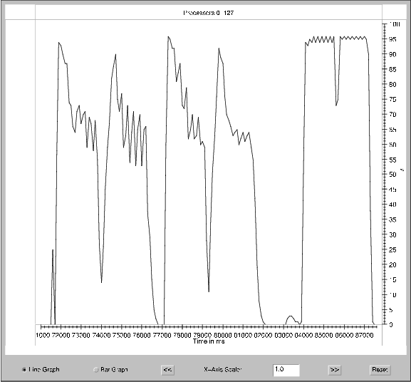
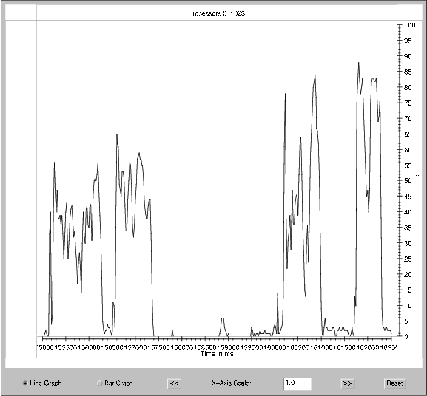
Load Balancing
Refinement Load Balancing
Aggressive Load Balancing
Processor Utilization against Time on (a) 128 (b) 1024 processors
On 128 processor, a single load balancing step suffices, but
On 1024 processors, we need a “refinement” step.

Slide 95
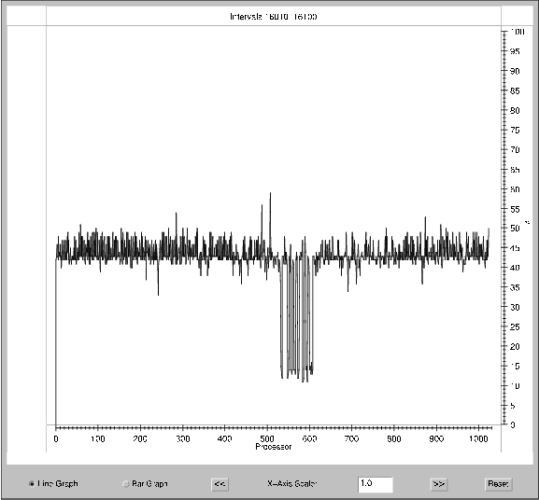
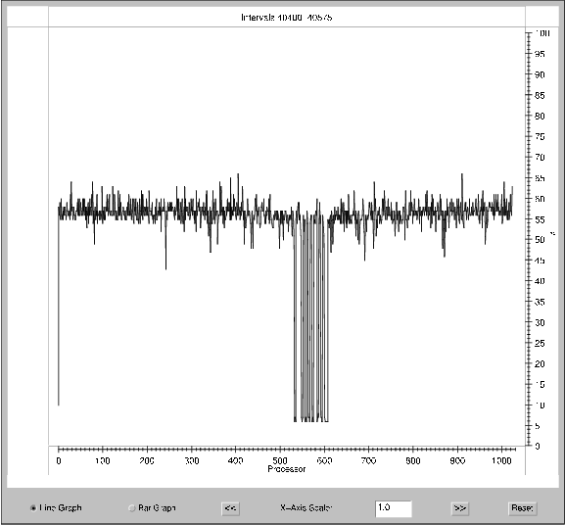
Some overloaded processors
Processor Utilization across processors after (a) greedy load balancing and (b) refining
Note that the underloaded processors are left underloaded (as they don’t impact perforamnce); refinement deals only with the overloaded ones

Slide 96
Communication Optimization
(Sameer Kumar)

Slide 97
Optimizing Communication
The parallel-objects Runtime System can observe, instrument, and measure communication patterns
  Communication libraries can optimize
    By substituting most suitable algorithm for each operation
    Learning at runtime
  E.g. All to all communication
    Performance depends on many runtime characteristics
    Library switches between different algorithms
  Communication is from/to objects, not processors
    Streaming messages optimization
V. Krishnan, MS Thesis, 1999
Ongoing work: Sameer Kumar, G Zheng, and Greg Koenig

Slide 98
Collective Communication
Communication operation where all (or most) the processors participate
  For example broadcast, barrier, all reduce, all to all communication etc
  Applications: NAMD multicast, NAMD PME, CPAIMD
Issues
  Performance impediment
  Naïve implementations often do not scale
  Synchronous implementations do not utilize the co-processor effectively

Slide 99
All to All Communication
All processors send data to all other processors
  All to all personalized communication (AAPC)
    MPI_Alltoall
  All to all multicast/broadcast (AAMC)
    MPI_Allgather

Slide 100
Optimization Strategies
Short message optimizations
  High software over head (α)
  Message combining
Large messages
  Network contention
Performance metrics
  Completion time
  Compute overhead
Notes:
High software overhead
-Affects short message performance
- High I/O and PCI overheads are responsible for this
Network contention
- affects large messages

Slide 101
Short Message Optimizations
Direct all to all communication is α dominated
Message combining for small messages
  Reduce the total number of messages
  Multistage algorithm to send messages along a virtual topology
  Group of messages combined and sent to an intermediate processor which then forwards them to their final destinations
  AAPC strategy may send same message multiple times

Slide 102


Virtual Topology: Mesh
Organize processors in a 2D (virtual) Mesh
Phase 1: Processors send messages to row neighbors
Phase 1: Processors send messages to column neighbors
2* messages instead of P-1
Message from (x1,y1) to (x2,y2) goes via (x1,y2)

Slide 103
Virtual Topology: Hypercube
Dimensional exchange
Log(P) messages instead of P-1
6
7
2
3
5
0
1

Slide 104
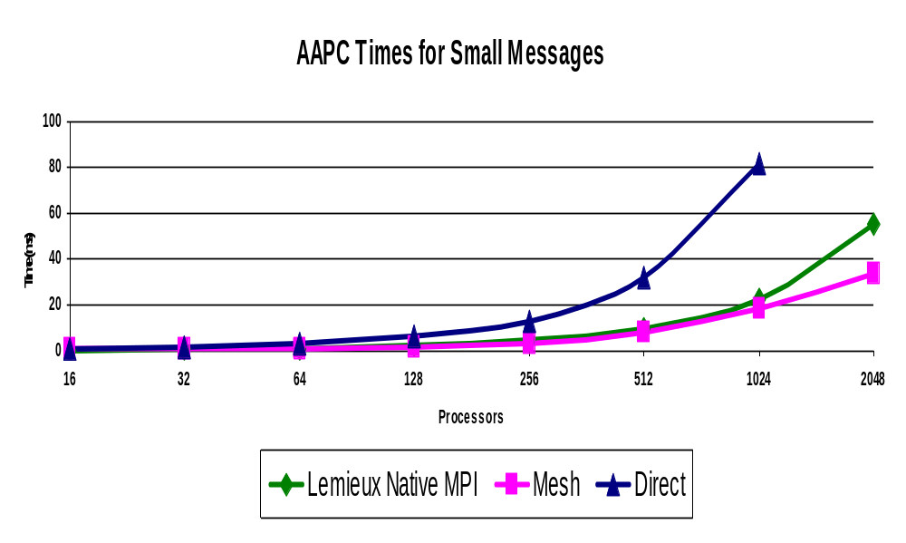
AAPC Performance

Slide 105
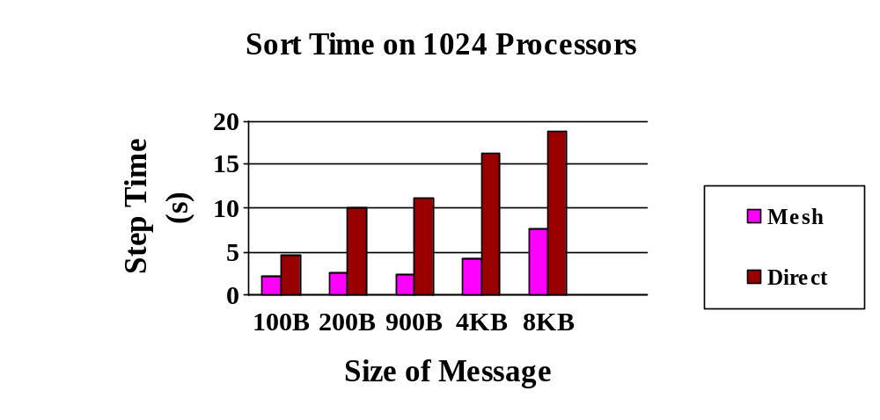
Radix Sort
AAPC Time (ms)
Size
Direct
Mesh
2KB
333
221
4KB
256
416
8KB
484
766

Slide 106
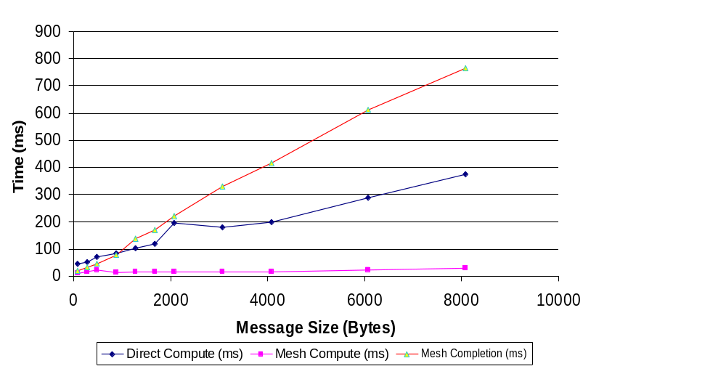
AAPC Processor Overhead
Mesh Completion Time
Direct Compute Time
Mesh Compute Time
Performance on 1024 processors of Lemieux

Slide 107
Compute Overhead: A New Metric
Strategies should also be evaluated on compute overhead
Asynchronous non blocking primitives needed
  Compute overhead of the mesh strategy is a small fraction of the total AAPC completion time
  A data driven system like Charm++ will automatically support this

Slide 108
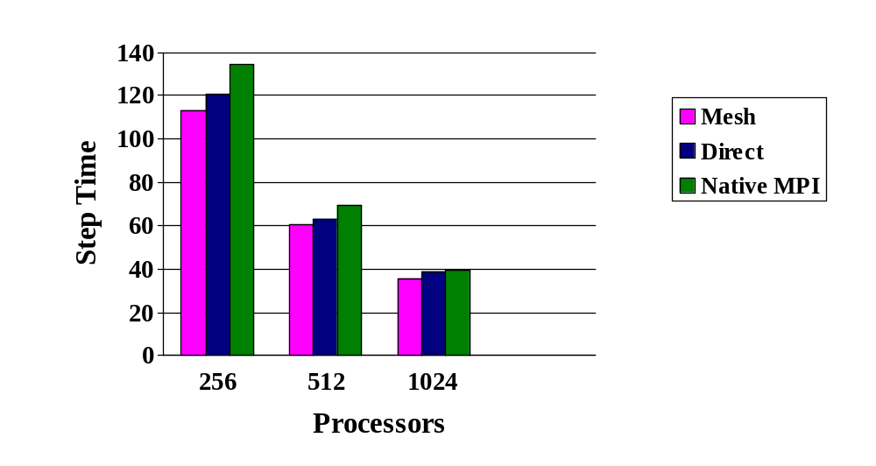
NAMD Performance
Performance of Namd with the Atpase molecule.
PME step in Namd involves an a 192 X 144 processor collective operation with 900 byte messages

Slide 109
Large Message Issues
Network contention
  Contention free schedules
  Topology specific optimizations

Slide 110
Ring Strategy for Collective Multicast
Performs all to all multicast by sending messages along a ring formed by the processors
Congestion free on most topologies
……
……..
0
1
2
i
i+1
P-1

Slide 111
Accessing the Communication Library
Charm++
  Creating a strategy
  //Creating an all to all communication strategy
    Strategy s = new EachToManyStrategy(USE_MESH);
    ComlibInstance inst = CkGetComlibInstance();
    inst.setStrategy(s);
    //In array entry method
    ComlibDelegate(&aproxy);
    //begin
    aproxy.method(…..);
    //end

Slide 112
Compiling
For strategies, you need to specify a communications topology, which specifies the message pattern you will be using
You must include –module commlib compile time option

Slide 113
Streaming Messages
Programs often have streams of short messages
Streaming library combines a bunch of messages and sends them off
To use streaming create a StreamingStrategy
  Strategy *strat = new StreamingStrategy(10);

Slide 114
AMPI Interface
The MPI_Alltoall call internally calls the communication library
  Running the program with +strategy option switches to the appropriate strategy
    charmrun pgm-ampi +p16 +strategy USE_MESH
Asynchronous collectives
  Collective operation posted
  Test/wait for its completion
  Meanwhile useful computation can utilize CPU
      MPI_Ialltoall( … , &req);
      /* other computation */
      MPI_Wait(req);

Slide 115
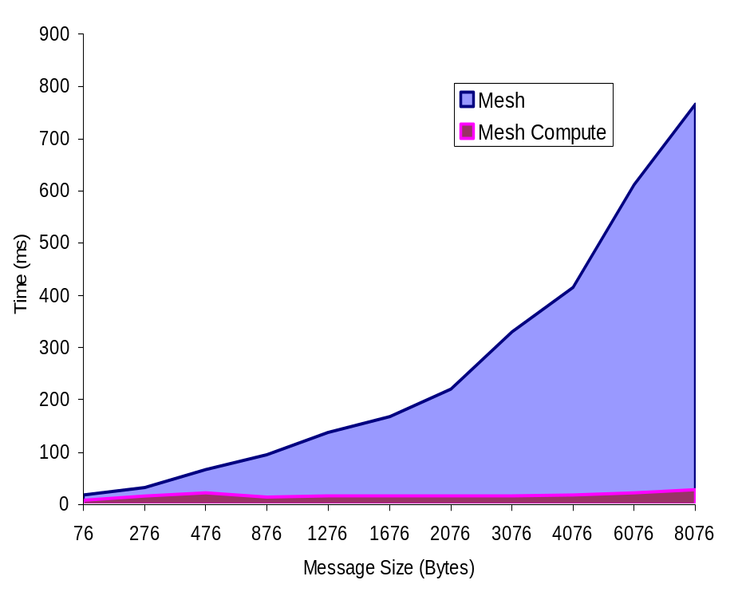
CPU Overhead vs Completion Time
Time breakdown of an all-to-all operation
using Mesh library
Computation is only a small proportion of the elapsed time
A number of optimization techniques are developed to improve collective communication performance
Notes:
Powerful idea used in Charm++, now applied to AMPI too.
First this idea of non-blocking collectives was implemented in IBM MPI, but as AMPI is based on threads and capable of migration, it has more flexibility to take advantage of the overlapping feature.

Slide 116
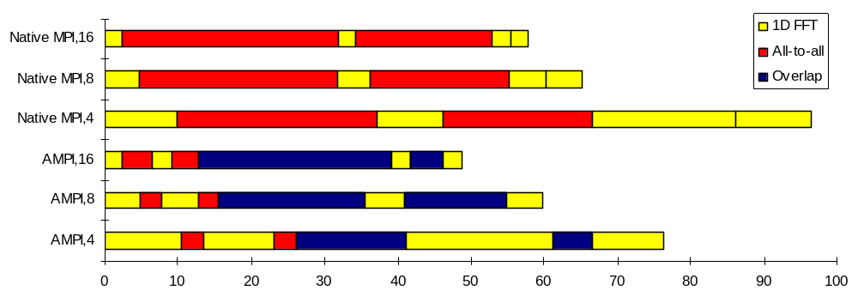
Asynchronous Collectives
Time breakdown of 2D FFT benchmark [ms]
VP’s implemented as threads
Overlapping computation with waiting time of collective operations
Total completion time reduced
Notes:
DON’T SAY the amount of reduced is equal to the amount of overlapped

Slide 117
Summary
We present optimization strategies for collective communication
Asynchronous collective communication
  New performance metric: CPU overhead

Slide 118
Future Work
Physical topologies
  ASCI-Q, Lemieux Fat-trees
  Bluegene (3-d grid)
Smart strategies for multiple simultaneous AAPCs over sections of processors

Slide 119
Advanced Features: Communications Optimization
Used to optimize communication patterns in your application
Can use either bracketed strategies or streaming strategies
Bracketed strategies are those where a specific start and end point for the communication are flagged
Streaming strategies use a preset time interval for bracketing messages

Slide 120
BigSim
(Sanjay Kale)

Slide 121
Overview
BigSim
  Component based, integrated simulation framework
  Performance prediction for a large variety of extremely large parallel machines
  Study alternate programming models

Slide 122
Our approach
Applications based on existing parallel languages
  AMPI
  Charm++
  Facilitate development of new programming languages
Detailed/accurate simulation of parallel performance
  Sequential part : performance counters, instruction level simulation
  Parallel part: simple latency based network model, network simulator

Slide 123
Parallel Simulator
Parallel performance is hard to model
  Communication subsystem
    Out of order messages
    Communication/computation overlap
  Event dependencies, causality.
Parallel Discrete Event Simulation
  Emulation program executes concurrently with event time stamp correction.
Exploit inherent determinacy of application

Slide 124
Emulation on a Parallel Machine
BG/C Nodes
Simulated processor
Simulating (Host) Processor

Slide 125
Emulator to Simulator
Predicting time of sequential code
  User supplied estimated elapsed time
  Wallclock measurement time on simulating machine with suitable multiplier
  Performance counters
  Hardware simulator
Predicting messaging performance
  No contention modeling, latency based
  Back patching
  Network simulator
Simulation can be in separate resolutions

Slide 126
Simulation Process
Compile MPI or Charm++ program and link with simulator library
Online mode simulation
  Run the program with +bgcorrect
  Visualize the performance data in Projections
Postmortem mode simulation
  Run the program with +bglog
  Run POSE based simulator with network simulation on different number of processors
  Visualize the performance data

Slide 127
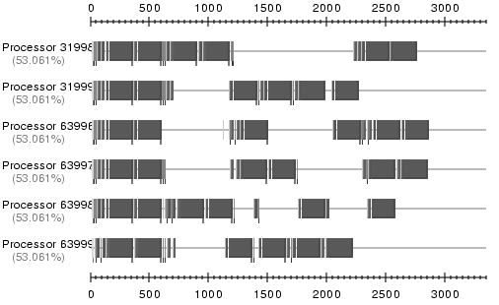
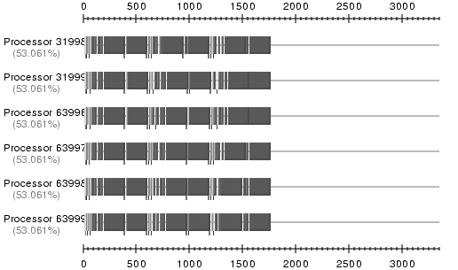
Projections before/after correction

Slide 128
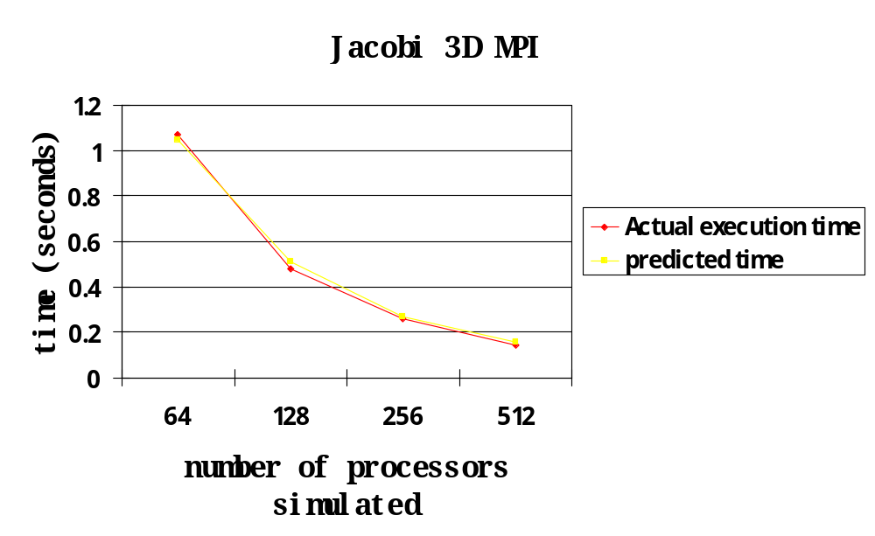
Validation

Slide 129
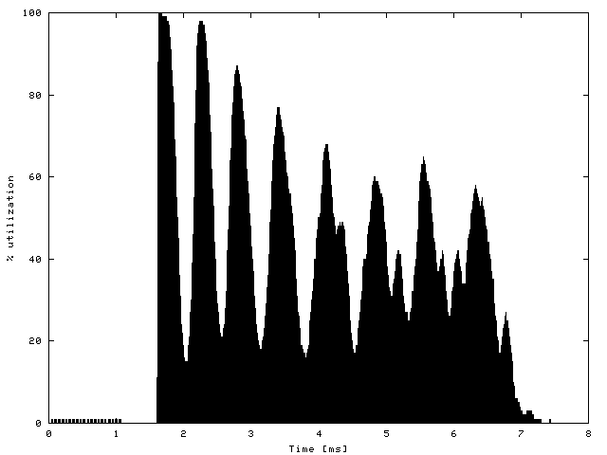
LeanMD Performance Analysis
      Benchmark 3-away ER-GRE
        36573 atoms
      1.6 million objects
      8 step simulation
      64k BG processors
Running on PSC Lemieux

Slide 130
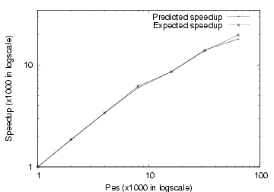
Predicted LeanMD speedup

Slide 131
Performance Analysis

Slide 132
Projections
Projections is designed for use with a virtualized model like Charm++ or AMPI
Instrumentation built into runtime system
Post-mortem tool with highly detailed traces as well as summary formats
Java-based visualization tool for presenting performance information

Slide 133
Trace Generation (Detailed)
Link-time option “-tracemode projections”
  In the log mode each event is recorded in full detail (including timestamp) in an internal buffer
  Memory footprint controlled by limiting number of log entries
  I/O perturbation can be reduced by increasing number of log entries
  Generates a <name>.<pe>.log file for each processor and a <name>.sts file for the entire application
Commonly used Run-time options
  +traceroot DIR
  +logsize NUM
Notes:
The charm++ runtime system can automatically instrument the code for performance analysis.This is because the runtime system gets control before and after the execution of every asynchronously invoked method, as well as when a message (method invocation) is sent out.
The runtime can record detailed traces of these events. Alternatively, in a “summary” mode, it records a short summary file for each processor. In this mode, it records data for each method, and for each time-interval. It maintains bins for a fixed number of intervals. If the program runs longer, it shrinks the number of intervals by doubling interval period.
Summary data -
Interval-based utilization data.

Slide 134
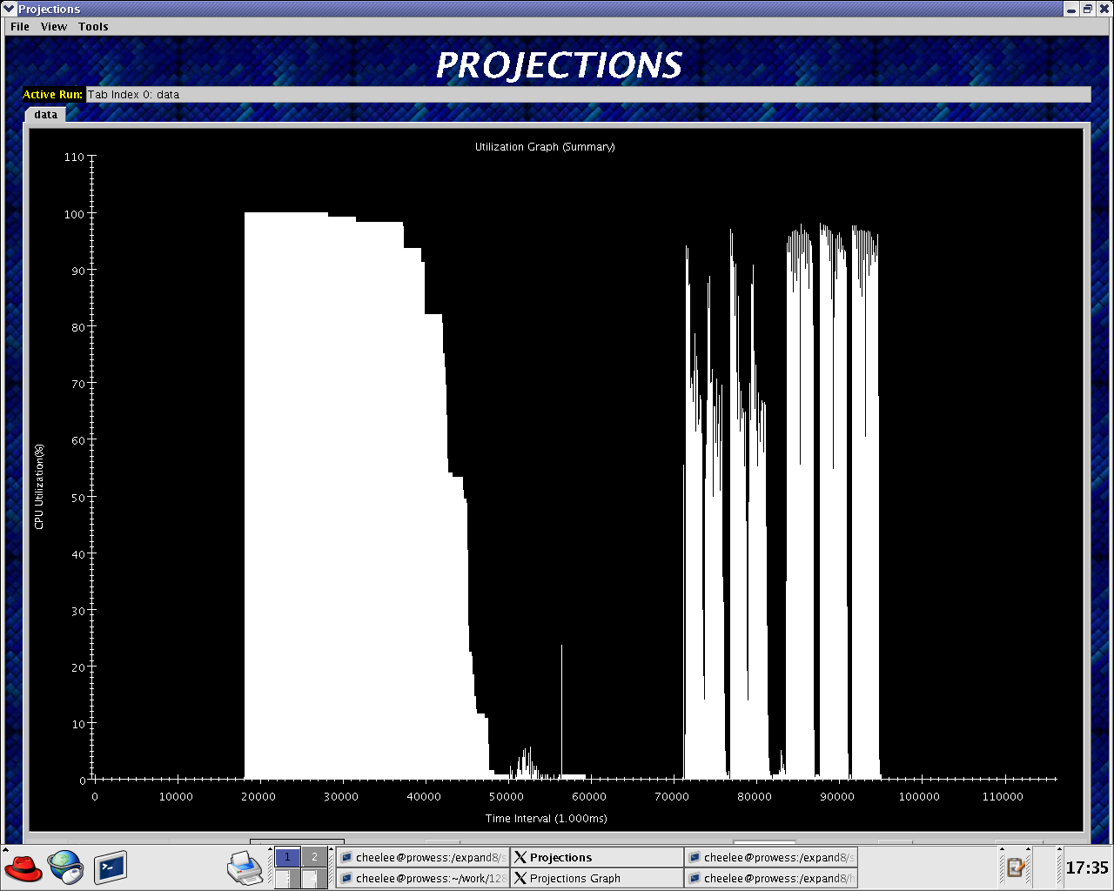
Visualization Main Window

Slide 135
Post mortem analysis: views
Utilization Graph
  Mainly useful as a function of processor utilization against time and time spent on specific parallel methods
Profile: stacked graphs:
  For a given period, breakdown of the time on each processor
    Includes idle time, and message-sending, receiving times
Timeline:
  upshot-like, but more details
  Pop-up views of method execution, message arrows, user-level events
Notes:
Trace data can be viewed using multiple views supported by projections. The major views are utilization-graph, timelines, and profile. These are shown on the next slide.

Slide 136
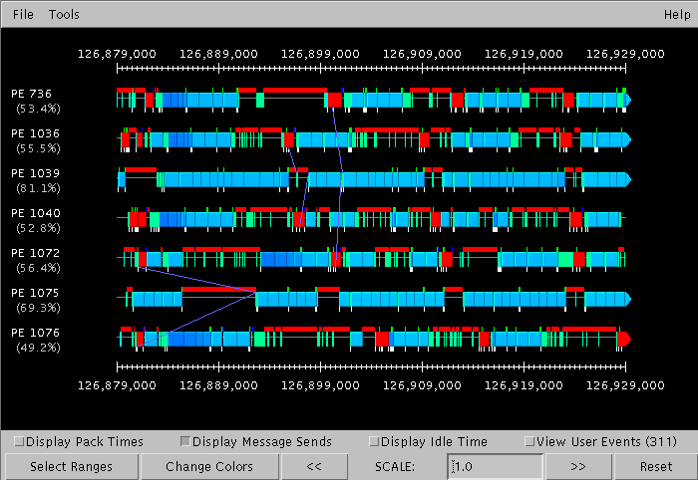
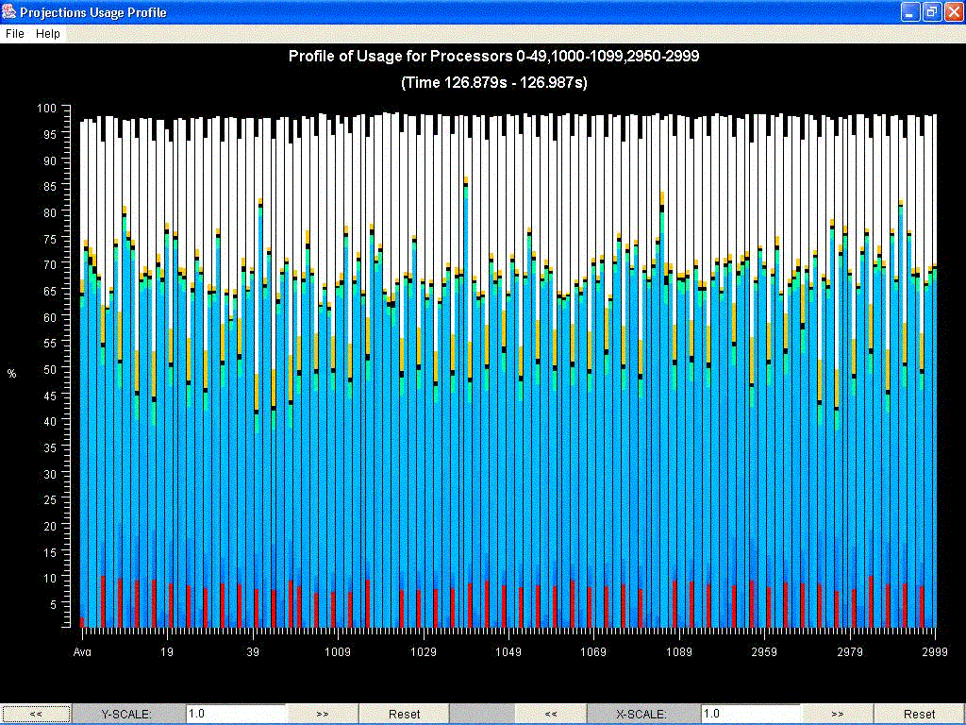

Slide 137
Projections Views: continued
Histogram of method execution times
  How many method-execution instances had a time of 0-1 ms? 1-2 ms? ..
Overview
  A fast utilization chart for entire machine across the entire time period

Slide 138
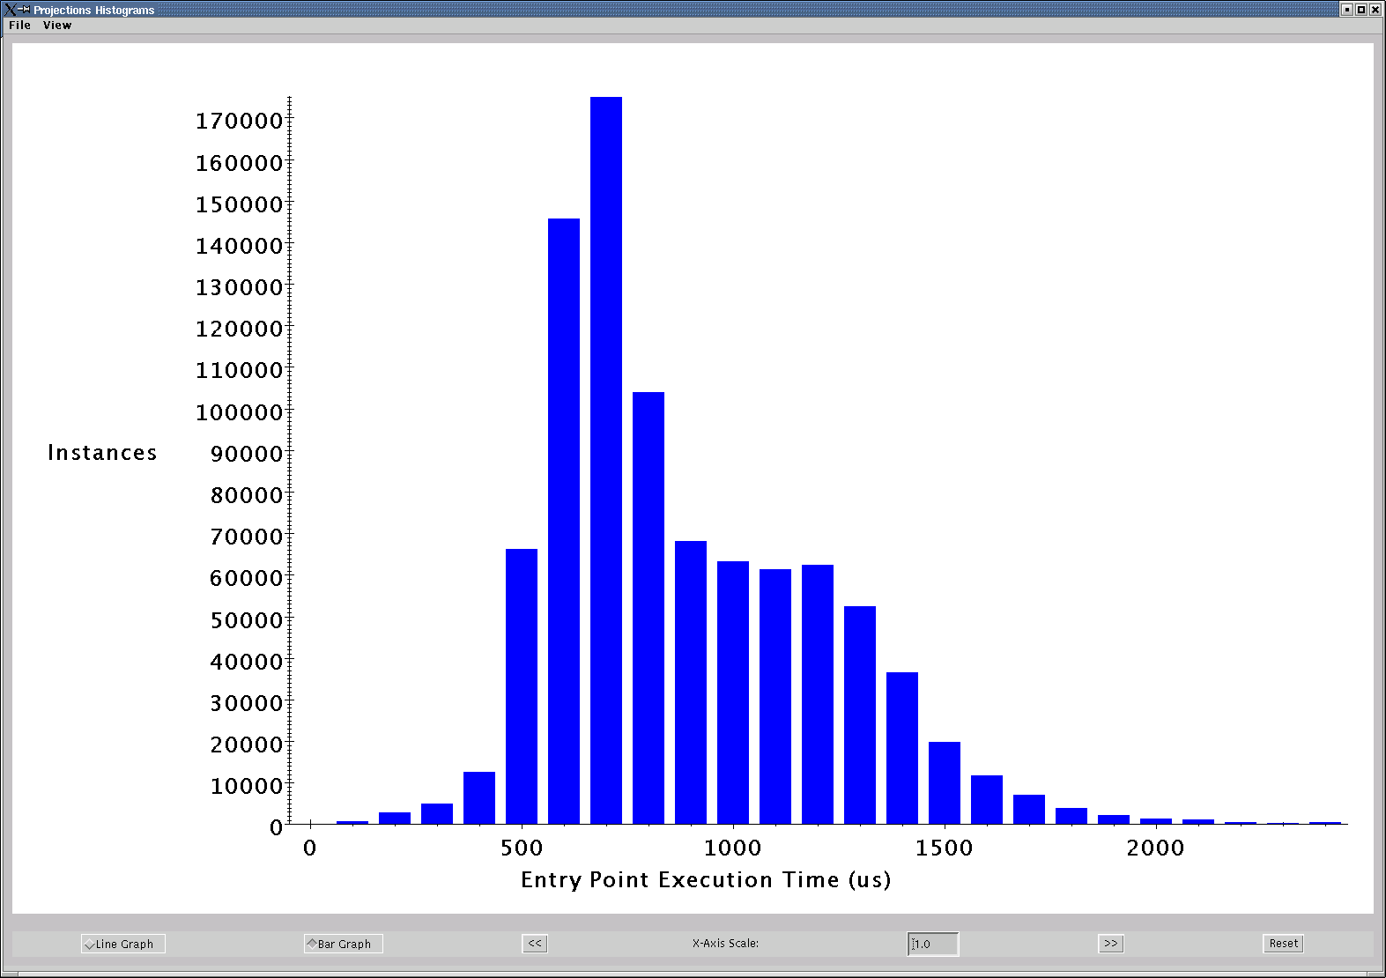
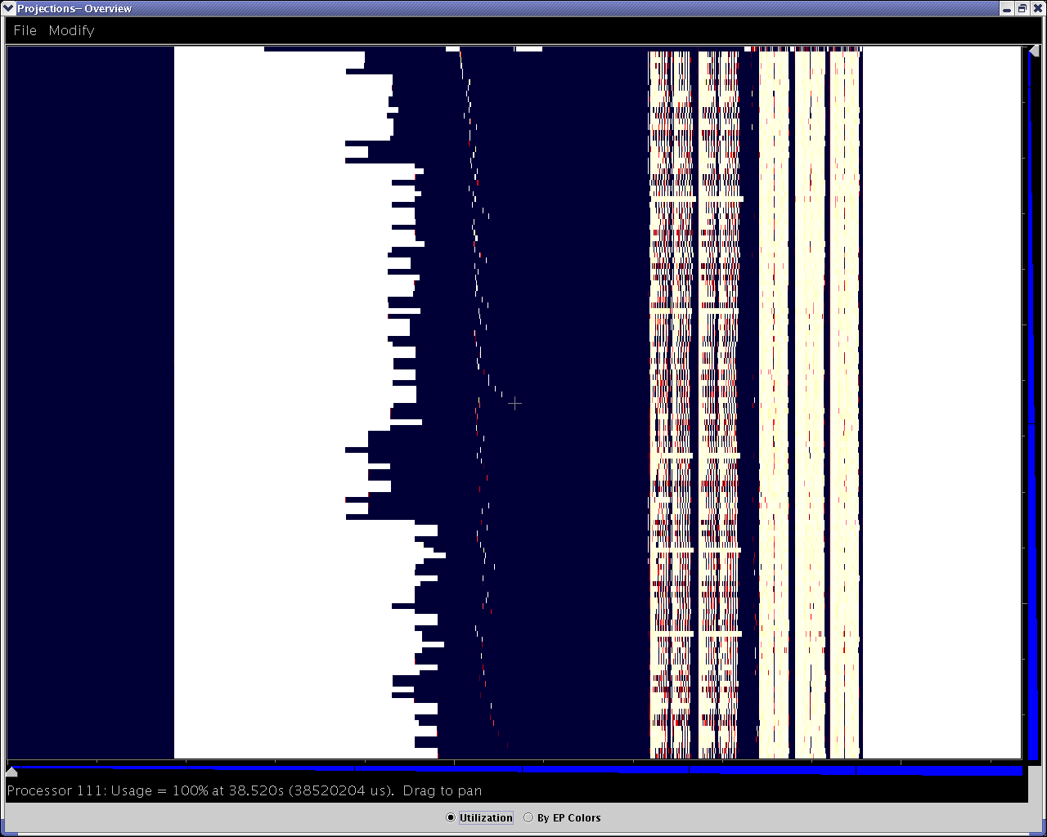
Notes:
Projection’s histogramming view was useful to check this was adequate. We saw that almost all of the objects took less then 2 msecs each, with a mode of around 700 microseconds.

Slide 139
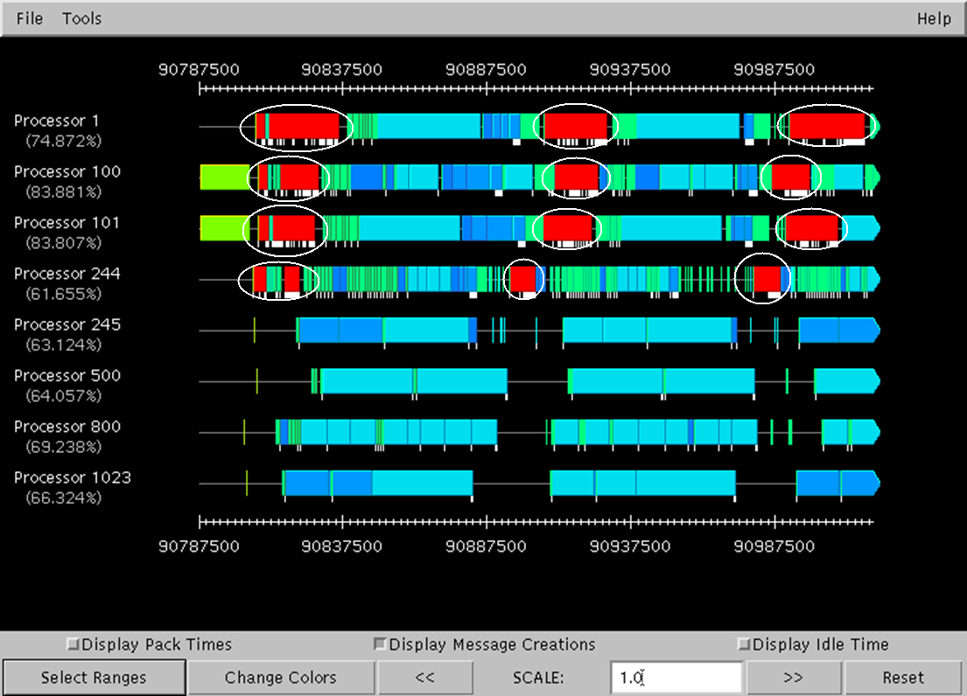
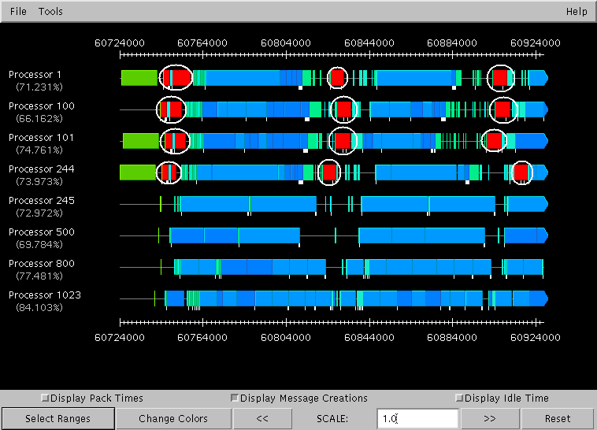
Message Packing Overhead
Effect of Multicast Optimization on Integration Overhead
By eliminating overhead of message copying and allocation.
Notes:
Projections timeline view identified a potential problem: the red color shows the integration carried out by each “cube”. After finishing its work, it was spending an inordinate amount of time sending messages, as indicated by the white lines hanging at the bottom of the red rectangles. This led us to investigate further and reimplement the message passing as a multicast, avoiding multiple message copyings and memory allocations that we going on. This led to a dramatic reduction in integration time, as seen on the right.

Slide 140
Projections Conclusions
Instrumentation built into runtime
Easy to include in Charm++ or AMPI program
Working on
  Automated analysis
  Scaling to tens of thousands of processors
  Integration with hardware performance counters

Slide 141
Charm++ FEM Framework

Slide 142
Why use the FEM Framework?
Makes parallelizing a serial code faster and easier
  Handles mesh partitioning
  Handles communication
  Handles load balancing (via Charm)
Allows extra features
  IFEM Matrix Library
  NetFEM Visualizer
  Collision Detection Library

Slide 143
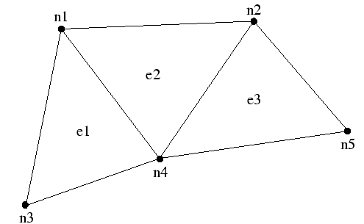
Serial FEM Mesh
Element | Surrounding Nodes
E1 | N1 | N3 | N4
E2 | N1 | N2 | N4
E3 | N2 | N4 | N5

Slide 144
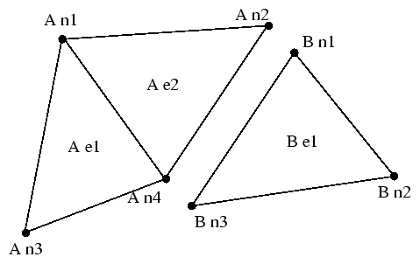
Partitioned Mesh
Element | Surrounding Nodes
E1 | N1 | N3 | N4
E2 | N1 | N2 | N3
Element | Surrounding Nodes
E1 | N1 | N2 | N3
Shared Nodes
A | B
N2 | N1
N4 | N3

Slide 145
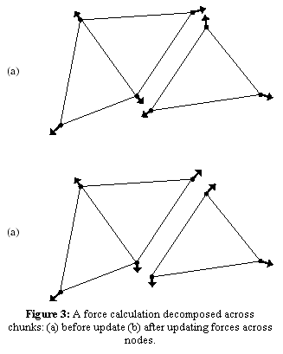
FEM Mesh: Node Communication
Summing forces from other processors only takes one call:
FEM_Update_field
Similar call for updating ghost regions

Slide 146
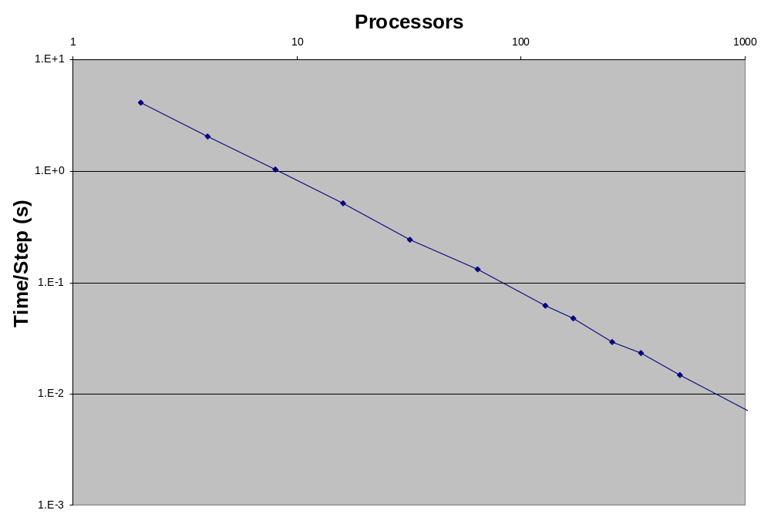
Scalability of FEM Framework

Slide 147
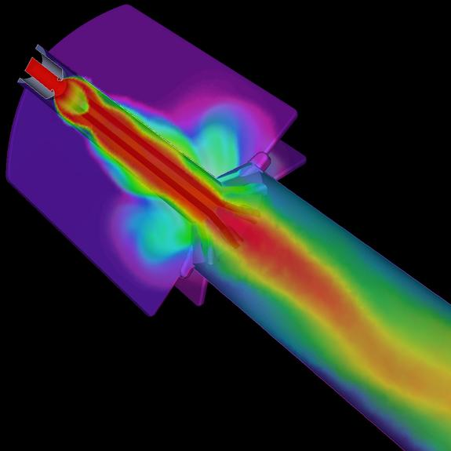
FEM Framework Users: CSAR
Rocflu fluids solver, a part of GENx
Finite-volume fluid dynamics code
Uses FEM ghost elements
Author: Andreas Haselbacher
Robert Fielder, Center for Simulation of Advanced Rockets

Slide 148
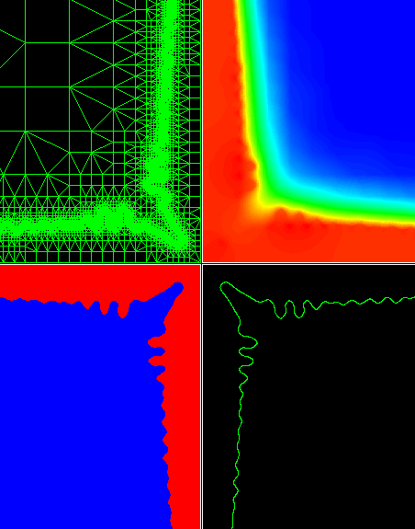
FEM Framework Users: DG
Dendritic Growth
Simulate metal solidification process
Solves mechanical, thermal, fluid, and interface equations
Implicit, uses BiCG
Adaptive 3D mesh
Authors: Jung-ho Jeong, John Danzig

Slide 149
Who uses it?

Slide 150
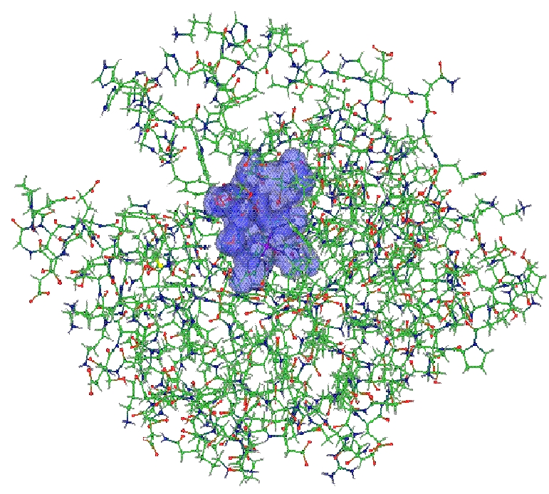
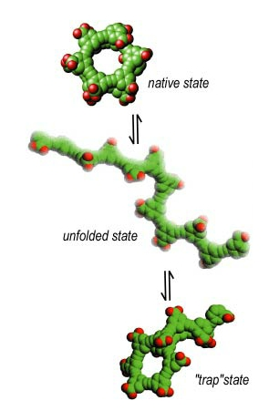
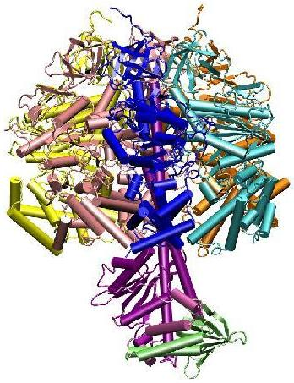
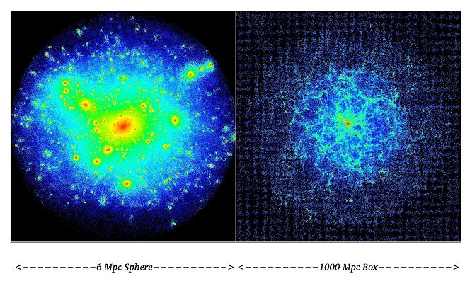
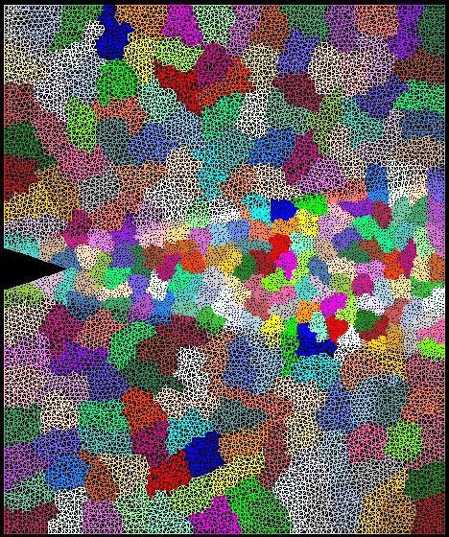
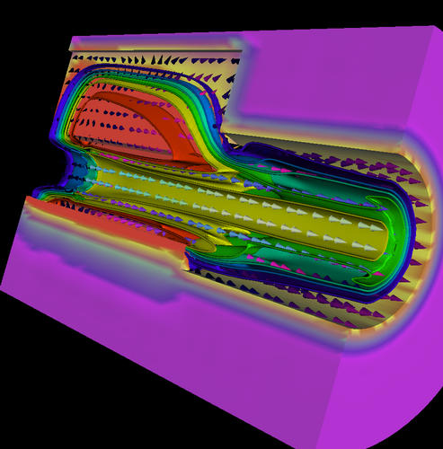
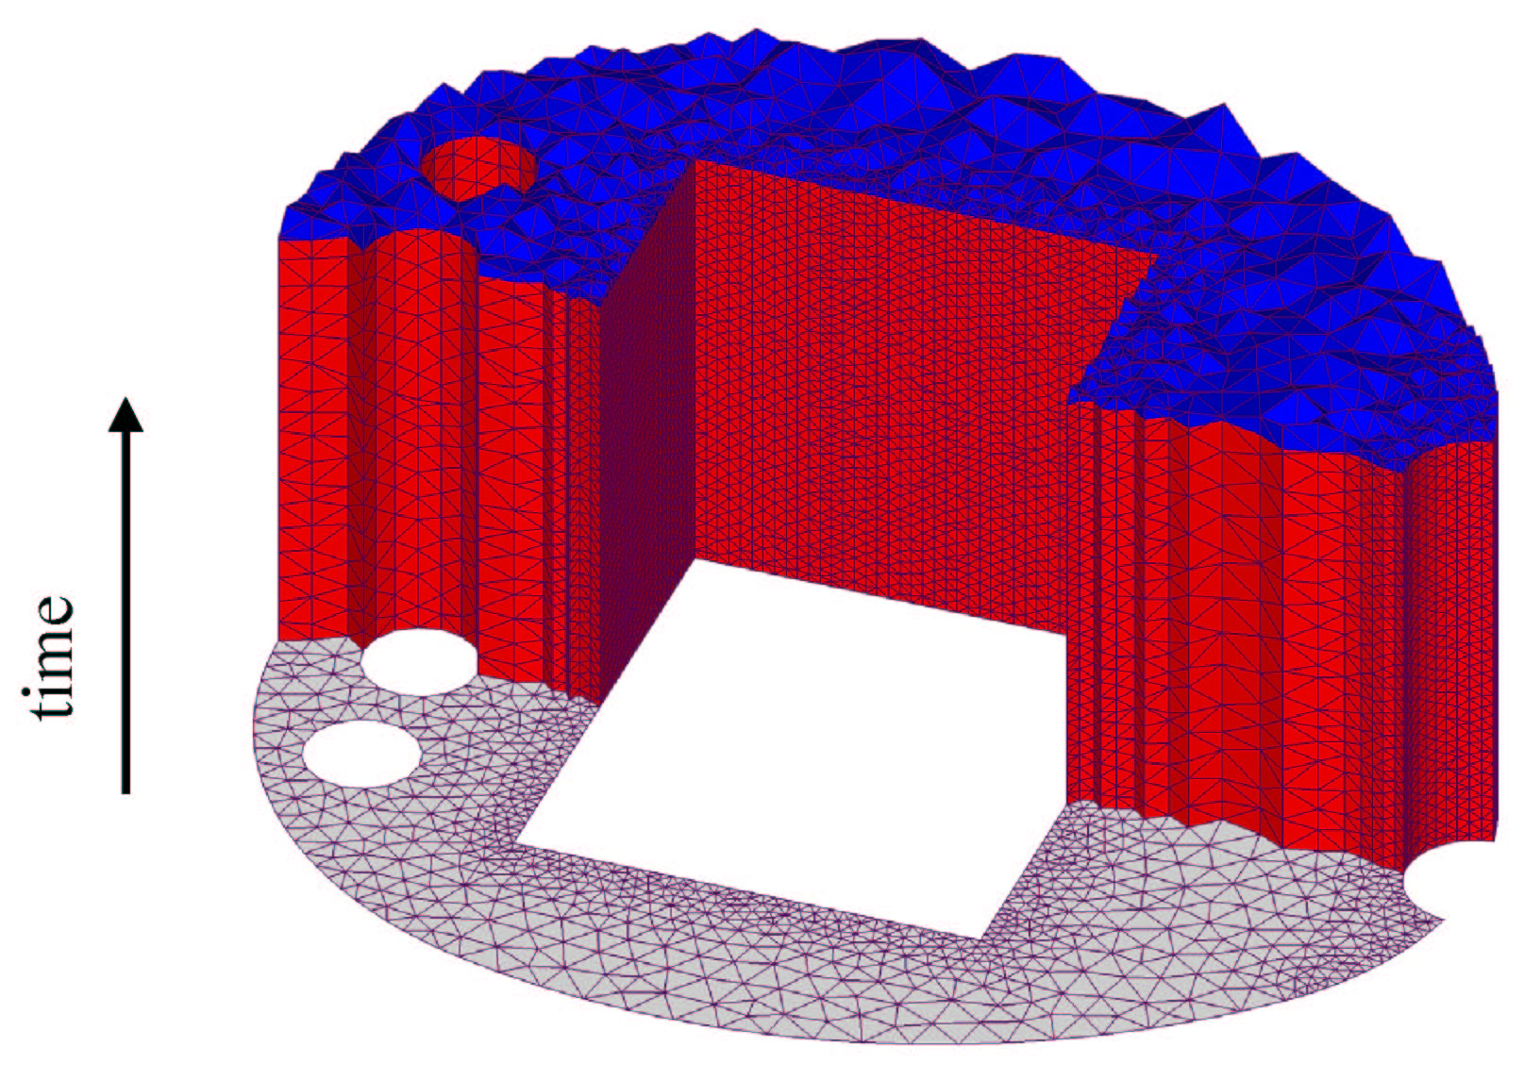
Enabling CS technology of parallel objects and intelligent runtime systems (Charm++ and AMPI) has led to several collaborative applications in CSE
Quantum Chemistry (QM/MM)
Protein Folding
Molecular Dynamics
Computational Cosmology
Parallel Objects,
Adaptive Runtime System
Libraries and Tools
Crack Propagation
Space-time meshes
Dendritic Growth
Rocket Simulation

Slide 151
Some Active Collaborations
Biophysics: Molecular Dynamics (NIH, ..)
  Long standing, 91-, Klaus Schulten, Bob Skeel
  Gordon bell award in 2002,
  Production program used by biophysicists
Quantum Chemistry (NSF)
  QM/MM via Car-Parinello method +
  Roberto Car, Mike Klein, Glenn Martyna, Mark Tuckerman,
  Nick Nystrom, Josep Torrelas, Laxmikant Kale
Material simulation (NSF)
  Dendritic growth, quenching, space-time meshes, QM/FEM
  R. Haber, D. Johnson, J. Dantzig, +
Rocket simulation (DOE)
  DOE, funded ASCI center
  Mike Heath, +30 faculty
Computational Cosmology (NSF, NASA)
  Simulation:
  Scalable Visualization:

Slide 152
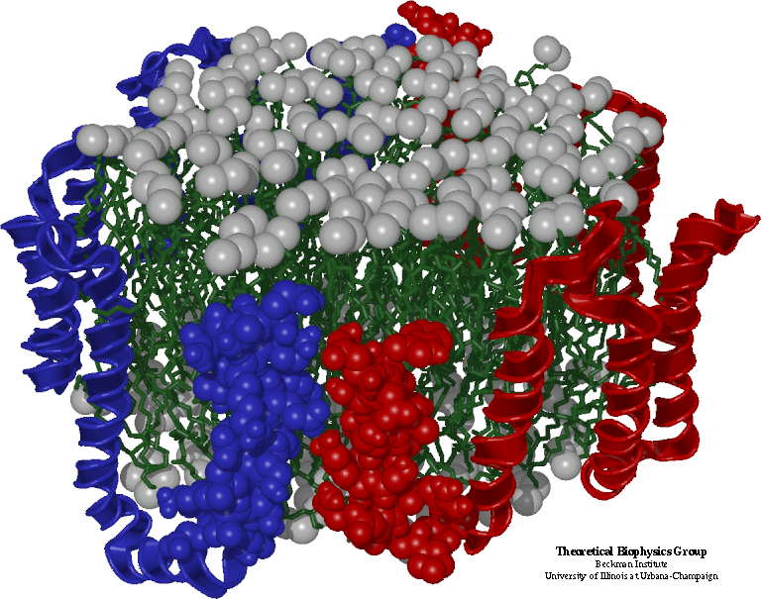
Molecular Dynamics in NAMD
Collection of [charged] atoms, with bonds
  Newtonian mechanics
  Thousands of atoms (1,000 - 500,000)
  1 femtosecond time-step, millions needed!
At each time-step
  Calculate forces on each atom
    Bonds:
    Non-bonded: electrostatic and van der Waal’s
      Short-distance: every timestep
      Long-distance: every 4 timesteps using PME (3D FFT)
      Multiple Time Stepping
  Calculate velocities and advance positions
Gordon Bell Prize in 2002
Collaboration with K. Schulten, R. Skeel, and coworkers

Slide 153
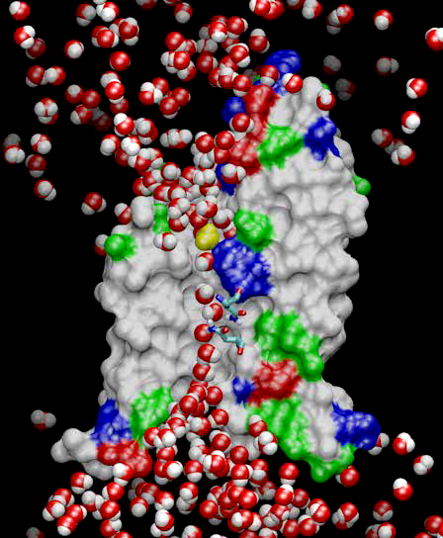
NAMD: A Production MD program
NAMD
Fully featured program
NIH-funded development
Distributed free of charge (~5000 downloads so far)
Binaries and source code
Installed at NSF centers
User training and support
Large published simulations (e.g., aquaporin simulation at left)

Slide 154

CPSD: Dendritic Growth
Studies evolution of solidification microstructures using a phase-field model computed on an adaptive finite element grid
Adaptive refinement and coarsening of grid involves re-partitioning
Jon Dantzig et al with O. Lawlor and Others from PPL

Slide 155
CPSD: Spacetime Meshing
Collaboration with:
  Bob Haber, Jeff Erickson, Mike Garland, ..
  NSF funded center
Space-time mesh is generated at runtime
  Mesh generation is an advancing front algorithm
  Adds an independent set of elements called patches to the mesh
  Each patch depends only on inflow elements (cone constraint)
Completed:
  Sequential mesh generation interleaved with parallel solution
  Ongoing: Parallel Mesh generation
  Planned: non-linear cone constraints, adaptive refinements

Slide 156
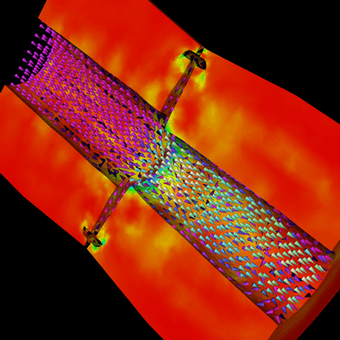
Rocket Simulation
Dynamic, coupled physics simulation in 3D
Finite-element solids on unstructured tet mesh
Finite-volume fluids on structured hex mesh
Coupling every timestep via a least-squares data transfer
Challenges:
  Multiple modules
  Dynamic behavior: burning surface, mesh adaptation
Robert Fielder, Center for Simulation of Advanced Rockets
Collaboration with M. Heath, P. Geubelle, others

Slide 157
Computational Cosmology
N body Simulation
  N particles (1 million to 1 billion), in a periodic box
  Move under gravitation
  Organized in a tree (oct, binary (k-d), ..)
Output data Analysis: in parallel
  Particles are read in parallel
  Interactive Analysis
Issues:
  Load balancing, fine-grained communication, tolerating communication latencies.
  Multiple-time stepping
Collaboration with T. Quinn, Y. Staedel, M. Winslett, others

Slide 158

QM/MM
Quantum Chemistry (NSF)
  QM/MM via Car-Parinello method +
  Roberto Car, Mike Klein, Glenn Martyna, Mark Tuckerman,
  Nick Nystrom, Josep Torrelas, Laxmikant Kale
Current Steps:
  Take the core methods in PinyMD (Martyna/Tuckerman)
  Reimplement them in Charm++
  Study effective parallelization techniques
Planned:
  LeanMD (Classical MD)
  Full QM/MM
  Integrated environment

Slide 159
Conclusions

Slide 160
Conclusions
AMPI and Charm++ provide a fully virtualized runtime system
  Load balancing via migration
  Communication optimizations
  Checkpoint/restart
Virtualization can significantly improve performance for real applications

Slide 161
Thank You!
Free source, binaries, manuals, and more information at:
http://charm.cs.uiuc.edu/
Parallel Programming Lab
at University of Illinois

