Slide 1
Bigsim Tutorial
Gengbin Zheng
Eric Bohm

Slide 2
Outline
Overview
BigSim Emulator
BigSim Simulator
Using BigSim to Estimate Application Performance

Slide 3
BigSim
Built on Charm++
Object-based processor virtualization
  Virtualized execution environment that allows running large-scale simulations on small-scale systems
Runs Charm++ and AMPI applications at large scale
Using BigSim to Estimate Application Performance

Slide 4
Performance Prediction
Two components:
  Time to execute blocks of sequential, computation code
    SEBs = Sequential Execution Blocks
  Communication time based on a particular network topology
Using BigSim to Estimate Application Performance

Slide 5
BigSim Components
Emulator
  Generates traces that capture SEB execution times, dependencies, and messages
Simulator (BigNetSim)
  Trace-driven
  PDES (Parallel Discrete Event Simulation)
  Calculates message timing based on the specified network model
Using BigSim to Estimate Application Performance

Slide 6
BigSim Architecture
Performance visualization (Projections), Link utilization stats, Terminal output‏
BigSim Simulator
POSE
Simulation trace logs
AMPI Runtime
Charm++ Runtime
BigSim Emulator
Charm++/AMPI applications
Using BigSim to Estimate Application Performance

Slide 7
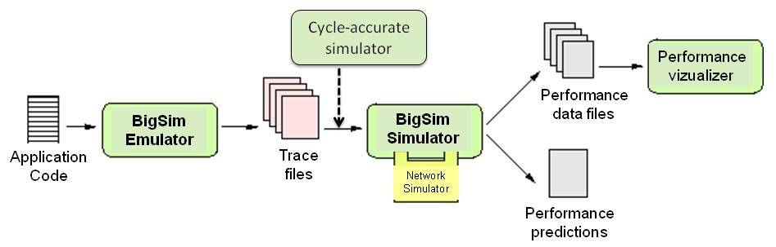
BigSim: Performance Analysis at Extreme Scale
BigSim Components:
  Two main phases: Emulation, Simulation
  Optional: Graphical performance visualization
  Ex: use 8K processors to emulate 256K processors, simulate on a few processors
BigSim
Notes:
Hypercubes
N-dimensional
Hybrid
Topology at the level of a node

Slide 8
Limitations
BigSim does not:
  Include cycle-accurate/instruction-level simulation
    But can be integrated with external simulators
  Predict cache and virtual memory effects
  Model interference
    Operating system
    External job
  Model non-deterministic applications
Using BigSim to Estimate Application Performance

Slide 9
Outline
Overview
BigSim Emulator
BigSim Simulator
Using BigSim to Estimate Application Performance

Slide 10
Emulator
Implemented on Charm++
  Libraries link to user application
Virtualized execution environment
  Each physical processor emulates multiple target processors
  Be careful of increased memory footprint
  Efficiencies realized
    NAMD: virt. ratio 128 => 7x memory, 19x run time
Using BigSim to Estimate Application Performance

Slide 11
Using the Emulator (64-Bit Linux Example)
Convert MPI application to AMPI (or use a Charm++ application)
Install emulator
  Download Charm++
    http://charm.cs.uiuc.edu/download/
  Compile Charm++/AMPI with “bigemulator” option
    ./build AMPI net-linux-x86_64 bigemulator -j8 -O
    This builds Charm++ and emulator libraries under net-linux-x86_64-bigemulator (work in this directory)
Using BigSim to Estimate Application Performance

Slide 12
Using the Emulator (continued)
Set parameters in a config file
  Note: the same topology (x, y, z dimensions and number of worker threads) will be used by the simulator
    wth = # worker threads = # cores / node
Compile the application to be emulated in the <net-layer>-bigemulator directory
Run the application with the config file via +bgconfig <config file>
Using BigSim to Estimate Application Performance

Slide 13
Example – AMPI Cjacobi3D
cd charm/net-linux-x86_64-bigemulator/examples/ampi/Cjacobi3D
make
Modify config file bg_config as desired:
  x 4
  y 2
  z 2
  Cth 1
  wth 8
  stacksize 10000
  timing walltime
  #timing bgelapse
  #timing counter
  cpufactor 1.0
  fpfactor 5e-7
  traceroot .
  log yes
  correct no
  network bluegene
  #projections 2,4-8
Using BigSim to Estimate Application Performance

Slide 14
Example – AMPI Cjacobi3D (continued)
Run emulation of 8 target processors (virtual processors) on 2 physical processors
  ./charmrun +p2 ./jacobi 2 2 2 +vp8 +bgconfig bg_config
As long as “log yes” is specified in the config file, 3 trace files will be written:
  bgTrace – summary file
  bgTrace0 – trace file for the 4 vps on processor 0
  bgTrace1 – trace file for the 4 vps on processor 1
Using BigSim to Estimate Application Performance

Slide 15
LogAnalyzer
Tool for analyzing emulator traces
Run as ./LogAnalyzer –i (interactive) or ./LogAnalyzer –c <choice #> (good for scripting)
Options:
  Display time line lengths
  Convert traces to ASCII files
  Display the number of messages sent and received by each target processor
  Display the total execution time of all events on each target processor
  Display the number of packets sent by each target processor
  Execution time estimation (experimental)
Using BigSim to Estimate Application Performance

Slide 16
Skip Points
Add to actual application code at places where control is completely given back to processor 0 (e.g., after allreduce, barrier, load balancing, etc.)
  BgSetStartEvent()
Skip points marked in trace files
Simulator can execute between skip points
Uses:
  Bypass start-up sequence
  Simulate only one application step
Using BigSim to Estimate Application Performance

Slide 17
Projections
Visual tool for analyzing program runs
Link the emulated application with –tracemode projections to get projections traces
Can be modified by the simulator
Using BigSim to Estimate Application Performance

Slide 18
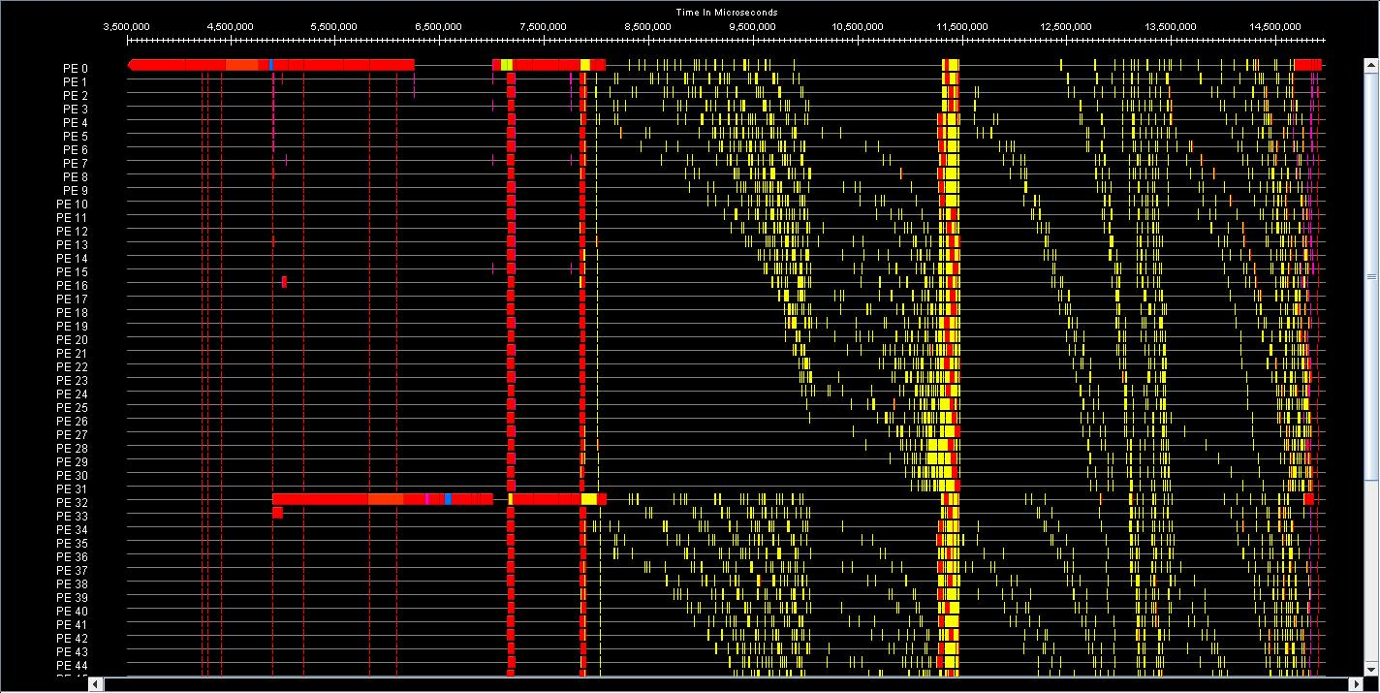
Projections Example – MPI AlltoAll Timeline
Using BigSim to Estimate Application Performance

Slide 19
Emulator – Other Features
Different levels of fidelity available for predicting performance
  Wallclock time with cpu scaling factor (already discussed)
  Manually elapse time with BgElapse() calls
  Performance counters
  Instruction-level/cycle-accurate simulation
  Model-based (time most-used functions and iterpolate to create model)
Out-of-core execution when emulation won’t fit in main memory
Record/replay subset of traces
Using BigSim to Estimate Application Performance

Slide 20
Outline
Overview
BigSim Emulator
BigSim Simulator
Using BigSim to Estimate Application Performance

Slide 21
Simulator (BigNetSim)
PDES simulator built on top of Charm++
  POSE framework
  BigSim trace API
Run BigNetSim on emulator traces to get final run results for a particular network model
Using BigSim to Estimate Application Performance

Slide 22

BigNetSim Build Flow
Download and compile charm
Compile POSE
Compile bigsim
Download BigNetSim
Compile BigNetSim
Run simulator
Output
Charm++ Workshop 2009

Slide 23

Download and compile charm (if not done already)
Download the latest version of charm from the PPL archives:
http://charm.cs.uiuc.edu/download/downloads.shtml
Compile charm
  cd charm
  ./build charm++ net-linux
Charm++ Workshop 2009

Slide 24

Compile POSE
cd charm
./build pose net-linux
options are set in pose_config.h
  stats enabled by POSE_STATS_ON=1
  user event tracing TRACE_DETAIL=1
  more advanced configuration options
    speculation
    checkpoints
    load balancing
Charm++ Workshop 2009

Slide 25
Compile bigsim
cd charm/net-linux/tmp
make bigsim
Charm++ Workshop 2009

Slide 26

Download BigNetSim
Download latest revision from repository:
  svn co https://charm.cs.uiuc.edu/svn/repos/BigNetSim
Directory structure: BigNetSim/trunk/
  BlueGene/ RedStorm/ and others - network models
  SimpleLatency/ - Simple Latency Model
  Topology/ Routing/ InputVcSelection/ OutputVcSelection/ - network configuration choices
  Main/ - main simulation files
  tools/ - tools directory
  tmp/ - working directory created during build
Charm++ Workshop 2009

Slide 27
Compile BigNetSim
Fix BigNetSim/trunk/Makefile.common so CHARMBASE points to your charm directory
For the Simple Latency Model:
  cd BigNetSim/trunk/SimpleLatency
  For parallel simulator:
  make
  For sequential simulator (runs only on 1 simulating processor):
  make SEQUENTIAL=1
Charm++ Workshop 2009

Slide 28
Run Simulator
cd BigNetSim/trunk/tmp
Copy bgTrace files into /tmp directory
For parallel build, run with:
  ./charmrun +p4 bigsimulator -lat 1 -bw 1
For sequential build, run with:
  ./bigsimulator -lat 1 -bw 1
Charm++ Workshop 2009

Slide 29
Simple Latency Model vs. Blue Waters Model
Simple Latency includes processors and nodes and implements the network with an equation:
  lat + (N / bw) + [cpp * (N / psize)]
    lat = latency in μs
    bw = bandwidth in GB/sec
    cpp = cost per packet in μs
    psize = packet size in bytes
    N = number of bytes sent
Blue Waters includes processors, nodes, Torrents, and links between the Torrents
  Currently NDA
Using BigSim to Estimate Application Performance

Slide 30
Command-Line Arguments – Simple Latency
Bandwidth and latency must be specified:
  -bw <double> Link bandwidth in GB/s
  -lat <double> Link latency in μs
Other optional arguments:
  -help Displays all available arguments
  -cpp <double> Cost per packet in μs
  -psize <int> Packet size in bytes
  -bw_in <double> Intra-node bandwidth in GB/s
    Defaults to -bw value if not specified
  -lat_in <double> Intra-node latency in μs
    Defaults to 0.5μs if not specified
Using BigSim to Estimate Application Performance

Slide 31
Command-Line Arguments – Simple Latency (continued)
  -check Checks for unexecuted events at the end of the
  simulation
  -cpufactor <double> A constant by which SEB execution times are
  multiplied; defaults to 1.0
  -debuglevel <0|1> 0: no debug statements
  1: high-level debug statements and summary info
  -projname <string> Sets the name of the projections logs that will be
  corrected based on network simulation
  -skip_start <int> Sets the skip point at which simulation execution begins
  -skip_end <int> Sets the skip point at which simulation execution ends
  -tproj Generate projections logs based only on network
  simulation
Using BigSim to Estimate Application Performance

Slide 32
BigNetSim Output – Terminal (Text)
BgPrintf(char *) statements
  Added to actual application code
  “%f” in function call argument converted to committed time during simulation
GVT = Global Virtual Time
  Final simulation virtual time expressed in GVT ticks
  1 GVT tick = 1 ns for the provided binaries
Link utilization statistics
Using BigSim to Estimate Application Performance

Slide 33
BigNetSim Output – Terminal (Text) – Example
Charm++: standalone mode (not using charmrun)
Charm++> Running on 1 unique compute nodes (8-way SMP).
================= Simulation Configuration =================
Production version: 1.0 (10/13/2010)
Simulation start time: Fri Oct 15 13:11:09 2010
Number of physical PEs: 1
POSE mode: Sequential
Network model: Blue Waters
...
============================================================
Construction phase complete
Initialization phase complete
Info> invoking startup task from proc 0 ...
Info> Starting at the beginning of the simulation
Info> Running to the end of the simulation
Entire first pass sequence took about 18.532318 seconds
[0:user_code] #MILC# - WHILE Loop Iterarion Starting at 0.509469
[0:user_code] #MILC# - LL-Fat Starting at 0.510801
...
Sequential Endtime Approximation: 906988512
Final link stats [Node 0, Channel 0, LL Link]: ovt: 906953211, utilization time: 257562, utilization %: 0.028397, packets sent: 2290 gvt=906988512
Final link stats [Node 0, Channel 11, LR Link]: ovt: 906953211, utilization time: 631426, utilization %: 0.069618, packets sent: 1827 gvt=906988512
1 PE Simulation finished at 74.104628.
Program finished.
Using BigSim to Estimate Application Performance

Slide 34
BigNetSim Output – Projections
Copy emulation Projections logs and sts file into directory with executable
  Two ways to use:
    Command-line parameter: -projname <name>
      Creates a new set of logs by updating the emulation logs
      Assumes emulation Projections logs are: <name>.*.log
      Output: <name>-bg.*.log
      Disadvantage: emulation Projections overhead included
    Command-line parameter: -tproj
      Creates a new set of logs from the trace files, ignoring the emulation logs
      Must first copy <name>.sts file to tproj.sts
      Output: tproj.*.log
      Advantage: no emulation Projections overhead included
Using BigSim to Estimate Application Performance

Slide 35
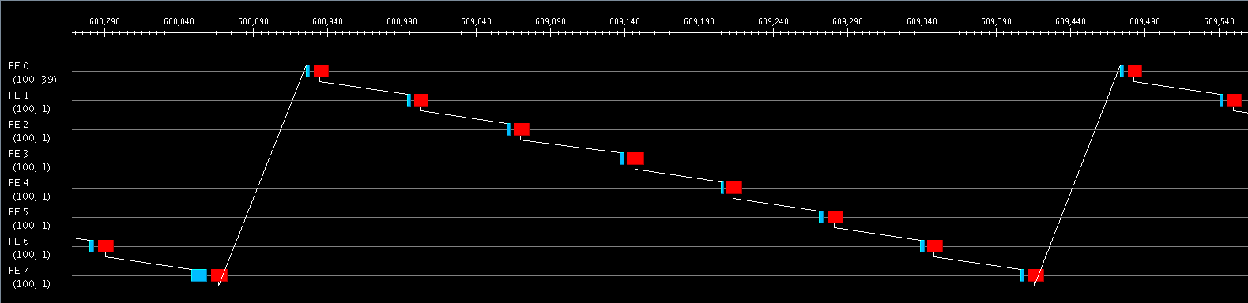
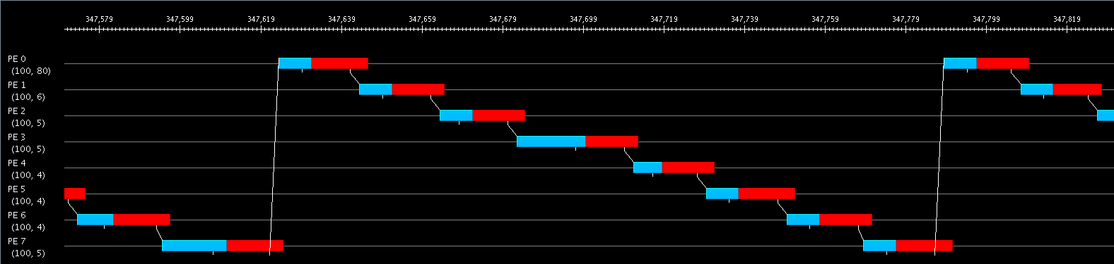
Projections – Ring Example
Emulation
Simulation: -lat 1 (latency = 1μs) generated with -tproj
Using BigSim to Estimate Application Performance

Slide 36
BigNetSim Output – Link Stat and Contention Traces (experimental)
Enabled on the command line at run time
Placed in a unique folder named link_traces_<simulation start time>
May significantly increase run time and memory footprint
LinkStatTraceAnalyzer tool examines link stat traces for links with high utilization and contention
  Writes reports listing links in order from most to least utilized
Using BigSim to Estimate Application Performance

Slide 37
BigNetSim Validation
Network traffic generator tests of the BigNetSim Blue Waters network model give simulation results within a couple percent of those of IBM’s hardware simulator
Using BigSim to Estimate Application Performance

Slide 38
BigNetSim Performance
Examples of sequential simulator performance on Blue Print
Simulation | Memory Footprint Estimate (GB) |  | Startup Time (hours) |  | Execution Time (hours) |  | Total Run Time (hours)
 | Sim Lat | BW | Sim Lat | BW | Sim Lat | BW | Sim Lat | BW
4k-VP MILC | 2.3 | 2.6 | 0.72 | 0.73 | 3.08 | 5.38 | 3.80 | 6.11
256k-VP 3D Jabobi (10x10x10 grid, 3 iters) | 17.5 | 18.3 | 0.51 | 0.51 | 0.47 | 1.50 | 0.98 | 2.01
256k-VP NAMD (1M atoms, 8 iters, skip startup) | 14.9 | 15.9 | 0.49 | 0.47 | 0.52 | 3.81 | 1.01 | 4.28
Parallel performance is comparable to sequential but does not scale well yet outside a single node on Blue Print
Using BigSim to Estimate Application Performance

Slide 39
BigNetSim – Other Features
Other network models (e.g., BlueGene)
Transceiver (traffic pattern generator) for testing network models without traces
Checkpoint-to-disk to allow restart if hardware on which BigNetSim is running goes down
Load balancing
Using BigSim to Estimate Application Performance

Slide 40
Additional Resources
BigSim manuals:
  http://charm.cs.uiuc.edu/manuals/
Recent Charm++ Workshop tutorials and talks
  2008 BigSim tutorial (bottom of page)
    http://charm.cs.illinois.edu/workshops/charmWorkshop2008/slides.html
  2009 BigSim tutorial (bottom of page)
    http://charm.cs.uiuc.edu/workshops/charmWorkshop2009/program.html
  2010 BigSim talk (near top of page)
    http://charm.cs.uiuc.edu/charmWorkshop/program.php
E-mail PPL for help: ppl@cs.uiuc.edu
Using BigSim to Estimate Application Performance

