Slide 1


Charm++ RTS Feature Overview
Presented by: Eric Bohm
http://charm.cs.uiuc.edu
Parallel Programming Laboratory
Department of Computer Science
University of Illinois at Urbana Champaign

Slide 2
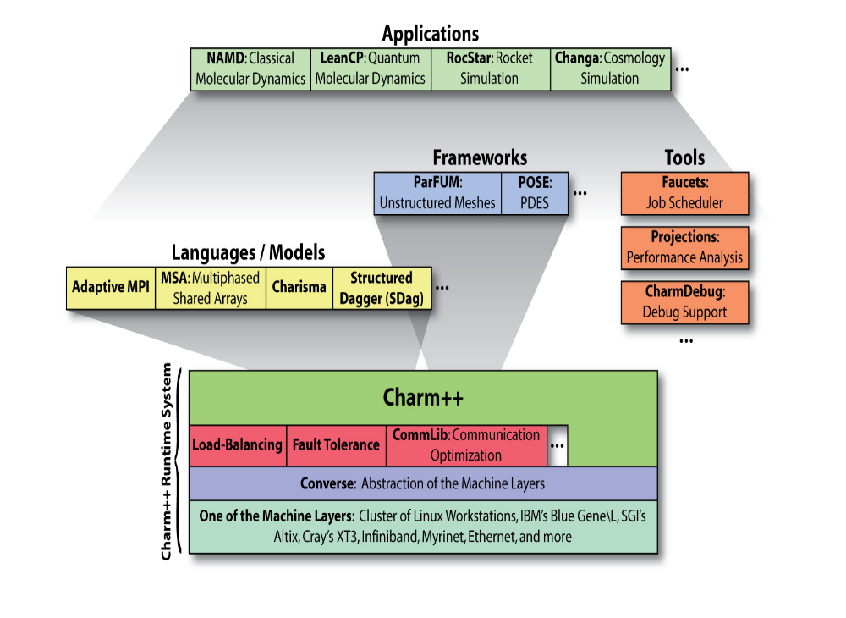

Slide 3
Portability
Cray XT (3|4|5)
  Cray XT6 in development
BlueGene (L|P)
  BG/Q in development
BlueWaters
  LAPI
  PAMI in development
SGI/Altix
Clusters
  X86, X86_64, Itanium
  MPI, UDP, TCP, LAPI, Infiniband, Myrinet, Elan, SHMEM
Accelerators
  Cell
  GPGPU

Slide 4
Load balancing for large machines: I
Centralized balancers achieve best balance
  Collect object-communication graph on one processor
  But won’t scale beyond tens of thousands of nodes
Fully distributed load balancers
  Avoid bottleneck but… Achieve poor load balance
  Not adequately agile
Hierarchical load balancers
  Careful control of what information goes up and down the hierarchy can lead to fast, high-quality balancers
Need for a universal balancer that works for all applications
12/13/10
Charm Tutorial 2010 CINS

Slide 5
Load balancing for large machines: II
Interconnection topology starts to matter again
  Was hidden due to wormhole routing etc.
  Latency variation is still small
  But bandwidth occupancy is a problem
Topology aware load balancers
  Some general heuristic have shown good performance
  But may require too much compute power
  Also, special-purpose heuristic work fine when applicable
  Still, many open challenges
12/13/10
Charm Tutorial 2010 CINS

Slide 6
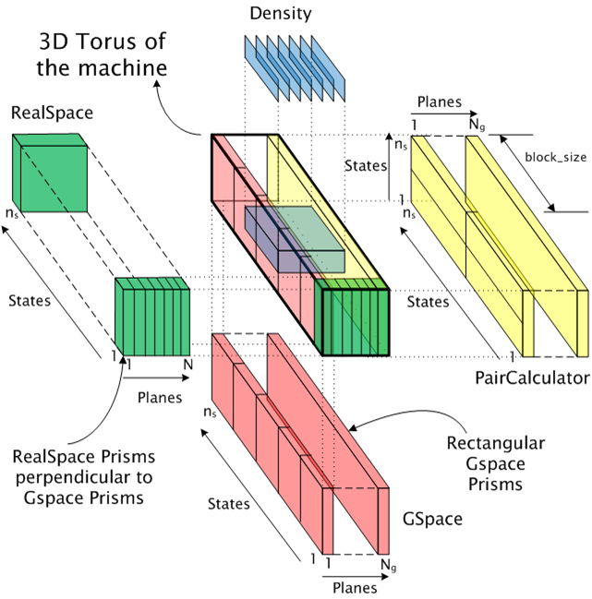
Topology aware mapping of objects
12/13/10
Charm Tutorial 2010 CINS

Slide 7
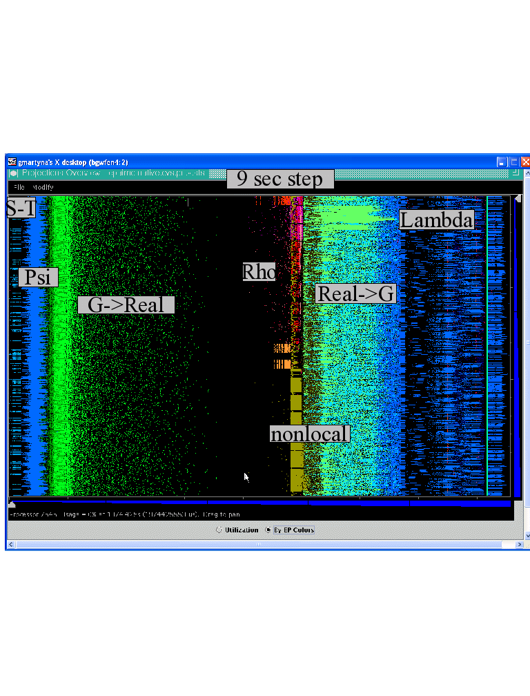
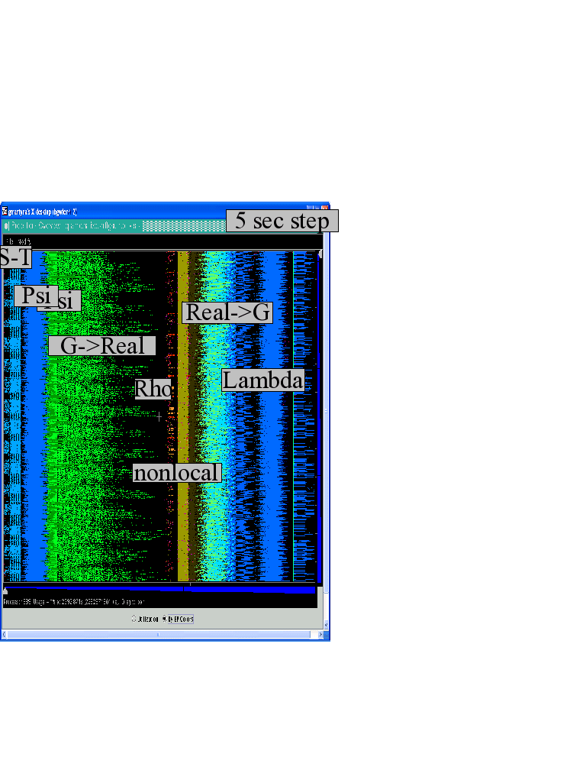
Improvements wrought by network topological aware mapping of computational work to processors
The simulation of the right panel, maps computational work to processors taking the network connectivity into account while the left panel simulation does not. The “black’’ or idle time processors spent waiting for computational work to arrive on processors is significantly reduced at left. (256waters, 70R, on BG/L 4096 cores)
12/13/10
Charm Tutorial 2010 CINS

Slide 8
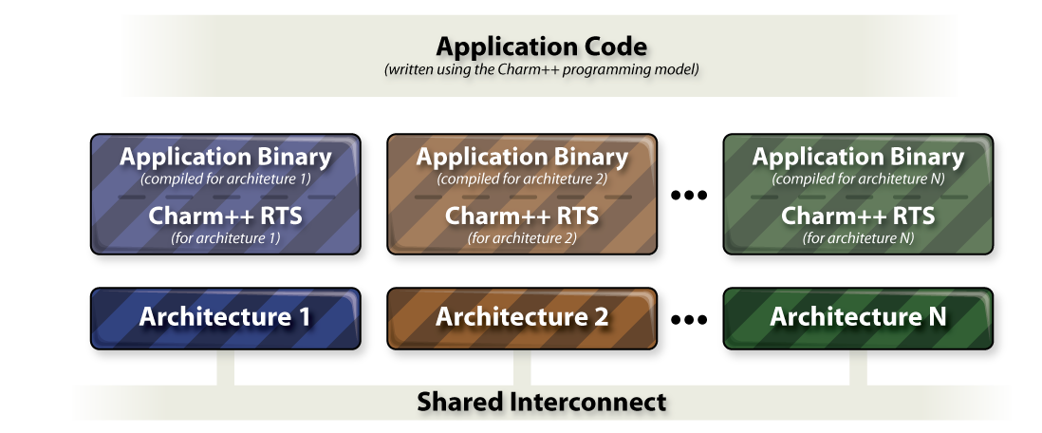
Heterogeneous Computing

Slide 9
Heterogeneous Computing
Cell Offload API
  [accel] entry method
  Schedules work for SPUs
  Automatic DMA overlap
  Completion
    Callback
    Or thread activation
  Single program can use
    x86 hosts
    PPC hosts
    Playstations
    Cell Blades.
Hybrid API for CUDA
  Asynchronous execution
  Work agglomeration
  Multiple kernels
  Hybrid execution on CPU+GPU
  Schedule kernel execution on GPU
  Completion callback

Slide 10
Fault Tolerance
Automatic Checkpointing
  Migrate objects to disk
  In-memory checkpointing as an option
  Automatic fault detection and restart
“Impending Fault” Response
  Migrate objects to other processors
  Adjust processor-level parallel data structures
Scalable fault tolerance
  When a processor out of 100,000 fails, all 99,999 shouldn’t have to run back to their checkpoints!
  Sender-side message logging
  Latency tolerance helps mitigate costs
  Parallel restart: Restart can be speeded up by spreading out objects from failed processor
  Can make progress even when MTBF < checkpoint period!
12/13/10
Charm Tutorial 2010 CINS

Slide 11
Converse Client Server
Dynamic Interaction with running application
  Requests in client application
  Appear as messages in parallel application
  Handler can return data in any form
  Requests can submit data or code
Uses
  [python] methods
  Nchilada visualizer
  Charm Debugger
  LiveViz API
Client API portability
  Python
  Java
  C/C++, etc

Slide 12
Projections
Tool (in Java) to analyze performance
Usage:
  compile with “-tracemode projections”
  the program will create one file per processor with all the performance measurements
Light usage:
  compile with “-tracemode summary”

Slide 13
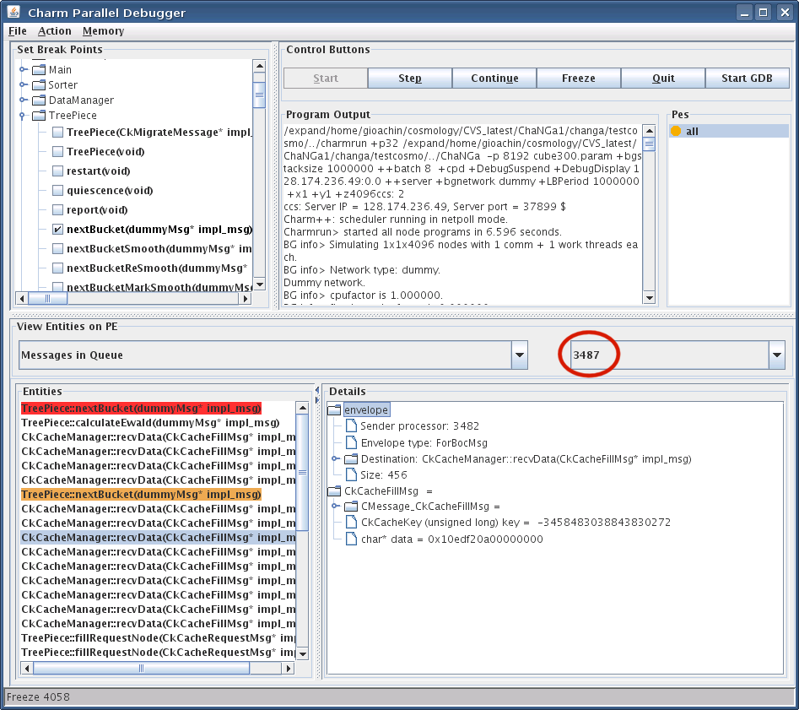
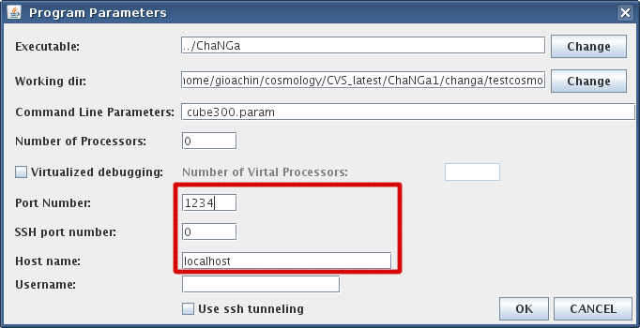
CharmDebug
Compilation
  Charm++ with “-g”
  Application “-debug”

Slide 14
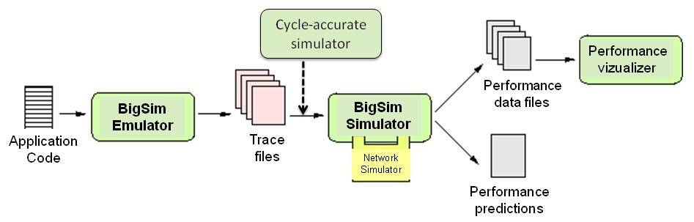
BigSim: Performance Analysis at Extreme Scale
BigSim Components:
  Two main phases: Emulation, Simulation
  Optional: Graphical performance visualization
  Ex: use 8K processors to emulate 256K processors, simulate on a few processors
BigSim
Notes:
Hypercubes
N-dimensional
Hybrid
Topology at the level of a node

Slide 15
Raising the Level of Abstraction
What we have seen so far, will help:
  by automating resource management, FT, ..
But: parallel interactions are still low-level
  Programmer has to spend considerable efforts in spelling out interactions, and data decompositions, in particular
Clearly, we need new programming models
12/13/10
Charm Tutorial 2010 CINS

Slide 16
Raising the Level of Abstraction
Two metapoints:
  Need for exploration (don’t standardize too soon)
  Interoperability
  Allows a “beachhead” for novel paradigms
  Long-term: Allow each module to be coded using the paradigm best suited for it
  Interoperability requires concurrent composition
  This may require message-driven execution
12/13/10
Charm Tutorial 2010 CINS

Slide 17
Simplifying Parallel Programming
By giving up completeness!
  A paradigm may be simple, but
  not suitable for expressing all parallel patterns
  yet, if it can cover a significant classes of patterns (applications, modules), it is useful
  A collection of incomplete models, backed by a few complete ones, will do the trick
Our own examples: both outlaw non-determinism
  Multiphase Shared Arrays (MSA): restricted shared memory
  LCPC ‘04
  Charisma: Static data flow among collections of objects
  LCR’04, HPDC ‘07
12/13/10
ADSC symposium

Slide 18
MSA: Multiphase Shared Arrays
Observations:
General shared address space abstraction is complex
Certain special cases are simple, and cover most uses
In the simple model:
A program consists of
  A collection of Charm threads, and
  Multiple collections of data-arrays
  Partitioned into pages (user-specified)
Each array is in one mode at a time
  But its mode may change from phase to phase
Modes
  Write-once
  Read-only
  Accumulate
  Owner-computes
C
C
C
C
A
B
12/13/10
Charm Tutorial 2010 CINS

Slide 19
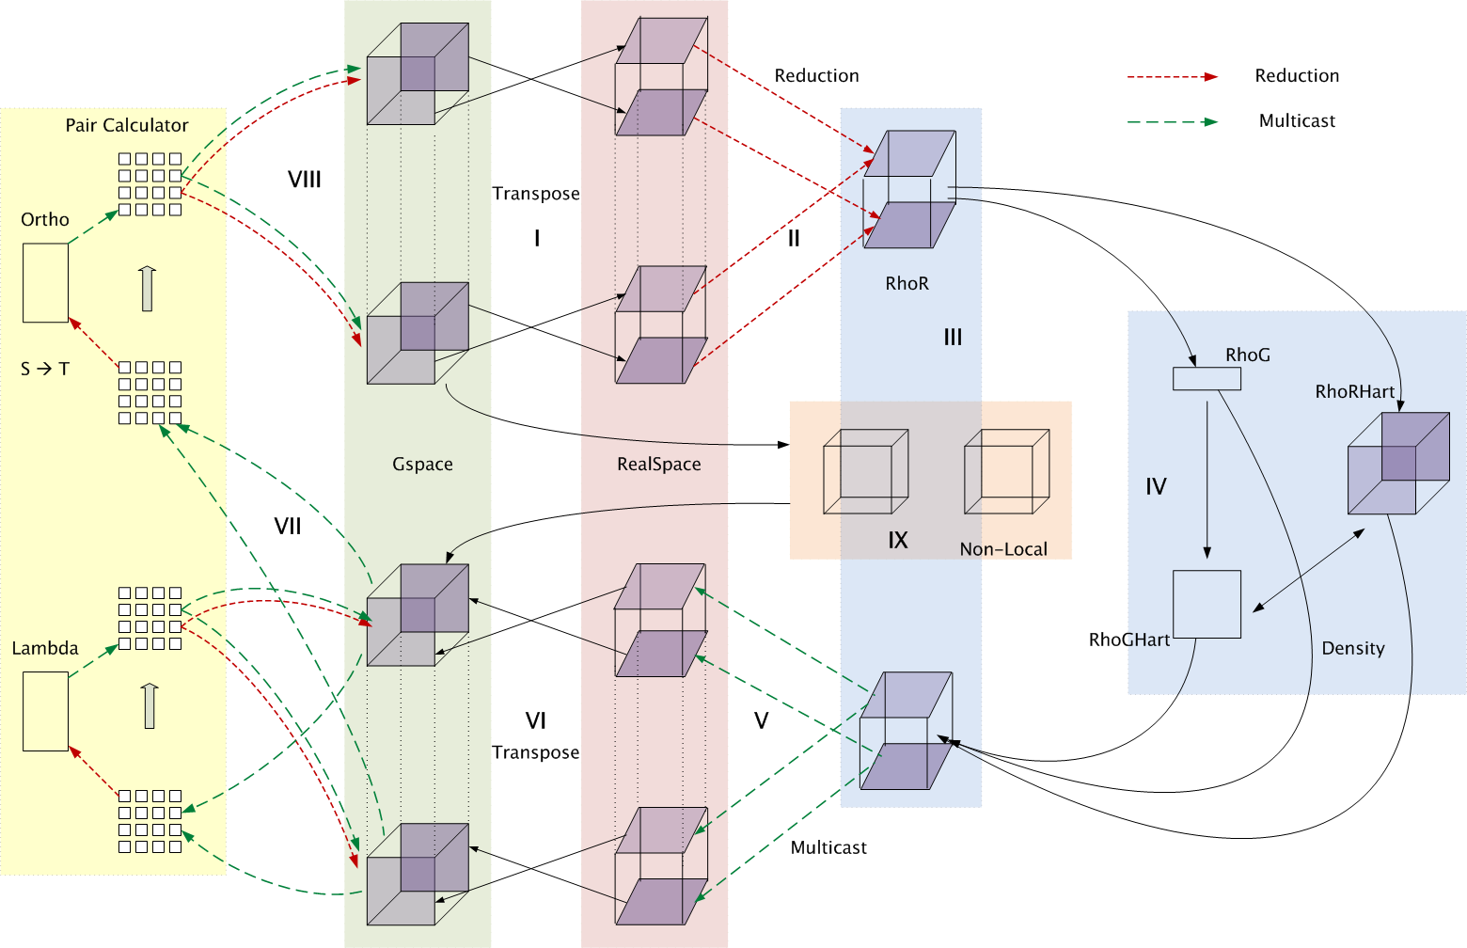
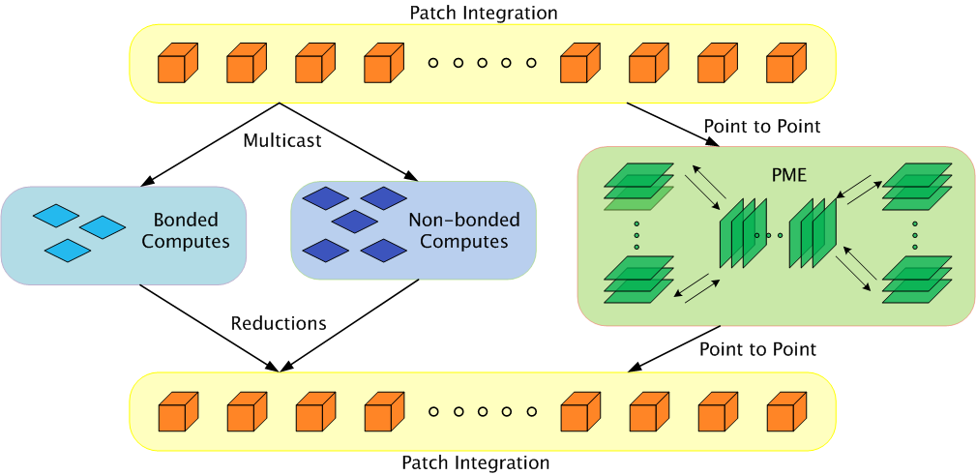
Charisma: Static Data Flow
Observation: many CSE applications or modules involve static data flow in a fixed network of entities
The amount of data may vary from iteration to iteration, but who talks to whom remains unchanged
12/13/10
ADSC symposium
Notes:
User code contains as little parallel control flow as possible, eg. Physics, computation,

Slide 20
Charisma: Sequential-Parallel Separation
parallel
parallel
modules
Program consists of
  Orchestration (.or) code
  Global flow of control and data
  “Physics” code
  Regular C++
  User variables
  Sequential methods
Sequential Modules
12/13/10
Charm Tutorial 2010 CINS
Notes:
User code contains as little parallel control flow as possible, eg. Physics, computation,

Slide 21
Charisma++ example (Simple)
while (e > threshold)
  forall i in J
  <+e, lb[i], rb[i]> := J[i].compute(rb[i-1],lb[i+1]);
12/13/10
Charm Tutorial 2010 CINS

Slide 22
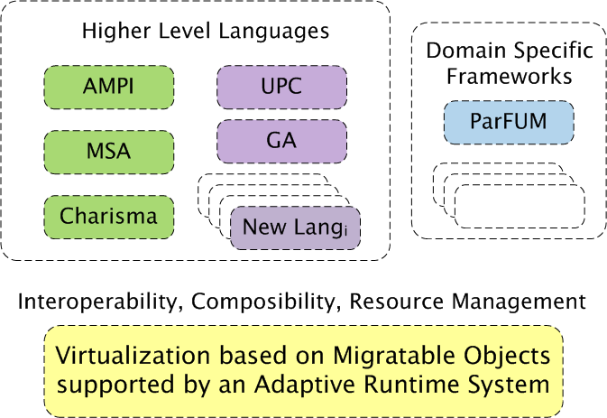
A View of an Interoperable Future
X10
12/13/10
Charm Tutorial 2010 CINS

Slide 23
Summary
Challenges in Resource management
  Decomposition and Compositionality
  Dynamic Load balancing
  Fault Tolerance
  Over-decomposition with Adaptive Runtime System helps
  Scalable Performance analysis, and debugging
  Early performance tuning ( BigSim)
Challenges in Raising the level of abstraction
  Via “Incomplete yet simple” paradigms, and
  domain-specific frameworks
  Supported by an interoperable runtime system
Exciting times ahead
More Info: http://charm.cs.uiuc.edu /
12/13/10
Charm Tutorial 2010 CINS

