Slide 1
Charm++ Basics
Chao Mei

Slide 2
The Charm++ Model
Parallel objects (chares) communicate via asynchronous method invocations (entry methods).
The runtime system maps chares onto processors and schedules execution of entry methods.

Slide 3
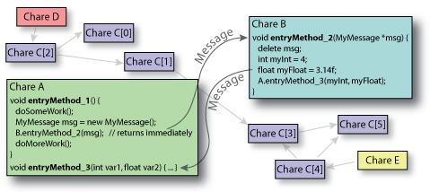
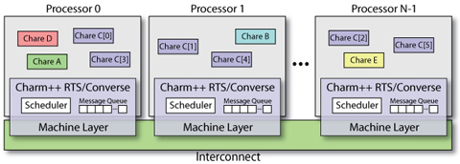
User View vs. System View
User View:
System View:

Slide 4
Architecures
Runs on:
Any machine with MPI installation
Clusters with Ethernet (UDP/TCP)
Clusters with Infiniband
Clusters with accelerators (GPU/CELL)
Windows
…
To install
“./build”

Slide 5
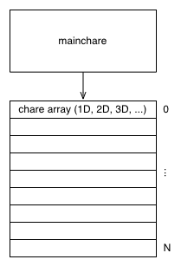
Charm++ Objects
A “chare” is a C++ object with methods that can be remotely invoked
The “mainchare” is the chare where the execution starts in the program
A “chare array” is a collection of chares of the same type
Typically the mainchare will spawn a chare array of workers

Slide 6

Charm++ File Structure
The C++ objects (whether they are chares or not)
Reside in regular .h and .cpp files
Chare objects, messages and entry methods (methods that can be called asynchronously and remotely)
Are defined in a .ci (Charm interface) file
And are implemented in the .cpp file

Slide 7
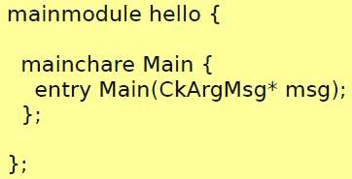
Hello World: .ci file
.ci: Charm Interface
Defines which type of chares are present in the application
At least a mainchare must be set
Each definition is inside a module
Modules can be included in other modules

Slide 8
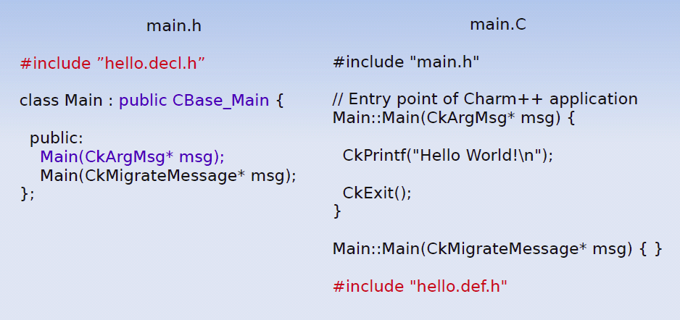
Hello World: the code

Slide 9
CkArgMsg in the Main::Main Method
Defined in charm++
struct CkArgMsg{
int argc;
char **argv;
}

Slide 10
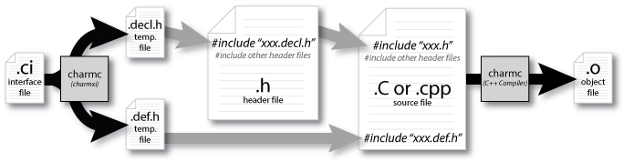
Compilation Process
charmc hello.ci
charmc –o main.o main.C (compile)
charmc –language charm++ -o pgm main.o (link)

Slide 11
Execution
./charmrun +p4 ./pgm
Or specific queueing system
Output:
Hello World!
Not a parallel code :(
Solution: create other chares, all of them saying “Hello World”

Slide 12
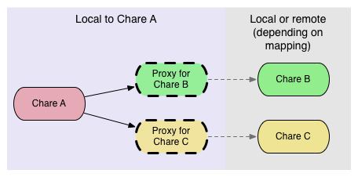
How to Communicate?
Chares spread across multiple processors
It is not possible to directly invoke methods
Use of Proxies – lightweight handles to potentially remote chares

Slide 13
The Proxy
A Proxy class is generated for every chare
For example, Cproxy_Main is the proxy generated for the class Main
Proxies know where a chare is inside the system
Methods invoked on a Proxy pack the input parameters, and send them to the processor where the chare is. The real method will be invoked on the destination processor.
Given a Proxy p, it is possible to call the method
p.method(msg)

Slide 14
A Slightly More Complex Hello World
Program’s asynchronous flow
Mainchare sends message to Hello object
Hello object prints “Hello World!”
Hello object sends message back to the mainchare
Mainchare quits the application

Slide 15
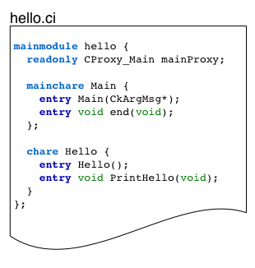
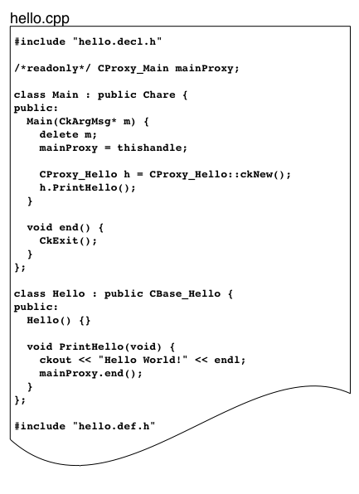
Code

Slide 16
“readonly” Variables
Defines a global variable
Every PE has its value
Can be set only in the mainchare!

Slide 17
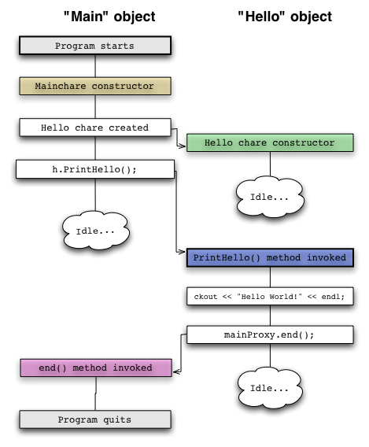
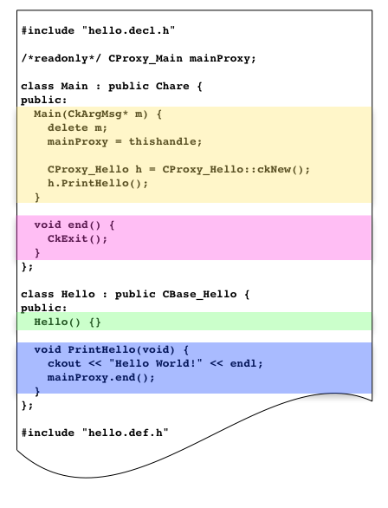
Workflow of Hello World

Slide 18
Limitations of Plain Proxies
In a large program, keeping track of all the proxies is difficult
A simple proxy doesn’t tell you anything about the chare other than its type.
Managing collective operations like broadcast and reduce is complicated.

Slide 19
Chare Arrays
Arrays organize chares into indexed collections.
There is a single name for the whole collection
Each chare in the array has a proxy for the other array elements, accessible using simple syntax
sampleArray[i] // i’th proxy

Slide 20
Array Dimensions
Anything can be used as array indices
integers
Tuples (e.g., 2D, 3D array)
bit vectors
user-defined types

Slide 21
Array Elements Mapping
Automatically by the runtime system
Programmer could control the mapping of array elements to PEs.
Round-robin, block-cyclic, etc
User defined mapping

Slide 22
Broadcasts
Simple way to invoke the same entry method on each array element.
Example: A 1D array “Cproxy_MyArray arr”
arr[3].method(): a point-to-point message to element 3.
arr.method(): a broadcast message to every elements

Slide 23
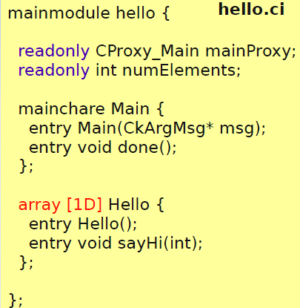
Hello World: Array Version
entry void sayHi(int)
Not meaningful to return a value
Parameter marshalling: runtime system will automatically pack arguments into a message or unpack the message into arguments

Slide 24
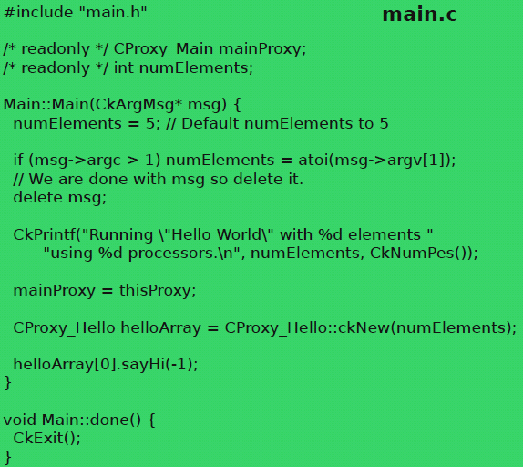
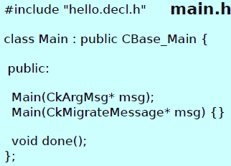
Hello World: Main Code

Slide 25
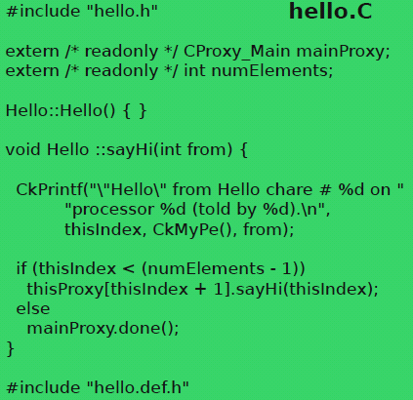
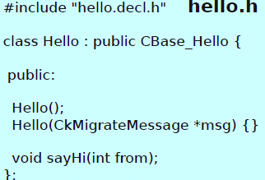
Hello World: Array Code

Slide 26
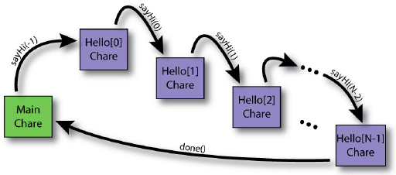
Result
$ ./charmrun +p3 ./hello 10
Running “Hello World” with 10 elements using 3 processors.
“Hello” from Hello chare #0 on processor 0 (told by -1)
“Hello” from Hello chare #1 on processor 0 (told by 0)
“Hello” from Hello chare #2 on processor 0 (told by 1)
“Hello” from Hello chare #3 on processor 0 (told by 2)
“Hello” from Hello chare #4 on processor 1 (told by 3)
“Hello” from Hello chare #5 on processor 1 (told by 4)
“Hello” from Hello chare #6 on processor 1 (told by 5)
“Hello” from Hello chare #7 on processor 2 (told by 6)
“Hello” from Hello chare #8 on processor 2 (told by 7)
“Hello” from Hello chare #9 on processor 2 (told by 8)

Slide 27
Reduction (1)
Every chare element will contribute its portion of data to someone, and data are combined through a particular op.
Naïve way:
Use a “master” to count how many messages need to be received.
Potential bottleneck on the “master”

Slide 28
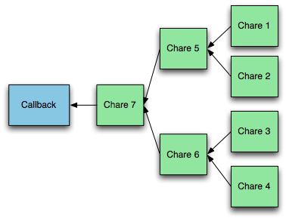
Reduction (2)
Runtime system builds reduction tree
User specifies reduction op
At root of tree, a callback is performed on a specified chare

Slide 29
Reduction in Charm++
No global flow of control, so each chare must contribute data independently using contribute(…).
void contribute(int nBytes, const void *data, CkReduction::reducerType type):
A user callback (created using CkCallback) is invoked when the reduction is complete.

Slide 30
Reduction Ops (CkReduction::reducerType)
Predefined:
Arithmetic (int, float, double)
CkReduction::sum_int, …
CkReduction::product_int, …
CkReduction::max_int, …
CkReduction::min_int, …
Logic:
CkReduction::logical_and, logic_or
CkReduction::bitvec_and, bitvec_or
Gather:
CkReduction::set, concat
Misc:
CkReduction::random
Defined by the user

Slide 31
Callback: where reductions go?
CkCallback(CkCallbackFn fn, void *param)
void myCallbackFn(void *param, void *msg)
CkCallback(int ep, const CkChareID &id)
ep=CkIndex_ChareName::EntryMethod(parameters)
CkCallback(int ep, const CkArrayID &id)
A Cproxy_MyArray may substitute CkArrayID
The callback will be called on all array elements
CkCallback(int ep, const CkArrayIndex &idx, const CkArrayID &id)
The callback will only be called on element[idx]
CkCallback(CkCallback::ignore)

Slide 32
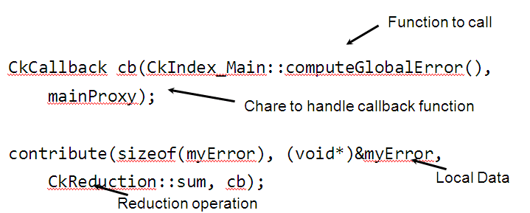
Example
Sum local error estimators to determine global error

