Slide 1
“Hello World” in Charm++
Chao Mei

Slide 2
The very first program
A simple “hello world” program
Preparation: build an appropriate charm for your machine
Help: ./build --help or ./smart-build.pl
./build charm++ net-linux-x86_64 -j8 --with-production --enable-tracing
./build charm++ net-linux-x86_64 ibverbs -j8 --with-production --enable-tracing
./build charm++ bluegenep xlc –j4

Slide 3
Makefile
CHARMC=$(HOME)/charm/net-linux-x86_64/bin/charmc $(OPTS)
OBJS = hello.o
all: hello
hello: $(OBJS)
$(CHARMC) -language charm++ -o hello $(OBJS)
hello.o: hello.C hello.decl.h
$(CHARMC) -c hello.C
hello.decl.h: hello.ci
$(CHARMC) hello.ci
clean:
rm -f *.decl.h *.def.h *.o hello charmrun

Slide 4
Hello.ci
mainmodule hello {
mainchare Main {
entry Main(CkArgMsg *m);
};
};

Slide 5
Hello.C
#include <stdio.h>
#include "hello.decl.h"
/*mainchare*/
class Main : public Chare{
public:
Main(CkArgMsg* m){
//m contains "argc" and "argv" as a normal main function has
//for its arguments.
//Start the computation
CkPrintf("Running on %d processors.\n", CkNumPes());
ckout << "Greetings from PPL@Illinois!" << endl;
CkExit();
};
};
#include "hello.def.h"

Slide 6
Compile and Run
Compile: Just “make”
Run: ./charmrun ++local +p<N> ./hello <arguments>
On some machines, you need to submit your application through a batcher scheduler (e.g. qsub …)
Output with “./charmrun ++local +p8 ./hello”
Charmrun> started all node programs in 0.006 seconds.
Charm++: scheduler running in netpoll mode.
Charm++> Running on 1 unique compute nodes (16-way SMP).
Charm++> cpu topology info is gathered in 0.007 seconds.
Running on 8 processors.
Greetings from PPL@Illinois!

Slide 7
A “hello world” in a Ring
Every chare (virtual processor) says Hi one by one in a ring
Communication flow: 0->1->2->3->4…->(last chare)->program finish
Makefile is same with the previous one

Slide 8
Hello.ci
mainmodule hello {
readonly CProxy_Main mainProxy;
readonly int nElements;
mainchare Main {
entry Main(CkArgMsg *m);
entry void done(void);
};
array [1D] Hello {
entry Hello(void);
entry void SayHi();
};
};

Slide 9
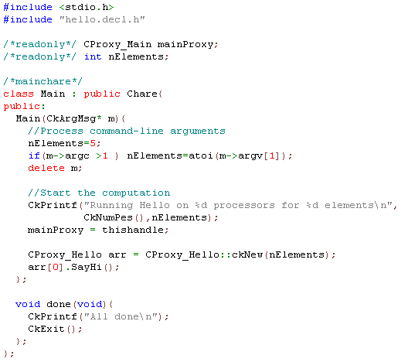
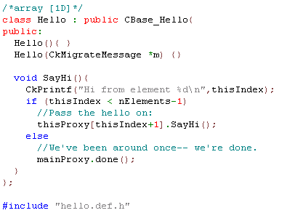
Hello.C

Slide 10
Output
./charmrun ++local +p8 ./hello 8
Charmrun> started all node programs in 0.006 seconds.
Charm++: scheduler running in netpoll mode.
Charm++> Running on 1 unique compute nodes (16-way SMP).
Charm++> cpu topology info is gathered in 0.008 seconds.
Running Hello on 8 processors for 8 elements
Hi from element 0
Hi from element 1
Hi from element 2
Hi from element 3
Hi from element 4
Hi from element 5
Hi from element 6
Hi from element 7
All done

