Slide 1
ChaNGa: Design Issues in High Performance Cosmology
Pritish Jetley
Parallel Programming Laboratory

Slide 2
Overview
Why Barnes-Hut?
Domain decomposition
Tree construction
Tree traversal
  Overlapping remote and local work
  Remote data caching
  Prefetching remote data
  Increasing local work
  Efficient sequential traversal
Load balancing
Multistepping

Slide 3
Why Barnes-Hut?
Gravity is a long-range force
  Every particle interacts with every other
Do not need N(N-1)/2 interactions
Groups of distant particles ≈ point masses
O(N lg N) interactions
Equivalent
point mass
Single interaction
Source
particles
Target particle

Slide 4
Parallel Barnes-Hut: Decomposition
Distribute particles among objects
To lower communication costs:
  Keep particles that are close to each other on the same object
  Make spatial partitions regularly shaped
Balance number of particles per partition

Slide 5
Decomposition strategies
SFC: Linearize particle coordinates
  Convert floats/doubles to integers
  Interleave bits of integers
Particle
(-0.49, 0.29, 0.41)
Key
(0x16C12685AE69F0000)
Scale to 21 bit
unsigned integers
Interleave bits,
prepend 1
x: 0x4E20
y: 0x181BE0
z: 0x1BC560

Slide 6
SFC
Interleaving leads to jagged line of particles
Line is split among objects (TreePieces)
TreePiece 0
TreePiece 1
TreePiece 2

Slide 7
Oct
Recursively divide partition into quadrants if more than τ particles within it
Iterative histogramming of particle counts
τ = 3

Slide 8
Tree construction
TreePieces construct
trees beneath themselves
independently of each other
Multipole moment information
is passed up the tree so that
every processor has it

Slide 9
Tree construction issues
Must distribute TreePieces evenly across processors
Particles stored as structures of arrays
  (Possibly) more cache friendly
  Easier to vectorize accessing code
Tree data structure layout?
  new for each node - BAD!
  Better: allocate all children together
  Better still: allocate in a DFS manner
4
1
2
3
8
5
6
7
9
16
14
15
10
11
12
13
17
18
19
20

Slide 10
Tree traversal
A TreePiece performs depth-first traversal of tree for each bucket of particles
For each node encountered,
  Is node far enough?
    Compute forces on bucket due to node
    Pop node from stack
  Node too close?
    Push next child onto stack

Slide 11
Illustration
Yellow circles
Represent
Opening criterion
checks
=

Slide 12
Tree traversal
Cannot have entire tree on every processor
  Local nodes
  Remote nodes
Remote nodes must be requested from other TreePieces
  Generate communication
Give high priority to remote work
  Do local work when waiting for remote nodes to arrive: overlap

Slide 13
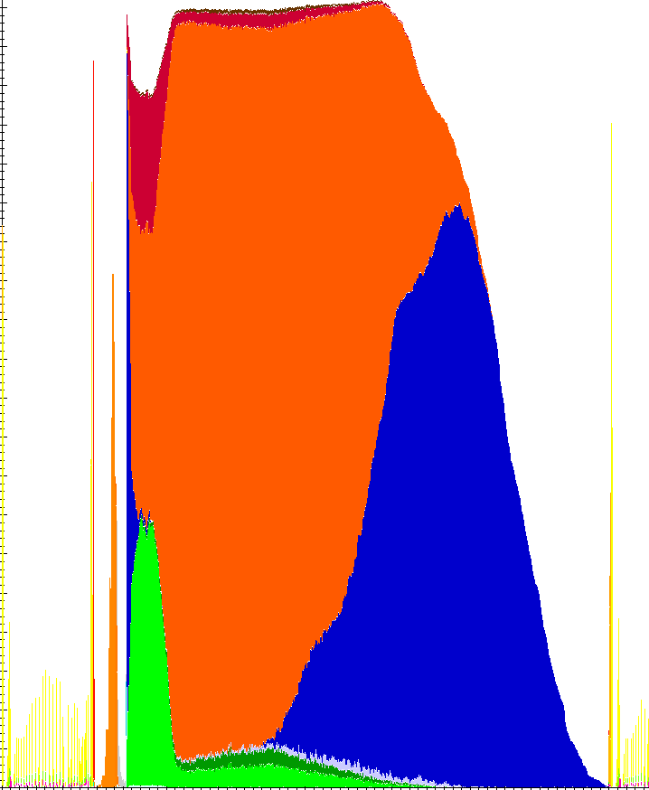
Overlapping remote and local work
Receive remote
requests
Remote work
Activity across
processors
Local work
Send remote
requests
Time

Slide 14
Remote data caching reduces communication
Reuse requested data to reduce number of requests
Cache requested remote data on processor
  Data requested by one TreePiece used by others
  Fewer messages
  Less overhead for processing remote data requests
Optimal cache line size (depth of tree beneath
requested node)
  About 2 for Octrees

Slide 15
Remote data caching

Slide 16
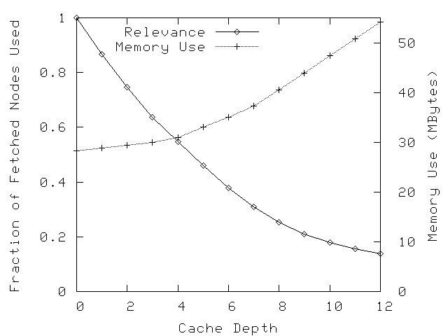
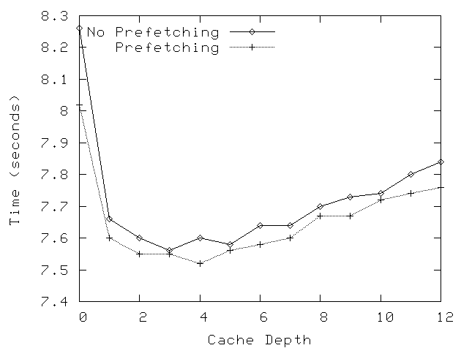
Remote data prefetching
Estimate remote data requirements of TreePieces, prefetch before traversal
  Reduces latency of node access during traversal

Slide 17
Increasing local work
Division of tree into TreePieces reduces the amount of local work per piece
Combine TreePieces in one processor to increase amount of local work
  Without combination, 16% local work per TreePiece
  With combination, 58%

Slide 18
Algorithmic efficiency
Normally, walk entire tree once for each bucket
However, proximal buckets have similar interactions with the rest of the universe
Share lists between buckets as far as possible
  Check distance between
    Remote tree node
    Local ancestor of buckets (instead of buckets)
Improvements of 7-10% over normal traversal

Slide 19
Load balancing
Density variations in input data create load imbalance
Load balancing must account for computation as well as communication

Slide 20
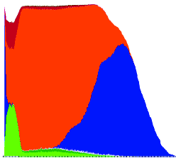
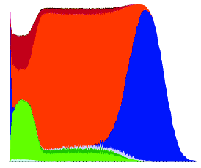
Balancing Load to Improve Performance
Increased
communication
Processor Activity →
Greater
balance
Time →
Computation
Communication
LB algorithms must consider both computation and communication
Notes:
We first approached the problem by using a greedy load balancing strategy.
This is a picture showing activity across all processors as time progresses
Notice first that the slope of the utilization profile is steeper during the second step, which means greater balance of load
However, this algorithm leads to an increased amount of communication since contiguous regions of space (that is, those facing a greater communication volume) are placed on different processors

Slide 21
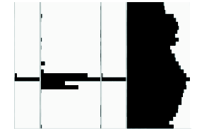
Multistepping
Group particles into rungs
  Faster rung → more speed
  Different rungs active at different times
Update slower rung particles less frequently
Less computation done than singlestepping
Computation split
into phases
Time →
0
1
0
2
0
1
0
2
0: rung 0
Processors
1: rungs 0,1
2: rungs 0,1,2
Notes:
To get even better scaling, we turn to algorithmic improvements in the computation process itself
The use multiple time scales, or multistepping can yield significant performance benefits
It proceeds by grouping particles into rungs, according to their accelerations
...
This leads to a processor load profile as shown below. The regions marked in green have only rung 0 particles active...
The computation can thus be thought of in terms of phases

Slide 22
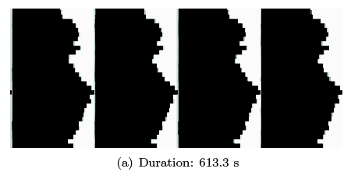
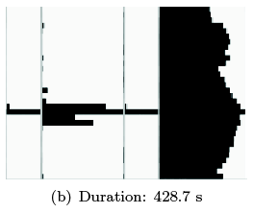
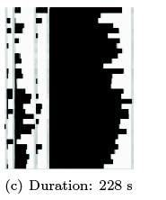
Load imbalance with multistepping
Singlestepped
(613 s)
Dwarf dataset
32 BG/L processors
Different timestepping schemes
Multistepped
(429 s)
Multistepped
with
load balancing
(228 s)
Notes:
Putting these principles to practice in our multiphase load balancer,
we obtained signifcant speedups both in comparison to plain multistepped and singlestepped runs

Slide 23
Thank you
Questions?

