Slide 1


Performance Analysis with Projections
Yanhua Sun
Parallel Programming Laboratory
Department of Computer Science
University of Illinois at Urbana Champaign

Slide 2
Tutorial Outline
General Introduction
Instrumentation
Trace Generation
Performance Analysis
Dealing with Scalability and Data Volume

Slide 3
General Introduction
Performance Analysis and Visualization Toolkit
Early version was developed in early 90s
Later version helped NAMD performance analysis
Large portions are rewritten in 2009
Runtime tracing modules and visualization client
Analysis is post-mortem and human-centric with some automation support.

Slide 4
Tutorial Outline
General Introduction
Instrumentation
Trace Generation
Performance Analysis
Dealing with Scalability and Data Volume

Slide 5
Instrumentation: Basics
Nothing to do!
Charm++’s built-in performance framework automatically instruments entry method execution and communication events whenever a performance module is linked with the application
In the majority of cases, this generates very useful data for analysis while introducing minimal overhead/perturbation.
The framework also provides the necessary abstraction for better interpretation of performance metrics for third-party performance modules like TAU profiling

Slide 6
Instrumentation: User-Events
If user-specific events (e.g. specific code-blocks) are required, these can be manually inserted into the application code:
Register:
int traceRegisterUserEvent(char* EventDesc, int EventNum=-1)
Record a Point-Event:
void traceUserEvent(int EventNum)
Record a Bracketed-Event:
void traceUserBracketEvent(int EventNum, double StartTime, double EndTime)

Slide 7
Instrumentation: Selective Tracing
Allows analyst to restrict the time period for which performance data is generated.
Simple Interface, but not so easy to use:
void traceBegin()
void traceEnd()
Calls have a per-processor effect, so users have to ensure consistency (calls are made from within objects and there can be more than one object per processor).

Slide 8
Tutorial Outline
General Introduction
Instrumentation
Trace Generation
Performance Analysis
Dealing with Scalability and Data Volume

Slide 9
Trace Generation
Performance Modules at Application Build Time
Projections Event Tracing
Projections Summary Profiles
Streamed Data (need to check)
TAU Profiles
Application Runtime Controls

Slide 10
The Projections Event Tracing Module
Records pertinent detailed metrics per Charm++ event.
e.g. Start of an entry method invocation – details:
source of the message
size of the incoming message
time of invocation
chare object id
One text line per event is written to the log file.
One log file is maintained per processor.

Slide 11
Tutorial Outline
General Introduction
Instrumentation
Trace Generation
Performance Analysis
Dealing with Scalability and Data Volume

Slide 12
Performance Analysis
Tools of coarsest granularity
Time profile
Histogram
Communication over time
Tools of fine raw data
Overview
Timeline
Tools of derived/processed data
Extrema analysis
Noise miner

Slide 13
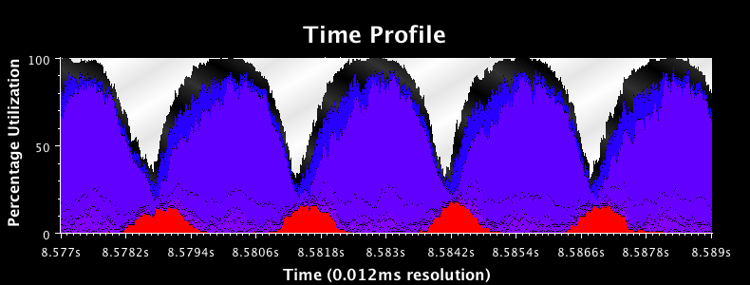
Time Profile
NAMD CPU Utilization on 1024 processors BGP

Slide 14
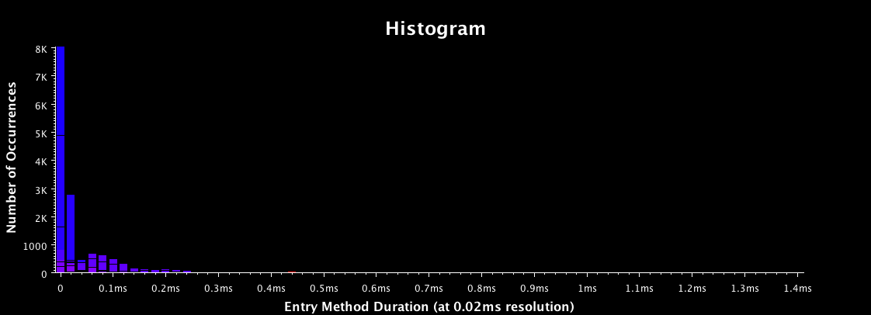
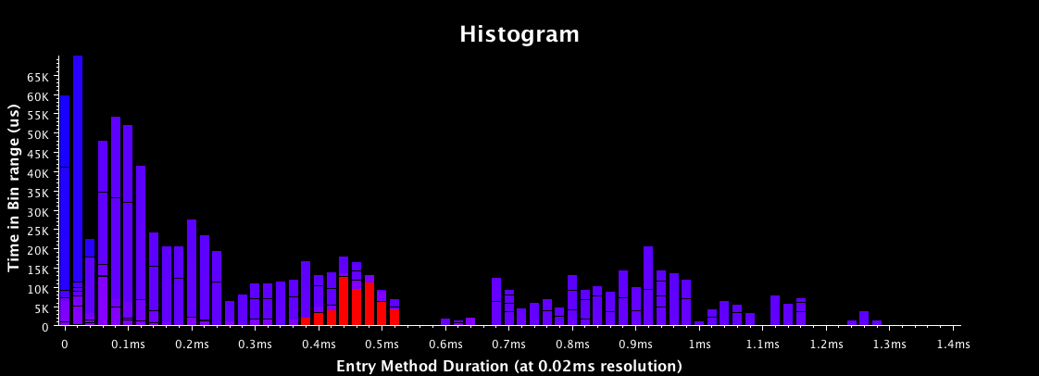
Histogram
Occurrence of entry methods for different grain size
Accumulated execution time for different entry methods

Slide 15
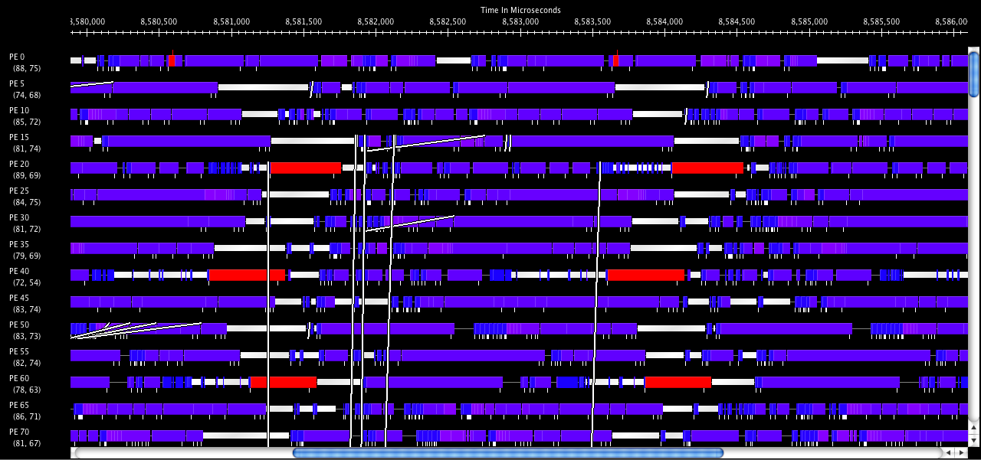
Timeline

Slide 16
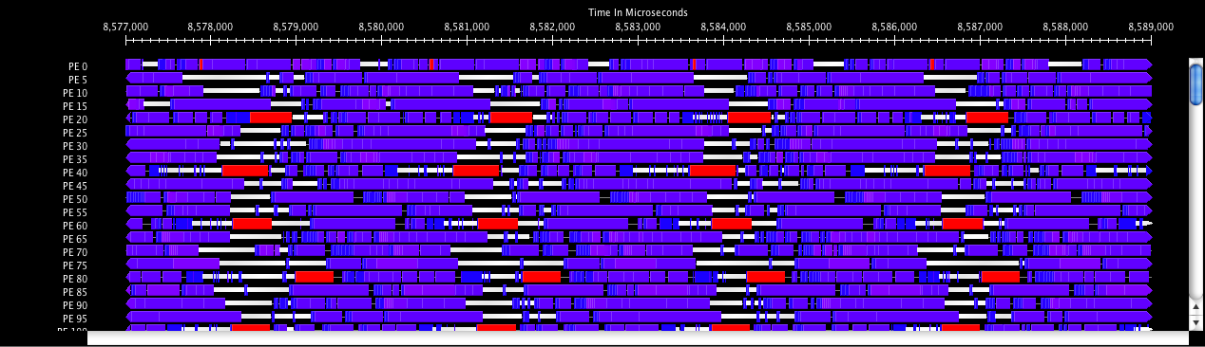
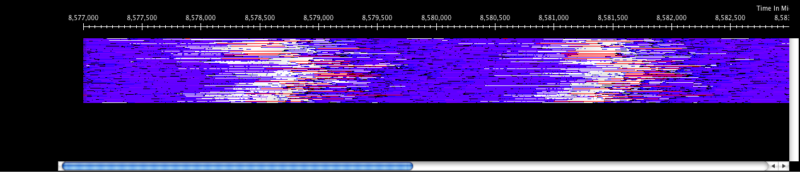
Timeline(compact)

Slide 17
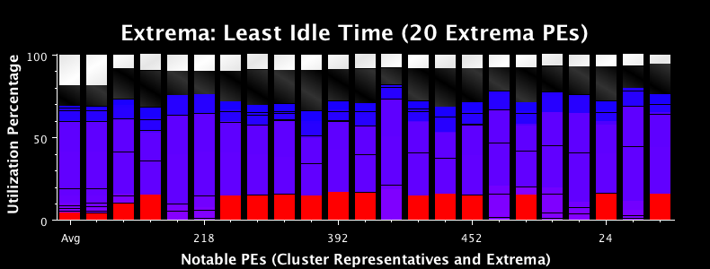
Extrema

Slide 18
Identify problems
Load imbalance
Time profile : lower CPU usage
Extrema analysis tool:
Least idle processors
Load the over-loaded processors in Timeline
Histogram : grain size issues

Slide 19
Tutorial Outline
General Introduction
Instrumentation
Trace Generation
Support for TAU profiles
Performance Analysis
Dealing with Scalability and Data Volume

Slide 20
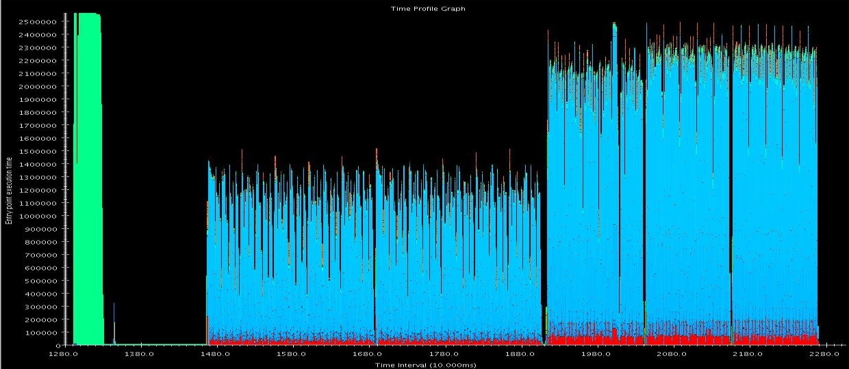
Limiting Data Volume
Careful use of traceBegin()/traceEnd() calls to limit instrumentation to a representative portion of a run.
Eg. In NAMD benchmarks, we often look at 100 steps after the first major load balancing phase, followed by a refinement load balancing phase, followed by another 100 steps.

Slide 21
Limiting Data Volume (2)
Pre-release feature – writing only a subset of processors’ performance data to disk.
Uses clustering to identify equivalence classes of processor behavior. This is done after the application is done, but before performance data is written to disk.
Select “exemplar” processors from each equivalence class. Select “outlier” processors from each equivalence class. These processors will represent the run.
Write the performance data of representative processors to disk.
Projections is able to handle the partial datasets when visualizing the information.

Slide 22
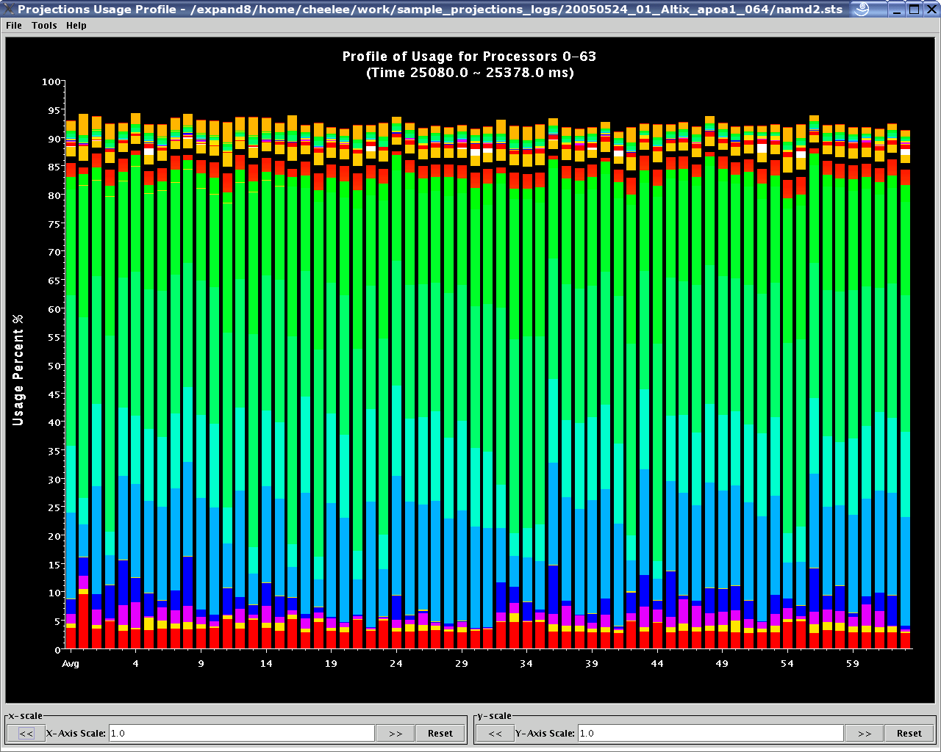
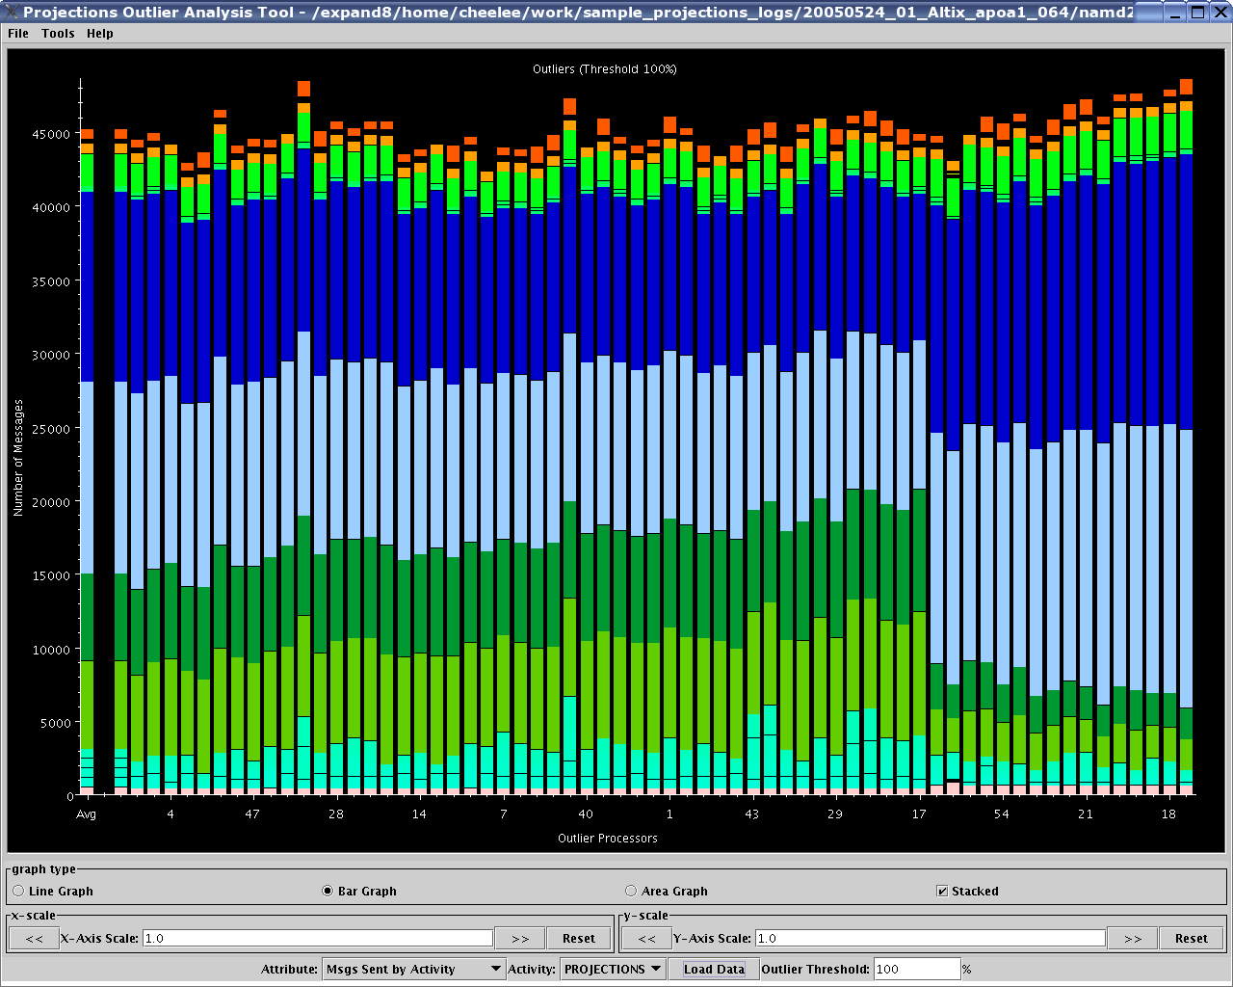
Visualizing Large Datasets
Usage Profile:
Only
64 processors.
What about
thousands?
Projections
Outlier
Analysis Tool:
Sorted by
“deviancy”

