Slide 1
Charm++ Tutorial
Presented by Eric Bohm

Slide 2
Outline
Basics
Introduction
Charm++ Objects
Chare Arrays
Chare Collectives
SDAG
Example
Intermission
Advanced
Prioritized Messaging
Interface file tricks
Initialization
Entry Method Tags
Groups & Node Groups
Threads

Slide 3
Expectations
Introduction to Charm++
Assumes parallel programming aware audience
Assume C++ aware audience
AMPI not covered
Goals
What Charm++ is
How it can help
How to write a basic charm program
Provide awareness of advanced features

Slide 4
What Charm++ Is Not
Not Magic Pixie Dust
Runtime system exists to help you
Decisions and customizations are necessary in proportion to the complexity of your application
Not a language
Platform independent library with a semantic
Works for C, C++, Fortran (not covered in this tutorial)
Not a Compiler
Not SPMD Model
Not Processor Centric Model
Decompose to individually addressable medium grain tasks
Not A Thread Model
They are available if you want to inflict them on your code
Not Bulk Synchronous

Slide 5
Charm++ Runtime System

Slide 6
The Charm++ Model
Parallel objects (chares) communicate via asynchronous method invocations (entry methods).
The runtime system maps chares onto processors and schedules execution of entry methods.
Similar to Active Messages or Actors

Slide 7
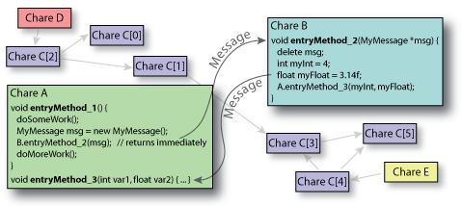
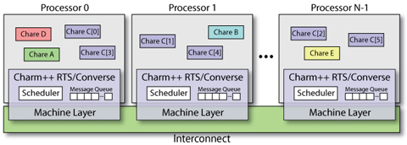
User View vs. System View
User View:
System View:

Slide 8
Architecures
Runs on:
Any machine with MPI installation
Clusters with Ethernet (UDP/TCP)
Clusters with Infiniband
Clusters with accelerators (GPU/CELL)
Windows
…
To install
“./build”

Slide 9
Portability
Cray XT (3|4|5)
Cray XT6 in development
BlueGene (L|P)
BG/Q in development
BlueWaters
LAPI
PAMI in development
SGI/Altix
Clusters
X86, X86_64, Itanium
MPI, UDP, TCP, LAPI, Infiniband, Myrinet, Elan, SHMEM
Accelerators
Cell
GPGPU

Slide 10
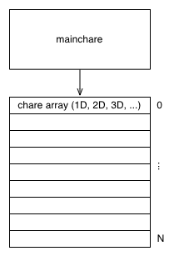
Charm++ Objects
A “chare” is a C++ object with methods that can be remotely invoked
The “mainchare” is the chare where the execution starts in the program
A “chare array” is a collection of chares of the same type
Typically the mainchare will spawn a chare array of workers

Slide 11
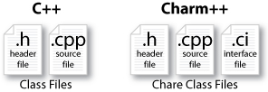
Charm++ File Structure
The C++ objects (whether they are chares or not)
Reside in regular .h and .cpp files
Chare objects, messages and entry methods (methods that can be called asynchronously and remotely)
Are defined in a .ci (Charm interface) file
And are implemented in the .cpp file

Slide 12
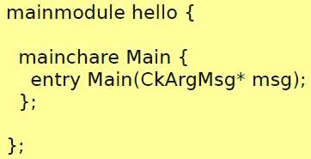
Hello World: .ci file
.ci: Charm Interface
Defines which type of chares are present in the application
At least a mainchare must be set
Each definition is inside a module
Modules can be included in other modules

Slide 13
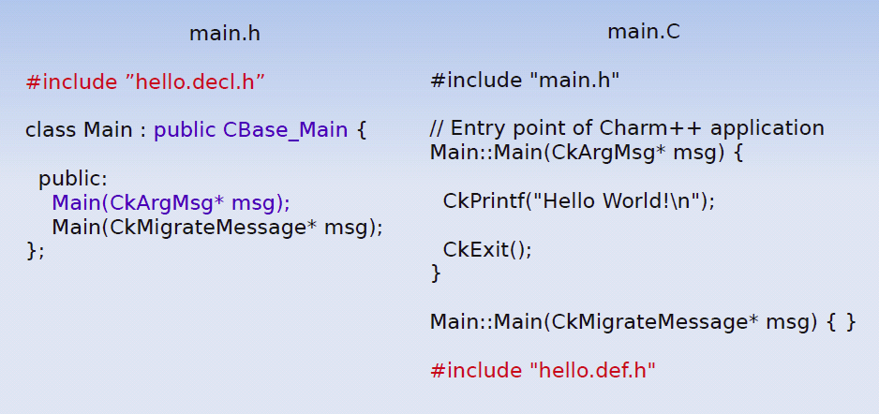
Hello World: the code

Slide 14
CkArgMsg in the Main::Main Method
Defined in charm++
struct CkArgMsg{
int argc;
char **argv;
}

Slide 15
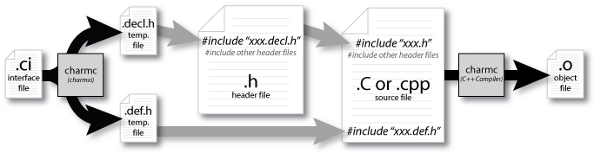
Compilation Process
charmc hello.ci
charmc –o main.o main.C (compile)
charmc –language charm++ -o pgm main.o (link)

Slide 16
Execution
./charmrun +p4 ./pgm
Or specific queueing system
Output:
Hello World!
Not a parallel code :(
Solution: create other chares, all of them saying “Hello World”

Slide 17
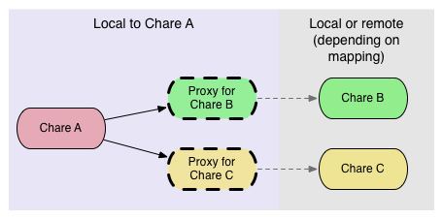
How to Communicate?
Chares spread across multiple processors
It is not possible to directly invoke methods
Use of Proxies – lightweight handles to potentially remote chares

Slide 18
The Proxy
A Proxy class is generated for every chare
For example, Cproxy_Main is the proxy generated for the class Main
Proxies know where a chare is inside the system
Methods invoked on a Proxy pack the input parameters, and send them to the processor where the chare is. The real method will be invoked on the destination processor.
Given a Proxy p, it is possible to call the method
p.method(msg)

Slide 19
A Slightly More Complex Hello World
Program’s asynchronous flow
Mainchare sends message to Hello object
Hello object prints “Hello World!”
Hello object sends message back to the mainchare
Mainchare quits the application

Slide 20
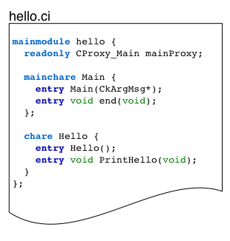
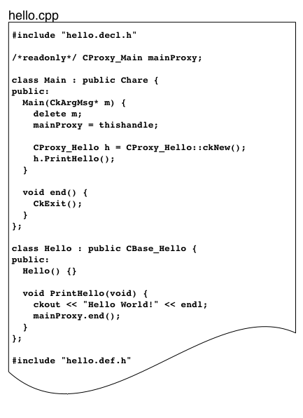
Code

Slide 21
“readonly” Variables
Defines a global variable
Every PE has its value
Can be set only in the mainchare!

Slide 22
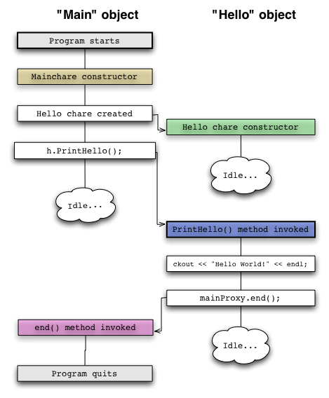
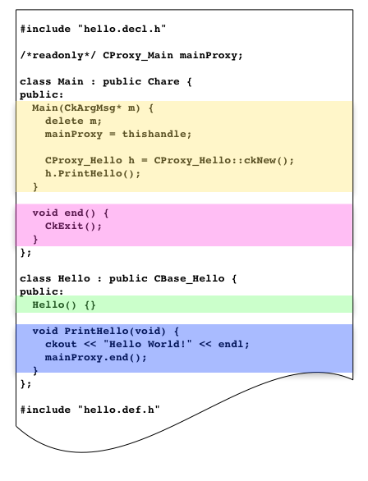
Workflow of Hello World

Slide 23
Limitations of Plain Proxies
In a large program, keeping track of all the proxies is difficult
A simple proxy doesn’t tell you anything about the chare other than its type.
Managing collective operations like broadcast and reduce is complicated.

Slide 24
Chare Arrays
Arrays organize chares into indexed collections.
There is a single name for the whole collection
Each chare in the array has a proxy for the other array elements, accessible using simple syntax
sampleArray[i] // i’th proxy

Slide 25
Array Dimensions
Anything can be used as array indices
integers
Tuples (e.g., 2D, 3D array)
bit vectors
user-defined types

Slide 26
Array Elements Mapping
Automatically by the runtime system
Programmer could control the mapping of array elements to PEs.
Round-robin, block-cyclic, etc
User defined mapping

Slide 27
Broadcasts
Simple way to invoke the same entry method on each array element.
Example: A 1D array “Cproxy_MyArray arr”
arr[3].method(): a point-to-point message to element 3.
arr.method(): a broadcast message to every elements

Slide 28
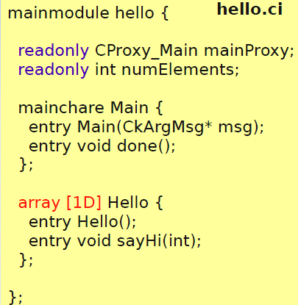
Hello World: Array Version
entry void sayHi(int)
Not meaningful to return a value
Parameter marshalling: runtime system will automatically pack arguments into a message or unpack the message into arguments

Slide 29
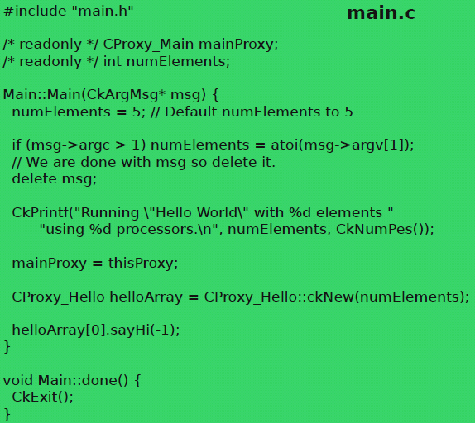
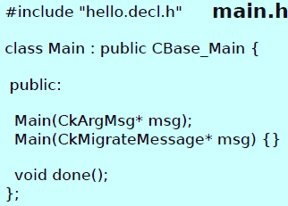
Hello World: Main Code

Slide 30
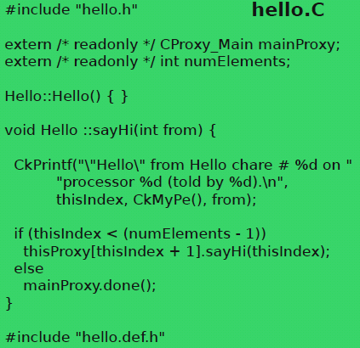
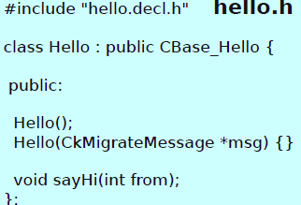
Hello World: Array Code

Slide 31
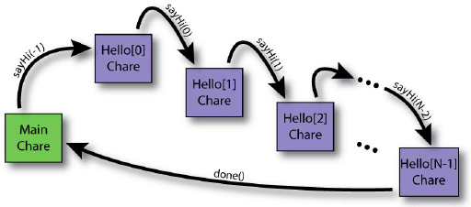
Result
$ ./charmrun +p3 ./hello 10
Running “Hello World” with 10 elements using 3 processors.
“Hello” from Hello chare #0 on processor 0 (told by -1)
“Hello” from Hello chare #1 on processor 0 (told by 0)
“Hello” from Hello chare #2 on processor 0 (told by 1)
“Hello” from Hello chare #3 on processor 0 (told by 2)
“Hello” from Hello chare #4 on processor 1 (told by 3)
“Hello” from Hello chare #5 on processor 1 (told by 4)
“Hello” from Hello chare #6 on processor 1 (told by 5)
“Hello” from Hello chare #7 on processor 2 (told by 6)
“Hello” from Hello chare #8 on processor 2 (told by 7)
“Hello” from Hello chare #9 on processor 2 (told by 8)

Slide 32
Reduction (1)
Every chare element will contribute its portion of data to someone, and data are combined through a particular op.
Naïve way:
Use a “master” to count how many messages need to be received.
Potential bottleneck on the “master”

Slide 33
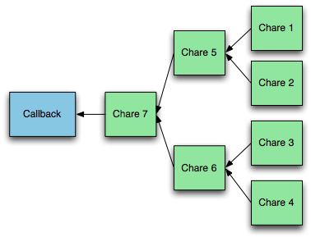
Reduction (2)
Runtime system builds reduction tree
User specifies reduction op
At root of tree, a callback is performed on a specified chare

Slide 34
Reduction in Charm++
No global flow of control, so each chare must contribute data independently using contribute(…).
void contribute(int nBytes, const void *data, CkReduction::reducerType type):
A user callback (created using CkCallback) is invoked when the reduction is complete.

Slide 35
Reduction Ops (CkReduction::reducerType)
Predefined:
Arithmetic (int, float, double)
CkReduction::sum_int, …
CkReduction::product_int, …
CkReduction::max_int, …
CkReduction::min_int, …
Logic:
CkReduction::logical_and, logic_or
CkReduction::bitvec_and, bitvec_or
Gather:
CkReduction::set, concat
Misc:
CkReduction::random
Defined by the user

Slide 36
Callback: where reductions go?
CkCallback(CkCallbackFn fn, void *param)
void myCallbackFn(void *param, void *msg)
CkCallback(int ep, const CkChareID &id)
ep=CkIndex_ChareName::EntryMethod(parameters)
CkCallback(int ep, const CkArrayID &id)
A Cproxy_MyArray may substitute CkArrayID
The callback will be called on all array elements
CkCallback(int ep, const CkArrayIndex &idx, const CkArrayID &id)
The callback will only be called on element[idx]
CkCallback(CkCallback::ignore)

Slide 37
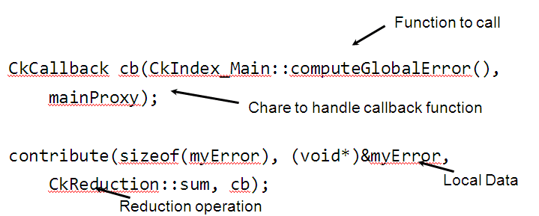
Example
Sum local error estimators to determine global error

Slide 38
SDAG JACOBI Example
Introduce SDAG
Using 5 point stencil

Slide 39
Example: Jacobi 2D
Use two interchangeable matrices
do {
update_matrix();
maxDiff = max(abs (A - B));
} while (maxDiff > DELTA)
update_matrix() {
foreach i,j {
B[i,j] = (A[i,j] + A[i+1,j] + A[i-1,j] + A[i,j+1] + A[i,j-1]) / 5;
}
swap (A, B);
}

Slide 40
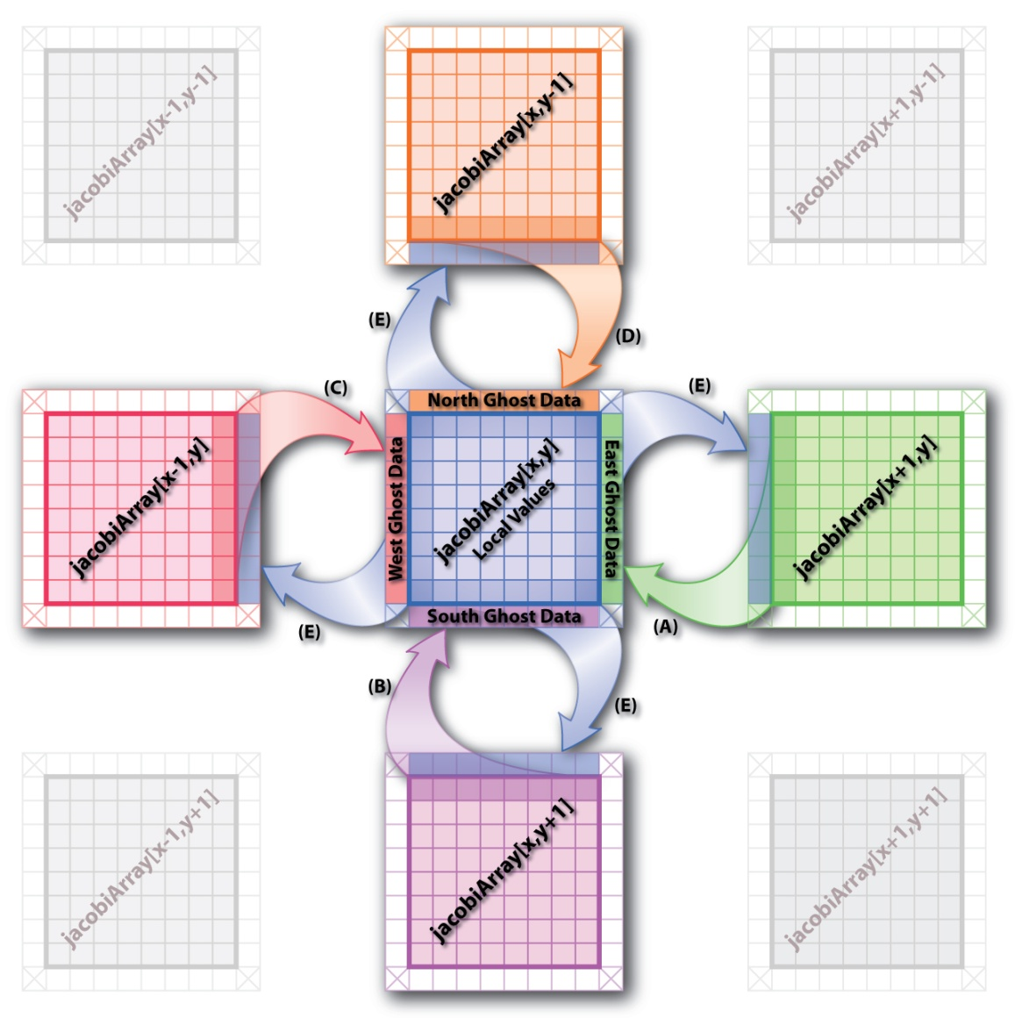
Jacobi in parallel
matrix decomposed
in chares

Slide 41
Jacobi: the code
Main(CkArgMsg* m) { // initialize everything
array = CProxy_Jacobi::ckNew(num_chare_x, num_chare_y);
array.begin_iteration();
}
void report(CkReductionMsg *msg) { // Each worker reports back to here when it completes an iteration
iterations++;
maxdifference=((double *) msg->getData())[0];
delete msg;
if ( maxdifference – THRESHHOLD<0) {
CkPrintf("Difference %.10g Satisfied Threshhold %.10g in %d Iterations\n",
maxdifference,THRESHHOLD,iterations);
done(true); }
else {array.begin_iteration();}
}
void Jacobi::begin_iteration(void) {
iterations++;
if(!leftBound)
{ double *leftGhost = new double[blockDimY];
for(int j=0; j<blockDimY; ++j)
leftGhost[j] = temperature[index(1, j+1)];
thisProxy(thisIndex.x-1, thisIndex.y)
.processGhosts( RIGHT, blockDimY, leftGhost);
delete [] leftGhost; }
…
}
void processGhosts(int dir, int size, double gh[]) {
switch(dir) {
case LEFT:
for(int j=0; j<size; ++j) emperature[index(0, j+1)] = gh[j];
...
if(++imsg==numExpected) check_and_compute(); }
}
void check_and_compute() {
imsg=0;
compute_kernel();
contribute(sizeof(double), &maxdifference, CkReduction::max_double, CkCallback(CkIndex_Main::report(NULL), mainProxy));
}
mainmodule jacobi2d {
readonly CProxy_Main mainProxy;
readonly int arrayDimX; readonly int arrayDimY;
readonly int blockDimX; readonly int blockDimY;
readonly int num_chare_x; readonly int num_chare_y;
readonly int maxiterations;
mainchare Main {
entry Main(CkArgMsg *m);
entry void report(CkReductionMsg *m);
};
array [2D] Jacobi {
entry Jacobi(void);
entry void begin_iteration(void);
entry void processGhosts(int dir, int size, double ghosts[size]);
};
};

Slide 42
Remove Barrier
More efficient
Problem!
Potential Race Condition
May receive neighbor update for next iteration
Solution
Send iteration counter
Buffer (and count for next iter) messages until ready

Slide 43
We can do better using SDAG
Structured DAGger
Directed Acyclic Graph (DAG)
Express event sequencing and dependency
Automate Message buffering
Automate Message counting
Express independence for overlap
Differentiate between parallel and sequential blocks
Negligible overhead

Slide 44
Structured Dagger Constructs
when <method list> {code}
Do not continue until method is called
Internally generates flags, checks, etc.
atomic {code}
Call ordinary sequential C++ code
if/else/for/while
C-like control flow
overlap {code1 code2 ...}
Execute code segments in parallel
forall
“Parallel Do”
Like a parameterized overlap

Slide 45
Reinvent Jacob2d in SDAG
Code walkthrough
Task 1
Convert to SDAG
Add _sdag directives
Add sdag control entry method
Make distinction between receiving and processing ghosts
Use SDAG iteration and message counting
Remove barrier

Slide 46
Jacob2d to 3d in SDAG
Hands on project homework
Task 2
Convert to 3D 7point stencil
Add “front” “back” neighbors and blocksizes
Revise numExpected calculation
Add FRONT BACK ghost cases
Add frontBound backBound,kStart, kFinish
Extend index(), k dimension to init + compute
Is there a need to change the SDAG code?
Answer can be found in Charm++ distribution

Slide 47

Intermission

Slide 48
Advanced Messaging

Slide 49
Prioritized Execution
Charm++ scheduler
Default - FIFO (oldest message)‏
Prioritized execution
If several messages available, Charm will process the messages in the order of their priorities
Very useful for speculative work, ordering timestamps, etc...

Slide 50
Priority Classes
Charm++ scheduler has three queues: high, default, and low
As signed integer priorities:
High -MAXINT to -1
Default 0
Low 1 to +MAXINT
As unsigned bitvector priorities:
0x0000 Highest priority -- 0x7FFF
0x8000 Default priority
0x8001 -- 0xFFFF Lowest priority

Slide 51
Prioritized Messages
Number of priority bits passed during message allocation
FooMsg * msg = new (size, nbits) FooMsg;
Priorities stored at the end of messages
Signed integer priorities
*CkPriorityPtr(msg)=-1;
CkSetQueueing(msg, CK_QUEUEING_IFIFO);
Unsigned bitvector priorities
CkPriorityPtr(msg)[0]=0x7fffffff;
CkSetQueueing(msg, CK_QUEUEING_BFIFO);

Slide 52
Prioritized Marshalled Messages
Pass “CkEntryOptions” as last parameter
For signed integer priorities:
CkEntryOptions opts;
opts.setPriority(-1);
fooProxy.bar(x,y,opts);
For bitvector priorities:
CkEntryOptions opts;
unsigned int prio[2]={0x7FFFFFFF,0xFFFFFFFF};
opts.setPriority(64,prio);
fooProxy.bar(x,y,opts);

Slide 53
Advanced Message Features
Nokeep (Read-only) messages
Entry method agrees not to modify or delete the message
Avoids message copy for broadcasts, saving time
Inline messages
Direct method invocation if on local processor
Expedited messages
Message do not go through the charm++ scheduler (ignore any Charm++ priorities)‏
Immediate messages
Entries are executed in an interrupt or the communication thread
Very fast, but tough to get right
Immediate messages only currently work for NodeGroups and Group (non-smp)‏
Notes:
Not sort on priority

Slide 54
Read-Only, Expedited, Immediate
All declared in the .ci file
{
entry [nokeep] void foo_readonly(Msg *);
entry [inline] void foo_inl(Msg *);
entry [expedited] void foo_exp(Msg *);
entry [immediate] void foo_imm(Msg *);
...
};

Slide 55
Interface File Example
mainmodule hello {
include “myType.h”
initnode void myNodeInit();
initproc void myInit();
mainchare mymain {
entry mymain(CkArgMsg *m);
};
array[1D] foo {
entry foo(int problemNo);
entry void bar1(int x);
entry void bar2(myType x);
};
};

Slide 56
Include and Initcall
Include
Include an external header files
Initcall
User plugging code to be invoked in Charm++’s startup phase
Initnode
Called once on every node
Initproc
Called once on every processor
Initnode calls are called before Initproc calls

Slide 57
Entry Attributes
Threaded
Function is invoked in a CthThread
Sync
Blocking methods, can return values as a message
Caller must be a thread
Exclusive
For Node Group
Do not execute while other exclusive entry methods of its node group are executing in the same node
Notrace
Invisible to trace projections
entry [notrace] void recvMsg(multicastGrpMsg *m);

Slide 58
Entry Attributes 2
Local
Local function call, traced like an entry method
Python
Callable by python scripts
Exclusive
For Node Group
Do not execute while other exclusive entry methods of its node group are executing in the same node

Slide 59
Groups/Node Groups

Slide 60
Groups and Node Groups
Groups
Similar to arrays:
Broadcasts, reductions, indexing
But not completely like arrays:
Non-migratable; one per processor
Exactly one representative on each processor
Ideally suited for system libraries
Historically called branch office chares (BOC)‏
Node Groups
One per SMP node
Notes:
Special chare array

Slide 61
Declarations
.ci file
group mygroup {
entry mygroup(); //Constructor
entry void foo(foomsg *); //Entry method
};
nodegroup mynodegroup {
entry mynodegroup(); //Constructor
entry void foo(foomsg *); //Entry method
};
C++ file
class mygroup : public Group {
mygroup() {}
void foo(foomsg *m) { CkPrintf(“Do Nothing”);}
};
class mynodegroup : public NodeGroup {
mynodegroup() {}
void foo(foomsg *m) { CkPrintf(“Do Nothing”);}
};

Slide 62
Creating and Calling Groups
Creation
p = CProxy_mygroup::ckNew();
Remote invocation
p.foo(msg); //broadcast
p[1].foo(msg); //asynchronous
p.foo(msg, npes, pes); // list send
Direct local access
mygroup *g=p.ckLocalBranch();
g->foo(….); //local invocation
Danger: if you migrate, the group stays behind!

Slide 63
Threads in Charm++

Slide 64
Why use Threads?
They provide one key feature: blocking
Suspend execution (e.g., at message receive)‏
Do something else
Resume later (e.g., after message arrives)‏
Example: MPI_Recv, MPI_Wait semantics
Function call interface more convenient than message-passing
Regular call/return structure (no CkCallbacks) with complete control flow
Allows blocking in middle of deeply nested communication subroutine
Notes:
Wait for reply

Slide 65
Why not use Threads?
Slower
Around 1us context-switching overhead unavoidable
Creation/deletion perhaps 10us
Migration more difficult
State of thread is scattered through stack, which is maintained by compiler
By contrast, state of object is maintained by users
Thread disadvantages form the motivation to use SDAG

Slide 66
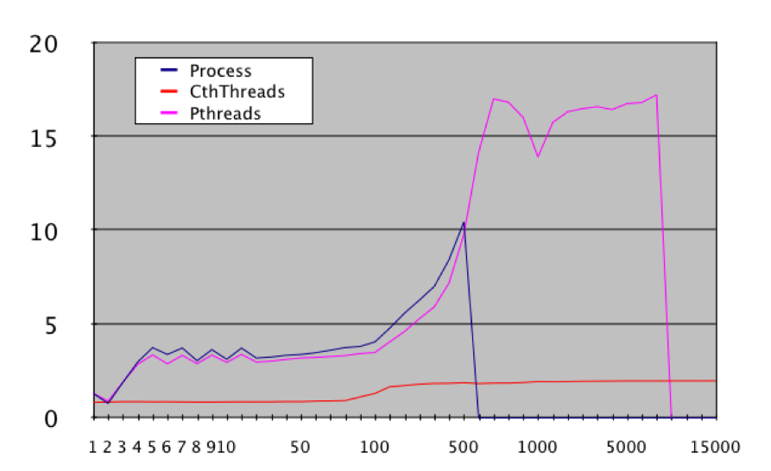
Context Switch Cost

Slide 67
What are (Converse) Threads?
One flow of control (instruction stream)‏
Machine Registers & program counter
Execution stack
Like pthreads (kernel threads)‏
Only different:
Implemented at user level (in Converse)‏
Scheduled at user level; non-preemptive
Migratable between nodes

Slide 68
How do I use Threads?
Many options:
AMPI
Always uses threads via TCharm library
Charm++
[threaded] entry methods run in a thread
[sync] methods
Converse
C routines CthCreate/CthSuspend/CthAwaken
Everything else is built on these
Implemented using
SYSV makecontext/setcontext
POSIX setjmp/alloca/longjmp
Assembly code

Slide 69
How do I use Threads (example)‏
Blocking API routine: find array element
int requestFoo(int src) {
myObject *obj=...;
return obj->fooRequest(src)‏
}
Send request and suspend
int myObject::fooRequest(int src) {
proxy[dest].fooNetworkRequest(thisIndex);
stashed_thread=CthSelf();
CthSuspend(); // -- blocks until awaken call --
return stashed_return;
}
Awaken thread when data arrives
void myObject::fooNetworkResponse(int ret) {
stashed_return=ret;
CthAwaken(stashed_thread);
}

Slide 70
How do I use Threads (example)‏
Send request, suspend, recv, awaken, return
int myObject::fooRequest(int src) {
proxy[dest].fooNetworkRequest(thisIndex);
stashed_thread=CthSelf();
CthSuspend();
return stashed_return;
}
void myObject::fooNetworkResponse(int ret) {
stashed_return=ret;
CthAwaken(stashed_thread);
}

Slide 71
Thread Migration

Slide 72
Stack Data
The stack is used by the compiler to track function calls and provide temporary storage
Local Variables
Subroutine Parameters
C “alloca” storage
Most of the variables in a typical application are stack data
Stack is allocated by Charm run-time as heap memory (+stacksize)‏

Slide 73
Migrate Stack Data
Without compiler support, cannot change stack’s address
Because we can’t change stack’s interior pointers (return frame pointer, function arguments, etc.)‏
Existing pointers to addresses in original stack become invalid
Solution: “isomalloc” addresses
Reserve address space on every processor for every thread stack
Use mmap to scatter stacks in virtual memory efficiently
Idea comes from PM²
Notes:
Isomalloc Stacks A user-level thread, when suspended, consists of a stack and a set of
preserved machine registers. During migration, the machine registers are simply copied
to the new processor. The stack, unfortunately, is very difficult to move. In a distributed
memory parallel machine, if the stack is moved to a new machine, it will almost undoubtedly
be allocated at a different location, so existing pointers to addresses in the
original stack would become invalid when the stack moves. We cannot reliably update
all the pointers to stack-allocated variables, because these pointers are stored in machine
registers and stack frames, whose layout is highly machine- and compiler-dependent.
PM2 [12] is another migratable thread system, which treats threads as remote procedure calls, which return some data on completion .
Multithreaded systems such as PM 2 [NM96] require every thread to store its state in specially allocated memory, so that the system can migrate the thread automatically

Slide 74
Migrate Stack Data
Processor A’s Memory
Processor B’s Memory
0xFFFFFFFF
0xFFFFFFFF
Thread 1 stack
Thread 2 stack
Migrate Thread 3
Thread 3 stack
Thread 4 stack
Heap
Heap
Globals
Globals
Code
Code
0x00000000
0x00000000

Slide 75
Migrate Stack Data: Isomalloc
Processor A’s Memory
Processor B’s Memory
0xFFFFFFFF
0xFFFFFFFF
Thread 1 stack
Thread 2 stack
Migrate Thread 3
Thread 3 stack
Thread 4 stack
Heap
Heap
Globals
Globals
Code
Code
0x00000000
0x00000000

Slide 76
Migrate Stack Data
Isomalloc is a completely automatic solution
No changes needed in application or compilers
Just like a software shared-memory system, but with proactive paging
But has a few limitations
Depends on having large quantities of virtual address space (best on 64-bit)‏
32-bit machines can only have a few gigs of isomalloc stacks across the whole machine
Depends on unportable mmap
Which addresses are safe? (We must guess!)‏
What about Windows? Or Blue Gene?

Slide 77
Aliasing Stack Data
Processor A’s Memory
Processor B’s Memory
0xFFFFFFFF
0xFFFFFFFF
Thread 3 stack
Heap
Thread 2 stack
Heap
Globals
Globals
Code
Code
0x00000000
0x00000000

Slide 78
Aliasing Stack Data: Run Thread 2
Processor A’s Memory
Processor B’s Memory
0xFFFFFFFF
0xFFFFFFFF
Thread 2 stack
Execution Copy
Thread 3 stack
Heap
Thread 2 stack
Heap
Globals
Globals
Code
Code
0x00000000
0x00000000

Slide 79
Aliasing Stack Data
Processor A’s Memory
Processor B’s Memory
0xFFFFFFFF
0xFFFFFFFF
Thread 3 stack
Heap
Thread 2 stack
Heap
Globals
Globals
Code
Code
0x00000000
0x00000000

Slide 80
Aliasing Stack Data: Run Thread 3
Processor A’s Memory
Processor B’s Memory
0xFFFFFFFF
0xFFFFFFFF
Thread 3 stack
Execution Copy
Thread 3 stack
Heap
Thread 2 stack
Heap
Globals
Globals
Code
Code
0x00000000
0x00000000

Slide 81
Aliasing Stack Data
Processor A’s Memory
Processor B’s Memory
0xFFFFFFFF
0xFFFFFFFF
Migrate Thread 3
Thread 3 stack
Heap
Thread 3 stack
Heap
Thread 2 stack
Globals
Globals
Code
Code
0x00000000
0x00000000

Slide 82
Aliasing Stack Data
Processor A’s Memory
Processor B’s Memory
0xFFFFFFFF
0xFFFFFFFF
Heap
Thread 3 stack
Heap
Thread 2 stack
Globals
Globals
Code
Code
0x00000000
0x00000000

Slide 83
Aliasing Stack Data
Processor A’s Memory
Processor B’s Memory
0xFFFFFFFF
0xFFFFFFFF
Execution Copy
Thread 3 stack
Heap
Thread 3 stack
Heap
Thread 2 stack
Globals
Globals
Code
Code
0x00000000
0x00000000

Slide 84
Aliasing Stack Data
Does not depend on having large quantities of virtual address space
Works well on 32-bit machines
Requires only one mmap’d region at a time
Works even on Blue Gene!
Downsides:
Thread context switch requires munmap/mmap (3us)‏
Can only have one thread running at a time (so no SMP’s!)‏
“-thread memoryalias” link time option

Slide 85
Heap Data
Heap data is any dynamically allocated data
C “malloc” and “free”
C++ “new” and “delete”
F90 “ALLOCATE” and “DEALLOCATE”
Arrays and linked data structures are almost always heap data

Slide 86
Migrate Heap Data
Automatic solution: isomalloc all heap data just like stacks!
“-memory isomalloc” link option
Overrides malloc/free
No new application code needed
Same limitations as isomalloc; page allocation granularity (huge!)‏
Manual solution: application moves its heap data
Need to be able to size message buffer, pack data into message, and unpack on other side
“pup” abstraction does all three

Slide 87
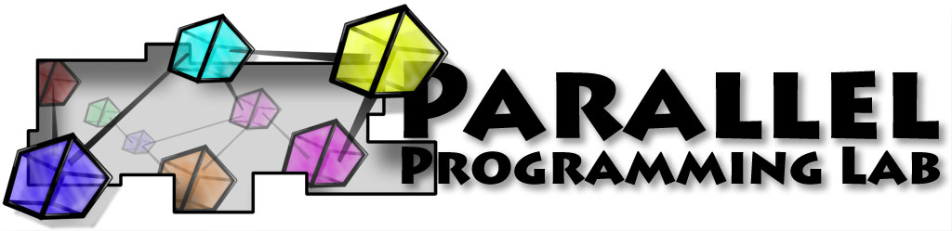
Thank You!
Free source, binaries, manuals, and more information at: http://charm.cs.uiuc.edu/
Parallel Programming Lab at University of Illinois

