Slide 1
Scalable Performance Optimizations for Dynamic Applications
Laxmikant Kale
http://charm.cs.uiuc.edu
Parallel Programming Laboratory
Dept. of Computer Science
University of Illinois at Urbana Champaign

Slide 2
Scalability Challenges
Scalability Challenges
  Machines are getting bigger and faster
But
  Communication Speeds?
  Memory speeds?
"Now, here, you see, it takes all the running you can do to keep in the same place"
---Red Queen to Alice in “Through The Looking Glass”
  Further:
    Applications are getting more ambitious and complex
      Irregular structures and Dynamic behavior
  Programming models?

Slide 3
Objectives for this Tutorial
Learn techniques that help achieve speedup
  On Large parallel machines
  On complex applications
    Irregular as well as regular structures
    Dynamic behaviors
    Multiple modules
Emphasis on:
  Systematic analysis
  Set of techniques : a toolbox
Real life examples
  Production codes (e.g. NAMD)
  Existing machines

Slide 4
Current Scenario: Machines
Extremely High Performance machines abound
Clusters in every lab
  GigaFLOPS per processor!
  100 GFLOPS/S performance possible
High End machines at centers and labs:
  Many thousand processors, multi-TF performance
  Earth Simulator, ASCI White, PSC Lemieux,..
Future Machines
  Blue Gene/L : 128k processors!
  Blue Gene Cyclops Design: 1M processors
    Multiple Processors per chip
    Low Memory to Processor Ratio

Slide 5
Communication Architecture
On clusters:
  100 MB ethernet
    100 μs latency
  Myrinet switches
    User level memory-mapped communication
    5-15 μs latency, 200 MB/S Bandwidth..
    Relatively expensive, when compared with cheap PCs
  VIA, Infiniband
On high end machines:
  5-10 μs latency, 300-500 MB/S BW
  Custom switches (IBM, SGI, ..)
  Quadrix
Overall:
  Communication speeds have increased but not as much as processor speeds

Slide 6
Memory and Caches
Bottom line again:
  Memories are faster, but not keeping pace with processors
  Deep memory hierarchies:
    On Chip and off chip.
  Must be handled almost explicitly in programs to get good performance
    A factor of 10 (or even 50) slowdown is possible with bad cache behavior
    Increase reuse of data: If the data is in cache, use it for as many different things you need to do..
    Blocking helps

Slide 7
Application Complexity is increasing
Why?
  With more FLOPS, need better algorithms..
    Not enough to just do more of the same..
  Better algorithms lead to complex structure
  Example: Gravitational force calculation
    Direct all-pairs: O(N²), but easy to parallelize
    Barnes-Hut: N log(N) but more complex
  Multiple modules, dual time-stepping
  Adaptive and dynamic refinements
Ambitious projects
  Projects with new objectives lead to dynamic behavior and multiple components

Slide 8
Disparity between peak and attained speed
As a combination of all of these factors:
  The attained performance of most real applications is substantially lower than the peak performance of machines
  Caution: Expecting to attain peak performance is a pitfall..
    We don’t use such a metric for our internal combustion engines, for example
    But it gives us a metric to gauge how much improvement is possible

Slide 9
Overview
Programming Models Overview:
  MPI
  Virtualization and AMPI/Charm++
Diagnostic tools and techniques
Analytical Techniques:
  Isoefficiency, ..
Introduce recurring application Examples
Performance Issues
  Define categories of performance problems
Optimization Techniques for each class
Case Studies woven through

Slide 10
Programming Models

Slide 11
Message Passing
Assume that processors have direct access to only their memory
Each processor typically executes the same executable, but may be running different part of the program at a time

Slide 12
Message passing basics:
Basic calls: send and recv
send(int proc, int tag, int size, char *buf);
recv(int proc, int tag, int size, char * buf);
Recv may return the actual number of bytes received in some systems
tag and proc may be wildcarded in a recv:
  recv(ANY, ANY, 1000, &buf);
Global Operations:
  broadcast
  Reductions, barrier
Global communication: gather, scatter
MPI standard led to a portable implementation of these

Slide 13
MPI: Gather, Scatter, All_to_All
Gather (example):
  MPI_Gather( sendarray, 100, MPI_INT, rbuf, 100, MPI_INT, root, comm);
  Gets data collected at the (one) processor whose rank == root, of size 100*number_of_processors
Scatter
  MPI_Scatter( sendbuf, 100, MPI_INT, rbuf, 100, MPI_INT, root, comm);
  Root has the data, whose segments of size 100 are sent to each processor
Variants:
  Gatherv, scatterv: variable amounts deposited by each proc
  AllGather, AllScatter:
    each processor is destination for the data, no root
All_to_all:
  Like allGather, but data meant for each destination is different

Slide 14
Virtualization: Charm++ and AMPI
These systems seek an optimal division of labor between the “system” and programmer:
  Decomposition done by programmer,
  Everything else automated
Decomposition
Abstraction
Mapping
Charm++
HPF
Scheduling
Expression
MPI
Specialization

Slide 15
Virtualization: Object-based Decomposition
Idea:
  Divide the computation into a large number of pieces
    Independent of number of processors
    Typically larger than number of processors
  Let the system map objects to processors
Old idea? G. Fox Book (’86?), DRMS (IBM), ..
This is “virtualization++”
  Language and runtime support for virtualization
  Exploitation of virtualization to the hilt

Slide 16
Object-based Parallelization
User is only concerned with interaction between objects
System implementation
User View

Slide 17
Data driven execution
Scheduler
Scheduler
Message Q
Message Q

Slide 18
Charm++
Parallel C++ with Data Driven Objects
Object Arrays/ Object Collections
Object Groups:
  Global object with a “representative” on each PE
Asynchronous method invocation
Prioritized scheduling
Mature, robust, portable
http://charm.cs.uiuc.edu

Slide 19
Charm++ : Object Arrays
A collection of data-driven objects (aka chares),
  With a single global name for the collection, and
  Each member addressed by an index
  Mapping of element objects to processors handled by the system
User’s view
A[0]
A[1]
A[2]
A[3]
A[..]

Slide 20
Charm++ : Object Arrays
A collection of chares,
  with a single global name for the collection, and
  each member addressed by an index
  Mapping of element objects to processors handled by the system
User’s view
A[0]
A[1]
A[2]
A[3]
A[..]
System view
A[0]
A[3]

Slide 21
Chare Arrays
Elements are data-driven objects
Elements are indexed by a user-defined data type-- [sparse] 1D, 2D, 3D, tree, ...
Send messages to index, receive messages at element. Reductions and broadcasts across the array
Dynamic insertion, deletion, migration-- and everything still has to work!

Slide 22
Comparison with MPI
Advantage: Charm++
  Modules/Abstractions are centered on application data structures,
    Not processors
  Abstraction allows advanced features like load balancing
Advantage: MPI
  Highly popular, widely available, industry standard
  “Anthropomorphic” view of processor
    Many developers find this intuitive
But mostly:
  There is no hope of weaning people away from MPI
  There is no need to choose between them!

Slide 23
Adaptive MPI
A migration path for legacy MPI codes
  Allows them dynamic load balancing capabilities of Charm++
AMPI = MPI + dynamic load balancing
Uses Charm++ object arrays and migratable threads
Minimal modifications to convert existing MPI programs
  Automated via AMPizer
Bindings for
  C, C++, and Fortran90

Slide 24
AMPI:
7 MPI processes

Slide 25
AMPI:
7 MPI “processes”
Implemented as virtual processors (user-level migratable threads)
Real Processors

Slide 26
Virtualization summary
Virtualization is
  using many “virtual processors” on each real processor
  A VP may be an object, an MPI thread, etc.
Charm++ and AMPI
  Examples of programming systems based on virtualization
Virtualization leads to:
  Message-driven (aka data-driven) execution
  Allows the runtime system to remap virtual processors to new processors
    Several performance benefits
For the purpose of this tutorial:
  Just be aware that there may be multiple independent things on a PE
  Also, we will use virtualization as a technique for solving some performance problems

Slide 27
Diagnostic Tools and Techniques

Slide 28
Diagnostic tools
Categories
  On-line, vs Post-mortem
  Visualizations vs numbers
  Raw data vs auto-analyses
Some simple tools (do it yourself analysis)
  Fast (on chip) timers
    Log them to buffers, print data at the end,
      to avoid interference from observation
  Histograms gathered at runtime
    Minimizes amount of data to be stored
    E.g. the number of bytes sent in each message
      Classify them using a histogram array,
      increment the count in one
  Back of the envelope calculations!

Slide 29
Live Visualization
Favorite of CS researchers
What does it do:
  As the program is running, you can see time varying plots of important metrics
    E.g. Processor utilization graph, processor utilization shown as an animation
    Communication patterns
  Some researchers have even argued for (and developed) live sonification
    Sound patterns indicate what is going on, and you can detect problems…
In my personal opinion, live analysis not as useful
  Even if we can provide feedback to application to steer it, a program module can often do that more effectively (no manual labor!)
  Sometimes it IS useful to have monitoring of application, but not necessarily for performance optimization

Slide 30
Postmortem data
Types of data and visualizations:
  Time-lines
    Example tools: upshot, projections, paragraph
    Shows a line for each (selected) processor
      With a rectangle for each type of activity
      Lines/markers for system and/or user-defined events
  Profiles
    By modules/functions
    By communication operations
      E.g. how much time spent in reductions
  Histograms
    E.g.: classify all executions of a particular function based on how much time it took.
    Outliers are often useful for analysis

Slide 31
Analytical Techniques

Slide 32
Major analytical/theoretical techniques
Typically involves simple algebraic formulas, and ratios
  Typical variables are:
    data size (N), number of processors (P), machine constants
  Model performance of individual operations, components, algorithms in terms of the above
    Be careful to characterize variations across processors, and model them with (typically) max operators
      E.g. max{Load _{I}}
  Remember that constants are important in practical parallel computing
    Be wary of asymptotic analysis: use it, but carefully
Scalability analysis:
  Isoefficiency

Slide 33
Scalability
The Program should scale up to use a large number of processors.
  But what does that mean?
An individual simulation isn’t truly scalable
Better definition of scalability:
  If I double the number of processors, I should be able to retain parallel efficiency by increasing the problem size

Slide 34
Isoefficiency
Quantify scalability
How much increase in problem size is needed to retain the same efficiency on a larger machine?
Efficiency : Seq. Time/ (P · Parallel Time)
  parallel time = computation + communication + idle
One way of analyzing scalability:
  Isoefficiency:
    Equation for equal-efficiency curves
  Use η(p,N) = η(x.p, y.N) to get this equation
  If no solution: the problem is not scalable
    in the sense defined by isoefficiency
Equal efficiency curves
Problem size
processors

Slide 35
Running Examples

Slide 36
Introduction to recurring applications
We will use these applications for example throughout
  Jacobi Relaxation
    Classic finite-stencil-on-regular-grid code
  Molecular Dynamics for biomolecules
    Interacting 3D points with short- and long-range forces
  Rocket Simulation
    Multiple interacting physics modules
  Cosmology / Tree-codes
    Barnes-hut-like fast trees

Slide 37
Jacobi Relaxation
Sequential pseudoCode:
Decomposition by:
While (maxError > Threshold) {
Re-apply Boundary conditions
maxError = 0;
for i = 0 to N-1 {
for j = 0 to N-1 {
B[i,j] = 0.2(A[i,j] +
A[I,j-1] +A[I,j+1] +
A[I+1, j] + A[I-1,j]) ;
if (|B[i,j]- A[i,j]| > maxError)
maxError = |B[i,j]- A[i,j]|
} }
swap B and A
}
Row
Blocks
Or Column

Slide 38
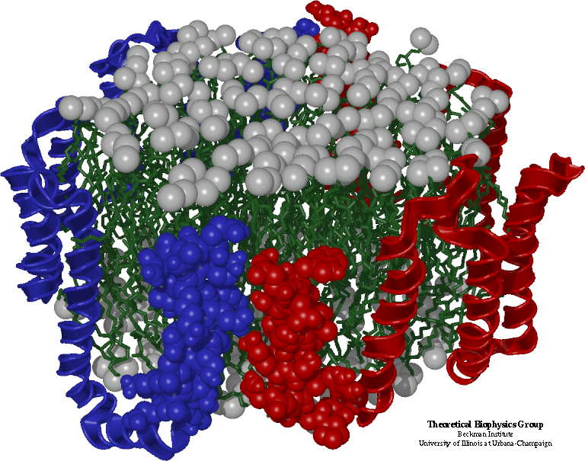
Molecular Dynamics in NAMD
Collection of [charged] atoms, with bonds
  Newtonian mechanics
  Thousands of atoms (1,000 - 500,000)
  1 femtosecond time-step, millions needed!
At each time-step
  Calculate forces on each atom
    Bonds:
    Non-bonded: electrostatic and van der Waal’s
      Short-distance: every timestep
      Long-distance: every 4 timesteps using PME (3D FFT)
      Multiple Time Stepping
  Calculate velocities and advance positions
Collaboration with K. Schulten, R. Skeel, and coworkers

Slide 39
Traditional Approaches: non isoefficient
Replicated Data:
  All atom coordinates stored on each processor
    Communication/Computation ratio: P log P
Partition the Atoms array across processors
  Nearby atoms may not be on the same processor
  C/C ratio: O(P)
Distribute force matrix to processors
  Matrix is sparse, non uniform,
  C/C Ratio: sqrt(P)
Not Scalable

Slide 40
Spatial Decomposition
Atoms distributed to cubes based on their location
Size of each cube :
  Just a bit larger than cut-off radius
  Communicate only with neighbors
  Work: for each pair of nbr objects
C/C ratio: O(1)
However:
  Load Imbalance
  Limited Parallelism
Cells, Cubes or“Patches”

Slide 41
Object Based Parallelization for MD:
Force Decomposition + Spatial Deomp.
Now, we have many objects to load balance:
  Each diamond can be assigned to any proc.
  Number of diamonds (3D):
  14·Number of Patches

Slide 42
Bond Forces
Multiple types of forces:
  Bonds(2), Angles(3), Dihedrals (4), ..
  Luckily, each involves atoms in neighboring patches only
Straightforward implementation:
  Send message to all neighbors,
  receive forces from them
  26*2 messages per patch!
Instead, we do:
  Send to (7) upstream nbrs
  Each force calculated at one patch
A
C
B

Slide 43
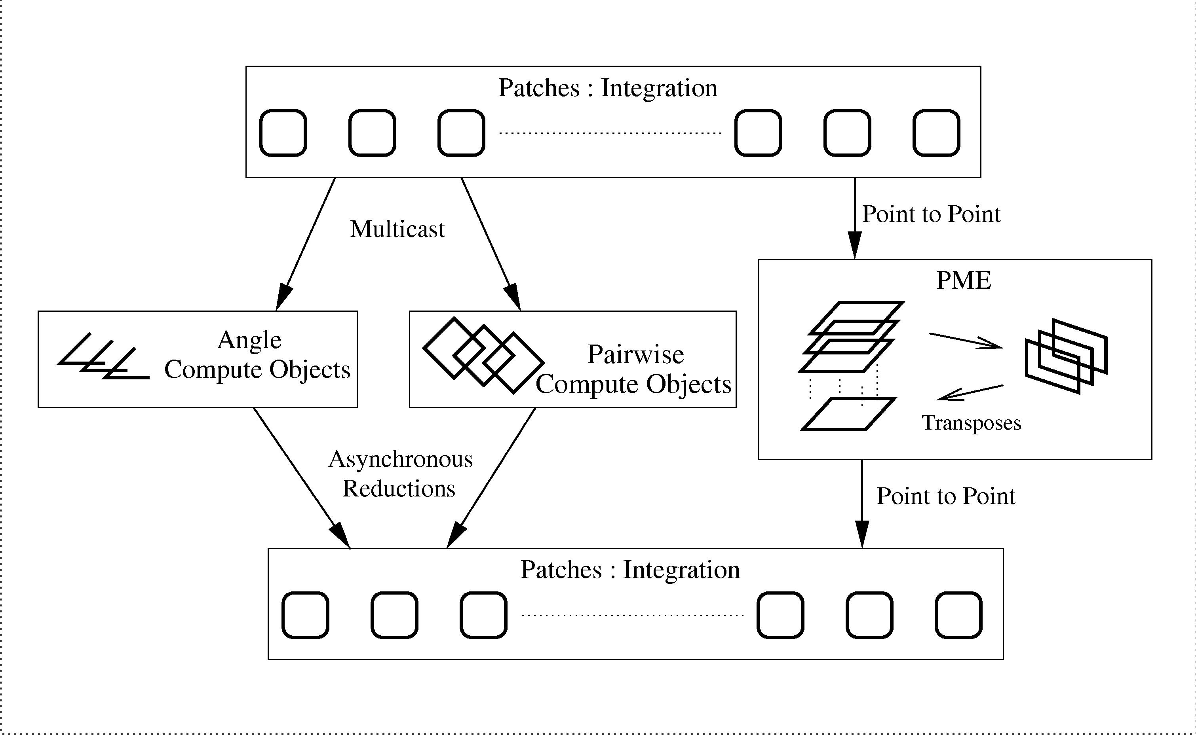
Virtualized Approach to implementation: using Charm++
192 + 144 VPs
700 VPs
30,000 VPs
These 30,000+ Virtual Processors (VPs) are mapped to real processors by charm runtime system

Slide 44
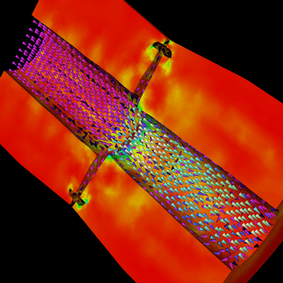
Rocket Simulation
Dynamic, coupled physics simulation in 3D
Finite-element solids on unstructured tet mesh
Finite-volume fluids on structured hex mesh
Coupling every timestep via a least-squares data transfer
Challenges:
  Multiple modules
  Dynamic behavior: burning surface, mesh adaptation
Robert Fielder, Center for Simulation of Advanced Rockets
Collaboration with M. Heath, P. Geubelle, others

Slide 45
Computational Cosmology
Here, we focus on n-body aspects of it
  N particles (1 to 100 million), in a periodic box
  Move under gravitation
  Organized in a tree (oct, binary (k-d), ..)
  Processors may request particles from specific nodes of the tree
Initialization and postmortem:
  Particles are read (say in parallel)
  Must distribute them to processor roughly equally
  Must form the tree at runtime
    Initially and after each step (or a few steps)
Issues:
  Load balancing, fine-grained communication, tolerating communication latencies.
  More complex versions may do multiple-time stepping
Collaboration with T. Quinn, Y. Staedel, others

Slide 46
Classification of Performance Problems

Slide 47
Causes of performance loss
If each processor is rated at k MFLOPS, and there are p processors, why don’t we see k•p MFLOPS performance?
  Several causes,
  Each must be understood separately, first
  But they interact with each other in complex ways
    Solution to one problem may create another
    One problem may mask another, which manifests itself under other conditions (e.g. increased p).

Slide 48
Performance Issues
Algorithmic overhead
Speculative Loss
Sequential Performance
Critical Paths
Bottlenecks
Communication Performance
  Overhead and grainsize
  Too many messages
  Global Synchronization
Load imbalance

Slide 49
Why Aren’t Applications Scalable?
Algorithmic overhead
  Some things just take more effort to do in parallel
    Example: Parallel Prefix (Scan)
Speculative Loss
  Do A and B in parallel, but B is ultimately not needed
Load Imbalance
  Makes all processor wait for the “slowest” one
  Dynamic behavior
Communication overhead
  Spending increasing proportion of time on communication
Critical Paths:
  Dependencies between computations spread across processors
Bottlenecks:
  One processor holds things up

Slide 50
Algorithmic Overhead
Sometimes, we have to use an algorithm with higher operation count in order to parallelize an algorithm
  Either the best sequential algorithm doesn’t parallelize at all
  Or, it doesn’t parallelize well (e.g. not scalable)
What to do?
  Choose algorithmic variants that minimize overhead
  Use two level algorithms
Examples:
  Parallel Prefix (Scan)
  Game Tree Search

Slide 51
Parallel Prefix
Given array A[0..N-1], produce B[N], such that B[k] is the sum of all elements of A upto A[k]
B[0] = A[0];
for (I=1; I<N; I++)
B[I] = B[I-1]+A[I];
Data dependency from iteration to iteration.
How can this be parallelized at all?
Theoreticians to the rescue:
they came up with a clever algorithm.

Slide 52
Parallel prefix : recursive doubling
5 | 3 | 7 | 2 | 1 | 3 | 1 | 2
N Data Items
P Processors
N=P
5 | 8 | 10 | 9 | 3 | 4 | 4 | 3
Log P Phases
P additions in each phase
P log P ops
Completes in O(P) time
5 | 8 | 15 | 17 | 13 | 13 | 7 | 7
5 | 8 | 15 | 17 | 18 | 21 | 22 | 24

Slide 53
Parallel Prefix: Engineering
Issue : N >> P
Recursive doubling : Naïve implementation
  Operation count: log(N) . N
A better implementation: well-engineered:
  Take blocking of data into account
  Each processor calculate its sum, then
    Participates in a parallel algorithm (with P numbers)
    to get sum to its left, and then adds to all its elements
  N + log(P) +N:
    Only doubling of operation Count
What did we do?
  Same algorithm, better parallelization/engineering

Slide 54
Parallelization overhead: summary of advice
Explore alternative algorithms
  Unless the algorithmic overhead is inevitable!
Don’t take algorithms that say “We use f(N) processors to solve a problem of size N” as they are.
  Use Clyde Kruskal’s metric
    Performance results must be in terms of
      N data items, P processors
  Reformulate accordingly

Slide 55
Algorithmic overhead: Game Tree Search
Game Trees for 2-person, zero-sum games (Chess)
  Bad Sequential Algorithm:
    Min-Max tree
  Good Sequential algorithm: Evaluate using α−β search
    Relies on left-to-right evaluation (dependency!)
      Not parallel!
    Prunes a large number of nodes

Slide 56
Algorithmic overhead: Game Tree Search
A (simple) solution:
  Use min-max at top level of trees
  Below a certain threshold (simple: depth),
    use sequential α−β
Other variations:
  Use prioritized tree generation at high levels, with Left-to-Right bias
  Use α−β at top! Firing only essential leaves as subtasks
    Useful for small # of processors
    Or, relax “essential” in interesting ways

Slide 57
Speculative Loss: Branch and Bound
Problem and parallelization via objects
  B&B leads to a search tree, with pruning
  Tree is naturally parallel structure, but…
Speculative loss:
  Number of tree nodes processed increases with procs
  Solution: Scalable Prioritized load balancing
  Memory balancing
Good Speedup on 512 processors
  1024 processor NCUBE, in 1990+
Lessons:
  Importance of priorities
  Need to work with application experts!
Sinha and Kale, 1992, Prioritized Load Balancing

Slide 58
Critical Paths
What: Long chain of dependence
  that holds a computation step up
Diagnostic:
  Performance scales upto P processors, after which is stagnates to a (relatively) fixed value
    That by itself may have other causes….
Solution:
  Eliminate long chains if possible
  Shorten chains by removing work from critical path

Slide 59
Bottlenecks
How to detect:
  One processor A is busy while others wait
  And there is a data dependency on the result produced by A
Typical situations:
  Everyone sends data to one processor, which computes some function and sends result to everyone.
  Master-slave: one processor assigning job in response to requests
Solution techniques:
  Typically, solved by using a spanning tree based collection mechanism
  Hierarchical schemes for master slave
  What makes it hard:
    Program may not show ill effects for a long time
    Eventually someone runs it on a large machine, where it shows up

Slide 60
Communication Overhead

Slide 61
Communication Operations
Kinds of communication operations:
  Point-to-point
  Synchronization
    Barriers, Scalar Reductions
  Vector reductions
    Data size is significant
  Broadcasts
    Short (Signals)
    Large
  Global (Collective) operations
    All-to-all operations, gather, scatter

Slide 62
Communication Basics: Point-to-point
Sending processor
Sending Co-processor
Network
Receiving co-processor
Receiving processor
Elan-3 cards on alphaservers (TCS):
Of 2.3 μs “put” time
1.0 : proc/PCI
1.0 : elan card
0.2: switch
0.1 Cable
Each component has a per-message cost, and per byte cost

Slide 63
Communication Basics
Each cost, for a n-byte message
  = ά + n β
Important metrics:
  Overhead at Processor, co-processor
  Network latency
  Network bandwidth consumed
    Number of hops traversed
Elan-3 TCS Quadrics data:
  MPI send/recv: 4-5 μs
  Shmem put: 2.5 μs
  Bandwidth : 325 MB/S (about 3 ns per byte)

Slide 64
Communication: Diagnostic Techniques
A simple technique:
  Count the number of messages per second of computation per processor! (max, average)
  Count number of bytes
  Calculate: computation per message (and per byte)
Use profiling tools:
  Identify time spent in different communication operations
  Classified by modules
Examine idle time using time-line displays
  On important processors
  Determine the causes
Be careful with “synchronization overhead”
  May be load balancing masquerading as sync overhead.
  Common mistake.

Slide 65
Communication: Problems and Issues
Too small a Grainsize
  Total Computation time / total number of messages
  Separated by phases, modules, etc.
Too many, but short messages
  α vs. β tradeoff
Processors wait too long
Locality of communication
  Local vs. non-local
  How far is non-local? (Does that matter?)
Synchronization
Global (Collective) operations
  All-to-all operations, gather, scatter

Slide 66
Communication: Solution Techniques
Summary:
  Overlap with Computation
    Manual
    Automatic and adaptive, using virtualization
  Increasing grainsize
  α-reducing optimizations
    Message combining
    communication patterns
  Controlled Pipelining
  Locality enhancement: decomposition control
    Local-remote and bw reduction
  Asynchronous reductions
  Improved Collective-operation implementations

Slide 67
Overlapping Communication-Computation
Problem:
  Processors wait for too long at “receive” statements
Idea:
  Instead of waiting for data, do useful work
  Issue: How to create such work?
    Can’t depend on the data to be received
Routine communication optimizations in MPI
  Move sends up and receives down
    Keep data dependencies in mind..
  Moving receive down has a cost: system needs to buffer message
    Use irecvs, but be careful
    irecv allows you to post a buffer for a recv, but not wait for it

Slide 68
Adaptive Overlap via Data-driven Objects
Problem:
  Processors wait for too long at “receive” statements
With Virtualization, you get Data-driven execution
  Charm++ and AMPI
  There are multiple entities (objects, threads) on each proc
    No single object or threads holds up the processor
    Each one is “continued” when its data arrives
  No need to guess which is likely to arrive first
  So: Achieves automatic and adaptive overlap of computation and communication
This kind of data-driven idea can be used in MPI as well.
  Using wild-card receives
  But as the program gets more complex, it gets harder to keep track of all pending communication in all places that are doing a receive

Slide 69
Modularity and Adaptive Overlap
“Parallel Composition Principle: For effective composition of parallel components, a compositional programming language should allow concurrent interleaving of component execution, with the order of execution constrained only by availability of data.”
(Ian Foster, Compositional parallel programming languages, ACM Transactions of Programming Languages and Systems, 1996)
Notes:
The first substantiation of our approach comes from Ian Foster’s parallel composition principle, which states that a programming language should allow individual components to concurrently interleave their execution. And the order of execution of these components should be implicitly determined by data availability.

Slide 70
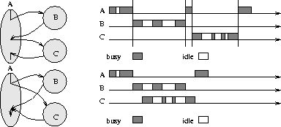
Why Message-Driven Modules ?
SPMD and Message-Driven Modules
(From A. Gursoy, Simplified expression of message-driven programs and quantification of their impact on performance, Ph.D Thesis, Apr 1994.)
Notes:
This is very nicely illustrated in a figure I borrowed from Attila Gursoy’s thesis. Module A needs to avail services from Module B and C. In a message-passing paradigm, these modules cannot execute concurrently, thus idle times in one modules cannot be substituted by computations from another module. This is possible in message-driven paradigm. We therefore base our component architecture on a message-driven runtime system, called Converse. We describe Converse next.

Slide 71
Grainsize optimizations
Symptom:
  Too much time spent in communication
    E.g. Comparing 1 proc. performance with 100 proc.
    Some profiling tools will show you.
  And too many messages
    Computation per message is small (say < 0.1 ms, today)
Solution:
  Try to increase the grainsize
    By changing object placement
    Reusing data that is communicated more

Slide 72
Grainsize control
A Simple definition of grainsize:
  Amount of computation per message
  Problem: short message/ long message
More realistic:
  Computation to communication ratio

Slide 73
Example: Matrix multiplication
How to parallelize this?
For (I=0; I<N; I++)
For (J=0; j<N; J++) // c[I][j] ==0
For(k=0; k<N; k++)
C[I][J] += A[I][K] * B[K][J];

Slide 74
Matmul: A simple algorithm:
Distribute A by rows, B by columns
  So,any processor can request a row of A and get it (in two messages).
    Same for a column of B,
  Distribute the work of computing each element of C using some load balancing scheme
    So it works even on machines with varying processor capabilities (e.g. timeshared clusters)
  What is the computation-to-communication ratio?
    For each object: 2•N ops, 2 messages with N bytes
Other Algorithms for Matrix Multiplication exist. This is just an example

Slide 75
Matmul: Grainsize Control
Store A as a collection row-bunches
  each bunch stores g rows
  Same of B’s columns
Each object now computes a g x g section of C
Computation to communication ratio:
  Computation: 2*g*g*N ops
  Communication:
    2 messages, gN bytes each
    α ratio: 2g*g*N/2,
    β ratio: g
g
B
g
A

Slide 76
Data Placement optimizations
Consider a discrete-event simulation program (DES)
  Simulates cars traveling on city roads
  Objects being modeled are:
    Intersections, traffic lights, ..
    Cars are modeled by messages…
  Program has fine-grained communication (typical for DES)
Mapping to processors:
  N Intersections are distributed across P processors randomly
    Each message is likely to go to a remote processor!

Slide 77
Data Placement: Simulation of City Traffic
Change the placement:
  Place communicating objects on the same processor
    Cluster by neighborhoods.
    With grid-like city: block decomposition or multi-row decomposition
    With a block decomposition, if the block is 10x10
      Only 40 out of 400 possible messages go outside a processor
      Communication cut down by 90% !
What if the numbers don’t match:
  The number of processors is not a square
    Intersections: 173 x 59? 80 x 120 ? with 20 processors?
  Solution : Virtualization
    Number of objects can be square, but number of proc.s doesn’t need to be.
    Case 1: 108 objects, on 20 processors: 5-6 each. Load balance.
      Or make them 8x8 objects

Slide 78
α vs β
The per message cost >> per byte cost
  By a factor of thousand
    E.g. 10 μs : 3 ns
  So, several optimizations are possible that make a trade-off:
ά optimizations aim at reducing the number of messages
  Typically increase β component of cost
  Useful when the application generates many short messages
Kinds of ά optimizations
  Message combining
  Taking advantage of Communication patterns
    Multi-stage communication techniques
  Each-to-many and each-to-all algorithms
    Personalized and multicasts

Slide 79
Communication: Message Combining
If multiple entities on processor A are sending messages to one or more objects on B
  Combine them into a single message
  Sometimes, you don’t know when the msg is generated:
    Is this the last one for the neighbor?
    Solution: send them to an intermediate module, and bracket all sends with two calls to the module:
  This is a classic α optimization, but may present a tradeoff
Objects / Virtualization advantage?
  The RTS has the opportunity to combine messages into a single message
  Provides a tunable control point

Slide 80
Exploiting Communication Patterns
Example problem Molecular Dynamics:
  Consider the step when each cube cell sends atoms that have moved out of its box to its appropriate neighbor
    26 neighbors
  Each Processor, assumed to house just one cell, needs to send 26 short messages to “neighboring” processors
  Assume Send/Receive each: α = 10 us, β : 2ns
  Time spent : α cost: (notice: 26 sends and 26 receives):
    26*2(10 ) = 520 us
  Can this be improved? How?

Slide 81
Exploiting Communication Patterns: MD
Take advantage of the structure of communication, and do communication in stages:
Let us look at 2-D case first:
  Need to send 8 distinct messages
  If my coordinates are (x,y):
    send to (x+1, y) anything that goes to (x+1,*)
    send to (x-1, y) anything that goes to (x-1,*)
  Then:
    Wait for messages from x neighbors, then
    Send to y neighbors a combined message, with all data sent by my x neighbors meant for them
  Reduces the number of messages from 8 to 4
3-D algorithm is similar:
  A total of 6 messages instead of 26
  Apparently longer critical path
  Almost 3 times increase in β cost (but ok, if few atoms migrate)

Slide 82
Another idea for atom migration..
Send all migrating atoms to processor 0
  Let processor 0 sort them out and send 1 message to each processor
  Works well if the number of processors is small
    Only one message sent and received
    Otherwise, bottleneck at 0
  Be aware that such algorithms may get embedded in the code
    And the problem won’t be revealed until you start running the application on a large number of processors

Slide 83
Each to Many, Personalized
Now suppose, At a particular step in an application
  Each processor sends a large number of messages to others
    All others, or most others (not just 26)
      Say Ki sent by processor i
    May not know ahead of time how many messages each processor wants to send
  Each message is distinct as before
    But no clear pattern, unlike before
This is the general “each-to-many personalized messages” problem

Slide 84
Each to Many, Personalized
Straightforward implementation
  Each one directly sends each message to its destination
  But how do we know when we are done?
    Each processor needs to know how many to receive
Solution 1: send to all processors
  Some get empty messages
  Cost: p^2 (α + n β)
    Per processor: p (α + n β)
  Too expensive if the number of zero messages is high
    Or if p is large, (remember α >> β)
Solution 2:
  Separately count messages going to each destination
  Via a vector sum reduction, broadcast to everyone.

Slide 85
Each to Many Personalized
Solution 2 didn’t address the case when p is very large
Dimensional exchange:
  Arrange processors in a virtual hypercube:
    Use binary representation of a processor’s number:
    Its neighbors are: all those with a bit different
  log P Phases:
    In each phase i:
      Send data to the i-’th dimension neighbor
      First, each proc sends any data it wants to send to the neighbor in the other plane, along the red link.

Slide 86
Dimensional exchange: analysis
Each PE is sending n bytes to each other PE
  Total bytes sent (and received) by each processor:
    n(P-1) or about nP bytes
  The baseline algorithm (direct sends):
    Each processor incurs overhead of: (P-1)(α +n β)
  Dimensional exchange:
    Each processor sends half of the data that is has to its neighbor in each phase:
    (lg P) (α +0.5 nP β)
    The α factor is significantly reduced, but the β factor has increased. Most data items go multiple hops
    OK when n is sufficiently small, and/or P is large
      p α > 0.5 (lg p) n β. Ie. N < 2p α / β(log p).
      In practice: n < 200 P is a good heuristic

Slide 87



Each to many using a 2D grid
Must reduce number of hops traveled by each data item
  (log p may be 10+ for a 1024 processor system)
Arrange processors in a 2D (virtual) grid
  Phase I: each processor sends messages within its column
  Phase II: each processors waits for messages within its column, and then sends messages within its row.
  Now the β factor is proportional to 2 (2 hops)
  α factor is proportional to 2
N | P | Direct | Hypercube | Grid
100 | 16 | 154.5 | 58 | 89
100 | 64 | 649 | 173 | 178
100 | 256 | 2627 | 692 | 453
100 | 1024 | 10537 | 3169 | 1234
α : 10 μs
β : 3 ns
Ignores BW contention

Slide 88
Generalizations: k-ary D-cube
Arrange processors in k-ary hypercube
  There are k processors in each row
  There are D dimensions to the “hypercube”
Arrange processors in a 3D grid:
  α cost: 3*cuberoot(P)
  β cost: 3 n β

Slide 89
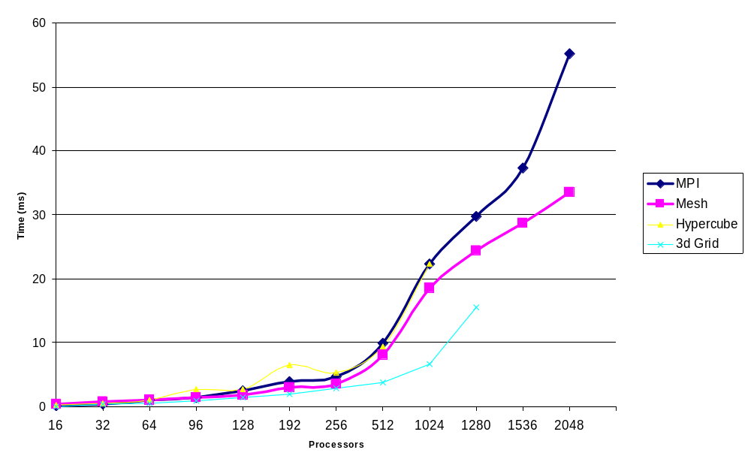
All to all on Lemieux for a 76 Byte Message

Slide 90
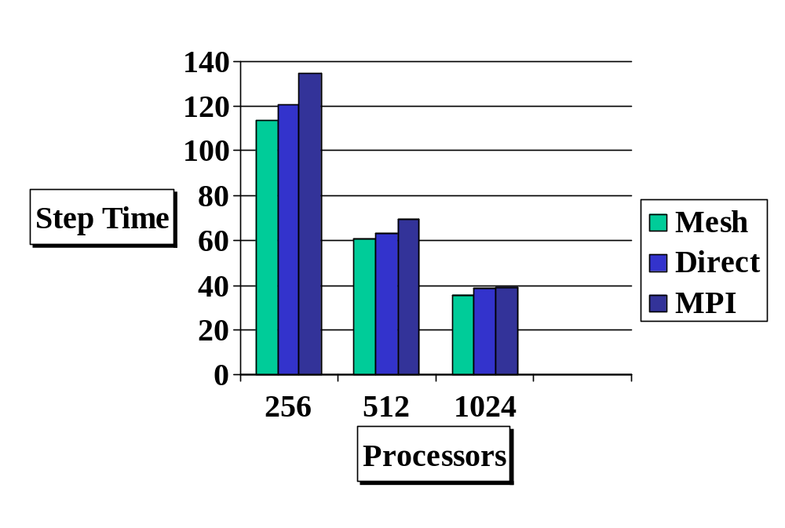
Impact on Application Performance
Namd Performance on Lemieux, with the transpose step implemented using different all-to-all algorithms

Slide 91
Each to many multicast
Identical message being sent from each processor
  Special case: each to all multicast (broadcast)
Can we adapt the previous algorithms?
  Send to one processor? Nah!
  Dimensional exchange, and row-column broadcast (grid) are alternatives to direct individual messages.
  Similar analysis

Slide 92
The Other Side: Pipelining
A sends a large message to B, whereupon B computes
  Problem: B is idle for a long time, while the message gets there.
  Solution: Pipelining
    Send the message in multiple pieces, triggering a computation on each
Objects makes this easy to do:
Example:
  Ab Initio Computations using Car-Parinello method
  Multiple 3D FFT kernel
Recent collaboration with: R. Car, M. Klein, G. Martyna, M, Tuckerman, N. Nystrom, J. Torrellas

Slide 93
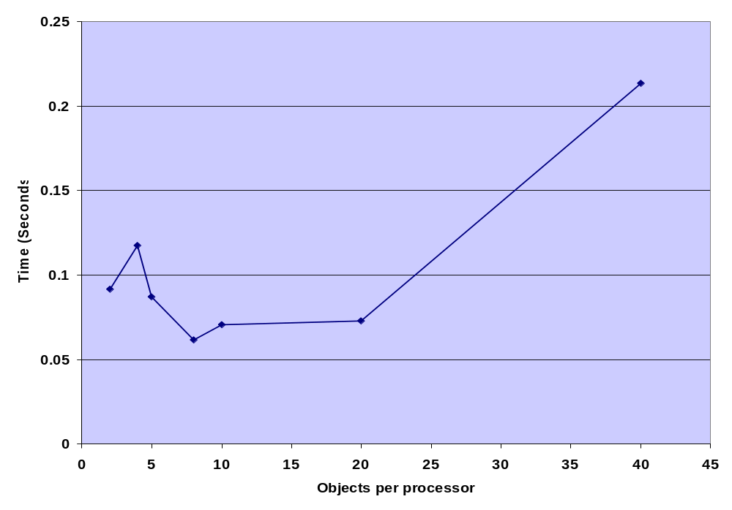
Effect of Pipelining
Multiple Concurrent 3D FFTs, on 64 Processors of Lemieux
Ramkumar Vadali (PPL)

Slide 94
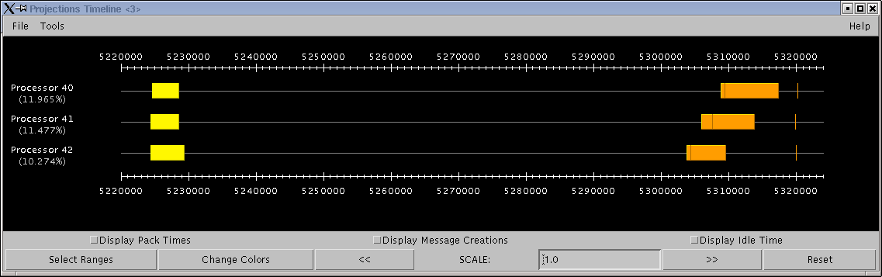
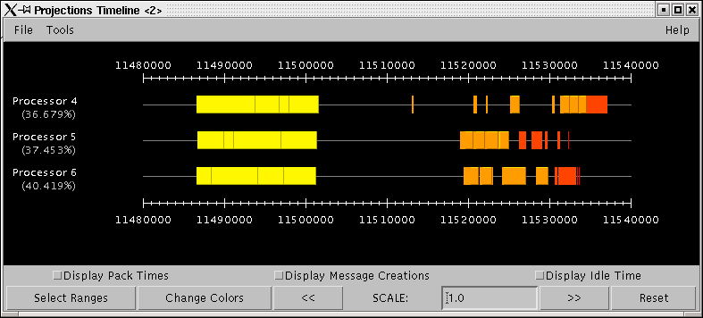
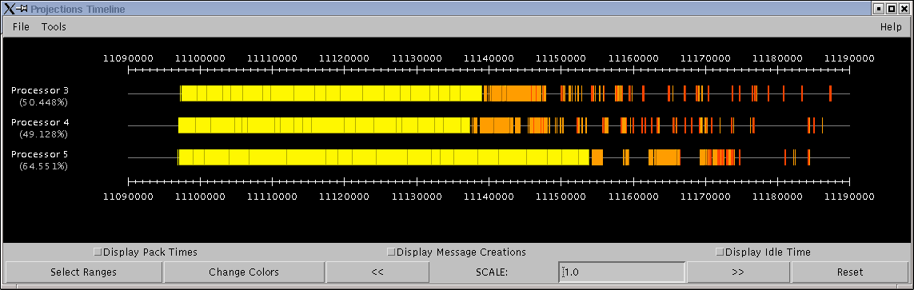

Slide 95
Optimizing for Communication Patterns
The parallel-objects Runtime System can observe, instrument, and measure communication patterns
  Communication is from/to objects, not processors
  Load balancers can use this to optimize object placement
  Communication libraries can optimize
    By substituting most suitable algorithm for each operation
    Learning at runtime
V. Krishnan, MS Thesis, 1996

Slide 96
Control Points: learning and tuning
The RTS can automatically optimize the degree of pipelining
  If it is given a control point (knob) to tune
  By the application
Controlling pipelining between a pair of objects:
S. Krishnan, PhD Thesis, 1994
Controlling degree of virtualization:
Orchestration Framework: Ongoing PhD thesis

Slide 97

Optimizing Reductions
Operation:
  Each processor contributes data, that must be “added” via any commutative-associative operation
  Result may be needed on only 1 processor, or on all.
  Assume that all PE’s are ready with their data simultaneously
Naïve algorithm: all send to PE 0. ( O(P) )
Basic Spanning tree algorithm:
  Organize processors in a k-ary tree
  Leaves: send contributions to parent
  Internal nodes: wait for data from all children, add mine,
  Then, if I am not the root, send to my parent
  What is a good value of k?
    Select k to minimize:
    L=2, 3 or 4.

Slide 98
Better spanning trees:
Observation: Only 1 level of the tree is active at a time
  Also, A PE can’t deal with data from second child until it has finished “receive” of data from 1st.
  So, second child could delay sending its data, with no impact
  It can collect data from someone else in the meanwhile
1
2
3
3
4
1
1
2
1
2
1

Slide 99
Hypercube based spanning tree
Use a variant of dimensional exchange:
  In each phase i, send data to neighbor in i’th dimension if its serial number is smaller than mine
  Accumulate data from neighbors until it is my turn to send
  log P phases, with at most one recv per processor per phase
More complex spanning trees:
  Exploit the actual values of send overhead, latency, and receive overhead

Slide 100


Reductions with large datasets
What if n is large?
  Example: simpler formulation of molecular dynamics:
    Each PE has an array of forces for all atoms
    Each PE is assigned a subset of pairs of atoms
    Accumulated forces must be summed up across PEs
New optimizations become possible with large n:
  Essential idea: use multiple concurrent reductions to keep all levels of the tree busy
  Divide data (n items) into segments of k items each
  Start reduction for each segment.
    N/k pipelined phases (I.e. phases overlap in time)
Instead of

Slide 101
Concurrent reductions: load balancing!
Leaves of the spanning tree are doing little work
  Use a different spanning tree for successive reductions:
    E.g. first reduction uses a normal spanning tree rooted at 0, while second reduction uses a mirror-image tree rooted at (P-1)
    This load balancing improve performance considerably

Slide 102
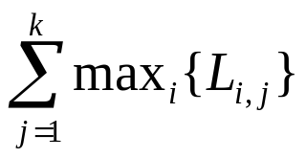
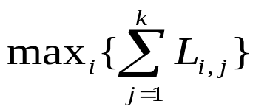
Synchronization overhead
Symptom:
  Too much time spent in barriers and scalar reductions
  Be careful: this may be load imbalance
    Most processors arrive at the barrier early and wait
Problem with barriers:
  Not the direct cost of the operation itself as much
  But it prevents the program from adjusting to small variations
    E.g. K phases, separated by barriers (or scalar reductions)
    Load is effectively balanced. But,
      In each phase, there may be slight non-determistic load imbalance
      Let Li,j be the load on I’th processor in j’th phase.
With barrier:
Without:

Slide 103
How to avoid Barriers/Reductions
Sometimes, they can be eliminated
  with careful reasoning
  Somewhat complex programming
When they cannot be avoided,
  one can often render them harmless
Use asynchronous reduction (not normal MPI)
  E.g. in NAMD, energies need to be computed via a reductions and output.
    Not used for anything except output
  Use Asynchronous reduction, working in the background
    When it reports to an object at the root, output it

Slide 104
Molecular Dynamics: Benefits of avoiding barrier
In NAMD:
  The energy reductions were made asynchronous
  No other global barriers are used in cut-off simulations
This came handy when:
  Running on Pittsburgh Lemieux (3000 processors)
  The machine (+ our way of using the communication layer) produced unpredictable, random delays in communication
    A send call would remain stuck for 20 ms, for example
How did the system handle it?
  See timeline plots

Slide 105
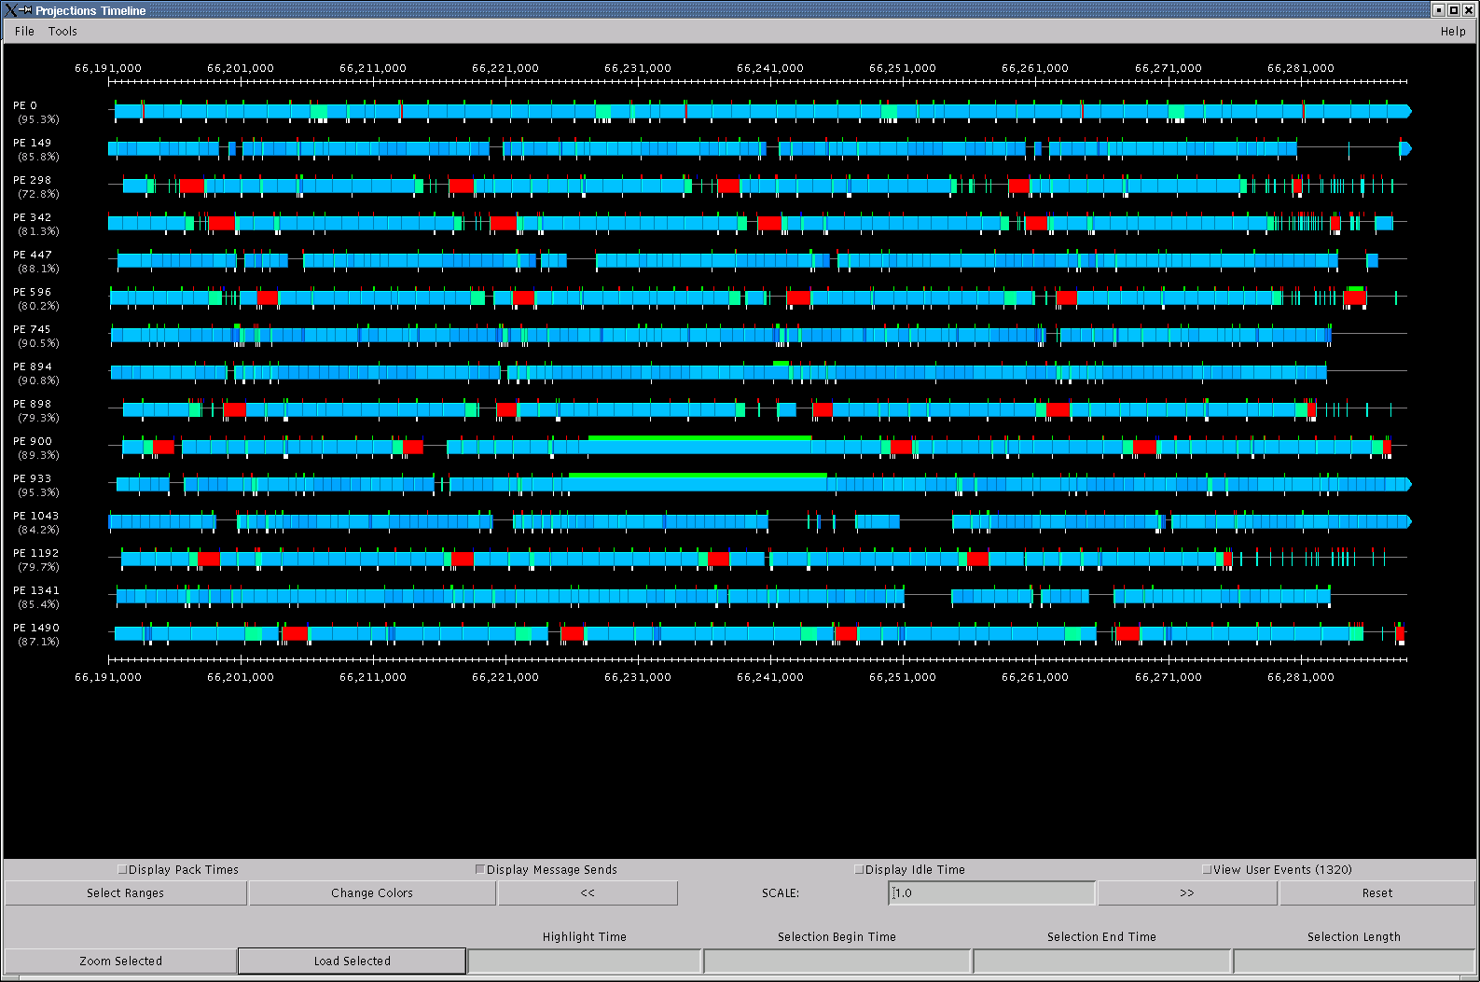

Slide 106
Asynchronous reductions: Jacobi
Convergence check
  At the end of each Jacobi iteration, we do a convergence check
  Via a scalar Reduction (on maxError)
But note:
  each processor can maintain old data for one iteration
So, use the result of the reduction one iteration later!
  Deposit of reduction is separated from its result.
  MPI_Ireduce(..) returns a handle (like MPI_Irecv)
    And later, MPI_Wait(handle) will block when you need to.

Slide 107
Asynchronous reductions in Jacobi
reduction
Processor timeline with sync. reduction
compute
compute
This gap is avoided below
Processor timeline with async. reduction
reduction
compute
compute

Slide 108
Summary of Communication Techniques
α - β tradeoff:
  Combining
  Pipelining
Overlapping communication with computation
  Sequencing
  Adaptive overlap via Message-driven execution
Increasing grainsize
Locality enhancement: decomposition control
  Local-remote and band-width reduction
α optimizations
Pipelining
Asynchronous reductions
Better Collective ops

Slide 109
Load Imbalance

Slide 110
How to diagnose load imbalance?
Often hidden in statements such as:
  Very high synchronization overhead
    Most processors are waiting at a reduction
Count total amount of computation (ops/flops) per processor
  In each phase!
  Because the balance may change from phase to phase

Slide 111
Golden Rule of Load Balancing
Fallacy: objective of load balancing is to minimize variance in load across processors
Example: 50,000 tasks of equal size, 500 processors:
A: All processors get 99, except last 5 gets 100+99 = 199
OR, B: All processors have 101, except last 5 get 1
Identical variance, but situation A is much worse!
Golden Rule: It is ok if a few processors idle, but avoid having processors that are overloaded with work
Finish time = max{Time on I’th processor}Excepting data dependence and communication overhead issues

Slide 112
Load Balancing: Unrestricted Exchange
Each processor read N_{i} particles
Before doing interesting things with the data, we want to distribute it equally across processors
It doesn’t matter where each piece of data goes
  No constraints
Issues:
  How to decide who sends data to whom
  How to minimize communication overhead in the process

Slide 113
Balancing number of data items: contd
Find the average (avg) using a reduction
  Each processor now knows if they are above or below avg
  Collect this information (load vector) globally
Then:
  Sort all donors (L_{i} > avg) by decreasing Li
  Sort all the receivers (L_{i} < avg) by decreasing need: (avg – L_{i})
  For each donor: assign the destination for its extra data
    Using the largest-need receiver first.
  This tends to produce the fewest number of messages
    But only as a heuristics
  Each processor can replicate this calculation!
    Assuming each received the load vector
    No need to broadcast results

Slide 114
Balancing using Dimensional Exchange
Log P phases: exchange info and then data with each neighbor
  Send message saying how many items you have
  Compare your number with neighbor’s
    Calculate average
    Send overage to them
  Load is balanced at the end of log P phase
    In each phase, two halves are perfectly balanced
    After first phase, the two planes above are equally loaded
      No need to return to exchanging data across planes (via red)

Slide 115
Amdahls’s Law and grainsize
Original “law”:
  If a program has K % sequential section, then speedup is limited to 100/K.
    If the rest of the program is parallelized completely
Grainsize corollary:
  If any individual piece of work is > K time units, and the sequential program takes T_{seq} ,
    Speedup is limited to T_{seq} / K
So:
  Examine performance data via histograms to find the sizes of remappable work units
  If some are too big, change the decomposition method to make smaller units

Slide 116
Grainsize and Amdahls’s law
A variant of Amdahl’s law, for objects:
  The fastest time can be no shorter than the time for the biggest single object!
How did it apply to us?
  Sequential step time was 57 seconds
  To run on 2k processors, no object should be more than 28 msecs.
  Analysis using our tools showed:

Slide 117
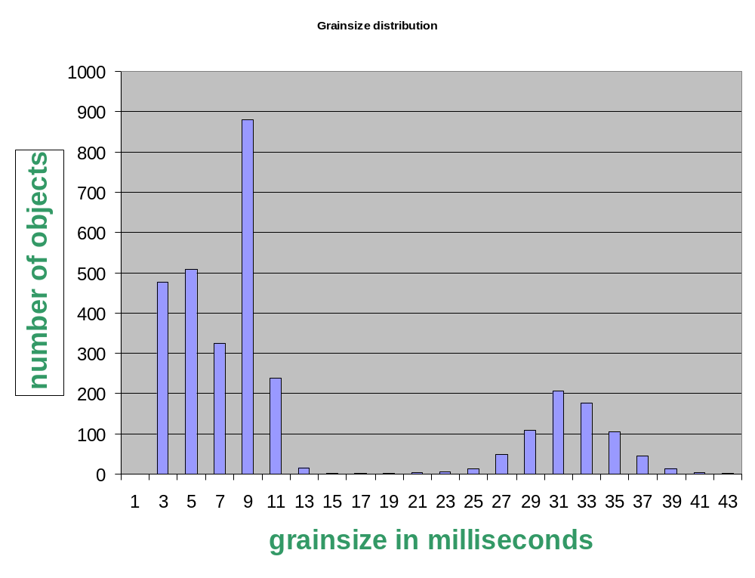
Grainsize analysis via Histograms
Solution:
Split compute objects that may have too much work:
using a heuristic based on number of interacting atoms
Problem

Slide 118
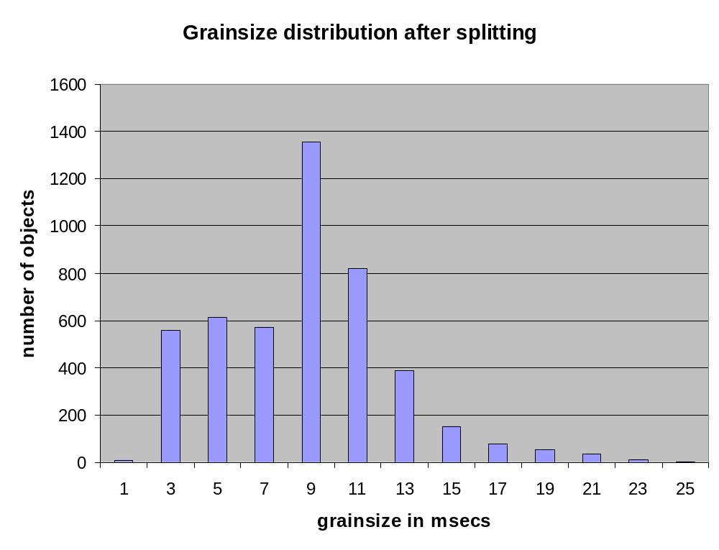
Grainsize reduced

Slide 119
Grainsize: LeanMD for Blue Gene/L
BG/L is a planned IBM machine with 128k processors
Need many more objects:
  Generalize hybrid decomposition scheme
    1-away to k-away
2-away :
cubes are half the size.

Slide 120
76,000 vps
5000 vps
256,000 vps

Slide 121
Dynamic Load Balancing using Objects
Many CSE applications exhibit dynamic behavior
  Adaptive mesh refinement
  Atom migration
  Particle migration in cosmology codes
Objects allow RTS to remap them to balance load
  Just move objects away from overloaded processors to underloaded processors
Just??

Slide 122
Measurement Based Load Balancing
Principle of persistence
  Object communication patterns and computational loads tend to persist over time
  In spite of dynamic behavior
    Abrupt but infrequent changes
    Slow and small changes
Runtime instrumentation
  Measures communication volume and computation time
Measurement based load balancers
  Use the instrumented data-base periodically to make new decisions
  Many alternative strategies can use the database

Slide 123
Quasi-dynamic Load balancing Strategies
Quasi: because we stop the computation
Centralized strategies:
  Charm RTS collects data (on one processor) about:
    Computational Load and Communication for each pair
  If you are not using AMPI/Charm, you can do the same instrumentation and data collection

Slide 124
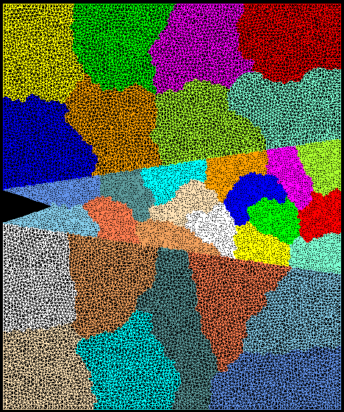
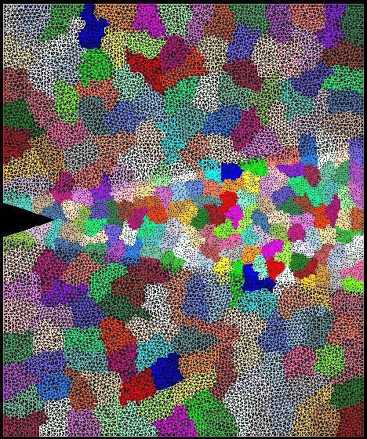
Crack Propagation
Decomposition into 16 chunks (left) and 128 chunks, 8 for each PE (right). The middle area contains cohesive elements. Both decompositions obtained using Metis. Pictures: S. Breitenfeld, and P. Geubelle
As computation progresses, crack propagates, and new elements are added, leading to more complex computations in some chunks

Slide 125
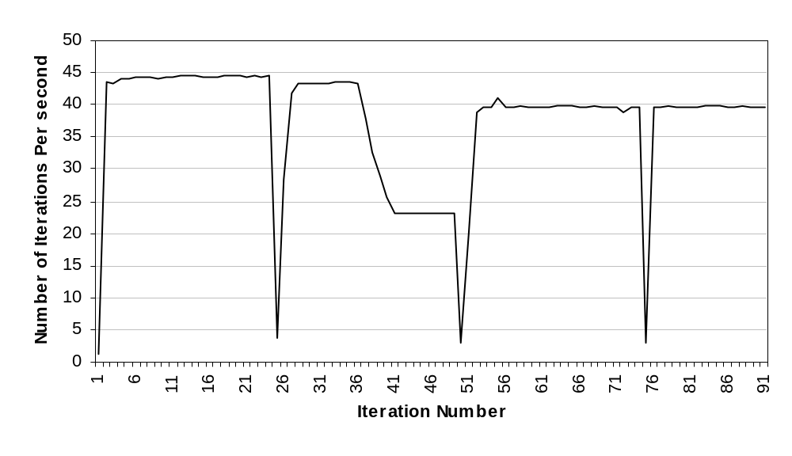
Load balancer in action
Automatic Load Balancing in Crack Propagation
1. Elements
Added
3. Chunks Migrated
2. Load
Balancer
Invoked

Slide 126
Distributed Load balancing
Centralized strategies
  Still ok for 3000 processors for NAMD
Distributed balancing is needed when:
  Number of processors is large and/or
  load variation is rapid
Large machines:
  Need to handle locality of communication
    Topology sensitive placement
  Need to work with scant global information
    Approx global information
    Incomplete global info (only “neighborhood”)
    Work diffusion strategies (1980’s work by author and others!)
  Achieving global effects by local action…

Slide 127
Building on Object-based Load Balancing
Application induced load imbalances
Environment induced performance issues:
  Dealing with extraneous loads on shared machines
  Vacating workstations
  Heterogeneous clusters
  Shrinking and expanding the set of processors allocated to a job!
Automatic checkpointing
  Restart on a different number of processors
Pre-fetch capability
  Out of Core execution
  Optimizing Cache performance

Slide 128
Case Studies

Slide 129
Case Studies Examples of Scalability
Series of examples
  Where we attained scalability
  What techniques were useful
  What lessons we learned
Molecular Dynamics: NAMD
Rocket Simulation
FEM computations
Collision detection

Slide 130
Optimizations in scaling NAMD to 1000
Parallelization is based on parallel objects
  Charm++ : a parallel C++
Series of optimizations were implemented to scale performance to 1000+ processors
Examples:
  Load Balancing:
    Grainsize distributions

Slide 131
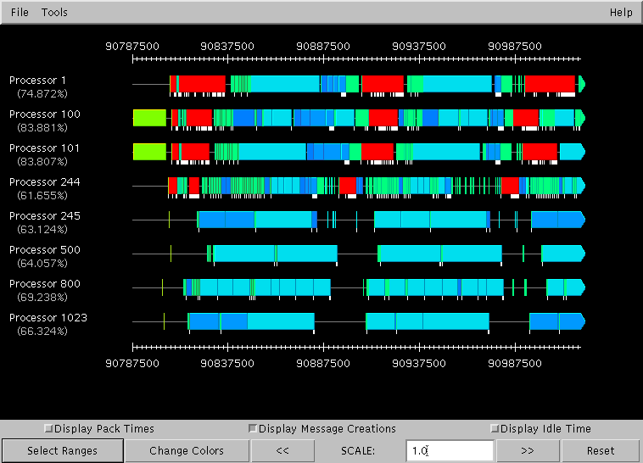
Integration overhead analysis
integration
Problem: integration time had doubled from sequential run

Slide 132
Integration overhead example:
Algorithmic overhead?
  No. (Same amount of work in each cube)
The visualization showed:
  The overhead was associated with sending messages.
Many cells were sending 30-40 messages.
  The overhead per message was too high
  Code analysis: memory allocations!
  Identical message being sent to 30+ processors.
Multicast support was added to Charm++
  Mainly eliminates (repeated) memory allocations, and packing

Slide 133
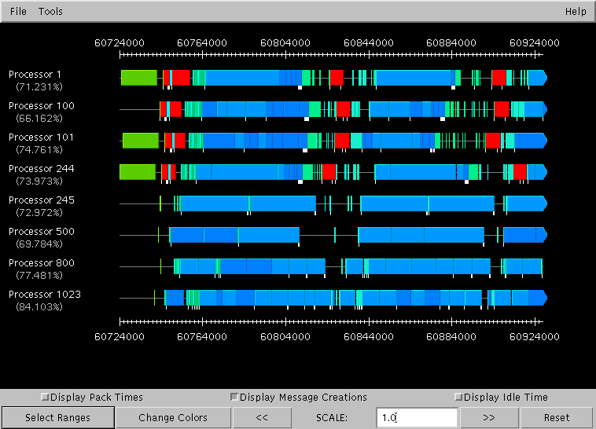
Integration overhead: After

Slide 134
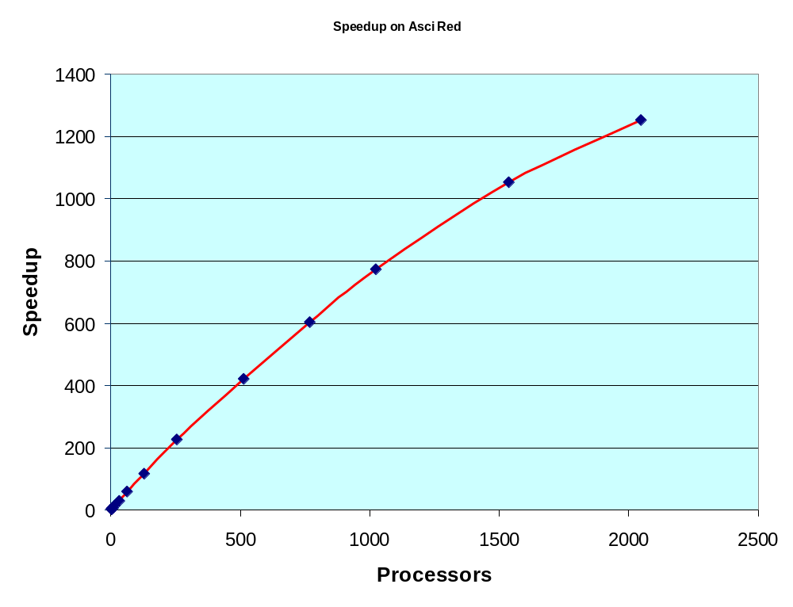
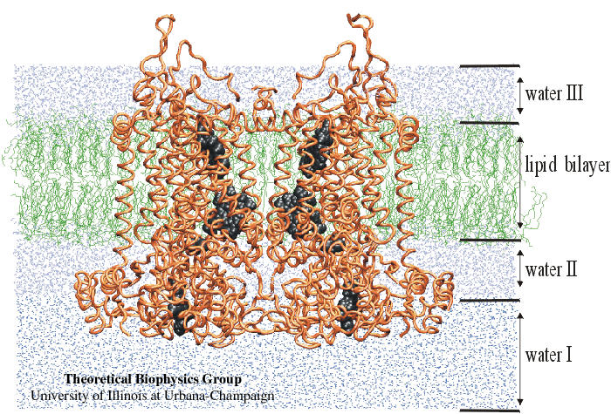
Improved Performance Data
Published in SC2000: Gordon Bell Award Finalist

Slide 135
Further Optimization on Lemieux
Two changes:
  PME with 3D FFT added
  New much faster machine used
    Sequential performance increased 10-fold!
    Communication to computation ratio now worse
Optimizations:
  PME implementation:
    Use sequential FFT library (FFTW)
      Although they have a parallel version
    Transposes and initial spreading optimized

Slide 136
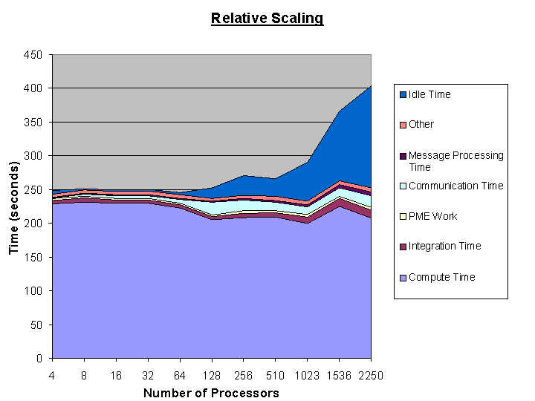
PME parallelization
Impor4t picture from sc02 paper (sindhura’s)

Slide 137
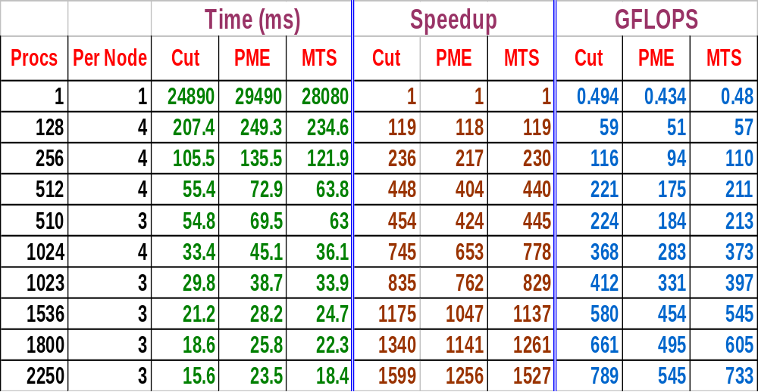
Performance: NAMD on Lemieux
ATPase: 320,000+ atoms including water

Slide 138
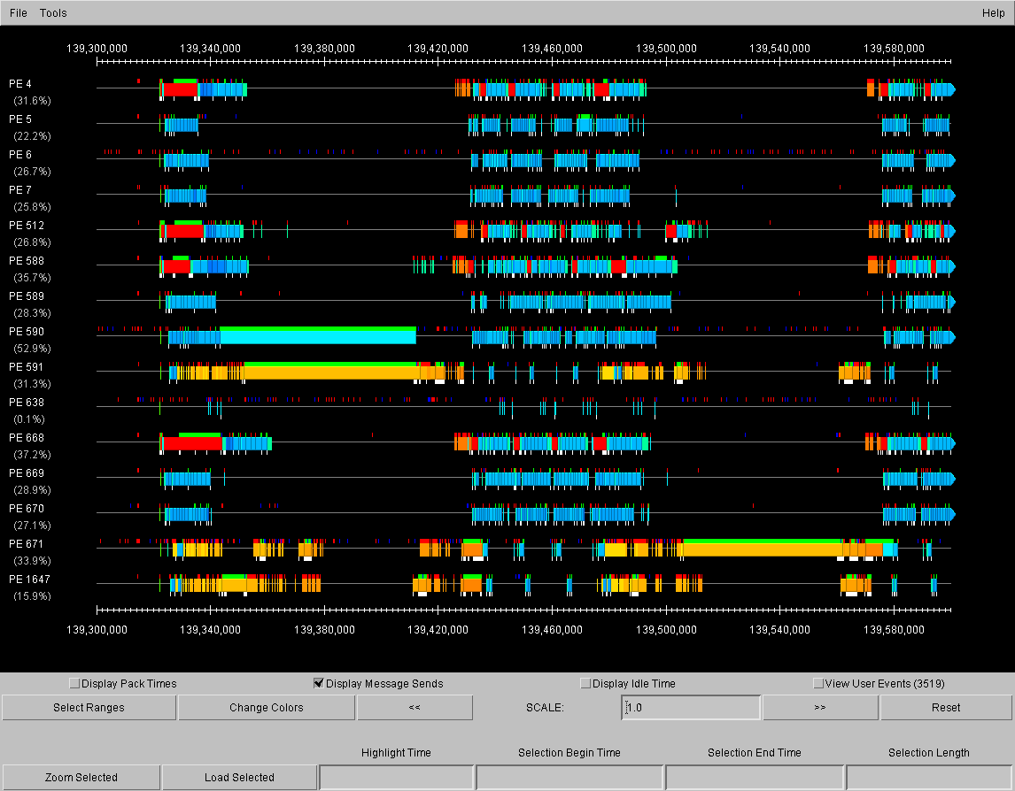

Slide 139
Scaling to 64K/128K processors of BG/L
What issues will arise?
  Communication
    Bandwidth use more important than processor overhead
    Locality:
  Global Synchronizations
    Costly, but not because it takes longer
    Rather, small “jitters” have a large impact
    Sum of Max vs Max of Sum
  Load imbalance important, but low grainsize is crucial
  Critical paths gains importance

Slide 140
Rocket simulation via virtual processors
Scalability challenges:
  Multiple independently developed modules,
    possibly executing concurrently
  Evolving simulation
    Changes the balance between fluid and solid
  Adaptive refinements
  Dynamic insertion of sub-scale simulation components
    Crack-driven fluid flow and combustion
  Heterogeneous (speed-wise) clusters

Slide 141
Rocket simulation via virtual processors
Rocflo
Rocflo
Rocflo
Rocflo
Rocface
Rocface
Rocflo
Rocface
Rocface
Rocsolid
Rocsolid
Rocface
Rocsolid
Rocsolid
Rocsolid
Rocflo
Rocflo
Rocflo
Rocflo
Rocflo
Rocface
Rocface
Rocface
Rocface
Rocface
Rocsolid
Rocsolid
Rocsolid
Rocsolid
Rocsolid

Slide 142
AMPI and Roc*: Communication
By separating independent modules into separate sets of virtual processors, flexibility was gained to deal with alternate formulations:
  Fluids and solids executing concurrently OR one after other.
  Change in pattern of load distribution within or across modules
Rocflo
Rocflo
Rocflo
Rocflo
Rocflo
Rocface
Rocface
Rocface
Rocface
Rocface
Rocsolid
Rocsolid
Rocsolid
Rocsolid
Rocsolid

Slide 143
Load Balancing with AMPI/Charm++
Turing cluster has processors with different speeds
Phase
16P3
16P2
8P3,8P2 w/o LB
8P3,8P2 w. LB
Fluid update
75.24
97.50
96.73
86.89
Solid update
41.86
52.50
52.20
46.83
Pre-Cor Iter
117.16
150.08
149.01
133.76
Time Step
235.19
301.56
299.85
267.75
By using virtualization, automatic load balancing that takes processor speeds into account was able to utilize a speed-heterogeneous machine

Slide 144
Component Frameworks
Motivation
  Reduce tedium of parallel programming for commonly used paradigms
  Encapsulate required parallel data structures and algorithms
  Provide easy to use interface,
    Sequential programming style preserved
    No alienating invasive constructs
  Use adaptive load balancing framework
Component frameworks
  FEM
  Multiblock
  AMR

Slide 145
FEM framework
Present clean, “almost serial” interface:
  Hide parallel implementation in the runtime system
  Leave physics and time integration to user
  Users write code similar to sequential code
  Or, easily modify sequential code
Input:
  connectivity file (mesh), boundary data and initial data
Framework:
  Partitions data, and
  Starts driver for each chunk in a separate thread
  Automates communication, once user registers fields to be communicated
  Automatic dynamic load balancing

Slide 146
FEM Experience
Previous:
  3-D volumetric/cohesive crack propagation code
    (P. Geubelle, S. Breitenfeld, et. al)
  3-D dendritic growth fluid solidification code
    (J. Dantzig, J. Jeong)
Recent
  Adaptive insertion of cohesive elements
    Mario Zaczek, Philippe Geubelle
    Performance data
  Multi-Grain contact (in progress)
    Spandan Maiti, S. Breitenfield, O. Lawlor, P. Guebelle
    Using FEM framework and collision detection
      NSF funded project
    Did initial parallelization in 4 days

Slide 147
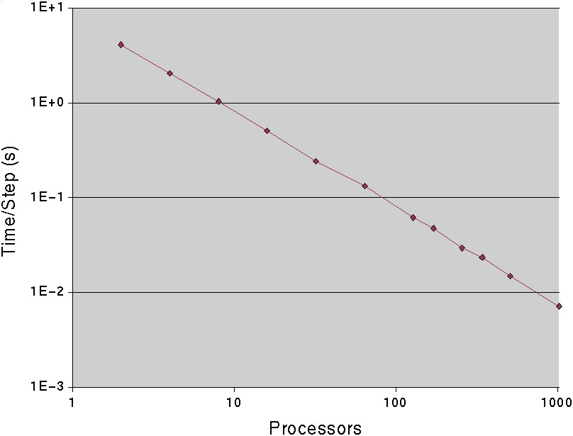
Performance data: ASCI Red
Mesh with
3.1 million
elements
Speedup of 1155
on 1024 processors.

Slide 148
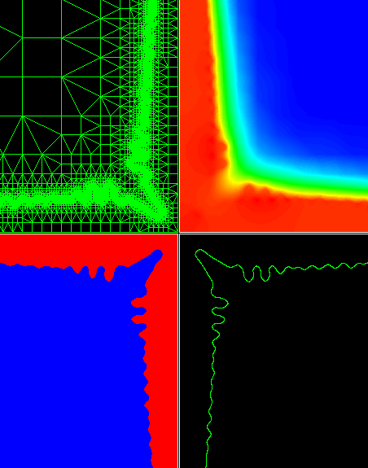

Dendritic Growth
Studies evolution of solidification microstructures using a phase-field model computed on an adaptive finite element grid
Adaptive refinement and coarsening of grid involves re-partitioning
Jon Dantzig et al with O. Lawlor and Others from PPL

Slide 149
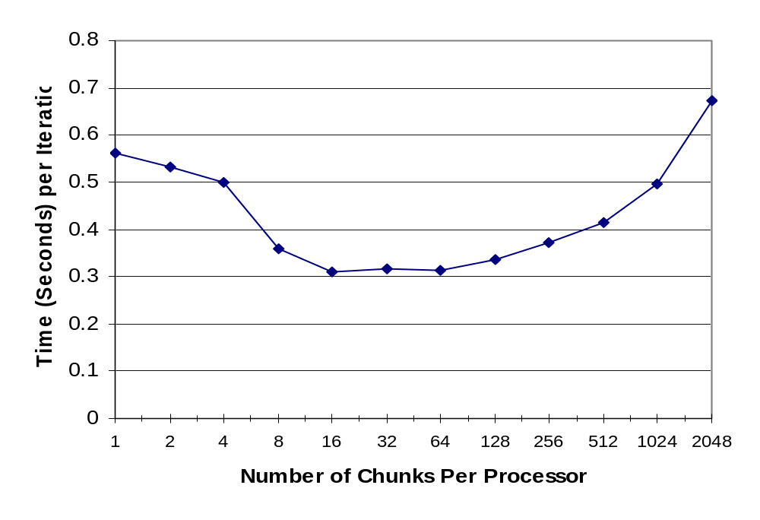
“Overhead” of Multipartitioning
Conclusion: Overhead of virtualization is small, and in fact it benefits by creating automatic

Slide 150
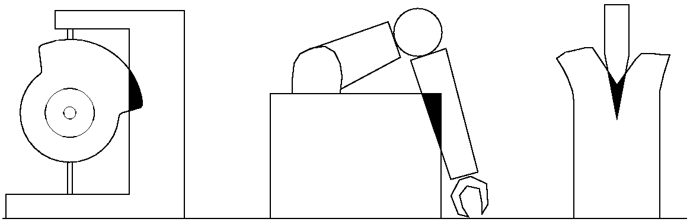
Parallel Collision Detection
Detect collisions (intersections) between objects scattered across processors
Approach, based on Charm++ Arrays
  Overlay regular, sparse 3D grid of voxels (boxes)
  Send objects to all voxels they touch
  Collide objects within each voxel independently and collect results
Leave collision response to user code

Slide 151
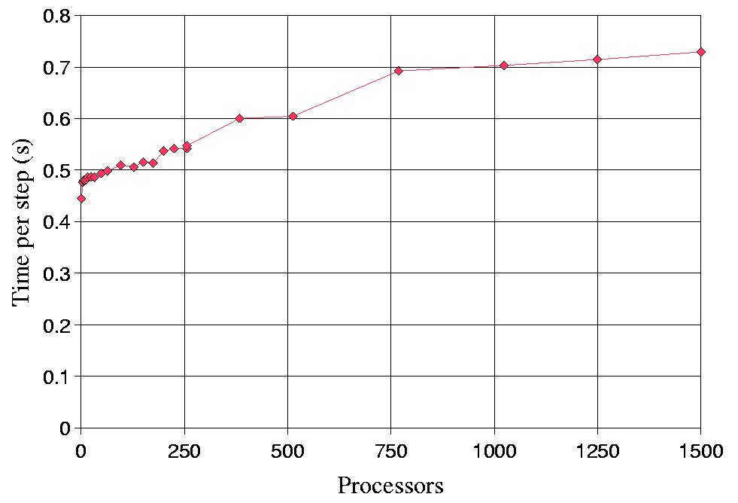
Parallel Collision Detection
Results: 2μs per polygon;
  Good speedups to 1000s of processors
ASCI Red, 65,000 polygons per processor.
(scaled problem)
Up to 100 million polygons
This was a significant improvement over the state-of-art.
Made possible by virtualization, and
  Asynchronous, as needed, creation of voxels
  Localization of communication: voxel often on the same processor as the contributing polygon

Slide 152
Summary and Conclusion
To get high performance first learn to measure and analyze performance
Choose scalable algorithm
  With short critical paths
  As small grained as feasible
  Do communication analysis
    Isoefficiency
If high communication costs:
  Grainsize control
  Alpha optimizations
  Collective operations
If high Synchronization costs
  Reduce need for global syncs
  Use async reductions
Load balance problems:
  Virtualization is most effective
  Automatic strategies
Beware the many headed monster:
  Performance problems may hide in your program, masked by either other problems or because you are using few processors

Slide 153
Partial Bibliography
Introduction to Parallel Computing: Algorithm Design and Analysis.
  Kumar V., Grama A., Gupta A., Karypis G., Benjamin Cummings/ Addison Wesley, Redword City, 1994.
  Isoefficiency, communication analysis
The Virtualization Approach to Parallel Programming: Runtime Optimizations and the State of the Art,
  LACSI 2002. Also available at http://charm.cs.uiuc.edu/papers/VirtualizationLACSI02.html
Charm++ Programming Manual
  http://charm.cs.uiuc.edu/ppl_manuals/
AMPI Programming Manual
  http://charm.cs.uiuc.edu/ppl_manuals/

Slide 154
Performance Analysis / visualization Tools
ParaGraph:
  http://www.csar.uiuc.edu/software/paragraph/index.html
MPICL: (trace library)
  http://www.epm.ornl.gov/picl
XPVM
  http://www.netlib.org/utk/icl/xpvm/xpvm.html
Projections:
  http://charm.cs.uiuc.edu

Slide 155
Communication Optimization
The Quadrics network: high-performance clustering technology
  Petrini, F.; Wu-chun Feng; Hoisie, A.; Coll, S.; Frachtenberg, E. Page(s): 46 -57
An Efficient Transposition Algorithm for Distributed Memory Computers,
  Christina Christara Xiaoliang Ding and Ken Jackson, High Performance Computing Systems and Applications, pages 349--368. Kluwer Academic Publishers, 1999.
Efficient scheduling of complete exchange on clusters,
  A.T.C. Tam and C.L. Wang, in the ISCA 13th International Conference On Parallel And Distributed Computing Systems (PDCS-2000),August 2000.

