Slide 1
Programming with Parallel Migratable Objects
Sanjay Kalé and PPL
Parallel Programming Laboratory
University of Illinois at Urbana-Champaign

Slide 2
Manual: http://charm.cs.illinois.edu/manuals/html/charm++/manual.html
Installation: http://charm.cs.illinois.edu/manuals/html/charm++/A.html

Slide 3
Outline
Introduction
Object Design
Execution Model
Hello World
Benefits of Charm++
Charm++ Basics
Object Collections
Overdecomposition
Migratability
Checkpointing and Resilience
Structured Dagger
Application Design
Performance Tuning
Using Dynamic Load Balancing
Interoperability
Debugging
Further Optimization

Slide 4
Outline
Introduction
Object Design
Execution Model
Hello World
Benefits of Charm++
Charm++ Basics
Object Collections
Overdecomposition
Migratability
Checkpointing and Resilience
Structured Dagger
Application Design
Performance Tuning
Using Dynamic Load Balancing
Interoperability
Debugging
Further Optimization

Slide 5
Harnessing Parallelism: Challenges Trends in System Architecture
Frequencies have stopped increasing
Memory costs are high
Relatively low per core memory
Increasing heterogeneity
Accelerators, SMT
Energy, power, and thermal considerations
Frequent component failures

Slide 6
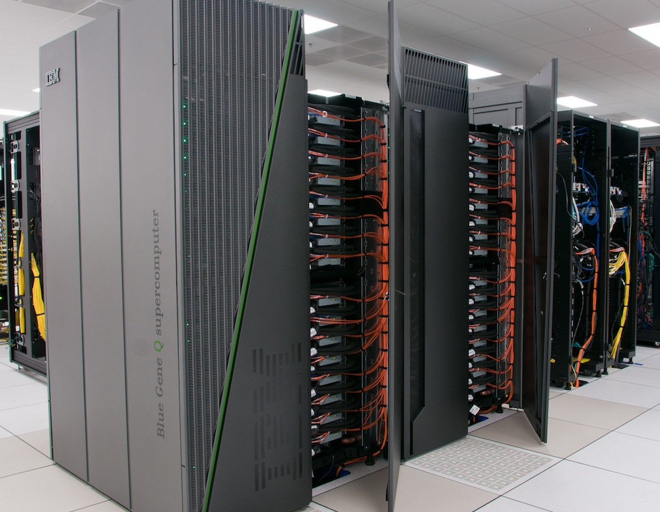
Harnessing Parallelism: Challenges Trends in System Architecture
However, compute resources are not faster cores, but more cores
Unprecedented levels of available concurrency
IBM BG/Q
‘Sequoia’: 1,572,864 cores
‘Mira’: 786,432 cores
Cray
XE6+XK6 ‘Bluewaters‘: 386,816 cores
XK6 ‘Titan’: 299,008 cores
K Supercomputer: 705,024 cores
Mid-size clusters will be ubiquitous
Implications
Each thread of execution has to:
Operate on lesser data
Wait relatively longer for remote data
Have to operate in strong scaling regime

Slide 7
Harnessing Parallelism: Challenges Next-generation Applications
Need for strong scaling
Faster solutions (not just larger problems)
Application Characteristics
Multi-resolution
Adaptive, spatial and temporal resolutions
Dynamic/adaptive refinements: to handle application variation
Multi-module (multi-physics)
Complex physics in multiple, interacting modules
Adapt to a volatile computational environment
Exploit heterogeneous architecture
Deal with thermal and energy considerations
So? Consequences:
Must support automated resource management
Must support interoperability and parallel composition

Slide 8
Harnessing Parallelism: Challenges Programming Models: MPI
Highly successful
Universally used
Has supported application evolution from gigascale to petascale
Library
Communication primitives
MPI does not directly support automated resource management (e.g. load balancing, fault tolerance, etc.)

Slide 9
Charm++ builds upon a proven approach: objects

Slide 11
Stuff you already know Benefits of Object-based code
Objects encapsulate data
Methods represent functionality relevant to that data
Method invocations can modify / update state of the object / data
Computation can be expressed in terms of objects interacting via method invocations
Methods are natural units of sequential computation on object data
Thoughtful design yields focused methods with single purpose
Naturally expresses an object’s response to inputs (signals / data)
Nothing new
Still quite uncommon in HPC code
Its not about language syntax. Its about program structure

Slide 12
Globally-Visible Objects: Chares and Proxies
2
8
4
Parallel Address Space
6
F
C
E
G
B
D
H
A
0
3
7
5
9
1
Certain “special” object instances are:
first-class citizens in the parallel address space,
with unique location-independent names
Under the hood, the runtime handles locality and provides the mechanisms to promote objects to the parallel space

Slide 13
Globally-Visible Methods: Entry Methods
Parallel Address Space
F.m4()
E.m1()
G
F
C
E.m3()
E
G.m2()
B.m2()
B
D
H.m2()
A
H
How can objects communicate across address spaces?
Just like a sequential object-oriented language, an object’s reference is used to invoke a method
In the parallel space, this is a handle that is location transparent
A method invocation becomes an act of communication

Slide 14
Method-Driven Asynchronous Communication
Instance A
Idle waiting for B
KernelA()
B.m1()
B.m1() returns
Instance B
Execute m1()
What happens if an object waits for a return value from a method invocation?
Performance
Latency
Reasoning about correctness

Slide 15
Design Principle: Do not wait for remote completion
Instance A
KernelA()
idle
B.m1()
A.m2() response
Instance B
Execute m1()
Hence, method invocations should be asynchronous
No return values
Computations are driven by the incoming data
Initiated by the sender or method caller

Slide 16
For example, a Jacobi reduction
reduction
synchronous
reduction
compute
compute
idle time
avoided
below
reduction
asynchronous
reduction
compute
compute

Slide 23
Chares are reactive
The way we described Charm++ so far, a chare is a reactive entity:
If it gets this method invocation, it does this action,
If it gets that method invocation then it does that action
But what does it do?
In typical programs, chares have a life-cycle
How to express the life-cycle of a chare in code?
Only when it exists
i.e. some chars may be truly reactive, and the programmer does not know the life cycle
But when it exists, its form is:
Computations depend on remote method invocations, and completion of other local computations
A DAG (Directed Acyclic Graph)!

Slide 24
Fibonacci Example
mainmodule fib {
mainchare Main {
entry Main(CkArgMsg∗ m);
};
chare Fib {
entry Fib(int n, bool isRoot, CProxy Fib parent);
entry void respond(int value);
};
};

Slide 25
Fibonacci Example
class Main : public CBase Main {
public: Main(CkArgMsg∗ m) {
CProxy Fib::ckNew(atoi(m−>argv[1]), true, CProxy Fib());
}
};
class Fib : public CBase Fib {
public: CProxy Fib parent; bool isRoot; int result, count;
Fib(int n, bool isRoot , CProxy Fib parent )
: parent(parent ), isRoot(isRoot ), result(0), count(2) {
if (n < 2) respond(n);
else {
CProxy Fib::ckNew(n − 1, false, thisProxy);
CProxy Fib::ckNew(n − 2, false, thisProxy);
}
}
void respond(int val) {
result += val;
if (−−count == 0 || n < 2) {
if (isRoot) {
CkPrintf(”Fibonacci number is: %d\n”, result);
CkExit();
} else
{ parent.respond(result);
delete this;
}
}
}
};

Slide 26
Consider Fibonacci Chare
The Fibonacci chare gets created
If its not a leaf,
It fires two chares
When both children return results (by calling respond ):
It can compute my result and send it up, or print it
But in our, this logic is hidden in the flags and counters . . .
This is simple for this simple example, but . . .
Lets look at how this would look with a little notational support

Slide 27
Structured Dagger The when construct
The when construct
Declare the actions to perform when a message is received
In sequence, it acts like a blocking receive
entry void someMethod() {
when entryMethod1(parameters) { /∗ block2 ∗/ }
when entryMethod2(parameters) { /∗ block3 ∗/ }
};

Slide 28
Structured Dagger The serial construct
The serial construct
A sequencial block of C++ code in the .ci file
The keyword serial means that the code block will be executed without interruption/preemption, like an entry method
Syntax serial <optionalString> { /* C++ code */ }
The <optionalString> is used for identifying the serial for performance analysis
Serial blocks can access all members of the class they belong to
Examples (.ci file):
entry void method1(parameters) {
serial
{ thisProxy.invokeMethod(10);
callSomeFunction();
}
};
entry void method2(parameters) {
serial ”setValue” {
value = 10;
}
};

Slide 29
Structured Dagger The when construct
entry void someMethod() {
serial { /∗ block1 ∗/ }
when entryMethod1(parameters) serial { /∗ block2 ∗/ }
when entryMethod2(parameters) serial { /∗ block3 ∗/ }
};
Sequence
Sequentially execute /* block1 */
Wait for entryMethod1 to arrive, if it has not, return control back to the Charm++ scheduler, otherwise, execute /* block2 */
Wait for entryMethod2 to arrive, if it has not, return control back to the Charm++ scheduler, otherwise, execute /* block3 */

Slide 30
Structured Dagger The when construct
Execute /* further sdag */ when myMethod arrives
when myMethod(int param1, int param2)
/∗ further code ∗/
Execute /* further sdag */ when myMethod1 and myMethod2 arrive
when myMethod1(int param1, int param2),
myMethod2(bool param3)
/∗ further code ∗/
Which is almost the same as this:
when myMethod1(int param1, int param2) {
when myMethod2(bool param3) { }
}
/* further code */

Slide 31
Structured Dagger Boilerplate
Structured Dagger can be used in any entry method (except for a constructor)
Can be used in a mainchare , chare , or array
For any class that has Structured Dagger in it you must insert two calls:
The Structured Dagger macro: [ClassName] SDAG CODE
For later: call the sdag pup() in the pup method

Slide 32
Structured Dagger Boilerplate
The .ci file:
The .cpp file:
[mainchare,chare,array] MyFoo {
…
entry void method(parameters) {
// … structured dagger code here …
};
…
}
class MyFoo : public CBase MyFoo {
MyFoo SDAG_Code/* insert SDAG macro */
public:
MyFoo() { }
};

Slide 33
Fibonacci with Structured Dagger
mainmodule fib {
mainchare Main {
entry Main(CkArgMsg∗ m);
};
chare Fib {
entry Fib(int n, bool isRoot, CProxy Fib parent);
entry void calc(int n) {
if (n < THRESHOLD) serial { respond(seqFib(n)); }
else {
serial {
CProxy Fib::ckNew(n − 1, false, thisProxy);
CProxy Fib::ckNew(n − 2, false, thisProxy);
}
when response(int val)
when response(int val2)
serial { respond(val + val2); }
}
};
entry void response(int);
};
};

Slide 34
Fibonacci with Structured Dagger
Fibonacci with Structured Dagger
#include ”fib.decl.h”
#define THRESHOLD 10
class Main : public CBase Main {
public: Main(CkArgMsg∗ m) { CProxy Fib::ckNew(atoi(m−>argv[1]), true, CProxy Fib()); }
};
class Fib : public CBase Fib {
public:
Fib SDAG CODE
CProxy Fib parent; bool isRoot;
Fib(int n, bool isRoot , CProxy Fib parent )
: parent(parent ), isRoot(isRoot ) {
calc(n);
}
int seqFib(int n) { return (n < 2) ? n : seqFib(n − 1) + seqFib(n − 2); }
void respond(int val) {
if (!isRoot)
{ parent.response(val);
delete this;
} else {
CkPrintf(”Fibonacci number is: %d\n”, val);
CkExit();
}
}
};
#include “fib.def.h”

Slide 35
Structured Dagger The when construct
What is the sequence?
when myMethod1(int param1, int param2) {
when myMethod2(bool param3),
myMethod3(int size, int arr[size]) /∗ sdag block1 ∗/
when myMethod4(bool param4) /∗ sdag block2 ∗/
}
Sequence:
Wait for myMethod1 , upon arrival execute body of myMethod1
Wait for myMethod2 and myMethod3 , upon arrival of both, execute /* sdag block1 */
Wait for myMethod4 , upon arrival execute /* sdag block2 */
Question: if myMethod4 arrives first what will happen?

Slide 36
Structured Dagger The when construct
The when clause can wait on a certain reference number
If a reference number is specified for a when , the first parameter for the when must be the reference number
Semantic: the when will “block” until a message arrives with that reference number
when method1[100](int ref, bool param1)
/∗ sdag block ∗/
serial {
proxy.method1(200, false); /∗ will not be delivered to the when ∗/
proxy.method1(100, true); /∗ will be delivered to the when ∗/
}

Slide 37
Structured Dagger The if-then-else construct
The if-then-else construct:
Same as the typical C if-then-else semantics and syntax
if (thisIndex.x == 10) {
when method1[block](int ref, bool someVal) /∗ code block1 ∗/
} else {
when method2(int payload) serial {
//... some C++ code
}
}

Slide 38
Structured Dagger The for construct
The for construct:
Defines a sequenced for loop (like a sequential C for loop)
Once the body for the ith iteration completes, the i + 1 iteration is started
for (iter = 0; iter < maxIter; ++iter) {
when recvLeft[iter](int num, int len, double data[len])
serial { computeKernel(LEFT, data); }
when recvRight[iter](int num, int len, double data[len])
serial { computeKernel(RIGHT, data); }
}
iter must be defined in the class as a member
class Foo : public CBase Foo {
public: int iter;
};

Slide 39
Structured Dagger The while construct
The while construct:
Defines a sequenced while loop (like a sequential C while loop)
while (i < numNeighbors) {
when recvData(int len, double data[len]) {
serial {
/∗ do something ∗/
}
when method1() /∗ block1 ∗/
when method2() /∗ block2 ∗/
}
serial { i++; }
}

Slide 40
Structured Dagger The overlap construct
The overlap construct:
By default, Structured Dagger defines a sequence that is followed sequentially
overlap allows multiple independent clauses to execute in any order
Any constructs in the body of an overlap can happen in any order
An overlap finishes in sequence when all the statements in it are executed
Syntax overlap { /* sdag constructs */ }
What are the possible execution sequences?
serial { /∗ block1 ∗/ }
overlap {
serial { /∗ block2 ∗/ }
when entryMethod1[100](int ref num, bool param1) /∗ block3 ∗/
when entryMethod2(char myChar) /∗ block4 ∗/
}
serial { /∗ block5 ∗/ }

Slide 41
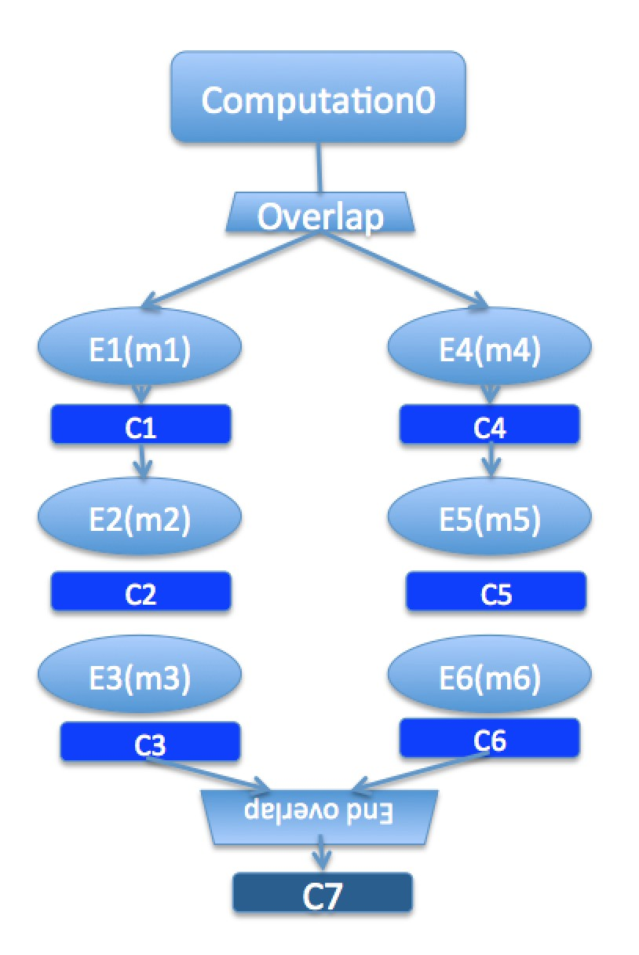
Illustration of a long “overlap”
Overlap can be used to get back some of the asynchrony within a chare
But it is constrained
Makes for more disciplined programming,
with fewer race conditions

Slide 42
Structured Dagger The forall construct
The forall construct:
Has “do-all” semantics: iterations may execute an any order
Syntax:
forall [<ident>] (<min> : <max>, <stride>) <body>
The range from <min> to <max> is inclusive
forall [block] (0 : numBlocks − 1, 1) {
when method1[block](int ref, bool someVal) /∗ code block1 ∗/
}
Assume block is declared in the class as public: int block;

Slide 43
Parallel Prefix with SDAG: .ci file I
mainmodule prefix {
readonly CProxy Main mainProxy;
readonly int numElements;
mainchare Main {
entry Main(CkArgMsg∗ msg);
entry [reductiontarget] void checkIn();
};
array [1D] Prefix {
entry Prefix();
entry void passValue(int step, unsigned int incomingValue);

Slide 44
Parallel Prefix with SDAG: .ci file I
entry void startPrefixCalculation() {
for(stage = 0; (1 << stage) < numElements; stage++) {
serial ”send value” {
targetIndex = thisIndex + (1<<stage);
if (targetIndex < numElements)
thisProxy[targetIndex].passValue(stage, value);
}
if (thisIndex >= (1<<stage))
when passValue[stage] (int incoming stage, unsigned int incoming value) serial
{
value += incoming value;
}
}
serial ”done” {
contribute(CkCallback(CkReductionTarget(Main, checkIn), mainProxy));
}
};
};
};

Slide 45
Parallel Prefix with SDAG: .ci file I
#include ”prefix.decl.h”
#include <stdlib.h>
/∗ readonly ∗/ CProxy Main mainProxy;
/∗ readonly ∗/ int numElements;
class Main : public CBase Main {
public:
CProxy Prefix prefixArray;
Main(CkArgMsg∗ msg) {
if (msg−>argc > 1) numElements = atoi(msg−>argv[1]);
mainProxy = thisProxy;
prefixArray = CProxy Prefix::ckNew(numElements);
prefixArray.startPrefixCalculation();
}
Main(CkMigrateMessage∗ msg) { }
void checkIn() {
CkExit();
}
};

Slide 46
Parallel Prefix with SDAG: .ci file II
class Prefix : public CBase Prefix {
Prefix SDAG CODE
public:
int stage, targetIndex, value;
Prefix() {
srand(thisIndex);
value = rand() % 10; // Random positive int between 0 and 9 (inclusive)
}
Prefix(CkMigrateMessage ∗msg) { }
};
#include ”prefix.def.h”

Slide 47
Stencil Codes
Iterative applications where array elements are updated according to some fixed pattern.
Used in computational simulations, solving partial differential equations, Jacobi kernel, GaussSeidel method, image processing applications etc.
Can be 2D or 3D

Slide 48
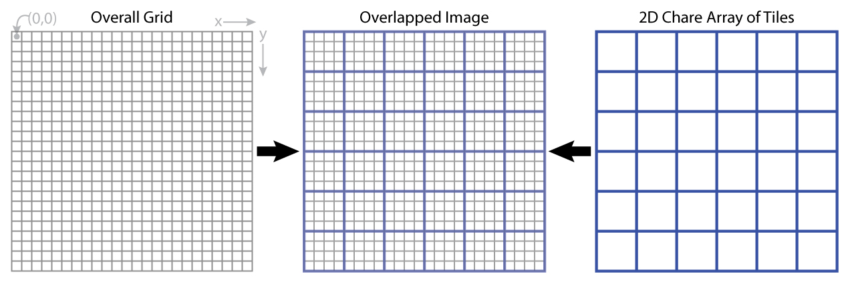
5-point Stencil

Slide 49
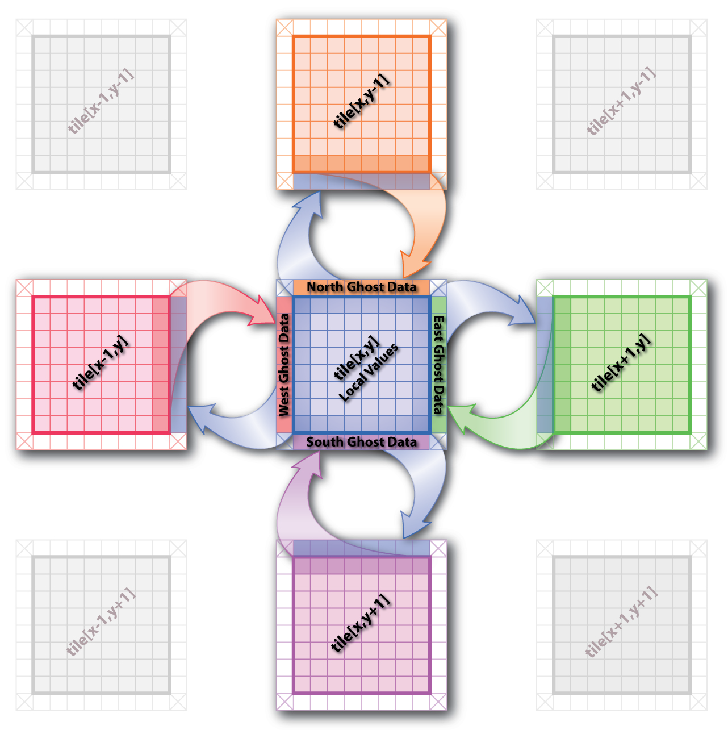
5-point Stencil

Slide 50
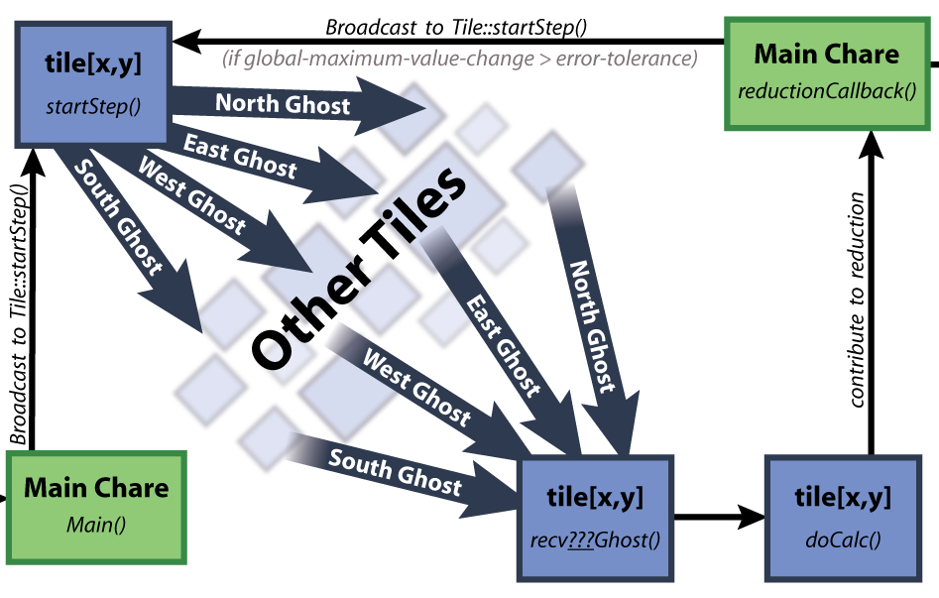
5-point Stencil

Slide 51
Jacobi: .ci file
mainmodule jacobi3d {
readonly CProxy Main mainProxy;
mainchare Main {
entry Main(CkArgMsg ∗m);
entry void done(int iterations);
};
array [3D] Jacobi {
entry Jacobi(void);
entry void updateGhosts(int ref, int dir, int w, int h, double gh[w∗h]);
entry [reductiontarget] void checkConverged(bool result);
entry void run() {
// ... main loop (next slide) ...
};
};
};

Slide 52
Jacobi: .ci file
entry void run() {
while (!converged) {
serial {
copyToBoundaries();
int x = thisIndex.x, y = thisIndex.y, z = thisIndex.z;
int bdX = blockDimX, bdY = blockDimY, bdZ = blockDimZ;
thisProxy(wrapX(x−1),y,z).updateGhosts(iter, RIGHT, bdY, bdZ, rightGhost);
thisProxy(wrapX(x+1),y,z).updateGhosts(iter, LEFT, bdY, bdZ, leftGhost);
thisProxy(x,wrapY(y−1),z).updateGhosts(iter, TOP, bdX, bdZ, topGhost);
thisProxy(x,wrapY(y+1),z).updateGhosts(iter, BOTTOM, bdX, bdZ, bottomGhost);
thisProxy(x,y,wrapZ(z−1)).updateGhosts(iter, BACK, bdX, bdY, backGhost);
thisProxy(x,y,wrapZ(z+1)).updateGhosts(iter, FRONT, bdX, bdY, frontGhost);
freeBoundaries();
}
for (remoteCount = 0; remoteCount < 6; remoteCount++)
when updateGhosts[iter](int ref, int dir, int w, int h, double buf[w∗h]) serial {
updateBoundary(dir, w, h, buf);
}
serial {
double error = computeKernel();
int conv = error < DELTA;
CkCallback cb(CkReductionTarget(Jacobi, checkConverged), thisProxy);
contribute(sizeof(int), &conv, CkReduction::logical and, cb);
}
when checkConverged(bool result)
if (result) serial { mainProxy.done(iter); converged = true; }
serial { ++iter; }
}
};

Slide 53
Jacobi: .ci file (with asynchronous reductions)
entry void run() {
while (!converged) {
serial {
copyToBoundaries();
int x = thisIndex.x, y = thisIndex.y, z = thisIndex.z;
int bdX = blockDimX, bdY = blockDimY, bdZ = blockDimZ;
thisProxy(wrapX(x−1),y,z).updateGhosts(iter, RIGHT, bdY, bdZ, rightGhost);
thisProxy(wrapX(x+1),y,z).updateGhosts(iter, LEFT, bdY, bdZ, leftGhost);
thisProxy(x,wrapY(y−1),z).updateGhosts(iter, TOP, bdX, bdZ, topGhost);
thisProxy(x,wrapY(y+1),z).updateGhosts(iter, BOTTOM, bdX, bdZ, bottomGhost);
thisProxy(x,y,wrapZ(z−1)).updateGhosts(iter, BACK, bdX, bdY, backGhost);
thisProxy(x,y,wrapZ(z+1)).updateGhosts(iter, FRONT, bdX, bdY, frontGhost);
freeBoundaries();
}
for (remoteCount = 0; remoteCount < 6; remoteCount++)
when updateGhosts[iter](int ref, int dir, int w, int h, double buf[w∗h]) serial {
updateBoundary(dir, w, h, buf);
}
serial {
double error = computeKernel();
int conv = error < DELTA;
if (iter % 5 == 1)
contribute(sizeof(int), &conv, CkReduction::logical and, CkCallback(CkReductionTarget(Jacobi,
checkConverged), thisProxy));
}
if (++iter % 5 == 0)
when checkConverged(bool result)
if (result) serial { mainProxy.done(iter); converged = true; }
}
};

Slide 54
Power of Asynchrony Example
Consider the following problem:
A large number of key-value pairs are distributed on several (hundred) processors (or chares)
Each chare needs to get some subset of these values before they can proceed to the next phase of the computation
The set of keys needed are not known in advance: they are determined based on the input data

Slide 55
Structured dagger version
entry void retrieveValues {
for (i = 0; i < n; i++) serial {
keys[i] = // compute i’th key;
keyValueProxy[keys[i] / B].requestValue(keys[i], thisProxy, i);
}
for (i = 0; i < n; i++)
when response(int i, ValueType value)
serial { values[i] = value; }
};
// next phase of computation thats uses the keys and values.
KeyValueClass::requestValue(int key, CProxy Client c, int ref) {
ValueType v = localTable[key];
c.response(ref, v);
}

