Slide 1
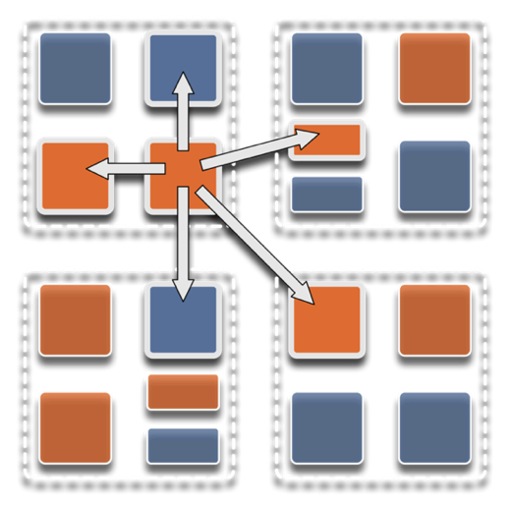
Parallel programming with Charm++: Programming with Parallel Migratable Objects
Laxmikant (Sanjay) Kalé,
Nikhil Jain, and Michael Robson
Theme by: Shanna DeSouza
Parallel Programming Laboratory
University of Illinois at Urbana-Champaign

Slide 2
Slides at: http://charm.cs.illinois.edu/~nikhil/presentations/
Manual: http://charm.cs.illinois.edu/manuals/html/charm++/manual.html
Installation: http://charm.cs.illinois.edu/manuals/html/charm++/A.html

Slide 3
Outline
Introduction
Object Design
Execution Model
Hello World
Benefits of Charm++
Charm++ Basics
Object Collections
Overdecomposition
Migratability
Checkpointing and Resilience
Structured Dagger
Application Design
Performance Tuning
Using Dynamic Load Balancing
Interoperability
Debugging
Further Optimization

Slide 4
Charm++/PPL Events@ SC’14
Tuesday
11 AM – 393-94-95 -- NAMD Irregular Topology paper
4 PM – 388-39-90 -- Dragonfly Network paper
5:15 PM onwards – Lobby -- ACM SRC and Regular Posters
Wednesday
4:30 PM – 391-92 -- Charm++ in Practice paper
Thursday
10:30 AM - 393-94-95 -- Overprovisioning in Data Centers paper
12:15 PM – 292 -- Charm++ BOF
2 PM – 388-89-90 -- Opt. Data Locality
4 PM – 393-94-95 -- Reconfigurable Cache Hierarchy

