Slide 1
Observations: Exascale applications
Development of new models must be driven by the needs of exascale applications
Multi-resolution
Multi-module (multi-physics)
Dynamic/adaptive: to handle application variation
Adapt to a volatile computational environment
Exploit heterogeneous architecture
Deal with thermal and energy considerations
So? Consequences:
Must support automated resource management
Must support interoperability and parallel composition

Slide 2
The Execution Model
Several objects live on a single “processor”
We will come back what we mean by a processor.
For now, think of it as a core
As a result,
the method invocations directed at objects on that processor will have to be stored in a pool,
And a user-level scheduler will select one invocation from the Quque and and runs it completion
Scheduler
Scheduler
Message Q
Message Q
Notes:
Replace figure with a new drawing

Slide 3
Message-driven Execution
Execution is trigggered by availability of a “message” (a method invocation)
When an entry method executes,
it may generate messages for other objects
The RTS deposits them in the message Q on the target processor
Scheduler
Scheduler
Message Q
Message Q
Notes:
Replace figure with a new drawing

Slide 4
Utility for Multi-cores, Many-cores, Accelerators:
Objects connote and promote locality
Message-driven execution is
A strong principle of prediction for data and code use
Much stronger than principle of locality
Can use to scale memory wall:
Prefetching of needed data:
into scratch pad memories, for example
Scheduler
Scheduler
Message Q
Message Q
Notes:
Replace figure with a new drawing

Slide 5
Impact on communication
Current use of communication network:
Compute-communicate cycles in typical MPI apps
So, the network is used for a fraction of time,
and is on the critical path
So, current communication networks are over-engineered for by necessity
With overdecomposition
Communication is spread over an iteration
Also, adaptive overlap of communication and computation

Slide 6
Example: Stencil Computation
Consider a simple stencil computation
With traditional design based on traditional methods (e.g. MPI-based)
Each processor has a chunk, which alternates between computing and communicating
With Charm++
Multiple chinks on each processor
Wait time for each chunk overlapped with useful computation for the other
Communication spreads over time
A Simple schematic timeline for both approaches?

Slide 7
P1
P2
P1
P2

Slide 8
Without message-driven execution (and virtualization), you get either:
Space-division
B
C
Time
Notes:
Replace “scanned” diagram on the left with a better one, in all the slides that use this.

Slide 9
OR: Sequentialization
B
C
Time

Slide 10
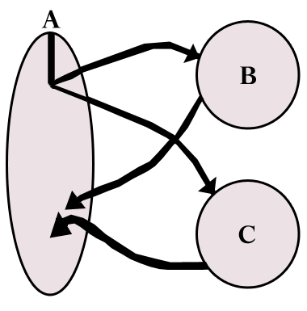
Parallel Composition: A1; (B || C ); A2
Recall: Different modules, written in different languages/paradigms, can overlap in time and on processors, without programmer having to worry about this explicitly

Slide 11
B
C
Time

Slide 12
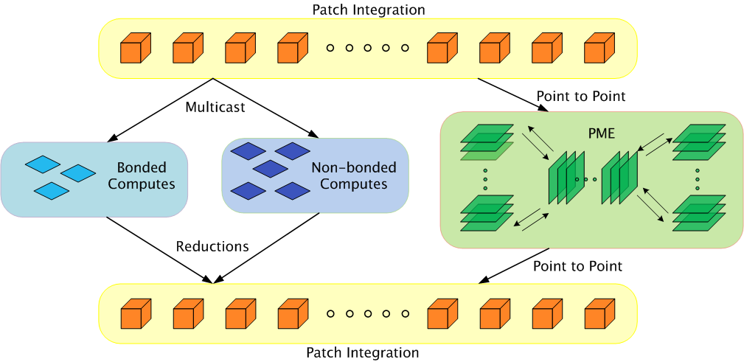
MD Parallelization Using Charm++
The computation is decomposed into “natural” objects of the application, which are assigned to processors by Charm++ RTS

Slide 13
MD Parallelization Using Charm++
The PME module is communication-dominated, with a long critical path, and small computation’
The non-bonded force computation module has a lot of floating point work, but relatively small computaiton

Slide 14
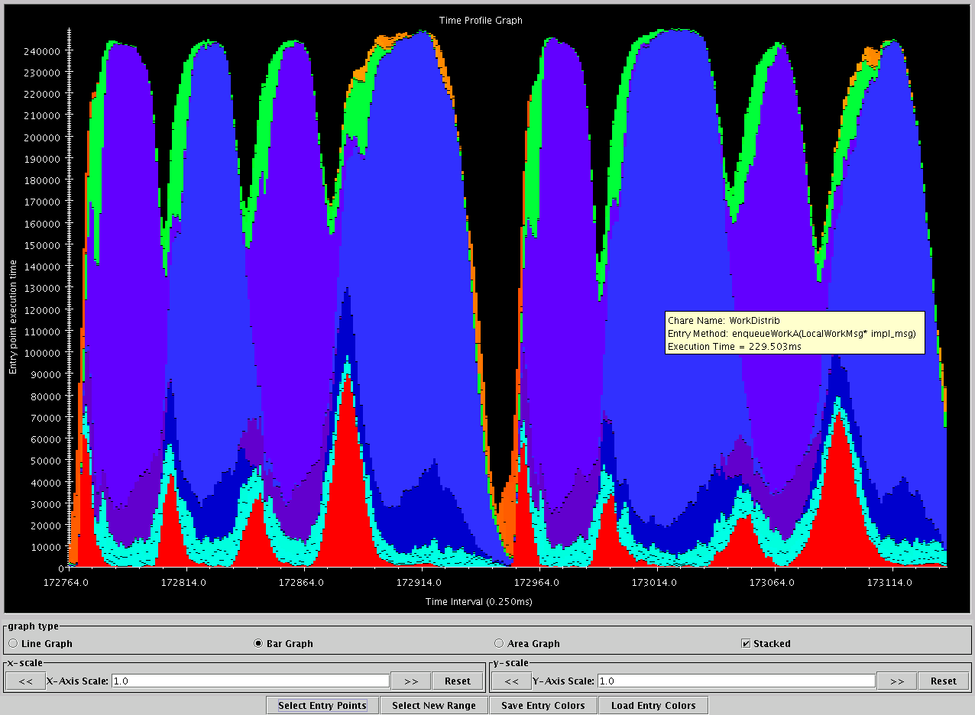
Apo-A1, on BlueGene/L, 1024 procs
Charm++’s “Projections” Analysis tool
Time intervals on x axis, activity added across processors on Y axis
The orange PME module is nicely overlapped with the blue non-bonded work
green: communication
Red: integration
Blue/Purple: electrostatics
Orange: PME
turquoise: angle/dihedral
Time

Slide 15
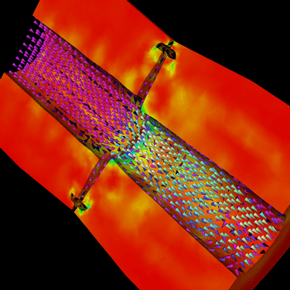
Decomposition Independent of numCores
Rocket simulation example under traditional MPI
With migratable-objects:
Benefit: load balance, communication optimizations, modularity
Solid
Solid
. . .
Solid
Fluid
Fluid
Fluid
1 2 P
Solid₁
Solid₂
Solid₃
. . .
Solid_{n}
Fluid₁
Fluid₂
. . .
Fluid_{m}
Notes:
15
In traditional MPI paradigm. The number of partitions of both modules is typically equal to the number of processor P
And although the i’th elements of fluid module and solid module are not connected geometrically in the simulation, they are glued together on the I’th processor.
Under Charm++/AMPI framework, the two modules each get their own set of parallel objects. And the size of the arrays are not restricted or related.
The benefit of this is performance optimizations and better modularity.
Problem: due to the asynchronous method invocation, the flow of control is buried deep into the object code

Slide 16
Migratability
Once the programmer has written the code without reference to processors
With all the communication expressed as that between objects
The system is free to migrate the objects across processors as and when it pleases
It must ensure it can deliver method invocations to the objects, whereever they go
This migratability turns out to be a key attribute for empowering an adaptive runtime system

