Slide 1
Outline
Introduction
Object Design
Execution Model
Hello World
Benefits of Charm++
Charm++ Basics
Object Collections
Overdecomposition
Migratability
Checkpointing and Resilience
Structured Dagger
Application Design
Performance Tuning
Using Dynamic Load Balancing
Interoperability
Debugging
Further Optimization

Slide 2
Automatic Dynamic Load Balancing
Measurement based load balancers
Principle of persistence: In many CSE applications, computational loads and communication patterns tend to persist, even in dynamic computations
Therefore, recent past is a good predictor of near future
Charm++ provides a suite of load-balancers
Periodic measurement and migration of objects
Seed balancers (for task-parallelism)
Useful for divide-and-conquer and state-space-search applications
Seeds for charm++ objects moved around until they take root

Slide 3
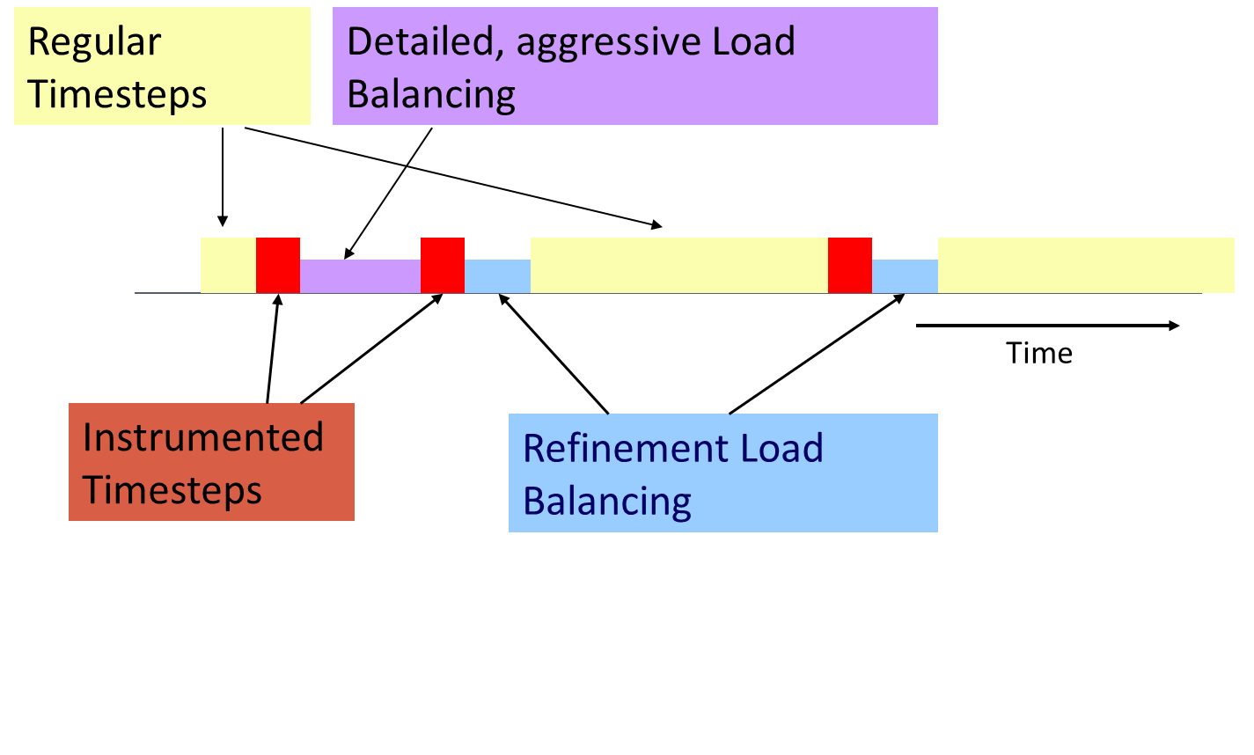
Typical Load Balancing Steps

Slide 4
Code to Use Load Balancing
Write PUP method to serialize the state of a chare
Insert if(myLBStep) AtSync(); call at natural barrier
Implement ResumeFromSync() to resume execution
Typical ResumeFromSync contribute to a reduction

Slide 5
Using the Load Balancer
link a LB module
-module <strategy>
RefineLB, NeighborLB, GreedyCommLB, others
EveryLB will include all load balancing strategies
compile time option (specify default balancer)
-balancer RefineLB
runtime option
+balancer RefineLB

Slide 6
Example: Stencil
while (!converged) {
serial {
int x = thisIndex.x, y = thisIndex.y, z = thisIndex.z;
copyToBoundaries(); thisProxy(wrapX(x - 1), y, z).updateGhosts(i, RIGHT, dimY, dimZ, right);
/∗ ...similar calls to send the 6 boundaries... ∗/
thisProxy(x, y, wrapZ(z + 1)).updateGhosts(i, FRONT, dimX, dimY, front);
} for (remoteCount = 0; remoteCount < 6; remoteCount++) {
when updateGhosts[i](int i, int d, int w, int h, double b[w∗h])
serial { updateBoundary(d, w, h, b); }
}
serial { int c = computeKernel() < DELTA; CkCallback cb(CkReductionTarget(Jacobi, checkConverged), thisProxy);
if (i % 5 == 1) contribute(sizeof(int), &c, CkReduction::logical_and, cb);
} if (i % lbPeriod == 0) { serial { AtSync(); } when ResumeFromSync() {} }
if (++i % 5 == 0) {
when checkConverged(bool result) serial {
if (result) { mainProxy.done(); converged = true; }
}
}
}

Slide 7
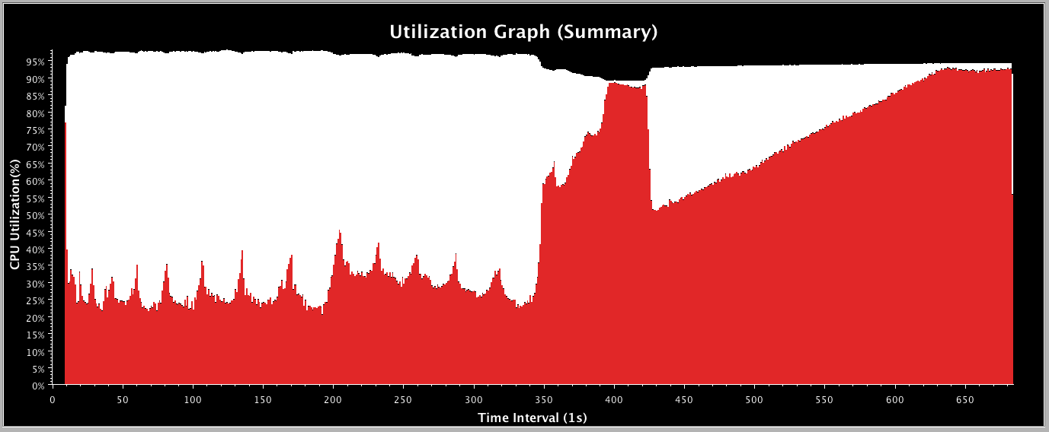
Performance – Before LB

Slide 8
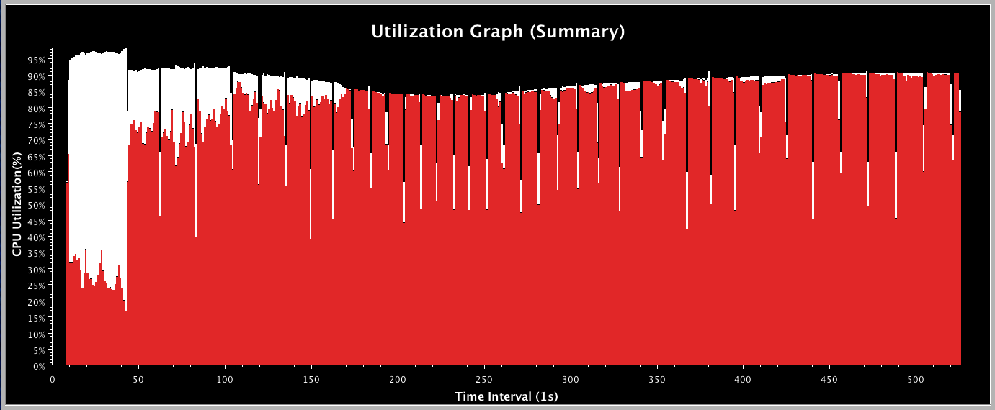
Performance – After LB

Slide 9
Golden Rule of Load Balancing
Fallacy: objective of load balancing is to minimize variance in load across processors
Example:
50,000 tasks of equal size, 500 processors:
A: All processors get 99, except last 5 gets 100 + 99 = 199
OR, B: All processors have 101, except last 5 get 1
Identical variance, but situation A is much worse!
Golden Rule: It is ok if a few processors idle, but avoid having processors that are overloaded with work
Finish time = max_{i}(Time on processor i)
excepting data dependence and communication overhead issues
The speed of any group is the speed of slowest member of that group.

Slide 10
Load Balancing Strategies
Classified by when it is done:
Initially
Dynamic: Periodically
Dynamic: Continuously
Classified by whether decisions are taken with global information
Fully centralized
Quite a good choice when load balancing period is high
Fully distributed
Each processor knows only about a constant number of neighbors
Extreme case: totally local decision (send work to a random destination processor, with some probability).
Use aggregated global information, and detailed neighborhood info.

Slide 11
Periodic Load Balancing
Centralized strategies:
Charm RTS collects data (on one processor) about:
Computational Load and Communication for each pair
Partition the graph of objects across processors
Take communication into account
Pt-to-pt, as well as multicast over a subset
As you map an object, add to the load on both sending and receiving processor
Multicasts to multiple co-located objects are effectively the cost of a single send

Slide 12
Object Partitioning Strategies
You can use graph partitioners like METIS, K-R
BUT: graphs are smaller, and optimization criteria are different
Greedy strategies:
If communication costs are low: use a simple greedy strategy
Sort objects by decreasing load
Maintain processors in a heap (by assigned load)
In each step: assign the heaviest remaining object to the least loaded processor
With small-to-moderate communication cost:
Same strategy, but add communication costs as you add an object to a processor
Always add a refinement step at the end:
Swap work from heaviest loaded processor to “some other processor”
Repeat a few times or until no improvement

Slide 13
Object Partitioning Strategies 2
When communication cost is significant:
Still use greedy strategy, but:
At each assignment step, choose between assigning O to least loaded processor and the processor that already has objects that communicate most with O.
Based on the degree of difference in the two metrics
Two-stage assignments:
In early stages, consider communication costs as long as the processors are in the same (broad) load class,
In later stages, decide based on load
Branch-and-bound
Searches for optimal, but can be stopped after a fixed time

Slide 14
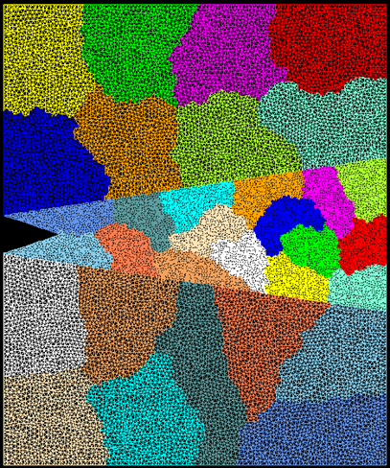
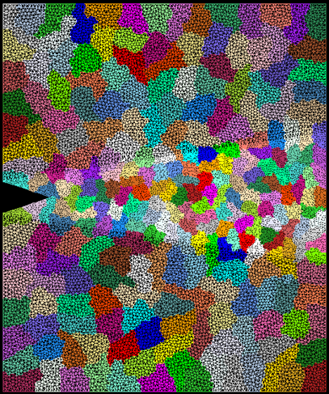
Crack Propagation
Decomposition into 16 chunks (left) and 128 chunks, 8 for each PE (right). The middle area contains cohesive elements. Both decompositions obtained using Metis. Pictures: S. Breitenfeld and P. Geubelle
As computation progresses, crack propagates, and new elements are added, leading to more complex computations in some chunks

Slide 15
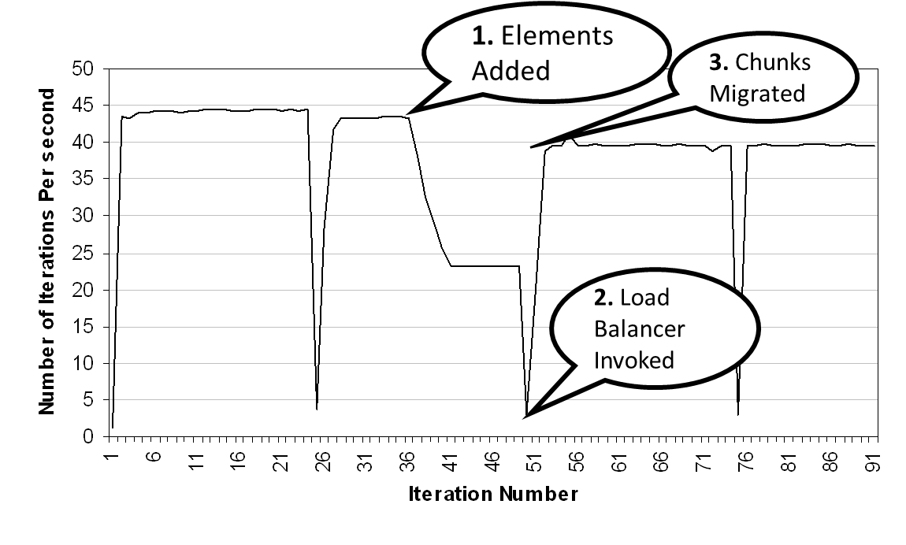
Load Balancing Crack Propagation

Slide 16
Distributed Load balancing
Centralized strategies
Still ok for 3000 processors for NAMD
Distributed balancing is needed when:
Number of processors is large and/or
Load variation is rapid
Large machines:
Need to handle locality of communication
Topology sensitive placement
Need to work with scant global information
Approximate or aggregated global information (average/max load)
Incomplete global info (only neighborhood)
Work diffusion strategies (1980s work by Kale and others!)
Achieving global effects by local action

Slide 17
Load Balancing on Large Machines
Centralized load balancing strategies don’t scale on extremely large machines
Limitations of centralized strategies:
Central node: memory/communication bottleneck
Decision-making algorithms tend to be very slow
Limitations of distributed strategies:
Difficult to achieve well-informed load balancing decisions

Slide 18
Hierarchical Load Balancers
Partition processor allocation into processor groups
Apply different strategies at each level
Scalable to a large number of processors

Slide 19
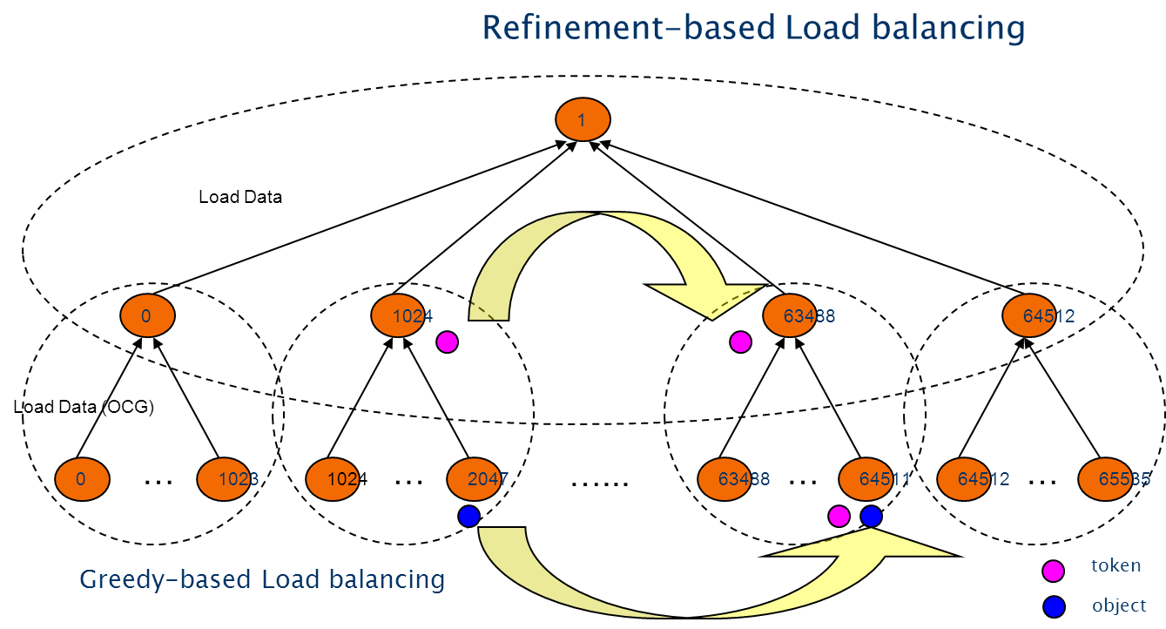
Our Hybrid Scheme

Slide 20
MetaBalancer - When and how to load balance?
Difficult to find the optimum load balancing period
Depends on the application characteristics
Depends on the machine the application is run on
Monitors the application continuously and predicts behavior.
Decides when to invoke which load balancer.
Command line argument - +MetaLB

Slide 21
Fractography with No Load Balancing
Large variation in processor utilization
Low utilization leading to resource wastage

Slide 22
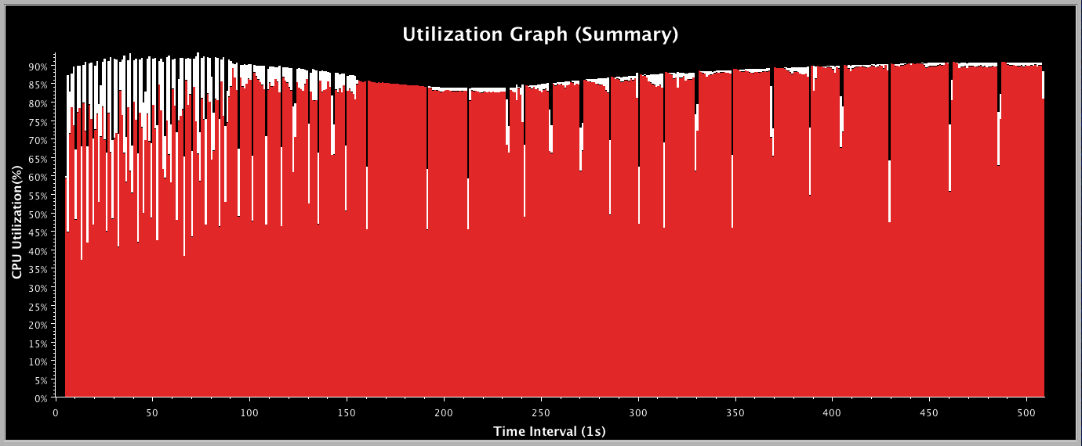
Metabalancer Utilization Graph for Fractography

