Slide 1
Charm++ Tutorial
Presented by Phil Miller
2012-04-30

Slide 2
Outline
Basics
Introduction
Charm++ Objects
Chare Arrays
Chare Collectives
SDAG
Example
Intermission
Advanced
Prioritized Messaging
Interface file tricks
Initialization
Entry Method Tags
Groups & Node Groups
Threads

Slide 3
Expectations
Introduction to Charm++
Assumes parallel programming aware audience
Assume C++ aware audience
AMPI not covered
Goals
What Charm++ is
How it can help
How to write a basic charm program
Provide awareness of advanced features

Slide 4
What Charm++ Is Not
Not Magic Pixie Dust
Runtime system exists to help you
Decisions and customizations are necessary in proportion to the complexity of your application
Not a language
Platform independent library with a semantic
Works for C, C++, Fortran (not covered in this tutorial)
Not a Compiler
Not SPMD Model
Not Processor Centric Model
Decompose to individually addressable medium grain tasks
Not A Thread Model
They are available if you want to inflict them on your code
Not Bulk Synchronous

Slide 5
Charm++ Ecosystem

Slide 6
The Charm++ Model
Parallel objects (chares) communicate via asynchronous method invocations (entry methods).
The runtime system maps chares onto processors and schedules execution of entry methods.
Similar to Active Messages or Actors

Slide 7
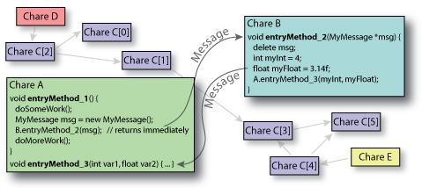
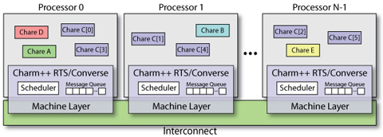
User View vs. System View
User View:
System View:

Slide 8
Architectures
Runs on:
Clusters with Ethernet (UDP/TCP)
Clusters with Infiniband
Clusters with accelerators (GPU/CELL)
IBM & Cray Supercomputers
Windows
Any machine with MPI installation
…
To install
“./build”

Slide 9
Portability
Cray XT (3|4|5|6)
- Kraken
Cray X(E|K) 6
- Titan, Blue Waters
BlueGene (L|P|Q)
- Intrepid, Mira
SGI/Altix
- Ember
Clusters
- X86_64, POWER
- MPI, UDP, TCP, LAPI, Infiniband
Accelerators
- GPGPU
- Cell

Slide 10
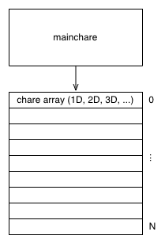
Charm++ Objects
A “chare” is a C++ object with methods that can be remotely invoked
The “mainchare” is the chare where the execution starts in the program
A “chare array” is a collection of chares of the same type
Typically the mainchare will spawn a chare array of workers

Slide 11
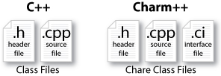
Charm++ File Structure
The C++ objects (whether they are chares or not)
Reside in regular .h and .cpp files
Chare objects, messages and entry methods (methods that can be called asynchronously and remotely)
Defined in a .ci (Charm interface) file
And are implemented in the .cpp file

Slide 12
Hello World: .ci file
mainmodule hello {
mainchare Main {
entry Main(CkArgMsg* m);
};
};
.ci: Charm Interface
Defines which type of chares are present in the application
At least a mainchare must be set
Each definition is inside a module

Slide 13
Hello World: the code
Interface
Implementation
mainmodule hello {
mainchare Main {
entry Main(CkArgMsg* m);
};
};
#include “hello.decl.h”
class Main : public CBase_Main {
public:
Main(CkArgMsg* m) {
CkPrintf(“Hello World!\n”);
CkExit();
}
};
#include “hello.def.h”

Slide 14
CkArgMsg in the Main::Main Method
Defined in charm++
struct CkArgMsg {
int argc;
char **argv;
};

Slide 15
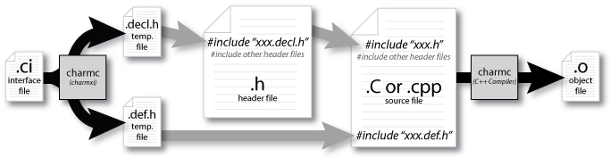
Compilation Process
charmc hello.ci
charmc –o main.o main.C # compile
# link
charmc –language charm++ -o pgm main.o

Slide 16
Execution
./charmrun +p4 ./pgm
Or specific queueing system
Output:
Hello World!
Not a parallel code :(
Solution: create other chares, all of them saying “Hello World”

Slide 17
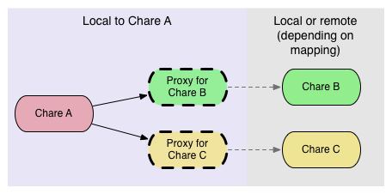
How to Communicate?
Chares spread across multiple processors
It is not possible to directly invoke methods
Use of Proxies – lightweight handles to potentially remote chares

Slide 18
The Proxy
A proxy class is generated for every chare
For example, CProxy_Main is the proxy generated for the chare Main
Proxies know where to find a chare in the system
Methods invoked on a Proxy pack the input parameters, and send them to the processor where the chare is. The real method will be invoked on the destination processor.
Given a proxy p, it is possible to call the method
p.method(msg)

Slide 19
Hello World with a New Chare
Program’s asynchronous flow
Mainchare sends message to Hello object
Hello object prints “Hello World!”
Hello object sends message back to the mainchare
Mainchare quits the application

Slide 20
Code
#include “hello.decl.h”
struct Main : public CBase_Main {
Main(CkArgMsg* m) {
delete m;
CProxy_Hello h =
CProxy_Hello::ckNew(thisProxy);
h.printHello();
}
void done() { CkExit(); }
};
struct Hello : public CBase_Hello {
CBase_Main main;
Hello(CProxy_Main main_)
: main(main_) { }
void printHello() {
CkPrintf(“Hello World!\n”);
main.done();
}
};
#include “hello.def.h”
mainmodule hello {
mainchare Main {
entry Main(CkArgMsg* m);
entry void done();
};
chare Hello {
entry Hello(CProxy_Main main);
entry void printHello();
};
};

Slide 21
Workflow of Hello World
#include “hello.decl.h”
struct Main : public CBase_Main {
Main(CkArgMsg* m) {
delete m;
CProxy_Hello h =
CProxy_Hello::ckNew(thisProxy);
h.printHello();
}
void done() { CkExit(); }
};
struct Hello : public CBase_Hello {
CBase_Main main;
Hello(CProxy_Main main_)
: main(main_) { }
void printHello() {
CkPrintf(“Hello World!\n”);
main.done();
}
};
#include “hello.def.h”

Slide 22
Workflow of Hello World
#include “hello.decl.h”
struct Main : public CBase_Main {
Main(CkArgMsg* m) {
delete m;
CProxy_Hello h =
CProxy_Hello::ckNew(thisProxy);
h.printHello();
}
void done() { CkExit(); }
};
struct Hello : public CBase_Hello {
CBase_Main main;
Hello(CProxy_Main main_)
: main(main_) { }
void printHello() {
CkPrintf(“Hello World!\n”);
main.done();
}
};
#include “hello.def.h”

Slide 23
Workflow of Hello World
#include “hello.decl.h”
struct Main : public CBase_Main {
Main(CkArgMsg* m) {
delete m;
CProxy_Hello h =
CProxy_Hello::ckNew(thisProxy);
h.printHello();
}
void done() { CkExit(); }
};
struct Hello : public CBase_Hello {
CBase_Main main;
Hello(CProxy_Main main_)
: main(main_) { }
void printHello() {
CkPrintf(“Hello World!\n”);
main.done();
}
};
#include “hello.def.h”

Slide 24
Workflow of Hello World
#include “hello.decl.h”
struct Main : public CBase_Main {
Main(CkArgMsg* m) {
delete m;
CProxy_Hello h =
CProxy_Hello::ckNew(thisProxy);
h.printHello();
}
void done() { CkExit(); }
};
struct Hello : public CBase_Hello {
CBase_Main main;
Hello(CProxy_Main main_)
: main(main_) { }
void printHello() {
CkPrintf(“Hello World!\n”);
main.done();
}
};
#include “hello.def.h”

Slide 25
Limitations of Plain Proxies
In a large program, keeping track of all the proxies is difficult
A simple proxy doesn’t tell you anything about the chare other than its type.
Managing collective operations like broadcast and reduce is complicated.

Slide 26
Chare Arrays
Chare Arrays organize chares into indexed collections.
One single name for the whole collection
Each chare in the array has a proxy for all the other array elements, accessible using simple syntax
sampleArray[i] // i’th proxy
sampleArray(i, j) // (i, j) proxy

Slide 27
Array Dimensions
Anything can be used as array indices
integers
Tuples (e.g., 2D, 3D array)
bit vectors
user-defined types
Dense or sparse in index space
Can insert and delete elements on the fly

Slide 28
Array Elements Mapping
Automatically by the runtime system
Programmer could control the mapping of array elements to PEs.
Round-robin, block-cyclic, etc
User defined mapping

Slide 29
Broadcasts
Simple way to invoke the same entry method on each array element.
Example: A 1D array “Cproxy_MyArray arr”
arr[3].method(): a point-to-point message to element 3.
arr.method(): a broadcast message to every elements

Slide 30
Hello World: Array Version
mainmodule hello {
mainchare Main {
entry Main(CkArgMsg* m);
entry void done();
};
array [1D] Hello {
entry Hello(CProxy_Main m,
int n);
entry void printHello();
};
};
struct Hello : public CBase_Hello {
CBase_Main main;
int numChares;
Hello(CProxy_Main m, int n)
: main(m), numChares(n)
{ }
void printHello() {
CkPrintf(“Hello World from %s!\n”,
thisIndex);
if (thisIndex < numChares - 1)
thisProxy[thisIndex+1].printHello();
else
main.done();
}
};

Slide 31
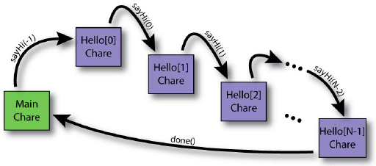
Result
# Running “Hello World” with 10 elements using 3 processors.
$ ./charmrun +p3 ./hello 10
Hello world from 0!
Hello world from 1!
Hello world from 2!
Hello world from 3!
Hello world from 4!
Hello world from 5!
Hello world from 6!
Hello world from 7!
Hello world from 8!
Hello world from 9!

Slide 32
readonly Variables
Defines a global constant
Everyone gets its value
Must be set only in the mainchare
mainmodule hello {
readonly CProxy_Main main;
readonly int numChares;
mainchare Main {
entry Main(CkArgMsg* m);
entry void done();
};
array [1D] Hello {
entry Hello();
entry void printHello();
};
};
CBase_Main main;
int numChares;
Main::Main(CkArgMsg *m) {
numChares = atoi(m->argv[1]);
main = thisProxy;
CProxy_Hello h = CProxy_Hello::ckNew();
h.printHello();
delete m;
}

Slide 33
Reductions
Every chare element will contribute its portion of data to someone, and data are combined through a particular operation.
Naïve way:
Use a “master” to count how many messages need to be received.
Potential bottleneck on the “master”

Slide 34
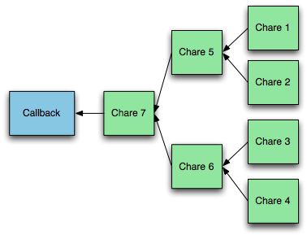
Reductions
Runtime system builds reduction tree
User specifies reduction operation
At root of tree, a callback is triggered

Slide 35
Reduction in Charm++
No global flow of control, so each chare must contribute data independently:
void contribute(int nBytes, const void *data, CkReduction::reducerType type,
CkCallback cb);
Callback cb is invoked when the reduction is complete.

Slide 36
Reduction Operations
Predefined instances of CkReduction::reducerType:
Arithmetic (int, float, double)
CkReduction::sum_int, CkReduction::sum_double, …
CkReduction::product_int, …
CkReduction::max_int, …
CkReduction::min_int, …
Logic:
CkReduction::logical_and, logic_or
CkReduction::bitvec_and, bitvec_or
Gather:
CkReduction::set, concat
Misc:
CkReduction::random
Defined by the user

Slide 37
Callback: where do reductions go?
CkCallback(CkCallbackFn fn, void *param)
void myCallbackFn(void *param, void *msg)
CkCallback(int ep, const CkChareID &id)
ep=CkReductionTarget(ChareName, EntryMethod)
CkCallback(int ep, const CkArrayID &id)
The callback will be called on all array elements
CkCallback(int ep, const CkArrayIndex &idx, const CkArrayID &id)
The callback will only be called on element[idx]
CkCallback(CkCallback::ckExit)

Slide 38
Example
Sum local error estimators to determine global error
CkCallback cb (CkReductionTarget(Main, computeGlobalError), mainProxy);
contribute(sizeof(double), &myError, CkReduction::sum_double, cb);
// in .ci file for Main:
// . . . .
entry void [reductiontarget] computeGlobalError(double error);

Slide 39
Example: Jacobi (Stencil)
Use two interchangeable matrices
do {
computeKernel();
maxDiff = max(abs (A - B));
} while (maxDiff > DELTA);
computeKernel() {
foreach i,j {
B[i,j] = (A[i,j] +
A[i+1,j] +
A[i-1,j] + A[i,j+1] +
A[i,j-1]) / 5;
}
swap (A, B);
}

Slide 40
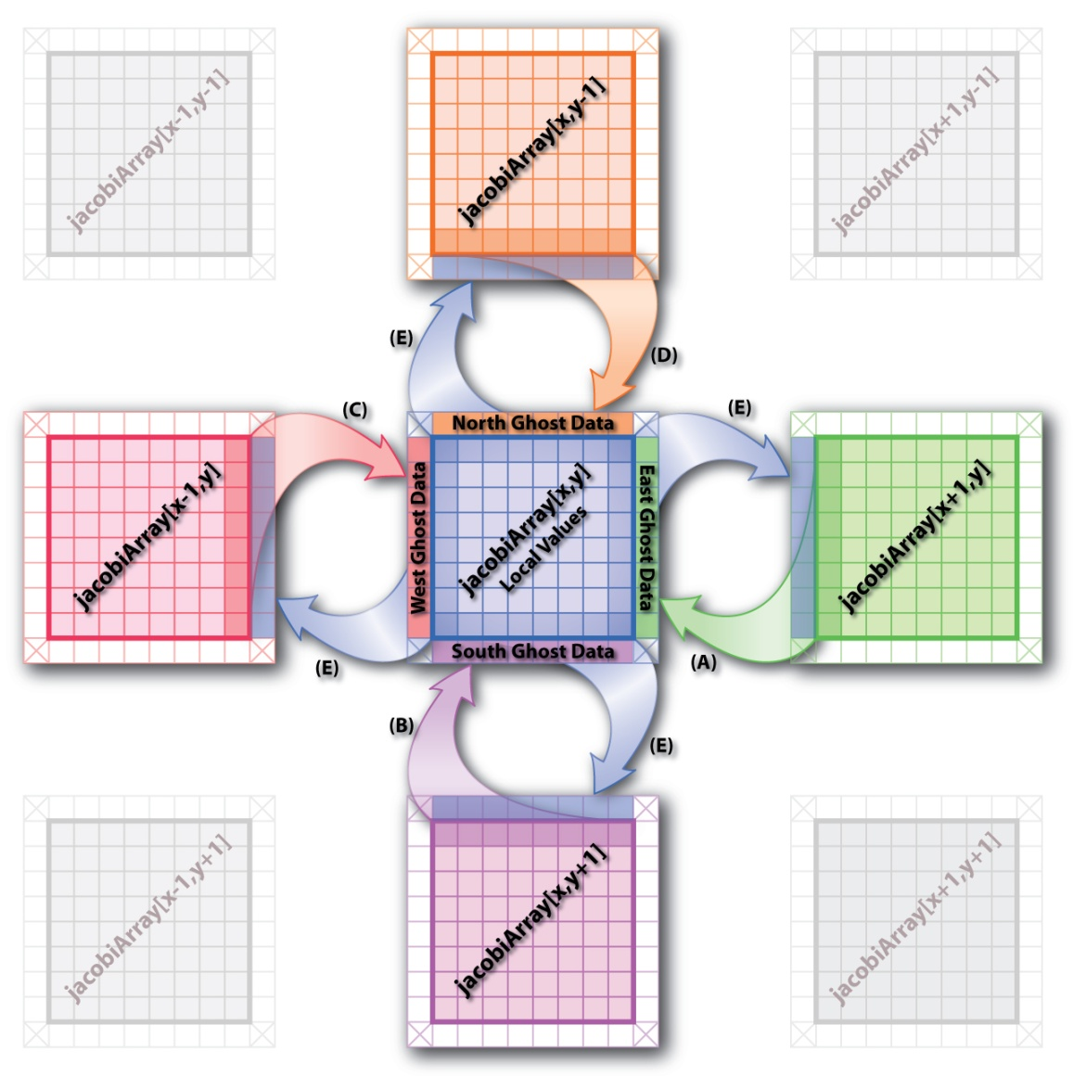
Jacobi in parallel

Slide 41
Control Flow using SDAG
Structured DAGger
Directed Acyclic Graph (DAG)
Express event sequencing and dependency
Automate Message buffering
Automate Message counting
Express independence for overlap
Differentiate between parallel and sequential blocks
Negligible overhead

Slide 42
Structured Dagger Constructs
when <method list> {code}
Do not continue until method is called
Internally generates flags, checks, etc.
atomic {code}
Call ordinary sequential C++ code
if/else/for/while
C-like control flow
overlap {code1 code2 ...}
Execute code segments in parallel
forall
“Parallel Do”
Like a parameterized overlap

Slide 43
Jacobi Example
while (!converged) {
atomic {
int x = thisIndex.x, y = thisIndex.y, z = thisIndex.z;
copyToBoundaries();
thisProxy(wrapX(x-1),y,z).updateGhosts(i, RIGHT, dimY, dimZ, right);
/* ...similar calls to send the 6 boundaries... */
thisProxy(x,y,wrapZ(z+1)).updateGhosts(i, FRONT, dimX, dimY, front);
}
for (remoteCount = 0; remoteCount < 6; remoteCount++) {
when updateGhosts[i](int i, int d, int w, int h, double b[w*h])
atomic { updateBoundary(d, w, h, b); }
}
atomic {
int c = computeKernel() < DELTA;
CkCallback cb(CkReductionTarget(Jacobi, checkConverged), thisProxy);
if (i % 5 == 1) contribute(sizeof(int), &c, CkReduction::logical_and, cb);
}
if (++i % 5 == 0) {
when checkConverged(bool result) atomic {
if (result) { mainProxy.done(); converged = true; }
}
}
}

Slide 44
Jacobi Example
while (!converged) {
atomic {
int x = thisIndex.x, y = thisIndex.y, z = thisIndex.z;
copyToBoundaries();
thisProxy(wrapX(x-1),y,z).updateGhosts(i, RIGHT, dimY, dimZ, right);
/* ...similar calls to send the 6 boundaries... */
thisProxy(x,y,wrapZ(z+1)).updateGhosts(i, FRONT, dimX, dimY, front);
}
for (remoteCount = 0; remoteCount < 6; remoteCount++) {
when updateGhosts[i](int i, int d, int w, int h, double b[w*h])
atomic { updateBoundary(d, w, h, b); }
}
atomic {
int c = computeKernel() < DELTA;
CkCallback cb(CkReductionTarget(Jacobi, checkConverged), thisProxy);
if (i % 5 == 1) contribute(sizeof(int), &c, CkReduction::logical_and, cb);
}
if (i % lbPeriod == 0) { atomic { AtSync(); } when ResumeFromSync() {} }
if (++i % 5 == 0) {
when checkConverged(bool result) atomic {
if (result) { mainProxy.done(); converged = true; }
}
}
}

Slide 45
Jacobi Example
while (!converged) {
atomic {
int x = thisIndex.x, y = thisIndex.y, z = thisIndex.z;
copyToBoundaries();
thisProxy(wrapX(x-1),y,z).updateGhosts(i, RIGHT, dimY, dimZ, right);
/* ...similar calls to send the 6 boundaries... */
thisProxy(x,y,wrapZ(z+1)).updateGhosts(i, FRONT, dimX, dimY, front);
}
for (remoteCount = 0; remoteCount < 6; remoteCount++) {
when updateGhosts[i](int i, int d, int w, int h, double b[w*h])
atomic { updateBoundary(d, w, h, b); }
}
atomic {
int c = computeKernel() < DELTA;
CkCallback cb(CkReductionTarget(Jacobi, checkConverged), thisProxy);
if (i % 5 == 1) contribute(sizeof(int), &c, CkReduction::logical_and, cb);
}
if (i % lbPeriod == 0) { atomic { AtSync(); } when ResumeFromSync() {} }
if (i % checkpointPeriod == 0) {
atomic {CkStartMemCheckpoint(CkCallback(CkIndex_Jacobi::cpDone(), thisProxy));}
when cpDone() { }
}
// . . .

Slide 46
Advanced Messaging

Slide 47
Prioritized Execution
Charm++ scheduler
Default - FIFO (oldest message)‏
Prioritized execution
If several messages available, Charm will process the messages in the order of their priorities
Very useful for speculative work, ordering timestamps, etc...

Slide 48
Prioritized Messages
Number of priority bits passed during message allocation
FooMsg * msg = new (size, nbits) FooMsg;
Priorities stored at the end of messages
Signed integer priorities
*CkPriorityPtr(msg)=-1;
CkSetQueueing(msg, CK_QUEUEING_IFIFO);
Unsigned bitvector priorities
CkPriorityPtr(msg)[0]=0x7fffffff;
CkSetQueueing(msg, CK_QUEUEING_BFIFO);

Slide 49
Prioritized Marshalled Messages
Pass “CkEntryOptions” as last parameter
For signed integer priorities:
CkEntryOptions opts;
opts.setPriority(-1);
fooProxy.bar(x,y,opts);
For bitvector priorities:
CkEntryOptions opts;
unsigned int prio[2]={0x7FFFFFFF,0xFFFFFFFF};
opts.setPriority(64,prio);
fooProxy.bar(x,y,opts);

Slide 50
Advanced Message Features
Nokeep (Read-only) messages
Entry method agrees not to modify or delete the message
Avoids message copy for broadcasts, saving time
Inline messages
Direct method invocation if on local processor
Expedited messages
Message do not go through the charm++ scheduler (ignore any Charm++ priorities)‏
Immediate messages
Entries are executed in an interrupt or the communication thread
Very fast, but tough to get right
Immediate messages only currently work for NodeGroups and Group (non-smp)‏
Notes:
Not sort on priority

Slide 51
Groups/Node Groups

Slide 52
Groups and Node Groups
Groups
Similar to arrays: Broadcasts, reductions, indexing
Exactly one representative on each processor
Ideally suited for system libraries, caches, etc.
Node Groups
One per OS process
Notes:
Special chare array

Slide 53
Declarations
.ci file
group mygroup {
entry mygroup(); //Constructor
entry void foo(foomsg *); //Entry method
};
nodegroup mynodegroup {
entry mynodegroup(); //Constructor
entry void foo(foomsg *); //Entry method
};
C++ file
class mygroup : public CBase_mygroup {
mygroup() {}
void foo(foomsg *m) { CkPrintf(“Do Nothing”);}
};
class mynodegroup : public CBase_mynodegroup {
mynodegroup() {}
void foo(foomsg *m) { CkPrintf(“Do Nothing”);}
};

Slide 54
Creating and Calling Groups
Creation
p = CProxy_mygroup::ckNew();
Remote invocation
p.foo(msg); //broadcast
p[1].foo(msg); //asynchronous
p.foo(msg, npes, pes); // list send
Direct local access
mygroup *g=p.ckLocalBranch();
g->foo(….); //local invocation
Danger: if you migrate, the group stays behind!

Slide 55
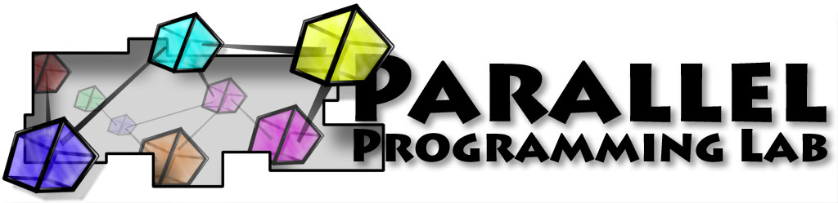
Thank You!
Free source, binaries, manuals, and more information at: http://charm.cs.illinois.edu/
Parallel Programming Lab at University of Illinois

