Slide 1
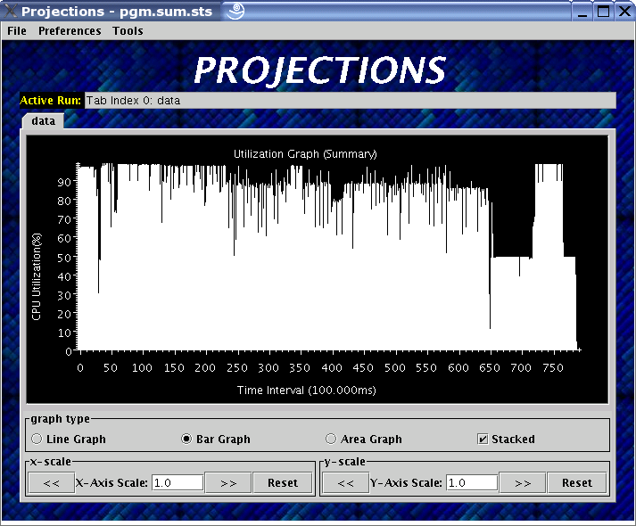
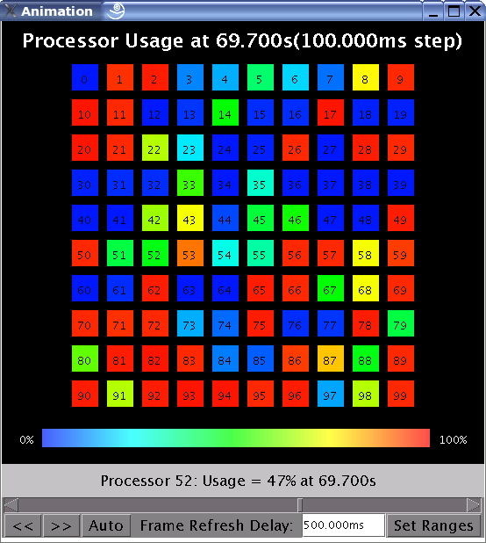
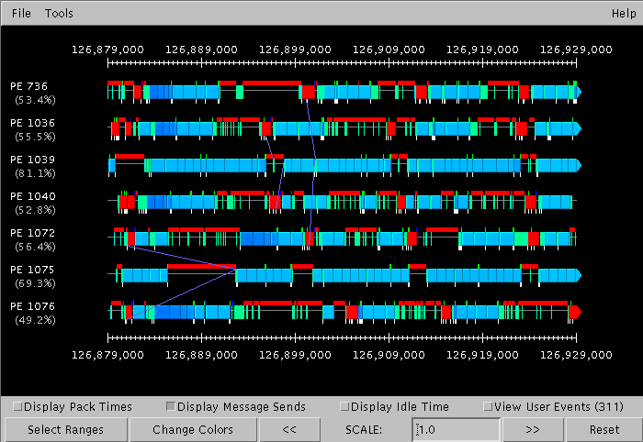
Projections: Performance Analysis Tool
Automatic instrumentation via runtime
Graphical visualizations
More insightful feedback
  because runtime understands application events better
Purdue

Slide 2
Exploit sophisticated Performance analysis tools
An example:
  Trying to identify the next performance obstacle for NAMD
    Running on 8192 processors, with 92,000 atom simulation
    Test scenario: without PME
    Time is 3 ms per step, but lower bound is 1.6ms or so..
Purdue

Slide 3
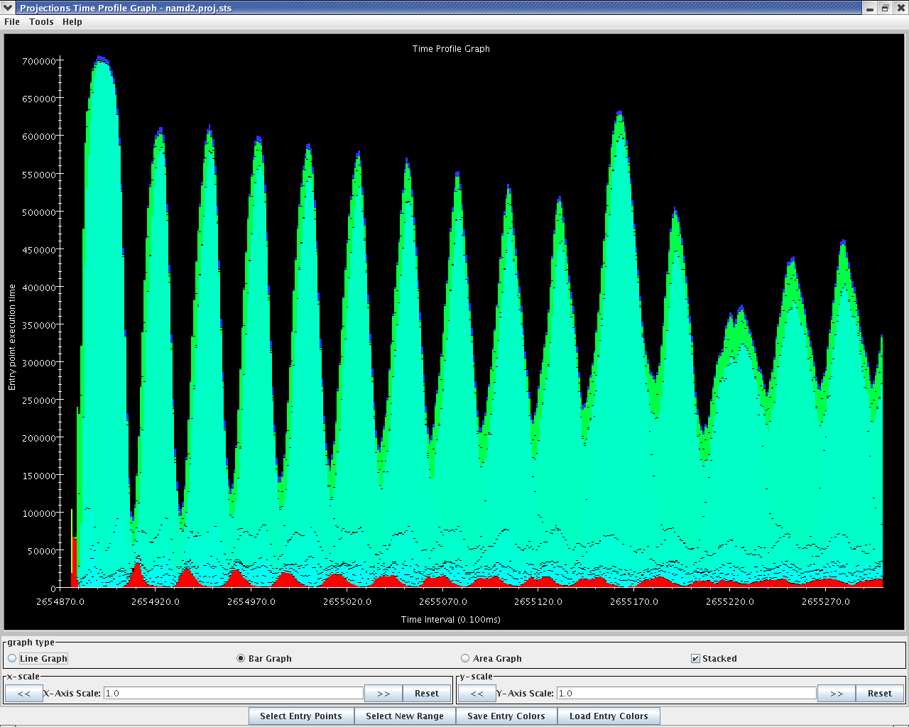
Purdue

Slide 4
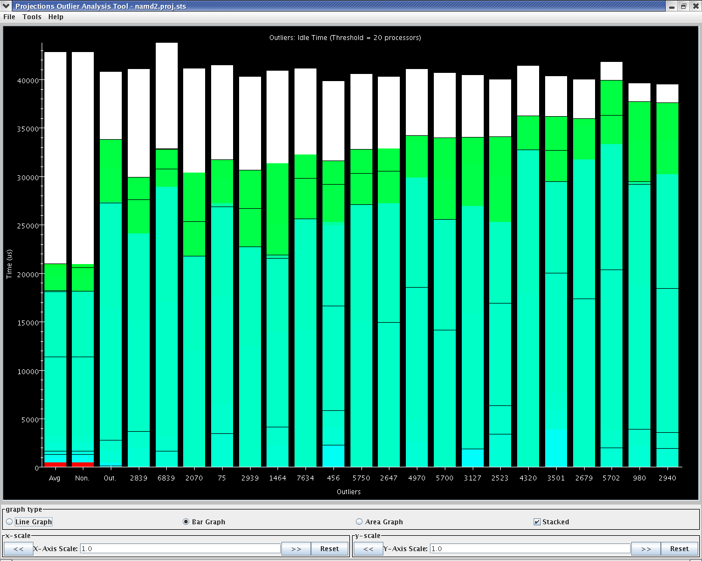
Purdue

Slide 5
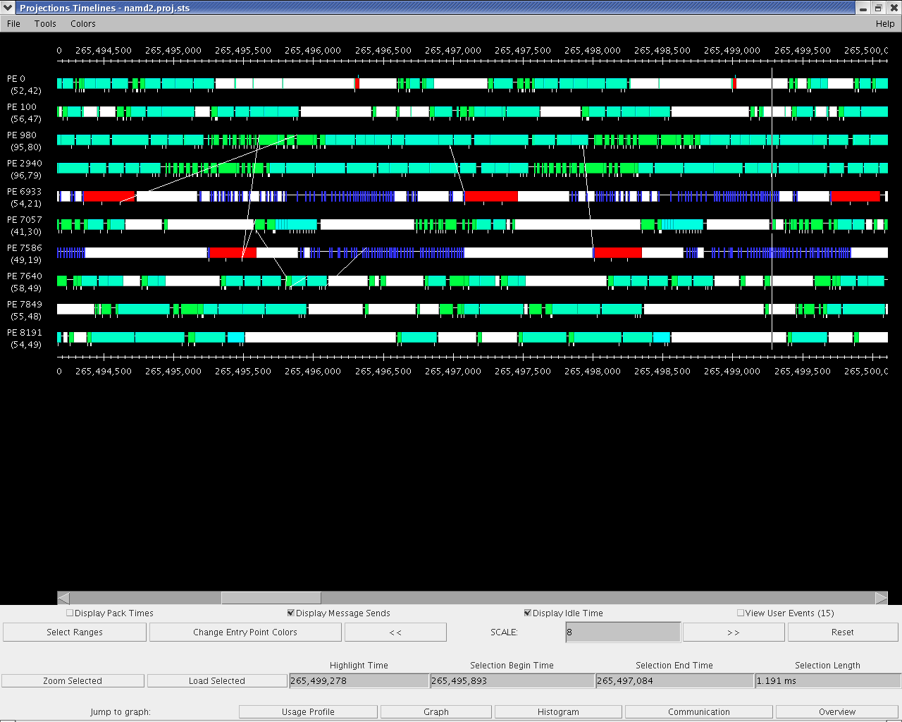
Purdue

