Slide 1
Outline
Introduction
Object Design
Execution Model
Hello World
Benefits of Charm++
Charm++ Basics
Object Collections
Overdecomposition
Migratability
Checkpointing and Resilience
Structured Dagger
Application Design
Performance Tuning
Using Dynamic Load Balancing
Interoperability
Debugging
Further Optimization

Slide 2
Impact on communication
Current use of communication network
Compute-communicate cycles in typical MPI apps
Network is used for a fraction of time
And is on the critical path
Hence, current communication networks are over-engineered by necessity
With overdecomposition
Communication is spread over an iteration
Adaptive overlap of communication and computation

Slide 3
Example Stencil Computation
Consider a simple stencil computation
With traditional design based on traditional methods (e.g. MPI-based)
Each processor has a chunk, which alternates between computing and communicating
With Charm++
Multiple chunks on each processor
Wait time for each chunk overlapped with useful computation for others
Communication spread over time

Slide 4
Example: Stencil Computation
Stencil in MPI: No overlap among computation and communication
Stencil in Charm: Communication of a chare overlaps with computation of others

Slide 5
Modularity and Compositionality
Without message-driven execution (and virtualization), you get either: Space-division

Slide 6
Modularity and Compositionality
Sequentialization

Slide 7
Modularity and Compositionality
Parallel Composition: A1; (B —— C ); A2
Recall: Different modules, written in different languages/paradigms, can overlap in time and on processors, without programmer having to worry about this explicitly

Slide 8
Migratability
Once the programmer has written the code without reference to processors, all of the communication is expressed among objects
The system is free to migrate the objects across processors as and when it pleases
It must ensure it can deliver method invocations to the objects, wherever they go
This migratability turns out to be a key attribute for empowering an adaptive runtime system

Slide 9
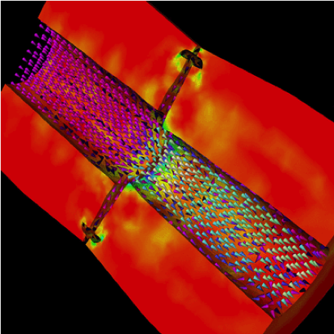
Decomposition Independent of numCores
Rocket simulation under traditional MPI
Rocket simulation with migratable objects
Benefits: load balance, communication optimizations, modularity

Slide 10
Utility for Multi-cores, Many-cores, Accelerators
Objects connote and promote locality
Message-driven execution is
A strong principle of prediction for data and code use
Much stronger than principle of locality
Can be used to scale memory wall
Prefetching of needed data, e.g, into scratch pad memories
Notes:
Made image from slides from presentation I made with these objects: loadBalancingBasics_SMD.pptx

Slide 11
Load Balancing
Static
Irregular applications
Programmer shouldn’t have to figure out ideal mapping
Dynamic
Applications are increasingly using adaptive strategies
Abrupt refinements
Continuous migration of work: e.g. particles in MD
Challenges
Performance limited by most overloaded processor
The chance that one processor is severely overloaded gets higher as #processors increases
Migratable Objects Empower Automated Load Balancing!

Slide 12
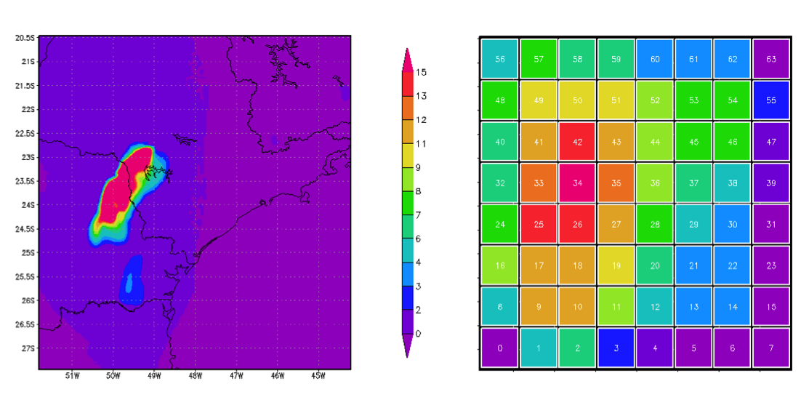
A quick Example Weather Forecasting in BRAMS
Brams: Brazillian weather code (based on RAMS)
AMPI version (Eduardo Rodrigues, with Mendes and J. Panetta)

Slide 13
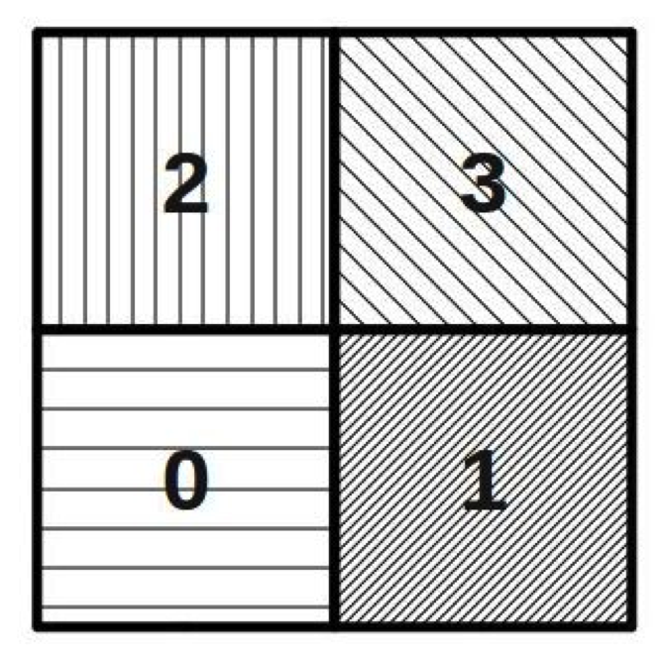
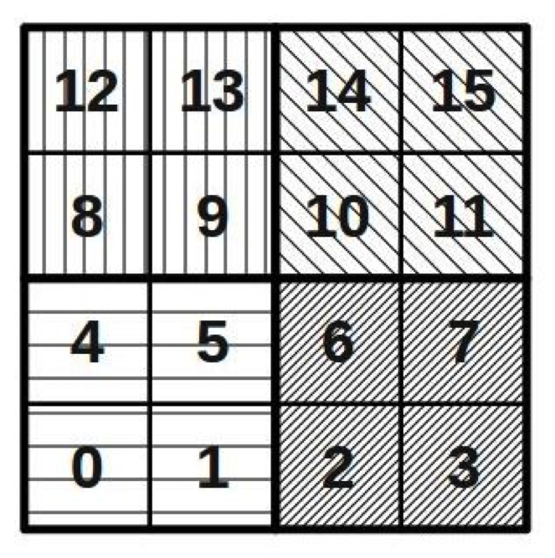
Basic Virtualization of BRAMS

Slide 14
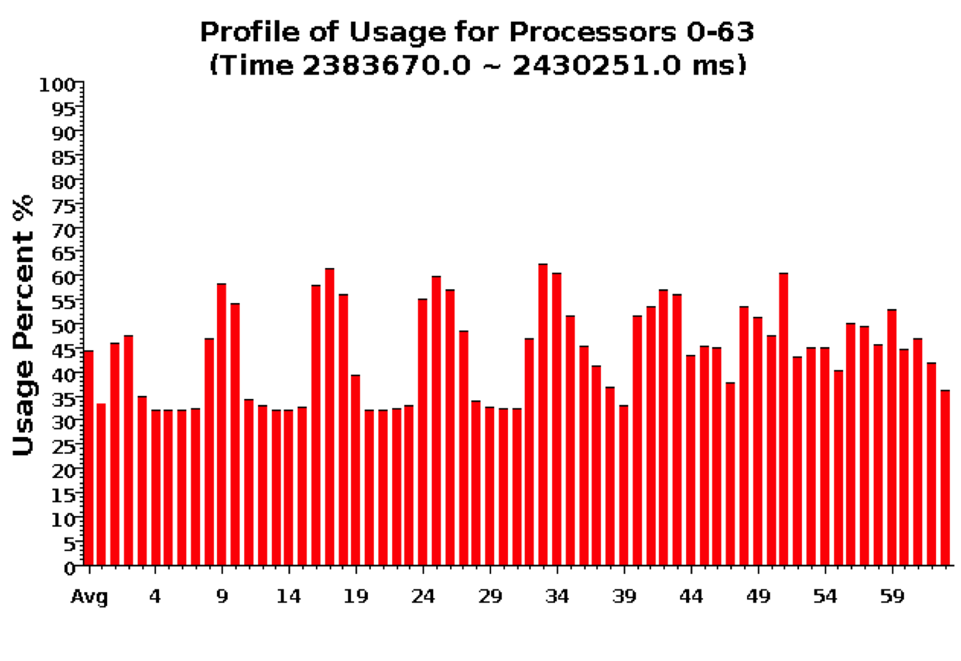
Baseline: 64 objects on 64 processors

Slide 15
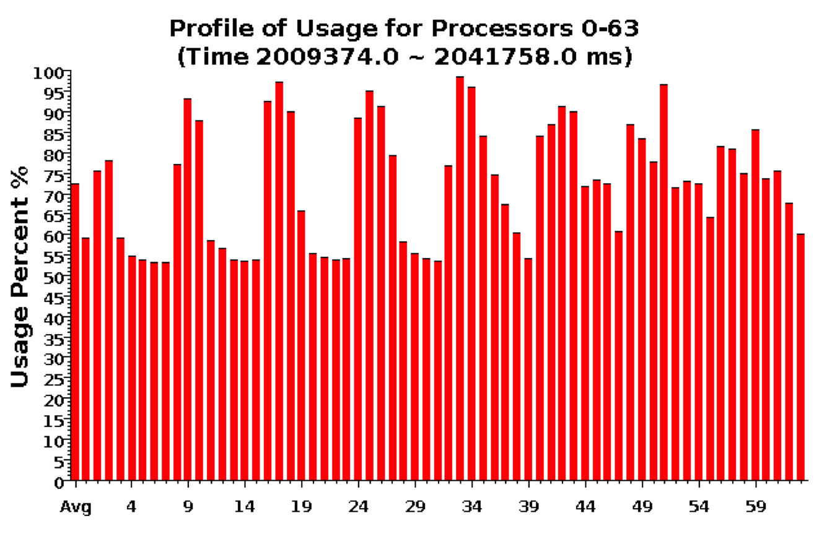
Over-decomposition: 1024 objects on 64 processors Benefits from communication/computation overlap

Slide 16
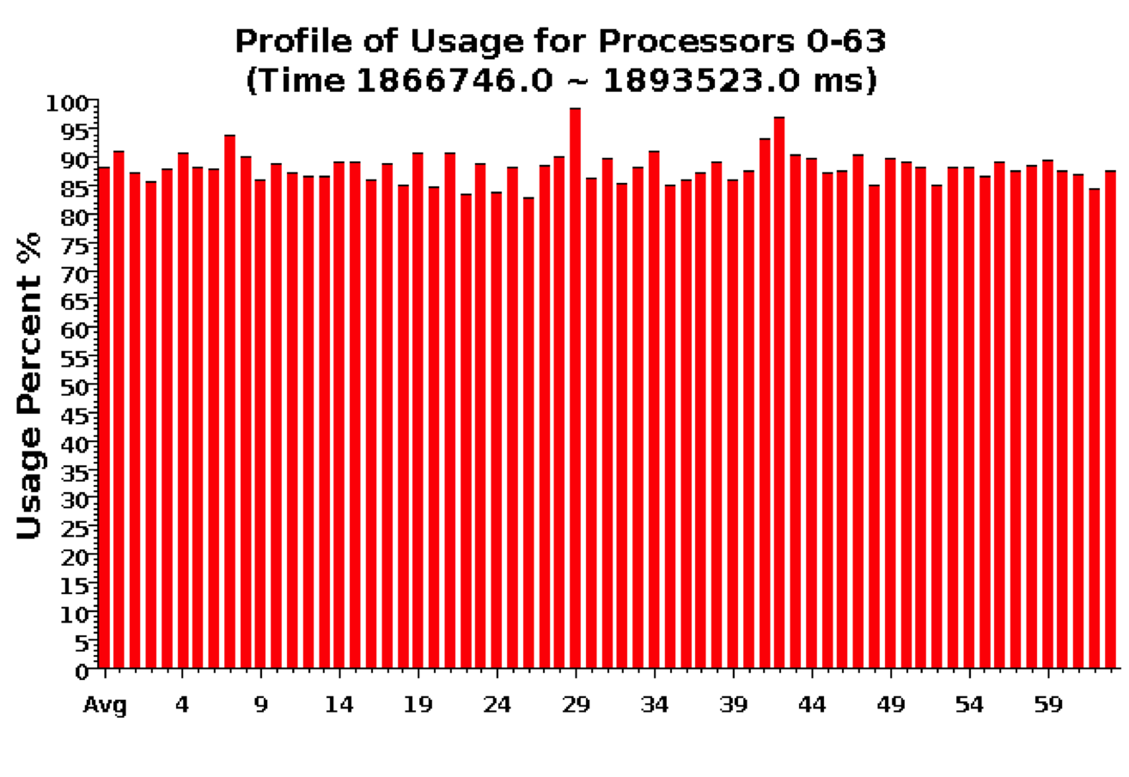
With Load Balancing: 1024 objects on 64 processors
No overdecomp (64 threads): 4988 sec
Overdecomp into 1024 threads: 3713 sec
Load balancing (1024 threads): 3367 sec

Slide 17
