Slide 1
Outline
Introduction
Object Design
Execution Model
Hello World
Benefits of Charm++
Charm++ Basics
Object Collections
Overdecomposition
Migratability
Checkpointing and Resilience
Structured Dagger
Application Design
Performance Tuning
Using Dynamic Load Balancing
Interoperability
Debugging
Further Optimization

Slide 2
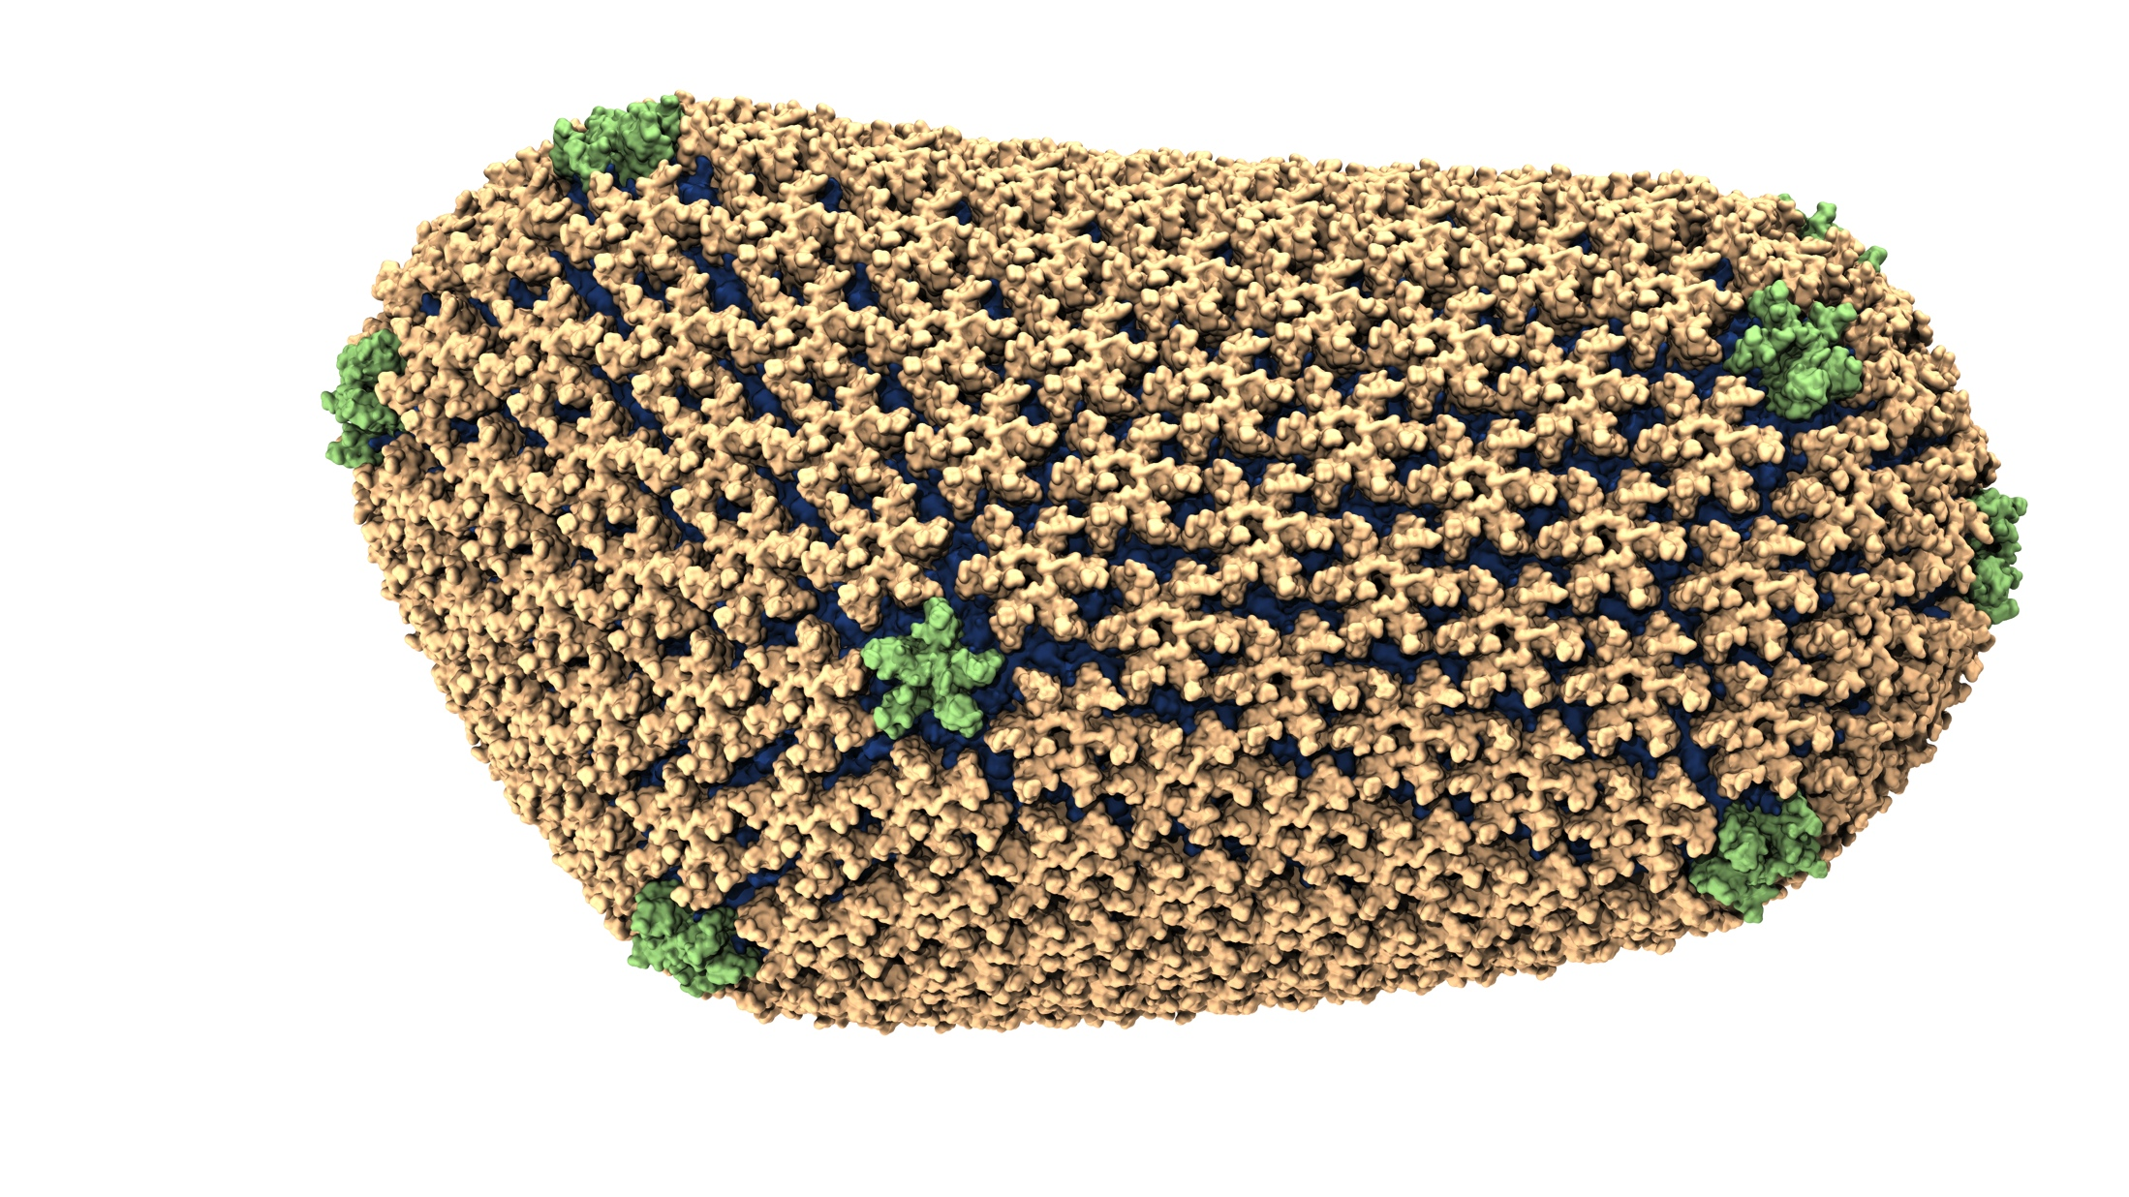
NAMD
Ground-breaking Nature article on the structure of the HIV capsid

Slide 3
Molecular Dynamics in NAMD
Collection of charged atoms, with bonds
Newtonian mechanics
Relatively small amount of atoms (100K – 10M)
Calculate forces on each atom
Bonds
Non-bonded: electrostatic and van der Waals
Short-distance: every timestep
Long-distance: using PME (3D FFT)
Multiple Time Stepping : PME every 4 timesteps
Calculate velocities and advance positions
Challenge: femtosecond time-step, millions needed!
Collaboration with K. Schulten, R. Skeel, and coworkers

Slide 4
Spatial Decomposition Via Charm
Atoms distributed to cubes based on their location
Size of each cube:
Just a bit larger than cut-off radius
Communicate only with neighbors
Work: for each pair of nbr objects
C/C ratio: O(1)
However:
Load imbalance
Limited parallelism
Charm++ is useful to handle this case

Slide 5
Object Based Parallelization for MD Force Decomposition + Spatial Decomposition
Now, we have many objects to load balance:
Each diamond can be assigned to any proc.
Number of diamonds (3D): 14*Number of Patches
2-away variation:
Half-size cubes
Communicate only with neighbors
5 x 5 x 5 interactions
3-away interactions: 7 x 7 x 7

Slide 6
NAMD Parallelization Using Charm++
The computation is decomposed into “natural” objects of the application, which are assigned to processors by Charm++ RTS

Slide 7
NAMD Projections

Slide 8
DHFR Performance on Titan
Best performance is 590us/step

Slide 9
Apoa1 Performance on BG/P BG/Q
Best performance on BG/Q is 794us/step

Slide 10
ChaNGa: Parallel Gravity
Collaborative project (NSF)
with Tom Quinn, Univ. of Washington
Evolution of Universe and Galaxy Formation
Gravity, gas dynamics
Barnes-Hut tree codes
Oct tree is natural decomposition
Geometry has better aspect ratios, so you open up fewer nodes
But is not used because it leads to bad load balance
Assumption: one-to-one map between sub-trees and PEs
Binary trees are considered better load balanced
With Charm++: Use Oct-Tree, and let Charm++ map subtrees to processors

Slide 11
ChaNGa: Control Flow

Slide 12
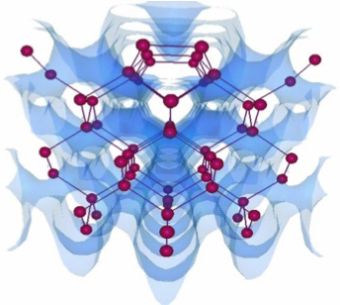
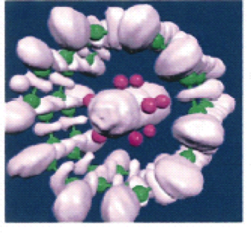
OpenAtom: MD with quantum effects
Much more fine-grained:
Each electronic state is modeled with a large array
Collaboration with:
G. Martyna (IBM)
M. Tuckerman (NYU)
Using Charm++ virtualization, we can efficiently scale small (32 molecule) systems to thousands of processors
Semiconductor Surfaces
Nanowires

Slide 13
OpenAtom: Decomposition and Computation Flow

