Slide 1
Outline
Introduction
Object Design
Execution Model
Hello World
Benefits of Charm++
Charm++ Basics
Object Collections
Overdecomposition
Migratability
Checkpointing and Resilience
Structured Dagger
Application Design
Performance Tuning
Using Dynamic Load Balancing
Interoperability
Debugging
Further Optimization

Slide 2
Performance Analysis Using Projections
Instrumentation and measurement
Link program with -tracemode projections or summary
Trace data is generated automatically during run
User events can be easily inserted as needed
Projections: visualization and analysis
Scalable tool to analyze up to 300,000 log files
A rich set of tool features: time profile, time lines, usage profile, histogram, extrema tool
Detect performance problems: load imbalance, grain size, communication bottleneck, etc

Slide 3
Using Projections
Tools of aggregated performance viewing
Time profile
Histogram
Communication over time
Tools of processor level granularity
Overview
Timeline
Tools of derived/processed data
Extrema analysis: identifies outliers
Noise miner: highlights probable interference

Slide 4
Problem Identification
Load imbalance
Time profile: lower CPU usage
Extrema analysis tool:
Least idle processors
Load the over-loaded processors in Timeline
Histogram: grain size issues

Slide 5
Using Projections
Example Demonstration
Trying to identify the next performance obstacle for NAMD
Running on 8192 processors, with 1 million atom simulation
Jaguar Cray XK6
Test scenario: with PME every step

Slide 6
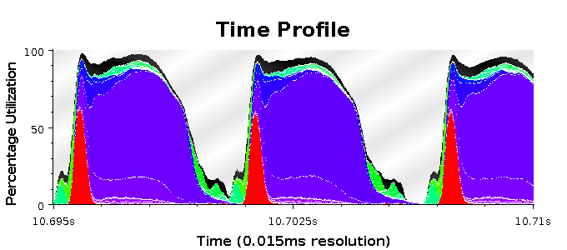
Time Profile

Slide 7
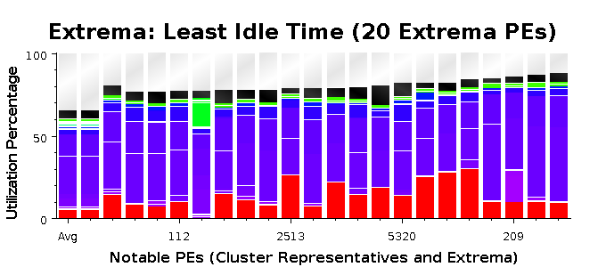
Extrema Tool for Least Idle Processors

Slide 8
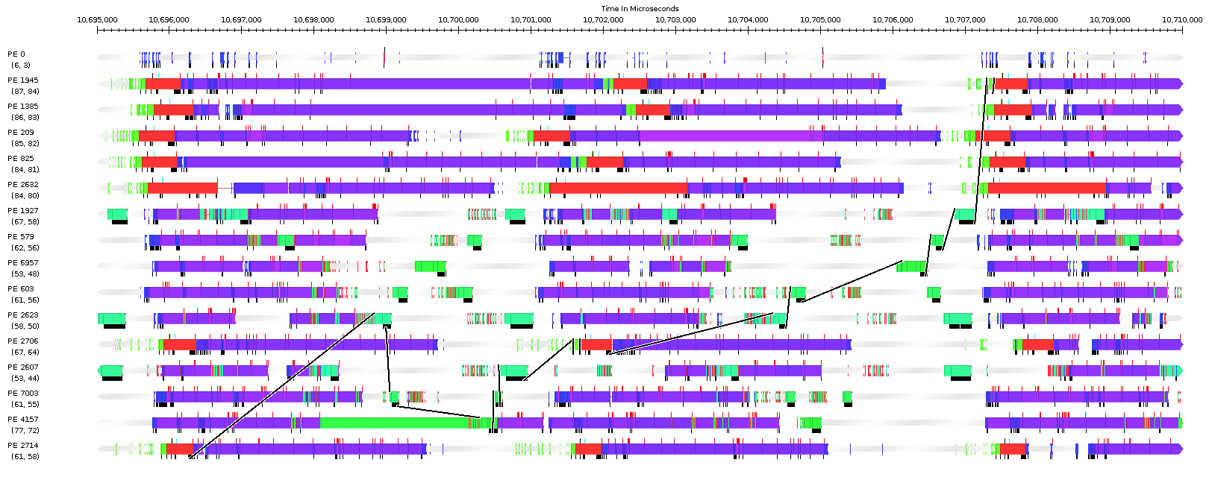
Time Lines with Message Back Tracing

Slide 9
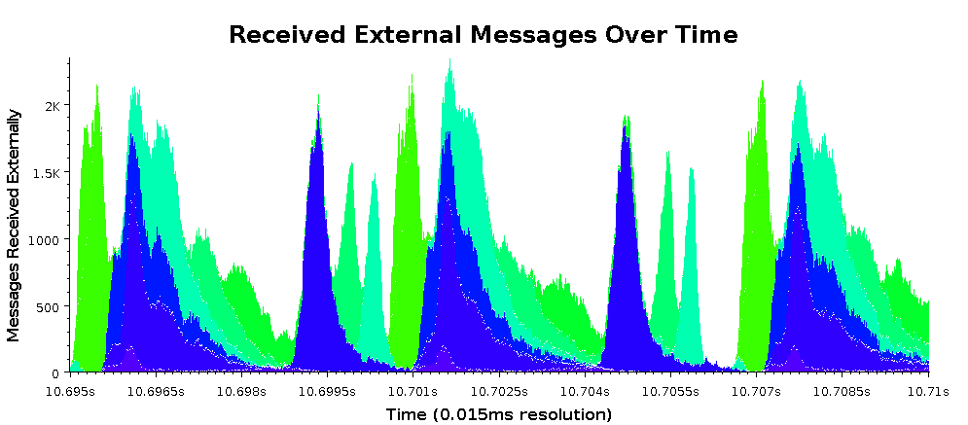
Communication over Time for all Processors

