Slide 1
Outline
Introduction
Object Design
Execution Model
Hello World
Benefits of Charm++
Charm++ Basics
Object Collections
Overdecomposition
Migratability
Checkpointing and Resilience
Structured Dagger
Application Design
Performance Tuning
Using Dynamic Load Balancing
Interoperability
Debugging
Further Optimization

Slide 2
Object Serialization Using PUP: The Pack/UnPack Framework

Slide 3
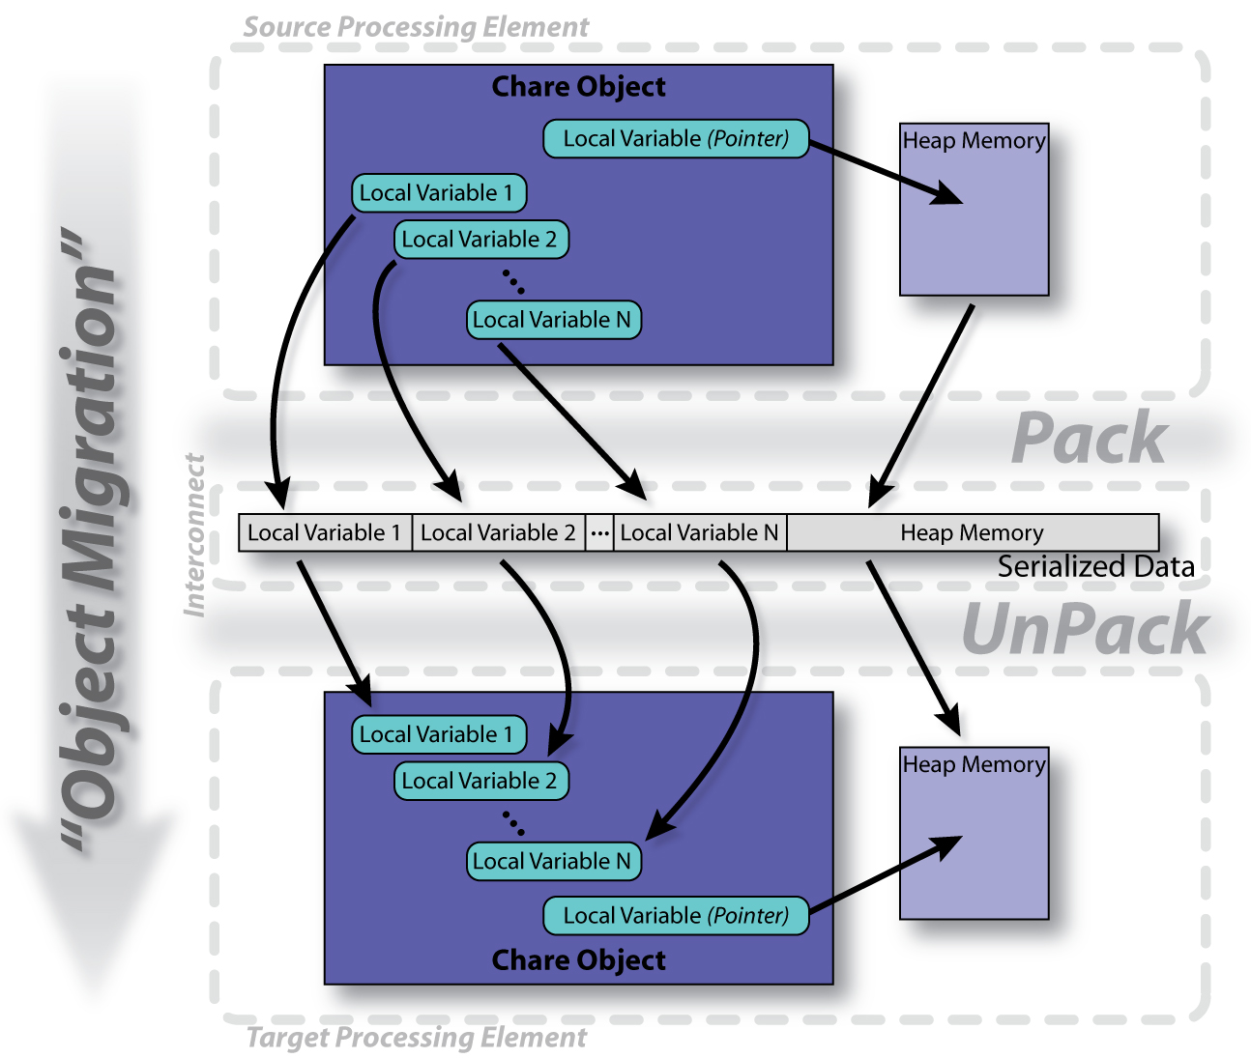
The PUP Process

Slide 4
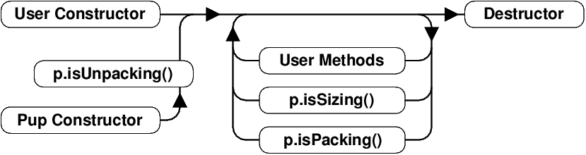
PUP Usage Sequence
Migration out:
ckAboutToMigrate
Sizing
Packing
Destructor
Migration in:
Migration constructor
UnPacking
ckJustMigrated

Slide 5
Writing a PUP routine
class MyChare : public
CBase_MyChare {
int a;
float b;
char c;
float localArray[LOCAL_SIZE];
};
void pup(PUP::er &p) {
CBase_MyChare::pup(p);
p | a;
p | b;
p | c;
p(localArray, LOCAL_SIZE);
}

Slide 6
Writing a PUP routine
void pup(PUP::er &p) {
CBase_MyChare::pup(p);
p | heapArraySize;
if (p.isUnpacking()) {
heapArray = new float[
heapArraySize];
}
p(heapArray, heapArraySize);
bool isNull = !pointer;
p | isNull;
if (!isNull) {
if(p.isUnpacking())
pointer = new MyClass();
p | ∗pointer;
}
}
}
class MyChare : public
CBase_MyChare {
int heapArraySize;
float∗ heapArray;
MyClass ∗pointer;
};

Slide 7
PUP: Pitfalls
If variables are added to an object, update the PUP routine
If the object allocates data on the heap, copy it recursively, not just the pointer
Remember to allocate memory while unpacking
Sizing, Packing, and Unpacking must scan the variables in the same order
Test PUP routines with +balancer RotateLB

Slide 8
Fault Tolerance in Charm++/AMPI
Four Approaches:
Disk-based checkpoint/restart
In-memory double checkpoint/restart
Experimental: Proactive object evacuation
Experimental: Message-logging for scalable fault tolerance
Common Features:
Easy checkpoint
Migrate-to-disk leverages object-migration capabilities
Based on dynamic runtime capabilities
Can be used in concert with load-balancing schemes

Slide 9
Checkpointing to the file system : Split Execution
The common form of checkpointing
The job runs for 5 hours, then will continue at the next allocation another day!
The existing Charm++ infrastructure for chare migration helps
Just “migrate” chares to disk
The call to checkpoint the application is made in the main chare at a synchronization point
CkCallback cb(CkIndex_Hello::SayHi(),helloProxy); CkStartCheckpoint(“log”,cb);
> ./charmrun hello +p4 +restart log

