Slide 1
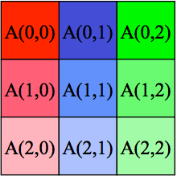
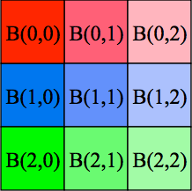
Matrix Multiplication
Cannon’s Matrix Multiplication Algorithm
Initially shift each row i by i columns, each column i by i rows.
Then circulate each chunk of data among processors within a row or column.
The code can be found in: charm/examples/charm++/matmul
Matrix figures are taken from Scott B. Baden’s slides: http://cseweb.ucsd.edu/classes/fa12/cse260-b/Lectures/Lec13.pdf

Slide 2
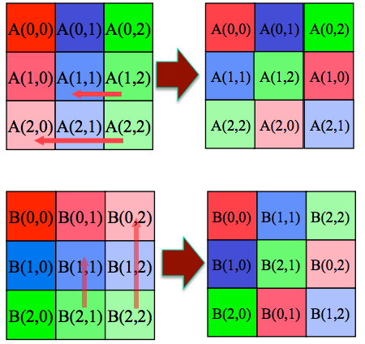
Cannon’s Matrix Multiplication Algorithm
Initial shift-by-i operation of the input matrices.
Each row i is shifted by i columns and each column i is shifted by i rows.

Slide 3
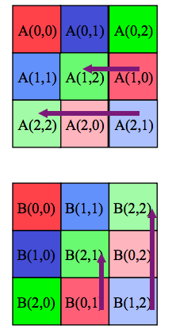
Cannon’s Matrix Multiplication Algorithm
Circularly shift:
each row by 1 column to the left(right)
each column by 1 row to the up(down)
M steps in total for M*M matrices
In each step:
multiply the coming A and B data
adding into the accumulated sum
*Instead of left/up shifts, right/down shifts can also be done in circular shift stage for A/B correspondingly, resulting C matrix will be the same.

Slide 4
0,0
0,1
0,2
0,3
0,4
C
1,0
1,1
1,2
1,3
1,4
A
2,0
2,1
2,2
2,3
2,4
C[0,0] +=
A[0,0]*
B[0,0]
C[0,1] +=
A[0,1]*
B[1,1]
C[0,2] +=
A[0,2]*
B[2,2]
C[0,3] +=
A[0,3]*
B[3,3]
C[0,4] +=
A[0,4]*
B[4,4]
3,0
3,1
3,2
3,3
3,4
C[1,0] +=
A[1,1]*
B[1,0]
C[1,1] +=
A[1,2]*
B[2,1]
C[1,2] +=
A[1,3]*
B[3,2]
C[1,3] +=
A[1,4]*
B[4,3]
C[1,4] +=
A[1,0]*
B[0,4]
4,0
4,1
4,2
4,3
4,4
C[2,0] +=
A[2,2]*
B[2,0]
C[2,1] +=
A[2,3]*
B[3,1]
C[2,2] +=
A[2,4]*
B[4,2]
C[2,3] +=
A[2,0]*
B[0,3]
C[2,4] +=
A[2,1]*
B[1,4]
0,0
0,1
0,1
0,3
0,4
C[3,0] +=
A[3,3]*
B[3,0]
C[3,1] +=
A[3,4]*
B[4,1]
C[3,2] +=
A[3,0]*
B[0,2]
C[3,3] +=
A[3,1]*
B[1,3]
C[3,4] +=
A[3,2]*
B[2,4]
1,0
1,1
1,2
1,3
1,4
B
C[4,0] +=
A[4,4]*
B[4,0]
C[4,1] +=
A[4,0]*
B[0,1]
C[4,2] +=
A[4,1]*
B[1,2]
C[4,3] +=
A[4,2]*
B[2,3]
C[4,4] +=
A[4,3]*
B[3,4]
2,0
2,1
2,2
2,3
2,4
3,0
3,1
3,2
3,3
3,4
4,0
4,1
4,2
4,3
4,4

Slide 5
Regular Matrix Multiply

Slide 6
A(0,0)
A(0,1)
A(0,2)
C(0,0)
C(0,1)
C(0,2)
A(1,0)
A(1,1)
A(1,2)
C(1,0)
C(1,1)
C(1,2)
A(2,0)
A(2,1)
A(2,2)
C(2,0)
C(2,1)
C(2,2)
B(0,0)
B(0,1)
B(0,2)
B(1,0)
B(1,1)
B(1,2)
B(2,0)
B(2,1)
B(2,2)

Slide 7
A(0,0)
A(0,1)
A(0,2)
C(0,0)
C(0,1)
C(0,2)
C[0,0] =
A(1,0)
A(1,1)
A(1,2)
C(1,0)
C(1,1)
C(1,2)
A(2,0)
A(2,1)
A(2,2)
C(2,0)
C(2,1)
C(2,2)
B(0,0)
B(0,1)
B(0,2)
B(1,0)
B(1,1)
B(1,2)
B(2,0)
B(2,1)
B(2,2)

Slide 8
A(0,0)
A(0,1)
A(0,2)
C(0,0)
C(0,1)
C(0,2)
C[0,0] = A[0,0]*B[0,0]
A(1,0)
A(1,1)
A(1,2)
C(1,0)
C(1,1)
C(1,2)
A(2,0)
A(2,1)
A(2,2)
C(2,0)
C(2,1)
C(2,2)
B(0,0)
B(0,1)
B(0,2)
B(1,0)
B(1,1)
B(1,2)
B(2,0)
B(2,1)
B(2,2)

Slide 9
A(0,0)
A(0,1)
A(0,2)
C(0,0)
C(0,1)
C(0,2)
C[0,0] = A[0,0]*B[0,0] + A[0,1]*B[1,0]
A(1,0)
A(1,1)
A(1,2)
C(1,0)
C(1,1)
C(1,2)
A(2,0)
A(2,1)
A(2,2)
C(2,0)
C(2,1)
C(2,2)
B(0,0)
B(0,1)
B(0,2)
B(1,0)
B(1,1)
B(1,2)
B(2,0)
B(2,1)
B(2,2)

Slide 10
A(0,0)
A(0,1)
A(0,2)
C(0,0)
C(0,1)
C(0,2)
C[0,0] = A[0,0]*B[0,0] + A[0,1]*B[1,0] + A[0,2]*B[2,0]
A(1,0)
A(1,1)
A(1,2)
C(1,0)
C(1,1)
C(1,2)
A(2,0)
A(2,1)
A(2,2)
C(2,0)
C(2,1)
C(2,2)
B(0,0)
B(0,1)
B(0,2)
B(1,0)
B(1,1)
B(1,2)
B(2,0)
B(2,1)
B(2,2)

Slide 11
Cannon’s Algorithm

Slide 12
0
1
2
0
1
2
A(0,0)
A(0,1)
A(0,2)
B(0,0)
B(0,1)
B(0,2)
0
0
A(1,0)
A(1,1)
A(1,2)
B(1,0)
B(1,1)
B(1,2)
1
1
A(2,0)
A(2,1)
A(2,2)
B(2,0)
B(2,1)
B(2,2)
2
2

Slide 13
0
1
2
0
1
2
A(0,0)
A(0,1)
A(0,2)
B(0,0)
B(0,1)
B(0,2)
0
0
A(1,0)
A(1,1)
A(1,2)
B(1,0)
B(1,1)
B(1,2)
1
1
A(2,0)
A(2,1)
A(2,2)
B(2,0)
B(2,1)
B(2,2)
2
2

Slide 14
0
1
2
0
1
2
A(0,0)
A(0,1)
A(0,2)
B(0,0)
B(0,1)
B(0,2)
0
0
A(1,1)
A(1,2)
A(1,0)
B(1,0)
B(1,1)
B(1,2)
1
1
A(2,1)
A(2,2)
A(2,0)
B(2,0)
B(2,1)
B(2,2)
2
2

Slide 15
0
1
2
0
1
2
A(0,0)
A(0,1)
A(0,2)
B(0,0)
B(0,1)
B(0,2)
0
0
A(1,1)
A(1,2)
A(1,0)
B(1,0)
B(1,1)
B(1,2)
1
1
A(2,2)
A(2,0)
A(2,1)
B(2,0)
B(2,1)
B(2,2)
2
2

Slide 16
0
1
2
0
1
2
A(0,0)
A(0,1)
A(0,2)
B(0,0)
B(1,1)
B(1,2)
0
0
A(1,1)
A(1,2)
A(1,0)
B(1,0)
B(2,1)
B(2,2)
1
1
A(2,2)
A(2,0)
A(2,1)
B(2,0)
B(0,1)
B(0,2)
2
2

Slide 17
A(0,0)
A(0,1)
A(0,2)
B(0,0)
B(1,1)
B(2,2)
C[1,1] =
A(1,1)
A(1,2)
A(1,0)
B(1,0)
B(2,1)
B(0,2)
*
A(2,2)
A(2,0)
A(2,1)
B(2,0)
B(0,1)
B(1,2)
C(0,0)
C(0,1)
C(0,2)
=
C(1,0)
C(1,1)
C(1,2)
C(2,0)
C(2,1)
C(2,2)
Notes:
The grid on the right symbolizes a 64 processor machine. The highlighted region is the chare that is responsible for the computation of C[1,1].

Slide 18
A(0,0)
A(0,1)
A(0,2)
B(0,0)
B(1,1)
B(2,2)
C[1,1] = A[1,2]*B[2,1] +
A(1,1)
A(1,2)
A(1,0)
B(1,0)
B(2,1)
B(0,2)
*
A(2,2)
A(2,0)
A(2,1)
B(2,0)
B(0,1)
B(1,2)
C(0,0)
C(0,1)
C(0,2)
=
C(1,0)
C(1,1)
C(1,2)
C(2,0)
C(2,1)
C(2,2)
Notes:
The grid on the right symbolizes a 64 processor machine. The highlighted region is the chare that is responsible for the computation of C[1,1].

Slide 19
A(0,0)
A(0,1)
A(0,2)
B(0,0)
B(1,1)
B(2,2)
C[1,1] = A[1,2]*B[2,1] +
A(1,1)
A(1,2)
A(1,0)
B(1,0)
B(2,1)
B(0,2)
*
A(2,2)
A(2,0)
A(2,1)
B(2,0)
B(0,1)
B(1,2)
C(0,0)
C(0,1)
C(0,2)
=
C(1,0)
C(1,1)
C(1,2)
C(2,0)
C(2,1)
C(2,2)
Notes:
The grid on the right symbolizes a 64 processor machine. The highlighted region is the chare that is responsible for the computation of C[1,1].

Slide 20
A(0,1)
A(0,2)
A(0,0)
B(1,0)
B(2,1)
B(0,2)
C[1,1] = A[1,2]*B[2,1] + A[1,0]*B[0,1] +
A(1,2)
A(1,0)
A(1,1)
B(2,0)
B(0,1)
B(1,2)
*
A(2,0)
A(2,1)
A(2,2)
B(0,0)
B(1,1)
B(2,2)
C(0,0)
C(0,1)
C(0,2)
=
C(1,0)
C(1,1)
C(1,2)
C(2,0)
C(2,1)
C(2,2)
Notes:
The grid on the right symbolizes a 64 processor machine. The highlighted region is the chare that is responsible for the computation of C[1,1].

Slide 21
A(0,2)
A(0,0)
A(0,1)
B(2,0)
B(0,1)
B(1,2)
C[1,1] = A[1,2]*B[2,1] + A[1,0]*B[0,1] + A[1,1]*B[1,1]
A(1,0)
A(1,1)
A(1,2)
B(0,0)
B(1,1)
B(2,2)
*
A(2,1)
A(2,2)
A(2,0)
B(1,0)
B(2,1)
B(0,2)
C(0,0)
C(0,1)
C(0,2)
=
C(1,0)
C(1,1)
C(1,2)
C(2,0)
C(2,1)
C(2,2)
Notes:
The grid on the right symbolizes a 64 processor machine. The highlighted region is the chare that is responsible for the computation of C[1,1].

Slide 22
matmul.ci file: M*M matrices
mainmodule matmul {
readonly CProxy_Main mainProxy;
mainchare Main {
entry Main(CkArgMsg *m);
entry [reductiontarget] void done();
};
array [2D] Block {
entry Block(bool randomInit, unsigned int blockSize, int M);
entry void sendData(CProxy_Block output, bool aOrB) {
serial {
if (aOrB) //initial shift for A and B is done here
output((thisIndex.x-thisIndex.y+M)%M, thisIndex.y).inputA(0, data, blockSize, blockSize);
else
output(thisIndex.x, (thisIndex.y-thisIndex.x+M)%M).inputB(0, data, blockSize, blockSize);
}
};
entry void inputA(int blockIdA, double blockA[M*KA], int M, int KA);
entry void inputB(int blockIdB, double blockB[KB*N], int KB, int N);

Slide 23
matmul.ci file contd.
entry void run(double alpha, CkCallback done) {
forall [block] (0:M-1,1) {
when
inputA[block](int blockIdA, double blockA[M*KA], int M, int KA),
inputB[block](int blockIdB, double blockB[KB*N], int KB, int N)
serial {
CkAssert(KA == KB);
local_multiply(M, N, KA, alpha, blockA, blockB, data);
if (blockIdA != M)
thisProxy((thisIndex.x + 1) % M, thisIndex.y).inputA(blockIdA+1, blockA, M, KA);
if (blockIdB != M)
thisProxy(thisIndex.x, (thisIndex.y + 1) % M).inputB(blockIdB+1, blockB, KB, N);
}
} serial { contribute(done); }
}; }; };

Slide 24
matmul.C file: Main chare
class Main : public CBase_Main {
double startTime;
int blockSize, M;
CProxy_Block a, b, c;
public:
Main(CkArgMsg* m) {
if (m->argc > 2) {
blockSize = atoi(m->argv[1]);
M = atoi(m->argv[2]);
} else {
CkAbort("Usage: matmul blockSize M");
}
mainProxy = thisProxy;
a = CProxy_Block::ckNew(true, blockSize, M, M, M); //boolean flag is for random initialization
b = CProxy_Block::ckNew(true, blockSize, M, M, M);
c = CProxy_Block::ckNew(false, blockSize, M, M, M);
a.sendData(c, true);
b.sendData(c, false);
c.run(1.0, CkCallback(CkReductionTarget(Main, done), thisProxy));
}
void done() { CkExit(); }
};

Slide 25
matmul.C file: Block array
class Block : public CBase_Block {
unsigned int blockSize, M, block;
double* data;
Block_SDAG_CODE
public:
Block(bool randomInit, unsigned int blockSize_, unsigned int M_)
: blockSize(blockSize_), M(M_)
{
unsigned int elems = blockSize * blockSize;
data = new double[elems];
if(randomInit)
for (int i = 0; i < elems; ++i)
data[i] = drand48();
else
for (int i = 0; i < elems; ++i)
data[i] = 0;
}
Block(CkMigrateMessage*) {}
};

Slide 26
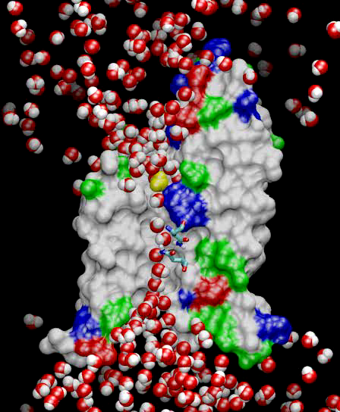
Molecular Dynamics
Collection of [charged] atoms, with bonds
Newtonian mechanics
Relatively small #of atoms (100K – 10M)
At each time-step
Calculate forces on each atom
Bonds:
Non-bonded: electrostatic and van der Waal’s
Short-distance: every timestep
Long-distance: using PME (3D FFT)
Multiple Time Stepping : PME every 4 timesteps
Calculate velocities and advance positions
Challenge: femtosecond time-step, millions needed!
Collaboration with K. Schulten, R. Skeel, and coworkers

Slide 27
Lennart-Jones Dynamics
We will look at a simpler problem:
Gas atoms moving around
Temperature tells you the average velocity
The only forces acting on them are van der Waals
Basically, if they come too close, they are repelled,
Otherwise, there is a small attractive force between all atoms
Algorithm: simulate each time step
Each atom has a mass, coordinates, and initial velocity
Calculate forces on each atom due to nearby atoms
Using forces, and Newton’s laws of motion, calculate acceleration, velocity, and update coordinates

Slide 28
Spatial Decomposition Via Charm
Atoms distributed to cubes based on their location
Size of each cube :
Just a bit larger than cut-off radius
Communicate only with neighbors
Work: for each pair of nbr objects
C/C ratio: O(1)
However:
Load Imbalance
Limited Parallelism
Charm++ is useful to handle this
Cells, Cubes or“Patches”

Slide 29
Object Based Parallelization for MD:
Force Decomposition + Spatial Decomposition
Now, we have many objects to load balance:
Each diamond can be assigned to any proc.
Number of diamonds (3D):
14·Number of Patches
2-away variation:
Half-size cubes
5x5x5 interactions
3-away interactions: 7x7x7

Slide 30
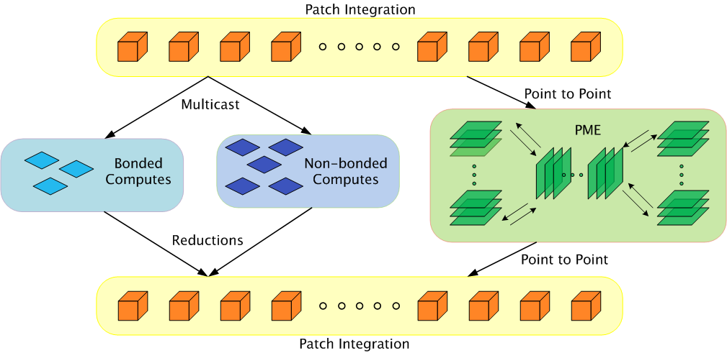
Parallelization Using Charm++
The computation is decomposed into “natural” objects of the application, which are assigned to processors by Charm++ RTS

Slide 31
Expressing in Charm++
Two chare arrays:
Cells: a 3D array of chares
Pairs: one object for each “neighboring” chare
What is the dimensionality of “pairs”?
Idea 1: make it a 3D array.. Does it work?
Idea 2: Make it a 1D array,
Explicitly assign indices to chares: the pair object between Cells[2,3,4] and Cells[2,3,5] is Pairs[someIndex].
Idea 3: Make it a 6D array
Pairs[2,3,4,2,3,5]
But: (a) it is sparse and
(b) symmetry? Do we also have Pairs[2,3,5,2,3,4]
Use only one of them.. (say “smaller” in dictionary order)

Slide 32
LJdynamics – Main chare
entry void run() {
when computesCreated() serial{
computeArray.doneInserting();
cellArray.run();
computeArray.run();
}
when done()
serial{ CkExit(); }
}; //end of run

Slide 33
LJdynamics - Cell
entry void run() {
for(step = 1; step <= finalStepCount; step++) {
serial{ sendPositions(); }
for(forceCount=0; forceCount < inbrs; forceCount++) when receiveForces[step](int iter, vec3 forces[n], int n)
serial{
addForces(forces);
updateProperties();
}
if ((step % MIGRATE_STEPCOUNT) == 0) {
serial{ sendParticles(); }
when statements for receiving particles from neighbor
}
serial{
CkCallback cb(CkReductionTarget(Main,done),mainProxy);
contribute(0, CkReduction::NULL, cb );
}
}

Slide 34
LJdynamics - Pair
entry void run() {
for(step = 1; step <= finalStepCount; step++) {
if ( thisIndex.x1==thisIndex.x2 && thisIndex.y1==thisIndex.y2 &&
thisIndex.z1==thisIndex.z2)
when calculateForces[step](ParticleData *data)
serial{ selfInteract(data); }
else {
when calculateForces[step] (ParticleData *data)
serial{ bufferedData = data; }
when calculateForces[step](ParticleData *data)
serial{ interact(data); }
}
}
};

