Slide 1
Outline
Introduction
Object Design
Execution Model
Hello World
Benefits of Charm++
Charm++ Basics
Object Collections
Overdecomposition
Migratability
Checkpointing and Resilience
Structured Dagger
Application Design
Performance Tuning
Using Dynamic Load Balancing
Interoperability
Debugging
Further Optimization

Slide 2
Task Parallelism with Objects
Divide-and-conquer
Each object recursively creates n objects that divide the problem into subproblems
Each object t then waits for all n objects to finish and then may ‘combine’ the responses
At some point the recursion stops (at the bottom of the tree), and some sequential kernel is executed
Then the result is propagated upward in the tree recursively
Examples: fibonacci, quick sort, . . .

Slide 3
Fibonacci Example
Each Fib object is a task that performs one of two actions:
Creates two new Fib objects to compute fib(n – 1) and fib(n – 2) and then waits for the response, adding up the two responses when they arrive
After both arrive, sends a response message with the result to the parent object
Or prints the value and exits if it is the root
If n = 1 or n = 0 (passed down from the parent) it sends a response message with n back to the parent object

Slide 4
Fibonacci Execution

Slide 5
Overdecomposing Your Application

Slide 6
Object-based Over-decomposition
Charm++ philosophy:
Let the programmer decompose their work and data into coarse-grained entities
It is important to understand what we mean by coarse-grained entities
You don’t write sequential programs that some system will auto-decompose
You don’t write programs when there is one object for each float
You consciously choose a grainsize, BUT choose it independent of the number of processors, or parameterize it, so you can tune later

Slide 7
Amdahls Law and Grainsize
Original “law”:
If a program has K% sequential section, then speedup is limited to .
If the rest of the program is parallelized completely
Grainsize corollary:
If any individual piece of work is > K time units, and the sequential program takes T_{seq},
Speedup is limited to
So:
Examine performance data via histograms to find the sizes of remappable work units
If some are too big, change the decomposition method to make smaller units

Slide 8
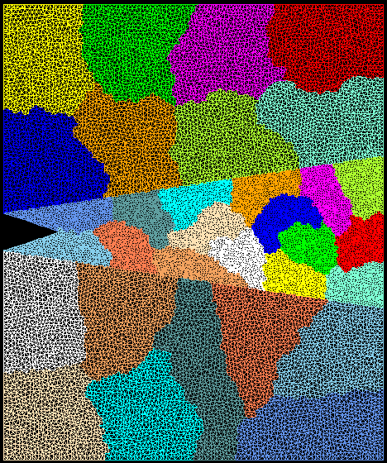
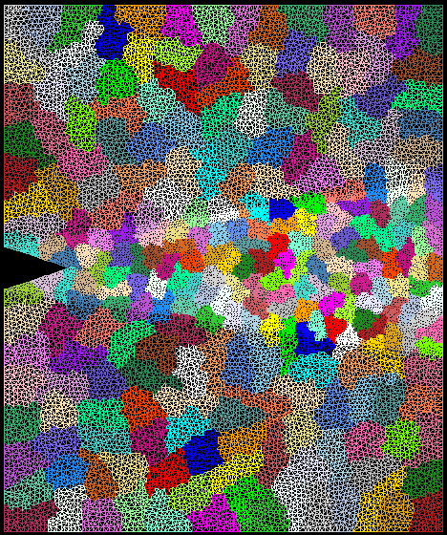
Quick Example: Crack Propagation
Decomposition into 16 chunks (left) and 128 chunks, 8 for each PE (right). The middle area contains cohesive elements. Both decompositions obtained using Metis. Pictures: S. Breitenfeld, and P. Geubelle

Slide 9
Overdecomposition and Grainsize
Common misconception: overdecomposition must be expensive
(working) Definition: the amount of computation per potentially parallel event (task creation, enqueue/dequeue, messaging, locking, etc.)

Slide 10
Grainsize and Overhead
What is the ideal grainsize?
Should it depend on the number of processors?
v: overhead per message,
T_{p}: p processor completion time
g: grainsize (computation per message)

Slide 11
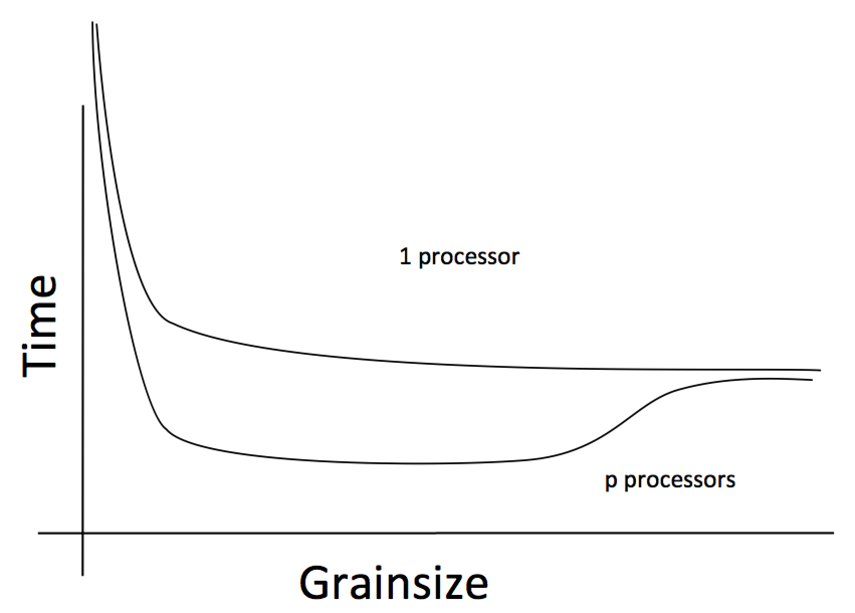
Grainsize and Scalability

Slide 12
Grainsize Study for Jacobi3D

Slide 13
Grainsize Study for Stencil Computation
Blue Waters (JYC), 2 nodes, 32 cores each
Typically, having tens of chares per code is adequate (although reasoning should be based on computation per message)

Slide 14
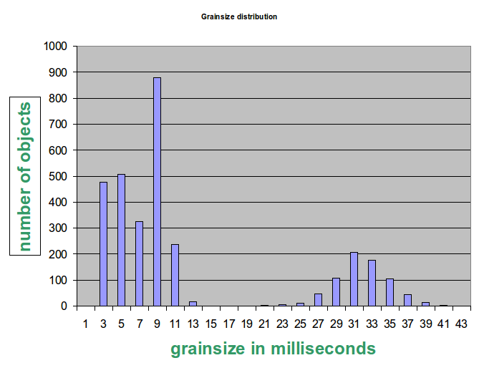
Grainsize and Load Balancing
How Much Balance Is Possible?
Solution:
Split compute objects that may have too much work, using a heuristic based on number of interacting atoms

Slide 15
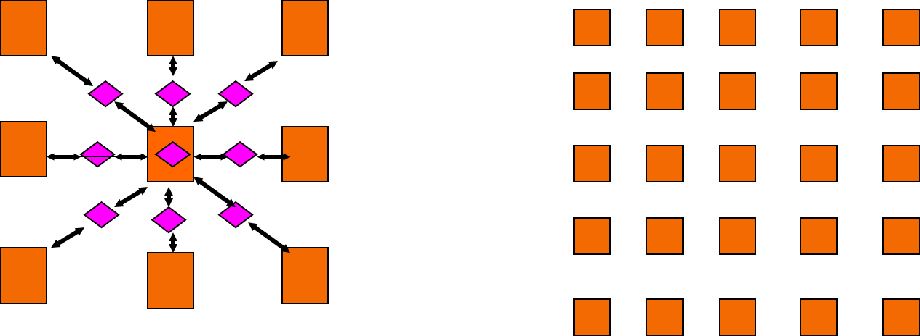
Grainsize For Extreme Scaling
Strong Scaling is limited by expressed parallelism
Minimum iteration time limited by lengthiest computation
Largest grains set lower bound
1-away generalized to k-away provides fine granularity control

Slide 16
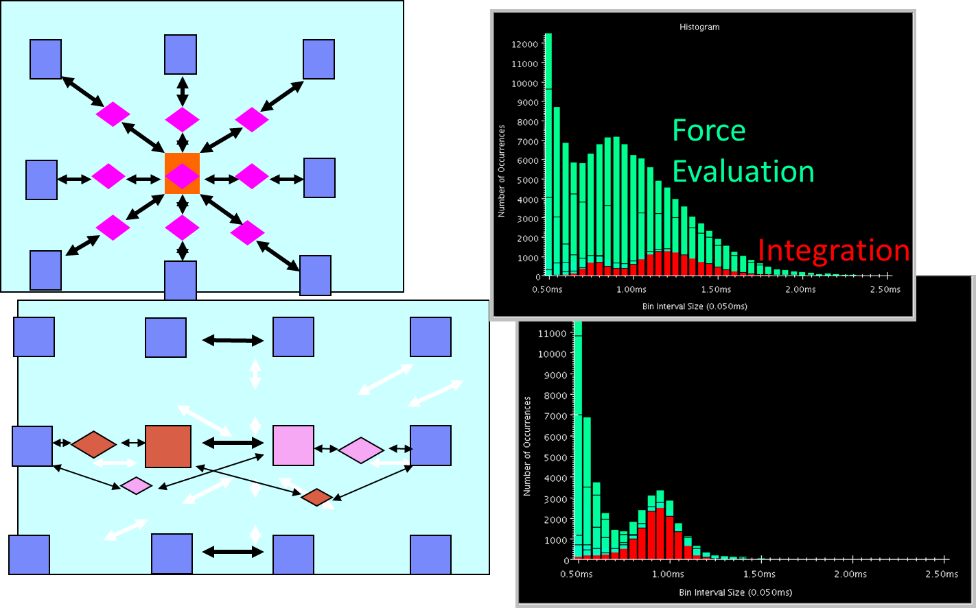
NAMD: 2-AwayX Example

Slide 17
Rules of thumb for grainsize
Make it as small as possible, as long as it amortizes the overhead
More specifically, ensure:
Average grainsize is greater than kv (say 10v)
No single grain should be allowed to be too large
Must be smaller than , but actually we can express it as: p
Must be smaller than kmv (say 100v)
Important corollary:
You can be at close to optimal grainsize without having to think about p, the number of processors
kv < g < mkv (10v < g < 100v)

Slide 18
Grain size for Fibonacci Example
Set a sequential threshold in the computational tree
Past this threshold (i.e. when n < threshold), instead of constructing two new chares, compute the fibonacci sequentially
Setting the grainsize limit at 4 (which is too small, but good for illustration)
The internal nodes of the tree do very little work, but
The coarser grains now amortize the cost of the fine-grained chares

