Slide 1
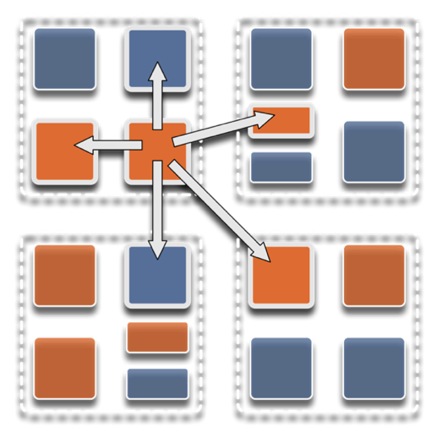
Parallel programming with Charm++: Programming with Parallel Migratable Objects
Laxmikant (Sanjay) Kalé,
Nikhil Jain, and Michael Robson
Theme by: Shanna DeSouza
Parallel Programming Laboratory
University of Illinois at Urbana-Champaign

Slide 2
Slides at: http://charm.cs.illinois.edu/~nikhil/presentations/
Manual: http://charm.cs.illinois.edu/manuals/html/charm++/manual.html
Installation: http://charm.cs.illinois.edu/manuals/html/charm++/A.html

Slide 3
Outline
Introduction
Object Design
Execution Model
Hello World
Benefits of Charm++
Charm++ Basics
Object Collections
Overdecomposition
Migratability
Checkpointing and Resilience
Structured Dagger
Application Design
Performance Tuning
Using Dynamic Load Balancing
Interoperability
Debugging
Further Optimization

