Slide 1
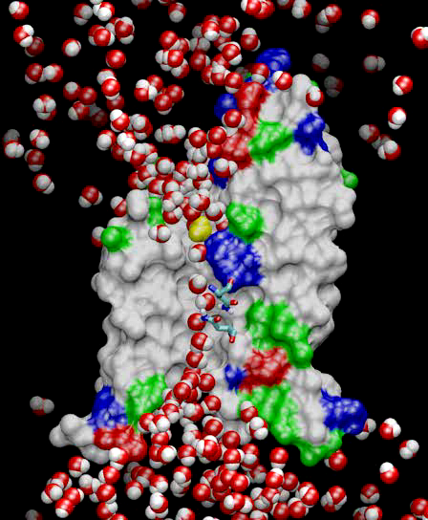
Molecular Dynamics in NAMD
Collection of [charged] atoms, with bonds
Newtonian mechanics
Relatively small #of atoms (100K – 10M)
At each time-step
Calculate forces on each atom
Bonds:
Non-bonded: electrostatic and van der Waal’s
Short-distance: every timestep
Long-distance: using PME (3D FFT)
Multiple Time Stepping : PME every 4 timesteps
Calculate velocities and advance positions
Challenge: femtosecond time-step, millions needed!
Collaboration with K. Schulten, R. Skeel, and coworkers

Slide 2
Spatial Decomposition Via Charm
Atoms distributed to cubes based on their location
Size of each cube :
Just a bit larger than cut-off radius
Communicate only with neighbors
Work: for each pair of nbr objects
C/C ratio: O(1)
However:
Load Imbalance
Limited Parallelism
Charm++ is useful to handle this
Cells, Cubes or“Patches”

Slide 3
Object Based Parallelization for MD:
Force Decomposition + Spatial Decomposition
Now, we have many objects to load balance:
Each diamond can be assigned to any proc.
Number of diamonds (3D):
14·Number of Patches
2-away variation:
Half-size cubes
5x5x5 interactions
3-away interactions: 7x7x7

Slide 4
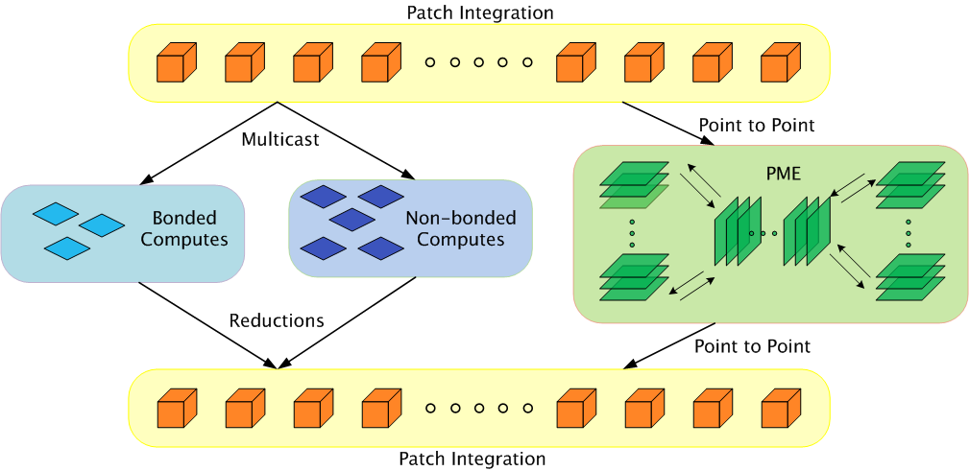
Parallelization Using Charm++
The computation is decomposed into “natural” objects of the application, which are assigned to processors by Charm++ RTS
Bhatele, A., Kumar, S., Mei, C., Phillips, J. C., Zheng, G. & Kale, L. V. 2008 Overcoming Scaling Challenges in Biomolecular Simulations across Multiple Platforms. In Proceedings of IEEE International Parallel and Distributed Processing Symposium, Miami, FL, USA, April 2008.

Slide 5
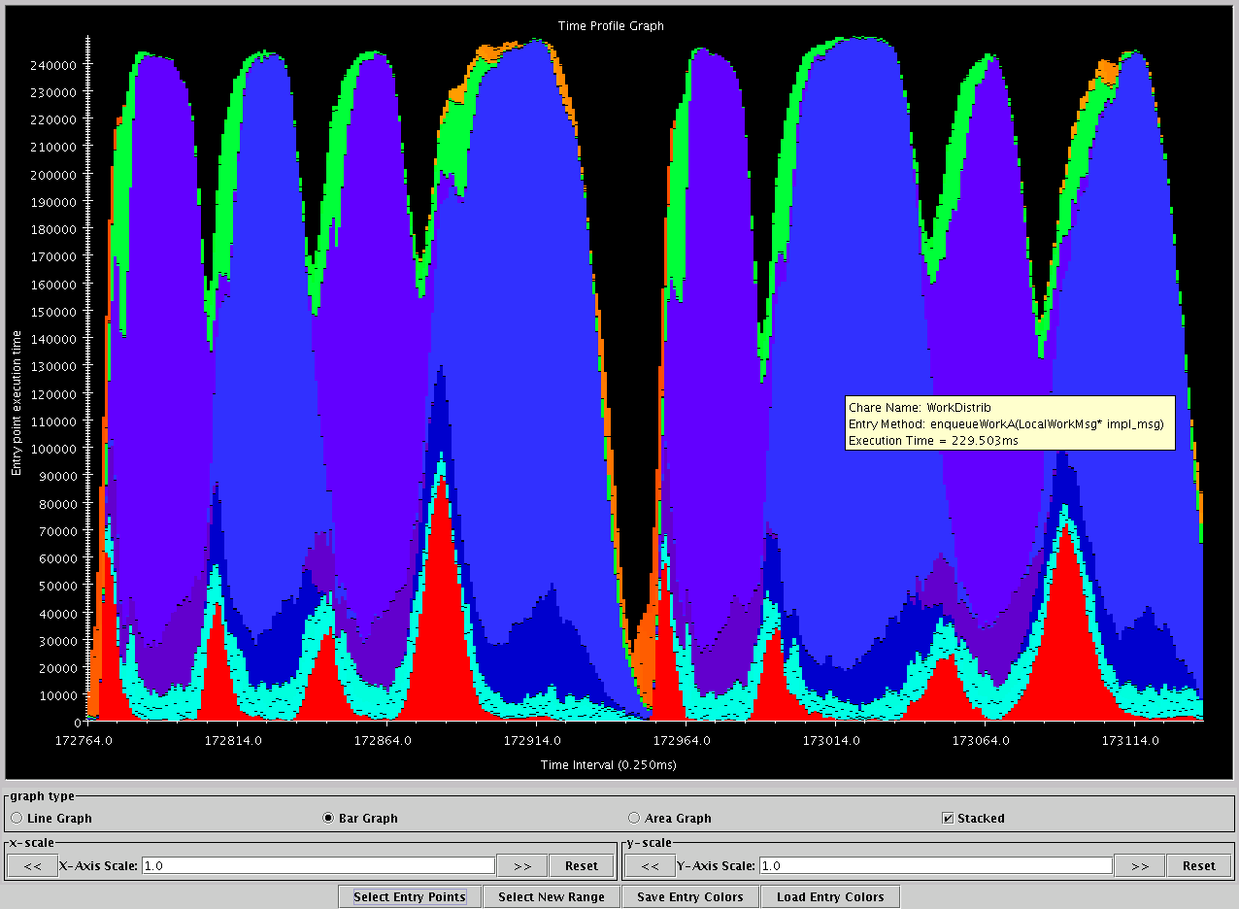
Apo-A1, on BlueGene/L, 1024 procs
Charm++’s “Projections” Analysis tool
Time intervals on x axis, activity added across processors on Y axis
green: communication
Red: integration
Blue/Purple: electrostatics
Orange: PME
turquoise: angle/dihedral
Time

Slide 6
Performance on Intrepid (BG/P)

Slide 7
SMP Performance on Titan(Dev)
Timestep (ms/step)
13ms/step
Number of cores
9 ms/step

Slide 8
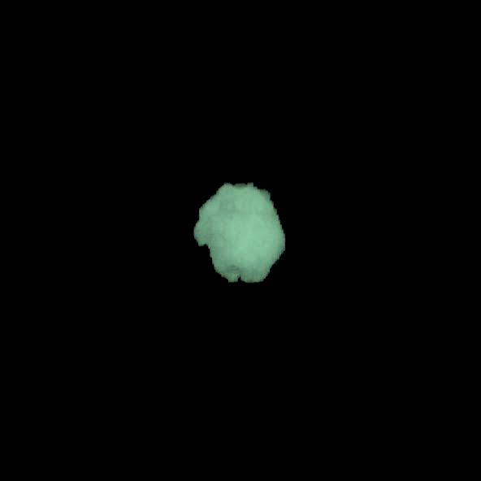
ChaNGa: Parallel Gravity
Evolution of Universe and Galaxy Formation
Collaborative project (NSF)
with Tom Quinn, Univ. of Washington
Gravity, gas dynamics
Barnes-Hut tree codes
Oct tree is natural decomp
Geometry has better aspect ratios, so you “open” up fewer nodes
But is not used because it leads to bad load balance
Assumption: one-to-one map between sub-trees and PEs
Binary trees are considered better load balanced
With Charm++: Use Oct-Tree, and let Charm++ map subtrees to processors

Slide 9
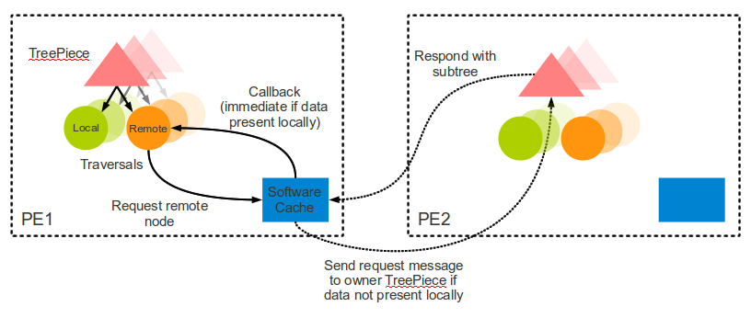
Control flow

Slide 10
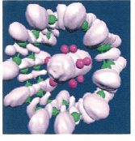
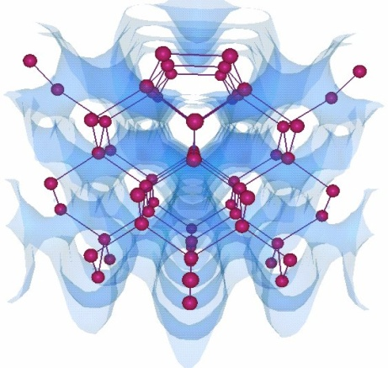
OpenAtom: MD with quantum effects
Semiconductor
Surfaces:
Nanowires:
Much more fine-grained:
Each electronic state is modeled with a large array
Collaboration with:
G. Martyna (IBM)
M. Tuckerman (NYU)
L. Kale (UIUC)
Using Charm++ virtualization, we can efficiently scale small (32 molecule) systems to thousands of processors

Slide 11
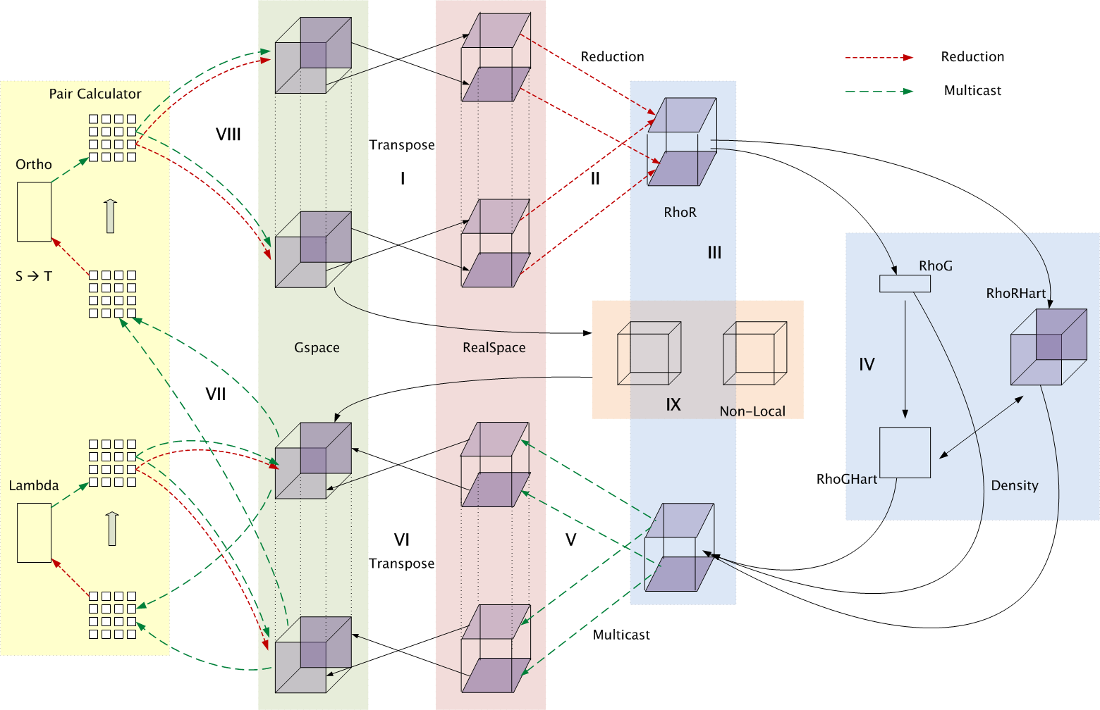
Decomposition and Computation Flow
Over a dozen different Chare Arrays

Slide 12
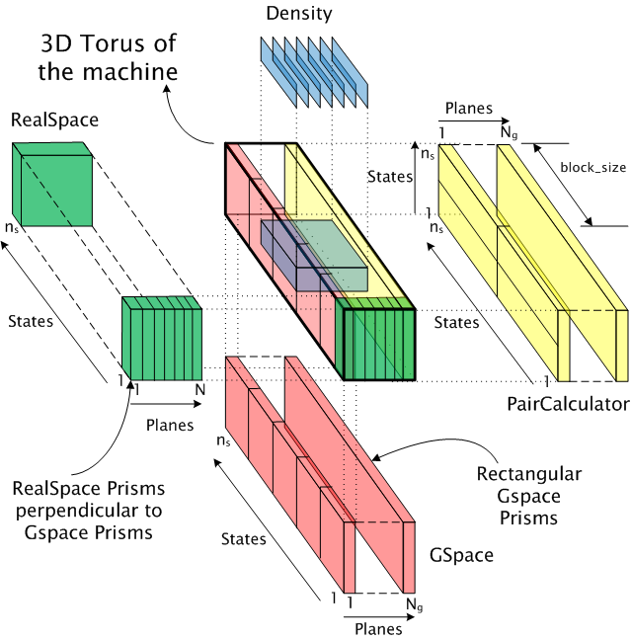
Topology Aware Mapping of Objects
Object based decomposition provides new degrees of freeedom to easily try different mappings of objects to processors, to help minimize contention

