Slide 1
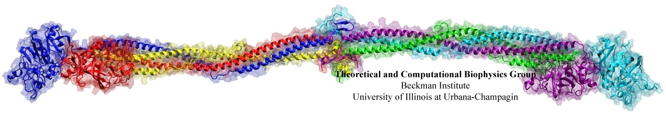
Overcoming Scaling Challenges in Bio-molecular Simulations
Abhinav Bhatelé, David Kunzman, Chee Wai Lee, Chao Mei, Osman
Sarood, Yanhua Sun, Gengbin Zheng, Laxmikant V. Kalé (PPL)
Robert Brunner, James C. Phillips, Klaus Schulten (TCBG)
Sameer Kumar (IBM Research)
Notes:
Fibrinogen – protein responsible for blood clots

Slide 2
Outline
NAMD: An Introduction
Scaling Challenges
Conflicting Adaptive Runtime Techniques
PME Computation
Memory Requirements
Performance Results
Recent Work
Summary
Notes:
Solutions might be applicable in other scenarios as well

Slide 3
What is NAMD ?
A parallel molecular dynamics application
Simulate the life of a bio-molecule
How is the simulation performed ?
Simulation window broken down into a large number of time steps (typically 1 fs each)
Forces on every atom calculated every time step
Velocities and positions updated and atoms migrated to their new positions
Notes:
Motivate why is it challenging to parallelize: Generally a few thousand atoms,
one time-step is a few seconds
This needs to be parallelized onto a large number of processors.
The no. of time-steps is large (million to billion) since interesting phenomena happens on the scale of ns or ms
1 fs = 10-15 secs

Slide 4
How is NAMD parallelized ?
HYBRID
DECOMPOSITION
Notes:
Dim = Rc + margin
Computes are Charm++ objects which can be load balanced and have adaptive overlap of computation and communication

Slide 5
Notes:
Bonded forces
Electrostatic and van der waal’s forces (decide margin Rc)
Short range: computes
Long range: pme

Slide 6
What makes NAMD efficient ?
Charm++ runtime support
Asynchronous message-driven model
Adaptive overlap of communication and computation
Notes:
One kind of computes can also have different amounts of work depending on the no. of atoms

Slide 7
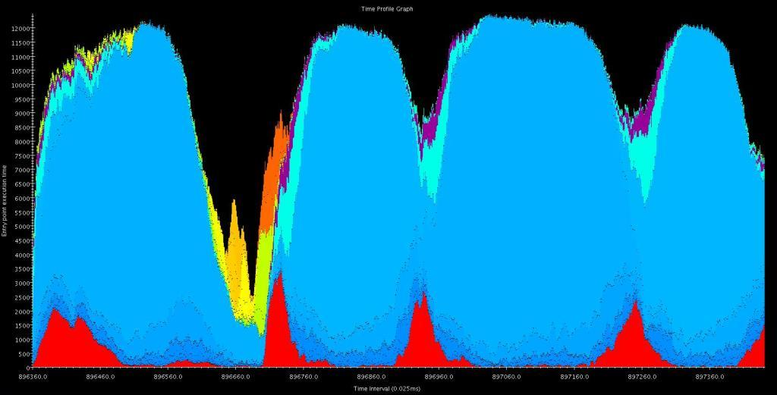
Non-bonded Work
Communication
PME
Bonded Work
Integration

Slide 8
What makes NAMD efficient ?
Charm++ runtime support
Asynchronous message-driven model
Adaptive overlap of communication and computation
Load balancing support
Difficult problem: balancing heterogeneous computation
Measurement-based load balancing
Notes:
One kind of computes can also have different amounts of work depending on the no. of atoms

Slide 9
What makes NAMD highly scalable ?
Hybrid decomposition scheme
Variants of this hybrid scheme used by Blue Matter and Desmond
Notes:
Further splitting of patches, 2-AwayX
Load balancer: balances computes, minimizes communication

Slide 10
Scaling Challenges
Scaling a few thousand atom simulations to tens of thousands of processors
Interaction of adaptive runtime techniques
Optimizing the PME implementation
Running multi-million atom simulations on machines with limited memory
Memory Optimizations

Slide 11
Conflicting Adaptive Runtime Techniques
Patches multicast data to computes
At load balancing step, computes re-assigned to processors
Tree re-built after computes have migrated
Notes:
Patches multicast data to computes
Intermediate nodes have heavy load

Slide 12
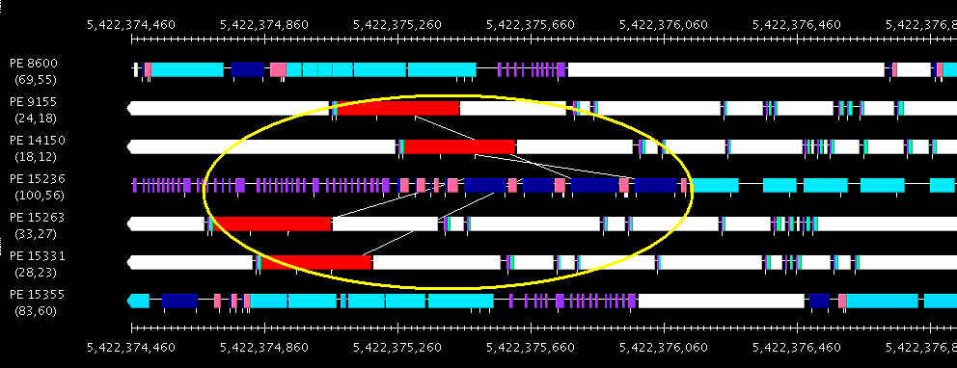

Slide 13
Solution
Persistent spanning trees
Centralized spanning tree creation
Unifying the two techniques
Notes:
Move just a few computes around

Slide 14
PME Calculation
Particle Mesh Ewald (PME) method used for long range interactions
1D decomposition of the FFT grid
PME is a small portion of the total computation
Better than the 2D decomposition for small number of processors
On larger partitions
Use a 2D decomposition
More parallelism and better overlap
Notes:
2D PME has more communication but it can be overlapped, 1D PME has less latency
1D FFT – single transpose and computation phase, 2D – 3 transposes and 2 phases of computation
PME – small portion of the computation, Has been done before
Need to decide at runtime which decomposition to use

Slide 15
Automatic Runtime Decisions
Use of 1D or 2D algorithm for PME
Use of spanning trees for multicast
Splitting of patches/computes for fine-grained parallelism
Depend on:
Characteristics of the machine
No. of processors
No. of atoms in the simulation

Slide 16
Reducing the memory footprint
Exploit the fact that building blocks for a bio-molecule have common structures
Store information about a particular kind of atom only once

Slide 17
H
H
-1
0
+1
-1
0
+1
14333
14332
14334
14496
14495
14497
O
O
H
H
H
H
O
O
H
H

Slide 18
Reducing the memory footprint
Exploit the fact that building blocks for a bio-molecule have common structures
Store information about a particular kind of atom only once
Static atom information increases only with the addition of unique proteins in the simulation
Allows simulation of 2.8 M Ribosome on Blue Gene/L

Slide 19
< 0.5 MB

Slide 20
NAMD’s Performance
STMV: ~1 million atoms
ApoA1: ~92K atoms

Slide 21
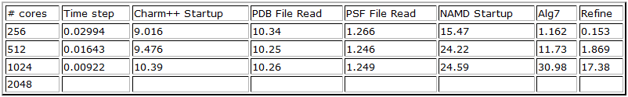
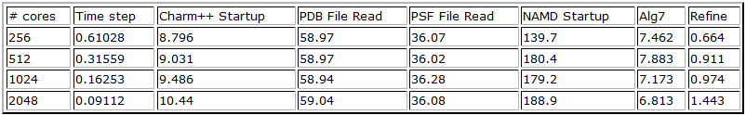
More Challenges
Reducing start-up and load balancing time
ApoA1 (92,222 atoms)
Ribosome (2.8M atoms)

Slide 22
Recent Work
Running NAMD on Petascale machines
Improved hierarchical load balancers
Parallel Input/Output
Reducing communication overhead with increasing fine-grained parallelism

Slide 23
Summary
NAMD is a highly scalable and portable MD program
Runs on a variety of architectures
Available free of cost on machines at most supercomputing centers
Supports a range of sizes of molecular systems
Uses adaptive runtime techniques for high scalability
Automatic selection of algorithms at runtime best suited for the scenario
With new optimizations, NAMD is ready for the next generation of parallel machines

Slide 24
Questions ?

