Slide 1
Advanced Charm++ Tutorial
Presented by:
Eric Bohm
11/30/2009

Slide 2
Topics For This Talk
Advanced messaging
Interface file (.ci)‏
Advanced load balancing
Chare Placement
Groups
Threads
Delegation
Section multicast/reduction
Shared Memory Optimizations

Slide 3
Virtualization:
Object-based Decomposition
Divide the computation into a large number of pieces
  Independent of number of processors
  Typically larger than number of processors
Let the system map objects to processors

Slide 4
Object-based Parallelization
User is only concerned with interaction between objects
System implementation
User View

Slide 5
Message-Driven Execution
Objects communicate asynchronously through remote method invocation
Encourages non-deterministic execution
Distributed flow of control
Benefits:
  Automatic overlap of computation with communication
  Communication latency tolerance
  Logical structure for scheduling

Slide 6
Charm++ on Parallel Machines
Runs on:
  Any machine with MPI, including
    IBM Blue Gene/L/P, SP
    Cray XT3/4/5
    SGI Altix
  Clusters with Ethernet (UDP/TCP)‏
  Clusters with Myrinet (GM or MX)‏
  Clusters with Infiniband
  Apple clusters
  Even Windows!
SMP-Aware (pthreads)‏

Slide 7
Communication Architecture
Converse
Communication
API
Net
use charmrun
MPI
BG/P
BG/L
UDP
(machine-eth.c)‏
TCP
(machine-tcp.c)‏
Infinband
(machine-ibverbs)‏
Myrinet
(machine-gm.c)‏
Notes:
Message layer
Building charm involves selecting both architecture types and communication architecture

Slide 8
Compiling Charm++
./build
Usage: build <target> <version> <options> [charmc-options ...]
<target>: converse charm++ LIBS AMPI FEM bigemulator pose jade msa
doc ps-doc pdf-doc html-doc
charm++ compile Charm++ core only
AMPI compile Adaptive MPI on top of Charm++
FEM compile FEM framework
LIBS compile additional parallel libraries with Charm++ core
bigemulator build additional BigSim libraries
pose build POSE parallel discrete event simulator
jade build Jade compiler (auto-builds charm++, msa)‏
msa build Multiphase Shared Arrays(MSA) library
Notes:
Charm use a communication-platform pair in most cases to represent basic compilation configuration.

Slide 9
Compiling Charm++
./build
Usage: build <target> <version> <options> [charmc-options ...]
<version>: Basic configurations
bluegenel mpi-sol-x86_64 net-linux-cell
bluegenep mpi-sp net-linux-ia64
cuda multicore-aix-ppc net-linux-ppc
elan-axp multicore-cygwin net-linux-x86_64
elan-linux multicore-darwin-x86 net-sol
elan-linux-ia64 multicore-darwin-x86_64 net-sol-x86
exemplar multicore-linux64 net-sol-x86_64
mpi-axp multicore-linux-ppc net-sun
mpi-bluegenel multicore-win32 net-win32
mpi-bluegenep ncube2 net-win64
mpi-crayx1 net-aix-ppc origin2000
mpi-crayxt net-axp origin-pthreads
mpi-crayxt3 net-cygwin portals-crayxt3
mpi-darwin-ppc net-darwin-ppc shmem-axp
mpi-exemplar net-darwin-x86 sim-linux
mpi-hp-ia64 net-darwin-x86_64 sp3
mpi-linux net-hp t3e
mpi-linux-amd64 net-hp-ia64 uth-linux
mpi-linux-axp net-irix uth-linux-x86_64
mpi-linux-ia64 net-linux uth-win32
mpi-linux-ppc net-linux-amd64 vmi-linux
mpi-linux-x86_64 net-linux-amd64-cuda vmi-linux-ia64
mpi-origin net-linux-axp vmi-linux-x86_64
mpi-sol
Notes:
Charm use a communication-platform pair in most cases to represent basic compilation configuration.

Slide 10
Compiling Charm++
./build
Usage: build <target> <version> <options> [charmc-options ...]
<version>: Basic configurations
bluegenel mpi-sol-x86_64 net-linux-cell
bluegenep mpi-sp net-linux-ia64
cuda multicore-aix-ppc net-linux-ppc
elan-axp multicore-cygwin net-linux-x86_64
elan-linux multicore-darwin-x86 net-sol
elan-linux-ia64 multicore-darwin-x86_64 net-sol-x86
exemplar multicore-linux64 net-sol-x86_64
mpi-axp multicore-linux-ppc net-sun
mpi-bluegenel multicore-win32 net-win32
mpi-bluegenep ncube2 net-win64
mpi-crayx1 net-aix-ppc origin2000
mpi-crayxt net-axp origin-pthreads
mpi-crayxt3 net-cygwin portals-crayxt3
mpi-darwin-ppc net-darwin-ppc shmem-axp
mpi-exemplar net-darwin-x86 sim-linux
mpi-hp-ia64 net-darwin-x86_64 sp3
mpi-linux net-hp t3e
mpi-linux-amd64 net-hp-ia64 uth-linux
mpi-linux-axp net-irix uth-linux-x86_64
mpi-linux-ia64 net-linux uth-win32
mpi-linux-ppc net-linux-amd64 vmi-linux
mpi-linux-x86_64 net-linux-amd64-cuda vmi-linux-ia64
mpi-origin net-linux-axp vmi-linux-x86_64
mpi-sol
Notes:
Charm use a communication-platform pair in most cases to represent basic compilation configuration.

Slide 11
Compiling Charm++
./build
Usage: build <target> <version> <options> [charmc-options ...]
<options>: compiler and platform specific options
Platform specific options (choose multiple if they apply):
lam Use LAM MPI
smp support for SMP, multithreaded charm on each node
mpt use SGI Message Passing Toolkit ( mpi version)‏
gm use Myrinet for communication
tcp use TCP sockets for communication (net version)‏
vmi use NCSA's VMI for communication ( mpi version)‏
scyld compile for Scyld Beowulf cluster based on bproc
clustermatic compile for Clustermatic (support version 3 and 4)
pthreads compile with pthreads Converse threads
ibverbs use Infiniband for communication (net only)‏
Notes:
Charm use a communication-platform pair in most cases to represent basic compilation configuration.

Slide 12
Compiling Charm++
./build
Usage: build <target> <version> <options> [charmc-options ...]
<options>: compiler and platform specific options
Advanced options:
bigemulator compile for BigSim simulator
ooc compile with out of core support
syncft compile with Charm++ fault tolerance support
papi compile with PAPI performance counter support (if any)‏
pxshm use posix shared memory within node (net only)‏
sysvshm use SYSV shared memory within node (net only)‏
Charm++ dynamic libraries:
--build-shared build Charm++ dynamic libraries (.so) (default)‏
--no-build-shared don't build Charm++'s shared libraries
Notes:
Charm use a communication-platform pair in most cases to represent basic compilation configuration.

Slide 13
Compiling Charm++
./build
Usage: build <target> <version> <options> [charmc-options ...]
<options>: compiler and platform specific options
Choose a C++ compiler (only one option is allowed from this section):
cc, cc64 For Sun WorkShop C++ 32/64 bit compilers
cxx DIGITAL C++ compiler (DEC Alpha)‏
kcc KAI C++ compiler
pgcc Portland Group's C++ compiler
acc HP aCC compiler
icc Intel C/C++ compiler for Linux IA32
ecc Intel C/C++ compiler for Linux IA64
gcc3 use gcc3 - GNU GCC/G++ version 3
gcc4 use gcc4 - GNU GCC/G++ version 4 (only mpi-crayxt3)‏
mpcc SUN Solaris C++ compiler for MPI
pathscale use pathscale compiler suite
xlc use IBM XL compiler suite
Notes:
Charm use a communication-platform pair in most cases to represent basic compilation configuration.

Slide 14
Compiling Charm++
./build
Usage: build <target> <version> <options> [charmc-options ...]
<options>: compiler and platform specific options
Choose a fortran compiler (only one option is allowed from this section):
g95 G95 at http://ww.g95.org
absoft Absoft fortran compiler
pgf90 Portland Group's Fortran compiler
ifc Intel Fortran compiler (older versions)‏
ifort Intel Fortran compiler (newer versions)‏
xlf IBM Fortran compiler
Notes:
Charm use a communication-platform pair in most cases to represent basic compilation configuration.

Slide 15
Compiling Charm++
./build
Usage: build <target> <version> <options> [charmc-options ...]
<charmc-options>: normal compiler options
-g -O -save -verbose
To see the latest versions of these lists or to get more detailed help, run
./build --help
Notes:
Charm use a communication-platform pair in most cases to represent basic compilation configuration.

Slide 16
Build Script
Build script does:
./build <target> <version> <options> [charmc-options ...]
  Creates directories <version> and <version>/tmp
  Copies src/scripts/Makefile into <version>/tmp
  Does a
  "make <target> <version> OPTS=<charmc-options>"
  in <version>/tmp
That's all build does. The rest is handled by the Makefile.
Use smart-build.pl if you don't want to worry about those details.

Slide 17
How ‘build’ works
build AMPI net-linux gm kcc
  Mkdir net-linux-gm-kcc
  Cat conv-mach-[kcc|gm|smp].h to conv-mach-opt.h
  Cat conv-mach-[kcc|gm].sh to conv-mach-opt.sh
  Gather files from net, etc (Makefile)‏
  Make charm++ under
    net-linux-gm/tmp

Slide 18
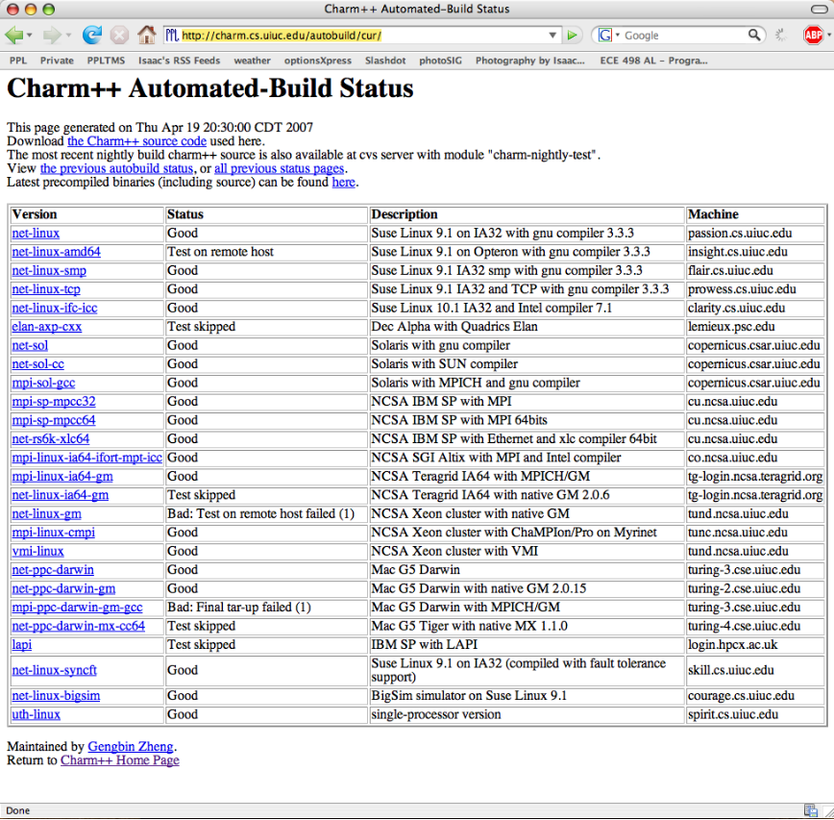
What if build fails?
Use latest version from GIT or CVS
Check the nightly auto-build tests:
http://charm.cs.uiuc.edu/autobuild/cur/
Email:
ppl@cs.uiuc.edu

Slide 19
How Charmrun Works?
ssh
connect
Acknowledge
Charmrun
charmrun +p4 ./pgm

Slide 20
Charmrun (batch mode)‏
ssh
connect
Acknowledge
Charmrun
charmrun +p4 ++batch 2

Slide 21
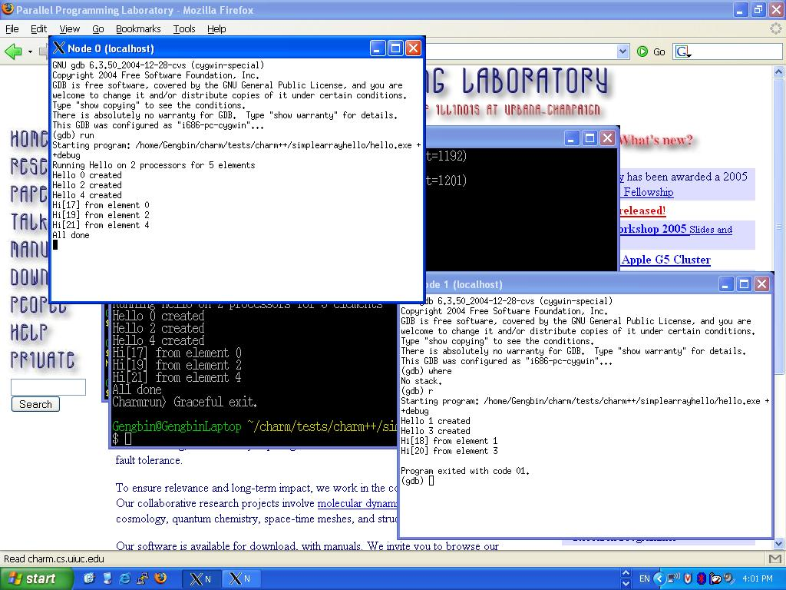
Debugging Charm++ Applications
printf
Gdb
  Sequentially (standalone mode)‏
    gdb ./pgm +vp16
  Attach gdb manually
  Run debugger in xterm
    charmrun +p4 pgm ++debug
    charmrun +p4 pgm ++debug-no-pause
  Memory paranoid
    -memory paranoid
  Parallel debugger

Slide 22
How to Become a Charm++ Hacker
Advanced Charm++
  Advanced Messaging
  Interface files (ci)‏
  Writing system libraries
    Groups
    Delegation
  Array multicast
  Threads
  SDAG

Slide 23
Advanced Messaging

Slide 24
Prioritized Execution
Charm++ scheduler
  Default - FIFO (oldest message)‏
Prioritized execution
  If several messages available, Charm will process the messages in the order of their priorities
Very useful for speculative work, ordering timestamps, etc...

Slide 25
Priority Classes
Charm++ scheduler has three queues: high, default, and low
As signed integer priorities:
  High -MAXINT to -1
  Default 0
  Low 1 to +MAXINT
As unsigned bitvector priorities:
  0x0000 Highest priority -- 0x7FFF
  0x8000 Default priority
  0x8001 -- 0xFFFF Lowest priority

Slide 26
Prioritized Messages
Number of priority bits passed during message allocation
FooMsg * msg = new (size, nbits) FooMsg;
  Priorities stored at the end of messages
Signed integer priorities
*CkPriorityPtr(msg)=-1;
CkSetQueueing(msg, CK_QUEUEING_IFIFO);
Unsigned bitvector priorities
CkPriorityPtr(msg)[0]=0x7fffffff;
CkSetQueueing(msg, CK_QUEUEING_BFIFO);

Slide 27
Prioritized Marshalled Messages
Pass “CkEntryOptions” as last parameter
For signed integer priorities:
CkEntryOptions opts;
opts.setPriority(-1);
fooProxy.bar(x,y,opts);
For bitvector priorities:
CkEntryOptions opts;
unsigned int prio[2]={0x7FFFFFFF,0xFFFFFFFF};
opts.setPriority(64,prio);
fooProxy.bar(x,y,opts);

Slide 28
Advanced Message Features
Nokeep (Read-only) messages
  Entry method agrees not to modify or delete the message
  Avoids message copy for broadcasts, saving time
Inline messages
  Direct method invocation if on local processor
Expedited messages
  Message do not go through the charm++ scheduler (ignore any Charm++ priorities)‏
Immediate messages
  Entries are executed in an interrupt or the communication thread
  Very fast, but tough to get right
  Immediate messages only currently work for NodeGroups and Group (non-smp)‏
Notes:
Not sort on priority

Slide 29
Read-Only, Expedited, Immediate
All declared in the .ci file
{
entry [nokeep] void foo_readonly(Msg *);
entry [inline] void foo_inl(Msg *);
entry [expedited] void foo_exp(Msg *);
entry [immediate] void foo_imm(Msg *);
...
};

Slide 30
Interface File (ci)‏

Slide 31
Interface File Example
mainmodule hello {
include “myType.h”
initnode void myNodeInit();
initproc void myInit();
mainchare mymain {
entry mymain(CkArgMsg *m);
};
array[1D] foo {
entry foo(int problemNo);
entry void bar1(int x);
entry void bar2(myType x);
};
};

Slide 32
Include and Initcall
Include
  Include an external header files
Initcall
  User plugging code to be invoked in Charm++’s startup phase
  Initnode
    Called once on every node
  Initproc
    Called once on every processor
  Initnode calls are called before Initproc calls

Slide 33
Entry Attributes
Threaded
  Function is invoked in a CthThread
Sync
  Blocking methods, can return values as a message
  Caller must be a thread
Exclusive
  For Node Group
  Do not execute while other exclusive entry methods of its node group are executing in the same node
Notrace
  Invisible to trace projections
  entry [notrace] void recvMsg(multicastGrpMsg *m);

Slide 34
Entry Attributes 2
Local
  Local function call, traced like an entry method
Python
  Callable by python scripts
Exclusive
  For Node Group
  Do not execute while other exclusive entry methods of its node group are executing in the same node

Slide 35
Groups/Node Groups

Slide 36
Groups and Node Groups
Groups
  Similar to arrays:
    Broadcasts, reductions, indexing
  But not completely like arrays:
    Non-migratable; one per processor
  Exactly one representative on each processor
    Ideally suited for system libraries
  Historically called branch office chares (BOC)‏
Node Groups
  One per SMP node
Notes:
Special chare array

Slide 37
Declarations
.ci file
group mygroup {
entry mygroup(); //Constructor
entry void foo(foomsg *); //Entry method
};
nodegroup mynodegroup {
entry mynodegroup(); //Constructor
entry void foo(foomsg *); //Entry method
};
C++ file
class mygroup : public Group {
mygroup() {}
void foo(foomsg *m) { CkPrintf(“Do Nothing”);}
};
class mynodegroup : public NodeGroup {
mynodegroup() {}
void foo(foomsg *m) { CkPrintf(“Do Nothing”);}
};

Slide 38
Creating and Calling Groups
Creation
p = CProxy_mygroup::ckNew();
Remote invocation
p.foo(msg); //broadcast
p[1].foo(msg); //asynchronous
p.foo(msg, npes, pes); // list send
Direct local access
mygroup *g=p.ckLocalBranch();
g->foo(….); //local invocation
  Danger: if you migrate, the group stays behind!

Slide 39
Advanced Load-balancers
Writing a Load-balancing Strategy

Slide 40
Advanced load balancing: Writing a new strategy
Inherit from CentralLB and implement the work(…) function
class foolb : public CentralLB {
public:
.. .. ..
void work (CentralLB::LDStats* stats, int count);
.. .. ..
};

Slide 41
LB Database
struct LDStats {
ProcStats *procs;
LDObjData* objData;
LDCommData* commData;
int *to_proc;
//.. .. ..
}
//Dummy Work function which assigns all objects to
//processor 0
//Don’t implement it!
void fooLB::work(CentralLB::LDStats* stats,int count){
for(int count=0;count < nobjs; count++)
stats.to_proc[count] = 0;
}

Slide 42
Compiling and Integration
Edit and run Makefile_lb.sh
  Creates Make.lb which is included by the main Makefile
Run make depends to correct dependencies
Rebuild charm++ and is now available in –balancer fooLB

Slide 43
Chare Placement

Slide 44
Initial Chare Placement
Default is round-robin.
  class YourMap : public CkArrayMap
    int procNum (int handle, const CkArrayIndex &idx)‏
    Based on the index return the int which is the pe number for this object
    During construction readonly variables are available for use as lookup tables
    Other groups are NOT

Slide 45
Topology Aware Placement
Use the TopoManager
  Supports BG/L, BG/P, Cray (Cray depends on scheduler)‏
  #include TopoManager
  TopoManager *topoMgr = new TopoManager();
    Provides getDim[XYZ], getDimN[XYZ] rankToCoordinates, getHopsBetweenRanks coordinatesToRank, sortRanksByHops, pickClosestRank, areNeighbors
  Use in procnum, or when creating lookup tables for procnum

Slide 46
Threads in Charm++

Slide 47
Why use Threads?
They provide one key feature: blocking
  Suspend execution (e.g., at message receive)‏
  Do something else
  Resume later (e.g., after message arrives)‏
Example: MPI_Recv, MPI_Wait semantics
Function call interface more convenient than message-passing
  Regular call/return structure (no CkCallbacks) with complete control flow
  Allows blocking in middle of deeply nested communication subroutine
Notes:
Wait for reply

Slide 48
Why not use Threads?
Slower
  Around 1us context-switching overhead unavoidable
  Creation/deletion perhaps 10us
Migration more difficult
  State of thread is scattered through stack, which is maintained by compiler
  By contrast, state of object is maintained by users
Thread disadvantages form the motivation to use SDAG

Slide 49
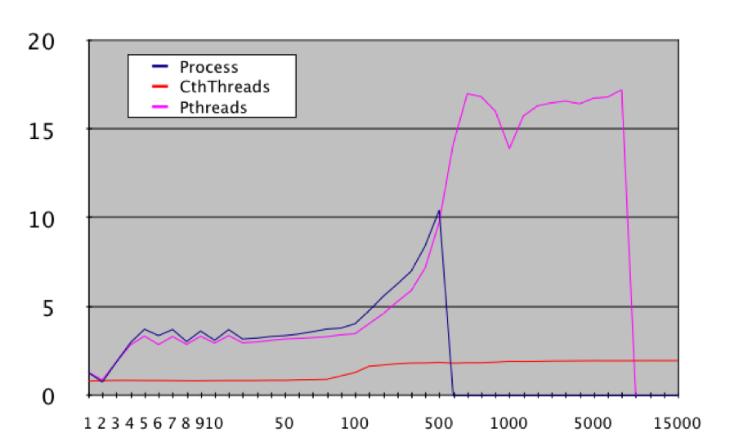
Context Switch Cost

Slide 50
What are (Converse) Threads?
One flow of control (instruction stream)‏
  Machine Registers & program counter
  Execution stack
Like pthreads (kernel threads)‏
Only different:
  Implemented at user level (in Converse)‏
  Scheduled at user level; non-preemptive
  Migratable between nodes

Slide 51
How do I use Threads?
Many options:
  AMPI
    Always uses threads via TCharm library
  Charm++
    [threaded] entry methods run in a thread
    [sync] methods
  Converse
    C routines CthCreate/CthSuspend/CthAwaken
    Everything else is built on these
    Implemented using
      SYSV makecontext/setcontext
      POSIX setjmp/alloca/longjmp
      Assembly code

Slide 52
How do I use Threads (example)‏
Blocking API routine: find array element
int requestFoo(int src) {
myObject *obj=...;
return obj->fooRequest(src)‏
}
Send request and suspend
int myObject::fooRequest(int src) {
proxy[dest].fooNetworkRequest(thisIndex);
stashed_thread=CthSelf();
CthSuspend(); // -- blocks until awaken call --
return stashed_return;
}
Awaken thread when data arrives
void myObject::fooNetworkResponse(int ret) {
stashed_return=ret;
CthAwaken(stashed_thread);
}

Slide 53
How do I use Threads (example)‏
Send request, suspend, recv, awaken, return
int myObject::fooRequest(int src) {
proxy[dest].fooNetworkRequest(thisIndex);
stashed_thread=CthSelf();
CthSuspend();
return stashed_return;
}
void myObject::fooNetworkResponse(int ret) {
stashed_return=ret;
CthAwaken(stashed_thread);
}

Slide 54
Thread Migration

Slide 55
Stack Data
The stack is used by the compiler to track function calls and provide temporary storage
  Local Variables
  Subroutine Parameters
  C “alloca” storage
Most of the variables in a typical application are stack data
Stack is allocated by Charm run-time as heap memory (+stacksize)‏

Slide 56
Migrate Stack Data
Without compiler support, cannot change stack’s address
  Because we can’t change stack’s interior pointers (return frame pointer, function arguments, etc.)‏
Existing pointers to addresses in original stack become invalid
Solution: “isomalloc” addresses
  Reserve address space on every processor for every thread stack
  Use mmap to scatter stacks in virtual memory efficiently
  Idea comes from PM²
Notes:
Isomalloc Stacks A user-level thread, when suspended, consists of a stack and a set of
preserved machine registers. During migration, the machine registers are simply copied
to the new processor. The stack, unfortunately, is very difficult to move. In a distributed
memory parallel machine, if the stack is moved to a new machine, it will almost undoubtedly
be allocated at a different location, so existing pointers to addresses in the
original stack would become invalid when the stack moves. We cannot reliably update
all the pointers to stack-allocated variables, because these pointers are stored in machine
registers and stack frames, whose layout is highly machine- and compiler-dependent.
PM2 [12] is another migratable thread system, which treats threads as remote procedure calls, which return some data on completion .
Multithreaded systems such as PM 2 [NM96] require every thread to store its state in specially allocated memory, so that the system can migrate the thread automatically

Slide 57
Migrate Stack Data
Processor A’s Memory
Processor B’s Memory
0xFFFFFFFF
0xFFFFFFFF
Thread 1 stack
Thread 2 stack
Migrate Thread 3
Thread 3 stack
Thread 4 stack
Heap
Heap
Globals
Globals
Code
Code
0x00000000
0x00000000

Slide 58
Migrate Stack Data: Isomalloc
Processor A’s Memory
Processor B’s Memory
0xFFFFFFFF
0xFFFFFFFF
Thread 1 stack
Thread 2 stack
Migrate Thread 3
Thread 3 stack
Thread 4 stack
Heap
Heap
Globals
Globals
Code
Code
0x00000000
0x00000000

Slide 59
Migrate Stack Data
Isomalloc is a completely automatic solution
  No changes needed in application or compilers
  Just like a software shared-memory system, but with proactive paging
But has a few limitations
  Depends on having large quantities of virtual address space (best on 64-bit)‏
    32-bit machines can only have a few gigs of isomalloc stacks across the whole machine
  Depends on unportable mmap
    Which addresses are safe? (We must guess!)‏
    What about Windows? Or Blue Gene?

Slide 60
Aliasing Stack Data
Processor A’s Memory
Processor B’s Memory
0xFFFFFFFF
0xFFFFFFFF
Thread 3 stack
Heap
Thread 2 stack
Heap
Globals
Globals
Code
Code
0x00000000
0x00000000

Slide 61
Aliasing Stack Data: Run Thread 2
Processor A’s Memory
Processor B’s Memory
0xFFFFFFFF
0xFFFFFFFF
Thread 2 stack
Execution Copy
Thread 3 stack
Heap
Thread 2 stack
Heap
Globals
Globals
Code
Code
0x00000000
0x00000000

Slide 62
Aliasing Stack Data
Processor A’s Memory
Processor B’s Memory
0xFFFFFFFF
0xFFFFFFFF
Thread 3 stack
Heap
Thread 2 stack
Heap
Globals
Globals
Code
Code
0x00000000
0x00000000

Slide 63
Aliasing Stack Data: Run Thread 3
Processor A’s Memory
Processor B’s Memory
0xFFFFFFFF
0xFFFFFFFF
Thread 3 stack
Execution Copy
Thread 3 stack
Heap
Thread 2 stack
Heap
Globals
Globals
Code
Code
0x00000000
0x00000000

Slide 64
Aliasing Stack Data
Processor A’s Memory
Processor B’s Memory
0xFFFFFFFF
0xFFFFFFFF
Migrate Thread 3
Thread 3 stack
Heap
Thread 3 stack
Heap
Thread 2 stack
Globals
Globals
Code
Code
0x00000000
0x00000000

Slide 65
Aliasing Stack Data
Processor A’s Memory
Processor B’s Memory
0xFFFFFFFF
0xFFFFFFFF
Heap
Thread 3 stack
Heap
Thread 2 stack
Globals
Globals
Code
Code
0x00000000
0x00000000

Slide 66
Aliasing Stack Data
Processor A’s Memory
Processor B’s Memory
0xFFFFFFFF
0xFFFFFFFF
Execution Copy
Thread 3 stack
Heap
Thread 3 stack
Heap
Thread 2 stack
Globals
Globals
Code
Code
0x00000000
0x00000000

Slide 67
Aliasing Stack Data
Does not depend on having large quantities of virtual address space
  Works well on 32-bit machines
Requires only one mmap’d region at a time
  Works even on Blue Gene!
Downsides:
  Thread context switch requires munmap/mmap (3us)‏
  Can only have one thread running at a time (so no SMP’s!)‏
“-thread memoryalias” link time option

Slide 68
Heap Data
Heap data is any dynamically allocated data
  C “malloc” and “free”
  C++ “new” and “delete”
  F90 “ALLOCATE” and “DEALLOCATE”
Arrays and linked data structures are almost always heap data

Slide 69
Migrate Heap Data
Automatic solution: isomalloc all heap data just like stacks!
  “-memory isomalloc” link option
  Overrides malloc/free
  No new application code needed
  Same limitations as isomalloc; page allocation granularity (huge!)‏
Manual solution: application moves its heap data
  Need to be able to size message buffer, pack data into message, and unpack on other side
  “pup” abstraction does all three

Slide 70
Delegation

Slide 71
Delegation
Customized implementation of messaging
  Enables Charm++ proxy messages to be forwarded to a delegation manager group
Delegation manager
  trap calls to proxy sends and apply optimizations
Delegation manager must inherit from CkDelegateMgr class
User program must to call
  proxy.ckDelegate(mgrID);

Slide 72
Delegation Interface
.ci file
group MyDelegateMgr {
entry MyDelegateMgr(); //Constructor
};
.h file
class MyDelegateMgr : public CkDelegateMgr {
MyDelegateMgr();
void ArraySend(...,int ep,void *m,const CkArrayIndexMax &idx,CkArrayID a);
void ArrayBroadcast(..);
void ArraySectionSend(.., CkSectionID &s);
……………..
……………..
}

Slide 73
Section Operations

Slide 74
Array Multicast/reduction library
Array section – a subset of chare array
Array section creation
  Enumerate array indices
    CkVec<CkArrayIndex3D> elems; // add array indices
    for (int i=0; i<10; i++)
    for (int j=0; j<20; j+=2)
    for (int k=0; k<30; k+=2)
    elems.push_back(CkArrayIndex3D(i, j, k));
    CProxySection_Hello proxy = CProxySection_Hello::ckNew(helloArrayID, elems.getVec(), elems.size());
  Alternatively, one can do the same thing by providing (lbound:ubound:stride) for each dimension:
    CProxySection_Hello proxy = CProxySection_Hello::ckNew(helloArrayID, 0, 9, 1, 0, 19, 2, 0, 29, 2);
    The above code creates a section proxy that contains array elements of [0:9, 0:19:2, 0:29:2].
  For user-defined array index other than CkArrayIndex1D to CkArrayIndex6D, one needs to use the generic array index type: CkArrayIndexMax.
    CkArrayIndexMax *elems; // add array indices
    int numElems;
    CProxySection_Hello proxy = CProxySection_Hello::ckNew(helloArrayID, elems, numElems);
Notes:
Multicast in MD

Slide 75
Array Section Multicast
Usage of an array section proxy
  do multicast to all the section members:
    CProxySection_Hello proxy;
    proxy.foo( msg) // multicast
  send messages to one member using its local index
    proxy[0].foo( msg)‏

Slide 76
Array Section Multicast
Multicast via delegation
  CkMulticast communication library
  CProxySection_Hello sectProxy = CProxySection_Hello::ckNew();
  CkGroupID mCastGrpId = CProxy_CkMulticastMgr::ckNew();
  CkMulticastMgr *mcastGrp = CProxy_CkMulticastMgr(mCastGrpId).ckLocalBranch();
  sectProxy.ckSectionDelegate(mCastGrpId); // initialize proxy
  sectProxy.foo(...); //multicast via delegation
Note, to use CkMulticast library, all multicast messages must inherit from CkMcastBaseMsg, as following:
class HiMsg : public CkMcastBaseMsg, public CMessage_HiMsg
{
public:
int *data;
};

Slide 77
Array Section Reduction
Section reduction with delegation
Use default reduction callback
CProxySection_Hello sectProxy;
CkMulticastMgr *mcastGrp = CProxy_CkMulticastMgr(mCastGrpId).ckLocalBranch();
mcastGrp->setReductionClient(sectProxy, new CkCallback(...));
Reduction
CkGetSectionInfo(sid, msg);
CkCallback cb(CkIndex_myArray::foo(NULL),thisProxy);
mcastGrp->contribute(sizeof(int), &data, CkReduction::sum_int, sid, cb);

Slide 78
With Migration
Works with migration
  When intermediate nodes migrate
    When migrates, multicast tree will be automatically rebuilt
  Root processor
    Application needs to initiate the rebuild
    Will change to automatic in future

Slide 79
Custom Reducers
A reduction function:
  Match the prototype
  Return a new reduction message
  Register within an initcall routine
  Be stateless
  Will be invoked by the reduction manager to merge messages

Slide 80
Custom Reducer API
Reduction function prototype
Example Function
Registration
CkReductionMsg *reductionFn(int nMsg,CkReductionMsg **msgs);
CkReductionMsg *sumTwoShorts(int nMsg,CkReductionMsg **msgs) {
short ret[2]=0,0; //Sum starts off at zero
for (int i=0;i<nMsg;i++) {
CkAssert(msgs[i]->getSize()==2*sizeof(short)); //Sanity check:
short *m=(short *)msgs[i]->getData(); //Extract this message's data
ret[0]+=m[0]; ret[1]+=m[1];
}
return CkReductionMsg::buildNew(2*sizeof(short),ret);
}
//In the .ci file:
initcall void registerSumTwoShorts(void);
//In some .C file:
/*global*/ CkReduction::reducerType sumTwoShortsType;
/*initcall*/ void registerSumTwoShorts(void)
{
sumTwoShortsType=CkReduction::addReducer(sumTwoShorts);
}

Slide 81
Group Multicast
Define sections by explicitly enumerating the elements
Use proxy as normal
int floor =CkNumPes()/2;
Int ceiling=CkNumPes();
int *elems= new int[sectionSize];
for(int i=floor,j=0;i<=ceiling;i++,j++)
elems[j]=i;
CproxySection_MyGroup HighSectProxy(thisgroup,elems,sectionSize);
HighSectProxy.recv(msg);

Slide 82
Cross Sections
Sections can span multiple instances of an array or group
Enumerate the elements in each array as per a normal section
Enumerate the arrays by CkArrayId
Use the proxy as normal
Same principle for cross group sections

Slide 83
Cross Group Section Example
CkArrayID *aidArr= new CkArrayID[3];
CProxy_MyArray1d *Aproxy= new CProxy_MyArray1d[3];
for(int i=0;i<3;i++)
{
Aproxy[i]=CProxy_MyArray1d::ckNew(masterproxy.ckGetGroupID(),ArraySize);
aidArr[i]=Aproxy[i].ckGetArrayID();
}
// make sections
int aboundary=ArraySize/2;
int afloor=aboundary;
int aceiling=ArraySize-1;
int asectionSize=aceiling-afloor+1;
// cross section lower half of each array
CkArrayIndexMax **aelems= new CkArrayIndexMax*[3];
aelems[0]= new CkArrayIndexMax[asectionSize];
aelems[1]= new CkArrayIndexMax[asectionSize];
aelems[2]= new CkArrayIndexMax[asectionSize];
int *naelems=new int[3];
for(int k=0;k<3;k++)
{
naelems[k]=asectionSize;
for(int i=afloor,j=0;i<=aceiling;i++,j++)
aelems[k][j]=CkArrayIndex1D(i);
}
const CkArrayIndexMax *constaelems[3]={aelems[0], aelems[1], aelems[2]};
CProxySection_MyArray1d arrayLowProxy(3,aidArr,constaelems,naelems);
myMsg *msg= new myMsg;
arrayLowProxy.recv(msg);

Slide 84
Shared Memory Optimizations

Slide 85
Multicore Node Features
Add smp to the charm options on the build line
  Launch 1 process with N pthreads per node
  Also 1 communication thread
  In single node case use multicore architecture target
Nodegroups
  Like groups, but only one exists per process
Conditional message packing
Pinning
CPU topology API

Slide 86
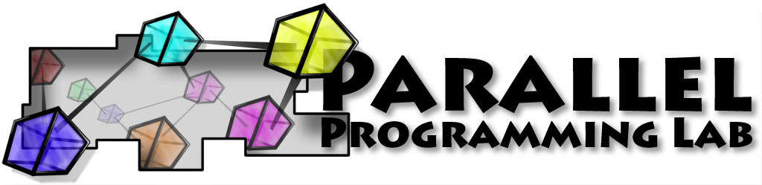
Thank You!
Free source, binaries, manuals, and more information at:
http://charm.cs.uiuc.edu/
Parallel Programming Lab
at University of Illinois

