Slide 1
CS420: Multi-phase Shared Arrays
Laxmikant V. Kale

Slide 2
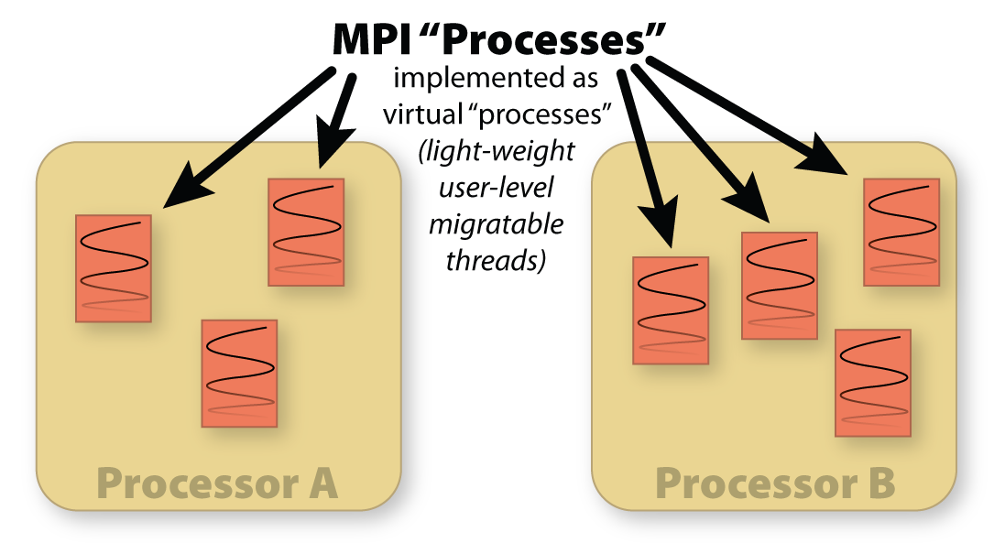
AMPI: Adaptive MPI

Slide 3
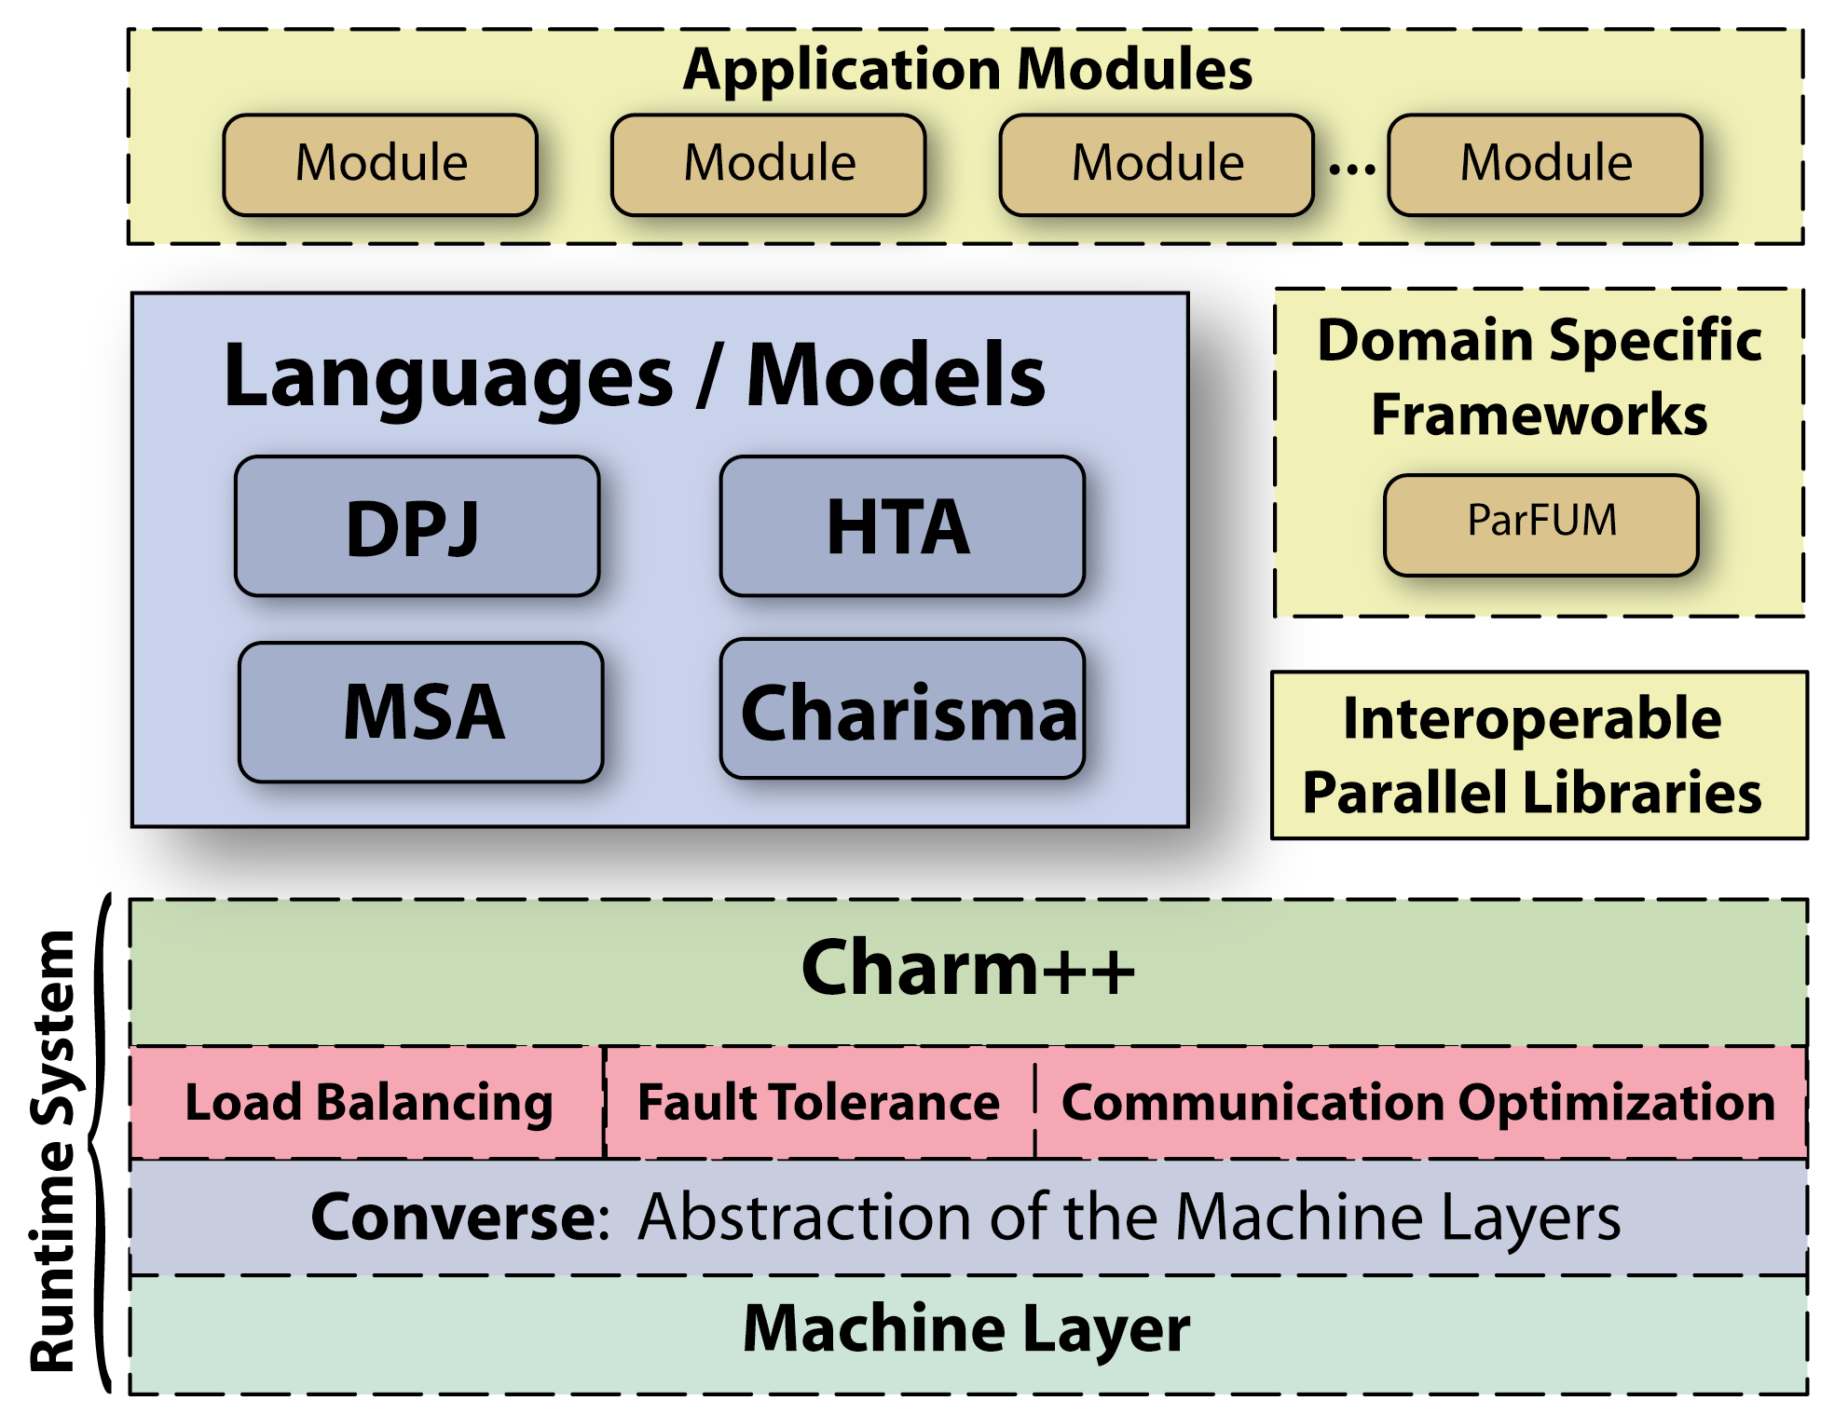
A set of “incomplete” but elegant/simple languages, backed by a low-level complete one

Slide 4
Multiphase Shared Arrays
Observations:
  General shared address space abstraction is complex
  Certain special cases are simple, and cover most uses
Each array is in one mode at a time
  But its mode may change from phase to phase
Modes
  Write-once
  Read-only
  Accumulate
  Owner-computes
All workers sync, at end of each phase
// Each worker thread
for(i=min;i<Max; i++)
A[i] += i; // ACCUMULATE
A.sync();

Slide 5
MSA
In the simple model:
A program consists of
  A collection of threads, and
  Multiple collections of data-arrays
    Partitioned into pages (user-specified)
Execution begins in a “main”
  Then all threads are fired in parallel
More complex model
  Multiple collections of threads
  …
C
C
C
C
A
B

Slide 6
Extensions
Need check for each access: is the page here?
  Pre-fetching, and known-local accesses
A Twist on ACCUMULATE
  Each array element can be a set
  Set Union operation is a valid accumulate operation.
  Example:
    Appending a list of (x,y) points

Slide 7
MSA: Matrix-Matrix Multiplication
typedef MSA2D<double, MSA_NullA<double>, 4096,MSA_ROW_MAJOR> MSA2DRowMjr;
typedef MSA2D<double, MSA_SumA<double>, 4096, MSA_COL_MAJOR> MSA2DColMjr;
// One thread creates MSAs and broadcasts their IDs
MSA2DRowMjr A(ROWS1, COLS1, NUMWORKERS, cacheSize1); // row major
MSA2DColMjr B(ROWS2, COLS2, NUMWORKERS, cacheSize2); // column major
MSA2DRowMjr C(ROWS1, COLS2, NUMWORKERS, cacheSize3); // product matrix
// Each thread executes the following code
A.enroll(); B.enroll(); C.enroll();
for(unsigned int c = 0; c < COLS2; c++) {
// Each thread computes a subset of rows of product matrix
for(unsigned int r = rowStart; r <= rowEnd; r++) {
double result = 0.0;
for(unsigned int k = 0; k < cols1; k++)
result += A[r][k] * B[k][c];
C[r][c] = result;
}
}
prod.sync();
// use product matrix afterwards

Slide 8
typedef MSA2D<double, MSA_NullA<double>, 4096,MSA_ROW_MAJOR> MSA2DRowMjr;
typedef MSA2D<double, MSA_SumA<double>, 4096, MSA_COL_MAJOR> MSA2DColMjr;
// One thread creates MSAs and broadcasts their IDs
MSA2DRowMjr A(ROWS1, COLS1, NUMWORKERS, cacheSize1); // row major
MSA2DColMjr B(ROWS2, COLS2, NUMWORKERS, cacheSize2); // column major
MSA2DRowMjr C(ROWS1, COLS2, NUMWORKERS, cacheSize3); // product matrix
// Each thread executes the following code
A.enroll(); B.enroll(); C.enroll();
…
for(unsigned int c = 0; c < COLS2; c++) {
// Each thread computes a subset of rows of product matrix
for(unsigned int r = rowStart; r <= rowEnd; r++) {
double result = 0.0;
for(unsigned int k = 0; k < cols1; k++)
result += A[r][k] * B[k][c];
C[r][c] = result;
}
}
prod.sync();
// use product matrix afterwards
..

Slide 9
MSA: Plimpton’s Algorithm for MD
// Declarations of the 3 arrays
class XYZ; // { double x; double y; double z; . }
typedef MSA1D<XYZ, MSA_SumA<XYZ>, DEFAULT_PAGE_SIZE> XyzMSA;
class AtomInfo;
typedef MSA1D<AtomInfo, MSA_SumA<AtomInfo>, PAGE_SIZE> AtomInfoMSA;
typedef MSA2D<int,MSA_NullA<int>, PAGE_SIZE,MSA_ROW_MAJOR> NeighborMSA;
XyzMSA coords;
XyzMSA forces;
AtomInfoMSA atominfo;
NeighborMSA nbrList;
//broadcast the above array handles to the worker threads.
// Each thread executes the following code
coords.enroll(numberOfWorkerThreads);
forces.enroll(numberOfWorkerThreads);
atominfo.enroll(numberOfWorkerThreads);
nbrList.enroll(numberOfWorkerThreads);

Slide 10
MSA: Plimpton MD
for timestep = 0 to Tmax {
// Phase I : Force Computation: for a section of the interaction matrix
for i = i_start to i_end
for j = j_start to j_end
if (nbrlist[i][j]) { // nbrlist enters ReadOnly mode
force = calculateForce(coords[i], atominfo[i], coords[j], atominfo[j]);
forces[i] += force; // Accumulate mode
forces[j] += -force;
}
nbrlist.sync(); forces.sync(); coords.sync(); atominfo.sync();
for k = myAtomsbegin to myAtomsEnd // Phase II : Integration
coords[k] = integrate(atominfo[k], forces[k]); // WriteOnly mode
coords.sync(); atominfo.sync(); forces.sync();
if (timestep %8 == 0) { // Phase III: update neighbor list every 8 steps
for i = i_start to i_end
for j = j_start to j_end
nbrList[i][j] = distance(coords[i], coords[j]) < CUTOFF;
nbrList.sync(); coords.sync();
}
}

Slide 11
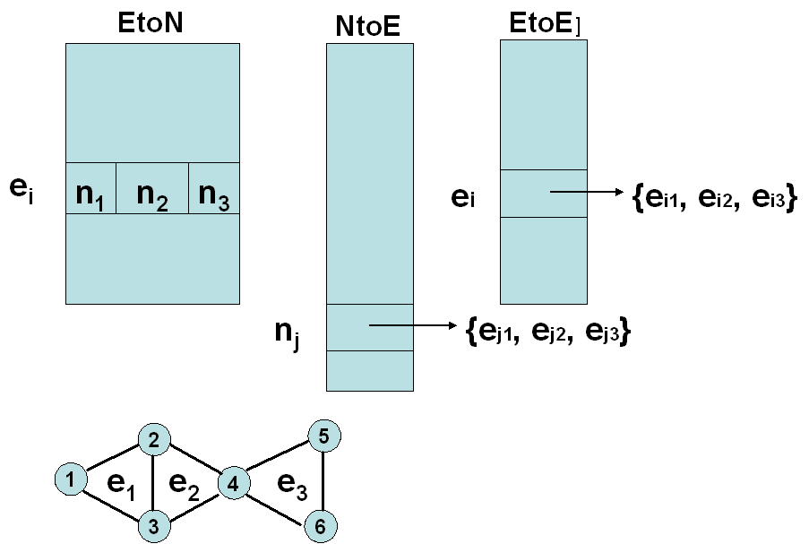
MSA: Graph Partition
// Phase I: EtoN: RO, NtoE: Accumulate
for i=1 to EtoN.length()
for j=1 to EtoN[i].length() {
n = EtoN[i][j];
NtoE[n] += i; // Accumulate
}
EtoN.sync(); NtoE.sync();
// Phase II: NtoE: RO, EtoE: Accumulate
for j = my section of j
//foreach pair e1, e2 elementof NtoE[j]
for i1 = 1 to NtoE[j].length()
for i2 = i1 + 1 to NtoE[j].length() {
e1 = NtoE[j][i1];
e2 = NtoE[j][i2];
EtoE[e1] += e2; // Accumulate
EtoE[e2] += e1;
}
EtoN.sync(); NtoE.sync();

