Slide 1
Programming
Cell & Larrabee
Using Accelerated Entry Methods
David Kunzman
Parallel Programming Lab
University of Illinois at Urbana-Champaign
11.30.2009

Slide 2
Motivation/Goals
Allow Charm++ programs to use accelerators
  Currently targeting Cell and Larrabee
  Difficult to program
Ease programmer burden
  Single programming model for all processing cores
  Portability
  Modularity

Slide 3
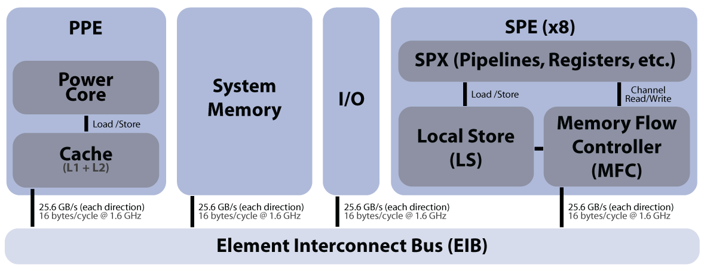
Cell Overview
Single Power Processing Element (PPE)
Multiple Synergistic Processing Elements (SPEs): Blade = 8, PS3 = 6, SpursEngine = 4
SPEs are in different address spaces with limited local store (scratchpad) memory
4-way SIMD (vector) instructions

Slide 4
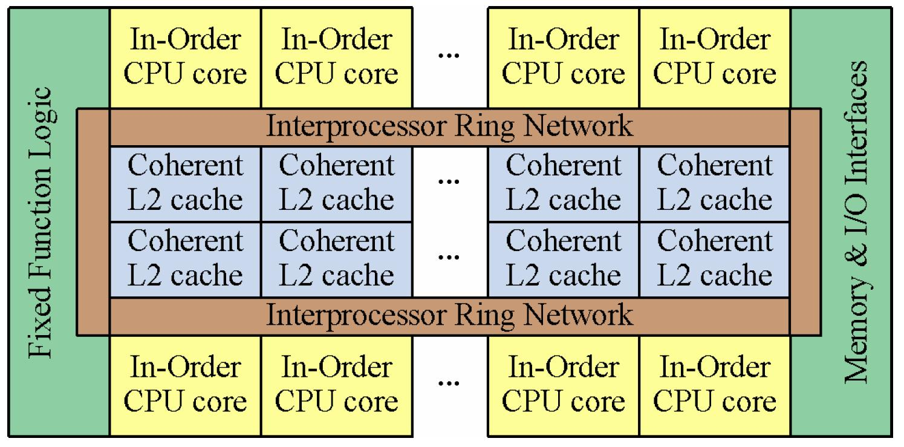
Larrabee Overview
Designed as GPU (accelerator to a host core)
Multiple cores
Cores access a coherent cache-based memory hierarchy
16-way SIMD (vector) instructions
Image from Larrabee SigGraph 2008 paper

Slide 5
Entry Method Structure
Interface File:
entry void entryName
( …passed parameters… );
Source File:
void ChareClass::entryName
( …passed parameters … )
{ … function body … }
Invocation:
objProxy.entryName(… passed parameters …)

Slide 6
Basic Entry Method
entry void accum(int inArrayLen, float inArray[inArrayLen]);
void ChareObj::accum(int inArrayLen, float* inArray) {
if (inArrayLen != localArrayLen) return;
for (int i = 0; i < inArrayLen; ++i)
  localArray[i] = localArray[i] + inArray[i];
}
To Invoke: myChareObj.accum(someFloatArray_len,
someFloatArray_ptr);

Slide 7
Extensions to Charm++
SIMD Instruction Abstraction
&
Accelerated Entry Methods

Slide 8
SIMD Abstraction
Abstract SIMD instructions supported by multiple architectures
  Currently adding support for: SSE (x86), AltiVec/VMX (PowerPC; PPE), SIMD instructions on SPEs, and Larrabee
  Generic C implementation when no direct architectural support is present
  Types: vecf, veclf, veci, ...
  Operations: vaddf, vmulf, vsqrtf, ...

Slide 9
SIMD Instruction Abstraction
entry void accum(int inArrayLen, align(sizeof(vecf)) float inArray[inArrayLen]);
void ChareObj::accum(int inArrayLen, float* inArray) {
if (inArrayLen != localArrayLen) return;
vecf* inArrayVec = (vecf*)inArray;
  vecf* localArrayVec = (vecf*)localArray;
  int arrayVecLen = inArrayLen / vecf_numElems;
  for (int i = 0; i < arrayVecLen; ++i)
    localArrayVec[i] = vaddf(localArrayVec[i], inArrayVec[i]);
  for (int i = arrayVecLen * vecf_numElems; i < inArrayLen; ++i)
  localArray[i] = localArray[i] + inArray[i];
}
To Invoke: myChareObj.accum(someFloatArray_len, someFloatArray_ptr);

Slide 10
Accelerated Entry Methods
Targets computationally intensive code
  Execute on accelerator if one or more supported accelerators are present
  Otherwise, execute on host core
Structure based on standard entry methods
  Data dependencies expressed via messages (passed parameters)
  Code is self-contained (accesses message and chare object data)
The runtime system manages…
  Data movement: DMAs automatically overlapped with work on the accelerator(s)
  Scheduling: based on data dependencies (messages and chare objects)
Multiple independently written portions of code share the same accelerator(s)

Slide 11
Accel Entry Method Structure
Basic
Interface File:
entry void entryName
( …passed parameters… );
Source File:
void ChareClass::entryName
( …passed parameters … )
{ … function body … }
Accelerated
Interface File:
entry [accel] void entryName
( …passed parameters… )
[ …local parameters… ]
{ … function body … }
callback_member_function;
vs.
Invocation (both): chareObj.entryName(… passed parameters …)

Slide 12
Same Entry Method Accelerated
entry [accel] void accum(int inArrayLen, align(sizeof(vecf)) float inArray[inArrayLen])
[ readOnly : int localArrayLen <impl_obj->localArrayLen>,
readWrite : float localArray[localArrayLen] <impl_obj->localArray> ] {
if (inArrayLen != localArrayLen) return;
  vecf* inArrayVec = (vecf*)inArray;
  vecf* localArrayVec = (vecf*)localArray;
  int arrayVecLen = inArrayLen / vecf_numElems;
  for (int i = 0; i < arrayVecLen; ++i)
    localArrayVec[i] = vaddf(localArrayVec[i], inArrayVec[i]);
  for (int i = arrayVecLen * vecf_numElems; i < inArrayLen; ++i)
  localArray[i] = localArray[i] + inArray[i];
} accum_callback;
To Invoke: myChareObj.accum(someFloatArray_len, someFloatArray_ptr);

Slide 13
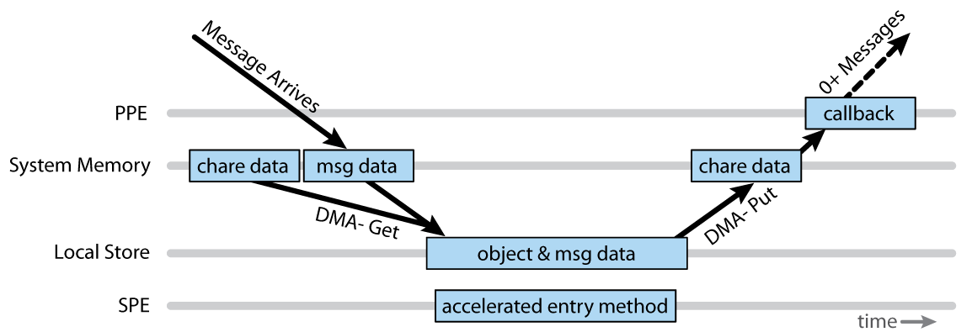
Timeline of Events
Runtime system…
  Directs data movement (messages & DMAs)
  Schedules accelerated entry methods and callbacks

Slide 14
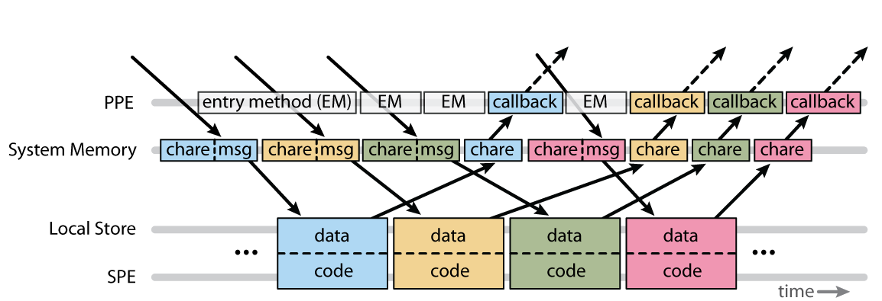
Communication Overlap
Data movement automatically overlapped with accelerated entry method execution on SPEs and entry method execution on PPE

Slide 15
A Step Further: Heterogeneity
Code already portable between systems with and without accelerators
  Have runtime system account for host core differences by automatically modifying application data (message data)
  Then able to use all cores (host and accelerators)

Slide 16
Summary
Common SIMD instructions abstracted via SIMD instruction abstraction
Accelerators available to Charm++ programs via accelerated entry methods
  Currently targeting Cell and Larrabee
  Ease programmer burden
Support for heterogeneous systems
Disclaimer: Still under development

