Slide 1
Performance Analysis with the Projections Tool
By Chee Wai Lee

Slide 2
Tutorial Outline
General Introduction
Instrumentation
Trace Generation
Performance Analysis
Dealing with Scalability and Data Volume

Slide 3
General Introduction
Introductions to Projections
Basic Charm++ Model

Slide 4
The Projections Framework
Projections is a performance framework designed for use with the Charm++ runtime system.
Supports the generation of detailed trace logs as well as summary profiles.
Supports a simple user-level API for user-directed instrumentation and visualization.
Java-based visualization tool.
Analysis is post-mortem and human-centric with some automation support.
Notes:
Mention online analysis work.

Slide 5
What you will need
A version of Charm++ built without the CMK_OPTIMIZE flag (Developers using pre-built binaries please consult your system administrators).
Java 5 Runtime or higher.
Projections Java Visualization binary:
Distributed in its own git repository.
Build with “ant”.

Slide 6
The Basic Charm++ Model
Processor
Object-Oriented: Chare objects encapsulate data and entry methods.
Message-Driven: An entry method is scheduled for execution on a processor when an incoming message is processed on a message queue.
Each processor executes an entry method to completion before scheduling the next one (if any).
Chare Object
Chare Object
entry method foo()
entry method qsort()
entry method bar()
New
Incoming
Message
Scheduler:
schedules appropriate method for next message on Q
Message Queue

Slide 7
Tutorial Outline
General Introduction
Instrumentation
Trace Generation
Performance Analysis
Dealing with Scalability and Data Volume

Slide 8
Instrumentation
Basics
Application Programmer’s Interface (API)
User-Specific Events
Turning Tracing On/Off

Slide 9
Instrumentation: Basics
Nothing to do!
Charm++’s built-in performance framework automatically instruments entry method execution and communication events whenever a performance module is linked with the application (see later).
In the majority of cases, this generates very useful data for analysis while introducing minimal overhead/perturbation.
The framework also provides the necessary abstraction for better interpretation of performance metrics for third-party performance modules like TAU profiling.

Slide 10
Instrumentation: User-Events
If user-specific events (e.g. specific code-blocks) are required, these can be manually inserted into the application code:
Register (at Initialization):
int traceRegisterUserEvent(char* EventDesc, int EventNum=-1)
Record a Point-Event:
void traceUserEvent(int EventNum)
Record a Bracketed-Event:
void traceUserBracketEvent(int EventNum, double StartTime, double EndTime)

Slide 11
Instrumentation: Selective Tracing
Allows analyst to restrict the time period for which performance data is generated.
Simple Interface, but not so easy to use:
void traceBegin()
void traceEnd()
Calls have a per-processor effect, so users have to ensure consistency (calls are made from within objects and there can be more than one object per processor).

Slide 12
Selective Tracing Example
// do this once on each PE, remember we are now in an array element.
// the (currently valid) assumption is that each PE has at least 1 object.
if (!CkpvAccess(traceFlagSet)) {
if (iteration == 0) {
traceBegin();
CkpvAccess(traceFlagSet) = true;
}
}

Slide 13
Tutorial Outline
General Introduction
Instrumentation
Trace Generation
Performance Analysis
Dealing with Scalability and Data Volume

Slide 14
Trace Generation
Performance Modules at Application Build Time
Projections Event Tracing
Projections Summary Profiles
Application Runtime Controls
The Projections Event Tracing Module.
The Projections Summary Profile Module.

Slide 15
Application Build Options
Link into Application one or more Performance Modules:
“-tracemode summary” for Projections Profiles.
“-tracemode projections” for Projections Event Traces.
Notes:
Mention PMPI and TAU here.

Slide 16
Application Runtime Options
General Options:
+traceoff tells the Performance Framework not to record events until it encounters a traceBegin() API call.
+traceroot <dir> tells the Performance Framework which folder to write output to.
+gz-trace tells the Performance Framework to output compressed data (default is text). This is useful on extremely large machine configurations where the attempt to write the logs for large number of processors would overwhelm the IO subsystem.

Slide 17
The Projections Event Tracing Module
Records pertinent detailed metrics per Charm++ event.
e.g. Start of an entry method invocation – details:
source of the message
size of the incoming message
time of invocation
chare object id
One text line per event is written to the log file.
One log file is maintained per processor.

Slide 18
The Projections Summary Profile Module
Entry Method Execution
50%
100%
100%
100%
50%
0
t
2t
3t
4t
5t
6t
7t
8t
When Application
encounters an event after 8t
75%
100%
75%
0
2t
4t
6t
8t
10t
12t
14t
16t

Slide 19
Tutorial Outline
General Introduction
Instrumentation
Trace Generation
Performance Analysis
Dealing with Scalability and Data Volume

Slide 20
Performance Analysis
Live demo with the simple object-imbalance code as an example.
We will see:
Building the code with tracemodes “projections”, “summary”.
Executing the code and generating logs on a local 8-core machine with some control options.
Visualizing the resulting performance data with Projections.
Repeating the above process with different experiments.

Slide 21
The Load Imbalance Example
4 objects assigned to each processor.
Objects on even processors get 2 units of work.
Objects on odd processors get 1 unit of work.
Each object computes its assigned work each iteration.
Each iteration is followed by a barrier.
Obj 3
Obj 2
Obj 1
Obj 7
Obj 6
Obj 0
Obj 5
Obj 4
PE 0
PE 1

Slide 22
The Load Imbalance Example (2)
Iteration 0
Iteration 1
PE 0
PE 1
Barrier
Barrier
Passage of Time

Slide 23
Rebalancing the Load
Iteration 0
took 8 units of time
Iteration 1
now takes 6 units of time
PE 0
PE 1
Load Balancing
(eg. Greedy strategy)
Barrier
Passage of Time

Slide 24
Using Projections on The Load Imbalance Example
Executed on 8 processors (single 8-core chip).
Charm++ program run over 10 iterations with Load Balancing attempted at iteration 5.
Experiments:
Experiment 1: No Load Balancing attempted (DummyLB).
Experiment 2: Greedy Load Balancing attempted.
Experiment 3: Make only object 0 do an insane amount of work and repeat 1 & 2.

Slide 25
Tutorial Outline
General Introduction
Instrumentation
Trace Generation
Performance Analysis
Dealing with Scalability and Data Volume

Slide 26
Scalability and Data Volume Control
Pre-release or beta features.
How do we handle event trace logs from thousands of processors?
What options do we have for limiting the volume of data generated?
How do we avoid getting lost trying to find performance problems when looking at visual displays from extremely large log sets?

Slide 27
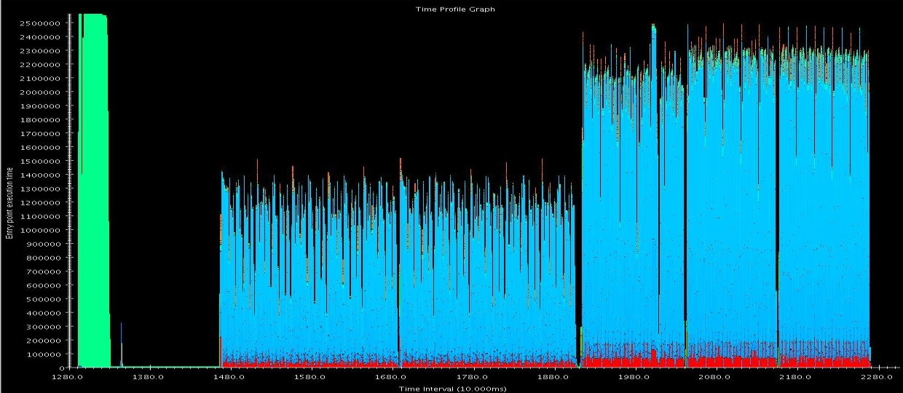
Limiting Data Volume
Careful use of traceBegin()/traceEnd() calls to limit instrumentation to a representative portion of a run.
Eg. In NAMD benchmarks, we often look at 100 steps after the first major load balancing phase, followed by a refinement load balancing phase, followed by another 100 steps.

Slide 28
Limiting Data Volume (2)
Pre-release feature – writing only a subset of processors’ performance data to disk.
Uses clustering to identify equivalence classes of processor behavior. This is done after the application is done, but before performance data is written to disk.
Select “exemplar” processors from each equivalence class. Select “outlier” processors from each equivalence class. These processors will represent the run.
Write the performance data of representative processors to disk.
Projections is able to handle the partial datasets when visualizing the information.

Slide 29
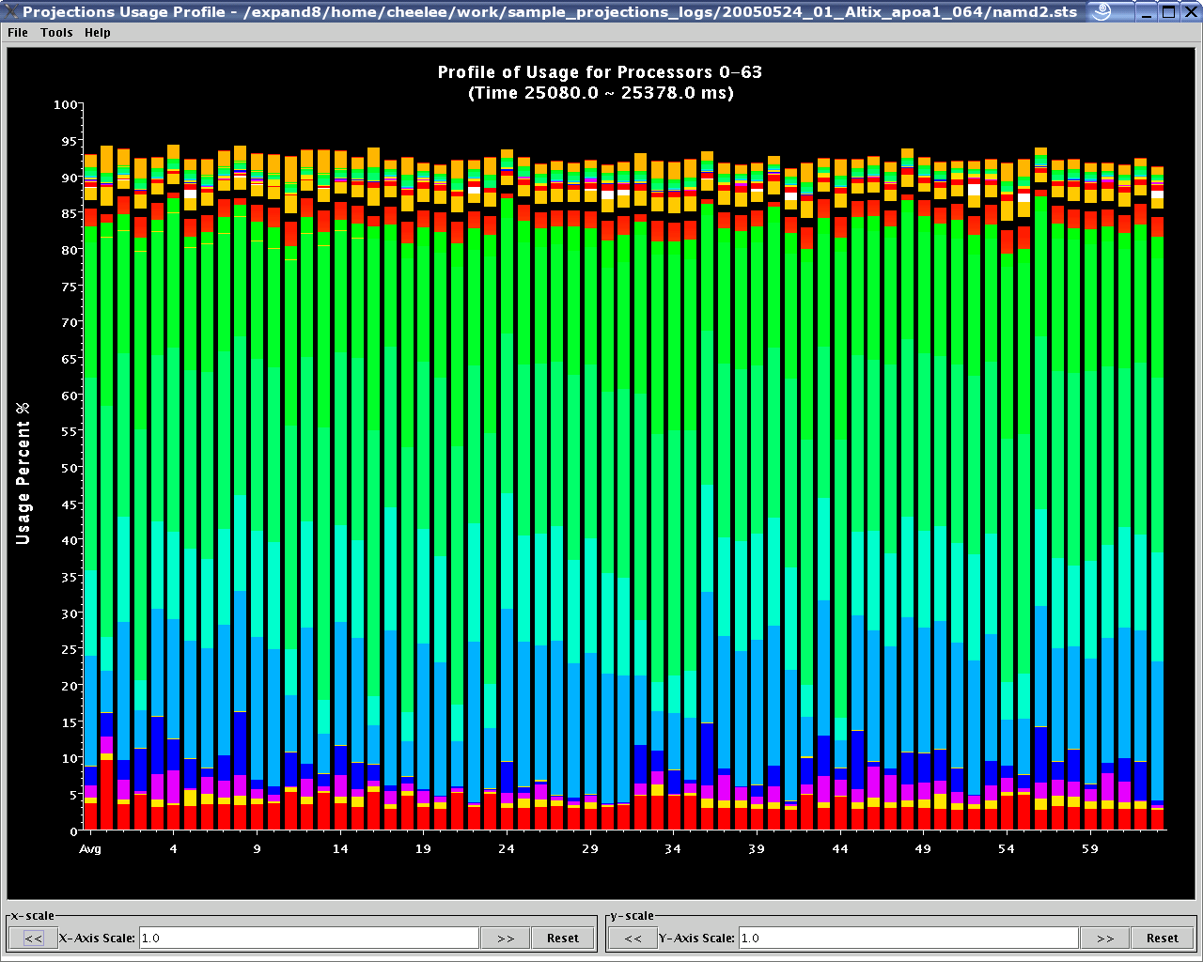
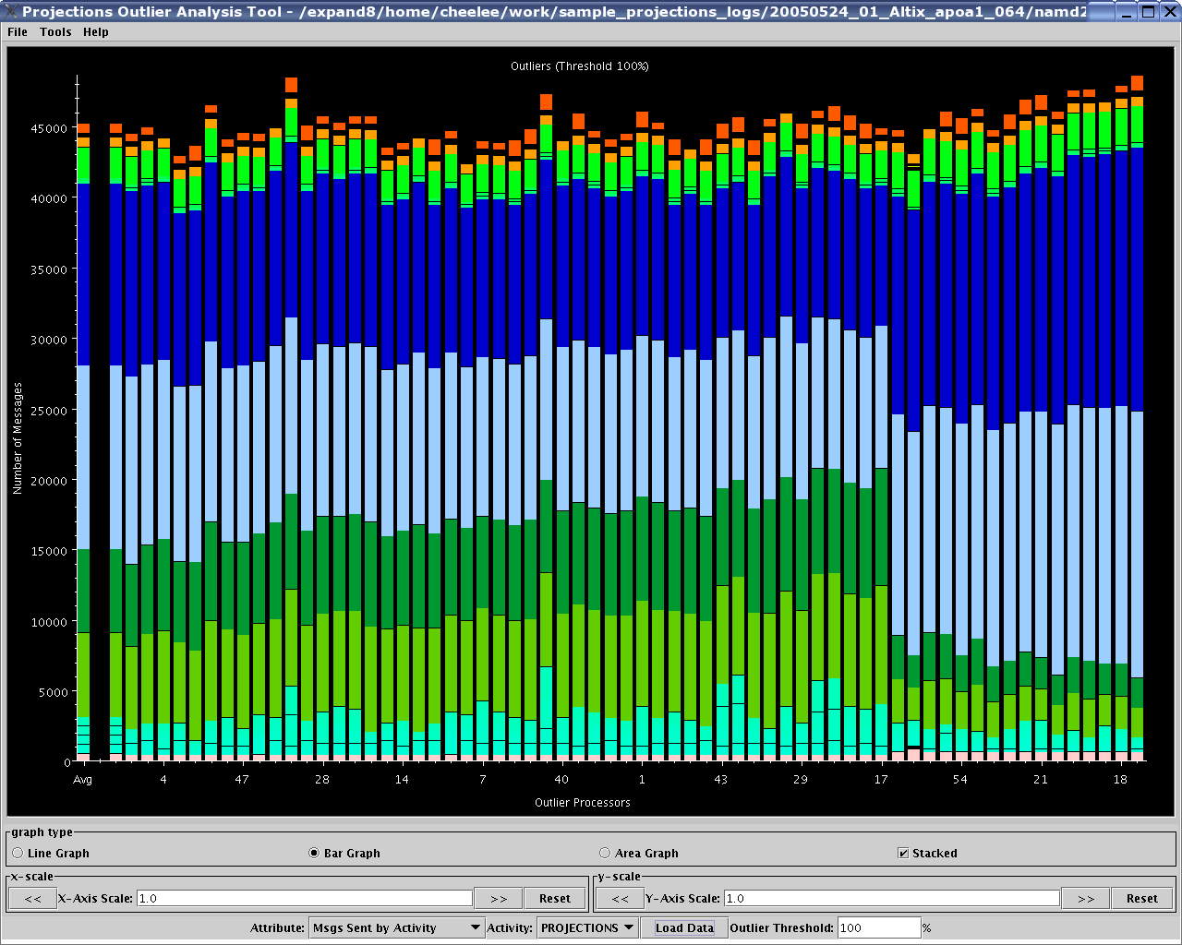
Visualizing Large Datasets
Usage Profile:
Only
64 processors.
What about
thousands?
Projections
Outlier
Analysis Tool:
Sorted by
“deviancy”
Notes:
Mention the pre-release +outlier feature.

Slide 30
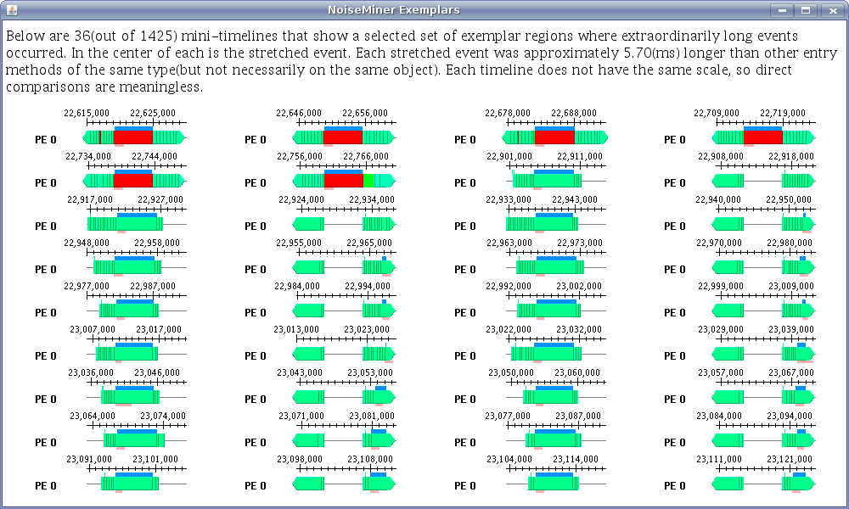
Automatic Analysis Support
Outlier Analysis (previous slide)
Noise Miner

