Slide 1
Load Balancing
Gengbin Zheng

Slide 2
Load Balancing
Goal: higher processor utilization
Object migration allows us to move the work load among processors easily
Measurement-based Load Balancing
Principle of Persistence
Application independent
Two major approaches to distributing work:
Centralized
Distributed

Slide 3
Migration
Array objects can migrate from one processor to another
Migration creates a new object on the destination processor while destroying the original
Need a way of packing an object into a message, then unpacking it on the receiving processor

Slide 4
PUP framework
PUP is a framework for packing and unpacking migratable objects into messages
To migrate, must implement pack/unpack or pup method
Pup method combines 3 functions
Data structure traversal : compute message size, in bytes
Pack : write object into message
Unpack : read object out of message

Slide 5
Writing a PUP Method
Class ShowPup {
double a; int x;
char y; unsigned long z;
float q[3]; int *r; // heap allocated memory
public:
void pup(PUP::er &p) {
if (p.isUnpacking())‏
r = new int[ARRAY_SIZE];
p | a; p |x; p|y // you can use | operator
p(z); p(q, 3) // or ()‏
p(r,ARRAY_SIZE);
}
};
Notes:
The system uses the one pup routine to do both packing and unpacking by passing different types of PUP::ers to it. You can determine what type of PUP::er has been passed to you with the p.isPacking(), p.isUnpacking(), and p.isSizing() methods. The p.isDeleting() method returns true if the pupped object will be deleted after packing.

Slide 6
Load Balancing Strategies
Classified by when it is done:
Initially
Dynamic: Periodically
Dynamic: Continuously
Classified by whether decisions are taken with global information
Fully centralized
Quite good a choice when load balancing period is high
Fully distributed
Each processor knows only about a constant number of neighbors
Extreme case: totally local decision (send work to a random destination processor, with some probability).
Use aggregated global information, and detailed neighborhood info.

Slide 7
The Principle of Persistence
Big Idea: the past predicts the future
Patterns of communication and computation remain nearly constant
By measuring these patterns we can improve our load balancing techniques

Slide 8
Load Balancing Steps
Regular Timesteps
Detailed, aggressive Load Balancing
Time
Instrumented Timesteps
Refinement Load Balancing

Slide 9
Centralized Load Balancing
Uses information about activity on all processors to make load balancing decisions
Advantage: Global information gives higher quality balancing
Disadvantage: Higher communication costs and latency
Algorithms: Greedy, Refine, Recursive Bisection (ORB), Metis

Slide 10
Neighborhood Load Balancing
Load balances among a small set of processors (the neighborhood)
Advantage: Lower communication costs
Disadvantage: Could leave a system which is poorly balanced globally
Algorithms: NeighborLB, WorkstationLB

Slide 11
When to Re-balance Load?
Default: Load balancer will migrate periodically
Programmer Control: AtSync load balancing AtSync method: enable load balancing at specific point
Object ready to migrate
Re-balance if needed
AtSync() called when your chare is ready to be load balanced
load balancing may not start right away
ResumeFromSync() called when load balancing for this chare has finished

Slide 12
Using a Load Balancer
link a LB module
-module <strategy>
RefineLB, NeighborLB, GreedyCommLB, others…
EveryLB will include all load balancing strategies
compile time option (specify default balancer)
-balancer RefineLB
runtime option
+balancer RefineLB

Slide 13
Load Balancing in Jacobi2D
Main:
Setup worker array, pass data to them
Workers:
Start looping
Send messages to all neighbors with ghost rows
Wait for all neighbors to send ghost rows to me
Once they arrive, do the regular Jacobi relaxation
Calculate maximum error, do a reduction to compute
global maximum error
If timestep is a multiple of 64, load balance the
computation. Then restart the loop.
Main:
Setup worker array, pass data to them
Workers:
Start looping
Send messages to all neighbors with ghost rows
Wait for all neighbors to send ghost rows to me
Once they arrive, do the regular Jacobi relaxation
Calculate maximum error, do a reduction to compute
global maximum error
If timestep is a multiple of 64, load balance the
computation. Then restart the loop.
Example is at: charm/tests/charm++/loadbalancing/jacobi2D

Slide 14
Load Balancing in Jacobi2D (cont.)
JacobiChunk::JacobiChunk(void) {
//Initialize other parameters
usesAtSync=CmiTrue;
}
Void JacobiChunk::refine(void){
// do all the jacobi computation
....
contribute(sizeof(float),&maxDelta,CkReduction::max_float);
}
Void JacobiChunk::refine(void){
numIters++;
if(numIters%10==5) AtSync();
else thisProxy.startNextIter();
}
void JacobiChunk::ResumeFromSync(void){
startNextIter();
}

Slide 15
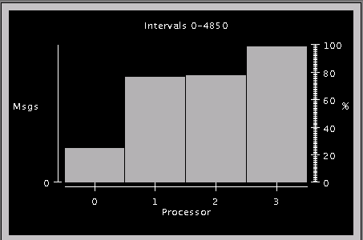
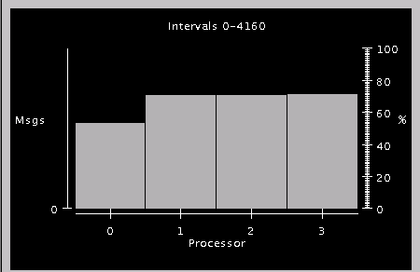
Processor Utilization: After Load Balance
Notes:
Interval 48.5s / 41.6s
Jacobi 2048 (dimension) .1 (threshold) 32 chares 4 processors

Slide 16
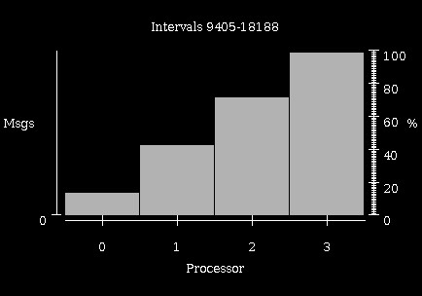
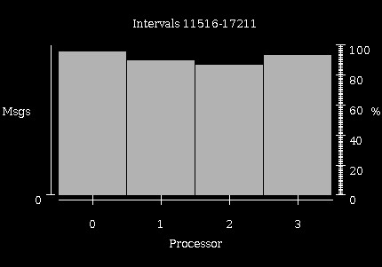
Processor Utilization: After Load Balance
6x6 chunks running on 4 processors
Each chunk is a 64x64 array
Artificial load imbalance

Slide 17
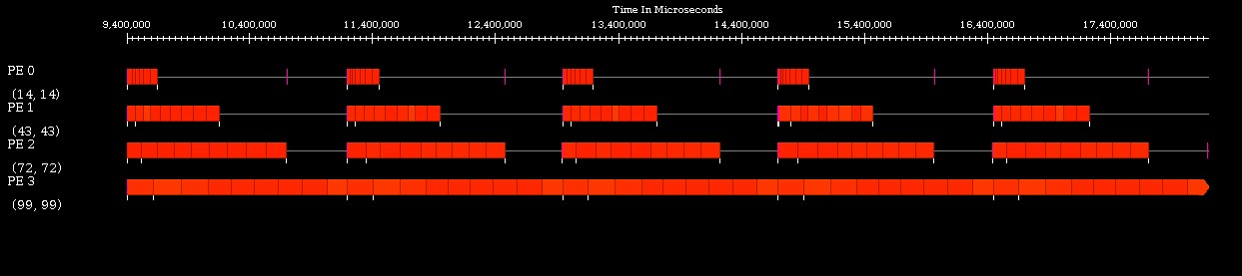
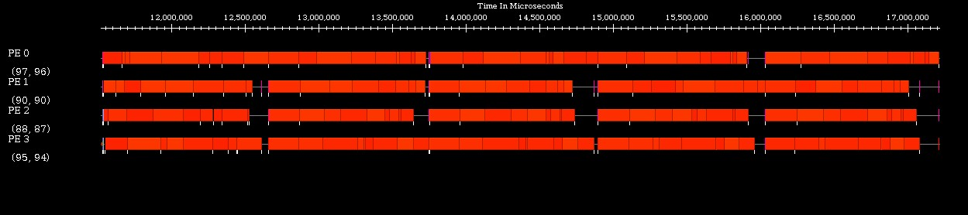
Timelines: Before and After Load Balancing
Notes:
Each chare waits for the others to complete for starting the next step
2 steps take Approx 500 us
2 steps take approx. 300 us

Slide 18
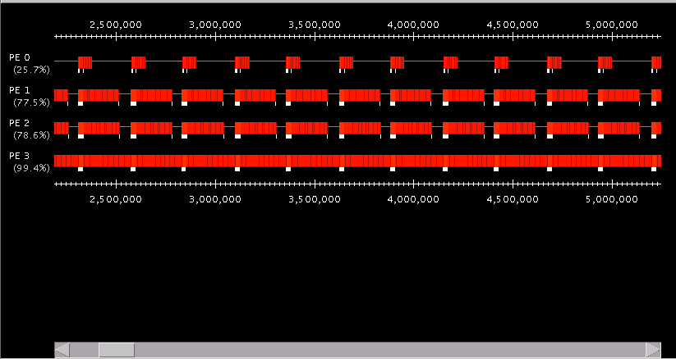
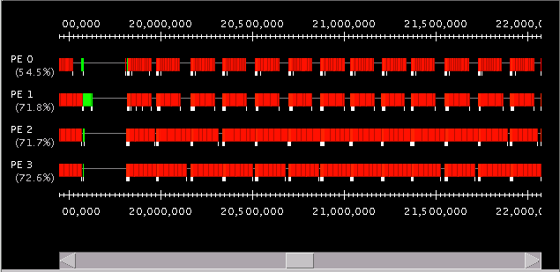
Timelines: Before and After Load Balancing
Notes:
Each chare waits for the others to complete for starting the next step
2 steps take Approx 500 us
2 steps take approx. 300 us

Slide 19
AMPI
Same idea, with MPI extention:
MPI_Migrate()
Migrate stack data:
Isomalloc
Migrate heap data
Isomalloc, or
MPI_Register(void *, MPI_PupFn)
Example at: charm/examples/ampi/Cjacobi3D

