Slide 1


A Multiparadigm Approach to Parallel Programming
Presented by
Aaron Becker, Pritish Jetley, and Phil Miller
11/30/2009

Slide 2
Multiparadigm Computing
A parallel computing paradigm is a way of expressing concurrency in an application
Multiparadigm applications use multiple paradigms together
For example, mixed-mode MPI/OpenMP applications

Slide 3
Some Parallel Paradigms
MPI (Message passing)
OpenMP (Shared memory)
OpenCL (Accelerator)
Charm++ (Message driven)
MapReduce

Slide 4
Not Parallel Paradigms
C++
Object-oriented programming
Clusters

Slide 5
Why Multiparadigm?
Interoperability
Flexibility
Efficiency
Simplicity

Slide 6
Composing Parallel Modules
High-performance, scalable libraries are very valuable.
What if your library
  requires MPI?
  assumes it will run by itself?
  has to coexist with other parallel libraries?

Slide 7
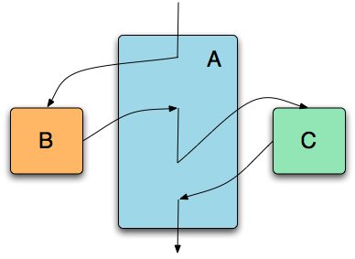
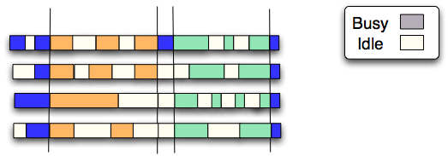


Composing Parallel Modules
Sequentialization

Slide 8
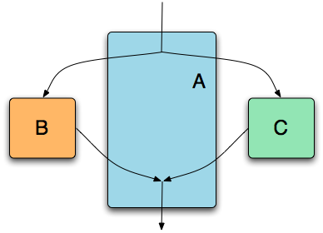
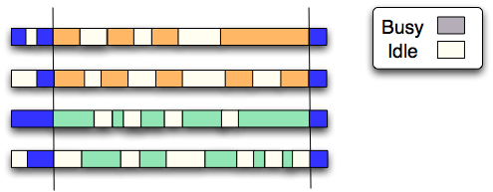
Composing Parallel Modules
Space Division

Slide 9
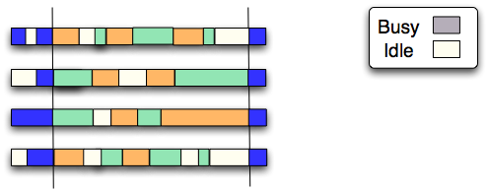
Composing Parallel Modules
Composition
(the Charm++ model)

Slide 10
Benefits of Parallel Composition
Flexibility
  No need to statically allocate hardware resources.
  No artificial synchronization points.
Utilization
  Overlap of idle time from one library with work from another.
  Each library need not scale to the whole machine.

Slide 11
Simplicity
Sometimes you don’t need a fully general programming model
Complete freedom implies the freedom to express all possible incorrect programs

Slide 12
Incomplete Models
Downside:
  some things won’t be expressible

Slide 13
Incomplete Models
Upside:
  some things won’t be expressible

Slide 14
Incomplete Models
Upside:
  stronger safety guarantees
  easier to optimize
  possibility for greater expressiveness

Slide 15
Incomplete Models
Idea: impose restrictions on the programming model in exchange for improved safety or performance.
Use the restricted model where it fits best, and fall back to general-purpose models elsewhere.

Slide 16
Incomplete Models in Charm
Multiphase Shared Arrays
    disciplined shared memory
Charisma
    static data-flow
Tied together with the Charm RTS

Slide 17
Multiphase Shared Arrays (MSA)
An MSA application consists of:
  Multiple computing threads
  Data arrays (MSAs), whose elements are accessible by all threads
  A local cache of MSA data for each thread
C
C
C
C
A
B

Slide 18
MSA Phases
Observation: many shared memory applications can be split into phases.
These phases are part of the algorithm, but aren’t expressed directly in code.

Slide 19
MSA Phases
In MSA, each shared array has explicit phases, e.g.
  Read only
  Exclusive Write
  Accumulate
Synchronization at phase boundaries

Slide 20
Safety Properties
Provably race free
All MSA operations obey phase semantics
All threads accessing an MSA agree on the same sequence of phases

Slide 21
Asynchrony
On remote access, fetch a remote chunk of the array into local cache
While waiting, other work can be scheduled
  With overdecomposition, other MSA threads can work.
  Unrelated chares using other programming models can run, in a multiparadigm application.

Slide 22
Example: Plimpton MD
for timestep = 0 to Tmax {
// Phase I : Force Computation: for a section of the interaction matrix
for i = i_start to i_end
for j = j_start to j_end
if (nbrlist[i][j]) { // nbrlist enters ReadOnly mode
force = calculateForce(coords[i], atominfo[i], coords[j], atominfo[j]);
forces[i] += force; // Accumulate mode
forces[j] += -force;
}
nbrlist.sync(); forces.sync(); coords.sync();
for k = myAtomsbegin to myAtomsEnd // Phase II : Integration
coords[k] = integrate(atominfo[k], forces[k]); // WriteOnly mode
coords.sync(); atominfo.sync(); forces.sync();
if (timestep %8 == 0) { // Phase III: update neighbor list every 8 steps
for i = i_start to i_end
for j = j_start to j_end
nbrList[i][j] = distance( coords[i],coords[j]) < CUTOFF;
nbrList.sync();
}
}

