Slide 1
Programming with Charm++
Laxmikant Kale, Jonathan Lifflander
http://charm.cs.uiuc.edu
Parallel Programming Laboratory
Department of Computer Science
University of Illinois at Urbana Champaign

Slide 2
Motivation, Concepts and Benefits
Before we plunge into the details of programming, let us examine
Why we developed Charm++
What are some of the central ideas
What benefits you get by using Charm++
And so, in what contexts is it especially useful
Specifically:
What is object-based over-decomposition
A bit of a look under the hood: how is it implemented
How Charm++ and AMPI embody this idea
Capabilities of the system: what it automates, supports, ..

Slide 3
Summarizing the State of Art
Petascale
Very powerful parallel computers are being built
Application domains exist that need that kind of power
New generation of applications
Use sophisticated algorithms
Dynamic adaptive refinements
Multi-scale, multi-physics
Challenge:
Parallel programming is more complex than sequential
Difficulty in achieving performance that scales to PetaFLOP/S and beyond
Difficulty in getting correct behavior from programs
Notes:
3

Slide 4
Guiding Principles Behind Charm++
No magic
Parallelizing compilers have achieved close to technical perfection, but are not enough
Sequential programs obscure too much information
Seek an optimal division of labor between the system and the programmer
Design abstractions based solidly on use-cases
Application-oriented yet computer-science centered approach
Notes:
4

Slide 5
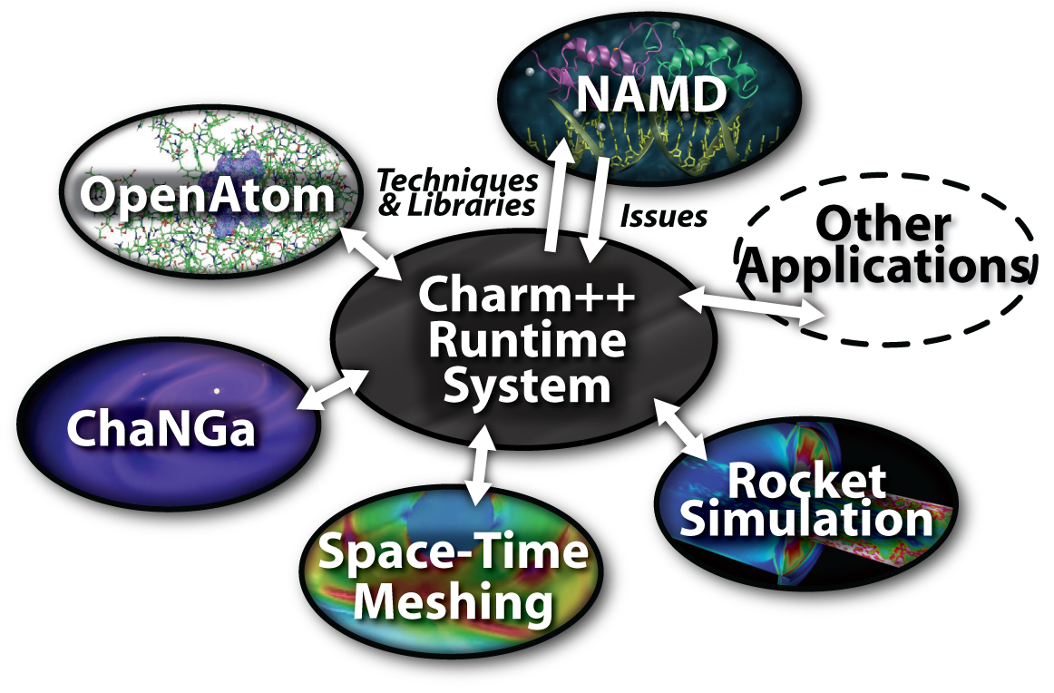
Charm ++ and CSE Applications
Well-known Biophysics molecular simulations App
Gordon Bell Award, 2002
Nano-Materials..
Synergy
Enabling CS technology of parallel objects and intelligent runtime systems has led to several CSE collaborative applications
Computational Astronomy

Slide 6
Object based over-decomposition
Let
the programmer decompose computation into objects
Work units, data-units, composites
Let an intelligent runtime system assign objects to processors
RTS can change this assignment (mapping) during execution
Locality of data references is a critical attribute for performance
A parallel object can access only its own data
Asynchronous method invocation for accessing other’s data

Slide 7
Object-based over-decomposition: Charm++
Multiple “indexed collections” of C++ objects
Indices can be multi-dimensional and/or sparse
Programmer expresses communication between objects
with no reference to processors
System implementation
User View

Slide 8
Object-based over-decomposition: AMPI
Each MPI process is implemented as a user-level thread
Threads are light-weight and migratable!
<1 microsecond context switch time, potentially >100k threads per core
Each thread is embedded in a charm++ object (chare)
MPI processes
Virtual Processors (user-level migratable threads)
Real Processors

Slide 9
Benefits of the Charm model: outline
Software engineering
Number of virtual processors can be independently controlled
Separate VPs for different modules
Message driven execution
Adaptive overlap of communication
Predictability :
Automatic out-of-core
Prefetch to local stores
Asynchronous reductions
Dynamic mapping
Heterogeneous clusters: Vacate, adjust to speed, share
Automatic checkpointing
Change set of processors used
Automatic dynamic load balancing
Communication optimization
Fault Tolerance

Slide 10
Parallel Decomposition and Processors
MPI-style encourages
Decomposition into P pieces, where P is the number of physical processors available
If your natural decomposition is a cube, then the number of processors must be a cube
…
Charm++/AMPI style “virtual processors”
Decompose into natural objects of the application
Let the runtime map them to processors
Decouple decomposition from load balancing

Slide 11
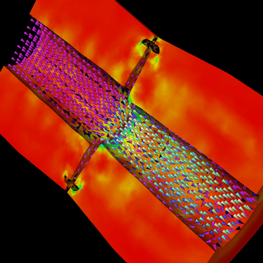
Decomposition independent of numCores
Rocket simulation example under traditional MPI vs. Charm++/AMPI framework
Benefit: load balance, communication optimizations, modularity
Solid
Solid
. . .
Solid
Fluid
Fluid
Fluid
1 2 P
Solid₁
Solid₂
Solid₃
. . .
Solid_{n}
Fluid₁
Fluid₂
. . .
Fluid_{m}
Notes:
11
In traditional MPI paradigm. The number of partitions of both modules is typically equal to the number of processor P
And although the i’th elements of fluid module and solid module are not connected geometrically in the simulation, they are glued together on the I’th processor.
Under Charm++/AMPI framework, the two modules each get their own set of parallel objects. And the size of the arrays are not restricted or related.
The benefit of this is performance optimizations and better modularity.
Problem: due to the asynchronous method invocation, the flow of control is buried deep into the object code

Slide 12
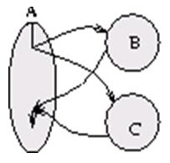
Parallel Composition: A1; (B || C ); A2
Recall: Different modules, written in different languages/paradigms, can overlap in time and on processors, without programmer having to worry about this explicitly

Slide 13
Without message-driven execution (and virtualization), you get either:
Space-division

Slide 14
OR: Sequentialization

Slide 15
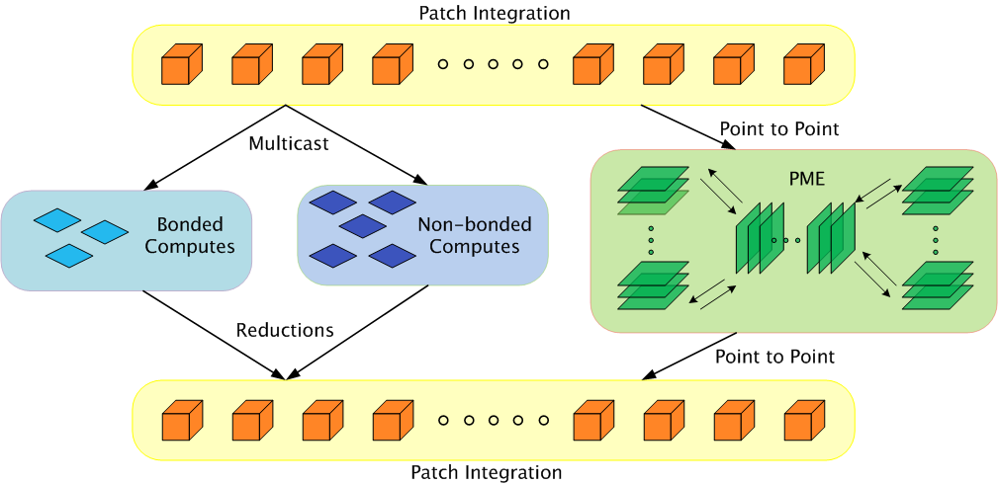
Parallelization using Charm++
Bhatele, A., Kumar, S., Mei, C., Phillips, J. C., Zheng, G. & Kale, L. V. 2008 Overcoming Scaling Challenges in Biomolecular Simulations across Multiple Platforms. In Proceedings of IEEE International Parallel and Distributed Processing Symposium, Miami, FL, USA, April 2008.

Slide 16
Performance of NAMD
Blue Gene results based on work on DCMF many-to-many pattern by Sameer Kumar, IBM Research
STMV: ~1 million atoms
Time (ms per step)
ApoA1: ~92K atoms
No. of cores

Slide 17
Message-driven execution
Adaptively and automatically overlaps communication and computation
Also, You can predict data access
You can peak ahead at the Queue
Can use to scale memory wall:
Prefetching of needed data:
into scratch pad memories, for example
Automatic Out-of-core execution
Scheduler
Scheduler
Message Q
Message Q

Slide 18
Automatic Dynamic Load Balancing
Measurement based load balancers:
Principle of persistence: In many CSE applications, computational loads and communication patterns tend to persist, even in dynamic computations
So, recent past is a good predictor of near future
Charm++ provides a suite of load-balancers:
periodic measurement and migration of objects
Seed balancers (for task-parallelism)
Useful for divide-and-conquer and state-space-search applications
Seeds for charm++ objects moved around until they take root

Slide 19
Fault Tolerance
Automatic Checkpointing
Migrate objects to disk
In-memory checkpointing as an option
Automatic fault detection and restart
“Impending Fault” Response
Migrate objects to other processors
Adjust processor-level parallel data structures
Experimental feature:
Scalable fault tolerance
When a processor out of 100,000 fails, all 99,999 shouldn’t have to run back to their checkpoints!
Sender-side message logging
Latency tolerance helps mitigate costs
Restart can be speeded up by spreading out objects from failed processor

Slide 20
How to tune performance for a future machine?
For example, Blue Waters will arrive in 2011
But need to prepare applications for it stating now
Even for extant machines:
Full size machine may not be available as often as needed for tuning runs
Our Approach: BigSim
Full scale Emulation, leveraging virtualization
Trace driven Simulation

