Slide 1
Outline
Introduction
Object Design
Execution Model
Hello World
Benefits of Charm++
Charm++ Basics
Object Collections
Overdecomposition
Migratability
Checkpointing and Resilience
Structured Dagger
Application Design
Performance Tuning
Using Dynamic Load Balancing
Interoperability
Debugging
Further Optimization

Slide 2
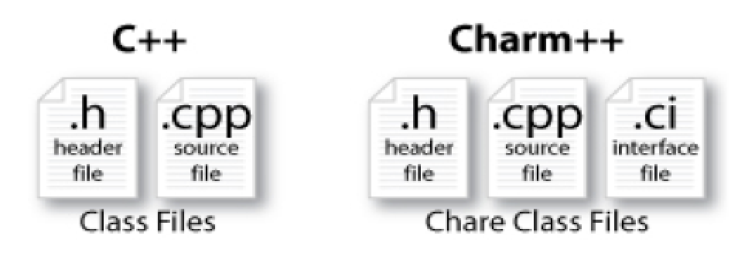
Charm++ File structure
C++ objects (including Charm++ objects)
Defined in regular .h and .C files
Chare objects, entry methods (asynchronous methods)
Defined in .ci file
Implemented in the .C file

Slide 3
Charm Interface: Modules
Charm++ programs are organized as a collection of modules
Each module has one or more chares
The module that contains the mainchare, is declared as the mainmodule
Each module, when compiled, generates two files:
MyModule.decl.h and MyModule.def.h
.ci file
[main]module MyModule {
//... chare definitions ...
};

Slide 4
Charm Interface: Chares
Chares are parallel objects that are managed by the RTS
Each chare has a set entry methods, which are asynchronous methods that may be invoked remotely
The following code, when compiled, generates a C++ class CBase_MyChare that encapsulates the RTS object
This generated class is extended and implemented in the .C file
.ci file
[main]chare MyChare {
//... entry method definitions ...
};
.C file
class MyChare : public CBase MyChare {
//... entry method implementations ...
};

Slide 5
Charm Interface: Entry Methods
Entry methods are C++ methods that can be remotely and asynchronously invoked by another chare
.ci file
entry MyChare(); /∗ constructor entry method ∗/
entry void foo();
entry void bar(int param);
.C file
MyChare::MyChare() { /∗... constructor code ...∗/ }
MyChare::foo() { /∗... code to execute ...∗/ }
MyChare::bar(int param) { /∗... code to execute ...∗/ }

Slide 6
Charm Interface: mainchare
Execution begins with the mainchare’s constructor
The mainchare’s constructor takes a pointer to system-defined class CkArgMsg
CkArgMsg contains argv and argc
The mainchare will typically creates some additional chares

Slide 7
Creating a Chare
A chare declared as chare MyChare {...}; can be instantiated by the following call:
CProxy_MyChare::ckNew(... constructor arguments ...);
To communicate with this class in the future, a proxy to it must be retained
CProxy_MyChare proxy =
CProxy_MyChare::ckNew(... constructor arguments ...);

Slide 8
Chare Proxies
A chare’s own proxy can be obtained through a special variable thisProxy
Chare proxies can also be passed so chares can learn about others
In this snippet, MyChare learns about a chare instance main , and then invokes a method on it:
.ci file
entry void foobar2(CProxy_Main main);
.C file
MyChare::foobar2(CProxy_Main main) {
main.foo();
}

Slide 9
Charm Termination
There is a special system call CkExit() that terminates the parallel execution on all processors (but it is called on one processor) and performs the requisite cleanup
The traditional exit() is insufficient because it only terminates one process, not the entire parallel job (and will cause a hang)
CkExit() should be called when you can safely terminate the application (you may want to synchronize before calling this)

Slide 10
Chare Creation Example: .ci file
mainmodule MyModule {
mainchare Main {
entry Main(CkArgMsg ∗m);
};
chare Simple {
entry Simple(int x, double y);
};
};

Slide 11
Chare Creation Example: .C file
#include <stdio.h>
#include ”MyModule.decl.h”
class Main : public CBase_Main {
public: Main(CkArgMsg∗ m) {
ckout << ”Hello World!” << endl;
if (m->argc > 1) ckout << “Hello” << m->argv[1] << “!!!” << endl;
double pi = 3.1415;
CProxy_Simple::ckNew(12, pi);
};
};
class Simple : public CBase_Simple {
public: Simple(int x, double y) {
ckout << “ Hello from a simple chare running on ” << CkMyPe() << endl;
ckout << “ Area of a circle of radius” << x << “ is ” << y*x*x << endl;
CkExit();
};
};
#include “MyModule.def.h”

Slide 12
Asynchronous Methods
Entry methods are invoked by performing a C++ method call on a chare’s proxy
CProxy MyChare proxy =
CProxy MyChare::ckNew(... constructor arguments ...);
proxy.foo();
proxy.bar(5);
The foo and bar methods will then be executed with the arguments, wherever the created chare, MyChare, happens to live
The policy is one-at-a-time scheduling (that is, one entry method on one chare executes on a processor at a time)

Slide 13
Asynchronous Methods
Method invocation is not ordered (between chares, entry methods on one chare, etc.)!
For example, if a chare executes this code:
CProxy_MyChare proxy = CProxy_MyChare::ckNew(); proxy.foo();
proxy.bar(5);
These prints may occur in any order
MyChare::foo() {
ckout << ”foo executes” << endl;
}
MyChare::bar(int param) {
ckout << ”bar executes with ” << param << endl;
}

Slide 14
Asynchronous Methods
For example, if a chare invokes the same entry method twice:
proxy.bar(7);
proxy.bar(5);
These may be delivered in any order
MyChare::bar(int param) {
ckout << “bar executes with ” << param << endl;
}
Output
OR
bar executes with 5
bar executes with 7
bar executes with 7
bar executes with 5

Slide 15
Asynchronous Example: .ci file
mainmodule MyModule {
mainchare Main {
entry Main(CkArgMsg ∗m);
};
chare Simple {
entry Simple(double y);
entry void findArea(int radius, bool done);
};
};

Slide 16
Asynchronous Example: .C file
Does this program execute correctly?
struct Main : public CBase_Main {
Main(CkArgMsg∗ m) {
double pi = 3.1415;
CProxy_Simple sim = CProxy_Simple::ckNew(pi);
for (int i = 1; i < 10; i++) sim.findArea(i, false);
sim.findArea(10, true);
};
};
struct Simple : public CBase Simple {
float y;
Simple(double pi) {
y = pi;
ckout << “Hello from a simple chare running on ” << CkMyPe() << endl;
}
void findArea(int r, bool done) {
ckout << ”Area of a circle of radius” << r << ” is ” << y∗r∗r << endl;
if (done) CkExit();
}

Slide 17
Data types and entry methods
You can pass basic C++ types to entry methods (int, char, bool, etc.)
C++ STL data structures can be passed by including pup_stl.h
Arrays of basic data types can also be passed like this:
.ci file:
entry void foobar(int length, int data[length]);
.C file
MyChare::foobar(int length, int∗ data) {
// ... foobar code ...
}

Slide 18
Collections of Objects: Concepts
Objects can be grouped into indexed collections
Basic examples
Matrix block
Chunk of unstructured mesh
Portion of distributed data structure
Volume of simulation space
Advanced Examples
Abstract portions of computation
Interactions among basic objects or underlying entities

Slide 19
Collections of Objects
Structured: 1D, 2D, . . . , 6D
Unstructured: Anything hashable
Dense
Sparse
Static - all created at once
Dynamic - elements come and go

Slide 20
Chare Array: Hello Example
mainmodule arr {
mainchare Main {
entry Main(CkArgMsg∗);
}
array [1D] hello {
entry hello(int);
entry void printHello();
}
}

Slide 21
Chare Array: Hello Example
#include “arr.decl.h”
struct Main : CBase_Main {
Main(CkArgMsg∗ msg) {
int arraySize = atoi(msg->argv[1]);
CProxy_hello p = CProxy_hello::ckNew(arraySize);
p[0].printHello();
}
};
struct hello : CBase_hello {
hello(int n) : arraySize(n) { }
hello(CkMigrateMessage*) { }
void printHello() {
CkPrintf(“PE[%d]: hello from p[%d]\n”, CkMyPe(), thisIndex);
if (thisIndex == arraySize – 1) CkExit();
else thisProxy[thisIndex + 1].printHello();
};
private:
int arraySize;
};
#include “arr.def.h”

Slide 22
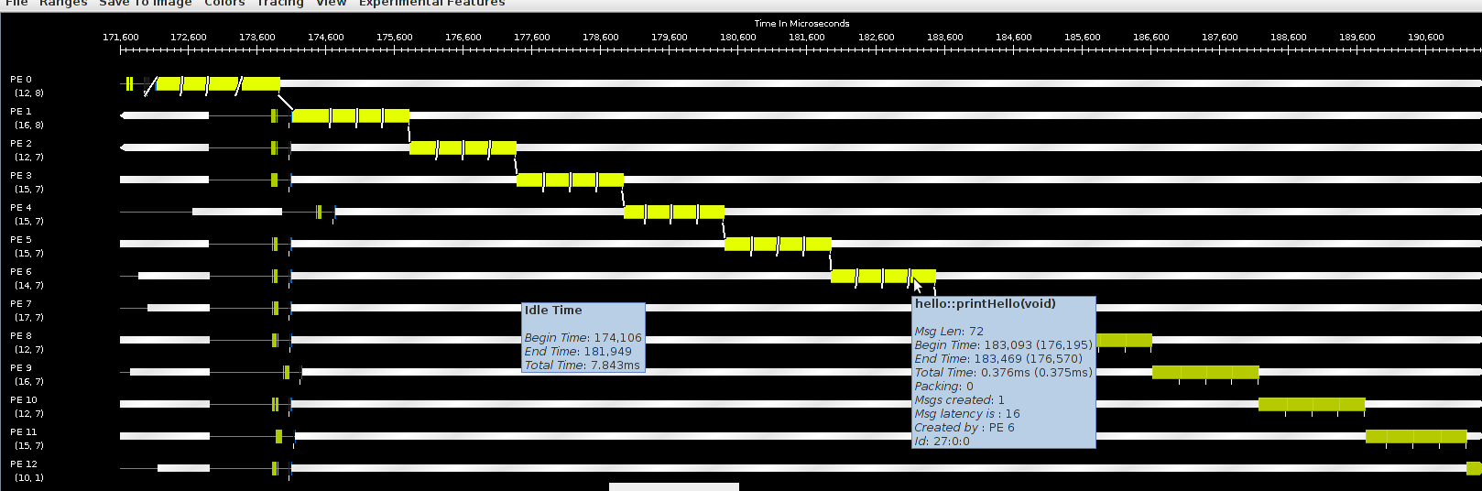
Hello World Array Projections Timeline View
Add -tracemode projections to link line to enable tracing
Run Projections tool to load trace log files and visualize performance
arrayHello on BG/Q 16 Nodes, mode c16, 1024 elements (4 per process)

Slide 23
Declaring a Chare Array
.ci file:
array [1d] foo {
entry foo(); // constructor
// ... entry methods ...
}
array [2d] bar {
entry bar(); // constructor
// ... entry methods ...
}
.C file:
struct foo : public CBase_foo {
foo() { }
foo(CkMigrateMessage∗) { }
// ... entry methods …
};
struct bar : public CBase_bar {
bar() { }
bar(CkMigrateMessage∗) { }

Slide 24
Constructing a Chare Array
Constructed much like a regular chare
The size of each dimension is passed to the constructor
void someMethod() {
CProxy_foo::ckNew(10);
CProxy_bar::ckNew(5, 5);
}
The proxy may be retained:
CProxy_foo myFoo = CProxy_foo::ckNew(10);
The proxy represents the entire array, and may be indexed to obtain a proxy to an individual element in the array
myFoo[4].invokeEntry();

Slide 25
thisIndex
1d: thisIndex returns the index of the current chare array element
2d: thisIndex.x and thisIndex.y return the indices of the current chare array element
.ci file:
array [1d] foo {
entry foo();
}
.C file:
struct foo : public CBase_foo {
foo() {
CkPrintf(“array index = %d”, thisIndex);
}
};

Slide 26
Chare Array: Hello Example
mainmodule arr {
mainchare Main {
entry Main(CkArgMsg∗);
}
array [1D] hello {
entry hello(int);
entry void printHello();
}
}

Slide 27
Chare Array: Hello Example
#include “arr.decl.h”
struct Main : CBase_Main {
Main(CkArgMsg∗ msg) {
int arraySize = atoi(msg->argv[1]);
CProxy_hello p = CProxy_hello::ckNew(arraySize);
p[0].printHello();
}
};
struct hello : CBase_hello {
hello(int n) : arraySize(n) { }
hello(CkMigrateMessage*) { }
void printHello() {
CkPrintf(“PE[%d]: hello from p[%d]\n”, CkMyPe(), thisIndex);
if (thisIndex == arraySize – 1) CkExit();
else thisProxy[thisIndex + 1].printHello();
}
private:
int arraySize;
};
#include “arr.def.h”

Slide 28
Hello World Array Projections Timeline View
Add -tracemode projections to link line to enable tracing
Run Projections tool to load trace log files and visualize performance
arrayHello on BG/Q 16 Nodes, mode c16, 1024 elements (4 per process)

Slide 29
Collections of Objects: Runtime Service
System knows how to ‘find’ objects efficiently: (collection, index) → processor
Applications can specify a mapping or use simple runtime-provided options (e.g. blocked, round-robin)
Distribution can be static or dynamic!
Key abstraction: application logic doesn’t change, even though performance might

Slide 30
Collections of Objects: Runtime Service
Can develop and test logic in objects separately from their distribution
Separation in time: make it work, then make it fast
Division of labor: domain specialist writes object code, computationalist writes mapping
Portability: different mappings for dfferent systems, scales, or configurations
Shared progress: improved mapping techniques can benefit existing code

Slide 31
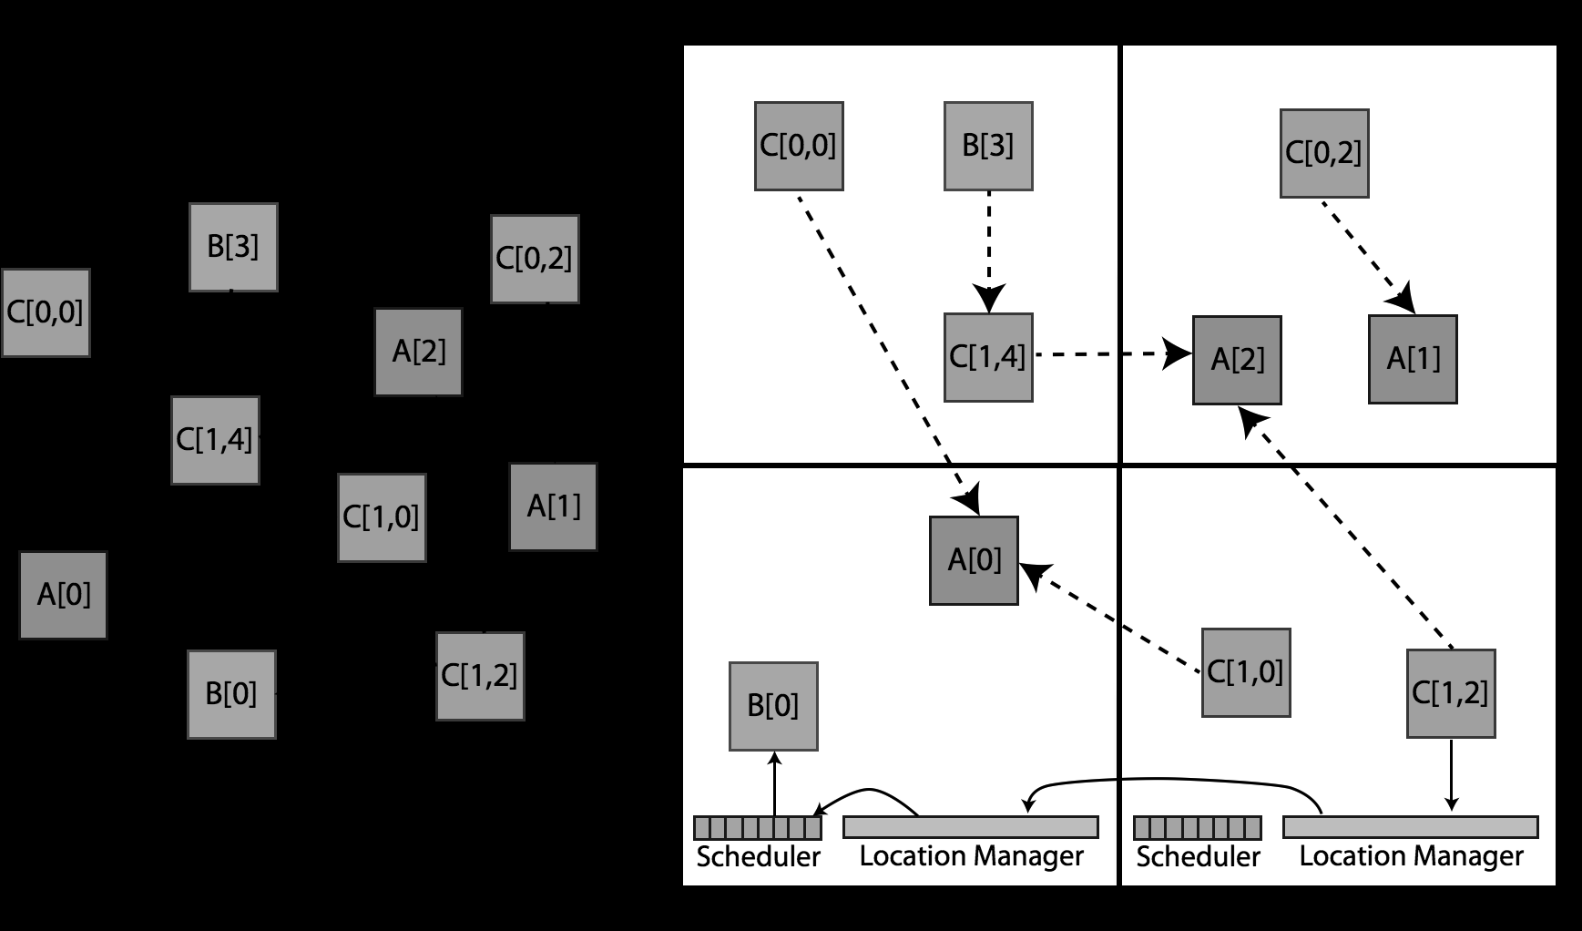
Collections of Objects

Slide 32
Collective Communication Operations
Point-to-point operations involve only two objects
Collective operations that involve a collection of objects
Broadcast: calls a method in each object of the array
Reduction: collects a contribution from each object of the array
A spanning tree is used to send/receive data

Slide 33
Broadcast
A message to each object in a collection
The chare array proxy object is used to perform a broadcast
It looks like a function call to the proxy object
From the main chare:
CProxy_Hello helloArray = CProxy_Hello::ckNew(helloArraySize);
helloArray.foo();
From a chare array element that is a member of the same array:
thisProxy.foo()
From any chare that has a proxy p to the chare array
p.foo()

Slide 34
Reduction
Combines a set of values: sum, max, aggregate
Usually reduces the set of values to a single value
Combination of values requires an operator
The operator must be commutative and associative
Each object calls contribute in a reduction

Slide 35
Reduction: Example
mainmodule reduction {
mainchare Main {
entry Main(CkArgMsg∗ msg);
entry [reductiontarget] void done(int value);
};
array [1D] Elem {
entry Elem(CProxy_Main mProxy);
};
}

Slide 36
Reduction: Example
#include “reduction.decl.h”
const int numElements = 49;
class Main : public CBase_Main {
public:
Main(CkArgMsg∗ msg) { CProxy_Elem::ckNew(thisProxy, numElements); }
void done(int value) {
CkAssert(value == numElements ∗ (numElements – 1) / 2);
CkPrintf(”value: %d\n”, value); CkExit();
}
};
class Elem : public CBase Elem {
public:
Elem(CProxy_Main mProxy) { int val = thisIndex; CkCallback cb(CkReductionTarget(Main, done), mProxy);
contribute(sizeof(int), &val, CkReduction::sum_int, cb);
}
Elem(CkMigrateMessage∗) { }
};
#include ”reduction.def.h”
Output:
value: 1176
Program finished.

