Slide 1
Programming with Parallel Migratable Objects
Sanjay Kalé and PPL
Parallel Programming Laboratory
University of Illinois at Urbana-Champaign

Slide 2
Manual: http://charm.cs.illinois.edu/manuals/html/charm++/manual.html
Installation: http://charm.cs.illinois.edu/manuals/html/charm++/A.html

Slide 3
Outline
Introduction
Object Design
Execution Model
Hello World
Benefits of Charm++
Charm++ Basics
Object Collections
Overdecomposition
Migratability
Checkpointing and Resilience
Structured Dagger
Application Design
Performance Tuning
Using Dynamic Load Balancing
Interoperability
Debugging
Further Optimization

Slide 4
Harnessing Parallelism: Challenges Trends in System Architecture
Frequencies have stopped increasing
Memory costs are high
Relatively low per-core memory
Increasing heterogeneity
Accelerators, SMT
Energy, power, and thermal considerations
Frequent component failures

Slide 5
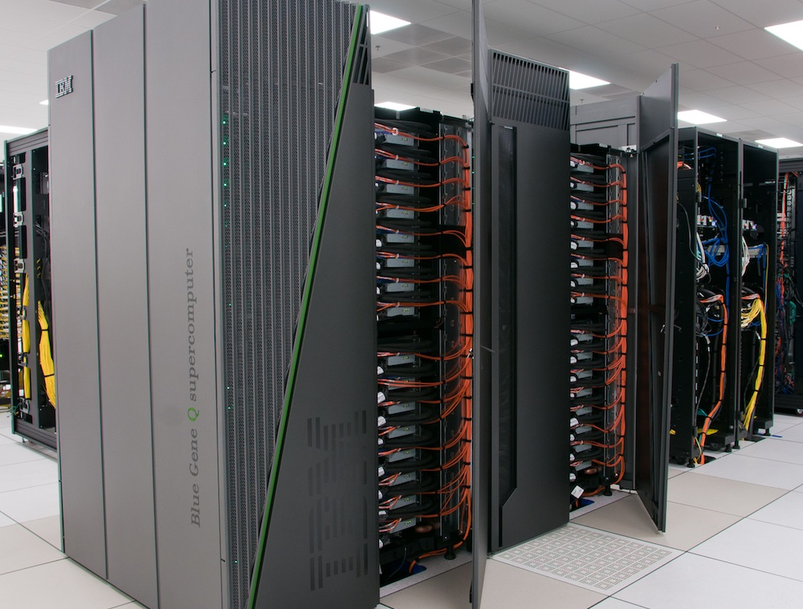
Harnessing Parallelism: Challenges Trends in System Architecture
However, compute resources are not faster cores, but more cores
Unprecedented levels of available concurrency
IBM BG/Q
‘Sequoia’: 1,572,864 cores
Cray
XE6+XK6 ‘BlueWaters‘: 386,816 cores
XK6 ‘Titan’: 299,008 cores
K Supercomputer: 705,024 cores
Mid-size clusters will be ubiquitous
Implications
Each thread of execution has to:
Operate on lesser data
Wait relatively longer for remote data
Have to operate in strong scaling regime

Slide 6
Harnessing Parallelism: Challenges Next-generation Applications
Need for strong scaling
Faster solutions (not just larger problems)
Application Characteristics
Multi-resolution
Adaptive, spatial and temporal resolutions
Dynamic/adaptive refinements: to handle application variation
Multi-module (multi-physics)
Complex physics in multiple, interacting modules
Adapt to a volatile computational environment
Exploit heterogeneous architecture
Deal with thermal and energy considerations
So? Consequences:
Must support automated resource management
Must support interoperability and parallel composition

Slide 7
Harnessing Parallelism: Challenges Programming Models: MPI
Highly successful
Universally used
Has supported application evolution from gigascale to petascale
Library
Communication primitives
MPI does not directly support automated resource management (e.g. load balancing, fault tolerance, etc.)

Slide 8
Programming Models: What is Charm++?
Charm++ is a generalized approach to writing parallel programs
An alternative to the likes of MPI, UPC, GA etc.
But not to sequential languages such as C, C++, and Fortran
Charm++ builds upon a proven approach: objects
Identify the entities being simulated (say atoms, routers, humans)
Define the computational tasks being performed (e.g. force computation)
Create C++ classes to encapsulate them
Use member functions to interact
What about processors? Do you really want to worry about them?

Slide 9
Stuff you already know Benefits of Object-based code
Objects encapsulate data
Methods represent functionality relevant to that data
Method invocations can modify / update state of the object / data
Computation can be expressed in terms of objects interacting via method invocations
Methods are natural units of sequential computation on object data
Thoughtful design yields focused methods with single purpose
Naturally expresses an object’s response to inputs (signals / data)
Nothing new
Still quite uncommon in HPC code
Its not about language syntax. Its about program structure

Slide 10
Globally-Visible Objects: Chares and Proxies
2
8
4
Parallel Address Space
6
F
C
E
G
B
D
H
A
0
3
7
5
9
1
Certain “special” object instances are:
first-class citizens in the parallel address space,
with unique location-independent names
Under the hood, the runtime handles locality and provides the mechanisms to promote objects to the parallel space

Slide 11
Globally-Visible Methods: Entry Methods
Parallel Address Space
F.m4()
E.m1()
G
F
C
E.m3()
E
G.m2()
B.m2()
B
D
H.m2()
A
H
How can objects communicate across address spaces?
Just like a sequential object-oriented language, an object’s reference is used to invoke a method
In the parallel space, this is a handle that is location transparent
A method invocation becomes an act of communication

Slide 12
Method-Driven Asynchronous Communication
What happens if an object waits for a return value from a method invocation?
Performance
Latency
Reasoning about correctness

Slide 13
Design Principle: Do not wait for remote completion
Hence, method invocations should be asynchronous
No return values
Computations are driven by the incoming data
Initiated by the sender or method caller

Slide 14
For example, a Jacobi reduction

Slide 15
Methods: Natural Units of Sequential Computation
Methods still have the same sequential semantics
Atomicity: methods do not execute in parallel
Methods cannot be interrupted or preempted
Methods interact and update state of an object in the same way
Method sequencing is what changes from sequential computation

Slide 16
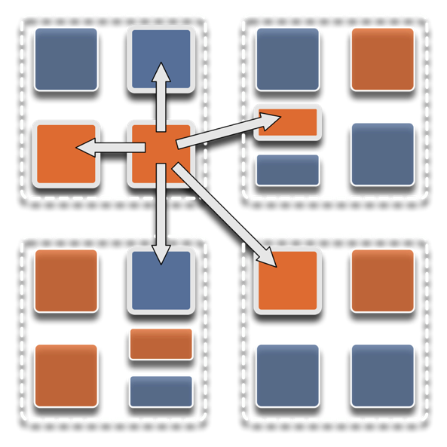
Overdecomposition
Decompose the work units & data units into many more pieces (chares) than execution units
Cores/Nodes/..
Not so hard: we do decomposition anyway

Slide 17
Migratability
Allow chares to be migratable at runtime
i.e. the programmer or runtime, can move them
Consequences for the app-developer
Communication must be addressed to logical units with global names, not to physical processors
But this is a good thing
Consequences for RTS
Must keep track of where each chare is
Naming and location management

Slide 18
The Execution Model
Several chares live on a single PE
For now, think of it as a core (or just “processor”)
As a result,
Method invocations directed at chares on that processor will have to be stored in a pool,
And a user-level scheduler will select one invocation from the queue and runs it to completion
A PE is the entity that has one scheduler instance associated with it
Execution is triggered by availability of a “message” (a method invocation)
When an entry method executes,
it may generate messages for other chares
the RTS deposits them in the message Q on the target processor
Notes:
Made image from slides from presentation I made with these objects: loadBalancingBasics_SMD.pptx

Slide 19
The Execution Model
A[..].foo(…)
Processor 0
Processor 1
Scheduler
Scheduler
Message Queue
Message Queue
Notes:
Made image from slides from presentation I made with these objects: loadBalancingBasics_SMD.pptx

Slide 20
Processor 0
Processor 1
Scheduler
Scheduler
Message Queue
Message Queue
Processor 2
Processor 3
Scheduler
Scheduler
Message Queue
Message Queue
Notes:
Made image from slides from presentation I made with these objects: loadBalancingBasics_SMD.pptx

Slide 21
Processor 0
Processor 1
Scheduler
Scheduler
Message Queue
Message Queue
Processor 2
Processor 3
Scheduler
Scheduler
Message Queue
Message Queue
Notes:
Made image from slides from presentation I made with these objects: loadBalancingBasics_SMD.pptx

Slide 22
Processor 0
Processor 1
Scheduler
Scheduler
Message Queue
Message Queue
Processor 2
Processor 3
Scheduler
Scheduler
Message Queue
Message Queue
Notes:
Made image from slides from presentation I made with these objects: loadBalancingBasics_SMD.pptx

Slide 23
Empowering the RTS
Adaptive
Runtime System
Introspection
Adaptivity
Asynchrony
Overdecomposition
Migratability
The Adaptive RTS can:
Dynamically balance loads
Optimize communication:
Spread over time, async collectives
Automatic latency tolerance
Prefetch data with almost perfect predictability
Notes:
Made image from slides from presentation I made with these objects: loadBalancingBasics_SMD.pptx

