Slide 1
Migratable Objects and Task-Based Parallel Programming with Charm++

Slide 2
Challenges in Parallel Programming
Applications are getting more sophisticated
Adaptive refinement
Multi-scale, multi-module, multi-physics
E.g. load imbalance emerges as a huge problem for some apps
Exacerbated by strong scaling needs from apps
Strong scaling: run an application with same input data on more processors, and get better speedups
Weak scaling: larger datasets on more processors in the same time
Hardware variability
Static/dynamic
Heterogeneity: processor types, process variation, etc.
Power/Temperature/Energy
Component failure

Slide 3
Our View
To deal with these challenges, we must seek:
Not full automation
Not full burden on app-developers
But: a good division of labor between the system and app developers
Programmer: what to do in parallel, System: where,when
Develop language driven by needs of real applications
Avoid “platonic” pursuit of “beautiful” ideas
Co-developed with NAMD, ChaNGa, OpenAtom,..
Pragmatic focus
Ground-up development, portability,
accessibility for a broad user base

Slide 4
What is Charm++?
Charm++ is a generalized approach to writing parallel programs
An alternative to the likes of MPI, UPC, GA etc.
But not to sequential languages such as C, C++, and Fortran
Represents:
The style of writing parallel programs
The runtime system
And the entire ecosystem that surrounds it
Three design principles:
Overdecomposition, Migratability, Asynchrony

Slide 5
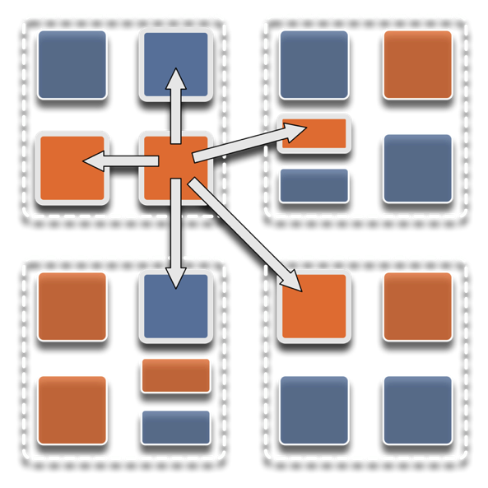
Overdecomposition
Decompose the work units & data units into many more pieces than execution units
Cores/Nodes/…
Not so hard: we do decomposition anyway

Slide 6
Migratability
Allow these work and data units to be migratable at runtime
i.e. the programmer or runtime can move them
Consequences for the application developer
Communication must now be addressed to logical units with global names, not to physical processors
But this is a good thing
Consequences for RTS
Must keep track of where each unit is
Naming and location management

Slide 7
Asynchrony: Message-Driven Execution
With over-decomposition and migratability:
You have multiple units on each processor
They address each other via logical names
Need for scheduling:
What sequence should the work units execute in?
One answer: let the programmer sequence them
Seen in current codes, e.g. some AMR frameworks
Message-driven execution:
Let the work-unit that happens to have data (“message”) available for it execute next
Let the RTS select among ready work units
Programmer should not specify what executes next, but can influence it via priorities

Slide 8
Key Ideas in our parallel programming model
Let the programmer decide what to do in parallel
Express decomposition, interactions
Let the system decide where and when
How: virtualize the notion of a processor
So as to automate resource management and associated functionalities
The migratable objects programming model
Charm++ is one of the (first/foundational) programming system within this model

Slide 9
Realization of This Model in Charm++
Overdecomposed entities: chares
Chares are C++ objects
With methods designated as “entry” methods
Which can be invoked asynchronously by remote chares
Chares are organized into indexed collections
Each collection may have its own indexing scheme
1D, ..., 6D
Sparse
Bitvector or string as an index
Chares communicate via asynchronous method invocations
A[i].foo(…);
A is the name of a collection, i is the index of the particular chare.

Slide 10
A Charm++ computation consists of multiple collections of globally visible objects
Each collection is individually indexed
Processor 0
Processor 1
Processor 2
Processor 3

Slide 11
A Charm++ computation consists of multiple collections of globally visible objects
Each collection is individually indexed
Objects are assigned to processors by the runtime system
Programmer does not need to know where an object is located
Processor 1
Processor 0
Scheduler
Scheduler
Scheduling on each processors is under the control of a user-space message-driven scheduler
Message Queue
Message Queue
Example: an object on 0 wants to invoke a method on object A[23]
The Runtime System packages the method invocation into a message
Locates where the target object is
Sends the message to the queue on destination processor
Scheduler invokes the method on the target object
Processor 2
Processor 3
Scheduler
Scheduler
Message Queue
Message Queue

Slide 12
The runtime system knows which processors are overloaded, which objects are computationally heavy, which objects talk to which
Processor 0
Processor 1
Scheduler
Scheduler
Message Queue
Message Queue
Processor 2
Processor 3
Scheduler
Scheduler
Message Queue
Message Queue

Slide 13
Processor 0
Processor 1
Using this information, it migrates objects to rebalance load and optimize communication
Scheduler
Scheduler
Message Queue
Message Queue
Processor 2
Processor 3
Scheduler
Scheduler
Message Queue
Message Queue

Slide 14
Capabilities
Capabilities
Dynamic load balancing
Fault Tolerance
Elasticity:
change the set of nodes allocated to a job
Adaptive overlap of communication and computation*
Communication optimizations
Out-of-core execution
Energy optimizations*
Asynchronous GPGPU interface
Demo on raspberry pi cluster:
https://www.hpccharm.com/demo
Programming Systems
Charm++
Adaptive MPI
Charm4Py
Charades
Experimental DSLs:
MSA, Charisma, ParFUM, …
Ongoing work on DSLs
Ergoline, EIR: DSL framework with compiler support
Justin Szaday
Python-based DSLs: libraries
Enthusiastic students, unfunded projects

Slide 15
Empowering the RTS
Adaptive
Runtime System
Introspection
Adaptivity
Asynchrony
Overdecomposition
Migratability
The Adaptive RTS can:
Dynamically balance loads
Optimize communication:
Spread over time, async collectives
Automatic latency tolerance
Prefetch data with almost perfect predictability

Slide 16
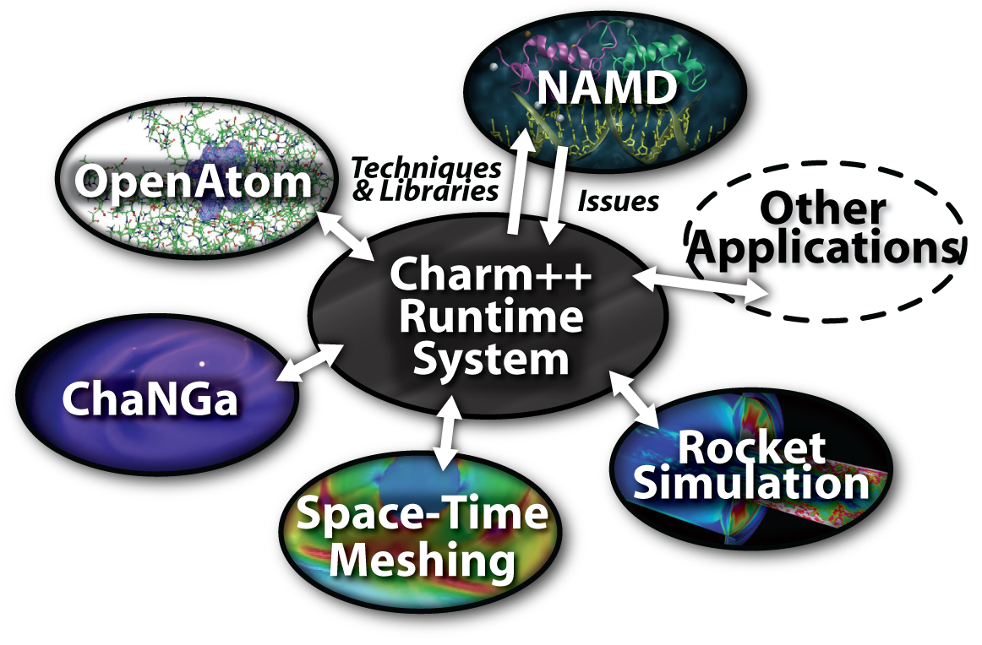
Charm++ and CSE Applications
Well-known Biophysics Molecular Simulation App
Gordon Bell Award, 2002
Nano-Materials
Synergy
Enabling CS technology of parallel objects and intelligent runtime systems has led to several CSE collaborative applications
Computational Astronomy

Slide 17
Summary: What is Charm++?
Charm++ is a way of parallel programming
It is based on:
Objects
Overdecomposition
Asynchrony
Asynchronous method invocations
Migratability
Adaptive runtime system
It has been co-developed synergistically with multiple CSE applications

