Slide 1
Grainsize

Slide 2
Grainsize
Charm++ philosophy:
Let the programmer decompose their work and data into coarse-grained entities
It is important to understand what I mean by coarse-grained entities
You don’t write sequential programs that some system will auto-decompose
You don’t write programs when there is one object for each float
You consciously choose a grainsize, but choose it independently of the number of processors
Or parameterize it, so you can tune later

Slide 3
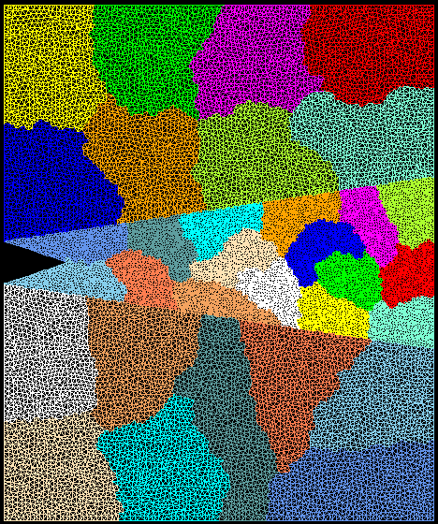
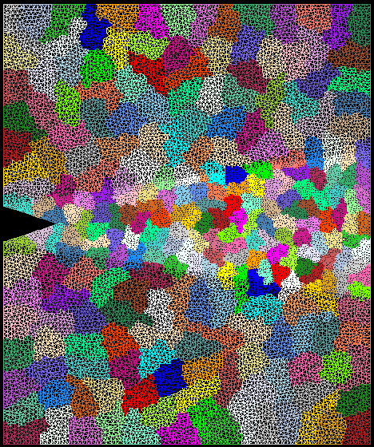
Crack Propagation
This is 2D, circa 2002...
but shows overdecomposition for unstructured meshes
Decomposition into 16 chunks (left) and 128 chunks, 8 for each PE (right). The middle area contains cohesive elements. Both decompositions obtained using Metis. Pictures: S. Breitenfeld, and P. Geubelle

Slide 4
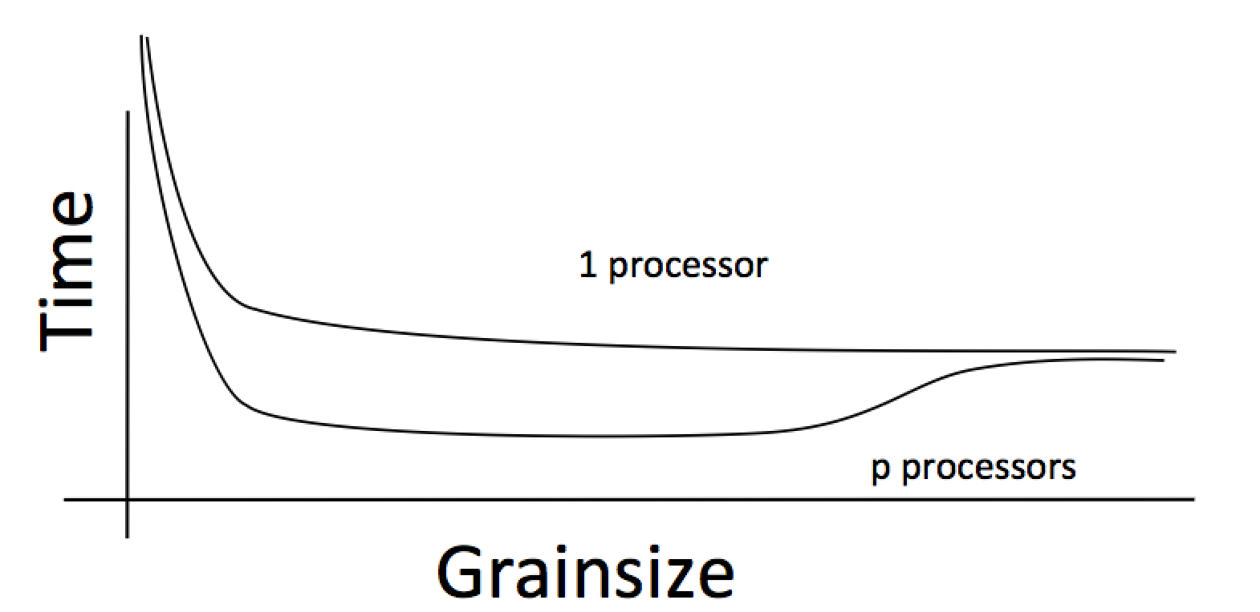
Working definition of grainsize:
amount of computation per remote interaction
Choose grainsize to be just large enough to amortize the overhead

Slide 5
Rules of Thumb for Grainsize
Make it as small as possible, as long as it amortizes the overhead
More specifically, ensure:
Average grainsize is greater than kv (for some k, say 10v)
v: overhead per message
No single grain should be allowed to be too large
Must be smaller than T/p, where p: number of processors, T: sequential execution time
Can generalize by saying must be smaller than kmv (say 100v)
Important corollary:
You can be at close to optimal grainsize without having to think about p, the number of processors

Slide 6
Grainsize in a common setting
2 MB/chare,
256 objects per core
number of points per chare

Slide 7
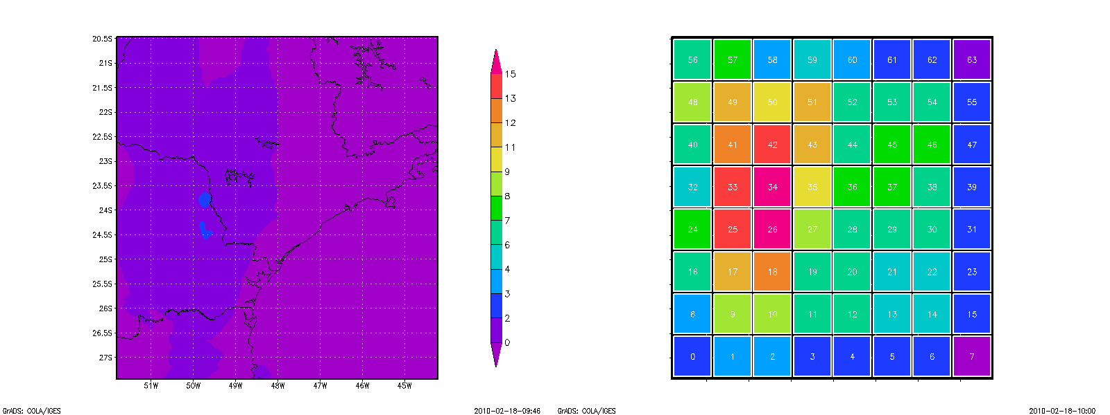
Grainsize: Weather Forecasting in BRAMS
BRAMS: Brazillian weather code (based on RAMS)
AMPI version (Eduardo Rodrigues, with Mendes, J. Panetta, ..)
Instead of using 64 work units on 64 cores, used 1024 on 64

Slide 8
Baseline: 64 Objects

Slide 9
Overdecomposition: 1024 Objects
Benefits from communication/computation overlap

Slide 10
With Load Balancing: 1024 objects
No overdecomp (64 threads) | 46 sec
+ Overdecomposition (1024 threads) | 33 sec
+ Load balancing (1024 threads) | 27 sec

