Slide 1
Charm++ Benefits
Overdecomposition
Scalable tools
Automatic overlap of communication and computation
Message-driven execution
Perfect prefetch
Compositionality
Emulation for performance prediction
Migratability
Fault tolerance
Dynamic load balancing (topology-aware, scalable)
Introspective and adaptive runtime system
Temperature/power/energy optimizations

Slide 2
Locality and Prefetch
Objects connote and promote locality
Message-driven execution
A strong principle of prediction for data and code use
Much stronger than principle of locality
Can use to scale memory wall:
Prefetching of needed data:
Into scratchpad memories, for example
Processor 1
Scheduler
Message Queue
Notes:
Replace figure with a new drawing

Slide 3
Impact on Communication
Current use of communication network:
Compute-communicate cycles in typical MPI apps
The network is used for a fraction of time
And is on the critical path
Current communication networks are over-engineered by necessity
P1
P2
BSP based application

Slide 4
Impact on Communication
With overdecomposition:
Communication is spread over an iteration
Adaptive overlap of communication and computation
P1
P2
Overdecomposition enables overlap

Slide 5
Decomposition Challenges
Current method is to decompose to processors
This has many problems
Deciding which processor does what work in detail is difficult at large scale
Decomposition should be independent of number of processors – enabled by object based decomposition
Let runtime system (RTS) assign objects to available resources adaptively

Slide 6
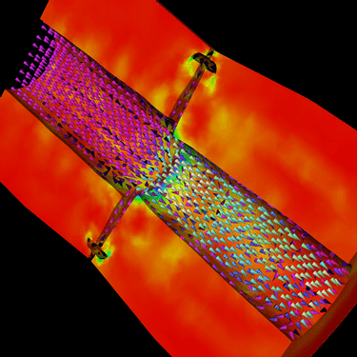
Decomposition Independent of numCores
Rocket simulation example under traditional MPI
With migratable-objects:
Benefit: load balance, communication optimizations, modularity
Solid
Solid
. . .
Solid
Fluid
Fluid
Fluid
1 2 P
Solid₁
Solid₂
Solid₃
. . .
Solid_{n}
Fluid₁
Fluid₂
. . .
Fluid_{m}
Notes:
6
In traditional MPI paradigm. The number of partitions of both modules is typically equal to the number of processor P
And although the i’th elements of fluid module and solid module are not connected geometrically in the simulation, they are glued together on the I’th processor.
Under Charm++/AMPI framework, the two modules each get their own set of parallel objects. And the size of the arrays are not restricted or related.
The benefit of this is performance optimizations and better modularity.
Problem: due to the asynchronous method invocation, the flow of control is buried deep into the object code

Slide 7
Compositionality
It is important to support parallel composition
For multi-module, multi-physics, multi-paradigm applications…
What I mean by parallel composition
B || C where B, C are independently developed modules
B is parallel module by itself, and so is C
Programmers who wrote B were unaware of C
No dependency between B and C
This is not supported well by MPI
Developers support it by breaking abstraction boundaries
E.g., wildcard recvs in module A to process messages for module B
Nor by OpenMP implementations

Slide 8
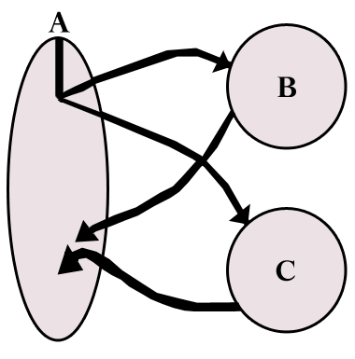
Without message-driven execution (and virtualization), you get either:
Space-division
B
C
Time
Notes:
Replace “scanned” diagram on the left with a better one, in all the slides that use this.

Slide 9
OR: Sequentialization
B
C
Time

Slide 10
Parallel Composition: A1; (B || C ); A2
Recall: different modules, written in different languages/paradigms, can overlap in time and on processors, without programmer having to worry about this explicitly

